Slide 1
Detecting DDoS attack using Logistic Regression
Supervised By
Mr. Jagdish Bhatta
CDCSIT
Submitted By
Brihat Ratna Bajracharya
19/075
Submitted To
Central Department of Computer Science and Information Technology

Slide 2
INTRODUCTION
DoS Attack
  denial of service attack
  continuous attack packets overloads the victim’s computer resources making the service unavailable to other devices and users throughout the network
DDoS attack
  distributed denial of service attack
  multiple systems target a single system with a DoS attack
  Two types
    Direct
      Targeting victim’s machine in its weakness
    Indirect
      Attack performed on elements associated with the victim’s machine

Slide 3
INTRODUCTION
Logistic Regression
  statistical method for analysing a dataset in which there are one or more independent variables that determine an categorical outcome
  Three types of logistic regression
    Binomial logistic regression
      For two possible outcome
      Uses sigmoid function
    Multinomial logistic regression
      For three or more outcome
      Uses softmax function (turns logits to probabilities that sums to one)
    Ordinal logistic regression
      For ordered outcome

Slide 4
LITERATURE REVIEW
Classification Based
  Sahi et al. [1] proposed new classifier system for detecting and preventing DDoS TCP flood attacks
  Classifies incoming packets and makes decision based on classification result in detection phase
  Also maintains backlist table of source IP of detected attacks for prevention phase and related packet is terminated

Slide 5
LITERATURE REVIEW
Entropy Based
  Gera et al. [6] proposed a system to differentiate DDoS attack from flash events based on the anomaly pattern (time interval and source entropy)
    Time interval – In DDoS, network traffic spikes abruptly whereas in flash event, the traffic increase gradually
    Source entropy – number of source IP addresses from which attack is launched
    Traffic cluster – traffic coming from the same network
  Classification
    Flash event – more source IPs but less traffic cluster
    DDoS (spoofed) – more source IPs and more traffic cluster
    DDoS (non-spoofed) – the source IP is same and the traffic cluster is more

Slide 6
LITERATURE REVIEW
Regression Based
  Divakaran et al. [5] proposed a framework of gathering evidences to detect traffic sessions related to attacks and malicious activities
  Three stages
    Modeling and analyzing sessions to detect anomalous patterns – by analysing the inter-arrival time of flows (set of packets) in the session, randomness is lesser for attack flow than normal flow
    Detecting scans and illegitimate TCP state sequences – using TCP state sequence, anything that does not correspond to normal flow (SYN, SYN_ACK, DATA, FIN) is considered illegitimate
    Evidence correlation and decision making - Spacial correlation (using IP addresses) is performed to correlate the anomalous pattern, regression model used to detect anomalous pattern

Slide 7
LITERATURE REVIEW
Artificial Neural Network
  Saied et al. [2] used supervised ANN (feed forward, error back propagation) approach on three different type of packets: TCP, UDP and ICMP
    ANN ICMP uses three input nodes (source_ip, icmp_sequence, and icmp_ip), four hidden nodes and one output node
    ANN TCP uses five input nodes (source_ip, tcp_sequence, source_port, destination_port, and tcp_flags), four hidden nodes and one output node
    ANN UDP, four input layer nodes (source_port, destination_port, source_ip, and packet_length), three hidden nodes and one output node
  Basic flow
    DDoS detectors are installed in different network, each detector registering the IP of neighboring detectors, communicating via encrypted messages and continuously monitors the number of passing packets
    If number of packets are greater than certain threshold, then attack is suspected. The packets are sorted and IP of the victim is identified. The ANN retrieves the required patterns and prepares for the ANN engine. The trained ANN engine takes the input and produces the output (attack or normal).
    Above step is repeated for three times and final outcome is the majority of three outputs.
  This ANN engine needs to be trained regularly for detecting up-to-date DDoS attacks.

Slide 8
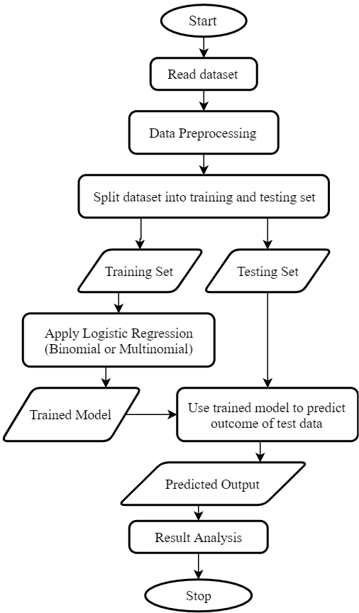
METHODOLOGY
Read Dataset
Data Pre-processing
  Encoding non numeric values
  Feature Selection (correlation test)
  Train Test Split
Model classifier using train set
Predict output using test set
Analysis
  Confusion Matrix
  Performance Metrics
    Accuracy, Precision, Recall, F1 Score
Conclusion

Slide 9
IMPLEMENTATION DETAILS
Dataset Details
  Used CICDDoS2019 dataset from University of New Brunswick [9]
  Result of abstract behaviour of 25 users based on the HTTP, HTTPS, FTP, SSH, and email protocols
  Analysed Portmap and LDAP and NetBIOS variant of DDoS attack
  Consist of 88 columns (87 features and one outcome column)
  Portmap dataset contains 191694 records and LDAP dataset contains 2113234 records

Slide 10
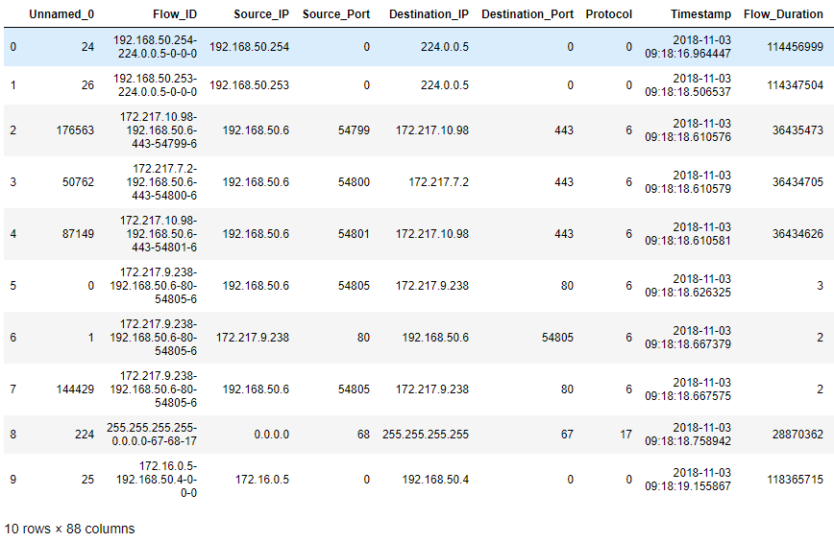
IMPLEMENTATION DETAILS
Portmap Dataset (1/2)

Slide 11
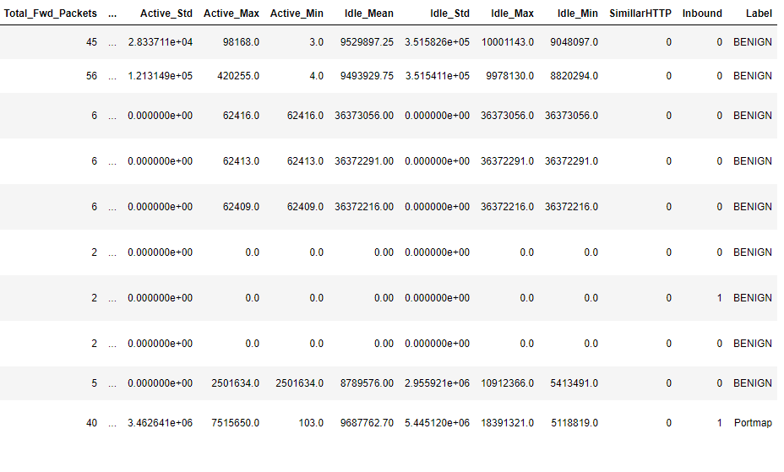
IMPLEMENTATION DETAILS
Portmap Dataset (2/2)

Slide 12
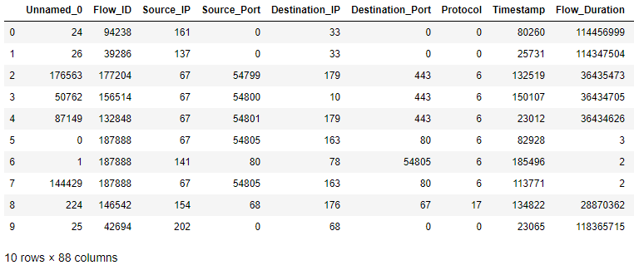
IMPLEMENTATION DETAILS
Portmap Dataset after encoding

Slide 13
IMPLEMENTATION DETAILS
Feature Selection using correlation test
  Selected features for Portmap dataset
Protocol: 0.705635574606102
Fwd_Packet_Length_Min: 0.7291026803636192
Min_Packet_Length: 0.7291679201346289
Source_Port: 0.8189050406122815
Inbound: 0.8600933612454168
Source_IP: 0.8660476930033244
Label: 1.0
  Some of discarded features for Portmap dataset
Down_Up_Ratio': 0.6485234774068003
URG_Flag_Count': 0.6150806663811492
Bwd_Packet_Length_Min': 0.5505265792832202
Destination_IP': 0.5434405331523054
CWE_Flag_Count': 0.4208864290747812
Avg_Bwd_Segment_Size': 0.41915492520184805
Bwd_Packet_Length_Mean': 0.41915492520184805
Fwd_IAT_Total': 0.3345362968706236
Unnamed_0': 0.11675730059144739

Slide 14
IMPLEMENTATION DETAILS
Feature Selection using correlation test
  Selected features for LDAP dataset
Min Packet Length: 0.9276131094369818
Fwd Packet Length Min: 0.9277359022458002
Avg Fwd Segment Size: 0.9291694741755031
Fwd Packet Length Mean: 0.9291694741755031
Average Packet Size: 0.9292312255418383
Packet Length Mean: 0.9302060576330425
Fwd Packet Length Max: 0.9327888918318388
Max Packet Length: 0.9359158567754134
Label: 1.0
  Some of discarded features for LDAP dataset
Protocol: 0.15101837887241756
Inbound: 0.14945687840206262
min_seg_size_forward: 0.05637313458482986
Fwd Header Length: 0.05629353491866543
Destination_Port: 0.012102190951823352
Bwd Header Length: 0.00633967032746798
Timestamp: 0.00018127588100869682
Flow ID: 0.0014231120955229765
SimillarHTTP: 0.014568932109410395
Active Std: 0.01713683548092619

Slide 15
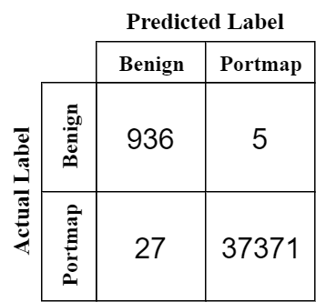
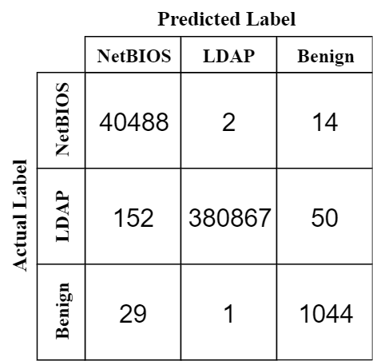
RESULT
Confusion Matrix for Portmap dataset and LDAP dataset
Performance Metrics for Portmap dataset
Accuracy = 99.91 %
Precision = 98.59 %
Recall = 99.69 %
F1 Score = 0.9913
Performance Metrics for LDAP dataset
Accuracy = 99.94 %
Precision = 97.92 %
Recall = 99.03 %
F1 Score = 0.9847

Slide 16
CONCLUSION
Out of 87 features, considering only few features that are highly correlated with the attack class is sufficient for detecting DDoS attack variants
We used six features for detecting portmap attack and eight features for detecting LDAP and NetBIOS variant of DDoS attack
From the result analysis, we see that performance metrics (accuracy and f1 score) of our classifier is high for both datasets
We have modeled a good classifier for detecting Portmap, LDAP and NetBIOS variant of DDoS attack

Slide 17
REFERENCES
A. Sahi, D. Lal, Y. Li, and M. Diykh, “An Efficient DDoS TCP Flood Attack Detection and Prevention System in a Cloud Environment”, in IEEE Access, vol. 5, pp. 6036-6048, 2017.
A. Saied, R. E. Overhill, T. Radzik, “Detection of known and unknown DDoS attacks using Artificial Neural Networks”, in Neurocomputing 172, pp. 385-393, 2016.
B. Cashell, W. D. Jackson, M. Jickling, and B. Webel, The Economic Impact of Cyber-Attacks, document CRS RL32331, Congressional Research Service Documents, Washington, DC, USA, 2004.
C. Bedon, A. Saied, Snort-AI (Version 2.4.3), “Open Source Project”, 2009. Available from: http://snort-ai.sourceforge.net/index.php/
D. M. Divakaran, K. W. Fok, I. Nevat, and V. L. L. Thing, “Evidence gathering for network security and forensics”, in Digital Investigation 20, pp. S56-S65, 2017.
J. Gera, and B. P. Battula, “Detection of spoofed and non-spoofed DDoS attacks and discriminating them from flash crowds”, in EURASIP Journal on Information Security, doi:10.1186/s13635-018-0079-6, 2018.
M. Roesch, Snort (Version 2.9), “Open Source Project”, 1998. Available from: http://www.snort.org/.
R. Russell, Iptables (Version 1.4.21), “Open Source Project”, 1998. Available from: http://ipset.netfilter,org/iptables.man.html/.
DDoS Evaluation Dataset ”CICDDoS2019” Dataset, [online] Available: http://205.174.165.80/CICDataset/CICDDoS2019/Dataset/CSVs/CSV-03-11.zip
“Logistic Regression For Dummies: A Detailed Explanation”. Accessed on: Dec. 9, 2019. [Online]. Available: https://towardsdatascience.com/logistic-regression-for-dummies-a-detailed-explanation-9597f76edf46

Slide 18
Thank You

