Slide 2
Pre-Processing
Train samples: 7K real images, 7k fake images
Validation samples: 14k random images having combination of real and fake
Resize : For the ResNeXt models, including resnext50_32x4d, the standard input size is 224x224.
ToTensor: Converts the image to a PyTorch tensor.
Normalize: The commonly used mean and standard deviation values for ImageNet normalization are:
Mean: [0.485, 0.456, 0.406]
Standard Deviation: [0.229, 0.224, 0.225]

Slide 3
Feature Extraction
Transfer Learning is used to select features from image file
What is Transfer Learning?
Transfer learning is a machine learning technique where a model developed for a particular task is reused as the starting point for a model on a second task.
In this scenario, a pre-trained model is used as a fixed feature extractor. The early layers of the pre-trained model are frozen, and only the later layers (usually fully connected layers) are replaced or retrained for the specific task at hand.
Reduced Training Time
Better Generalization
Effective in Limited Data Scenarios
PyTorch and TensorFlow provide pre-trained models that can be easily used for transfer learning. i.e. VGG, ResNet, Inception, and others.

Slide 4
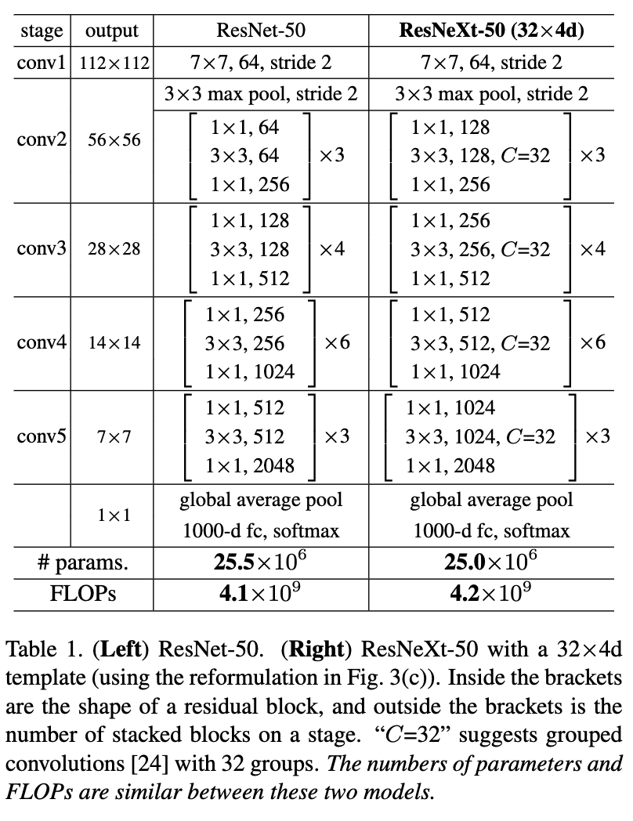
ResNeXt50_32x4d
Is a ResNeXt architecture with 50 layers that uses a block design with a cardinality of 32 and a width of 4
Cardinality refers to the number of parallel paths or groups within a ResNeXt block
Width is another parameter in ResNeXt that influences the number of parallel paths within a block.

Slide 5
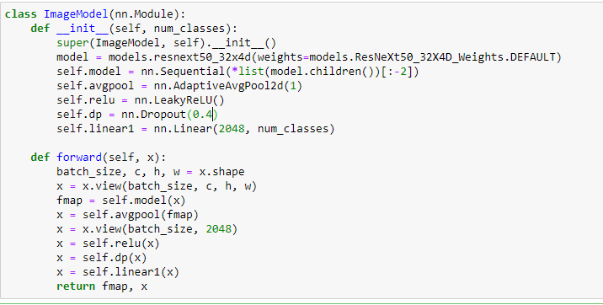

Slide 6
Model
The last two layers of the original ResNeXt model are excluded, leaving the feature extraction part.
Steps for model training :
1. Reshape Input Tensor: The input tensor x is initially reshaped to have dimensions (batch_size, c, h, w) where batch_size is the number of input samples, c is the number of channels, and h and w are the height and width of the input image.
2. Feature Extraction: The reshaped input tensor is passed through the self.model module, which represents the feature extraction part of the ResNeXt50_32x4d model. The result is stored in the variable fmap.
3. Adaptive Average Pooling:Adaptive average pooling is applied to the feature map (fmap) to convert it to a fixed-size representation with spatial dimensions of 1x1. This is achieved using self.avgpool.
4. Flatten the Tensor:The output of the adaptive average pooling is then flattened to a one-dimensional tensor with size (batch_size, 2048).
5. LeakyReLU Activation:The LeakyReLU activation function (self.relu) is applied element-wise to the flattened tensor.
6. Dropout:Dropout (self.dp) is applied for regularization, randomly setting a fraction of the input elements to zero during training.
7. Classification Layer: The output of the dropout layer is passed through the linear layer (self.linear1) to obtain the final classification result. The number of output nodes in this layer corresponds to the specified num_classes.
8. Return Feature Map and Classification Result:The function returns both the feature map (fmap) and the classification result (x).

Slide 7
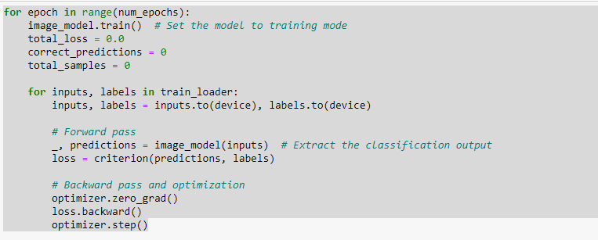
Training and Optimization
CrossEntropyLoss: is a commonly used loss function for classification problems. It combines the SoftMax activation function and the negative log-likelihood loss
Adam Optimizer: an optimization algorithm that combines ideas from RMSprop and momentum. It adapts the learning rates for each parameter based on the historical gradients.

Slide 8
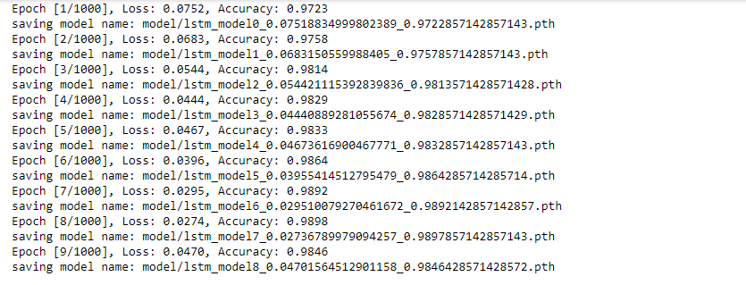
Training Evaluation

Slide 9
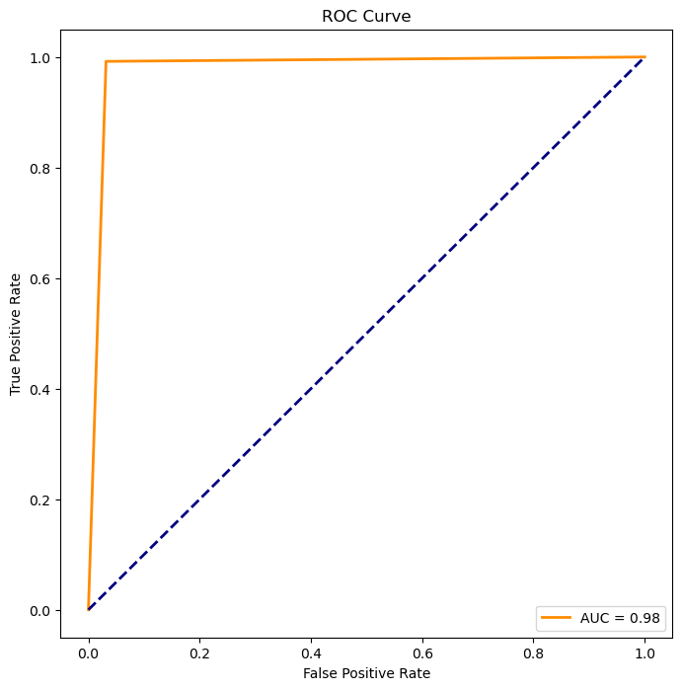
Validation Evaluation
Accuracy: 0.9803
Precision: 0.9695
Recall: 0.9921
F1 Score: 0.9806
AUC-ROC: 0.9802

