Slide 1
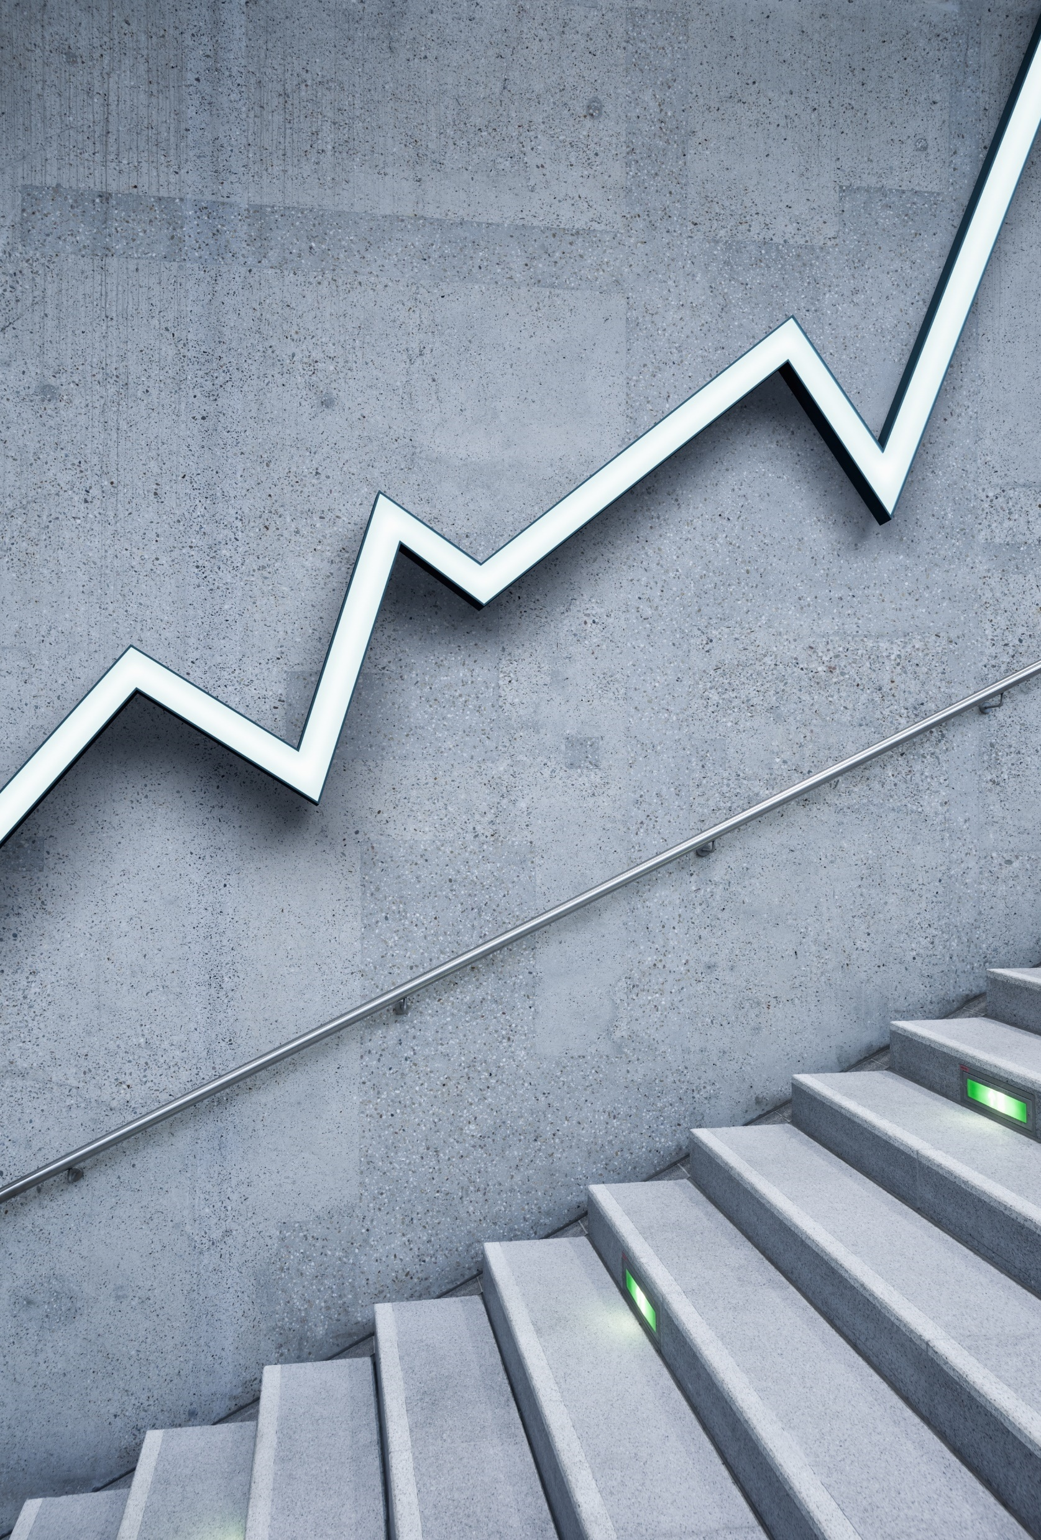
PID-026
Pg-71
Ganpat university.
Project by brijesh s Upadhyay.

Slide 2
Topic “**cleaning of solar panel with less amount of water**”

Slide 3
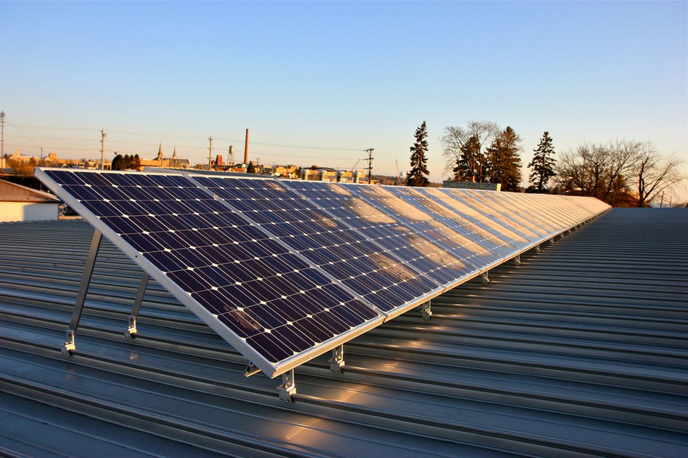
advantages
1>pollution free
2>life time free energy
3>no extra cost
4>flexible to use it

Slide 4
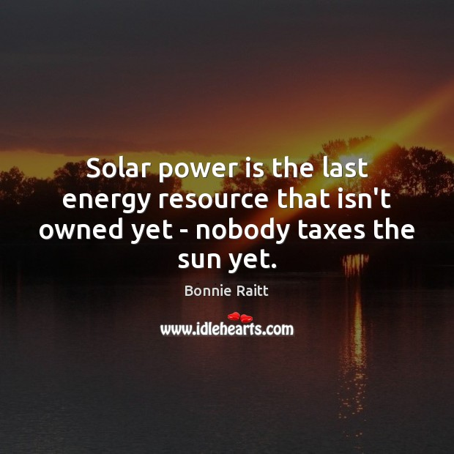
care
1>for better performance and life span we have to clean it well and perfectly time wise.

Slide 5
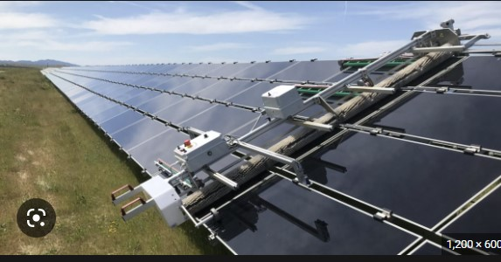
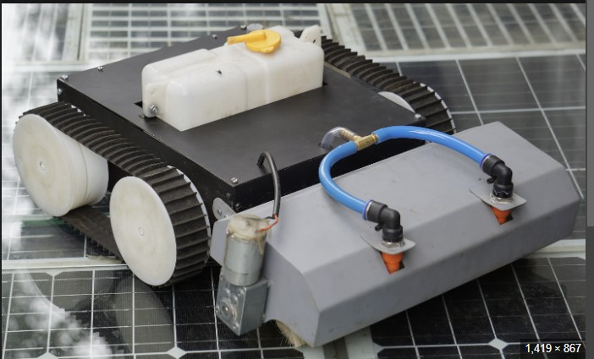
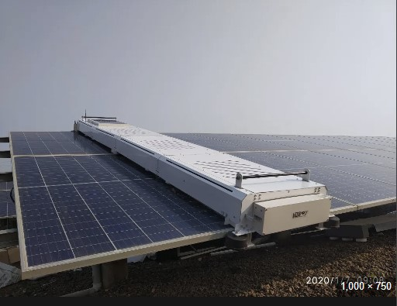
3 types
1>automatic robot
2>offline person
3>advance robo which can clean solar panel without water

Slide 6
thankyou

