Slide 1

TIC TAC TOE
PYEXPO 2021
Crew
Jayandhan.R CSE
Brijesh.M AI&DS
Sarveshwaran ECE
Surya ECE
Mentor
Ms.Kamala.V

Slide 2
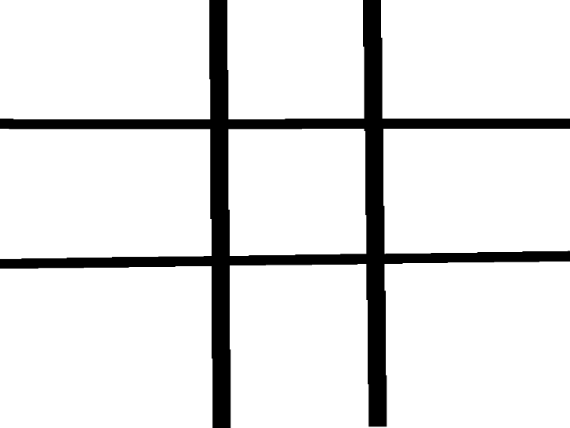
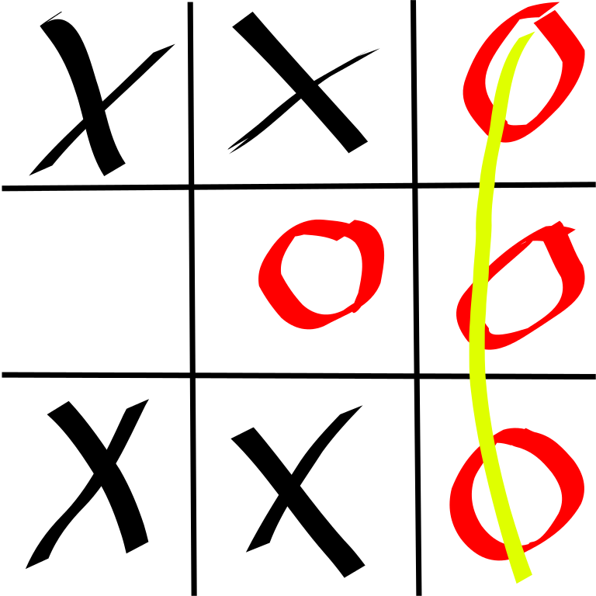
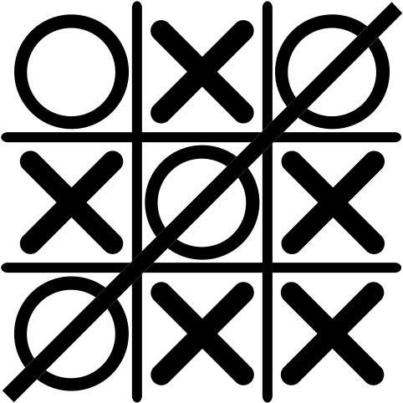

Slide 3
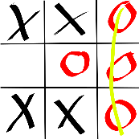
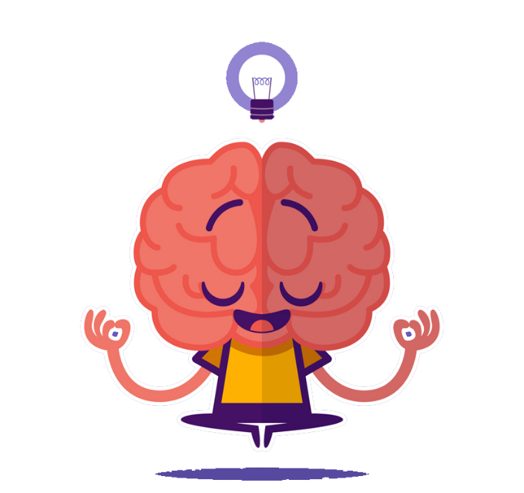
Problem Statement
Program a two-person game of Tic -Tac- Toe. The game is played on a three by three board.
Each player has a marker. One player has an ‘X’, the other an ‘O’. Players alternate turns to
place their marker on the board.
The first player to get three in a row either diagonally, horizontally, or
vertically, wins the games.
In the event all squares are taken on the board without a winner then it is a tie.
The program should set up the game by asking for the names of the players.
Player one should be assigned an ‘X’ as their marker, player two should be assigned
the ‘O’. After the game has been completed, the program should congratulate the
winner.

Slide 4

AIM
To build a tic-tac-toe game so you can play it and improve
your concentration.
Two Players X & O and both players play by putting their marks in empty squares.

Slide 5
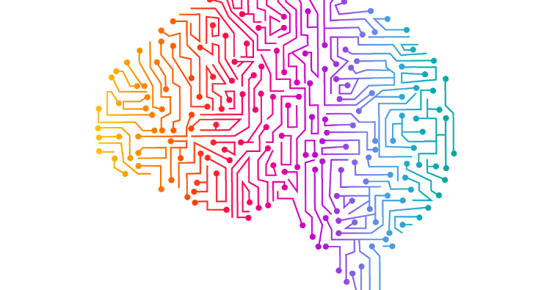
Tkinter
Most commonly used method.
Shipped with Python.
Python + Tkinter = Fastest & Easiest way to create the GUI applications.
Widgets used : Tk, ttk, button, messagebox, simpledialog.

Slide 6
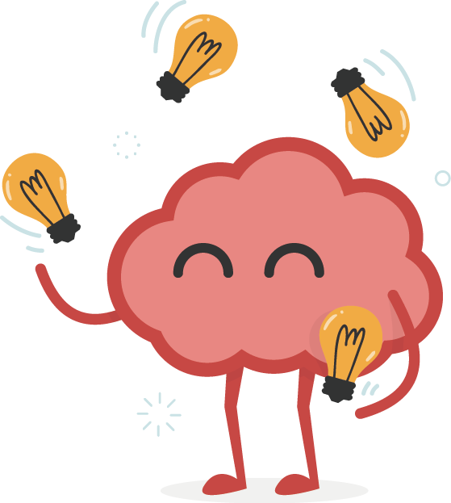
ADVANTAGES
Playing Tic-Tac-Toe can help a child predict the outcome of
another's moves.
It helps children Improve memory, Deepens focus, Elevates
Creativity, Boosts planning skills at an early age.
Blocking the other player and keeping them from winning
while trying to win yourself.

Slide 7
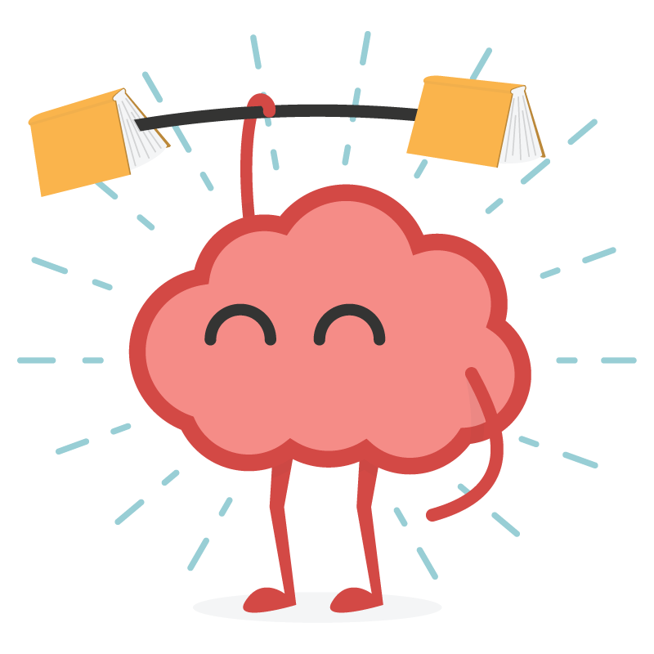
RULES
The game is played on 3X3 Sq grid. Player1 = X & Player2 = O.
Players take turns dropping their marks in empty squares.
Players cannot overwrite the another player’s mark
The first player to get 3 of her marks in a row (up, down, across, or diagonally)
is the winner.
When all 9 squares are full, the game is over.

Slide 8
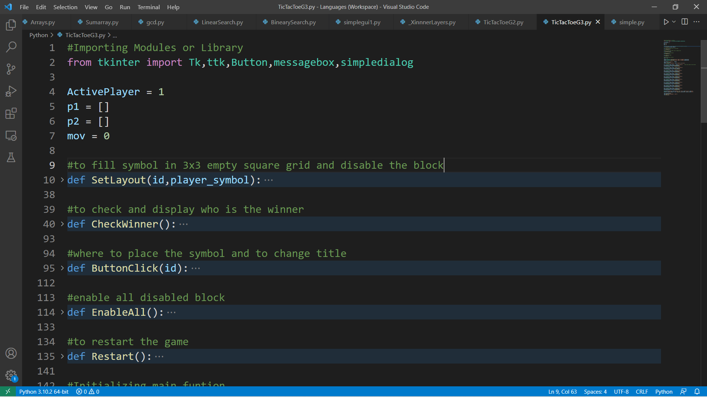
Sample code

Slide 9
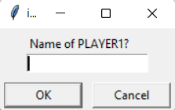

Slide 10
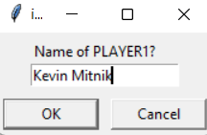

Slide 11
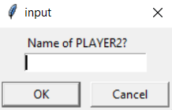

Slide 12
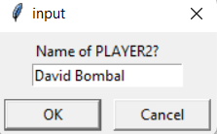

Slide 13
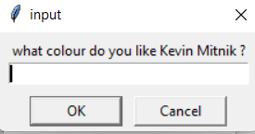

Slide 14
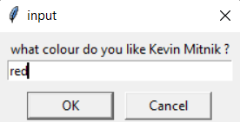

Slide 15
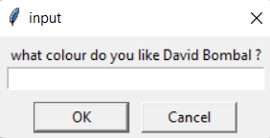

Slide 16
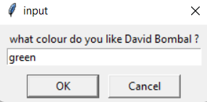

Slide 17
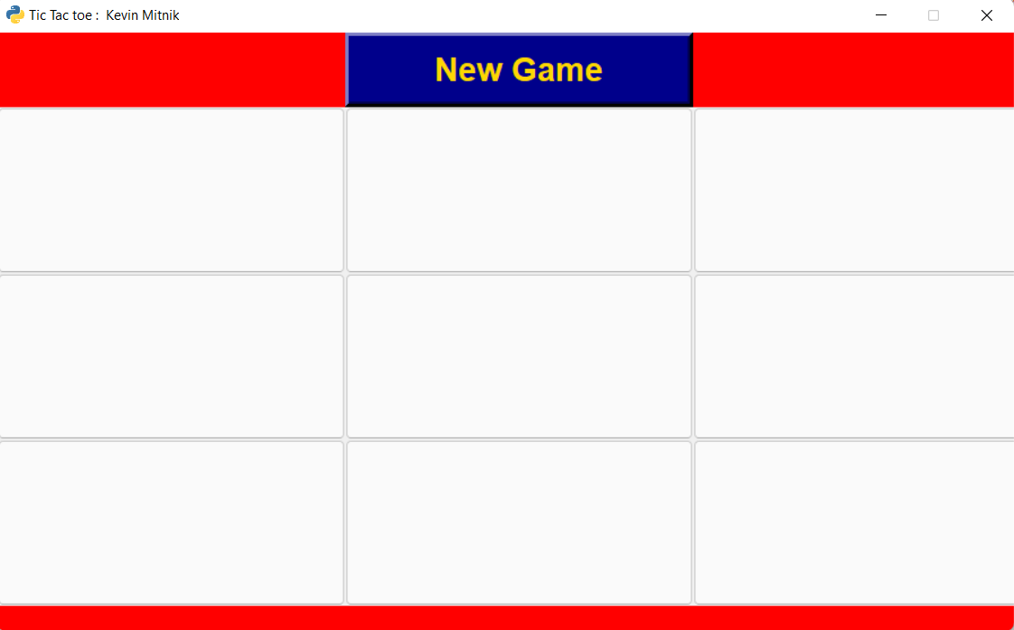
Game start’s here
Player’s name is displayed here.
Main
window
Colour changes to indicate the player’s turns.

Slide 18
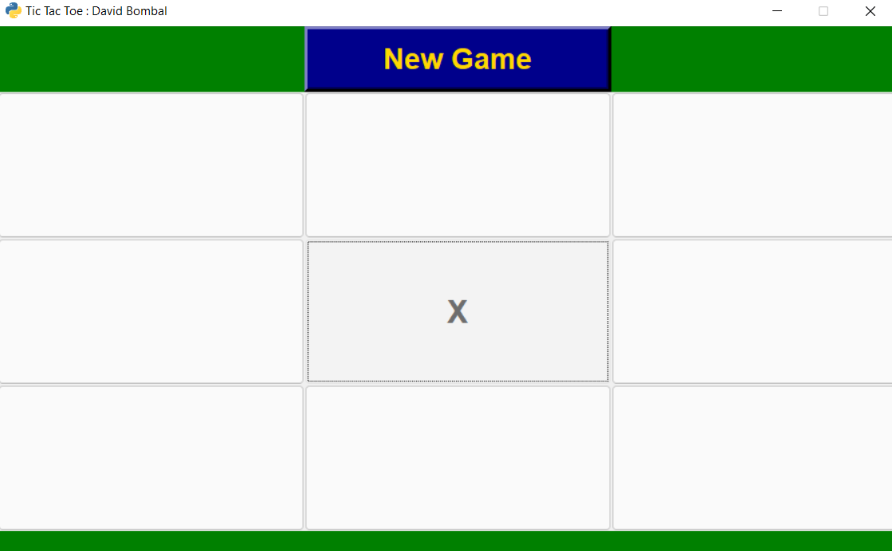
Window after player 1’s move.

Slide 19
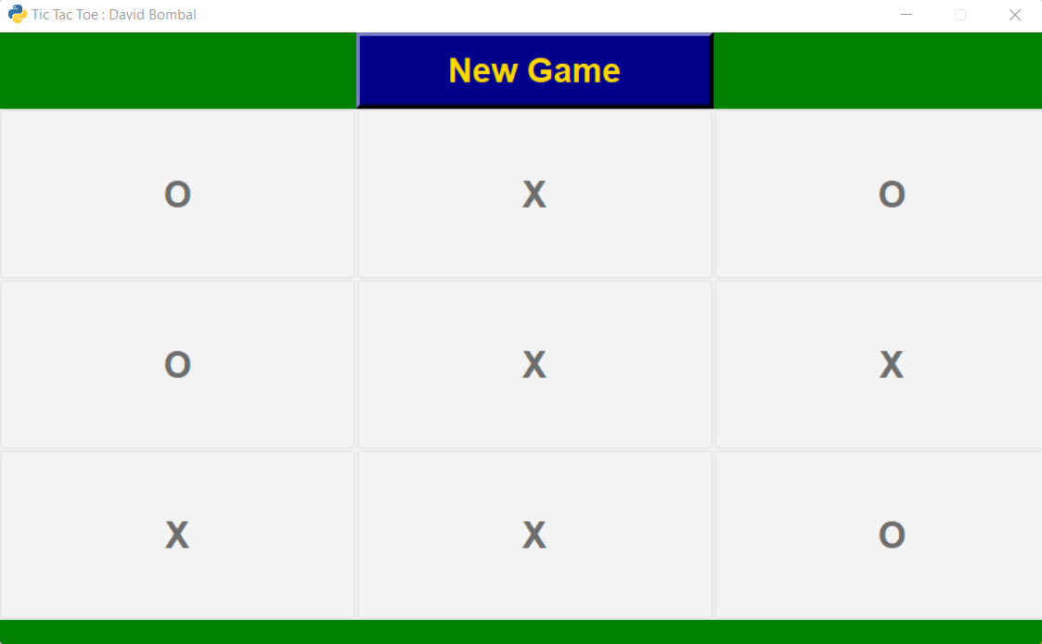
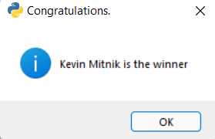
Winner : Player 1

Slide 20
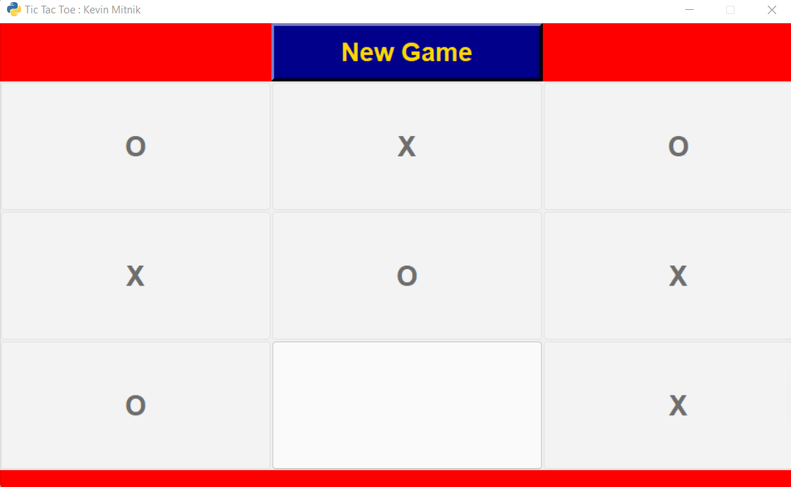
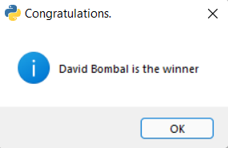
Winner : Player 2

Slide 21
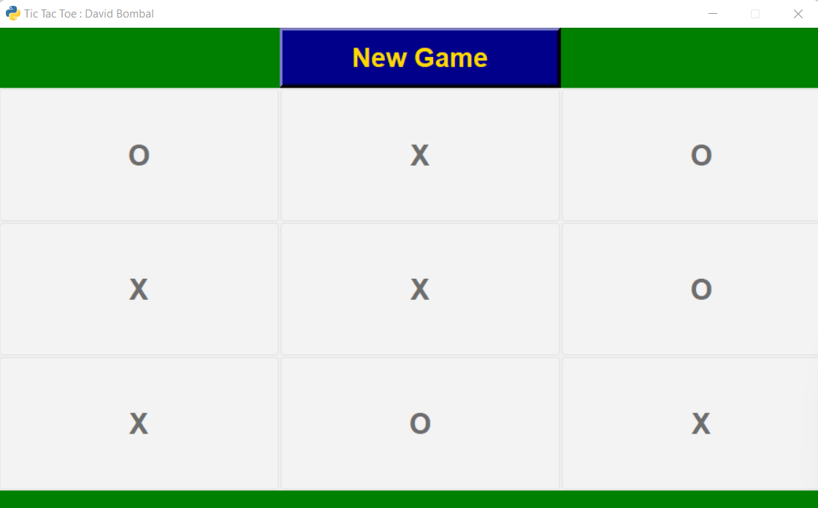
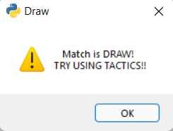
DRAW

Slide 22





Alternatives (Tkinter)
Kivy

Slide 23
Conclusion
This project done using Tkinter helped us learn in-depth about the various constituents of the Tkinter package and their versatility.
Features that we are still working on:
Pop-up animation
Background image
Ai implementation

Slide 24


