Slide 1
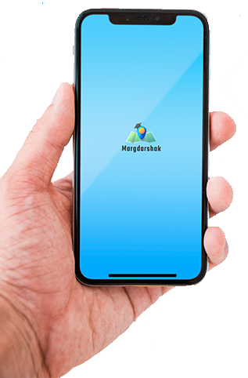
Chatbot For Education (Margdarshak)
A. V. PAREKH TECHNICAL INSTITUTE

Slide 2
Project Guide & Members
Desai Rajvi B. | 186020307514
Dixit Nishchay S. | 186020307516
Jagad Brijesh N. | 186020307525
Vasani Jeet K. | 186020307559
PROJECT GUIDE | - | Prof. D. S. Pathak
HOD | - | Prof. H. H. Rupareliya

Slide 3
ABSTRACT
The main objective of this system is to provide a Virtual Assistant(chatbot) for admission guidance after 10th Board.
This System will guide users by providing various functionalities like a chatbot for virtual interaction, information of various streams and of the various schools and colleges.
This project is intended for students and parents who are currently having dilemmas about carrier and future scope for choosing a particular stream based on their preferences.

Slide 4
Features
Easy to Understand UI
User Friendly Application
Faster and Easier access to the Institute Information
Availability (24 X 7)

Slide 5
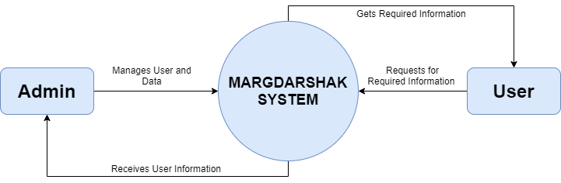
DATA FLOW CONTEXT-0 DIAGRAM

Slide 6
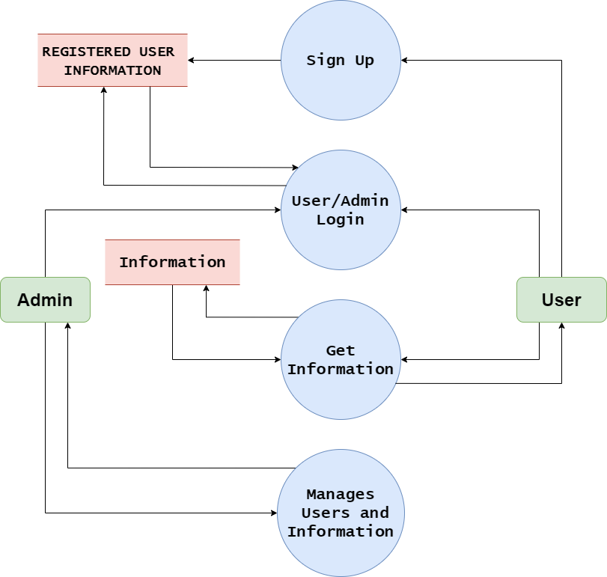
DATA FLOW CONTEXT-1 DIAGRAM

Slide 7
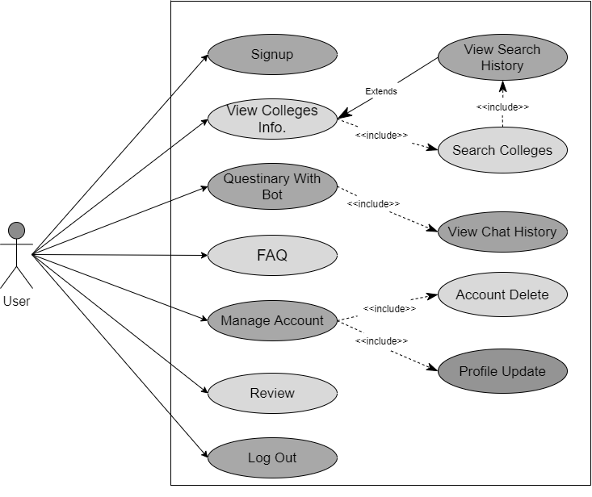
USE CASE DIAGRAM

Slide 8
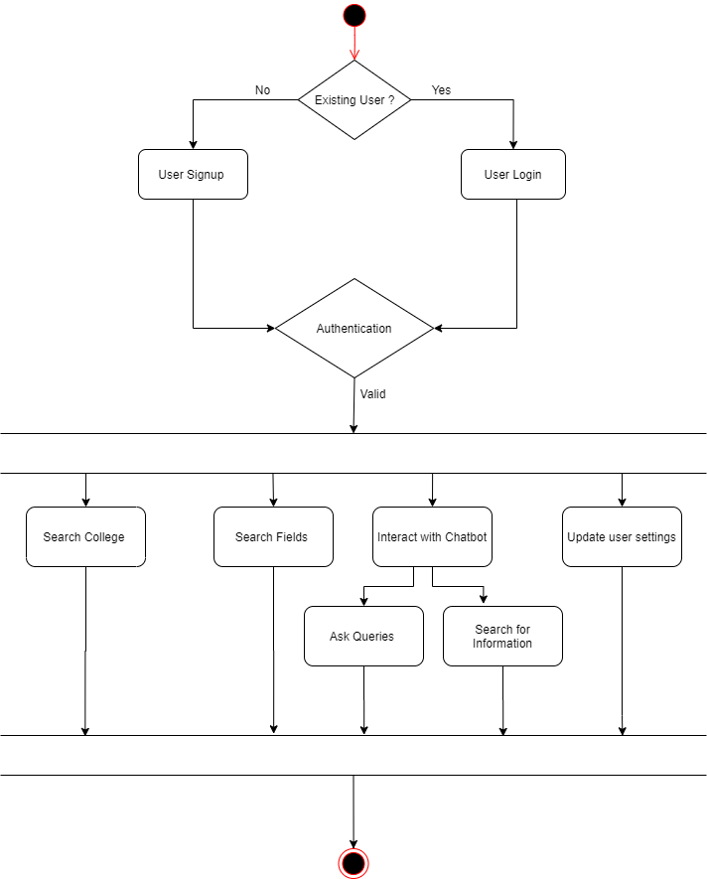
ACTIVITY DIAGRAM

Slide 9
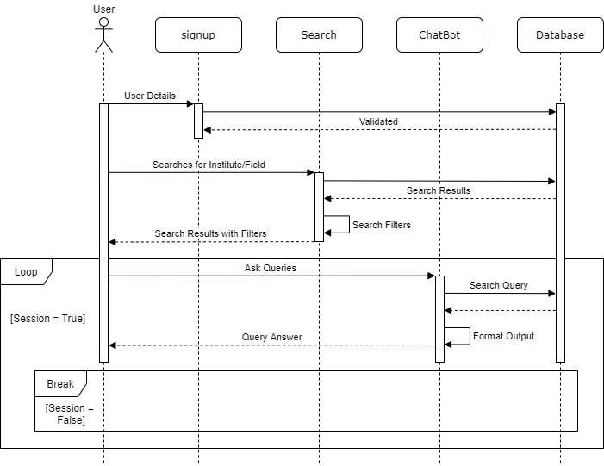
SEQUENCE DIAGRAM

Slide 10
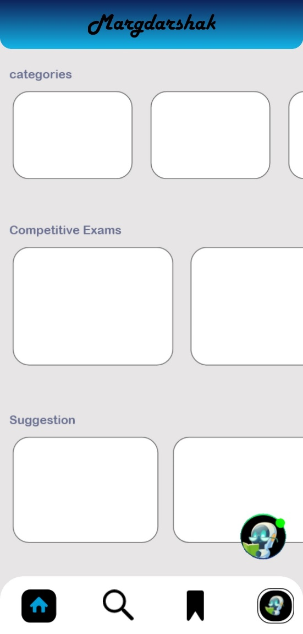
Preview

Slide 11
FUTURE SCOPE
AI Chatbot can be implemented
Voice Assistance
UI improvements for fluid interaction
Optimize System for Better Performance
Desktop & IOS Application implementation

Slide 12
TECHNOLOGIES USED
Android Studio
Java
Php
MySQL
Adobe PhotoShop
Adobe XD

Slide 13
References
Dictionary:
https://translate.google.co.in/
https://www.grammarly.com/
Diagrams:
https://app.diagrams.net/ (Draw.io)
https://www.freepik.com/
Content:
https://www.geeksforgeeks.org/
https://www.wikipedia.org/
https://www.javatpoint.com/

Slide 14
Thank You!!

