Slide 1

FIRST REVIEW
Network Traffic Analyzer and
Intrusion Detection System
A Web-Based Platform for Real-Time Network Monitoring and Threat Detection
Sameer Sha
Roll No: 45
Reg. No: CHN25MCA-2045
Guide: Smt. Beena K, Assistant Professor

Slide 2
Introduction
Network devices continuously exchange data in the form of packets.
A large amount of network traffic is difficult to monitor manually.
Raw packet information can be complex to understand.
Suspicious network activities may go unnoticed.
Network traffic analysis helps understand how a network is being used.
Intrusion detection helps identify potentially harmful activity.
The proposed system combines both functions in a single web platform.
From Raw Packets
to Real Insight
Monitoring + Detection,
in one platform
Network Traffic Analyzer and Intrusion Detection System
2

Slide 3

Problem Statement
To develop a web-based system that can monitor network traffic in real time, analyze packet information, and identify potentially suspicious activities such as port scanning, DoS-like traffic, abnormal traffic patterns and the system should present the analyzed information through a simple dashboard with real-time alerts and historical data for easier network monitoring.
Network Traffic Analyzer and Intrusion Detection System
3

Slide 4

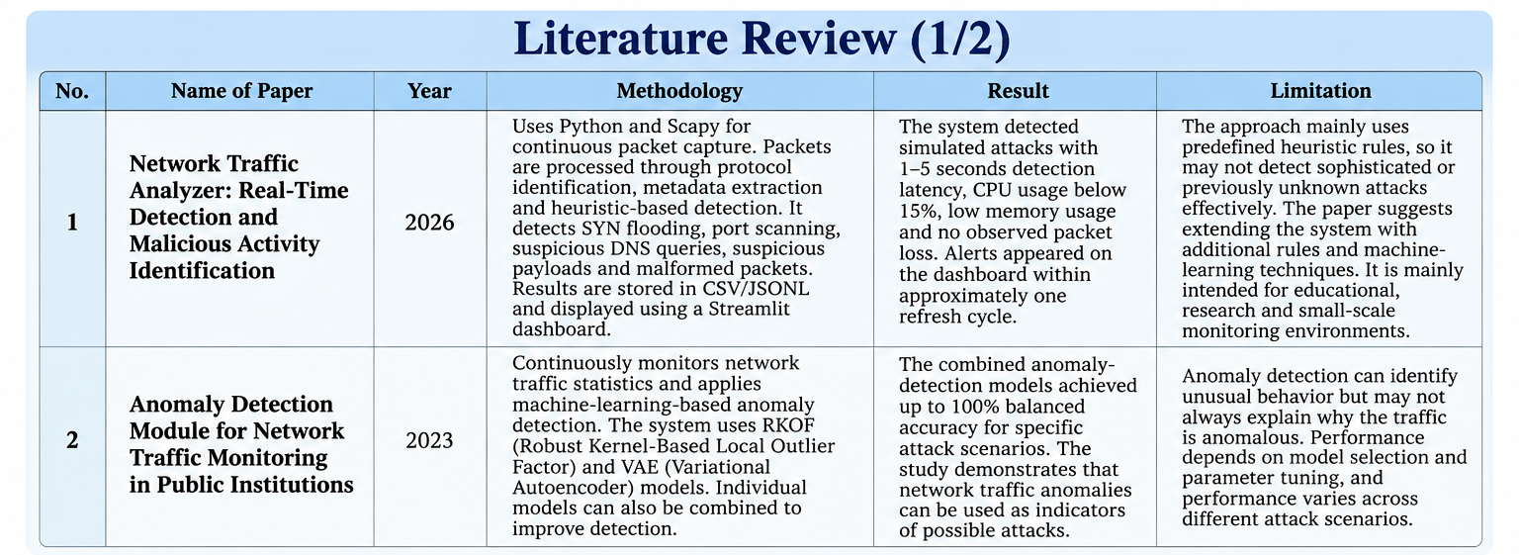
Literature Review
Network Traffic Analyzer and Intrusion Detection System
4

Slide 5
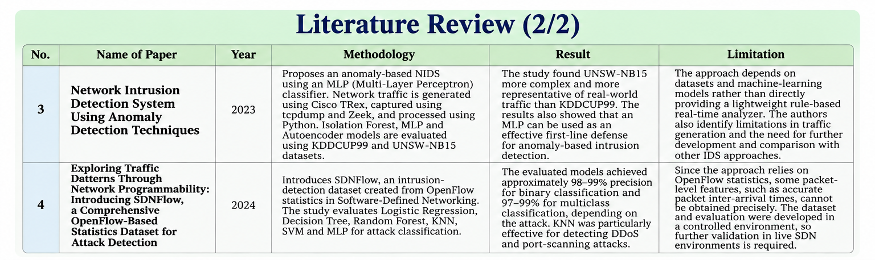
Literature Review
Network Traffic Analyzer and Intrusion Detection System
5

Slide 6
Gap Identified
Network devices continuously exchange data in the form of packets.
Heuristic-based systems can provide fast and understandable detection, but predefined rules may not identify new or sophisticated attacks.
Machine-learning-based systems can detect abnormal traffic patterns, but they require datasets, model training and parameter tuning.
Some anomaly-detection approaches can identify unusual traffic but may not clearly explain why the traffic was considered suspicious.
There is a need for a lightweight, real-time and user-friendly monitoring system that combines traffic analysis, multiple detection rules, risk assessment and clear visualization.
From Detection
to Understanding
Existing methods detect threats, but practical, explainable monitoring remains a challenge.
Network Traffic Analyzer and Intrusion Detection System
6

Slide 7
Proposed Solution
Real-time Network Monitoring – Continuously monitor live network traffic.
Packet Capture – Capture network packets using Python and Scapy.
Packet Analysis – Extract source/destination IP, ports, protocol, packet size and other relevant information.
Traffic Classification – Identify protocols such as TCP, UDP, DNS and IP.
Intrusion Detection – Detect suspicious activities using predefined detection rules.
Attack Detection – Identify patterns such as SYN Flood, Port Scanning, Suspicious DNS Requests , Suspicious Payloads, Malformed Packets etc.
Alert Generation – Generate alerts when suspicious behavior crosses defined thresholds.
Real-time Dashboard – Display traffic statistics, detected threats, alerts and host activity.
Data Logging – Store packet information and detected events for later analysis.
From Raw Packets
to Real Insight
Monitoring + Detection,
in one platform
Network Traffic Analyzer and Intrusion Detection System
7

Slide 8
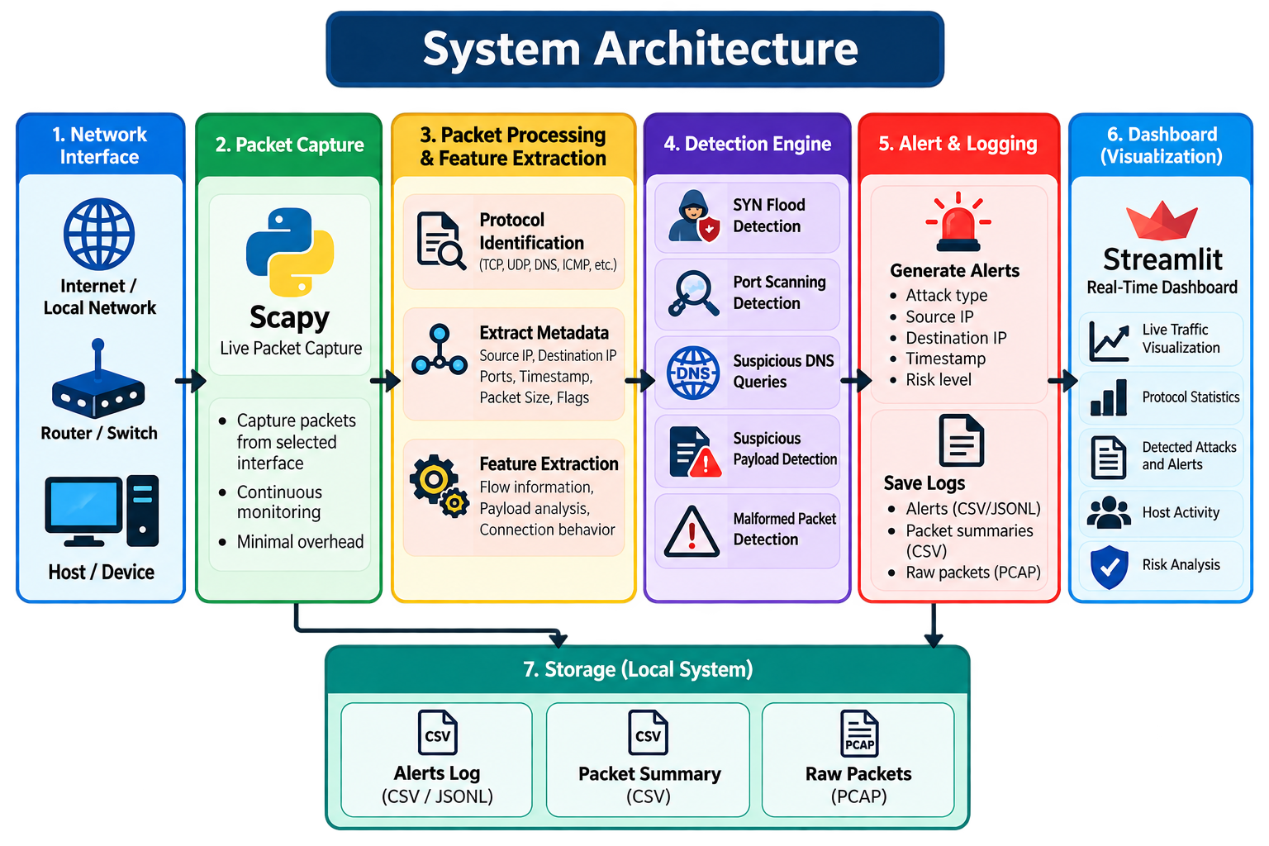
System Architecture
Network Traffic Analyzer and Intrusion Detection System
8

Slide 9
Architecture Overview
The system continuously captures network packets, extracts relevant information, analyzes the traffic using predefined detection rules, generates alerts for suspicious activities, and presents the results through a dashboard.
Live Traffic → Packet Capture → Feature Extraction → Detection → Alerts → Visualization
Network Traffic Analyzer and Intrusion Detection System
9

Slide 10
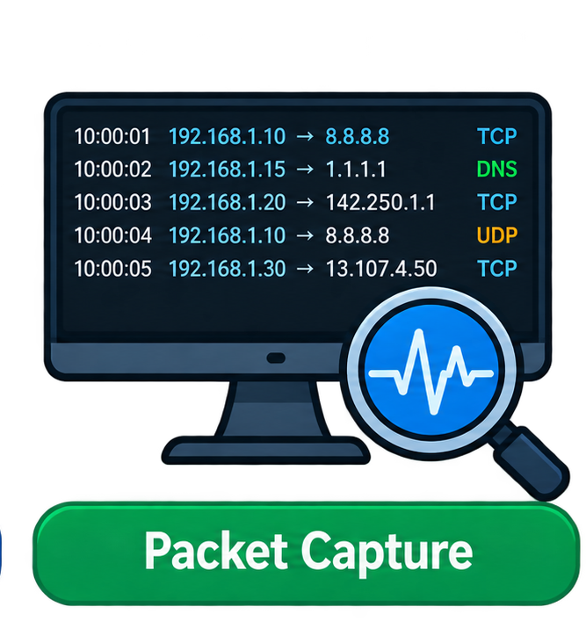
Architecture Components
Network Interface
  Connects the system to the network.
  Receives network traffic from the selected interface.
  Acts as the entry point for packet monitoring.
Packet Capture
  Captures live network packets.
  Uses Python and Scapy.
  Continuously monitors network traffic.
  Passes captured packets to the processing module.
Packet Processing & Feature Extraction
  Identifies the packet protocol.
  Extracts Source IP , Destination IP, source and destination ports.
  Records timestamp and packet size.
  Prepares packet information for detection.
Packet Capture
Uses Python + Scapy
Network Traffic Analyzer and Intrusion Detection System
10

Slide 11
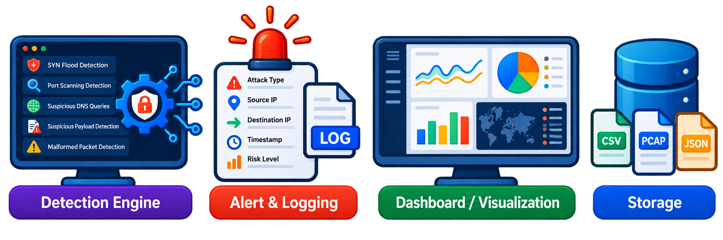
Detection Engine
  Analyzes the extracted packet information.
  Applies predefined detection rules.
  Detects SYN flood attacks, port scanning, suspicious DNS queries.
  Detects malformed packets.
Alert & Logging
  Generates alerts when suspicious activity is detected.
  Records the type of detected attack.
  Records source and destination information.
  Records timestamp and risk level.
  Stores alert and packet-summary information for later analysis.
Detection & Alert
Detect + Alert,
in real time
Network Traffic Analyzer and Intrusion Detection System
11

Slide 12
Dashboard / Visualization
  Provides a real-time view of network activity.
  Displays live traffic information, protocol statistics.
  Displays detected attacks and alerts.
  Shows host activity and risk information.
  Helps the user understand detected network threats.
Storage
  Stores alert logs.
  Stores packet summaries
  .Stores captured raw packets (PCAP).
  Supports offline analysis and investigation.
Dashboard & Storage
Visualize + Store ,
in one place
Network Traffic Analyzer and Intrusion Detection System
12

Slide 13
Module Description
Frontend UI : Provides a simple and responsive interface for monitoring network activity, viewing alerts, and accessing system reports.
Network Monitoring Module : Captures live network packets using Python and Scapy and continuously monitors network traffic.
Packet Analysis & Intrusion Detection Module : Processes packets, extracts relevant features, and detects suspicious activities using predefined detection rules.
Alert & Reporting Module : Generates security alerts, records detected incidents and risk levels, and provides historical reports.
Dashboard / Visualization Module : Displays real-time network traffic, protocol statistics, detected attacks, alerts, and host risk information.
Storage Module : Stores packet summaries, alert logs, and captured raw packets for later analysis and investigation.
Network Traffic Analyzer and Intrusion Detection System
13

Slide 14
DATA FLOW DIAGRAM
Network Traffic Analyzer and Intrusion Detection System
14

Slide 15
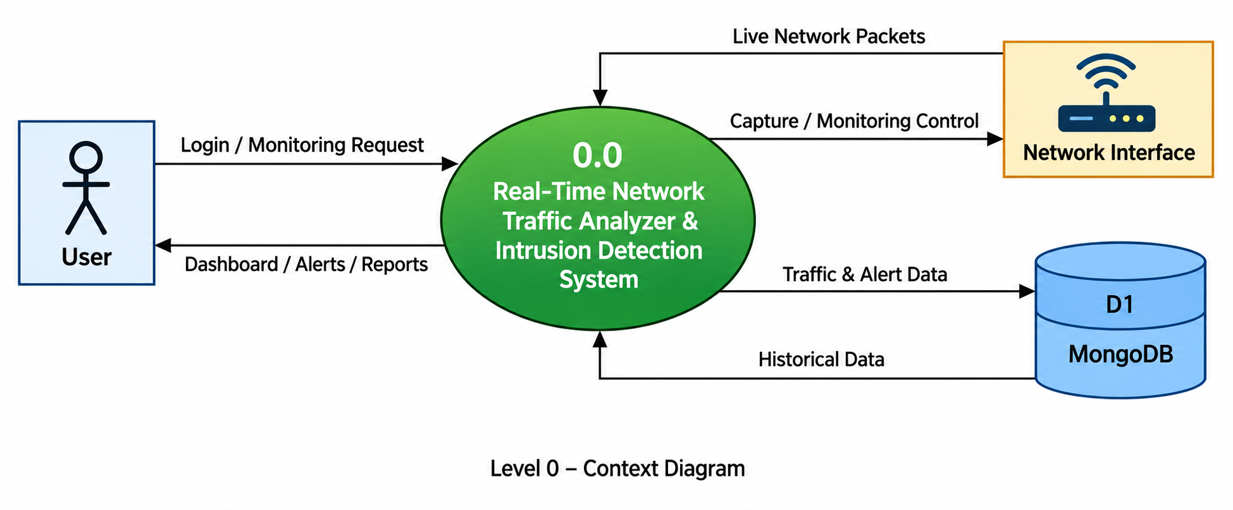
LEVEL 0
Network Traffic Analyzer and Intrusion Detection System
15

Slide 16
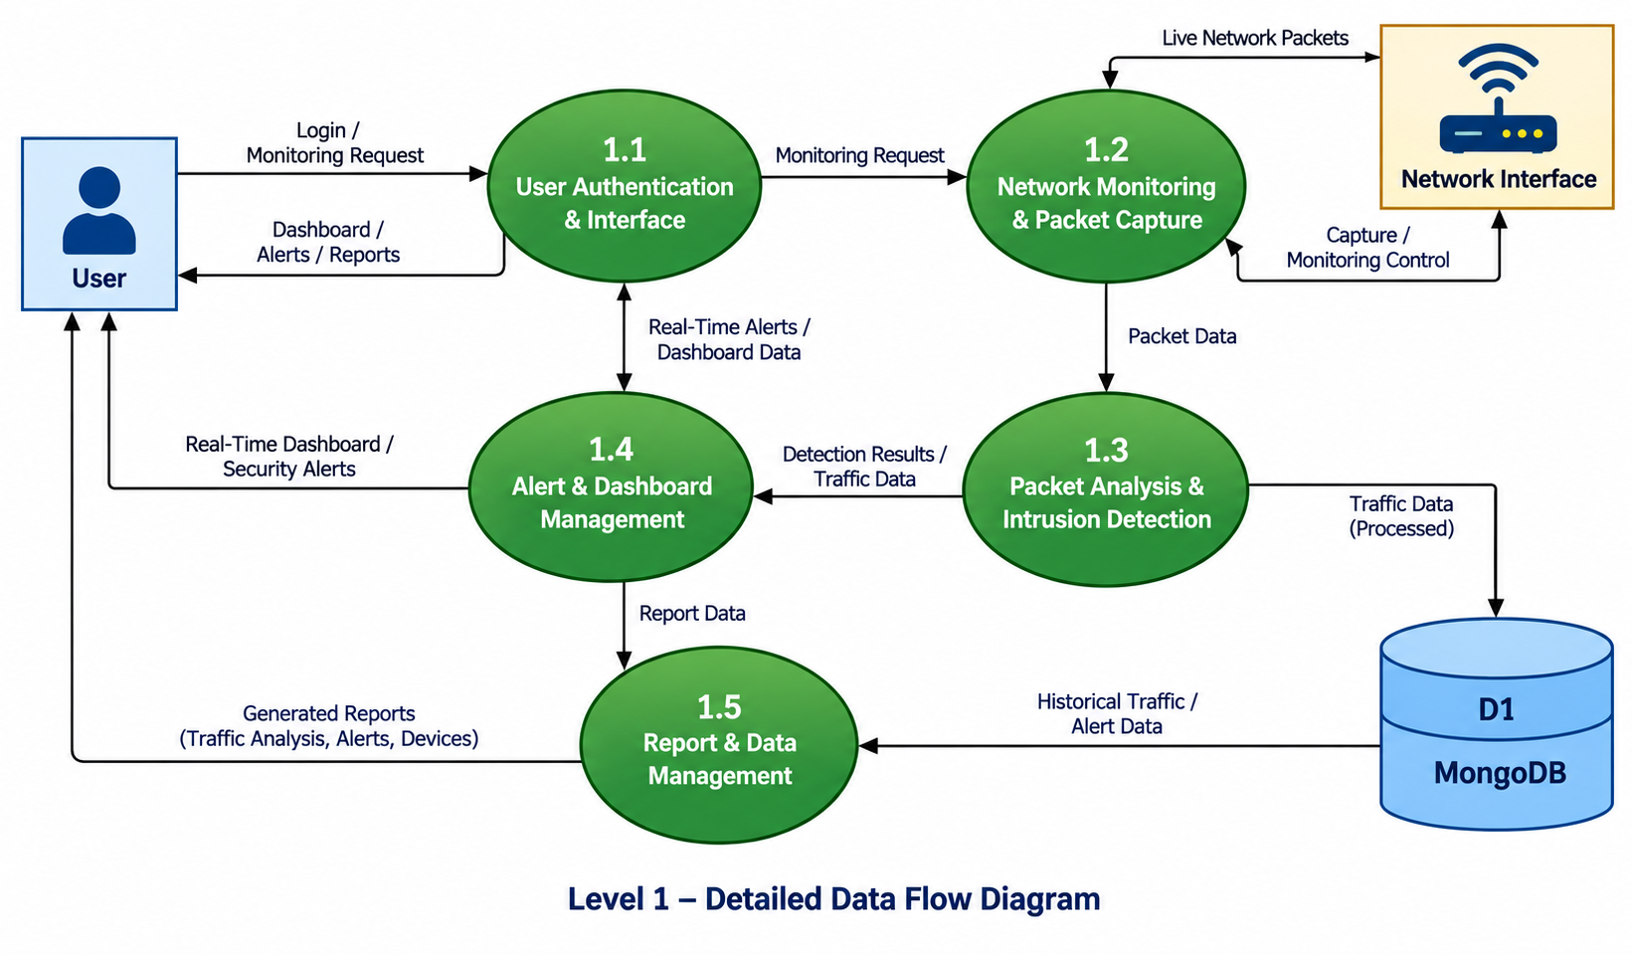
LEVEL 1
Network Traffic Analyzer and Intrusion Detection System
16

Slide 17
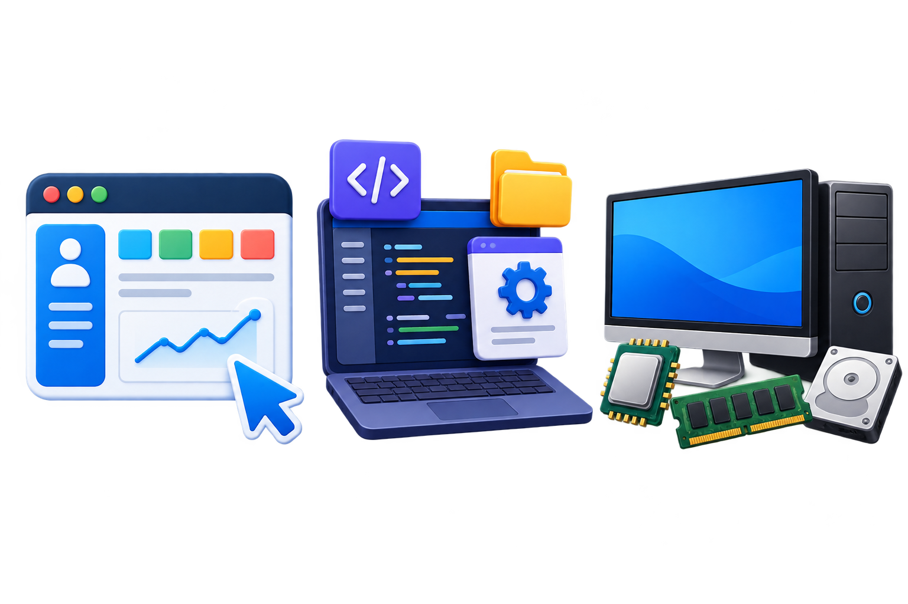
Software Requirement Specifications
USER INTERFACE
The system provides a simple and responsive web-based interface.
The frontend is developed using React.js.
Displays real-time network traffic and protocol statistics.
Shows detected attacks, security alerts and risk levels.
Provides charts, tables and filtering options for traffic analysis.
User Interface
responsive web-based interface
Network Traffic Analyzer and Intrusion Detection System
17

Slide 18
Software Requirements
Operating System: Windows / Linux
Frontend: React.js, HTML, CSS, JavaScript
Backend: Python
Packet Capture: Scapy
API: Flask / FastAPI
Real-Time Communication: WebSocket
Data Processing: Pandas
Data Storage: CSV / JSONL / PCAP
Web Browser: Chrome / Edge / Firefox
Development Tool: VS Code
Software Requirement
Frontend + Backend + Database
Network Traffic Analyzer and Intrusion Detection System
18

Slide 19
Hardware Requirements
Computer/Laptop: Minimum 4 GB RAM and dual-core processor.
Storage: At least 10 GB of free storage.
Network Interface: Wi-Fi or Ethernet adapter for packet capture.
Display: Monitor or laptop screen for viewing the React dashboard.
Network: Local network connection for real-time traffic monitoring.
Optional: Additional network device for generating and testing traffic.
Hardware Requirement
Laptop + Storage + Wifi
Network Traffic Analyzer and Intrusion Detection System
19

Slide 20
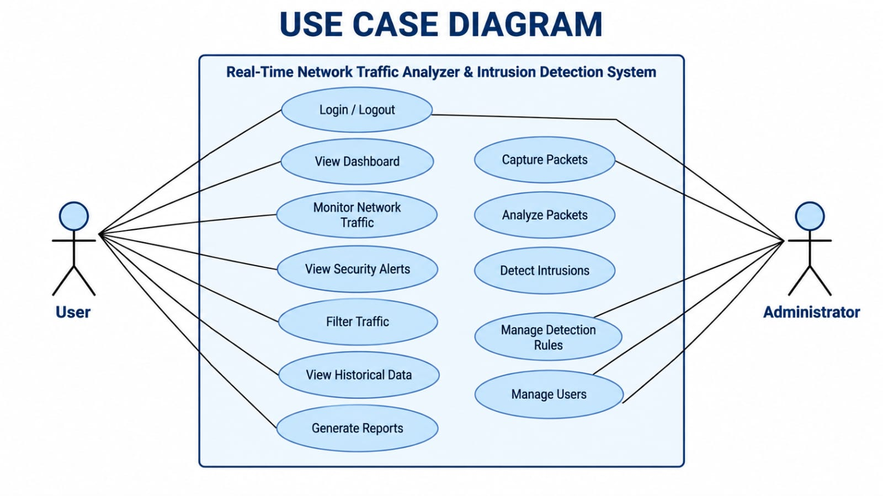
Use Case Diagram
Network Traffic Analyzer and Intrusion Detection System
20

Slide 21

Database Requirements
Database: MongoDB
Network Traffic: Stores packet and traffic details.
Alerts: Stores detected attacks, severity and timestamps.
Devices: Stores discovered device information.
Users: Stores authentication and user details.
Reports: Stores historical analysis and generated reports.
Backup: Important packet captures can be retained as PCAP files rather than putting every raw packet directly into MongoDB
Database Requirement
MongoDB
Network Traffic Analyzer and Intrusion Detection System
21

Slide 22
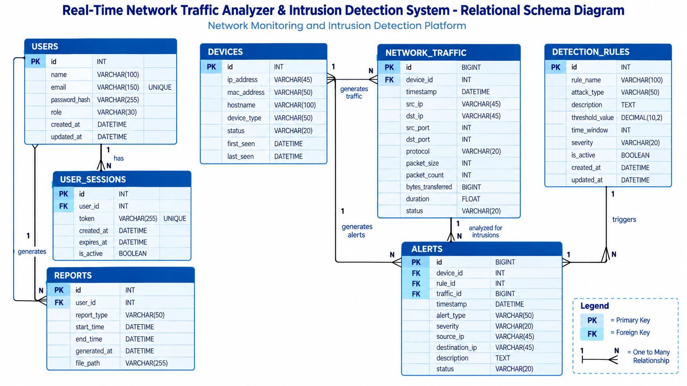
Relational Schema Diagram
Network Traffic Analyzer and Intrusion Detection System
22

Slide 23

Functional Requirements
Functional Requirements
User authentication
Real-time packet capture
Packet information analysis
Protocol and bandwidth monitoring
Device discovery
Suspicious activity detection
Security alert management
Real-time dashboard
Historical traffic analysis
Packet filtering
Report generation
Network Traffic Analyzer and Intrusion Detection System
23

Slide 24

Non-Functional Requirements
Non-Functional Requirements
Simple and responsive interface
Real-time performance
Secure data handling
Reliable packet processing
Scalable architecture
Efficient database storage
Easy maintenance
Support for future enhancements
Network Traffic Analyzer and Intrusion Detection System
24

Slide 25
RESULTS
Network Traffic Analyzer and Intrusion Detection System
25

Slide 26
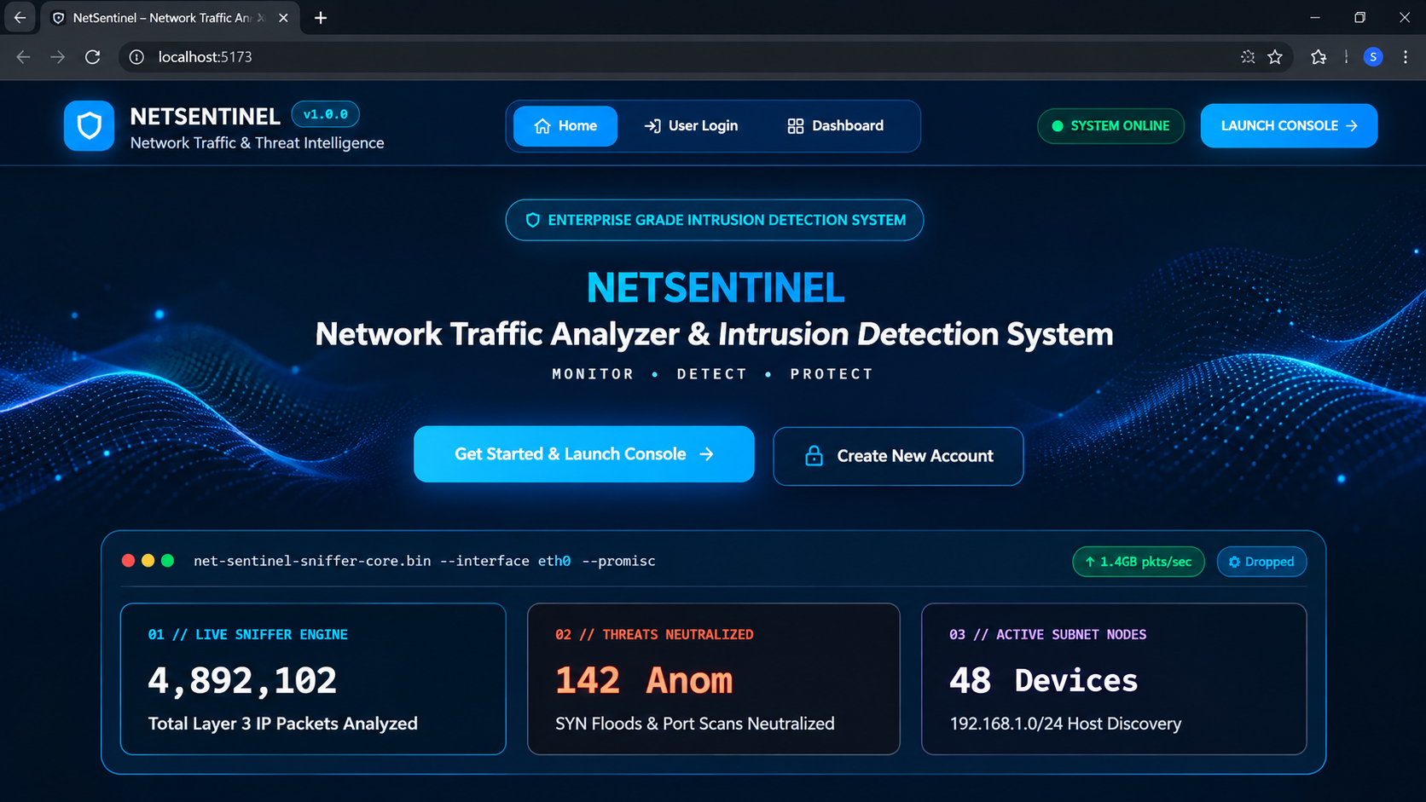
1- Home Page
Network Traffic Analyzer and Intrusion Detection System
26

Slide 27
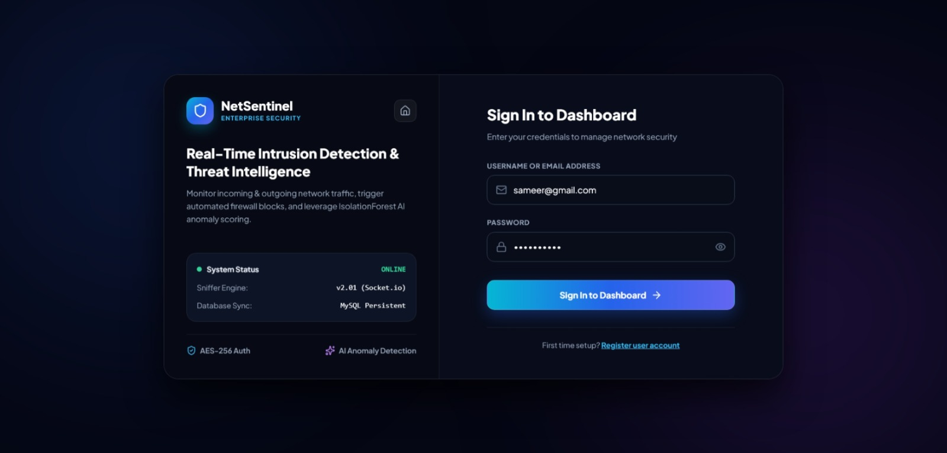
2 – Login Page
Network Traffic Analyzer and Intrusion Detection System
27

Slide 28
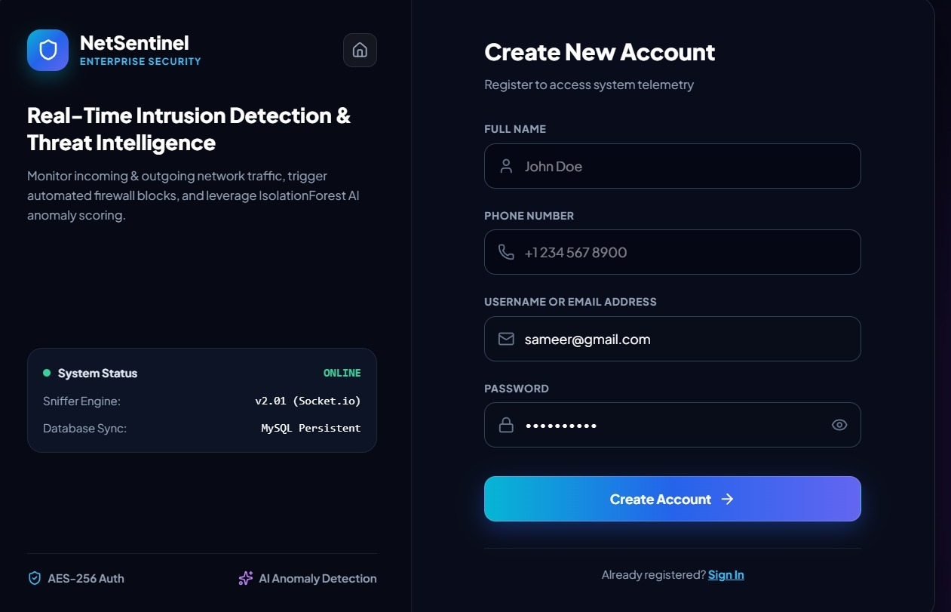
3 – Registration Page
Network Traffic Analyzer and Intrusion Detection System
28

Slide 29
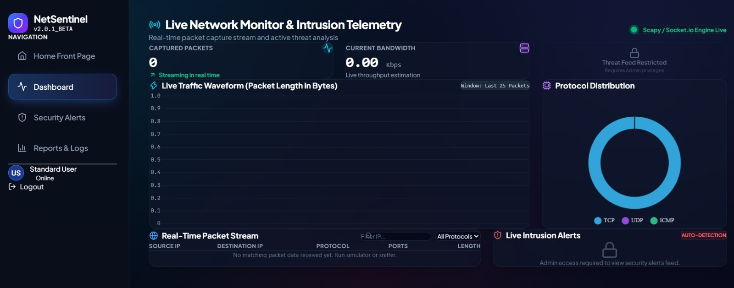
4 - Dashboard
Network Traffic Analyzer and Intrusion Detection System
29

Slide 30
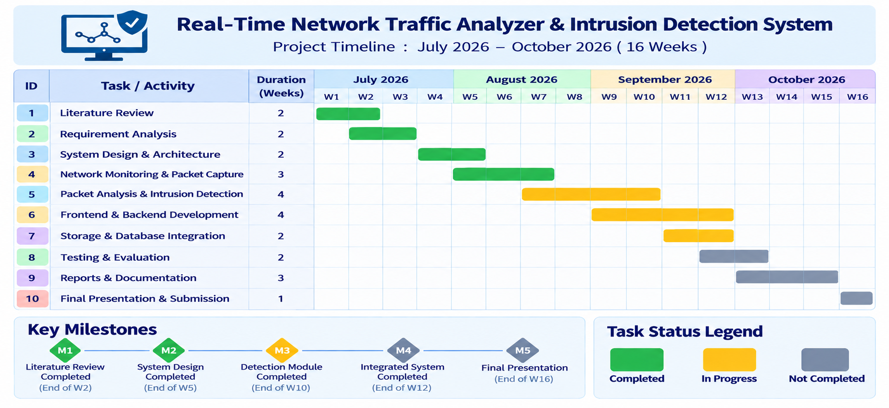
Gantt Chart
Network Traffic Analyzer and Intrusion Detection System
30

Slide 31





Conclusion
The proposed system aims to make network monitoring and basic security analysis easier through a single web-based platform.
Real-time network monitoring
Packet and protocol analysis
Traffic visualization
Suspicious activity detection
Real-time security alerts
Historical traffic analysis
Device monitoring
Report generation
Built with Python and Scapy for packet analysis and the MERN Stack for the web application — a practical, user-friendly solution for network monitoring and cybersecurity learning.
31

Slide 32
References
Tamrakar, A., Chaturvedi, J., Poddar, M., & Kumari, S. (2026). Network Traffic Analyzer: Real-Time Detection and Malicious Activity Identification. International Journal on Advanced Computer Theory and Engineering.
Wawrowski, Ł., Białas, A., Kajzer, A., et al. (2023). Anomaly Detection Module for Network Traffic Monitoring in Public Institutions. Sensors, 23(6), 2974.
Oroian, D., Bolboaca, R., Roman, A.-S., & Dobrota, V. (2024). Network Intrusion Detection System Using Anomaly Detection Techniques. IEEE 20th International Conference on Intelligent Computer Communication and Processing (ICCP), 93–100.
Buzzio-García, J., et al. (2024). Exploring Traffic Patterns Through Network Programmability: Introducing SDNFlow, a Comprehensive OpenFlow-Based Statistics Dataset for Attack Detection. IEEE Access, 12, 42163–42180.
32

Slide 33

Thank You!
Questions & Discussion

