Slide 1



SIDDAGANGA INSTITUTE OF TECHNOLOGY
(An Autonomous institution affiliated to Visvesvaraya Technological University- Belagavi, Approved by AICTE, Accredited by NAAC with ‘A++’ Grade, Awarded Diamond College Rating by QS I-GAUGE & ISO 9001:2015 certified )
Department of Computer Science and Engineering
LLM BASED AGENT FOR GENERATING USER CONTENT
Batch No: B14

Slide 2
Agenda
Problem Statement
Motivation
Literature Survey
Objective
High-Level Design
Project Outcomes

Slide 3
Problem Statement & Motivation
The motivation behind our project lies in addressing the challenges faced by individuals in generating diverse and compelling content efficiently. LLMs, with their ability to understand context, nuances, and diverse linguistic styles, have demonstrated remarkable capabilities in natural language understanding and generation. By harnessing the power of LLMs, we aim to develop an intelligent agent that not only assists but elevates the content creation process to new heights.
The core motivation lies in the quest to optimize and revolutionize the content creation process. By leveraging the advanced capabilities of LLMs, we aim to empower content creators, businesses, and publishers to produce high-quality, informative articles efficiently and with precision. This aspiration aligns with the growing demand for streamlined and effective content generation in various professional contexts.
The main motivations are,
Enhanced Creativity
Efficiency and Productivity
Adaptability to Varied Domains
Personalization and Audience Engagement
Stay Current with Technological Trends
Research and Innovation
In conclusion, our motivation is rooted in the belief that the convergence of these objectives will not only advance the field of natural language processing but will also yield practical applications that redefine content creation, scriptwriting, information retrieval, and user engagement. Through this project, we aspire to contribute meaningfully to the evolution of language models and their impact on diverse professional and user-oriented domains.

Slide 4
Objective
Understand the human language.
Developing AI agents that understand human language is a challenging task for natural language processing researchers. It requires a deep understanding of language structure, meaning, and the ability to adapt to new patterns. Significant strides have been made using machine learning and neural networks, and continued research will create more sophisticated and accurate language models for future AI agents to interact with humans more intuitively.
Answering questions based on the information given to it.
Intelligent systems can answer questions by using natural language processing techniques to understand input and retrieve relevant data from their knowledge base. This feature is useful in fields such as customer support, education, and research. With advancements in AI and machine learning, these systems will become even more valuable tools in the future.

Slide 5
Improved B﻿ook Comprehension
Enhanced book comprehension. By providing clear explanations and answers to complex concepts, students are expected to better understand the material in their textbooks.
Easy integrating with other application
The application's feature allows for seamless integration with other tools and platforms through GraphQL or REST-API. This enables data sharing, workflow automation, and process streamlining, boosting productivity and driving success for developers, project managers, and business owners.

Slide 6
Literature survey
SL. No. | Research Paper | Description
1 | A Comprehensive Overview of Large Language Models | The article presents a comprehensive overview of concepts related to LLMs, including both basic and advanced topics. It aims to help researchers and practitioners in the field by providing insights into existing works and advancing LLM research. LLMs have shown exceptional capabilities in natural language processing, leading to numerous contributions in areas such as training strategies, fine-tuning, and multi-modal LLMs. https://arxiv.org/pdf/2307.06435.pdf
2 | Attention Is All You Need | This paper presents a new network architecture called the Transformer, based only on attention mechanisms, for sequence transduction tasks. It outperforms existing models, is more parallelizable, and requires less time to train. The model achieves state-of-the-art results on machine translation tasks and generalizes well to other tasks. https://arxiv.org/pdf/1706.03762.pdf

Slide 7
SL. No. | Research Paper | Description
3 | Improving alignment of dialogue agents via targeted human judgements | Reinforcement learning from human feedback (RLHF) is essential for machine learning systems operating in settings without an objective program. Human judgments of behavior are crucial for training, but effective human supervision relies on informed and motivated humans and a robust data collection setup, applicable to natural language, robotics, and other tasks. https://arxiv.org/pdf/2209.14375.pdf
4 | TEAL: Tokenize and embed all for multi-modal large language models | TEAL proposes to treat input from any modality as a token sequence and learn a joint embedding space for all modalities, enabling LLMs to predict multi-modal tokens and perform both understanding and generation tasks involving non-textual modalities with substantial improvements. It offers a simple scheme for multi-modal generations. https://arxiv.org/pdf/2311.04589.pdf

Slide 8
SL. No. | Research Paper | Description
5 | Processing Data for Large Language Models | The article offers a guide to help practitioners developing large language models (LLMs) overcome challenges such as handling junk data, de-duplication, bias control, and personally identifiable information control. The complexity of LLMs presents significant challenges, particularly in terms of scale. https://wandb.ai/wandb_gen/llm-data-processing/reports/Processing-Data-for-Large-Language-Models--VmlldzozMDg4MTM2
6 | Full Parameter Fine-Tuning for Large Language Models With Limited Resources | TEAL proposes to treat input from any modality as a token sequence and learn a joint embedding space for all modalities, enabling LLMs to predict multi-modal tokens and perform both understanding and generation tasks involving non-textual modalities with substantial improvements. It offers a simple scheme for multi-modal generations. https://arxiv.org/pdf/2311.04589.pdf

Slide 9
SL. No. | Research Paper | Description
7 | BERT: Pre-training of Deep Bidirectional Transformers for Language Understanding | BERT is a language representation model that pre-trains deep bidirectional representations from unlabeled text by conditioning on both left and right context in all layers. It can be fine-tuned with one additional output layer for various natural language processing tasks, achieving state-of-the-art results on eleven tasks, including question answering and language inference https://arxiv.org/pdf/1810.04805.pdf
8 | LaMDA: Language Models for Dialog Applications | LaMDA is a neural language model pre-trained on public dialog data and web text, with up to 137B parameters. It can be fine-tuned with annotated data and external knowledge sources to improve safety and factual grounding. Its potential uses include education and content recommendations, with helpfulness and role consistency analyzed. https://arxiv.org/pdf/2201.08239.pdf

Slide 10
SL. No. | Research Paper | Description
9 | LLM-Adapters: An Adapter Family for Parameter-Efficient Fine-Tuning of Large Language Models | This research paper introduces a novel approach for fine-tuning large language models (LLMs) with fewer parameters. The method leverages parameter sparsity to enhance model stability and generalization. Additionally, the paper presents the concept of LLM-Adapters, which integrates various adapters into LLMs for task-specific fine-tuning. https://arxiv.org/abs/2304.01933
10 | Enhancing LLM with Evolutionary Fine Tuning for News Summary Generation | The study speaks about new method for generating news summaries using large language models (LLMs). The method uses LLMs to extract and evolve event patterns from news paragraphs, and then inputs the most adaptive event pattern to the LLM to generate a summary. https://arxiv.org/abs/2307.02839

Slide 11
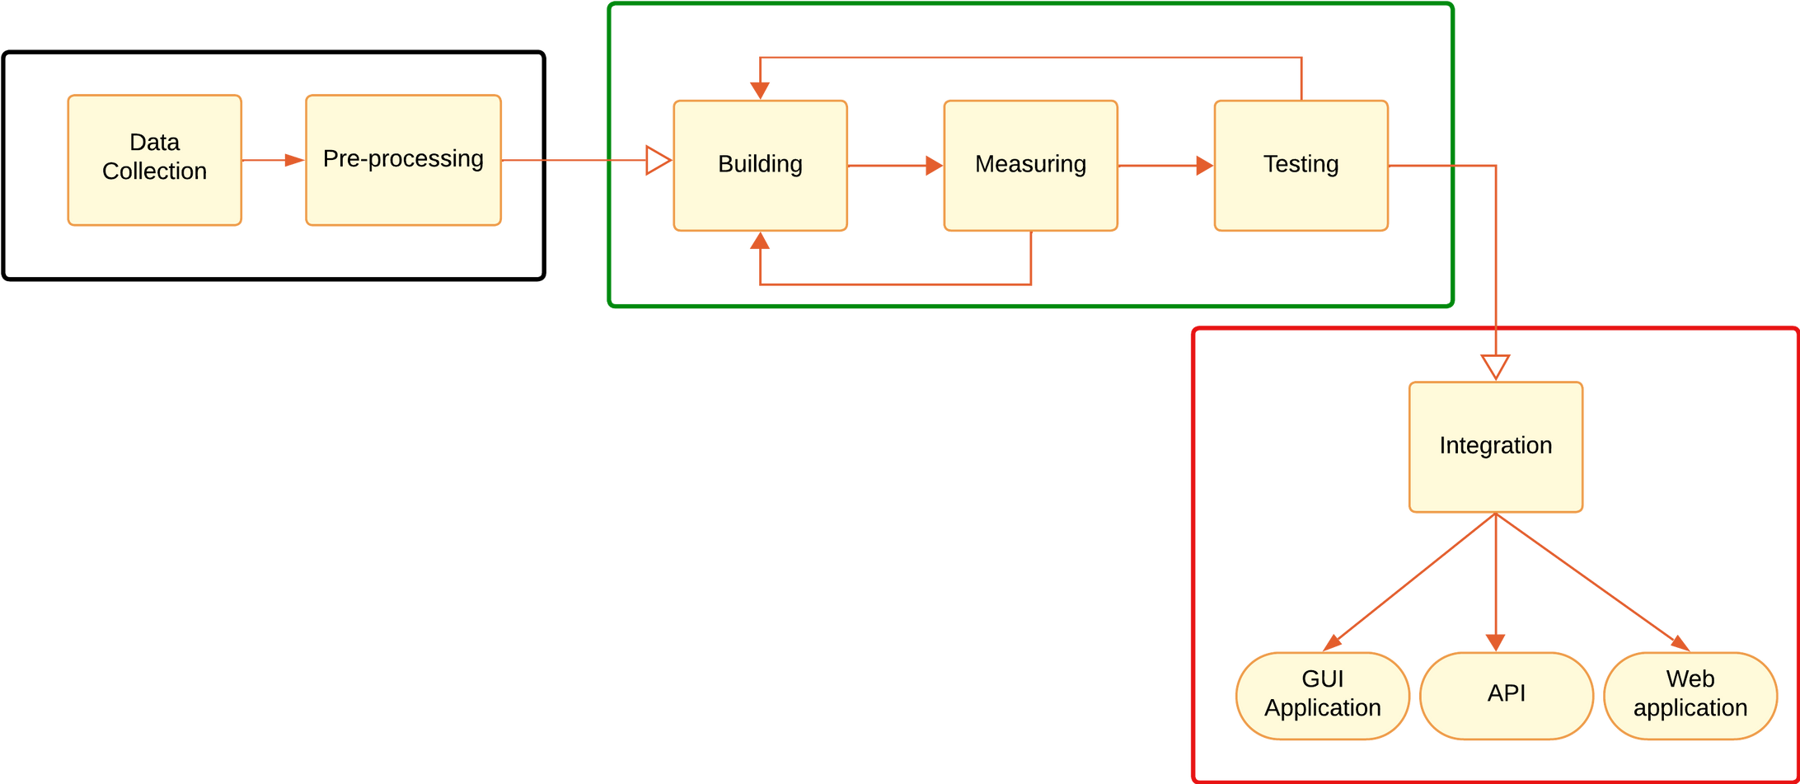
High level design

Slide 12
Outcome
The agent will able to understand and communicate in english
The successful development of the project will lead to understanding of the English language and more efficient communication between users and AI agents.
It will provide response or suggestion to posed question based on the information given
AI agents offer accurate and relevant responses to user queries based on their ability to process vast amounts of data and learn from it. This saves time and ensures reliable and personalized information.
Agent can make reasonable suggestion
Agent can be integrated with other application

Slide 13
Agent will able to accept information in different format
like: pdf,text
The AI Agent can accept information in various formats, such as PDF or text files, allowing for greater flexibility in user interaction and a wider range of data processing. This feature improves the user experience and can lead to more accurate results.
It will able integrate with other applications.
AI agent applications are popular for automating tasks and processes, increasing efficiency, and integrating with other applications through API protocols like REST and GraphQL for seamless communication and data sharing. They enable businesses to streamline operations and deliver better value to customers.
Agent can make reasonable suggestion
Agent can be integrated with other application

Slide 14
Thank you
Guide : Sowmya M N
Assistant Professor CSE
A presentation by
Adarsh Reddy P 1SI20CS137
Brijesh Krishna G A 1SI20CS139
Puneeth A R 1SI20CS083
S N Saagar 1SI20CS093

Slide 16
Objective
Making the agent able to understand the human language.
Agent can answer questions based on the information given to it.
Agent can make reasonable suggestions.
Making Agent can be integrated with other application easily with a GraphQL or REST-API.

Slide 17
Working of LLMs
Improving Alignment of Dialogue Agents
Talks about the benefit of using reinforcement learning along with human feedback to fine tune per-trained LLM based agents.
https://arxiv.org/abs/1810.04805
Tokenize and Embed All for Multi-modal Large Language Models.
Discusses about Tokenizing the inputs and Embeddings. Converting a input to meaningful numbers.
https://arxiv.org/abs/2311.04589

Slide 18
Improving the performance of LLMs
Processing Data for Large Language Models.
Discusses about handling junk data , de-duplication , Bias Control
Personally Identifiable Information Control.
https://wandb.ai/wandb_gen/llm-data-processing/reports/Processing-Data-for-Large-Language-Models-- mlldzozMDg4MTM2
Full Parameter Fine-Tuning for Large Language Models
Talks about methods to optimization data processing before training begins.
https://wandb.ai/wandb_gen/llm-data-processing/reports/Processing-Data-for-Large-Language-Models--mlldzozMDg4MTM2

Slide 19
Literature survey
Understand architectures of LLMs
A Comprehensive Overview of Large Language Models
Understanding and Overview of large language models
https://arxiv.org/pdf/2307.06435.pdf
Attention Is All You Need
Presents the original transformer model. it helps with sequence-to-sequence tasks, such as machine translation.
https://arxiv.org/pdf/2307.06435.pdf

Slide 20
BERT
Pre-training of Deep Bi-directional Transformers for Language Understanding ,helps in modeling and prediction.
https://arxiv.org/abs/1810.04805
LaMDA
Language Models for Dialog Applications is Transformer-based neural language models.
https://arxiv.org/abs/2201.08239

Slide 21
AI agent applications are popular for automating tasks and processes, increasing efficiency, and integrating with other applications through API protocols like REST and GraphQL for seamless communication and data sharing. They enable businesses to streamline operations and deliver better value to customers.

Slide 22
Cramming: Training a Language Model on a Single GPU in One Day
Paper focuses on a way to increase the performance by using minimum computing power.
https://arxiv.org/abs/2212.14034

Slide 23
Motivation
For a free and open based ai agent for understanding and communicating human language , which is able to answer question based on the user given information which can accept the data in any format and able to produce a appropriate responce and this agent can be integrated with other application using Api
use﻿r content generation AI agent is becoming increasingly important in today's world, where communication is a vital aspect of almost every industry. With the ability to understand and process natural language, this AI agent can provide quick and accurate answers to user queries, making it an invaluable tool for businesses and individuals alike.
Furthermore, this AI agent can be easily integrated with other applications using an API. This means that businesses can incorporate the agent into their existing software infrastructure, allowing for seamless communication between the agent and other tools.
Overall, this free and open-based AI agent for understanding and communicating human language is a powerful tool that has the potential to revolutionize the way we interact with technology. Its ability to process natural language and its flexibility when it comes to data formats make it an invaluable asset for businesses and individuals alike.
This AI agent is highly flexible and can accept data in any format, including text, voice, and images, making it easily accessible to users who can communicate in the way that is most convenient for them.

Slide 24
B14
SIDDAGANGA INSTITUTE OF TECHNOLOGY
LLM BASED AGENT FOR GENERATING USER CONTENT

Slide 25
Outcome
The agent will able to understand and communicate in english
It will provide appropriate a response or suggestion to posed question based on the information given
Agent will able to accept information in different format
like: pdf,test
It will able integrate with other applications.
Agent can make reasonable suggestion
Agent can be integrated with other application

