Slide 1

Presented By
Brijesh Pant
(Senior Consultant)
Senior Consultant

Slide 2
Agenda
Understanding AKKA
Actor System
Communication between Actors
Example using actors
Supervisor Strategy
Falt tolerant
Become/Unbecome
Akka Remoting

Slide 3
CONCURRENCY
In computer science, concurrency is a property of systems in which
several computations are making progress simultaneously and potentially
interacting with each other ,even though they are not executing simultaneously

Slide 4
Concurrency
class BankAccount { private var balance = 0 def deposit(amount: Int): Unit = if (amount > 0) balance = balance + amount def withdraw(amount: Int): Int = if (0 < amount && amount <= balance) { balance = balance - amount balance } else throw new IllegalStateException("Balance insufficient") }

Slide 5
Concurrency
class BankAccount { private var balance = 0 def deposit(amount: Int): Unit = this.synchronized { if (amount > 0) balance = balance + amount } def withdraw(amount: Int): Int = this.synchronized { if (0 < amount && amount <= balance) { balance = balance - amount balance } else throw new Error("insufficient funds") }
}

Slide 6
Concurrency
class BankAccount { private var balance = 0 def deposit(amount: Int): Unit = this.synchronized { if (amount > 0) balance = balance + amount } def withdraw(amount: Int): Int = this.synchronized { if (0 < amount && amount <= balance) { balance = balance - amount balance } else throw new Error("insufficient funds") } def transfer(from: BankAccount, to: BankAccount, amount: Int): Unit = { from.synchronized { to.synchronized { from.withdraw(amount) to.deposit(amount) } } } }

Slide 7
Concurrency
It’s not about threads
It’s not about locks as well
Only purpose is to make sure controlled access of mutable state

Slide 8
Concurrency
What if we just don’t share state!
problem solved isn’t it?
It will help to write loosely coupled sate full objects.
less chances of making state inconsistent.
scalability.

Slide 9

Resilience
the ability of a substance or object to spring back into shape; elasticity
the capacity to recover quickly from difficulties; toughness
Resiliency is the ability of a server, network, storage system, or an entire data center, to recover quickly and continue operating even when there has been an equipment failure, power outage or other disruption.

Slide 10
Resilient Systems
Embrace Failure
Self healing

Slide 11

AKKA
AKKA is a toolkit and runtime
for building highly concurrent,
distributed, and resilient
message-driven applications
on the JVM.

Slide 12
Actors
Encapsulate sate and its behaviour
• Lightweight concurrent entities - 2.5m / GB mem
• Uses asynchronous event driven receive loop
• Focus is on workflow rather than concurrency
• Supports both Scala & Java

Slide 13


Actors
Behaviour
MailBox
Child Actors
Super visor

Slide 14
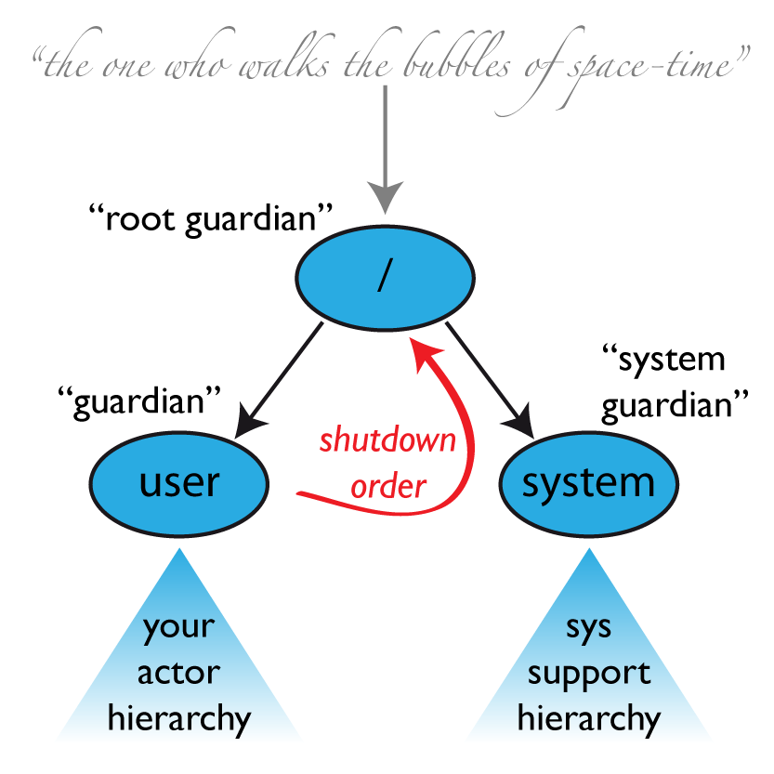
Actor System

Slide 15
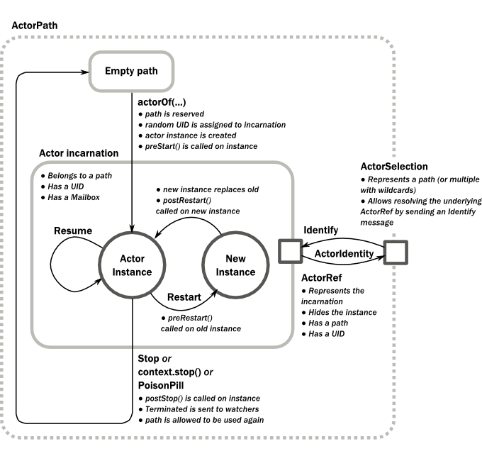
Actor life cycle

Slide 16
Defining An Actor
class MyActor extends Actor { def receive = { case "Message" => sender ! "Message was received" case "Message2" => println("received Message2") }
}

Slide 17
Examples

Slide 18
Actor Supervision
Resume the subordinate, keeping its accumulated internal state
Restart the subordinate, clearing out its accumulated internal state
Stop the subordinate permanently
Escalate the failure, thereby failing itself

Slide 19
AKKA use cases
•
• Investment and Merchant Banking • Retail
• Social Media
• Simulation • Gaming and Betting • Automobile and Traffic Systems
• Health Care • Data Analytics

Slide 20

Active users

Slide 21
Questions ?

Slide 22
Thanks

