Slide 1



Sustainable Agriculture: Crop Yield Prediction using Machine Learning & Deep Learning Algorithms

Slide 2

Learning Objectives
Collect and preprocess crop production dataset (India 1997–2015).
Perform detailed Exploratory Data Analysis (EDA).
Build machine learning models (Linear Regression, Decision Tree, Random Forest).
Evaluate performance with R², MAE, MSE, RMSE.
Deploy best model with Streamlit app.
Objective: Combine technology and agriculture for sustainability.
GOAL
Source :
www.freepik.com/

Slide 3
Goal
The goal is to predict crop yield accurately using ML models.
Reduce farming risks due to climate and soil uncertainties.
Provide farmers with data-driven insights for better planning.
Support sustainable agriculture and increase productivity.

Slide 4
Tools and Technology used
Python: Core language for data analysis and ML.
Libraries: Pandas, NumPy, Matplotlib, Seaborn, Scikit-learn.
Joblib: To save trained models as .pkl.
Platform: Jupyter Notebook for development.
Deployment: Streamlit for real-time app.
Dataset: Kaggle Crop Production (1997–2015).

Slide 5
Methodology 1:
Data Collection: Imported crop production dataset from Kaggle.
Data Preprocessing: Removed missing/duplicate values, engineered yield column.
EDA: Yield distribution, top 10 crops, yearly production trends.
Ensured dataset is clean and ready for ML modeling.

Slide 6
Methodology 2:
Model Training: Trained Linear Regression, Decision Tree, Random Forest.
Evaluation: Compared R², MAE, RMSE → Random Forest best.
Deployment: Final model saved as .pkl and integrated in Streamlit app.
End-to-end pipeline built from raw data to app deployment.

Slide 7
Problem Statement:
Farmers face uncertainty in predicting yields due to:
Weather fluctuations 🌦
Soil fertility variation 🌱
Seasonal crop variability 🌾l leads to resource wastage and financial losses.
A smart prediction system is needed for planning.

Slide 8
Solution:
Developed an ML-based yield prediction system.
Inputs: State, District, Season, Crop, Year, Area.
Output: Predicted yield (quintals/ha).
Provides insights into which crops perform better where.
Supports sustainable farming practices and resource management.

Slide 9
Github Repositories Week Wise:
Contains full source code, datasets, and notebooks.Includes Week 1 (EDA), Week 2 (Modeling), and Final Submission.
Streamlit app file crop_yield_prediction.py also included.
SUSTAINABLE-AGRICULTURE-USING-MACHINE-LEARNING-DEEP-LEARNING-ALGORITHMS-WEEK-1:
https://github.com/Brijeshrath67/SUSTAINABLE-AGRICULTURE-USING-MACHINE-LEARNING-DEEP-LEARNING-ALGORITHMS-WEEK-1.git
SUSTAINABLE-AGRICULTURE-USING-MACHINE-LEARNING-DEEP-LEARNING-ALGORITHMS-WEEK-2:
https://github.com/Brijeshrath67/SUSTAINABLE-AGRICULTURE-USING-MACHINE-LEARNING-DEEP-LEARNING-ALGORITHMS-WEEK-2.git
SUSTAINABLE-AGRICULTURE-USING-MACHINE-LEARNING-DEEP-LEARNING-ALGORITHMS-FINAL:
https://github.com/Brijeshrath67/SUSTAINABLE-AGRICULTURE-USING-MACHINE-LEARNING-DEEP-LEARNING-ALGORITHMS-FINAL.git

Slide 10
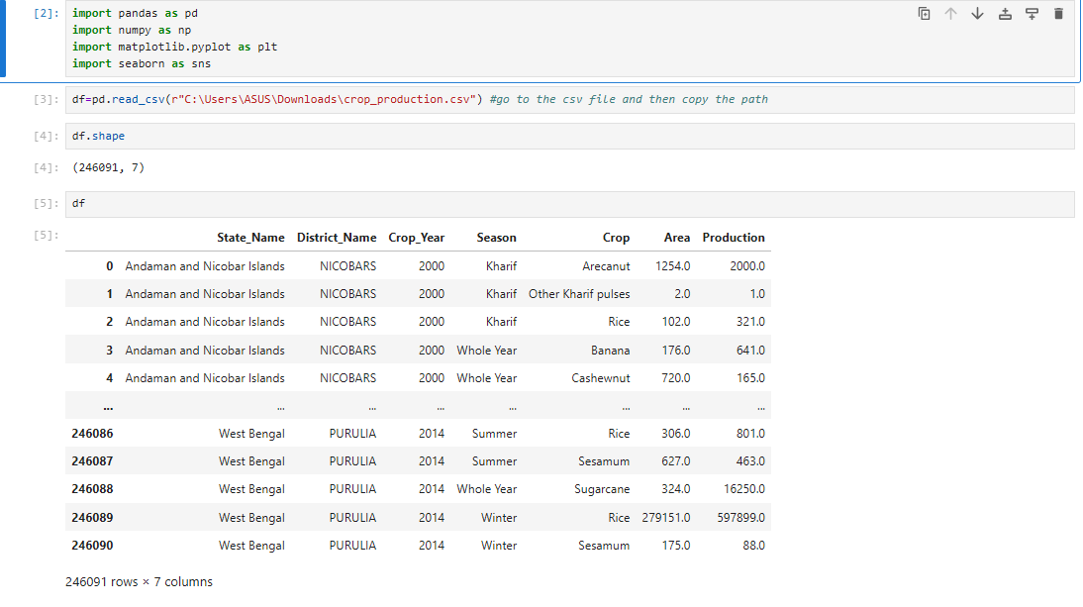
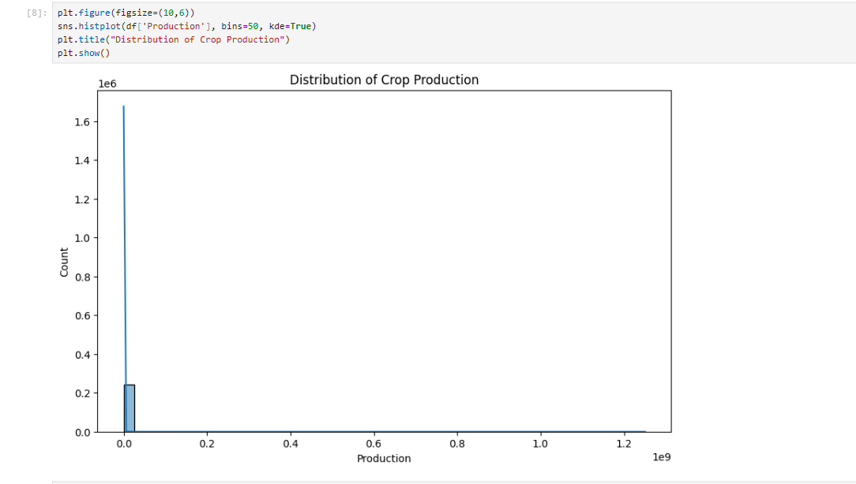
Screenshot of Output:
Jupyter Notebook EDA (Graphs like Top crops & Yield Distribution).
Streamlit app showing predicted yield.
Demonstrates working of both analysis & deployment phases.

Slide 11
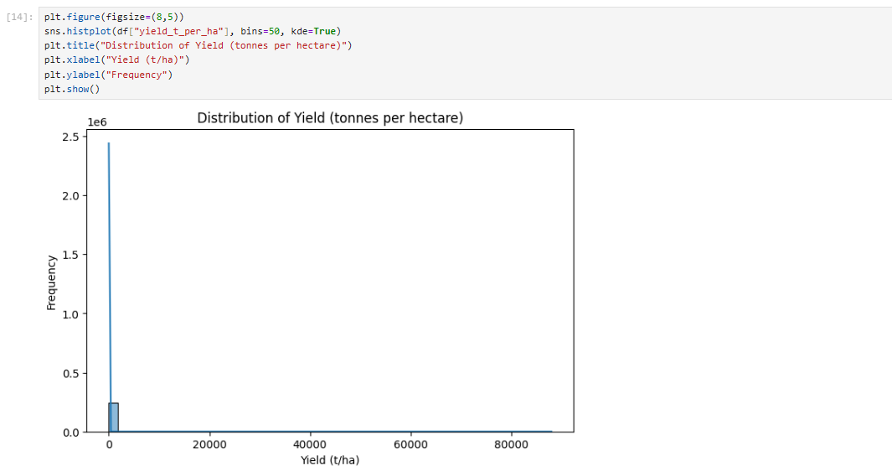
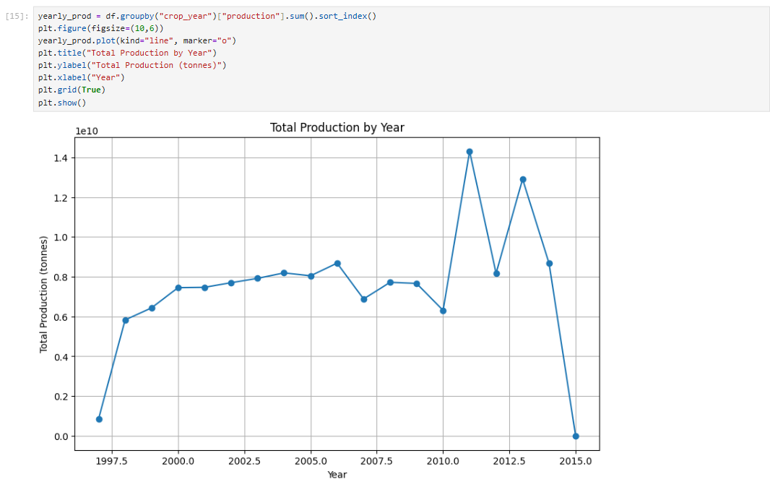
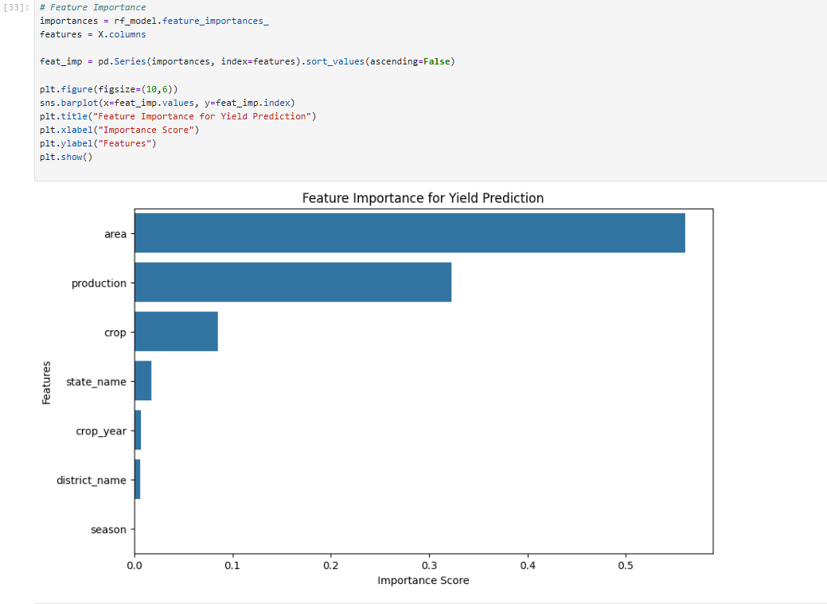
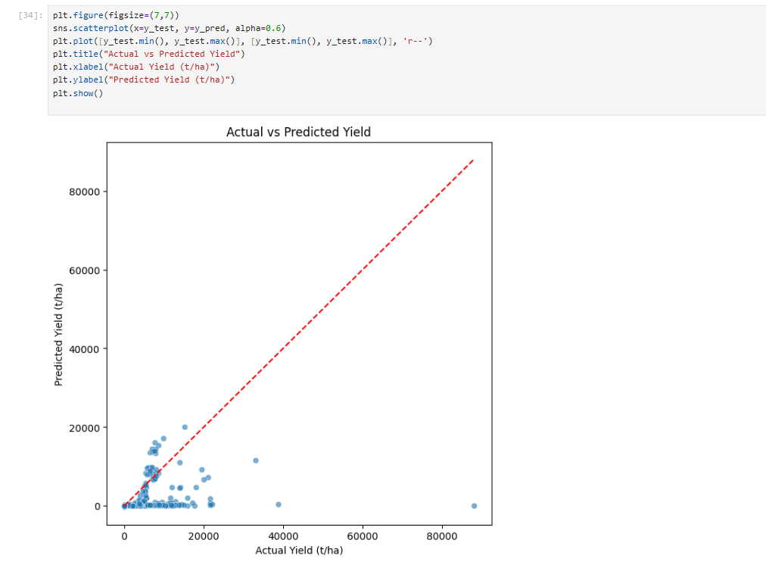
Screenshot of Output:

Slide 12
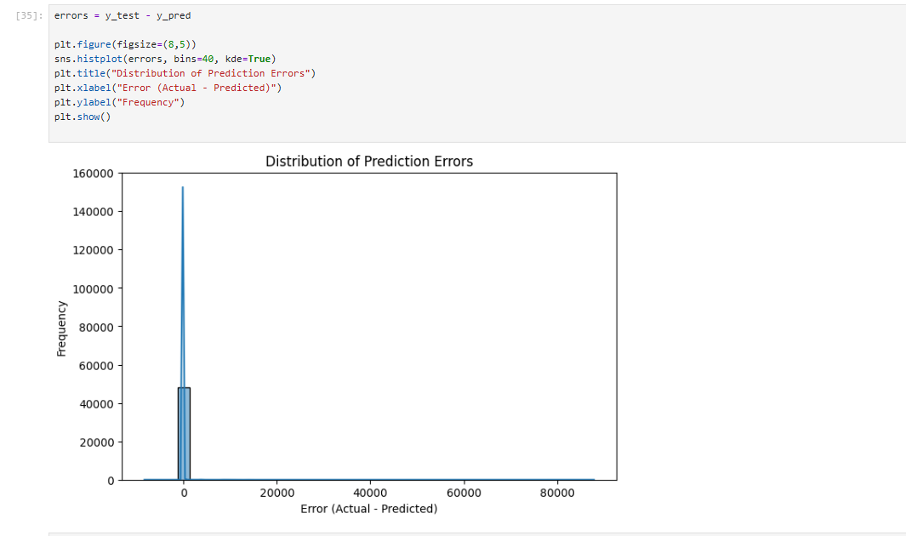
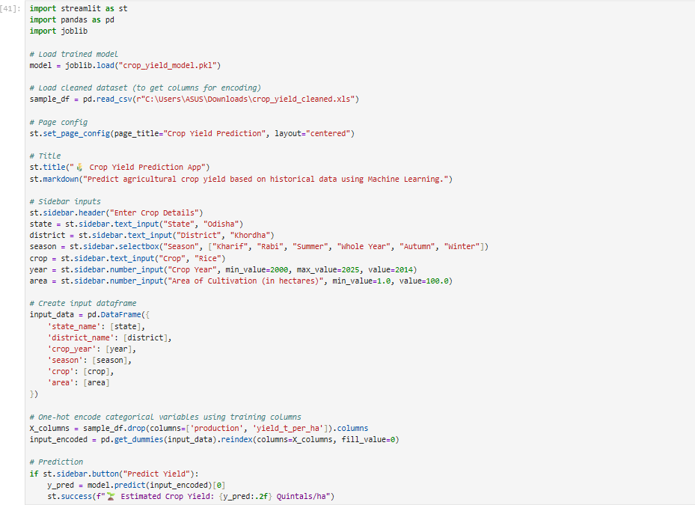
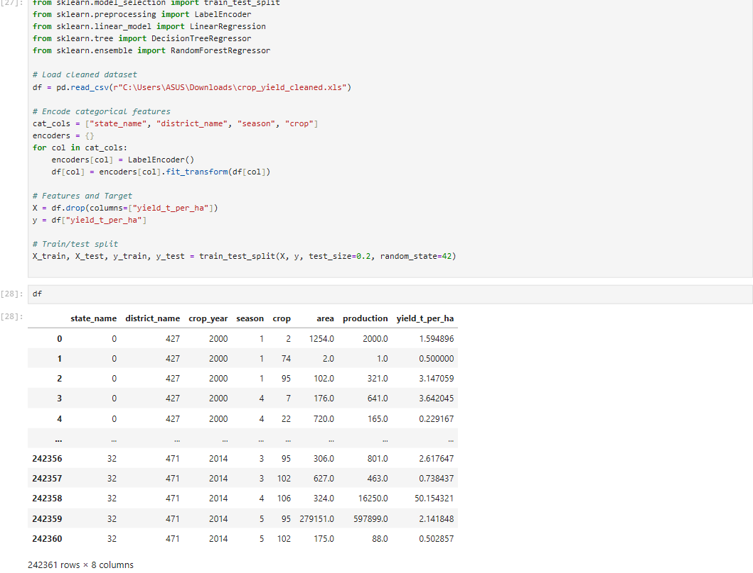
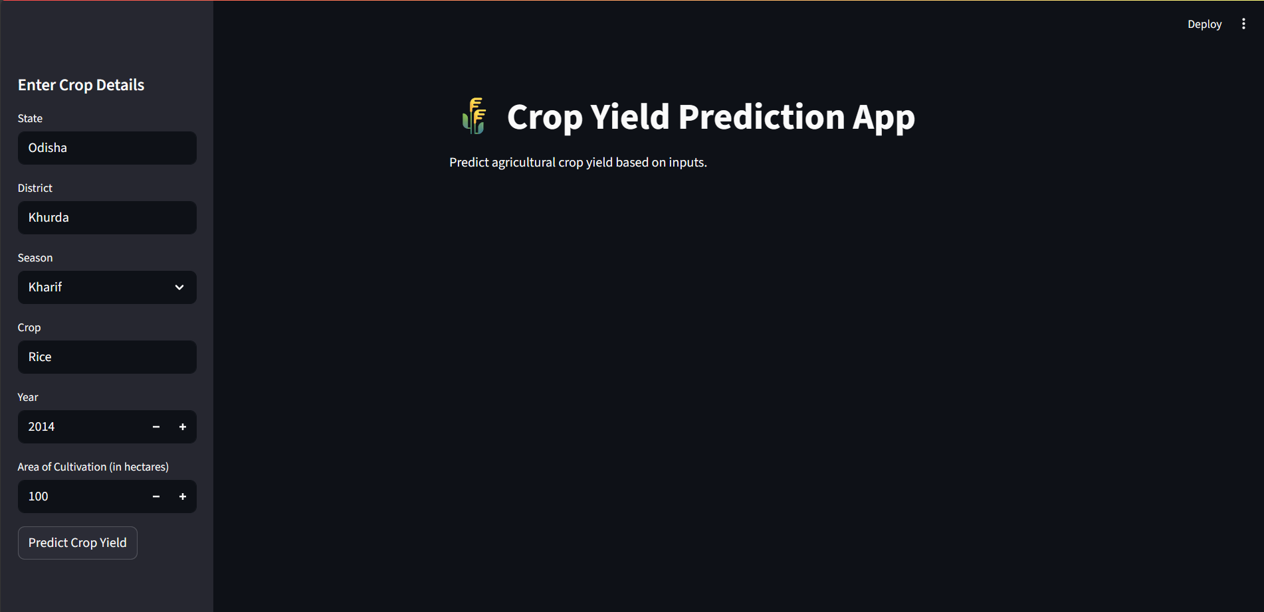
Screenshot of Output:

Slide 13
Conclusion:
Random Forest performed best with highest accuracy.
Yield prediction helps reduce risks in farming.Data + AI = Future of sustainable agriculture.
Farmers can use app for better crop planning.

Slide 14
Future Scope:
Integrate weather and soil parameters for more accuracy.
Expand dataset with recent years & satellite data.
Deploy as a mobile app for farmers.
Aim: Scalable and accessible AI solution for agriculture.

