Slide 1
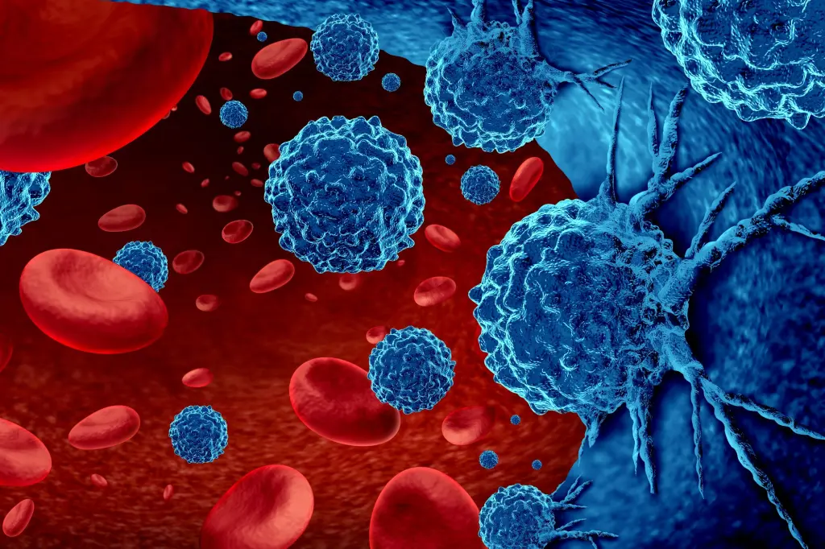
CANCER DETECTION USING MACHINE LEARNING
Done by,
Brijith keran K

Slide 2
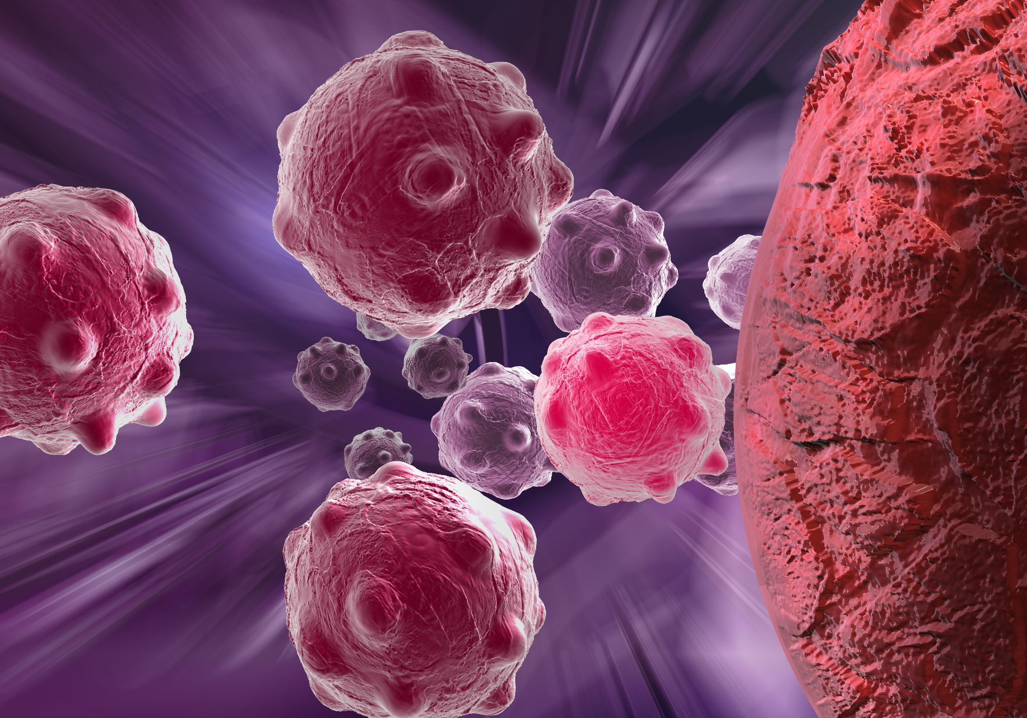
Introduction
spread of plant diseases
Molecular detection methods
high cost and bulky equipment required

Slide 3
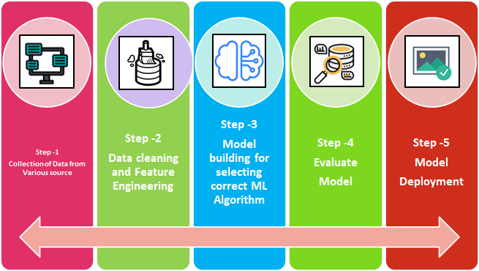
Methodology

Slide 4

GATHERING DATA
More training examples.
Comparable number of samples in each class.
The most common data sources to collect data for a ML model:
Open Source Datasets (eg:kaggle, Government Datasets
Manual Data Generation

Slide 5
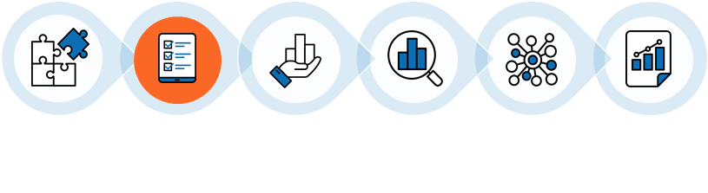
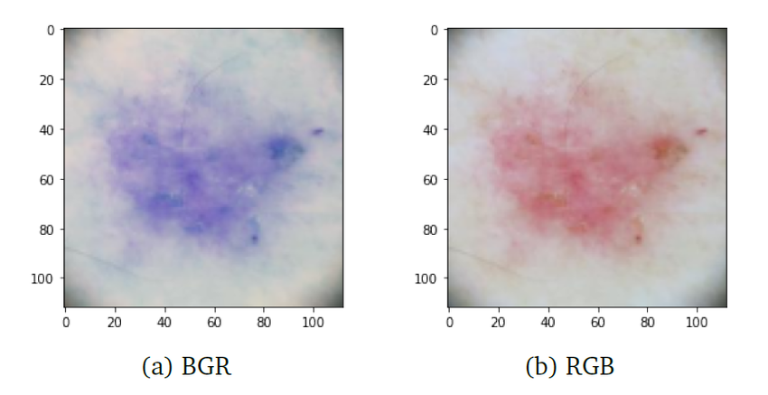
PREPROCESSING PHASE
3.Normalizing
1.RESIZING
2. BGR2RGB

Slide 6
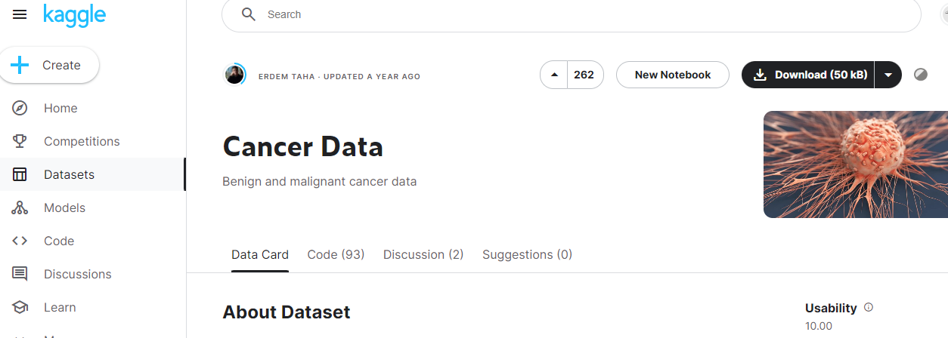


1.
3.
2.

Slide 7
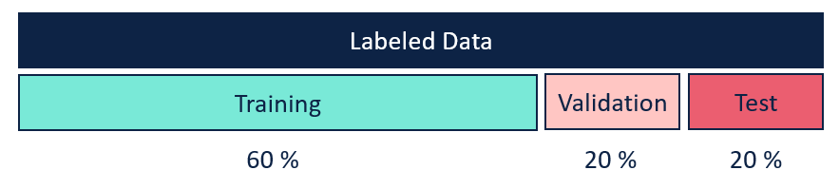
DATA PREPARATION

Slide 8


1.
2.
3.

Slide 9
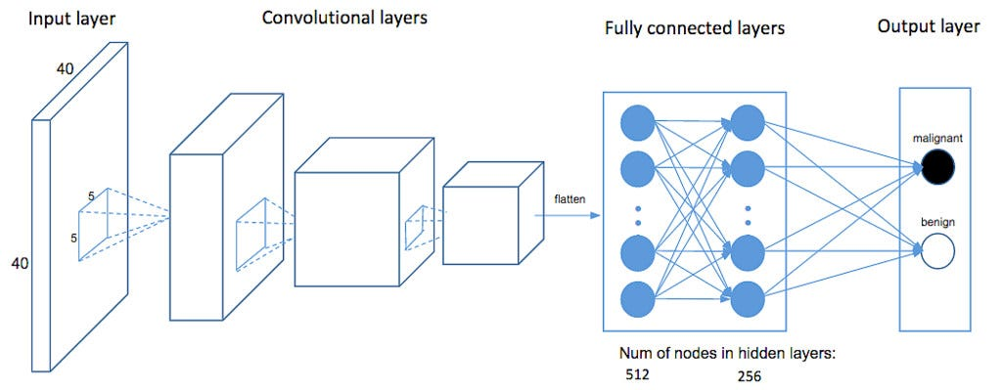
MODEL CHOICE
(Feqture extraction)

Slide 10
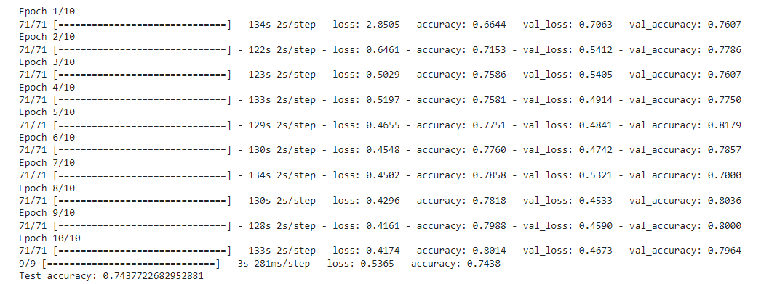
TRAINING
CNN PARAMETERS:
Convolutional filters
Weights
Biases

Slide 11
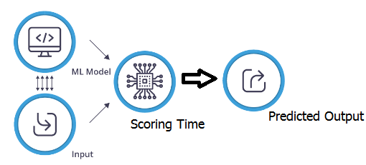
Evaluation

Slide 12


1.
2.

Slide 13
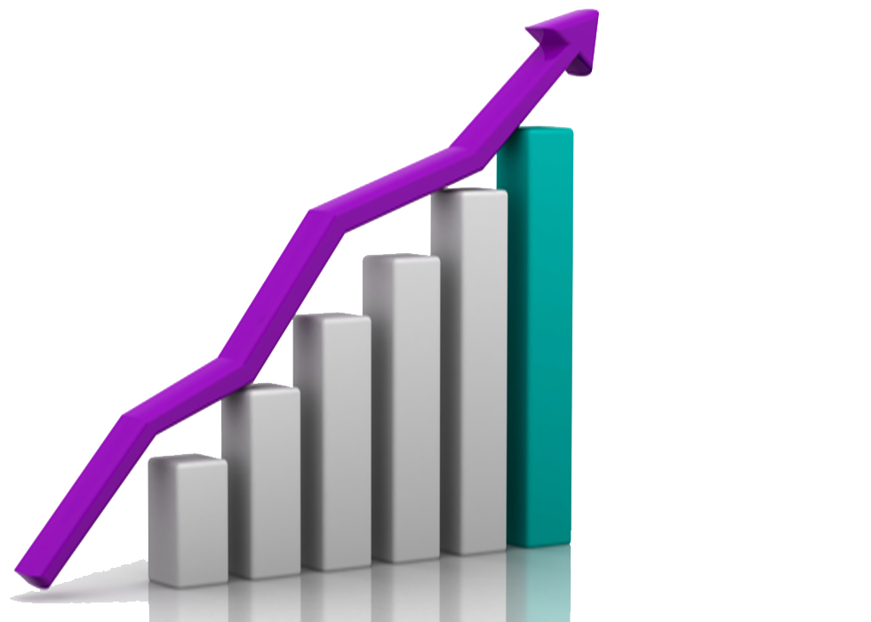
Conclusion and Future Implications
Increasing Accessibility
Improving Efficiency
Enhancing Outreach

Slide 14
THANK YOU

