Slide 1
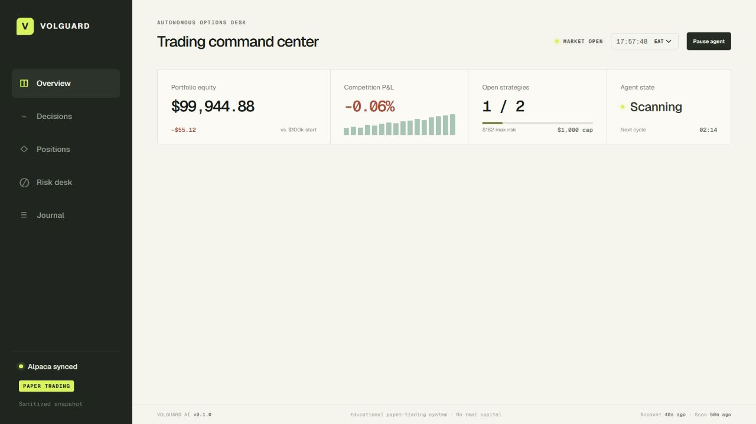
ALPACA AI TRADING AGENTS HACKATHON
LIVE PRODUCT
VolGuard AI
An autonomous, risk-governed options desk that knows when not to trade.
REAL ALPACA PAPER FILL • 13 RISK GATES • 5-MINUTE MONITOR
Sanitized telemetry · responsive dashboard
Educational paper-trading system · No real capital
Notes:
Most trading bots are optimized to place trades. VolGuard AI is optimized to deserve them. It is an autonomous, risk-governed options desk built on Alpaca paper trading, and every trade—or decision not to trade—leaves an inspectable evidence trail.
[Sources]
- Live VolGuard dashboard capture, 2026-09-02
- README.md and docs/PRODUCT_GUIDE.md

Slide 2
VOLGUARD AI / ALPACA PAPER OPTIONS
The agent earns permission to trade
01
02
03
04
05
06
Snapshot
Scan
Signal
Construct
Council
Govern
Paper account
and market clock
SPY · QQQ
IWM · GLD
Six data-quality
and edge checks
Exact defined-risk
option legs
Five transparent
specialists
Thirteen gates
or abstain
A failed input is a decision—not a missing result.
VolGuard records candidates, blocks, and abstentions so the operator can review the full opportunity set instead of only the trades that survived.
02
Notes:
Every cycle scans SPY, QQQ, IWM, and GLD. The signal model compares recent realized movement with the live at-the-money options price, then checks the session, history, paired quotes, liquidity, freshness, and edge. If any check fails, VolGuard records an abstention. A five-specialist council now includes Decision Memory, which requires repeated recent open-market agreement before a paper entry can pass.
[Sources]
- docs/PRODUCT_GUIDE.md — option intelligence and Decision Memory
- lib/option-intelligence.ts — signal checks
- lib/decision-memory.ts — 60-minute confirmation policy

Slide 3
VOLGUARD AI / ALPACA PAPER OPTIONS
Risk is policy, not a prompt
The specialist council explains the evidence. Only the deterministic governor can approve a proposal.
13
$500
$1,000
hard gates
max loss / strategy
combined open risk
All must pass
Defined before entry
At most two strategies
Paper only • Defined loss • Covered shorts • No same-day expiry • Quote age ≤ 60s
Spread ≤ 12% • Confidence ≥ 65% • Drawdown limits • Capacity • One strategy per underlying
Any mismatch, stale quote, memory conflict, or red-team veto stops the workflow.
03
Notes:
A candidate still cannot trade. The constructor chooses exact defined-risk legs and prices buys at the ask and sells at the bid. Five transparent specialists test regime, volatility, verified catalysts, recent decision memory, and failure modes. Memory requires two matching open-market observations within sixty minutes and at least sixty percent agreement. Then thirteen deterministic gates enforce paper mode, covered shorts, expiry, quote quality, confidence, drawdown, capacity, and the loss budget.
[Sources]
- lib/risk-governor.ts — thirteen gates
- lib/domain.ts — policy thresholds
- lib/agent-council.ts — five specialist votes
- lib/decision-memory.ts — confirmation policy

Slide 4
VOLGUARD AI / ALPACA PAPER OPTIONS
A real paper fill proves the full path
GLD
1
Six signal checks
Fresh GLD candidate ranked first
SEP 4 · 398 / 391 BEAR-PUT SPREAD
2
Council + 13/13 gates
Red Team issued no veto
BUY 1 × 398 PUT
3
Atomic Alpaca dry run
SELL 1 × 391 PUT
Same legs, quantity, and limit
4
Paper fill + reconciliation
$1.82 limit
$1.79 fill
Both broker legs matched
5
Automated HOLD
$182 max loss · $518 theoretical max expiration profit
No exit threshold reached
04
Notes:
On September first, VolGuard selected the September fourth GLD 398–391 bear-put spread. The conservative limit was one dollar eighty-two, maximum loss was one hundred eighty-two dollars, and theoretical maximum expiration profit was five hundred eighteen dollars. The Alpaca dry run validated the atomic order, and the paper account filled at one dollar seventy-nine. This historical fill predates the Decision Memory gate; subsequent entries must also pass memory confirmation.
[Sources]
- docs/BUILD_JOURNAL.md — 2026-09-01 first governed paper execution
- Append-only paper order and lifecycle events in VolGuard telemetry
- lib/decision-memory.ts — subsequent-entry confirmation policy

Slide 5
VOLGUARD AI / ALPACA PAPER OPTIONS
Automation never broadens trading authority
ALPACA
RUNNER
EVIDENCE
PRODUCT
Paper account
CLI boundary
Cloudflare D1
VolGuard UI
Trading + market data
Credentials stay local
Sanitized append-only data
Six responsive pages
Separate entry and exit locks
Cloudflare Worker → GitHub Actions → serialized paper cycle
Every 5 minutes: reconcile + monitor exits. Every 10 minutes: fresh scan + memory-confirmed entry attempt.
05
Notes:
Every five minutes during the weekday New York session window, a Cloudflare Worker dispatches one authenticated GitHub Actions paper cycle. Every run reconciles broker state and independently evaluates each open strategy's profit, loss, and time exit. Every other run also refreshes the account, scans for an entry, and requires a matching D1 Decision Memory verdict. If reconciliation, evidence, memory, capacity, or policy fails, the system holds.
[Sources]
- workers/github-scheduler/wrangler.jsonc — session-aware schedule
- .github/workflows/monitor-paper-position.yml — serialized paper cycle
- lib/decision-memory.ts — D1-backed confirmation
- docs/DEPLOYMENT.md — credential and persistence boundary

Slide 6
VOLGUARD AI
Autonomy you can audit.
V
Autonomous enough to act.
Constrained enough to abstain.
Transparent enough to improve.
Alpaca options • Paper execution • Risk governance • Lifecycle evidence
Notes:
The Journal keeps scans, abstentions, approvals, submissions, fills, holds, exits, and realized results in one append-only review trail. VolGuard is autonomous enough to act, constrained enough to abstain, and transparent enough to improve. That is risk-governed autonomy for options trading.
[Sources]
- docs/PRODUCT_GUIDE.md
- docs/BUILD_JOURNAL.md

