Slide 1
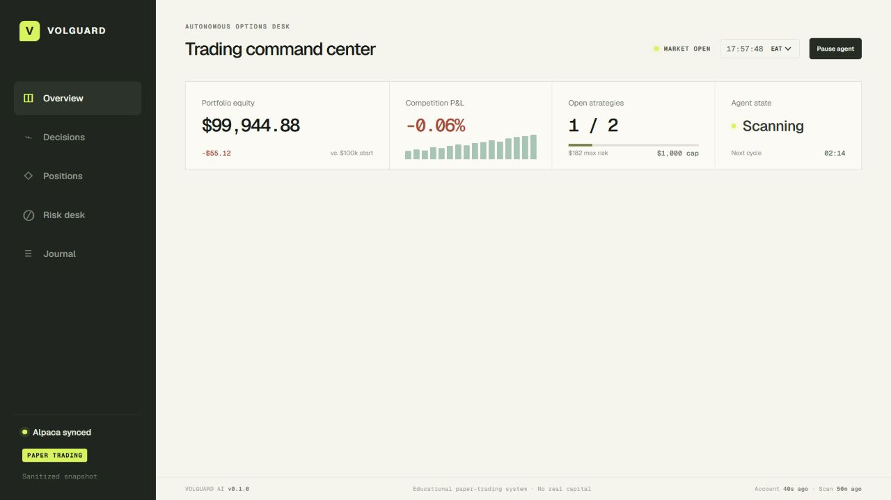
ALPACA AI TRADING AGENTS HACKATHON
LIVE PRODUCT
VolGuard AI
An autonomous, risk-governed options desk that knows when not to trade.
REAL ALPACA PAPER FILL • 14 RISK GATES • 5-MINUTE MONITOR
Sanitized telemetry · responsive dashboard
Educational paper-trading system · No real capital
Notes:
[Sources]
- https://volguard-ai.briankinyua0101.chatgpt.site — product screenshot and public demo

Slide 2
VOLGUARD AI / ALPACA PAPER OPTIONS
The agent earns permission to trade
01
02
03
04
05
06
Snapshot
Scan
Signal
Construct
Council
Govern
Paper account
and market clock
SPY · QQQ
IWM · GLD
Six data-quality
and edge checks
Exact defined-risk
option legs
Five transparent
specialists
Fourteen gates
or abstain
A failed input is a decision—not a missing result.
VolGuard records candidates, blocks, and abstentions so the operator can review the full opportunity set instead of only the trades that survived.
02
Notes:
[Sources]
- https://github.com/Brikita/Alpaca — VolGuard source and process implementation

Slide 3
VOLGUARD AI / ALPACA PAPER OPTIONS
Risk is policy, not a prompt
The specialist council explains the evidence. Only the deterministic governor can approve a proposal.
14
$500
$1,000
hard gates
max loss / strategy
combined open risk
All must pass
Defined before entry
At most two strategies
Paper only • Defined loss • Covered shorts • No same-day expiry • Reward/risk ≥ 0.25x
Quote ≤ 60s • Spread ≤ 12% • Confidence ≥ 65% • Drawdown • Capacity • One symbol
Any mismatch, stale quote, memory conflict, or red-team veto stops the workflow.
03
Notes:
[Sources]
- https://github.com/Brikita/Alpaca/blob/master/lib/risk-governor.ts — deterministic gate implementation
- https://github.com/Brikita/Alpaca/blob/master/lib/domain.ts — policy thresholds

Slide 4
VOLGUARD AI / ALPACA PAPER OPTIONS
Live evidence improved the governor
GLD
1
Memory-confirmed GLD
6/6 scans agreed over 50 minutes
SEP 11 · 407 / 412 / 417 BUTTERFLY
2
Five specialists approved
5/5 votes · then-current 13/13 gates
BUY 1 × 412 CALL + PUT
3
Atomic Alpaca dry run
SELL 1 × 417 CALL + 407 PUT
Exact four legs and $4.76 limit
4
Paper fill + reconciliation
$4.76 limit
$4.55 fill
$4.55 fill · all four legs matched
5
Evidence changed policy
$476 max loss · $24 pre-trade max profit
New 0.25x payoff-quality gate
04
Notes:
[Sources]
- https://volguard-ai.briankinyua0101.chatgpt.site/api/history — sanitized execution and monitoring events, captured 2026-09-03
- https://github.com/Brikita/Alpaca/actions/runs/33786161540 — successful automated paper cycle

Slide 5
VOLGUARD AI / ALPACA PAPER OPTIONS
Automation never broadens trading authority
ALPACA
RUNNER
EVIDENCE
PRODUCT
Paper account
CLI boundary
Cloudflare D1
VolGuard UI
Trading + market data
Credentials stay local
Sanitized append-only data
Six responsive pages
Separate entry and exit locks
Cloudflare Worker → GitHub Actions → serialized paper cycle
Every 5 minutes: reconcile + monitor exits. Every 10 minutes: fresh scan + memory-confirmed entry attempt.
05
Notes:
[Sources]
- https://github.com/Brikita/Alpaca/blob/master/workers/github-scheduler/src/index.mjs — authenticated scheduler
- https://github.com/Brikita/Alpaca/blob/master/.github/workflows/monitor-paper-position.yml — serialized paper cycle

Slide 6
VOLGUARD AI
Autonomy you can audit.
V
Autonomous enough to act.
Constrained enough to abstain.
Transparent enough to improve.
Alpaca options • Paper execution • Risk governance • Lifecycle evidence
Notes:
[Sources]
- https://github.com/Brikita/Alpaca — public source
- https://volguard-ai.briankinyua0101.chatgpt.site — public product

