Slide 1

ARC
(Annotated Research Context)

Slide 2



Towards Fair Digital Objects (FDOs)
metadata specialists
domain experts
service provider /
technology experts
ARC

Slide 3




Bag your research in an ARC
(Annotated Research Context)
experimental data
computation
intensity
CAGAGGTGA
=
m/z
CAGAG
AGAGG
GAGGT
AGGTG
GGTGA
annotation
Your whole investigation in a single unified bag
https://github.com/nfdi4plants/ARC-specification

Slide 4
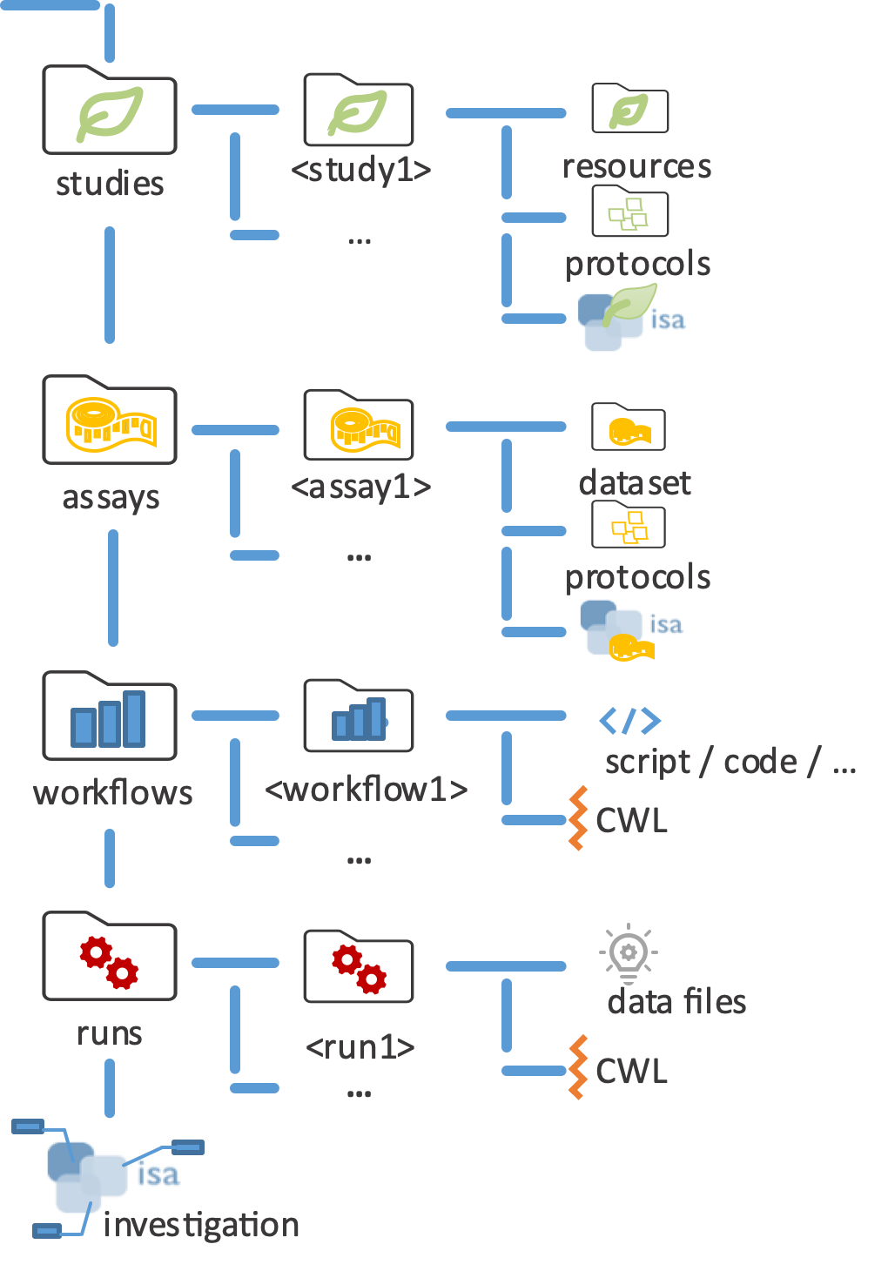
A real-world ARC is a folder structure
sample material or data
measurement data
computation / tools
processing results
User-friendly scaffold for research data and analyses, including a change tracking system to ensure provenance

Slide 5
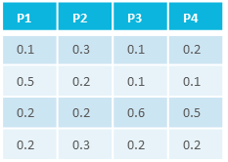


A real-world ARC is a folder structure
characteristics
C₁
C₂
C₃
…
C_{n}
studies
material
samples/data
process
P₁
P₂
P₃
…
P_{n}
intensity
m/z
assays
samples
measurement
workflows
<study/assay>
result files
<run1>
<workflow1>
result files
runs
<run2>
<workflow2>
administrative metadata

Slide 6




ARC is built on top of existing standards
studies
<study1>
resources
…
protocols
isa
assays
<assay1>
dataset
…
protocols
workflows
<workflow1>
script / code / …
…
CWL
runs
data files
<run1>
CWL
…
investigation

Slide 7
ISA investigation file
INVESTIGATION
Investigation Identifier | 210703_sampleARC
Investigation Title | Creation of a sample ARC
Investigation Description | Highlighting the isa.investigation.xlsx format
Investigation Submission Date | 2021-07-03
Investigation Public Release Date | 2021-08-24
INVESTIGATION PUBLICATIONS
Investigation Publication PubMed ID | 12345678
Investigation Publication DOI | 10.1000/xyz123
Investigation Publication Author List | Doe, John; Doe, Jane; …
… | …
isa.investigation.xlsx → concised and aggregated manner → known excel working environment → spreadsheetML open XML data format ensures data structure and enables machine readability
Sections and subsections organized in a per-column system → labels case-sensitive
Notes:
Why is this possible

Slide 8
ISA investigation file
INVESTIGATION
Investigation Identifier | 210703_sampleARC
Investigation Title | Creation of a sample ARC
Investigation Description | Highlighting the isa.investigation.xlsx format
Investigation Submission Date | 2021-07-03
Investigation Public Release Date | 2021-08-24
INVESTIGATION PUBLICATIONS
Investigation Publication PubMed ID | 12345678
Investigation Publication DOI | 10.1000/xyz123
Investigation Publication Author List | Doe, John; Doe, Jane; …
… | …
ONTOLOGY SOURCE REFERENCE
INVESTIGATION
INVESTIGATION PUBLICATIONS
INVESTIGATION CONTACTS
STUDY
STUDY DESIGN DESCRIPTORS
STUDY PUBLICATIONS
STUDY FACTORS
STUDY ASSAYS
STUDY PROTOCOLS
STUDY CONTACTS
Notes:
Why is this possible

Slide 9
Hierarchical ISA model structure
investigation
high level concept to link related studies
study
the central unit, containing information
on the subject under study, its
characteristics and any treatments applied.
a study has associated assays
assay
test performed either on material taken
from the subject or on the whole initial
subject, which produce qualitative or
quantitative measurements (data)
administrative
investigation
experimental
study
study
assay(s)
assay(s)
Notes:
Next would be study, but we adjusted model to our needs

Slide 10
ISA data model as central unit
Assay
isa.assay.xlsx
ARC Commander
Endpoint repositories
Charac.|
Parameter|
Factor
Person
Input
Output
ISA data model
Visualization
Parameter
Person
Input
Output
isa.json
Charac.
Factor
Parameter
Databases
Input
Output
Charac.
Factor
Notes:
ISA data model and ARC to come back to original structure afterwards -> from there aided processing

Slide 11

ARCs: Share yours and work together
ARCs are the basis of the collaborative research platform
ARCs can be shared between researchers seamlessly

Slide 12
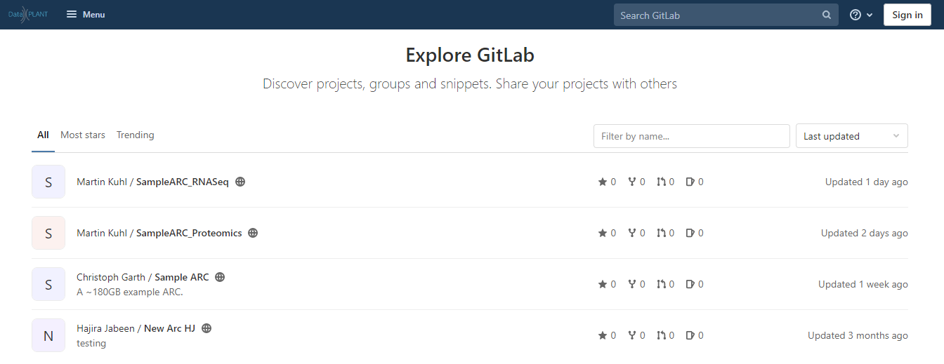
Find ARCs in the ARC registry
Explore DataPLANT

