Slide 1

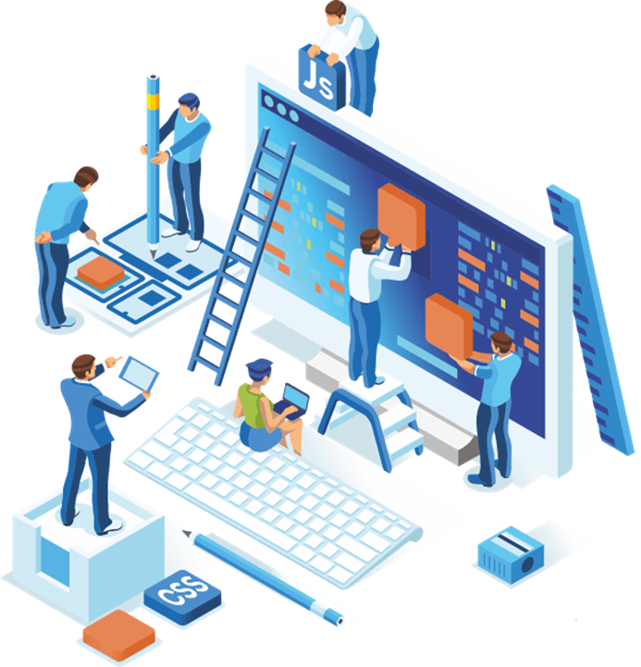
Secure Software Development
Portfolio №1
University of Roehampton, Cyber Security
Group №5: Alex, Jakh, Dmitriy, Asad

Slide 2

USE CASE №1
Company Name: Pitrix
Company Specialisation: A leading developer and manufacturer of advanced vehicle tracking and navigation systems for professional motor racing teams..
Cyber risk appetite: High Risk

Slide 3
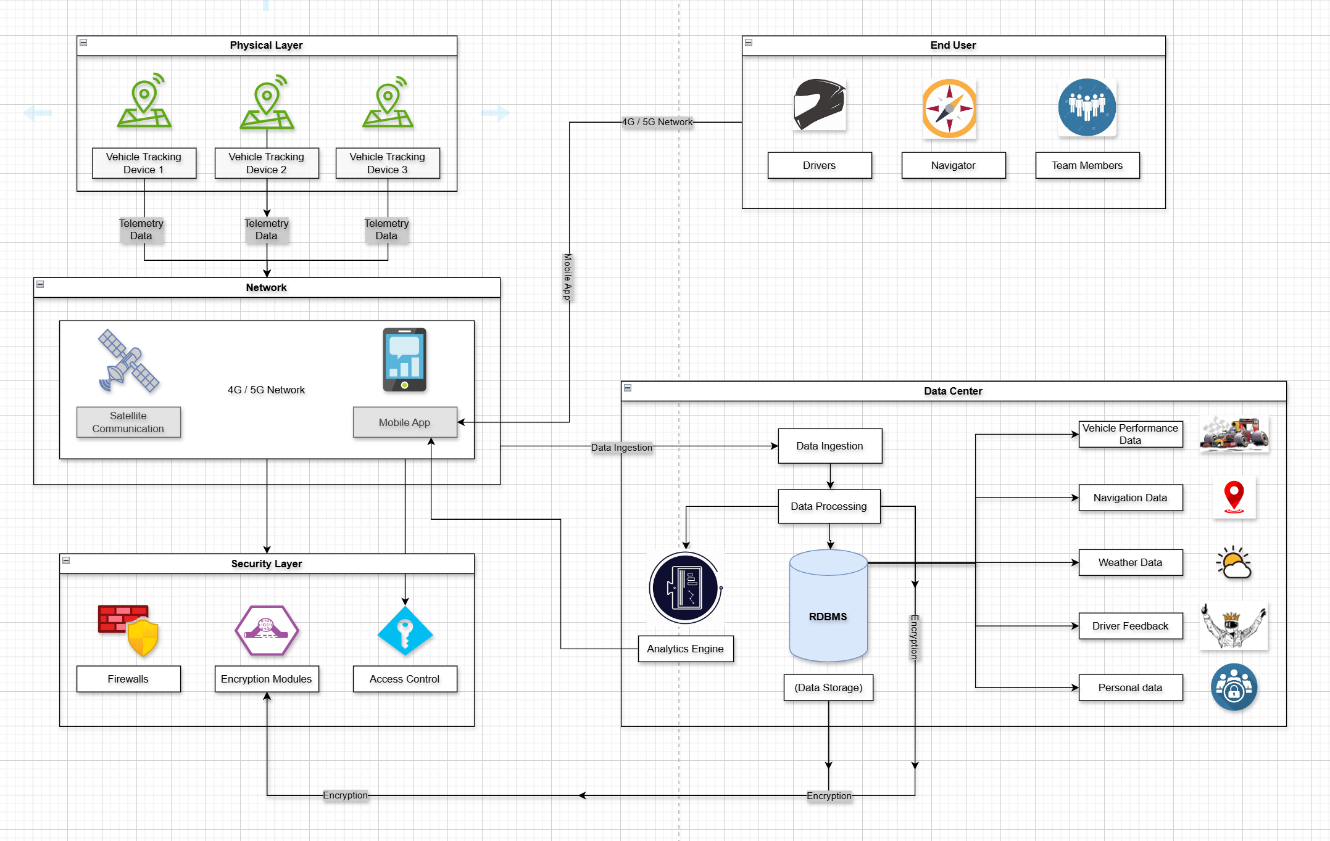
PRODUCT ARCHITECTURE FOR NAVTRACK (PITRIX) PROJECT

Slide 4
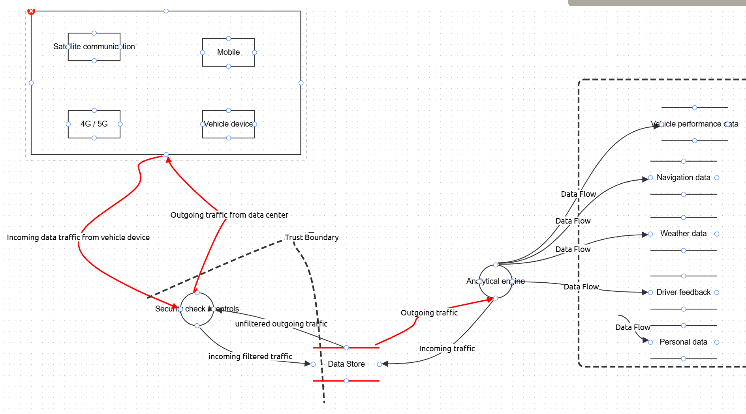
THREAT MODEL FOR NAVTRACK (PITRIX) PROJECT

Slide 5
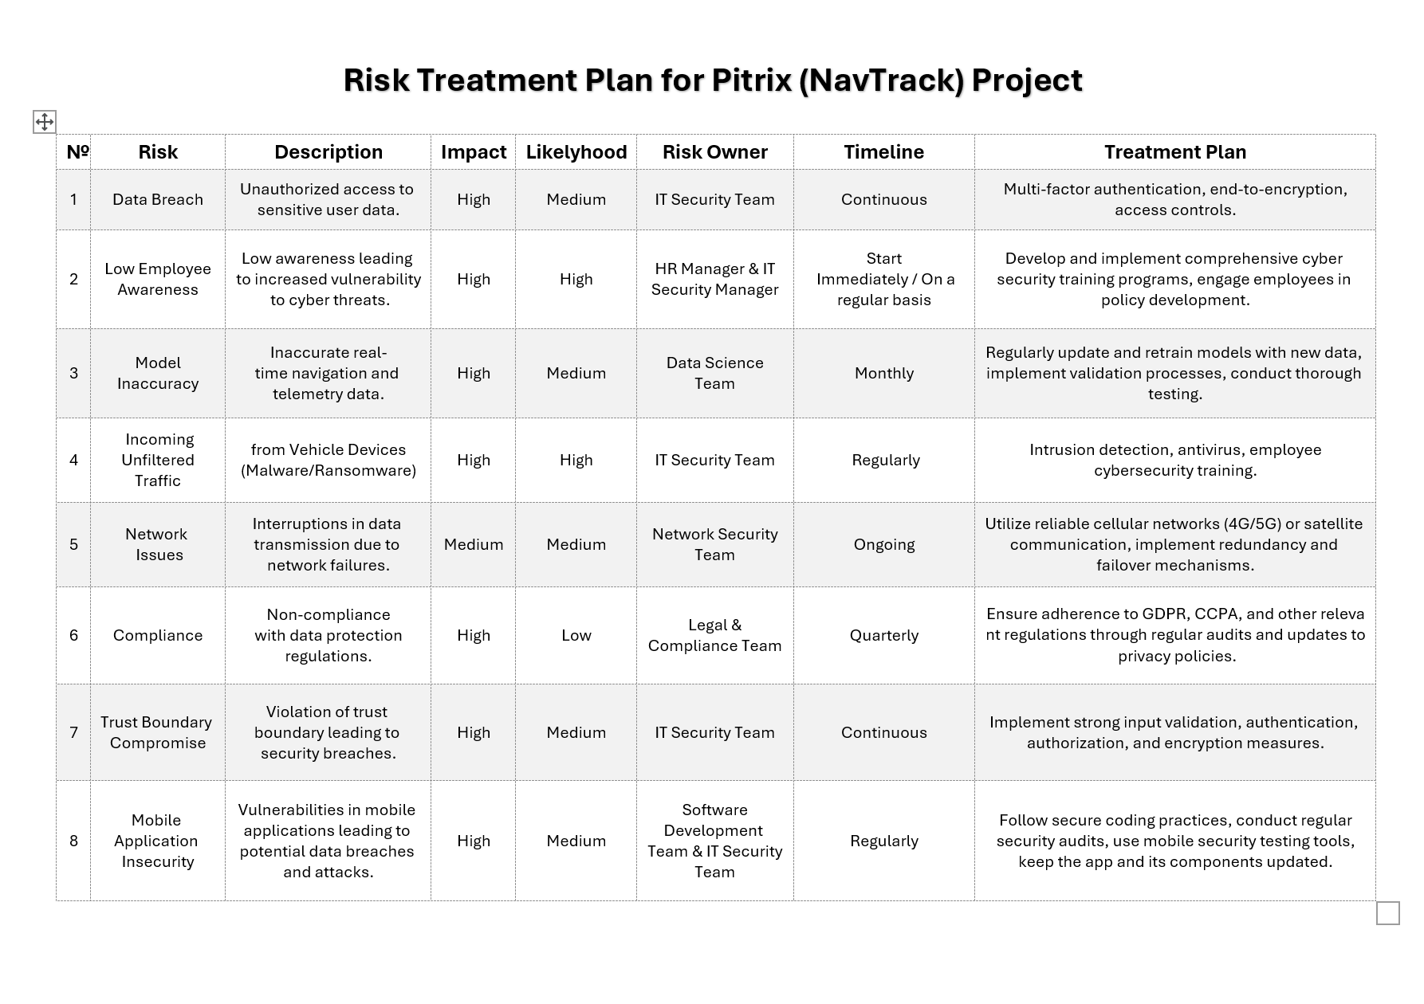
This risk treatment plan outlines strategies to mitigate the key vulnerabilities identified in Pitrix's threat model. Recognizing Pitrix's high cyber risk appetite and its current security posture, the plan balances risk reduction with operational efficiency.

Slide 6

SOFTWARE DEVELOPMENT PLAN
Introduction and Scope
Pitrix is a company which is going to be the manufacturer of advanced vehicle tracking and navigation systems for professional motor racing teams. The company aims to optimize vehicle performance, reduce lap times, and enhance overall racing experience through the creation of a mobile application which will provide real-time navigation data, vehicle telemetry and analytics. The end goal is to allow professional motor racing teams to gain a competitive edge to increase their chances of winning.
2. Objective:
To develop a secure software solution that provides accurate navigation and telemetry data for vehicle tracking, while minimizing cyber risks.

Slide 7

SOFTWARE DEVELOPMENT PLAN
3. Roles and Responsibilities
IT Security Team: Responsible for implementing cybersecurity controls, including multi-factor authentication, encryption, intrusion detection, and security training.
HR Manager: Hiring new employees, managing employee relations, handling training and development, and ensuring workplace policies are followed.
Data Science Team: a group of professionals who use data analysis, machine learning, and statistical methods to extract insights and make data-driven decisions.
Network Security Team: Manages network infrastructure and its security, redundancy, and failover mechanisms.
Legal & Compliance Team: Ensures the software adheres to relevant data protection regulations (e.g., GDPR, CCPA).
Software Development Team: Develops secure code, updates mobile applications, and collaborates with the IT Security Team on vulnerability management.

Slide 8
SOFTWARE DEVELOPMENT PLAN
4. Requirements and Specifications
Functional Requirements:
Implement secure user authentication (multi-factor).
Enable real-time tracking with high data accuracy.
Provide mobile access with secure communication protocols.
Non-Functional Requirements:
Ensure high availability and reliability of network connections.
Comply with privacy regulations and policies.
Technical Requirements:
Use end-to-end encryption for data transmission.
Enable secure coding practices for mobile applications.

Slide 9
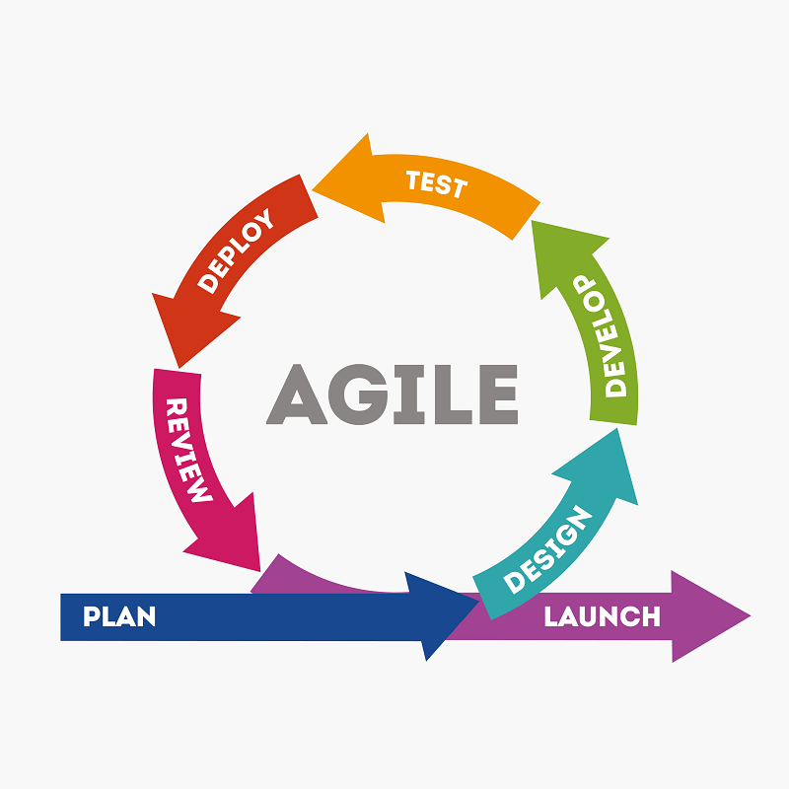
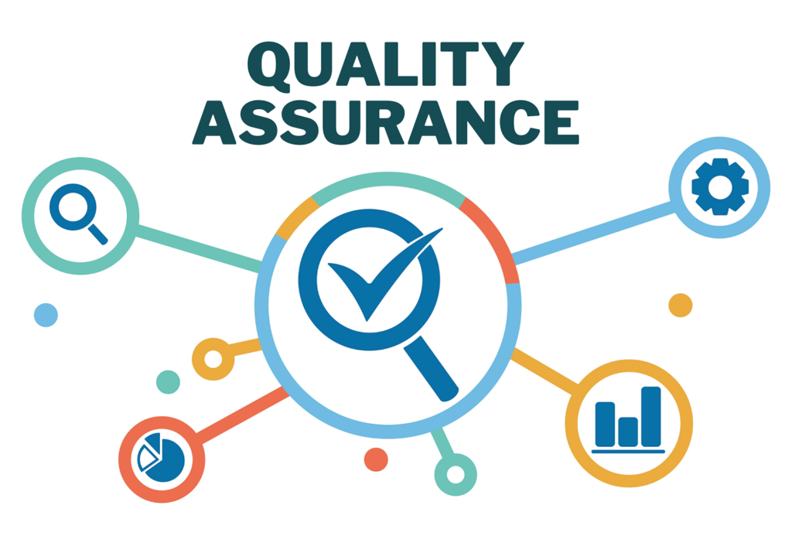
SOFTWARE DEVELOPMENT PLAN
5. Development Methodology
Agile Methodology:
Due to the project’s need for continuous updates and frequent security enhancements, Agile is chosen as the development methodology. Sprint reviews will be conducted to ensure timely responses to security requirements and risk management actions.
6. Quality Assurance (QA) and Testing
Testing Approach:
Security testing to detect vulnerabilities in mobile apps and data transmission.
Model validation tests to ensure data accuracy.
Regular penetration testing and security audits.
KPIs:
Number of security incidents detected and mitigated.
Compliance rate with data protection regulations.
Model accuracy rate for real-time navigation data.

Slide 10


Thank You for your attention!
Group №5: Alex, Jakh, Dmitriy, Asad

