Slide 1
START

Slide 2
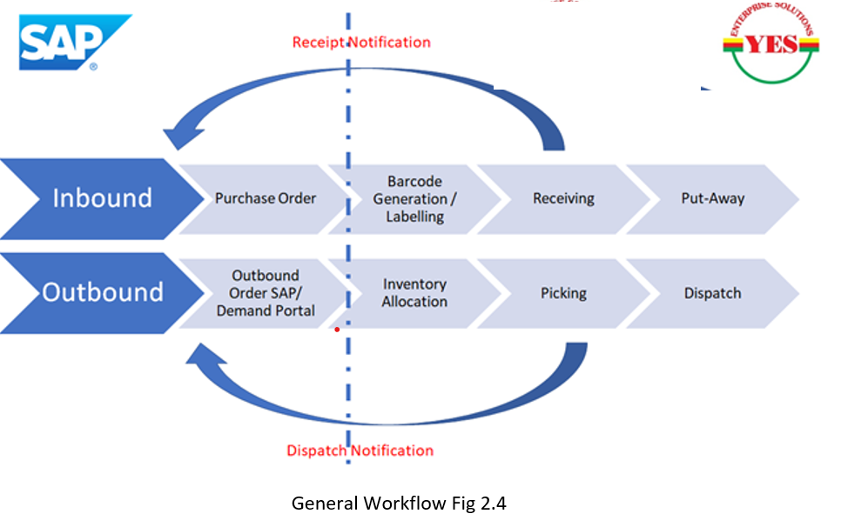
WORK FLOW

Slide 3
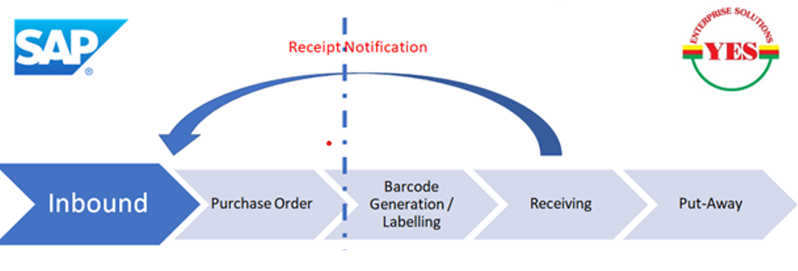
INBOUND – WITH SAP & PALLET ( MOH & RBTS )
Inbound Workflow – With Pallet
Purpose ` | This flow will allow to receive the Material inside warehouse
Scope | Receiving order from SAP / Manually creating, Label Generation, Good Receiving with Pallet, Sending Good Receipt Notification, Put-Away
User | Warehouse Operations (Receiver), Purchase
Procedure

Slide 4
INBOUND – WITH SAP & PALLET ( MOH & RBTS )
# | Activity | System | Remark
01 | Create Purchase order in SAP | SAP | ERP Will Generate Purchase have based on YES-rilliantWMS Input or as Normal Purchase Order ,
02 | Create Inbound Order in iWMS | SAP/iWMS | SAP to call iWMS Purchase Order API to create Purchase Order MOH – System will Allow user to Create Purchase Order in iWMS
03 | Label Generation – SKU/Item Barcode Generation | iWMS | Operator to select Order and Generate Barcode Label & Apply Label on the Material Received
03 | Good Receive | iWMS (HHT) | Operator Select Purchase Order , Palletize Receipt by scanning Pallet ( RFID / BARCODE ) & CARTON Barcode
04 | Good Receive Notification | iWMS | iWMS to Send Good Receive Message to SAP Not Applicable of MOH
05 | Put-Away | iWMS (HHT) | iWMS to generate Put-Away plan , Operator to scan Pallet ( RFID / BARCODE ) & Location ( RFID / BARCODE )

Slide 5
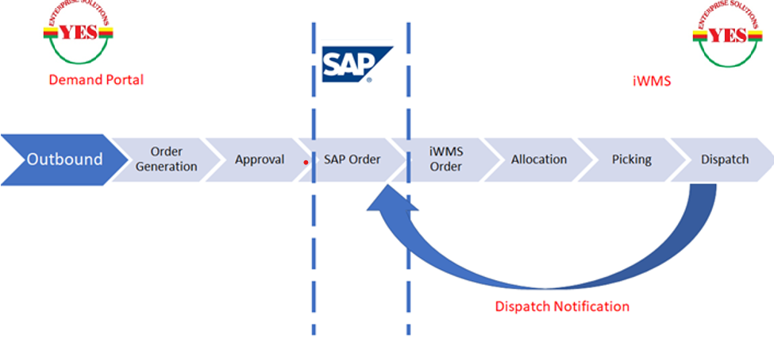
DEMAND PORTAL ( MOH & RBTS )
Order – Demand Portal
Purpose ` | With this flow user will able to place the Order through Demand Portal , Order will be configured for MOH Approval , Upon Approval , iWMS ( Demand Portal) will call SAP API to create Outbound Order , upon Order Creation iWMS order will be updated for SAP reference no , iWMS will allocate Inventory and perform picking and dispatch operations
Scope | Order Creations , Approval , Inventory Allocation , Shipping Label , Picking , Dispatch
User | Demand Portal User , MOH Approval , Picker
Procedure

Slide 6
DEMAND PORTAL ( MOH & RBTS )
# | Activity | System | Remark
01 | New Demand Creations | iWMS (Demand) | Demand Portal user will view the Available Balance and Demand for the Inventory, Upon order creation system will sent email notification about order creation and will email to Approval, requesting for Approval
02 | Demand Approval / Rejections | iWMS (Demand) | MOH Approver Approve / Reject Order Approval – iWMS call SAP and create Order & update Order for SAP reference no Reject – iWMS marked Order as Rejected
03 | SAP Order Creations | SAP | Upon Order Approval SAP to create new Outbound Order and return SAP Order no
04 | Inventory Allocation | iWMS | Operator to select Order and Allocate Inventory
05 | Picking | iWMS ( HHT) | System to create Pick Ticket based On Order , Operator to Pick the Material by Scanning Location ( RFID/BARCODE) & Pallet ( RFID/BARCODE)
06 | Dispatch | iWMS | Shipper to select Order , Generate Shipping Label , Enter Dispatch Detail and Mark Order as Dispatch
07 | Dispatch Notification | iWMS | iWMS to call SAP API and update dispatch details
08 | Delivered | iWMS | Carrier Partner / Demand Portal user to update Delivery status as Delivered

Slide 7
DEMAND PORTAL NOTIFICATION EMAIL
# | Notification | Purpose | When | Workflow
MINISTRY OF HEALTH
1 | Customer Registration Email | Registration | New Registration | Registration
2 | Customer Registration Approval Request | New Customer Approval | New Registration | Registration
3 | Customer Registration Approval | Registration Acceptance | Upon Approval | Registration
4 | Customer Registration Rejection | Registration Rejection | Upon Rejection | Registration
5 | New Demand | Demand Details | New Order | Demand
6 | Demand Approval Request | Demand Approval Request | New Order | Demand
7 | Demand Approval | Demand Approval | Upon Approval | Demand
8 | Demand Rejection | Demand Rejected | Upon Rejection | Demand
9 | Order Ready for Dispatch | Order Ready for Dispatch | Prepared Dispatch | Demand
10 | Order Dispatch | Order Dispatch | Picked by Carrier | Demand
11 | Order Delivered | Order Delivered | Order Delivered | Demand

Slide 8
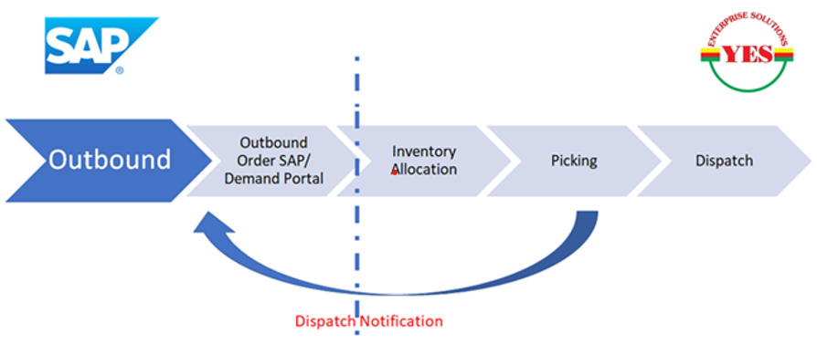
OUTBOUND – ORDER ( MOH & RBTS )
Order – Direct SAP Order
Purpose | With this flow user will able to place the Order through SAP ,SAP will push outbound Order for , iWMS ( Demand Portal) will call SAP API to create Outbound Order , iWMS will allocate Inventory and perform picking and dispatch operations
Scope | Order Creations , Inventory Allocation , Shipping Label , Picking , Dispatch
User | Sales, MOH Approval, Picker
Procedure

Slide 9
OUTBOUND – ORDER ( MOH & RBTS )
# | Activity | System | Remark
01 | SAP Order Creations | SAP | SAP user to create new Outbound Order & Call iWMS API create Outbound in iWMS
02 | Inventory Allocation | iWMS | Operator to select Order and Allocate Inventory
03 | Picking | iWMS ( HHT) | System to create Pick Ticket based On Order , Operator to Pick the Material by Scanning Location ( RFID/BARCODE) & Pallet ( RFID/BARCODE)
04 | Dispatch | iWMS | Shipper to select Order , Generate Shipping Label , Enter Dispatch Detail and Mark Order as Dispatch
05 | Dispatch Notification | iWMS | iWMS to call SAP API and update dispatch details
06 | Delivered | iWMS | Carrier Partner to update Delivery status as Delivered

Slide 10
THANK YOU

