Slide 1
SZAOS

Slide 2
Base idea
Creating an easy and cheap cloud service option for entrepenuers, Lowering the cost of running their business.
The client would contacts us, then he/she tells us what they need, and we give them a server of their choice.

Slide 3
What does it solve?
It helps bring down costs for especialy small companies in need of cloud services, thus increasing profit margins

Slide 4
How it started
A company (ITus) was in need of efficent data storage, they were making webdesigns to Non-Profit companies around the world, so they were looking for a more cost effective option

Slide 5
Project responsibilies
Gruber J. Alexander: PROJECT MANAGER, BALAMIJOBB, KOZEP, KOZEP2, FONOKSEG
Kovács Renátó: Documentation, TELEPIRANYITO2, IRANYITO1, IRANYITO2
Lörincz Dániel: Testing TELEP1, TELEP2, TELEPIRANYITO

Slide 6
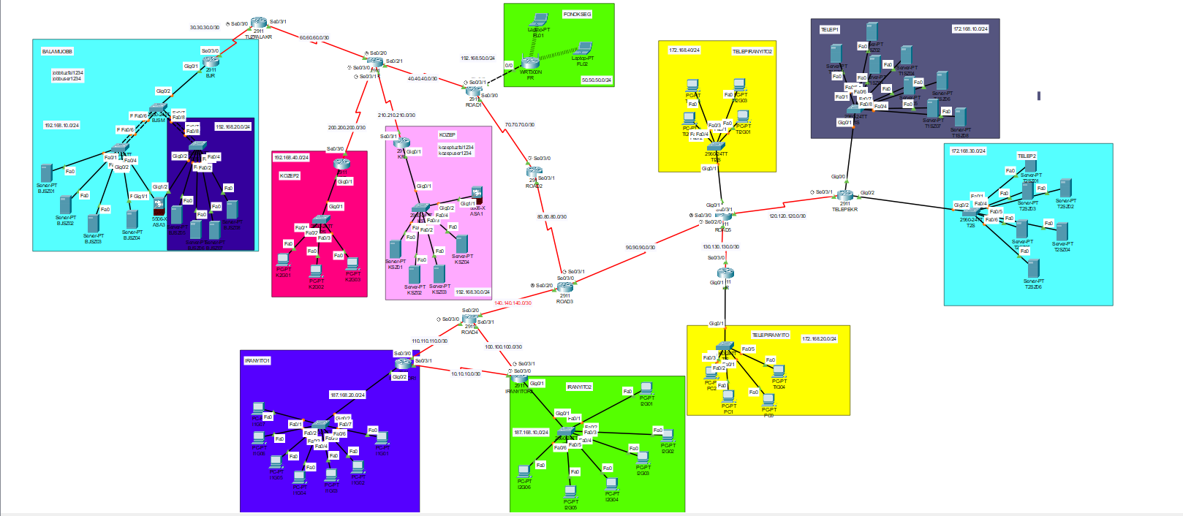
Our CISCO prototype

Slide 7
Our prototype mainly works with IPV4, but we use IPV6 as well.
Our team used RIPv2 protocoll for easy routing and safe packet-tracing.
VPN and Redundacies were also a part of our prototype for safety of data.
Vlan protocoll is a nice addition for data-controll and good traceability.

Slide 8
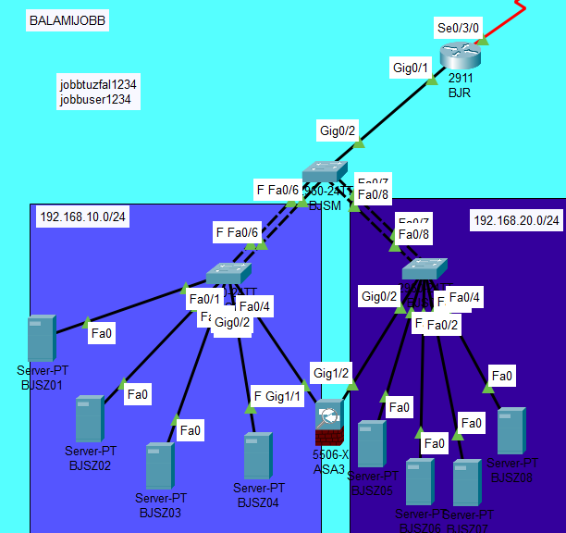
BALAMIJOBB
IPv4
RIPv2
Redundancies
Firewall protection
DHCP

Slide 9
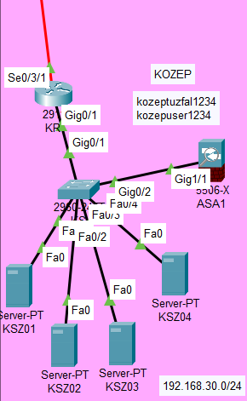
KOZEP
IPv4
RIPv2
Firewall
DHCP
VPN

Slide 10
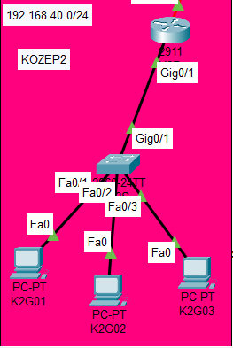
KOZEP2
IPv4
RIPv2
DHCP
VPN

Slide 11
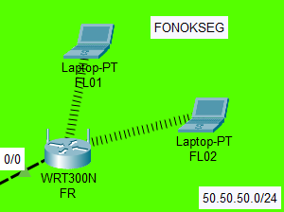
FONOKSEG
Local WLAN
IPv4
DHCP
RIPv2

Slide 12
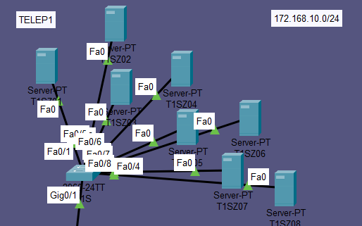
TELEP1
IPv4
Static NAT
DHCP
RIPv2
VPN

Slide 13
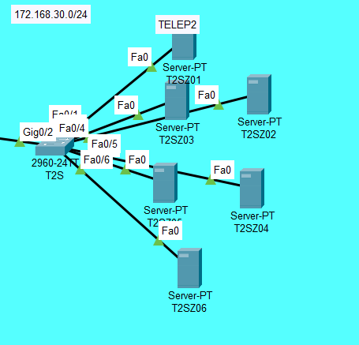
TELEP2
IPv4
DHCP
RIPv2
VPN

Slide 14
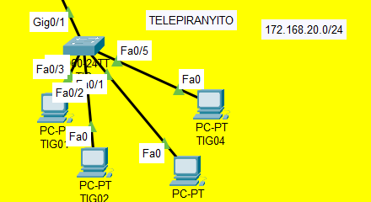
TELEPIRANYITO
IPv4
DHCP
VPN

Slide 15
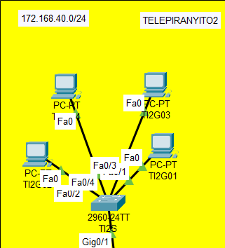
TELEPIRANYITO2
IPv4
DHCP
Dinamic NAT
VPN

Slide 16
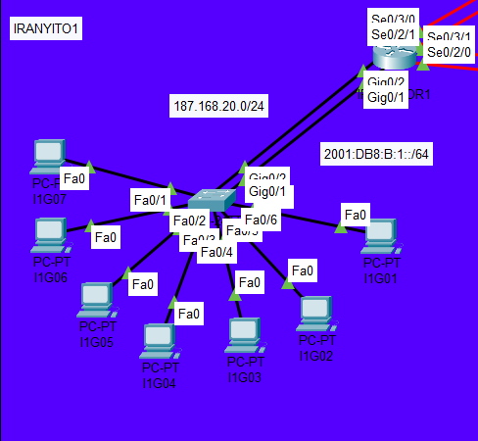
IRANYITO1
IPv4
IPv6
DHCP
RIPv2
Static IPv6 Routing

Slide 17
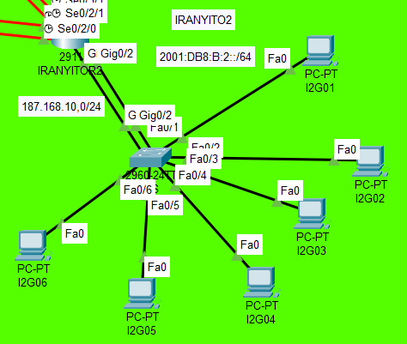
IRANYITO2
IPv4
IPv6
DHCP
RIPv2
Static IPv6 Routing

Slide 18
Our Team
Our team consists of 3 members:
PM: Gruber J. Alexander
Assistants: Lörincz Dániel, Kovács Renátó
The PM oversaw everything going on and took a big part of creating the prototype, the assistants made sure the test and documentation were torough.

Slide 19
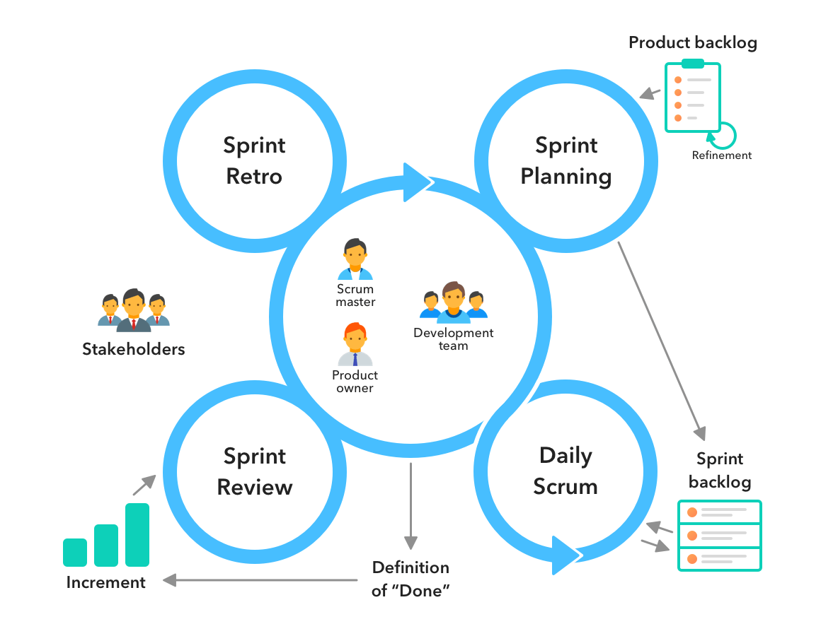
scrum
Scrum is an empirical process, where decisions are based on observation, experience and experimentation. Scrum has three base pillars:
-transparency
-inspection
-adaptation

Slide 20
Other programs we used
Jira: It helped keeping the time-schedules and overseeing the project itself.
Git: The program helped seeing where the project actually was, everything published was a milestone.

Slide 21
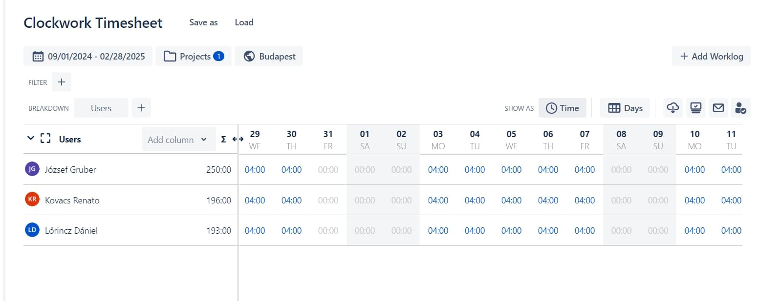
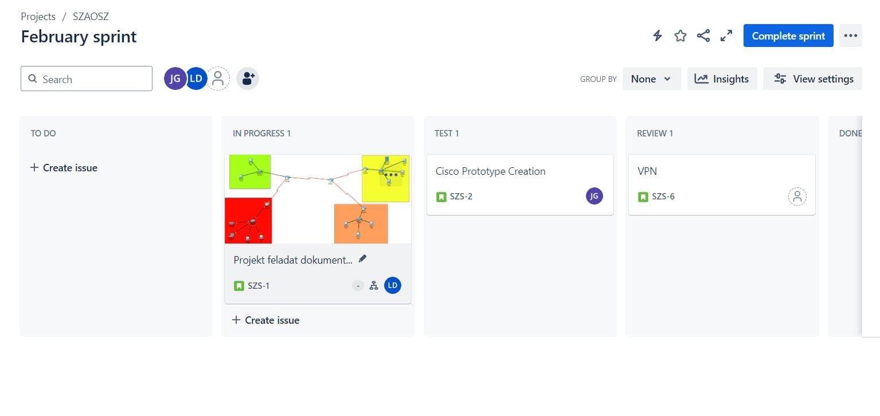
Why jira
With Jira we can keep track of our work-time managment and make sure all of our team members pull their weight with the project.

Slide 22
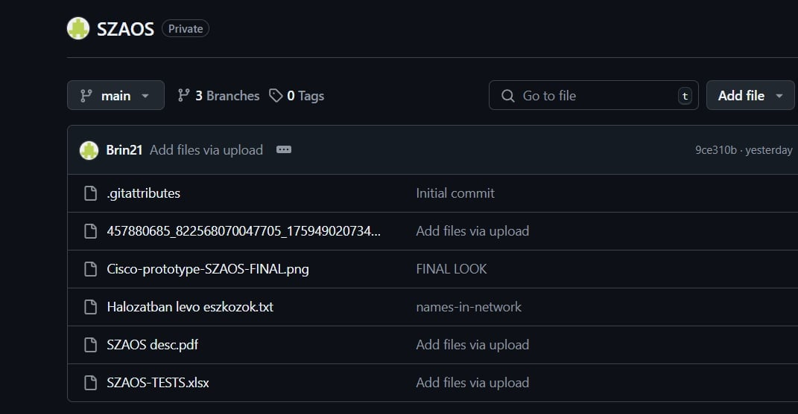
Why gitHUB
We used github to make sure our progress dosent get lost no matter what happens to any one of the laptops that we worked with.

Slide 23
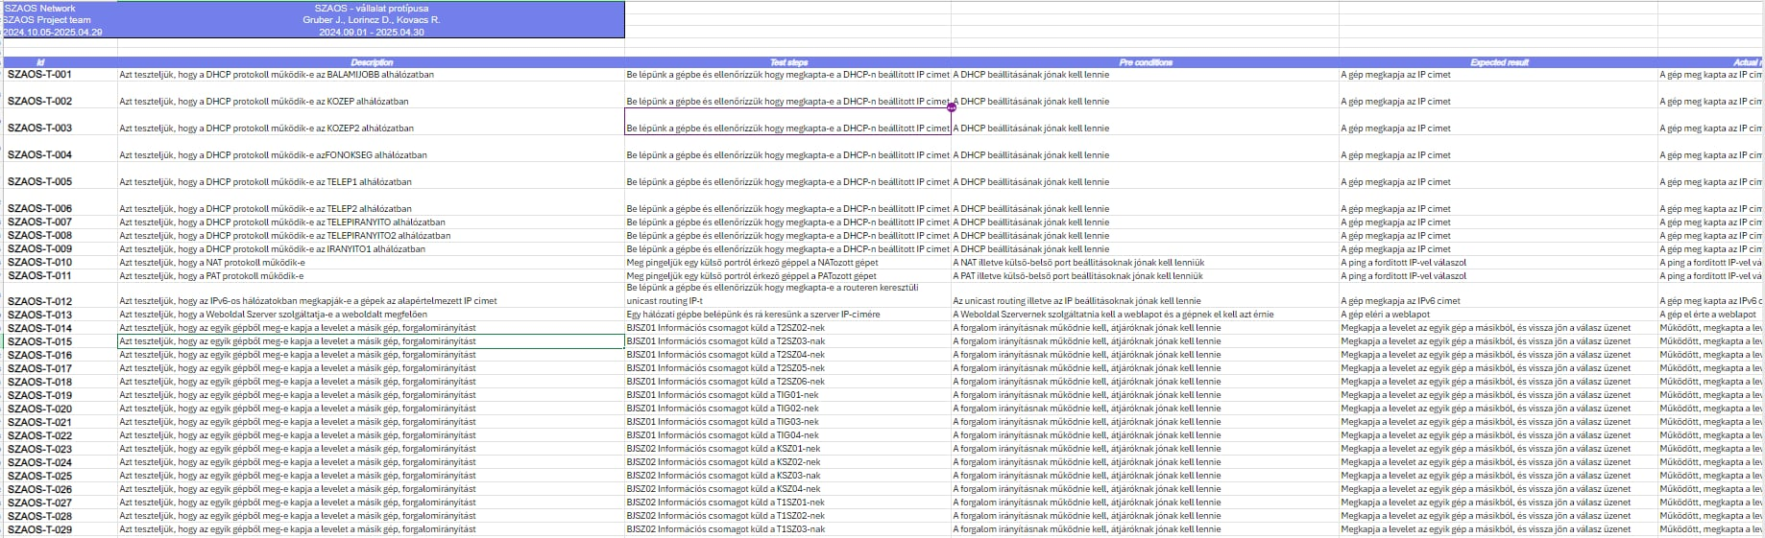
Tests

Slide 24


Servers
Windows Server:
-ADDS
-DHCP
-DNS
-HTTP/HTTPS
-Printer Extention
Linux Server:
-Automated Saving
-Client-Side automated software download

Slide 25
Why divide like that?
We found it the easiest and quickest solution, due to our skills being advanced in Windows Servers we taught doing more over there would be the best in regards of the requirements

Slide 26
Future plans
For now, our plan is to expand the server-parks, and make it even easier for small-business owners to access our services.

Slide 27

Thank you for your attention

