Slide 1

Programming
Introduction to C++

Slide 2
Introduction to C++
C is a programming language developed in the 1970's alongside the UNIX operating system.
C provides a comprehensive set of features for handling a wide variety of applications, such as systems development and scientific computation.
C++ is an “extension” of the C language, in that most C programs are also C++ programs.
C++, as opposed to C, supports “object-oriented programming.”

Slide 3
General form of a C++ program
// Program description
#include directives
int main()
{
constant declarations
variable declarations
executable statements
return 0;
}

Slide 4
C++ keywords
Keywords appear in blue in Visual C++.
Each keyword has a predefined purpose in the language.
Do not use keywords as variable and constant names!!
The complete list of keywords is on page 673 of the textbook.
We shall cover the following keywords in this class:
bool, break, case, char, const, continue, do, default, double, else, extern, false, float, for, if, int, long, namespace, return, short, static, struct, switch, typedef, true, unsigned, void, while

Slide 5
Example 0 – adding 2 numbers
Peter: Hey Frank, I just learned how to add two numbers together.
Frank: Cool!
Peter : Give me the first number.
Frank: 2.
Peter : Ok, and give me the second number.
Frank: 5.
Peter : Ok, here's the answer: 2 + 5 = 7.
Frank: Wow! You are amazing!
after Frank says “2”, Peter has to keep this number in his mind.
after Frank says “5”, Peter also needs to keep this number in his mind.
First number:
2
Second number:
5
Sum:
7

Slide 6
The Corresponding C++ Program
#include <iostream>
using namespace std;
int main()
{
int first, second, sum;
cout << "Peter: Hey Frank, I just learned how to add”
<< “ two numbers together."<< endl;
cout << "Frank: Cool!" <<endl;
cout << "Peter: Give me the first number."<< endl;
cout << "Frank: ";
cin >> first;
cout << "Peter: Give me the second number."<< endl;
cout << "Frank: ";
cin >> second;
sum = first + second;
cout << "Peter: OK, here is the answer:";
cout << sum << endl;
cout << "Frank: Wow! You are amazing!" << endl;
return 0;
}

Slide 7
Demo Example 1
#include <iostream>
using namespace std;
int main()
{
int number_of_pods, peas_per_pod, total_peas;
cout << "Press return after entering a number.\n";
cout << "Enter the number of pods:\n";
cin >> number_of_pods;
cout << "Enter the number of peas in a pod:\n";
cin >> peas_per_pod;
total_peas = number_of_pods * peas_per_pod;

Slide 8
Demo Example 1
cout << "If you have ";
cout << number_of_pods;
cout << " pea pots\n";
cout << "and ";
cout << peas_per_pod;
cout << " pea in each pod, then \n";
cout << "you have ";
cout << total_peas;
cout << " peas in all the pods.\n";
return 0;
}

Slide 9
C++ identifiers
Identifiers appear in black in Visual C++.
  An identifier is a name for a variable, constant, function, etc.
  It consists of a letter followed by any sequence of letters, digits, and underscores.
  Examples of valid identifiers: First_name, age, y2000, y2k
  Examples of invalid identifiers: 2000y
  Identifiers cannot have special characters in them. For example: X=Y, J-20, ~Ricky,*Michael are invalid identifiers.
  Identifiers are case-sensitive. For example: Hello, hello, WHOAMI, WhoAmI, whoami are unique identifiers.

Slide 10
C++ comments
Comments appear in green in Visual C++.
Comments are explanatory notes; they are ignored by the compiler.
There are two ways to include comments in a program:
  // A double slash marks the start of a //single line comment.
  /* A slash followed by an asterisk marks the start of a multiple line comment. It ends with an asterisk followed by a slash. */

Slide 11
C++ compiler directives
Compiler directives appear in blue in Visual C++.
The #include directive tells the compiler to include some already existing C++ code in your program.
The included file is then linked with the program.
There are two forms of #include statements:
#include <iostream> //for pre-defined files
#include "my_lib.h" //for user-defined files

Slide 12
Programming Style
C++ is a free-format language, which means that:
Extra blanks (spaces) or tabs before or after identifiers/operators are ignored.
Blank lines are ignored by the compiler just like comments.
Code can be indented in any way.
There can be more than one statement on a single line.
A single statement can continue over several lines.

Slide 13
Programming Style (cont. )
In order to improve the readability of your program, use the following conventions:
Start the program with a header that tells what the program does.
Use meaningful variable names.
Document each variable declaration with a comment telling what the variable is used for.
Place each executable statement on a single line.
A segment of code is a sequence of executable statements that belong together.
  Use blank lines to separate different segments of code.
  Document each segment of code with a comment telling what the segment does.

Slide 14
What makes a bad program?
Bad !!
Writing Code without detailed analysis and design
Repeating trial and error without understanding the problem
Debugging the program line by line, statement by statement
Writing tricky and dirty programs
Bad !!
Bad !!

Slide 15


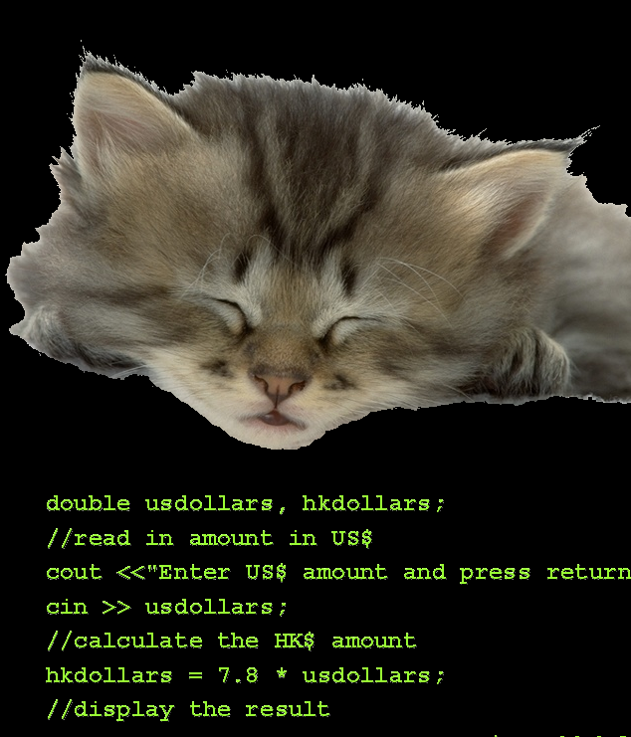

PROGRAMMER'S DRINKING SONG!!
100 little bugs in the code,
100 bugs in the code,
fix one bug, compile it again,
101 little bugs in the code.
101 little bugs in the code …
Repeat until BUGS = 0
—The Internet Joke Book

