Slide 1




Internet and Java
Foundations, Programming and Practice
Rajkumar Buyya
School of Computer Science and Software Engineering
Monash University
Melbourne, Australia
Email: rajkumar@dgs.monash.edu.au
URL: http://www.dgs.monash.edu.au/~rajkumar

Slide 2
Agenda
Internet and its Evolution
Internet Tools
Web and its Programming
Java for Internet Programming
Java Nuts and Bolts
Java Platform
Developing Applets and Applications
Challenges and Future Directions

Slide 3

What is the Internet ?
It is a global network of computers
that communicate with each other
using a variety of protocols and
overcoming various communication
barriers.
It is like International Telephone
System

Slide 4
Internet Technology Evolution
Internet is much bigger than what we think
More than 25 years old
More than doubling every year
Technology effect
  suddenly every body sees the need for a technology
  like the radio or the TV
10 terabytes flows everyday

Slide 5
Internet
Use of internet advertisement/elections/newspapers
information is public
Ubiquitous technology
Network is the computer
Intranets - internal TCP/IP nets
PC accounts for 55% of total IT
Applications tied to platform - API lock-in

Slide 6
Internet Evolution
Internet everywhere
Internet appliances
Price based services
Live communities
?
?
?
?
?
?
?
On line connects
to internet
Secure payments
Multi media Authoring
Java
VRML
HTML
File & mail
TCP/IP
Webpages
Netscape
10% of
Market
20% of
Market
Total
Market

Slide 7
Early Internet
Early Internet supported only email .
File Transfer Protocol development - ftp sites.
Network News was added to the Internet.
Archie - A program to canvass anonymous ftp sites and create a database of what is available
Gopher- A menu-driven interface used to search for information.
Archie and Gopher could answer questions only like ‘what FTP server contains info about “xxxx” ‘

Slide 8

World Wide Web
World Wide Web conceptualized by Tim Berners-Lee at CERN in Switzerland
Concept of Hypertext led to the development of the Hypertext Markup Language (HTML)
Tim Berners-Lee proposed the ‘Browser’ program
Scientists at CERN designed a TCP/IP based protocol to share Hypertext information called HTTP.
WWW officially is described as a” Wide-area hypermedia information retrieval initiative aiming to give universal access to a large universe of documents.

Slide 9
HTML
Hypertext -A little Hype and a Little Text.
Hypertext point to information which can be local or remotely located.
HTML -Derivative of the SGML( Standard Generalized Markup Language).
HTML -information , commands for the Browser for formatting documents.
HTML -The de-facto language for publishing on the Internet.
Hypermedia- Hyper-links to Multimedia.

Slide 10
Internet Tools
Browsers- A tool used to view documents on the WWW
Web servers - Machines which run the HTTP-server Software that respond to HTTP requests which it receives
Authoring Tools - Editors specially made for editing HTML documents
Filters -Tools to convert legacy documents to HTML format
Scripting -Languages used for scripting
WAIS- Wide Area Information Servers (WAIS) for indexing and doing full text searches

Slide 11
How does the Web work ?
Web -Designed around Client/Server Architecture
Web Clients ( Web Browsers ) -send requests for documents to any Web Server
Web Server -Program that responds to HTTP requests
Hyperlink
Web client connects to the specified Web Server
The server responds by sending the information asked for
The Browser formats the received HTML data and displays it

Slide 12
How does the Web Work
Send the “INFORMATION ABOUT C-DAC ACTS”
HTTP
The client sends an HTTP message to a computer
running a Web Server program and asks for a document
The information
about
C-DAC ACTS
The web server sends the hypermedia HTML documents to the client.
You end up seeing the document on your screen

Slide 13
HTML document
<HTML>
<TITLE>Centre for Development of Advanced Computing
</TITLE>
<BODY BGCOLOR=“#E7CCCC” TEXT=“#000000” LINK=“#0000FF”>
...
...
<A HREF=“mailto:webmaster@cdacb.ernet.in> webmaster</A>
</BODY>
</HTML>

Slide 14
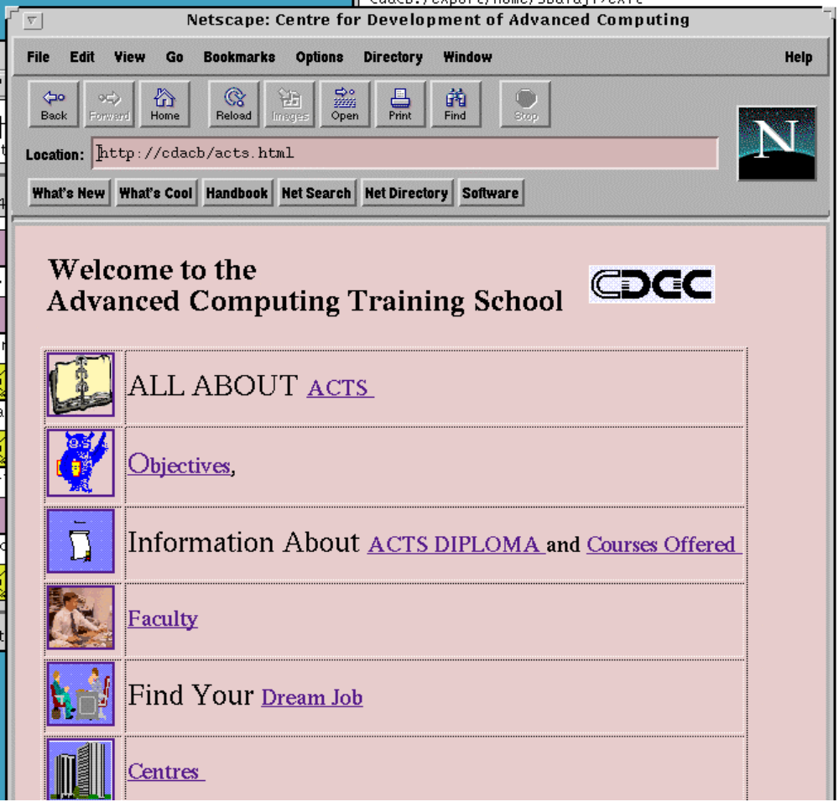

Slide 15
URLs
URLs- The Hypertext links we use today are known as Universal Resource Locator
URLs-Each name is unique across the Internet
An URL looks like this
http://system.domain.ext:999/dir1/dir2/dir3/file.html?blue#
Parts of a URL are,
  Service type, System Name, Port, Directory path, Filename,Search Components or Variables
Service type, System Name, Directory path are the required parts of the URL

Slide 16

CGI (Common Gateway Interface)
CGI makes the Web a Two-way interface
CGI -lets the user run a script when a web page is accessed
Information from the Web Client is received through simple ‘fill-in-the-forms’ kind of interface
FORMS - Integrates data sheets, menus , check boxes
CGI makes the Web interactive
CGI -complicated to setup ,requires PERL knowledge
HTML books talk less about CGI

Slide 17
Authoring tools and Filters
Authoring tools- Editors for HTML documents
Editors similar to WYSIWYG word processing programs
Semi-WYSIWYG or completely WYSIWYG
Provide syntax checking and correction
Filters -Convert legacy documents to HTML format
Filters are useful when the documents already exist
Authoring tools- HoTMetaL, HTML Assistant -Shareware

Slide 18
Preconfigured v/s Integrated Internet Products
Integrated Internet Products- From multiple vendors
Preconfigured Systems- Web Server and a Client ready to use
Sun’s Netra Internet Server
SGI’s WebFORCE Indy and WebFORCE Challenge S
Apple’s Internet Server Solution
DEC’s Internet AlphaServer
Integraph’s Web Server 10

Slide 19
Future Directions
Additions to HTML (Grammar, Maths, Display control)
VRML (Virtual Reality Markup Language)
Security - Using Scrambling and Encryption
Common Client Interface (CCI)- Allows Clients to pass information back and forth between the Browser and the External Viewer
Charge Mechanisms
Performance Enhancements- Sending a page and graphics for that page in one connection

Slide 20
Interesting URLs
http://www.whitehouse.gov ( The WhiteHouse)
http://www.w3.org (Everything about the WWW)
http://sunsite.unc.edu (Software on Sun)
http://www.indnet.org (India Net Foundation Services)
telnet://www.arbornet.org (Free Public Access Unix System)
http://www.infoseek.com (Search engines, Add URL)
http://www.infophil.com (World Alumni on the net)
http://www.rocketmail.com (Free Email )
http://members.tripod.com (Free Website,2MB space)
http://www.bangaloreonline.com (Offers virtual web servvices for compinies to host their website).
http://www.prajavani.com (Kannada news paper on web)

Slide 21
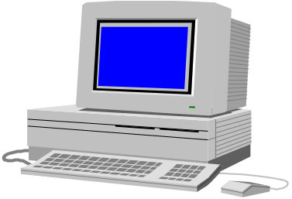
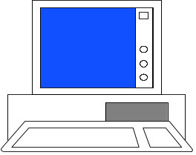
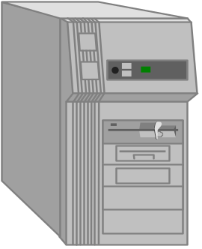
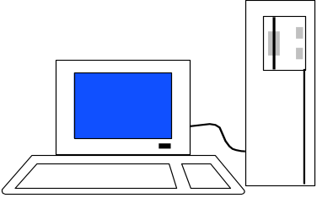
API Bottleneck
MAC
PC
LAN
LAN
Server
SUN
Network
Notes:
How do you write and distribute applications that run on all operating systems, versions, platforms.
Different binaries reside in all machines
Different binaries for user interfaces.

Slide 22
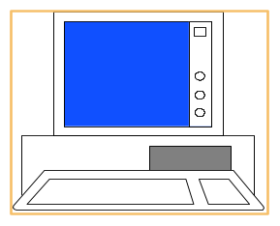
The OS - Platform lock
Applications tied to OS
OS tied to Platform
Application
Application
Application
OS
Application
Application

Slide 23



The Web
* Seeded by HTML from CERN
* Revolutionised by MOSAIC
* Standardised, universal interface
to data
* Graphical
Application
Application
Application
BROWSER
OS
OS
OS
OS
Application
Application
* Broadcast capability -
publish once, reach millions

Slide 24
Making life easier!
Data on the web
Browser platform independent
Click on application - run on any machine
Java the programming language of the 21 century

Slide 25

Java and Java Computing

Slide 26

Java - An Introduction
Java - The new programming language from Sun Microsystems
Java -Allows anyone to publish a web page with Java code in it
Java - CPU Independent language
Created for consumer electronics
Java - James , Arthur Van , and others
Java -The name that survived a patent search
Oak -The predecessor of Java
Java is “C++ -- ++ “

Slide 27
Java From 10,000 Ft.
According to the world, Java is...
According to Sun, Java is...
On closer inspection, Java is

Slide 28
According to the World, Java Is...
Snazzy Web pages
The cross-platform language we want
The rest-of-the-worlds answer to Bill
The C++ replacement we need
The C++ replacement we dont need
A bunch of hype

Slide 29
According to Sun, Java is...
Simple and Powerful
Object Oriented
Portable
Architecture Neutral
Distributed
Multi-threaded
Robust, Secure/Safe
Interpreted
High Performance
Dynamic pogramming language/platform.
Buzzword compliant!

Slide 30
On Closer Inspection, Java is...
Simple
Pure
Portable
Surprisingly effective

Slide 31
As a whole, Java is a Comprehensive Programming Solution
Object Oriented
Portable
High Performance
Geared for Distributed Environments
Secure

Slide 32
Java as Object Oriented
“Objects all the way down”
Simple and Familiar: “C++ Lite”
No Pointers!
Garbage Collector
Dynamic Binding
Single Inheritance with “Interfaces”

Slide 33
Java as Portable
Unlike other language compilers, Java complier generates code (byte codes) for Universal Machine.
Java Virtual Machine (JVM): Interprets bytecodes at runtime
Architecture Neutral
No Link Phase
Higher Level Portable Features: AWT, Unicode

Slide 34
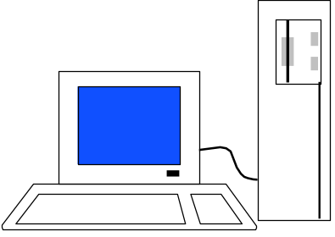

Total Platform Independence
JAVA COMPILER
(translator)
JAVA BYTE CODE
(same for all platforms)
JAVA INTERPRETER
(one for each different system)
Windows 95
Macintosh
Solaris
Windows NT
Notes:
1

Slide 35
Java
Write Once, Run Anywhere

Slide 36
Architecture Neutral & Portable
Java Compiler -Java source code to bytecode
Bytecode - an intermediate form, closer to machine representation
A virtual machine on any target platform interprets the bytecode
Porting the java system to any new platform involves writing an interpreter that supports the Java Virtual Machine
The interpreter will figure out what the equivalent machine dependent code to run

Slide 37
Java as High Performance
JVM uses “lean and mean” bytecodes
Small binary class filtes
Just-in-time Compilers
Multithreading
Native Methods

Slide 38
Java in the World of Distributed Computing
Class Loader
Lightweight Binary Class Files
Multithreading
Dynamic
Good communication constructs
Secure

Slide 39
Java as Secure
Language designed as safe
Strict compiler
Dynamic Runtime Loading (Verifier)
Runtime Security Manager

Slide 40
Object Oriented Languages -a Comparison
Objective
Feature
C++
C
Ada
Java
Encapsulation
Yes
Yes
Yes
Yes
Inheritance
Yes
Yes
No
Yes
Multiple Inherit.
Yes
Yes
No
No
Polymorphism
Yes
Yes
Yes
Yes
Binding (Early/Late)
Both
Both
Early
Late
Concurrency
Poor
Poor
Difficult
Yes
Garbage Collection
No
Yes
No
Yes
Genericity
Yes
No
Yes
No
Class Libraries
Yes
Yes
Limited
Yes

Slide 41
Java better than C++ ?
No Typedefs, Defines, or Preprocessor
No Global Variables
No Goto statements
No Pointers
No Unsafe Structures
No Multiple Inheritance
No Operator Overloading
No Automatic Coercions
No Fragile Data Types
?

Slide 42
Basic Data Types
Types
  boolean either true of false
  char 16 bit Unicode 1.1
  byte 8-bit integer (signed)
  short 16-bit integer (signed)
  int 32-bit integer (signed)
  long 64-bit integer (singed)
  float 32-bit floating point (IEEE 754-1985)
  double 64-bit floating point (IEEE 754-1985)
String (class for manipulating strings)
Java uses Unicode to represent characters internally

Slide 43

Java Integrates
Power of Compiled Languages
and
Flexibility of Interpreted Languages

Slide 44
Two Types of JavaApplications
Different ways to write/run a Java codes are:
  Application- A stand-alone program that can be invoked from command line . A program that has a “main” method
  Applet- A program embedded in a web page , to be run when the page is browsed . A program that contains no “main” method
Application -Java interpreter
Applets- Java enabled web browser (Linked to HTML via <APPLET> tag. in html file)

Slide 45
Java Environment/
Life Cycle of Java Code
Compile-time Environment
Runtime Environment
Class Loader
Bytecode
Verifier
Java Class
Libraries
Java
Source
(.java)
Java
Interpreter
Just in Time
Compiler
Java
Bytecodes
move locally
or through
network
Java
Virtual
machine
Java
Compiler
Runtime System
Java
Bytecode
(.class )
Operating System
Hardware

Slide 46

Java Development Kit
javac - The Java Compiler
java - The Java Interpreter
jdb- The Java Debugger
appletviewer -Tool to run the applets
javap - to print the Java bytecodes
javaprof - Java profiler
javadoc - documentation generator
javah - creates C header files

Slide 47
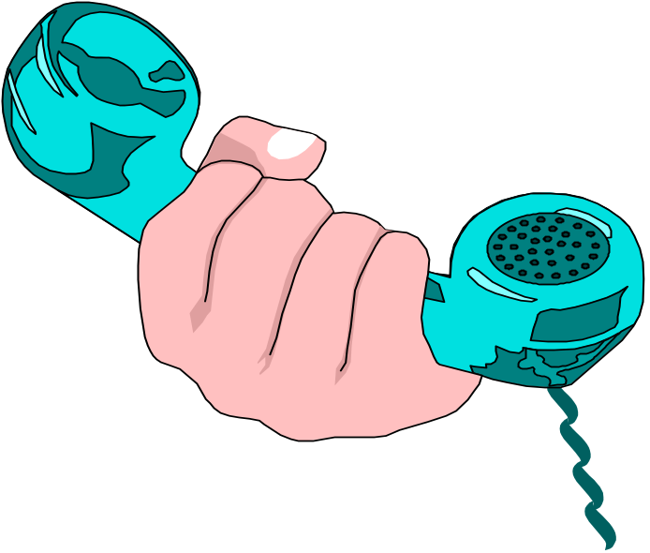
Hello Internet
// hello.java: Hello Internet program
class HelloInternet
{
public static void main(String args[])
{
System.out.println(“Hello Internet”);
}
}

Slide 48
Program Processing
Compilation
  # javac hello.java
  results in HelloInternet.class
Execution
  # java HelloInternet
  Hello Internet
  #

Slide 49
Simple Java Applet
// HelloWorld.java: A sample applet
import java.applet.Applet;
public class HelloWorld extends Applet {
  public void paint(Graphics g)
  {
      g.drawString(“Hello World !”,25,25);
    }
}

Slide 50
Calling an Applet
<HTML>
<TITLE> Hello Worls Applet </TITLE>
<APPLET code=“HelloWorld.class” width=500 height=500>
</APPLET>
</HTML>

Slide 51

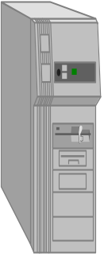

Execution of Applets
2
4
5
1
3
APPLET Development “hello.java”
AT
CDAC-India
hello.class
AT C-DAC’S
WEB SERVER
Create Applet
tag in HTML
document
Accessing
from
CRAY Corp.
(USA)
The browser creates
a new window and
a new thread and
then runs the code
Hello Java
<app=
“Hello”>
The Internet
Hello

Slide 52
Web Perspective
How did Web interactions work?
How do they work with Java?
Distributed Java objects and the Web

Slide 53
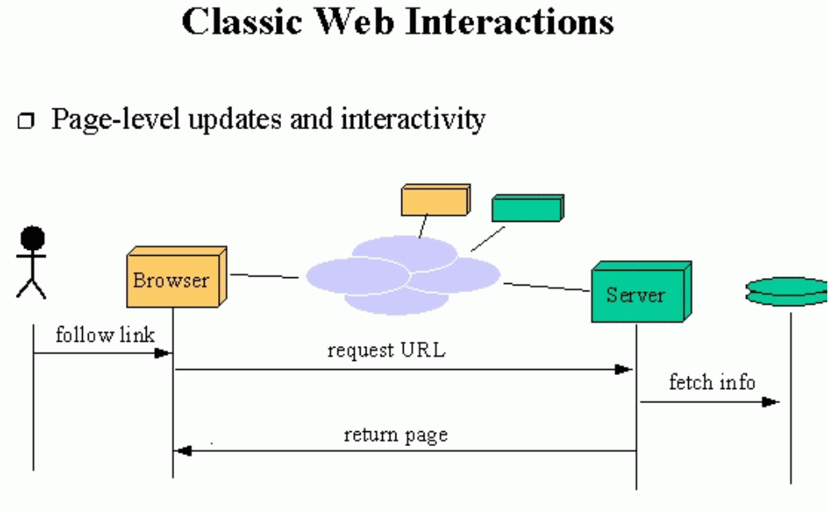
Classical Web Perspective

Slide 54
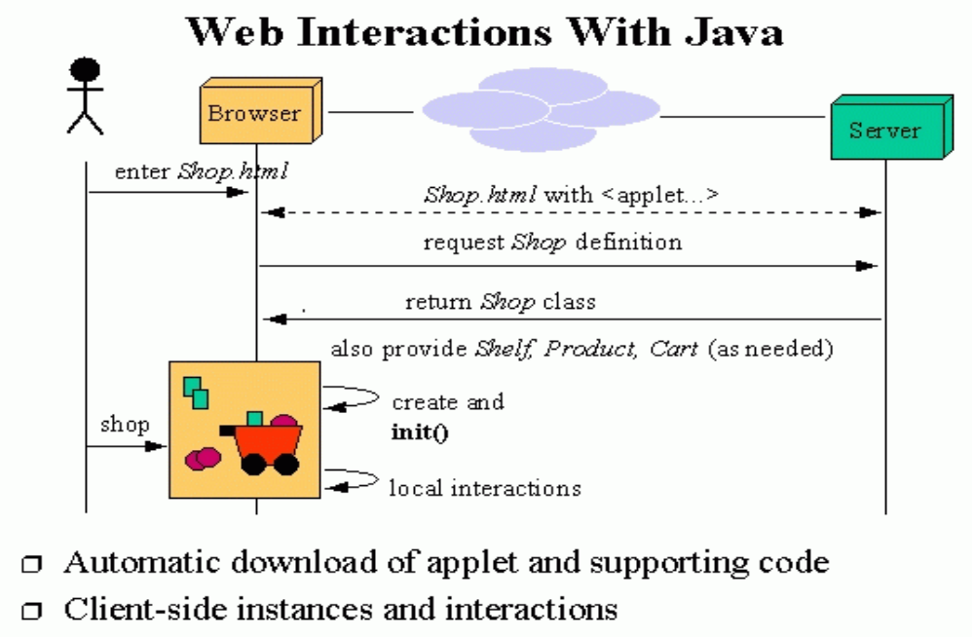
Java Web Perspective

Slide 55
Significance of downloading Applets
Interactive WWW
Flashy animation instead of static web pages
Applets react to users input and dynamically change
Display of dynamic data
WWW with Java - more than a document publishing medium
http://www.javasoft.com/applets/alpha/applets/StockDemo/standalone.html

Slide 56
Power of Java and the Web
Deliver applications, not just information
Eliminate porting
Eliminate end-user installation
Slash software distribution costs
Reach millions of customers - instantly

Slide 57
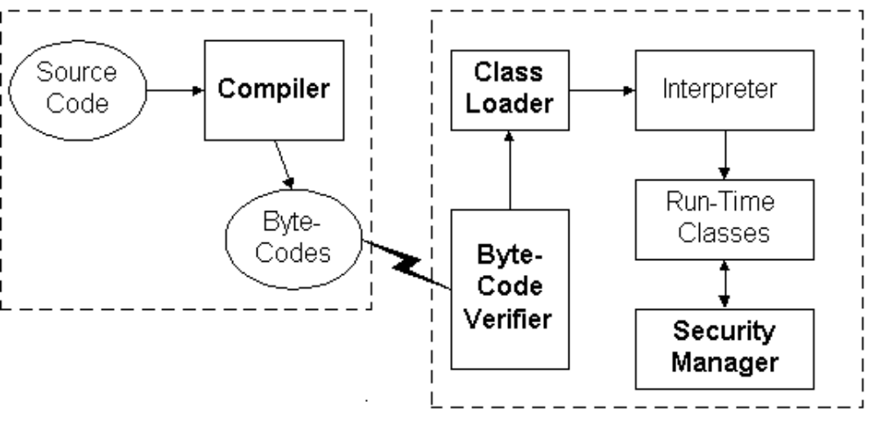
Lifecycle of Java Code

Slide 58
Bytecode Verifier
Called when class is first loaded in runtime environment
Verifies bytecodes meet certain set of properties
Verifier uses Theorem Prover
Verified code runs faster
After verification, interpreter defines memory layout

Slide 59
Class Loader
Unique “Namespace” for each origin
Local namespace classes are called “built-ins”
Prevents class “spoofing”

Slide 60
Security Manager
Prevents unauthorized disk read/writes
Restricts network access
Other access restrictions (native methods)
Implementation is browser dependent

Slide 61
General Language Features
C/C++ like syntax
No pointers
Objects all the way down
Objects request services of other objects through messages
Messages result in invocation of class methods

Slide 62
Removed From C++
Operator overloading
Pointers and Array/pointers
Multiple-inheritance of implementation
Enum, typedef, #define
Copy constructors, destructors
Templates
And other stuff....

Slide 63
Added or Improved over C++
Interfaces: type Vs. class
Garbage collection
Exceptions (More powerful than C++)
Strings
Instanceof
Package
Multi-threads

Slide 64

Rich Object Environment
Core Classes
  language
  Utilities
  Input/Output
  Low-Level Networking
  Abstract Graphical User Interface
Internet Classes
  TCP/IP Networking
  WWW and HTML
  Distributed Programs

Slide 65
Main Packages
java.lang
java.util
java.io
java.awt
java.awt.image
java.applet
java.net

Slide 66

Java Fundamentals
Constructs
Graphics
Multithreading
Streams and Networking
Networking

Slide 67
Unit I--Java Constructs
what is Java, basic constructs, including
  classes and objects
  constructors,
  this and super keywords,
  inheritance,
  abstract classes, interfaces,
  inner classes,
  exceptions.

Slide 68
Unit II--Graphics Programming
How to build Graphical User Interfaces in Java:
  GUI components,
  event handling,
  layout management.

Slide 69
Unit III--Advanced Features
Applets,
Threads,
Streams I/O,
Networking

Slide 70
Unit I -- What is Java ?
A programming language:
  Object oriented (no friends, all functions are members of classes, no function libraries -- just class libraries)
  simple (no pointer arithmetic, no need for programmer to deallocate memory)
  platform independent
  dynamic
  interpreted

Slide 71
Types
Eight basic types
  4 integers (byte, short, int, short) [ int a; ]
  2 floating point (float, double) [ double a;]
  1 character (char) [ char a; ]
  1 boolean (boolean) [ boolean a; ]
Everything else is an object
  String s;

Slide 72
Classes and objects
declaring a class
  class MyClass {
  member variables;
  …
  member functions () ;
  …
  } // end class MyClass

Slide 73
Java programs
Two kinds
  Applications
    have main()
    run from the OS prompt
  Applets
    have init(), start(), stop(), paint(), update(), repaint(), destroy()
    run from within a web page

Slide 74
The first Java Application
class MyApp {
public static void main(String s [ ] ) {
System.out.println(“Hello World”);
}
} // end class MyApp

Slide 75
Declaring and creating objects
declare a reference
  String s;
create/define an object
  s = new String (“India”);
India

Slide 76
Arrays (are objects in Java)
declare
  int a [ ] ; // 1-dim
  int [ ] b ; // 1-dim
  int [ ] c [ ]; // 2-dim
  int c [ ][]; // 2-dim
allocate space
  a = new int [7];
  c = new int [7][11];

Slide 77
Arrays have length
used to retrieve the size of an array
  int a [ ] = new int [7]; // 1-dim
    System.out.println(a.length); will print ‘7’
  int b [ ] [ ] = new int [7] [11];
    System.out.println(a.length); will print ‘7’
    System.out.println(b.length * b[0].length); will print ‘77’

Slide 78
… this is because
Let int [][][][] array = new int [7][11][10][21] , then …
array.length * array[3].length * array[3][5].length * array[3][5][2].length is 7 x 11 x 10 x 21

Slide 79
… this is because

Slide 80
Constructors
All objects are created through constructors
They are invoked automatically
class Weight {
int lb; int oz;
public Weight (int a, int b ) {
lb = a; oz = b;
}
}

Slide 81
this keyword
refers to “this” object (object in which it is used)
usage:
  with an instance variable or method of “this” class
  as a function inside a constructor of “this” class
  as “this” object, when passed as parameter

Slide 82
this :: with a variable
refers to “this” object’s data member
class Weight {
int lb; int oz;
public Weight (int lb, int oz ) {
this.lb = lb; this.oz = oz;
}
}

Slide 83
this :: with a method
refers to another method of “this” class
class Weight {
public int m1 (int a) {
int x = this.m2(a); return x;
}
public int m2(int b) { return b*7 ; }
}

Slide 84
this :: as a function inside a constructor of “this” class
must be used with a constructor
class Weight {
int lb, oz;
public Weight (int a, int b) { lb = a; oz = b; }
}
public Weight (int x) { this( x, 0); }
}
Constructor is also overloaded (Java allows overloading of all methods, including constructors)

Slide 85
this :: as “this” object, when passed as parameter
refers to the object that used to call the calling method
class MyApp {
int a;
public static void main(String [] s ) { (new MyApp()).myMethod(); }
public void myMethod() { yourMethod(this); }
public void yourMethod(MyApp inMyApp) { inMyApp.a = 77; }
}

Slide 86
static keyword
means “global”--all all objects refer to the same storage.
applies to variables or methods”
usage:
  with an instance variable of a class
  with a method of a class

Slide 87
static keyword (with variables)
class PurchaseOrder {
private static int POCount; // var. ‘a’ is shared by all objects of this class
public static void main(String [] s ) {
PurchaseOrder po1 = new PurchaseOrder();
po1.updatePOCount();
}
public void updatePOCount() { POCount++; }
}

Slide 88
static keyword (w/ methods)
class Math {
public static double sqrt(double x) {
// calculate
return result;
}
}
class MyApp {
public static void main(String [] s ) {
double dd;
dd = Math.sqrt(7.11);
}
}

Slide 89
Inheritance (subclassing)
class Employee {
protected String name;
protected double salary;
public void raise(double dd) {
salary += salary * dd/100;
}
public Employee ( … ) { … }
}

Slide 90
Manager can be made a sub/derived-class of Employee
class Manager extends Employee {
private double bonus;
public void setBonus(double bb) {
bonus = salary * bb/100;
}
public Manager ( … ) { … }
}

Slide 91
Overriding (methods)
class Manager extends Employee {
private double bonus;
public void setBonus(double bb) { …}
public void raise(double dd) {
salary += salary * dd/100 + bonus;
}
public Manager ( … ) { … }
}

Slide 92
class First { public First() { System.out.println(“ First class “); }
} public class Second extends First { public Second() { System.out.println(“Second class”); }
} public class Third extends Second { public Third() {System.out.println(“Third class”);}
}
Inheritance and Constructors
First class
Second class
Third class
Topmost class constructor is invoked first
(like us …grandparent-->parent-->child->)

Slide 93
access modifiers
private
  same class only
public
  everywhere
protected
  same class, same package, any subclass
(default)
  same class, same package

Slide 94
super keyword
refers to the superclass (base class)
usage:
  with a variable or method (most common with a method)
  as a function inside a constructor of the subclass

Slide 95
super :: with a method
class Manager extends Employee {
private double bonus;
public void setBonus(double bb) { …}
public void raise(double dd) { //overrides raise() of Employee
super.raise(dd); // call Employee’s raise()
salary += bonus;
}
public Manager ( … ) { … }
}

Slide 96
super :: as a function inside a constructor of the subclass
class Manager extends Employee {
private double bonus;
public void setBonus(double bb) { …}
public Manager ( String name, double salary, double bonus ) {
super(name, salary);
this.bonus = bonus;
}
}

Slide 97
final keyword
means “constant”
applies to
  variables (makes a var. constant), or
  methods (makes a method non-overridable), or
  classes (makes a class non-subclassable means “objects cannot be created”).

Slide 98
final keyword with a variable
class Math {
public final double pi = 3.1412;
public static double method(double x) {
double x = pi * pi;
}
}
note: variable pi is made “read-only”

Slide 99
final keyword with a method
class Employee {
protected String name;
protected double salary;
public final void raise(double dd) {
salary += salary * dd/100;
}
public Employee ( … ) { … }
}
then: cannot ovveride method raise() inside the Manager class

Slide 100
final keyword with a class
final class Employee {
protected String name;
protected double salary;
public void raise(double dd) {
salary += salary * dd/100;
}
public Employee ( … ) { … }
}
then: cannot create class Manager as a subclass of class Employee (all are equal)

Slide 101
abstract classes and interfaces
abstract classes
  may have both implemented and non-implemented methods
interfaces
  have only non-implemented methods
(concrete classes)
  have all their methods implemented

Slide 102
sample abstract class
abstract class TwoDimensionalGeoFigure {
public abstract double area();
public abstract double perimeter();
public abstract void printInfo();
public void setOutlineColor(Color cc) {
// code to set the color
}
public void setInsideColor(Color cc) {
// code to set the color
}
}

Slide 103
sample interface
interface ResponceToMouseClick {
public void mouseDown();
public void mouseUp();
public void mouseDoubleClick();
}
class ConcreteMouseClick implements ResponseToMouse Click {
// all above methods implemented here
}

Slide 104
Exceptions (error handling)
A nice way to handle errors in Java programs
code without exceptions:
...
int a = 7, b = 0, result;
if ( b != 0) {
result = a/b;
}
else {
System.out.println(“b is zero”);
}
...
code with exceptions:
...
int a = 7, b = 0, result;
try {
result = a/b;
}
catch (ArithmeticException e ) {
System.out.println(“b is zero”);
}
...

Slide 105
Exceptions (cont’d)
...
int a = 7, b = 0, result;
try {
result = a/b;
/// more code .. reading from a file
}
catch (ArithmeticException e ) {
System.out.println(“b is zero”);
}
catch (IOException e ) {
System.out.println(“Can’t read”);
}
finally {
Sysytem.out.println(“Closing file”);
/// code to close file
}
...

Slide 106
methods throwing exceptions
public int divide (int x, int y ) throws ArithmeticException {
if (y == 0 ) {
throw new ArithmeticException();
}
else {
return a/b ;
}
} // end divide()

Slide 107
Defining your own exceptions
class MyException extends ArithmeticException {}frm
public int divide (int x, int y ) throws MyException {
if (y == 0 ) {
throw new MyException();
}
else {
return a/b ;
}
} // end divide()

Slide 108
GUI Programming in Java
(AWT and Event Handling)

Slide 109
AWT - Abstract Windowing Toolkit
Single Windowing Interface on Multiple Platforms
Supports functions common to all window systems
Uses Underlying Native Window system
AWT provides
  GUI widgets
  Event Handling
  Containers for widgets
  Layout managers
  Graphic operations

Slide 110
AWT - Abstract Window Toolkit
Portable GUI - preserves native look & feel
Standard GUI Components (buttons…)
Containers - Panels, Frames, Dialogs
Graphics class for custom drawing
Layouts responsible for actual positioning of components:
  BorderLayout, GridLayout, FlowLayout, null layoit

Slide 111
Adding Components via Layouts
setLayout(new BorderLayout());
// Add text field to top
add("North",new TextField());
// Create the panel with buttons at the bottom...
Panel p = new Panel(); // FlowLayout
p.add(new Button("OK"));
p.add(new Button("Cancel"));
add("South",p);

Slide 112
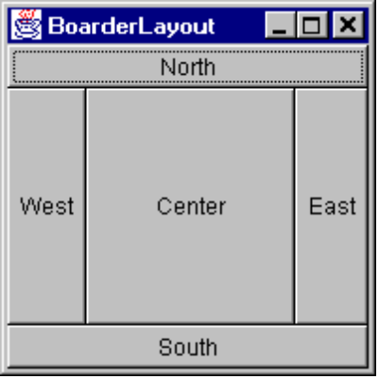
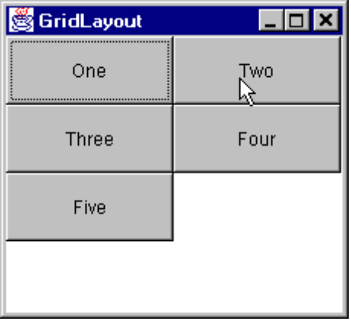
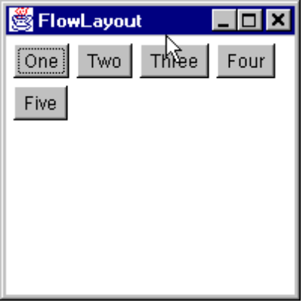
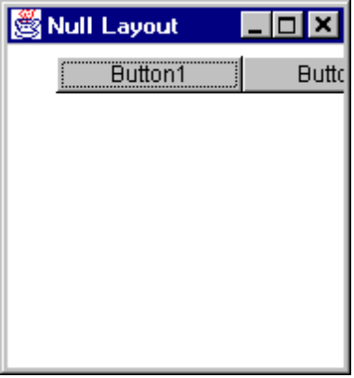
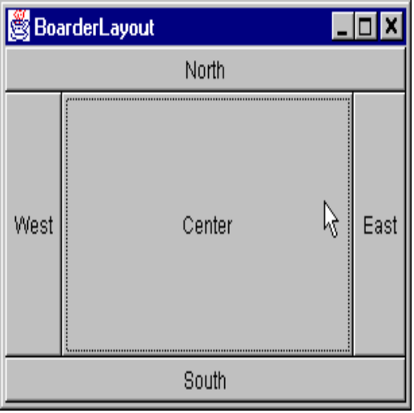
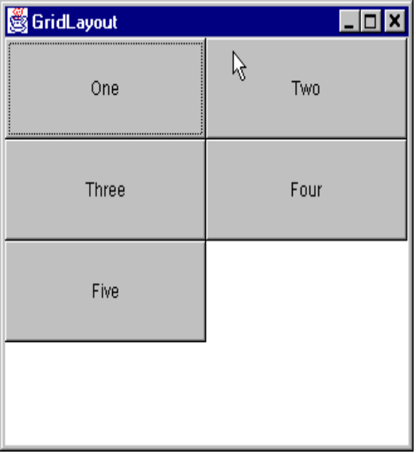
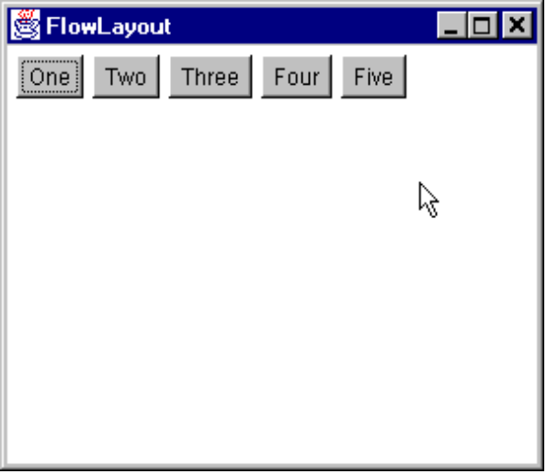
Adding Components via Layouts

Slide 113
Building Graphical User Interfaces
import java.awt.*;
Assemble the GUI
  use GUI components,
    basic components (e.g., Button, TextField)
    containers (Frame, Panel)
  set the positioning of the components
    use Layout Managers
Attach events

Slide 114
A sample GUI program
Import java.awt.*;
class MyGui {
public static void main(String [] s ) {
Frame f = new Frame (“My Frame”);
Button b = new Button(“OK”);
TextField tf = new TextField(“George”, 20); f.setLayout(new FlowLayout());
f.add(b);
f.add(tf);
f.setSize(300, 300);
f.setVisible(true);
}
}

Slide 115
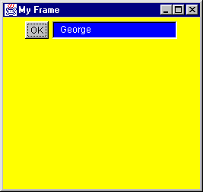
output

Slide 116

Events
b.addActionListener( );
Button
method to add a listener
listener object
Frame
f.addWindowListener( );

Slide 117
Events
Each GUI component (e.g., a Button) that wishes to respond to an event type (e.g., click), must register an event handler, called a Listener.
The listener is an object of a "Listener" interface.
A Listener class can be created by subclassing (through "implements") one of Listener interfaces (all listener inrefaces are in the java.awt.event package = > must import java.awt.event.*; )
The registration of the listener is done by a call to a method such as addActionListener(<Listener Object>). Each GUI component class has one or more such add…() methods, where applicable.

Slide 118
Listener Interfaces
INTERFACE NAME (IN JAVA.AWT.EVENT )
[1] ActionListener
[2] ItemListener
[3] MouseMotionListener
[4] MouseListener
[5] KeyListener
[6] FocusListener
[7] AdjustmentListener
[8] ComponentListener
[9] WindowListener
[10] ContainerListener
[11] TextListener

Slide 119
Listener Interfaces
Each listener interface has methods that need to be implemented for handling different kinds of events.
For example, the MouseMotionListener interface has two methods:
1) mouseDragged(MouseEvent) - Invoked when a mouse button is pressed on a component and then dragged.
2) mouseMoved(MouseEvent) - Invoked when the mouse button has been moved on a component (with no buttons down).

Slide 120
1) windowActivated(WindowEvent) - Invoked when a window is activated.
2) windowClosed(WindowEvent) - Invoked when a window has been closed.
3) windowClosing(WindowEvent) - Invoked when a window is in the process of being closed.
4) windowDeactivated(WindowEvent) - Invoked when a window is de-activated.
5) windowDeiconified(WindowEvent) - Invoked when a window is de-iconified.
6) windowIconified(WindowEvent) - Invoked when a window is iconified.
7) windowOpened(WindowEvent) - Invoked when a window has been opened.
... the WindowListener interface has seven methods:

Slide 121
How to create an object of a listener interface ?
Interfaces cannot be instantiated.
Therefore, cannot do new WindowListener();
Instead, have to subclass the interface and then create object of the subclass

Slide 122
Implementing the ActionListener Interface and attaching an event handler to a button
class MyApp implements ActionListener {
Button b = new Button(“OK”);
public static void main(String [] s ) {
(new MyApp()).go();
}
public void go() {
b.addActionListener( this );
}
public void actionPerformed(ActionEvent e ) {
// what to do when the button is clicked
if( e.getSource() == b )
{ System.out.println(“OK pressed"); }
}
}

Slide 123
class MyApp implements ActionListener, WindowListener {
Button b = new Button(“OK”);
Frame f = new Frame(“My Frame”); public static void main(String [] s ) {(new MyApp()).go(); } public void go() { b.addActionListener( this ); f.addWindowListener( this );
} public void actionPerformed(ActionEvent e ) { … } public void windowActivated(WindowEvent e ) { … } public void windowClosed(WindowEvent e ) { … } public void windowClosing(WindowEvent e ) { … } public void windowDeactivated(WindowEvent e) { … } public void windowDeiconified(WindowEvent e) { … } public void windowIconified(WindowEvent e) { … } public void windowOpened(WindowEvent e) { … }
}
Implementing 2 interfaces

Slide 124
or … use Adapters
class MyApp extends WindowAdapter {
Button b = new Button(“OK”);
Frame f = new Frame(“My Frame”);
public static void main(String [] s ) {(new MyApp()).go(); }
public void go() {
f.addWindowListener( this );
}
public void windowClosing(WindowEvent e ) { … }
}
Need only implement the method(s) that are required, instead of all seven methods of the WindowListener interface

Slide 125
But, we can only use one Adapter at a time (no multiple inheritance)
I.e., cannot have :
class MyApp extends WindowAdapter, MouseAdapter, ... {
… … … ...
}

Slide 126
However … can use inner classes instead !!!
class MyApp {
Button b = new Button(“OK”);
Frame f = new Frame(“My Frame”);
public static void main(String [] s ) {
((new MyApp()).go(); }
public void go() {
f.addWindowListener( new FrameHandler() );
b.addMouseListener( new ButtonHandler() );
}
class ButtonHandler extends MouseAdapter {
public void mousePressed (MouseEvent e ) { … }
}
class FrameHandler extends WindowAdapter {
public void windowClosing (WindowEvent e ) { … }
}
}

Slide 127
Popup Menu and Event Handling...
//popup.java: popup menu and event handling
import java.applet.Applet;
import java.awt.*;
import java.awt.event.*;
public class popup extends Frame implements ActionListener, MouseListener
{
TextField text1;
PopupMenu popup;
MenuItem menuitem1, menuitem2, menuitem3;
public popup()
{
super( "Popup Menu" );
setLayout(new FlowLayout());
setBounds(10, 10, 300, 200 );
setVisible(true);
init();
}
public void init()
{
popup = new PopupMenu("Resource Usage" );

Slide 128
Popup Menu and Event Handling...
menuitem1 = new MenuItem("CPU");
menuitem1.addActionListener(this);
menuitem2 = new MenuItem("Disk");
menuitem2.addActionListener(this);
menuitem3 = new MenuItem("Memory");
menuitem3.addActionListener(this);
popup.add(menuitem1);
popup.add(menuitem2);
popup.add(menuitem3);
add(popup);
text1 = new TextField(20);
text1.setBounds(20, 40, 120, 30 );
add(text1);
addMouseListener(this);
}
public void mousePressed(MouseEvent e )
{
if( e.getModifiers() != 0 )
popup.show(this, e.getX(), e.getY() );
}

Slide 129
Popup Menu and Event Handling
public void mouseReleased( MouseEvent e )
{ System.out.print("Mouse Released\n" ); }
public void mouseEntered( MouseEvent e )
{ System.out.print("Mouse Entered\n" ); }
public void mouseExited( MouseEvent e )
{ System.out.print("Mouse Exited\n" ); }
public void actionPerformed( ActionEvent e )
{
if( e.getSource() == menuitem1 )
{ text1.setText("CPU"); }
if( e.getSource() == menuitem2 )
{ text1.setText("Disk"); }
if( e.getSource() == menuitem3 )
{ text1.setText("Memory"); }
}
public static void main( String args[] )
{
popup p = new popup();
}
}

Slide 130
Applets and GUI

Slide 131
AWT & Applets
An Applet is a Java program capable of running from within a web page (HTML document)
Steps to incorporate and run an applet:
· Have MyApplet.java
· javac MyApplet.java
· Have MyApplet.class
· Create MyApplet.html
<applet code = MyApplet.class width = 200 height = 300 >
</applet>
· appletviewer MyApplet.html (or open MyApplet.html in browsers like Netscape/IE).

Slide 132
Applet methods
Unlike Applications, Applets do not have main().
Instead, they have : init(), start(), stop(), paint(), update(), repaint(), destroy().
All methods need not be implemented -- there are default versions for all of them.
AppletContext
  “Applet” derived from AWT Panel
  Hooks into Browser environment
  Can be used to link to another Web page

Slide 133
A sample Applet
// HelloApplet.java: for processing applet methods
import java.awt.*;
import java.applet.*;
public class HelloApplet extends Applet
{
public void init() {
setBackground(Color.yellow);
System.out.println("init() method invoked");
}
public void start()
{
System.out.println("start() method invoked");
}
public void paint( Graphics g )
{
System.out.println("paint() method invoked");
g.drawString( "Hi there", 24, 25 );
}
public void stop()
{
System.out.println("stop() method invoked");
}
}

Slide 134
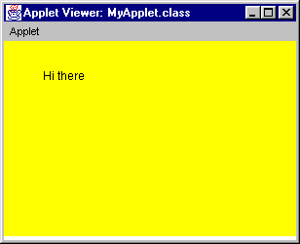
sample Applet

Slide 135
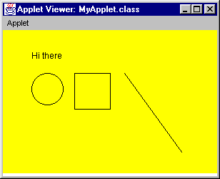
another sample Applet (run in Applet Viewer)

Slide 136
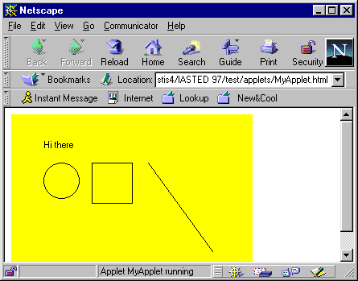
sample Applet running within Netscape

Slide 137
sample Applet code
import java.applet.*; // for Applet class
import java.awt.*; // for Graphics class
public class MyApplet extends Applet {
public void paint( Graphics g ) {
g.drawString("Hi there", 40, 40);
g.drawOval(40, 60, 45, 45);
g.drawRect(100, 60, 50, 50);
g.drawLine(170, 60, 250, 170);
} // end paint()
public void init() {
setBackground(Color.yellow);
}
} // end class MyApplet

Slide 138
Another example
// MyApplet.java: draws rectangle with yellow color fill
import java.applet.*;
import java.awt.*;
public class MyApplet extends Applet
{
public synchronized void paint(Graphics g)
{
int x,y,width,height;
Dimension dm = size();
x = dm.width/4;
y = dm.height / 4;
width = dm.width / 2;
height = dm.height / 2;
// Draw the rectangle in the center with colors!
g.setColor(Color.blue);
g.drawRect(x,y,width,height);
g.setColor(Color.yellow);
g.fillRect(x + 1,y + 1,width - 2,height - 2);
}
}

Slide 139
order of Applet method execution
As soon as the browser (or Appletviewer) accesses the page that contains the applet:
    It calls init(), first
    It calls start(), second.
    It calls paint(), third.

Slide 140
order of Applet method execution (cont’d)
After the above three initial calls, invocation of the other methods depends on user's activity while in the browser:
no activity => none of the methods is invoked
leave to a different URL => stop() is invoked (and if later come back to this URL, then start() will be invoked).
close down the browser => destroy() is invoked
none of the above => either paint() or update() or repaint() is invoked.

Slide 141
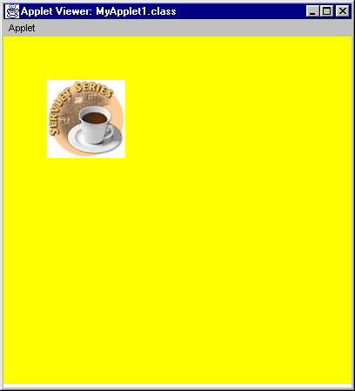
Incorporating Images and sound in Applets

Slide 142
sample Applet with sound
… … … (MyAppletSound.java)

Slide 143
how to do that ….
Step 1 : LOAD (image of sound file)
Step 2 : DISPLAY -or- PLAY

Slide 144
Applet that displays image
import java.applet.*;
import java.awt.*;
public class MyApplet1 extends Applet {
Image im;
public void init () {
// load
im = getImage(getDocumentBase(),"BOTTOMDOLLAR.JPG");
setBackground(Color.yellow);
}
public void paint(Graphics g ) {
g.drawImage(im, 50, 50, this); // display
}
} // end class MyApplet1

Slide 145
Applet that plays sound
import java.applet.*;
import java.awt.*;
public class MyAppletSound extends Applet {
AudioClip ac;
public void init () {
// load
ac = getAudioClip(getDocumentBase(), "chirp1.au");
}
public void start() {
ac.loop(); // play
}
public void stop() {
ac.stop(); // stop the sound upon leaving this web page
}
} // end class MyAppletSound

Slide 146
Multithreading in Java
(A built-in feature in Java)

Slide 147
Single and Multithreaded Processes
threads are light-weight processes within a process
Single-threaded Process
Multiplethreaded Process
Threads of
Execution
Single instruction stream
Multiple instruction stream
Common
Address Space

Slide 148
Threads
Java has built in thread support for Multithreading
Synchronization
Thread Scheduling
Inter-Thread Communication:
  currentThread start setPriority
  yield run getPriority
  sleep stop suspend
  resume
Java Garbage Collector is a low-priority thread

Slide 149
Thread states
new
wait()
sleep()
suspend()
blocked
start()
runnable
non-runnable
notify()
slept
resume()
unblocked
stop()
dead

Slide 150
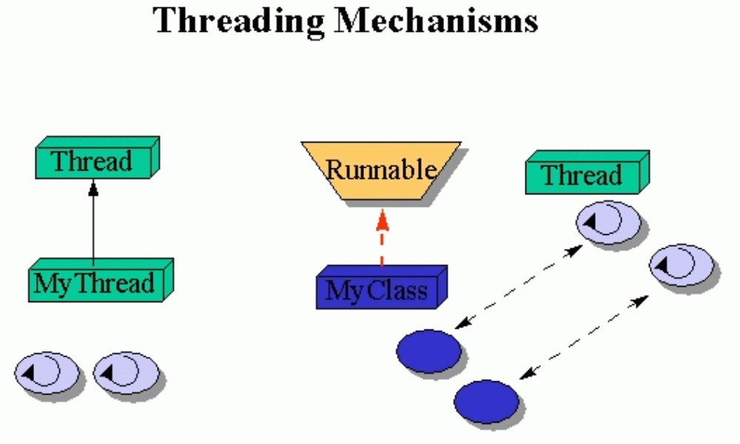
Threading Mechanisms...
Create a class that extends the Thread class
Create a class that implements the Runnable interface

Slide 151
1st method: Extending Thread class
1st Method: Extending the Thread class
class MyThread extends Thread
{
public void run()
{
// thread body of execution
}
}
Creating thread:
MyThread thr1 = new MyThread();
Start Execution:
thr1.start();

Slide 152
An example
class MyThread extends Thread { // the thread
public void run() {
System.out.println(" this thread is running ... ");
}
} // end class MyThread
class ThreadEx2 { // a program that utilizes the thread
public static void main(String [] args ) {
// note, the created object myThreadObject IS A Thread as well.
MyThread t = new MyThread();
// due to extending the Thread class (above)
// I can call start(), and this will call
// run(). start() is a method in class Thread.
t.start();
} // end main()
} // end class ThreadEx2

Slide 153
2nd method: Threads by implementing Runnable interface
class MyThread implements Runnable
{
.....
public void run()
{
// thread body of execution
}
}
Creating Object:
MyThread myObject = new MyThread();
Creating Thread Object:
Thread thr1 = new Thread( myObject );
Start Execution:
thr1.start();

Slide 154
An example
class MyThread implements Runnable {
public void run() {
System.out.println(" this thread is running ... ");
}
} // end class MyThread
class ThreadEx21 {
public static void main(String [] args ) {
Thread t = new Thread(new MyThread());
// due to implementing the Runnable interface
// I can call start(), and this will call run().
t.start();
} // end main()
} // end class ThreadEx2

Slide 155
A program with two threads
class MyThread implements Runnable {
public void run() { System.out.println("This is 'MyThread' ); }
}
class YourThread implements Runnable {
public void run() { System.out.println("This is 'YourThread'); }
}
class ThreadEx4 {
public static void main(String [] args ) {
Thread t1 = new Thread(new MyThread());
Thread t2 = new Thread(new YourThread());
t1.start();
t2.start();
}
} // end class ThreadEx4

Slide 156



Monitor model (for Syncronisation)
Method 1
Method 2
Key
Block 1
Threads
Monitor (synchronised) solves race-condition problem

Slide 157
examples :: program with two threads and shared object
class MyThread implements Runnable {
Shared so;
public MyThread (Shared s) { so = s;}
public void run() { so.method1(); }
} // end class MyThread
class YourThread implements Runnable {
Shared so;
public YourThread (Shared s) { so = s; }
public void run() { so.method2(); }
} // end class YourThread
class HerThread implements Runnable {
Shared so;
public HerThread (Shared s) { so = s; }
public void run() {so.method3(); }
} // end class HerThread
so

Slide 158
the monitor (shared object)
class Shared { // the 'monitor'
// if 'synchronized' is removed, the outcome is unpredictable
public synchronized void method1( ) {
for (int i = 0; i < 200; i++) { System.out.print(" [1] :: " + i ) ; }
}
// if the 'synchronized' is removed, the outcome is unpredictable
public synchronized void method2( ) {
for (int i = 0; i < 200; i++) { System.out.print(" [2] :: " + i ) ; }
}
// if the 'synchronized' is removed, the outcome is unpredictable
public synchronized void method3( ) {
for (int i = 0; i < 200; i++) { System.out.print(" [3] :: " + i ) ; }
}
} // end class Shared

Slide 159
the driver
class MyMainClass {
public static void main(String [] args ) {
Shared sharedObject = new Shared ();
Thread t1 = new Thread(new MyThread(sharedObject));
Thread t2 = new Thread(new YourThread(sharedObject));
Thread t3 = new Thread(new HerThread(sharedObject));
t1.start();
t2.start();
t3.start();
} // end main()
} // end class ThreadEx5

Slide 160

Threads in Action...
Cooperative threads - File Copy
reader()
{
  - - - - - - - - - -
  lock(buff[i]);
  read(src,buff[i]);
  unlock(buff[i]);
  - - - - - - - - - -
}
writer()
{
  - - - - - - - - - -
  lock(buff[i]);
  write(src,buff[i]);
  unlock(buff[i]);
  - - - - - - - - - -
}
buff[0]
buff[1]
Cooperative Parallel Synchronized Threads

Slide 161
Streams and I/O

Slide 162
Streams and I/O
basic classes for file IO
  FileInputStream, for reading from a file
  FileOutputStream, for writing to a file
Example:
Open a file "myfile.txt" for reading
FileInputStream fis = new FileInputStream("myfile.txt");
Open a file "outfile.txt" for writing
FileOutputStream fos = new FileOutputStream ("myfile.txt");

Slide 163
Display File Contents
import java.io.*;
public class FileToOut1 {
public static void main(String args[]) {
try {
FileInputStream infile = new FileInputStream("testfile.txt");
byte buffer[] = new byte[50];
int nBytesRead;
do {
nBytesRead = infile.read(buffer);
System.out.write(buffer, 0, nBytesRead);
} while (nBytesRead == buffer.length);
}
catch (FileNotFoundException e) {
System.err.println("File not found");
}
catch (IOException e) { System.err.println("Read failed"); }
}
}

Slide 164
Filters
Once a stream (e.g., file) has been opened, we can attach filters
Filters make reading/writing more efficient
Most popular filters:
For basic types:
    DataInputStream, DataOutputStream
For objects:
    ObjectInputStream, ObjectOutputStream

Slide 165
Writing data to a file using Filters
import java.io.*;
public class GenerateData {
public static void main(String args[]) {
try {
FileOutputStream fos = new FileOutputStream("stuff.dat");
DataOutputStream dos = new DataOutputStream(fos);
dos.writeInt(2);
dos.writeDouble(2.7182818284590451);
dos.writeDouble(3.1415926535);
dos.close(); fos.close();
}
catch (FileNotFoundException e) {
System.err.println("File not found");
}
catch (IOException e) {
System.err.println("Read or write failed");
}
}
}

Slide 166
Reading data from a file using filters
import java.io.*;
public class ReadData {
public static void main(String args[]) {
try {
FileInputStream fis = new FileInputStream("stuff.dat");
DataInputStream dis = new DataInputStream(fis);
int n = dis.readInt();
System.out.println(n);
for( int i = 0; i < n; i++ ) { System.out.println(dis.readDouble());
}
dis.close(); fis.close();
}
catch (FileNotFoundException e) {
System.err.println("File not found");
}
catch (IOException e) { System.err.println("Read or write failed");
}
}
}

Slide 167
Object serialization
Write objects to a file, instead of writing primitive types.
Use the ObjectInputStream, ObjectOutputStream classes, the same way that filters are used.

Slide 168
Write an object to a file
import java.io.*;
import java.util.*;
public class WriteDate {
public WriteDate () {
Date d = new Date();
try {
FileOutputStream f = new FileOutputStream("date.ser");
ObjectOutputStream s = new ObjectOutputStream (f);
s.writeObject (d);
s.close ();
}
catch (IOException e) { e.printStackTrace(); }
public static void main (String args[]) {
new WriteDate ();
}
}

Slide 169
Read an object from a file
import java.util.*;
public class ReadDate {
public ReadDate () {
Date d = null;
ObjectInputStream s = null;
try { FileInputStream f = new FileInputStream ("date.ser");
s = new ObjectInputStream (f);
} catch (IOException e) { e.printStackTrace(); }
try { d = (Date)s.readObject (); }
catch (ClassNotFoundException e) { e.printStackTrace(); }
catch (InvalidClassException e) { e.printStackTrace(); }
catch (StreamCorruptedException e) { e.printStackTrace(); }
catch (OptionalDataException e) { e.printStackTrace(); }
catch (IOException e) { e.printStackTrace(); }
System.out.println ("Date serialized at: "+ d);
}
public static void main (String args[]) { new ReadDate (); }
}

Slide 170
Network/Socket Programming in Java

Slide 171
java.net
Used to manage:
  URL streams
  Client/server sockets
  Datagrams

Slide 172
Part III - Networking
ServerSocket(1234)
Output/write stream
Input/read stream
Socket(“130.63.122.1”, 1234)
Server_name: “cdacb.ernet.in”

Slide 173
Server side Socket Operations
1. Open Server Socket:
String server; Socket slink;
DataOutputStream os;
DataInputStream is;
server = new ServerSocket( PORT );
2. Wait for Client Request:
Socket client = server.accept();
3. Create I/O streams for communicating to clients
is = new DataInputStream( client.getInputStream() );
os = new DataOutputStream( client.getOutputStream() );
4. Perform communication with client
Receiive from client: String line = is.readLine();
Send to client: os.writeBytes("Hello\n");
5. Close sockets: client.close();
For multithreade server:
while(true) {
i. wait for client requests (step 2 above)
ii. create a thread with “client” socket as parameter (the thread creates streams (as in step (3) and does communication as stated in (4). Remove thread once service is provided.
}

Slide 174
Client side Socket Operations
1. Get connection to server:
client = new Socket( server, port_id );
2. Create I/O streams for communicating to clients
is = new DataInputStream( client.getInputStream() );
os = new DataOutputStream( client.getOutputStream() );
3. Perform communication with client
Receiive from client: String line = is.readLine();
Send to client: os.writeBytes("Hello\n");
4. Close sockets: client.close();

Slide 175
A simple server (simplified code)
import java.net.*;
import java.io.*;
public class ASimpleServer {
public static void main(String args[]) {
// Register service on port 1234
ServerSocket s = new ServerSocket(1234);
Socket s1=s.accept(); // Wait and accept a connection
// Get a communication stream associated with the socket
OutputStream s1out = s1.getOutputStream();
DataOutputStream dos = new DataOutputStream (s1out);
// Send a string!
dos.writeUTF(“Hi there”);
// Close the connection, but not the server socket
dos.close();
s1out.close();
s1.close();
}
}

Slide 176
A simple client (simplified code)
import java.net.*;
import java.io.*;
public class SimpleClient {
public static void main(String args[]) throws IOException {
// Open your connection to a server, at port 1234
Socket s1 = new Socket("130.63.122.1",1234);
// Get an input file handle from the socket and read the input
InputStream s1In = s1.getInputStream();
DataInputStream dis = new DataInputStream(s1In);
String st = new String (dis.readUTF());
System.out.println(st);
// When done, just close the connection and exit
dis.close();
s1In.close();
s1.close();
}
}

Slide 177
Echo Server Client..
//client.java: client interface to server
import java.io.*;
import java.net.*;
public class client
{
int port_id;
String server; Socket slink;
DataOutputStream os;
DataInputStream is;
DataInputStream kbd;
public client( String args[] )
{
server = args[0];
port_id = Integer.valueOf(args[1]).intValue();
try
{
slink = new Socket( server, port_id );
os = new DataOutputStream( slink.getOutputStream() );
is = new DataInputStream( slink.getInputStream() );
kbd = new DataInputStream( System.in );
}

Slide 178
Echo Server Client..
catch( UnknownHostException e )
{
System.err.println( "Don't know about host: " );
System.exit(1);
}
catch( IOException e )
{
System.err.println( "Could not get I/O for the connection to "+server);
System.exit(1);
}
}
void communicate()
{
while(true)
{
try {
System.out.print("Enter Input <end to stop>: ");
String line = kbd.readLine();
os.writeBytes( line+"\n" );

Slide 179
Echo Server Client..
if( line.equals("end") )
{ os.close(); is.close(); slink.close();
break;
}
String line2 = is.readLine();
System.out.println("Output: "+line2);
}
catch( IOException e )
{ System.out.println(e); }
}
}
public static void main( String [] args )
{
if( args.length < 2 )
{
System.out.println("Usage: java client server_name port_id" );
System.exit(1);
}
client cln = new client( args );
cln.communicate();
}
}

Slide 180
Echo Server ...
// server.java: echo server
import java.io.*;
import java.net.*;
public class server
{
// public final static int PORT = 4779;
public static void main( String [] args )
{
ServerSocket server = null;
DataOutputStream os = null;
DataInputStream is = null;
boolean shutdown = false;
if( args.length < 1 )
{
System.out.println( "Usage: java server port_num" );
System.exit( 1 );
}
int PORT = Integer.valueOf(args[0]).intValue();
try {
server = new ServerSocket( PORT );
}

Slide 181
Echo Server ...
catch( IOException e )
{
System.err.println( "Could not get I/O for the connection to: ");
}
while(!shutdown)
{
if( server != null )
{
try
{
Socket client = server.accept();
System.out.println("Connected");
InetAddress cip = client.getInetAddress();
System.out.println( "Client IP Addr: "+cip.toString());
is = new DataInputStream( client.getInputStream() );
os = new DataOutputStream( client.getOutputStream() );
for(;;)
{
String line = is.readLine();
if( line == null )
break;

Slide 182
Echo Server ...
if( line.startsWith("end" ) )
{
shutdown = true;
break;
}
os.writeBytes(line.toUpperCase());
os.writeBytes("\n");
System.out.println(line);
}
is.close(); client.close();
}
catch( UnknownHostException e )
{
System.err.println( "Server Open fails" );
}
catch( IOException e )
{
System.err.println( "Could not get I/O for the connection to:"+args[0]);
}
}
}

Slide 183
Echo Server
System.out.println( "Server Down" );
try {
server.close();
} catch(IOException e) {}
}
}

Slide 184
Threads in Action...
Multithreaded Server
Server Process
Client Process
Server
Threads
Client Process
User Mode
Kernel Mode
Message Passing
Facility

Slide 185
Java System Architecture & Availability

Slide 186
A Look Inside the Java Platform
Applets and Applications
Java Base API
Java Base Classes
Java Standard Extension API
Java Standard Extension Classes
The
Java
Base
Platform
(in black)
Java Virtual Machine
Porting Interface
Adapter
Adapter
Adapter
JavaOS
Browser
OS
OS
OS
Hardware
Hardware
Hardware
Hardware
Network
Java on
a Browser
Java on a
Desktop OS
Java on a
Smaller OS
Java on
JavaOS

Slide 187
Java Applications!
Java applications are now available
Cost of manfg zero, cost of distribution zero, cost of marketing zero!
Hot Java is lean - loads everything else from the net.
Java itself is small - 40k to 225k
New class of small machines will emerge
Java on cellular phones, credit cards, washing machines, and everywhere ?

Slide 188
Universal Interface
Web Servers
with JAVA
applications
Internet
Clients
running
any OS on
any platform

Slide 189
Java on my platform ?
Sun (SPARC) ftp://java.sun.com
Sun(x86) ftp://xm.com:/pub/
IBM(Aix, OS/2)ftp://ncc.hursley.ibm.com/javainfo
DEC(Alpha OSF/1) http://www.gr.osf.org:8001/projects/web/java/
SGI http://liawww.epfl.ch/~simon/java/irix-jdk.html
HP http://www.gr.osf.org:8001/projects/web/java
Linux http://www.blackdown.org
AT & T http://www.gr.osf.org:8001/projects/web/java
Windows 3.1 http://www.alphaworks.ibm.com

Slide 190
Java Development Tools
(Present and Planned)

Slide 191
Sun’s Java WorkShop
JDK:
  Compiler and runtime environment
  Class Libraries
  Documentation
  javadoc - Automated Documentation
    Takes comments and converts to HTML
IDE: Visual Java, and integrated tools, JavaBeans
Other Products and API: JavaHelp, Java Card, Java Blend, JavaOS, Java Mail, Java Management, Java Electronic Commerce Framework
Java Enterprise API: Java Naming and Directory Interface, Java IDL, JDBC, RMI and Object Serialization

Slide 192
Symantec Cafe 1.0 (Released)
Full IDE for Windows 95/NT
Graphic Development Tools
Two Compilers
Debugger
Class Browser

Slide 193
Microsoft Jakarta (Planned)
Visual C++ type interface
Will Support ActiveX/COM
Internet Explorer 3.0 will have Just-In-Time Java compiler

Slide 194
Borland JBuilder
Visual RAD workbench for maximum productivity.
Rapid Application Development (RAD) and Open Component Architecture patterned after Delphi.
100+ JavaBean components, with source code, for drag-and-drop applications.
Beans Express--easiest way to create industry-standard Java-Bean components.
DataExpress -- the fastest way to build business and database appplications.
Borland DataGateway for Java connectivity to all major database servers.
Multi-tier applications with integrated RMI and CORBA.
Versions: Standard, Professional, & Client/Server

Slide 195
Challenges & Possible Directions
Performance
AWT - need better GUI!
Maintaining Interoperability
Security - current restrictions limit what can be done
Native Compilers
Is Portability that Important?

Slide 196
Comments
Java is a fun and easy programming language
Portability = Mediocrity?
Java will become a programming language of choice, but may take on a final form that will surprise many!

Slide 197
JDBC
Java API for Relational Databases
Being standardized by all major players

Slide 198
Javascript and Java (Preview)
Javascript can control Java applets
Static data accessible as properties of applet
var i = Bank.Account.count
Public methods invocable on Java instances
Provided those instances are accessible through the Applet
Applet is accessible through document
document.applet_Name_Attribute.do_Stuff()

Slide 199
Java for HPC!
Many efforts are in in progress for making java as a language for parallel programming.
Java computing frameworks (HPC, numeric, data parallel)
Java in distributed simulations and applications (e.g., real-world HPC, grand chalenge)
Source to source translators (C, Fortran, C++ to Java)
Web based computation environment in Java
Java for HPC conference: http://www.cs.ucsb.edu/conferences/java98
Java for Science and Engineering computing: subscribe java-for-cse to majordomo@npac.syr.edu
http://www.jhpc.org

Slide 200
How to Convert Programs to AWT 1.1...
1. Change source code so that it import event package:
import java.awt.event.*;
2. Figure out which component generates each event type: (1.0 uses handleEvent() and action())
Button, List, MenuItem, TextField:
Interface: ActionListener
Method: actionPerformed(ActionEvent event)
Checkbox, CheckboxMenuItem, Choice:
Interface: ItemListener Method: itemStateChanged(..)
Dialog, Frame:
Interface: WindowListener
Method: windowClosing(), windowOpened(),...

Slide 201
How to Convert Programs to AWT 1.1...
3. Change class declaration so that class implements
public class MyClass extends SomeComponent
implements ActionListener
4. Register action Listener
newComponentObject.addActionListener(this);
5. Change event handling method:
Old: public boolean action(Event e, Object arg)
New: public void actionPerformed(ActionEvent e)

Slide 202
How to Convert Programs to AWT 1.1
6. Delete the event handling code in this way
(a) Delete all return statements
(b) Change e.target to e.getSource()
(c) Delete all code the unnecessarily tests for which
component the event come from
(d) Perform any other modification require to make
the program compile

Slide 203
Just to Summarize
Java as a Comprehensive Programming Solution
  Object Oriented
  Portable
  High Performance
  Geared for Distributed Environments
  Secure
  Highly suitable for Internet programming

Slide 204
Summary
Java is really very well poised
Incredible leverage from the Web
Will impact the C++ and Smalltalk markets
Rate of progress is astonishingly high
  Development environments
  CORBA linkages
  Components
Fasten you seat-belts!

Slide 205

Thank You ...
?

