Slide 1
ASP .NET MVC 5
By: Shijil Pannian | Suyati Technologies.

Slide 2
ASP .NET Framework

Slide 3
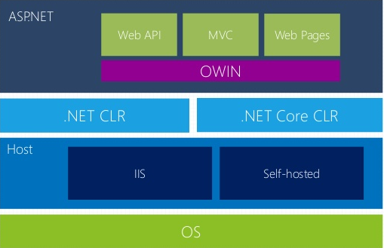
ASP .NET version 5

Slide 4
ASP .NET Web Form Vs ASP .NET MVC
Web Form
RAD development.
Supports View state and PostBack events.
Event driven development.
MVC
Enables the full control over the HTML.
Provides clean separation of concerns (SoC).
Easley enables Test Driven Development (TDD).
RESTful URLs that enables SEO.
No ViewState and PostBack events.

Slide 5
Introduction to ASP .NET MVC
Controller
(Input)
View
(Presentation)
Model
(Data)

Slide 6
Introduction to ASP .NET MVC (contd...)
Request
Controller
Controller may or may not retrieves Model.
It does Something
Model
View
Visually represents the model
Response

Slide 7
Controller

Slide 8
Controller
Controller takes the browser request and based on the logic it responds to that browser request
A controller can return a view, redirect to another controller, or can return error messages
“A controller contains application flow control logics”

Slide 9
Controller (Contd...)
A controller action returns something called an ”action result”. The ASP.NET MVC
framework supports several types of action results including;
ViewResult - Represents HTML and markup.
EmptyResult - Represents no result.
RedirectResult - Represents a redirection to a new URL.
JSONResult - Represents a JavaScript Object Notation result that can be
used in an AJAX application.
JavaScriptResult - Represents a JavaScript script.
ContentResult - Represents a text result.
FileContentResult - Represents a downloadable file (with the binary content )
FilePathResult - Represents a downloadable file (with a path).
FileStreamResult - Represents a downloadable file (with a file stream).

Slide 10
Routing
The ASP .NET routing module is responsible for mapping incoming browser requests to particular MVC controller actions. All ASP .NET application is configured to use ASP.NET Routing

Slide 11
Routing (Contd..)
//RouteConfig.cs
public static void RegisterRoutes(RouteCollection routes) { routes.IgnoreRoute("{resource}.axd/{*pathInfo}"); routes.MapRoute( "Default", "{controller}/{action}/{id}", new { controller = “Home", action = “Index", id = UrlParameter.Optional } ); }
//Gloabal.asax
protected void Application_Start() { RegisterRoutes(RouteTable.Routes); }

Slide 12
Attribute Routing
Attributes are used to define routes. Attribute routing provides you more control over the URIs by defining routes directly on actions and controllers in your ASP.NET MVC application and WEB API.
Attribute routing should configure before the convention-based routing.
When you combine attribute routing with convention-based routing, actions which do not have Route attribute for defining attribute-based routing will work according to convention-based routing.
When you have only attribute routing, actions which do not have Route attribute for defining attribute-based routing will not be the part of attribute routing.

Slide 13
Attribute Routing (Contd..)
public class RouteConfig
{
public static void RegisterRoutes(RouteCollection routes)
{
routes.IgnoreRoute("{resource}.axd/{*pathInfo}");
//enabling attribute routing
routes.MapMvcAttributeRoutes();
//convention-based routing
routes.MapRoute(
name: "Default",
url: "{controller}/{action}/{id}",
defaults: new { controller = "Home", action = "Index", id = UrlParameter.Optional });
}
}

Slide 14
Demo

Slide 15
Model

Slide 16
Model
Model can contain data
Model can contains business logics, validation logics etc..

Slide 17
Validation & Data Annotations
Model validations are done by using Data Annotations. Many built in validation attributes like Required, Range, RegularExpression, StringLength, etc are available out of the box with ASP .Net MVC.
Eg: public class Employee {
[Required(ErrorMessage=“Name is required”)]
public string Name { get; set; }
[Required(ErrorMessage = “Date of birth is required")]
[DisplayName(“Date of birth”)]
[DisplayFormat(DataFormatString = "{0:MM/dd/yyyy}")]
public DateTime DOB { get; set; }
[Required(ErrorMessage = “Email is required")]
[DataType(DataType.EmailAddress)]
public string Email { get; set; }
}

Slide 18
View

Slide 19
View
A View is what you see in asp.net MVC application
A View can contain HTML, scripts
There no direct correspondence with the URL and View

Slide 20
View Engines in MVC
View (contd…)
Aspx View Engine
Razor View Engine

Slide 21
Razor View Engine
View (contd…)
The Razor view engine use Razor template to produce HTML. The razor template has the extension .cshtml
Razor Template
Model Data
HTML output
(view)

Slide 22
View (contd…)
Razor View Engine - Syntax
Razor Code Expressions
Instead of Response.Write Razor using @symbol to write something into response object, the difference between Response.Write and @ symbol is, @ symbol automatically does the HTML encoding (this will help to prevent cross side scripting attack).
Types of code expressions :
Implicit Code Expressions
ex: <h3> Rate :</h3> @model.Rate
Explicit Code Expressions (Expression with in ‘()’)
ex: <h3>Total Amount: </h3>@(model.Rate*10.0)

Slide 23
View (contd…)
Razor View Engine - Syntax
Razor code block (@{})
ex : @{
var msg = “Hello World”;
}
ex: @foreach (var item in Model)
{
<h1>@item.Name</h1>
}
The Razor comments
@* and *@

Slide 24
Razor Physical Pages
View (contd…)
1. Layout.cshtml
Layout views are similar to “master pages” on ASP .Net Web forms
Layout view has two special methods
RenderBody()
This method inserts the page content
RenderSection()
This method helps to insert a section of the page
Syntax : @RenderSection(“section name”, bool required)
2. ViewStart.cshtml
Used to define common view code that you want to execute at the start of each View’s rendering.

Slide 25
HTML Helpers
View (contd…)
Html helper is used to create small html elements like input elements, form elements, link elements etc..
ex: Html.ValidationMessageFor()
Html.ValidationSummary ()
Html.LabelFor()
Html.DisplayFor()
etc….
Also we can create custom helpers using extension methods.

Slide 26
Partial Views
A partial view is a type of view which contains markups and server side codes and that can be reused.
Syntax : @Html.Partial(“partial view name”, model)
@Html.Action(“ActionMethod”, ”controller”)
Scenarios of partial view;
1. To make main view more readable
2. To render a portion of model to a specific view

Slide 27
Passing Data to View
ViewData
ViewData is a dictionary object that is derived from ViewDataDictionary class.
ViewBag
ViewBag is a dynamic property that takes advantage of the new dynamic features in C# 4.0.
TempData
TempData is a dictionary object that is derived from TempDataDictionary class and stored in short lives session.

Slide 28
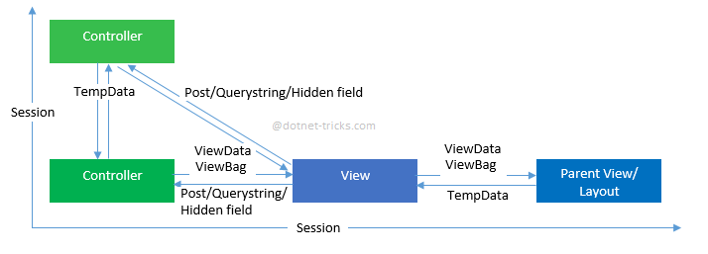
Passing Data to View (contd…)
ViewData Vs ViewBag Vs TempData
Session
Session is also used to pass data within the ASP.NET MVC application and Unlike TempData, it never expires.

Slide 29
Model Binder
What Model binder does is that it takes the values coming from an HTML page and map it to a corresponding model.

Slide 30
Filters
ASP.NET MVC provides a simple way to inject your piece of code or logic either before or after an action is executed.
This is achieved by decorating the controllers or actions with ASP.NET MVC attributes or custom attributes.

Slide 31
Types of Filters
Authentication filters (New in ASP.NET MVC5)
Authorization filters
Action filters
Result filters
Exception filters

Slide 32
Configuring Filters
Global level
Controller level
Action level

Slide 33
Custom Filters

Slide 34
Bundling & Minification
A bundle is a logical group of files (scripts, styles etc..) that is loaded with a single HTTP request.
Eg: bundles.Add(new StyleBundle("~/Content/css").Include("~/Content/site.min.css",
"~/Content/mystyle.min.css"));
Bundle using the "*" Wildcard Character
bundles.Add(new ScriptBundle("~/bundles/jqueryval").Include("~/Scripts/jquery*.js"));
bundles.Add(new StyleBundle("~/Content/css").Include("~/Content/*.css"));

Slide 35
Bundling & Minification (Contd…)
Registering Bundle
protected void Application_Start()
{
BundleConfig.RegisterBundles(BundleTable.Bundles);
}
Minification
Minification is technique for removing unnecessary characters, spaces and comments from the JavaScript and CSS files to reduce the size which cause improved load times of a webpage.

Slide 36
Demo....

Slide 37
Design Patterns
Introduction to Dependency Injection (DI)
Introduction to Repository Pattern

Slide 38
Dependency Injection
Dependency injection (DI) helps to avoid instantiating the concrete implementations of a depended class inside another class.
In DI dependencies are usually injected to a class through constructor or through properties as well.
There are many frameworks available to simplify dependency injection like Castle Windsor, Unity, Autofac, StructureMap, Ninject etc.

Slide 39
Repository Pattern
Repository hides the details of how exactly the data is being fetched/persisted from/to the database.
It allows all of your code to use objects without having to know how the objects are persisted.

Slide 40
Working With Data

Slide 41
ORM Frameworks
ORM provides a framework for mapping an object oriented domain model to a traditional relational database
Entity Framework
Dapper
Nhibernate
LINQ to SQL
DataObjetcs .NET
DatabaseObjects
nHydrate
Persistor.NET

Slide 42
EntityFramework

Slide 43
Demo....

Slide 45
References
http://www.asp.net/mvc
http://msdn.microsoft.com/en-us/library/gg416514(v=vs.108).aspx

Slide 46
Thank you

