Slide 1
Introduction to C++
CS-2303
System Programming Concepts
(Slides include materials from The C Programming Language, 2nd edition, by Kernighan and Ritchie and from C: How to Program, 5th and 6th editions, by Deitel and Deitel)
Slides (shamelessly) borrowed from Prof. Knicki

Slide 2
Reading
Deitel & Deitel, 5th edition — Chapter 18
Deitel & Deitel, 6th edition — Chapter 15
For reference:–
  Bjarne Stroustrup, The C++ Programming Language: Special Edition
  Nicolai M. Josuttis, The C++ Standard Library: A Tutorial and Reference

Slide 3
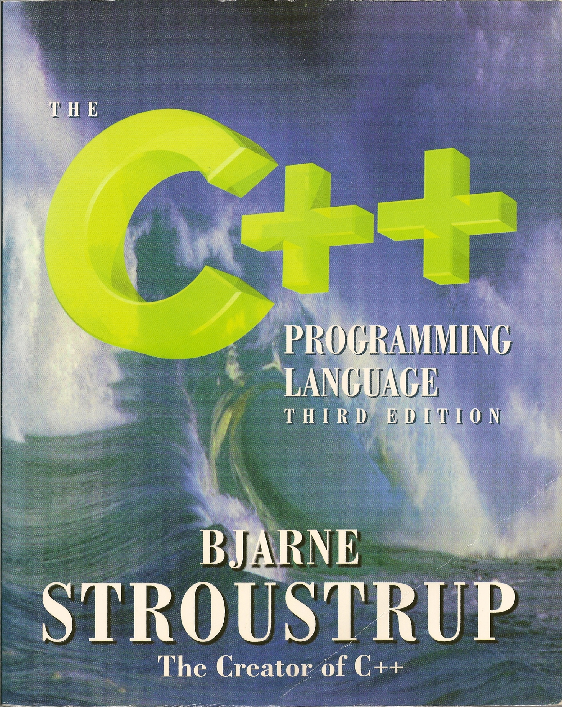
An Older Edition of Stroustrup’s Book
Stroustrup 3rd edition

Slide 4
What Is C++?
(Mostly) an extension of C to include:–
  Classes
  Templates
  Inheritance and Multiple Inheritance
  Function and Operator Overloading
  New (and better) Standard Library
  References and Reference Parameters
  Default Arguments
  Inline Functions
  …
A few small syntactic differences from C
Note: Objective C was invented
at about the same time, with
similar goals.

Slide 5
Compiling C++
Use gcc, Visual Studio, etc.
File types
    .cc, .cp, .cpp, .CPP, .cxx, .c++, .C
    .h, .H
Some of these have special properties.

Slide 6
In this Topic
Syntax differences between C and C++
A Simple C++ Example
    C++ Input/Output
C++ Libraries
    C++ Header Files
References and Reference Parameters
Call by Reference in C++

Slide 7
In this Topic (continued)
Default Arguments
Unary Scope Resolution Operator
Function Overloading
Function Templates

Slide 8
Background
C++ was developed by Bjarne Stroustrup at Bell Laboratories
  Originally called “C with classes”
  The name C++ is based on C’s increment operator (++)
    Indicating that C++ is an enhanced version of C
Widely used in many applications and fields
Well-suited to “Programming in the Large”

Slide 9
A Simple C++ Example — D&D Figure 18.1
// C++ simple example
#include <iostream> //for C++ Input and Output
int main ()
{
int number3;
std::cout << "Enter a number:";
std::cin >> number3;
int number2, sum;
std::cout << "Enter another number:";
std::cin >> number2;
sum = number2 + number3;
std::cout << "Sum is: " << sum <<std::endl;
return 0;
}
C++ style comments
standard output stream object
stream insertion operator
stream extraction operator
standard input stream object
stream manipulator
Concatenating insertion operators

Slide 10

A Simple C++ Program
<iostream>
  Must be included for any program that outputs data to the screen or inputs data from the keyboard using C++ style stream input/output.
  Replaces <stdio.h> of C
C++ requires you to specify the return type, possibly void, for all functions.
  Specifying a parameter list with empty parentheses is equivalent to specifying a void parameter list in C.

Slide 11
Notes on Simple C++ Program
Stream manipulator std::endl
  Outputs a newline.
  Flushes the output buffer
The notation std::cout specifies a name (cout ) that belongs to the namespace std.
Note: std::ends flushes the buffer
but does not add newline.
Namespace: a generalization of scope.
C++ allows access to multiple namespaces
with the ' :: ' operator

Slide 12
§18.5 Header Files
C++ Standard Library header files
  Each contains a portion of the Standard Library.
    Function prototypes for the related functions
    Definitions of various class types and functions
    Constants needed by those functions
  “Instruct” the compiler on how to interface with library and user-written components.
  Header file names ending in .h
    Are “old-style” header files
    Superseded by the C++ Standard Library header files
  Use #include directive to include class in a program.

Slide 13
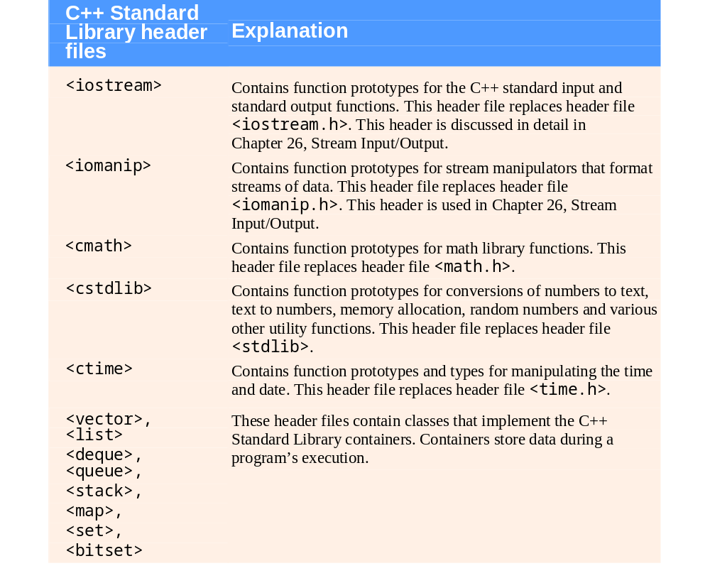
Fig. 18.2 C++ Standard Library header files
Continues for
three pages!

Slide 14
Needed for Lab #4
<iostream>
    cin and cout for stream input and output
<cmath>
    sqrt()

Slide 15
§18.6 Inline Functions
Reduce function call overhead—especially for small functions.
Qualifier inline before a function’s return type in the function definition
  “Advises” the compiler to generate a copy of the function’s code in place (when appropriate) to avoid a function call.
Trade-off of inline functions
  Multiple copies of the function code are inserted in the program (often making the program larger).
The compiler can ignore the inline qualifier and typically does so for all but the smallest functions.

Slide 16
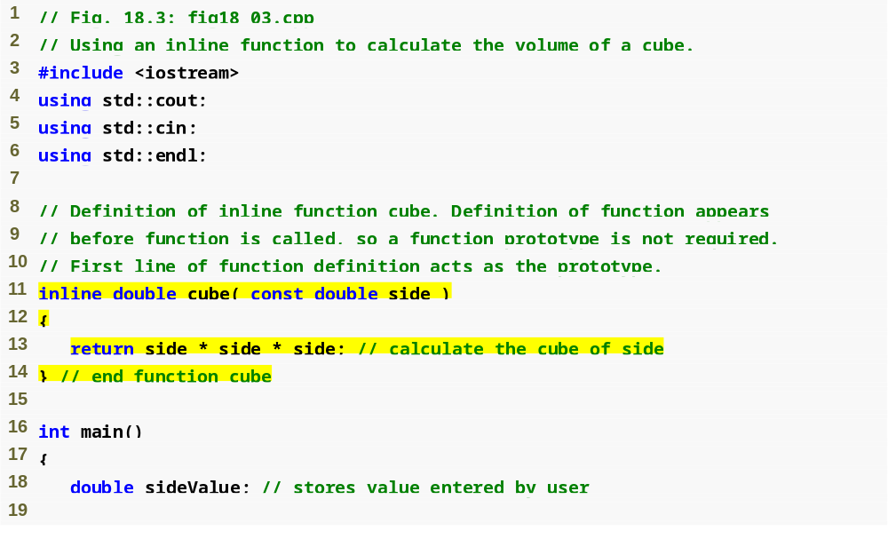
Another Simple C++ Program
using avoids repeating std::
inline qualifier
Complete function definition so the compiler knows how to expand a cube function call into its inlined code.

Slide 17
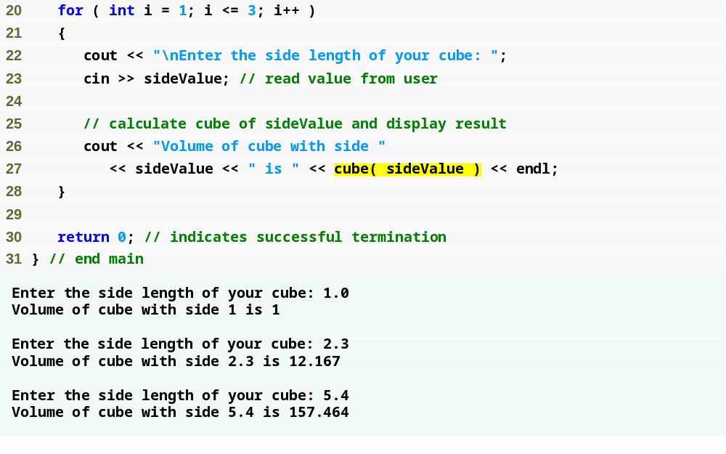
Another Simple C++ Program (continued)
cube function call that could be inlined

Slide 18
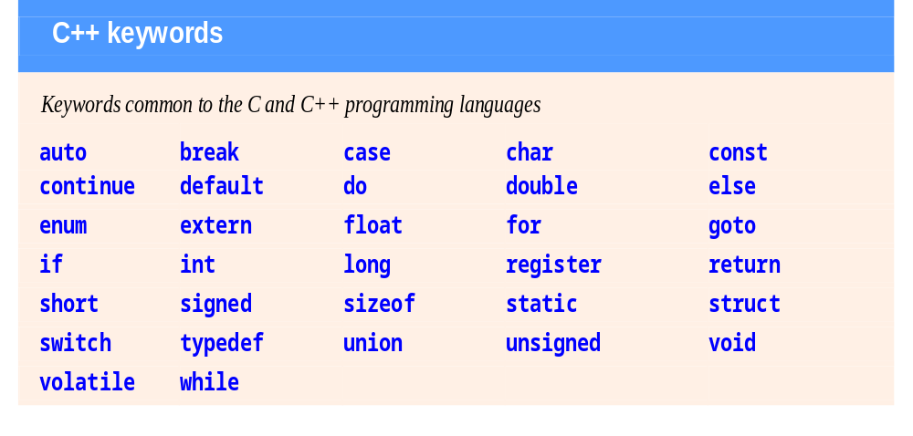
Keywords Shared with C
Figure 18.4 in D&D

Slide 19
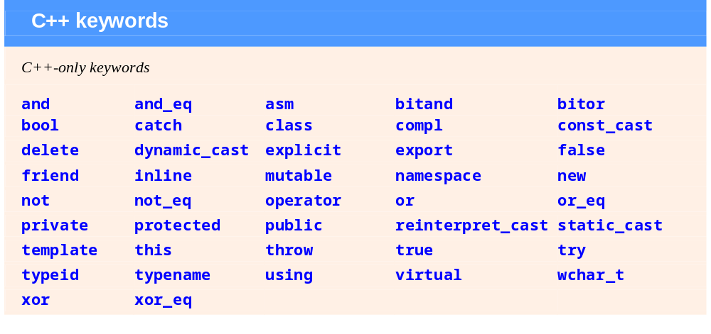
New Keywords in C++
Figure 18.4 in D&D

Slide 20
18.6 Inline Functions (Cont.)
using statements help eliminate the need to repeat the namespace prefix
  Ex: std::
for statement’s condition evaluates to either 0 (false) or nonzero (true)
  Type bool represents boolean (true/false) values.
    The two possible values of a bool are the keywords true and false.
      When true and false are converted to integers, they become the values 1 and 0, respectively.
      When non-boolean values are converted to type bool, non-zero values become true, and zero or null pointer values become false.

Slide 21
References in C++
Definition Reference:– An Alternative Name for an Object
BIG difference from Java
References are only created in declarations and parameters
A reference can only appear where the object itself could have appeared

Slide 22
Simple References
void f() {
int j = 1;
int &r = j; //r and j refer to same int
int x = r; // x now is 1
r = 2; // j now is 2
} //f
int k;
int &r1 = k; // okay: r1 is initialized
int &r2; // error; initializer missing
extern int &r3; //okay; r3 defined elsewhere
Sometimes, reference
declarations are written as
int& r1 = k

Slide 23
Simple References (continued)
void g() {
int ii = 0;
int &rr = ii;
rr++; // ii now is 1
int *pp = &rr; // pp now points to ii
} //g
This '&' is the unary address
operator brought over from C.
Note: This declares a pointer exactly as in C,
and initializes it with the address of rr
(which is another name for ii)
These '*' and '&' are not operators
but rather declaration qualifiers.

Slide 24
Example Usage of a Reference
int grid[1000];
int rowSize, x, y;
...
int &element = grid[x*rowSize+y];
...
/* computations on integer named element */

Slide 25
Reference Parameters
An alias for its corresponding argument in a function call.
  & placed after the parameter type in the function prototype and function header
Example
  int &count in a function header
    Pronounced as “count is a reference to an int”
Parameter name in the called function body actually refers to the original variable in the calling function.

Slide 26
Reference Parameter Example
C version
  void swap (int *a, int *b) {
  int temp = *a;
  *a = *b;
  *b = temp;
  } // void swap(…)
C++ version
  void swap (int &a, int &b) {
  int temp = a;
  a = b;
  b = temp;
  } // void swap(…)
Hazard: a NULL pointer
Non-hazard: no pointer here

Slide 27
Notes on References and Pointers
Pointers in C do multiple duty
  Links, as in linked lists and trees
  Parameters, where the function needs to return a value to an argument provided by the caller
  Short-hand, a short way of referring to an object that otherwise would need a complex expression
  …

Slide 28
Java vs. C++ References
In Java, a reference is a data type.
    It can be assigned to, compared, copied, stored, etc.
    Same reference can refer to different objects at different times during execution
In C++, a reference is an alias for an object
    It cannot be assigned to; assignment is through the reference to the underlying object
      Similar to dereferencing a pointer in C
    A reference always refers to the same object for the duration of its scope

Slide 29
Repeat Three Times
A reference is not a pointer, …
A reference is not a pointer, …
A reference is not a pointer, …
And neither of them resembles a
Java reference

Slide 30
Questions?

