Slide 1
Folder Cleaner
Dalgo-Crafters
Brinda Sorathiya - 202301182
Mahek Vaghera – 202301066
Nisarg Bhatia – 202301187
Hardik Vala - 202301190

Slide 2
Problem
You are to build a Folder Cleaner. It deletes files that are:
Redundant files (i.e., a newer copy is present),
Files old for more than N number of months,
Empty files (i.e., no content),
Files that have not been accessed for at least M number of times.

Slide 3
Algorithm
Remove redundant files :
Check for Copy Algorithm:
This algorithm takes the paths of two files as input and determines whether they are copies of each other. It opens both files and iterates over their contents. If the contents match, it returns true; otherwise, it returns false.
Check for Empty Function:
This function examines a 2D linked list representing folders and files. It iterates through each folder and file, checking if any files are empty. Depending on the user's choice for scheduled or normal cleaning, it either adds the file path to a vector or pushes the file to a stack for deletion. It then removes the file from the linked list.
Check for Redundant File Function:
This function takes a 2D linked list as input and identifies redundant files. It iterates through each node and compares it with all other nodes to find copies. If a copy is found, it deletes the older version of the file from the linked list.

Slide 4
How the 2D linked list would be…
Address,
Link to file,
Link to next folder,
Tail of the list.
folder1
file11
file12
file13
file14
folder2
file21
file22
folder3
file31
file32
file33
Address,
Link to next file,
Size,
Creation date,
Count of access
folder4
file41
file42
file43
file44

Slide 5
Algorithm
Remove files accessed less than M times:
This function takes a node of a 2D linked list, a stack, a vector, an integer M representing the minimum number of accesses, and a flag indicating the user's preference for scheduled or normal cleaning. It deletes files that have been accessed less than M times. While traversing through the linked list nodes, it iterates over each file in the directory. If the access count of the current file is less than M, it checks the user's cleaning preference. For normal cleaning, it pushes the file path onto the history stack and deletes the file. For scheduled cleaning, it pushes the file's address into the vector. After processing each file, it calls delete_node() to delete the current file node from the inner linked list. This process continues until all files are checked.

Slide 6
Algorithm
Remove files older than N months:
parseDateTime Function:
This function takes a timestamp, a datetime string, and a format string as input. It uses stringstream to parse the datetime string into a tm struct object, then converts it to a time_t object using mktime.
Months_diff Function:
This function calculates the month difference between the current date and a given date in string format. It calls parseDateTime to convert the given date string into a tm struct object, then calculates the difference in months between the current time and the given time.
compare_diff Function:
This function compares the age of two files represented by nodes in a 2D linked list. It calculates the month difference between the dates stored in the nodes using Months_diff and returns a pointer to the node representing the older file.
Delete_files_older_than_N_months Function:
This function deletes files that are older than N months from a linked list. It iterates through each node, calculates the month difference between the file's date and the current date using Months_diff, and deletes the file if it exceeds N months. The function also handles whether to push the file path into a stack for normal cleaning or a vector for scheduled cleaning based on user preference.

Slide 7
Algorithm
Delete_files_through_content Function:
This function takes a pointer to the head of a linked list of nodes, a keyword to search for in file content, and a vector of tuples passed by reference. It deletes files that contain the given keyword and their file paths. The algorithm initializes a temporary pointer to the head of the linked list and traverses through the file linked list for the current folder. It then traverses through the inner linked list for files, opens each file, and reads each word. If a word matches the given keyword, it stores the file's details, including its address and pointers to nodes for deletion, in a vector. After processing all files, if the vector is not empty, it prints the list of file names containing the keyword. It then prompts the user to enter the name of the file they want to delete and iterates through the vector to delete the file and its corresponding node. Finally, it prints a success message if the file is deleted.

Slide 8
Algorithm
Sort_by_lexicographical Function:
The Lexicographic File Sorting algorithm takes a 2D-linked list as input and sorts all files in all folders by lexicographic order. It iterates through each node of the linked list, checking if the folder path exists using filesystem functions like fs::exists or fs::is_directory. It then creates a vector of string file paths to store file paths within the folder and sorts them lexicologically. After sorting, it creates a temporary folder, moves all files from the vector to the temporary folder, and renames the file paths. Next, it moves all files from the temporary folder back to the original folder, renaming the file paths to their original form. Finally, it deletes the temporary folder.

Slide 9
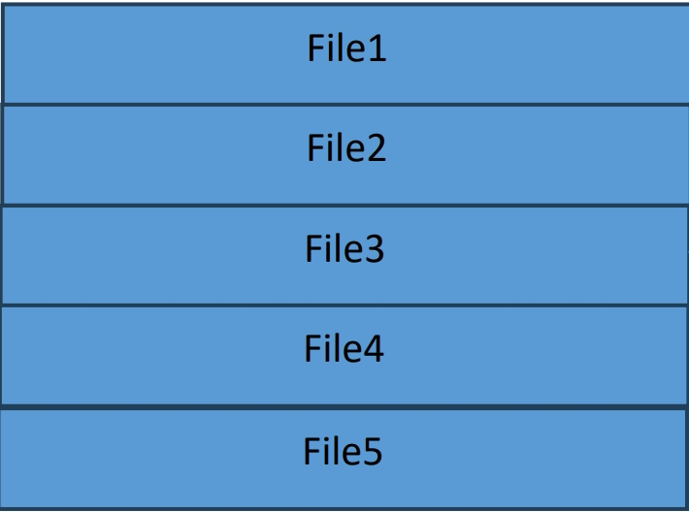
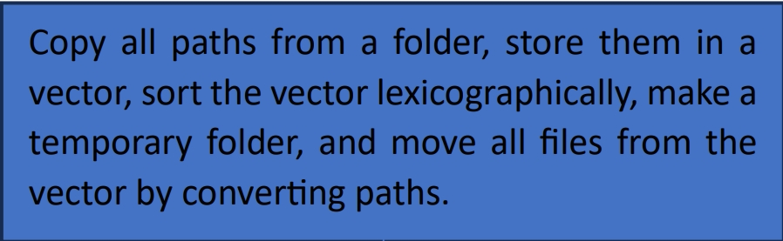
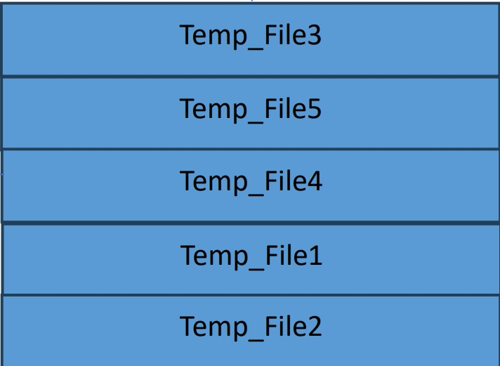
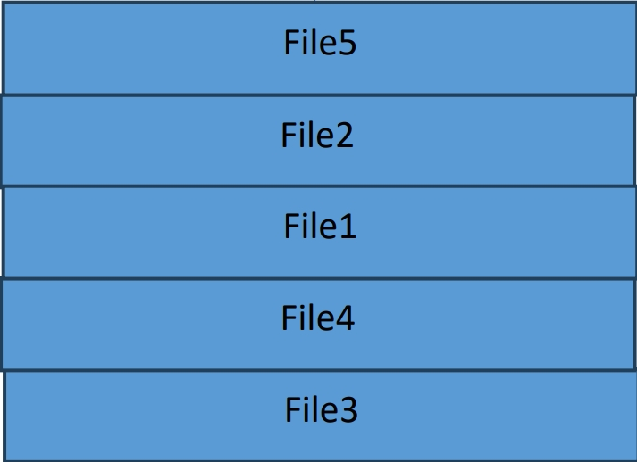
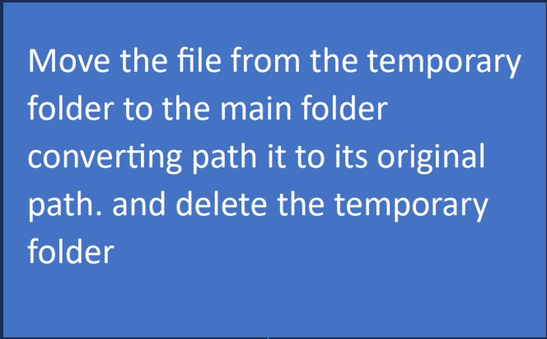
Main Folder (Before)
Main Folder (After sorting)

Slide 10
Data Structure Chosen
2D linked list
Stack
Vector
Tuple
Map

Slide 11
2D linked list
2D linked list is formed by two kinds of node
M_node(represents folder)
Node(represents file)
By maintaining the tail pointer easier to do insertion and deletion
Can allocate and deallocate more quickly than an array

Slide 12
Stack
To store the history of the deleted files
Easier to fetch recently deleted files

Slide 13
Vector
To store the scattered tuples
No need to manage pointers like as linked list for trivial works

Slide 14
Tuple
To store information of file, the folder in which file lies and previous of the file in a one group.
Better to store different data types as a group

Slide 15
Map
To easily map the extension of the file with name of the sub-folder
Easy to search with less time complexity than array and linked list

Slide 16
Time Complexity
Remove Empty files : O(n)
Remove Copied files :
Traversal : O(n^2)
Detect content whether copy or not: O(x)
Remove files accessed less than M times: O(n)
Remove older than N months: O(n)
Sorting files: O(n)
Content based deletion: O(n*x)
Lexicographical sorting: O(nlogn)
// n : the total sum of the files presented in folder
// x : total number of characters in file

Slide 17
Space Complexity
Remove Empty files : O(n)
Remove Copied files : O(n)
Remove files accessed less than M times: O(n)
Remove older than N months: O(n)
Sorting files: O(x)
Content based deletion: O(n)
Lexicographical sorting: O(n)
// n : the total sum of the files presented in folder
// x : space retained by the map

Slide 18
Video Link
click here to watch video

