Slide 1



Prediction of Covid-19 Cases in Kerala based on meteorological parameters using BiLSTM Technique.
Authors:
Jerome Francis^{1,} , Brinda Dasgupta ^{2,} , Abraham G K^{3,} and Dr. Mahuya Deb^{4,}
Department of Advanced Computing, St Joseph’s College(Autonomous), Bangalore, Karnataka, India
Presented By:
Jerome Francis^{1,} , Brinda Dasgupta ^{2,} , Abraham G K³

Slide 2
Introduction
The rate of disease transmission can be reduced if the rate of disease transmission is determined. This will help governments plan better public health policies to deal with the consequences of the pandemic.
Climatic and environmental factors strongly influence the transmissibility of Covid19. It affects the spatial and temporal distribution of infectious diseases. Therefore, it is important to understand how transmission is catalyzed by environmental conditions. Hence, we undertake this study to analyze the role of environmental and climate variables in the spread of Covid19

Slide 3
Literature Survey
Talib Dbouk, and Dimitris Drikakis-The results suggest that two pandemic outbreaks per year are more likely a natural phenomenon that is directly related to the weather seasonality during a pandemic evolution.
Amitesh Gupta1 · Biswajeet Pradhan2,3 · Khairul Nizam Abdul Maulud3,4: COVID-19 cases are significantly associated with a very certain range of temperature parameters and wind speed. Thus, much better than linear correlation, the nonlinear SVM-based regression approach efficiently resolved this complex association
Sarvan Kumar, Prof. Rajendra Singh, Veer Bahadur Singh : The hypothesis that high Temp and high humidity will reduce the number of cases due to the coronavirus is not found working for the Indian region.

Slide 4
Keerthi Sasikumar1,2, Debashis Nath3 , Reshmita Nath3, and Wen Chen1,2: The survival and growth of SARS‐CoV‐2 in the environment have tighter association with ambient temperature and relative humidity. Extreme climate change has an important role in the spread of COVID‐19 pandemic in India.
Gaurav Kumar, Ritu Raj Kumar: It was found that RH and P were having relatively strong influence on the COVID-19 active cases. Since the surface pressure parameter was having negligible variation during the study period therefore it can be dropped off and finally, RH can be regarded as the major parameter.

Slide 5
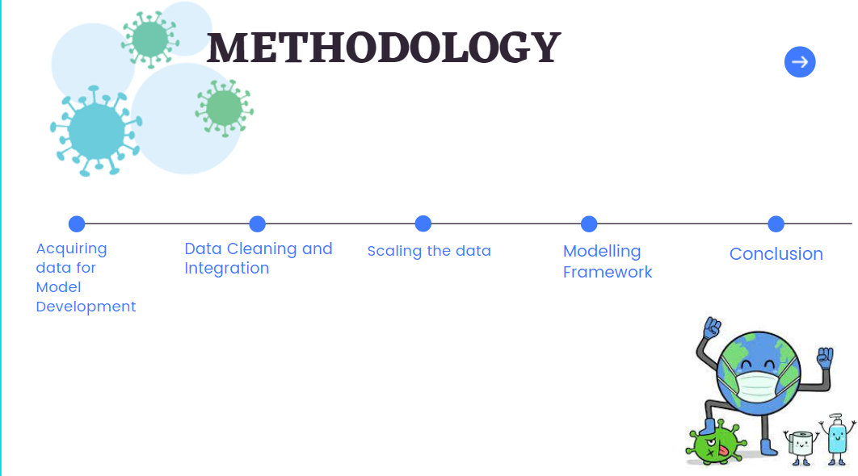
Proposed Model

Slide 6
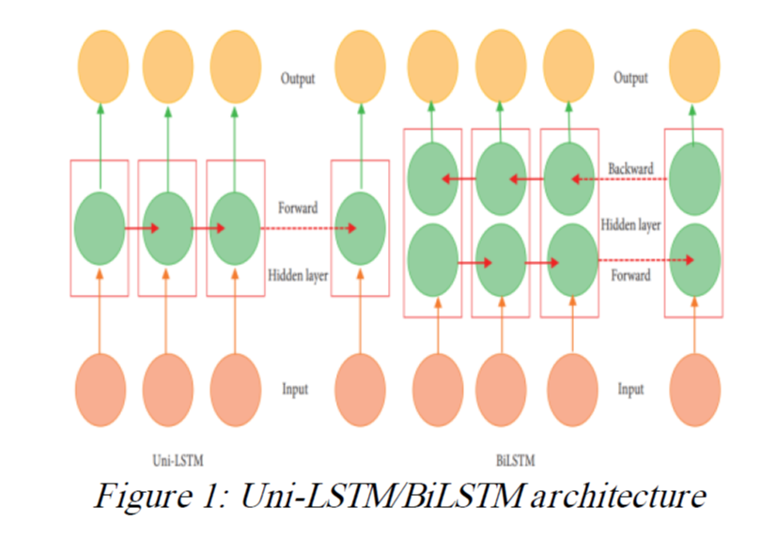

Slide 7
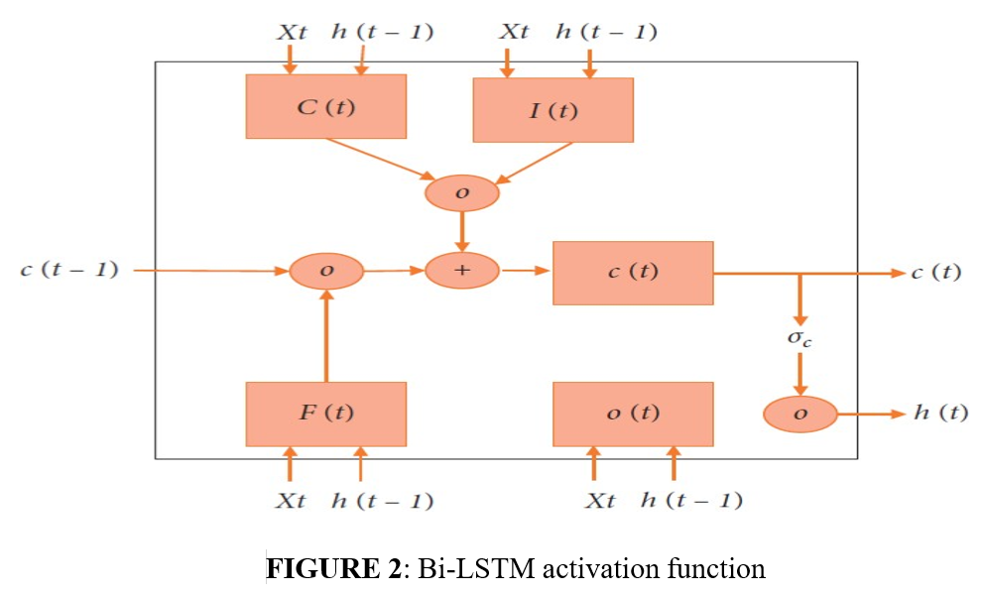

Slide 8
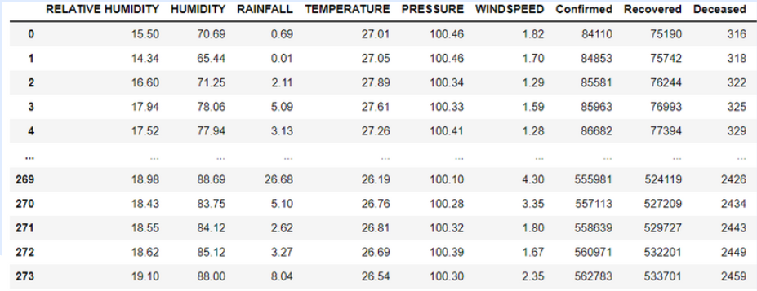
Dataset

Slide 9
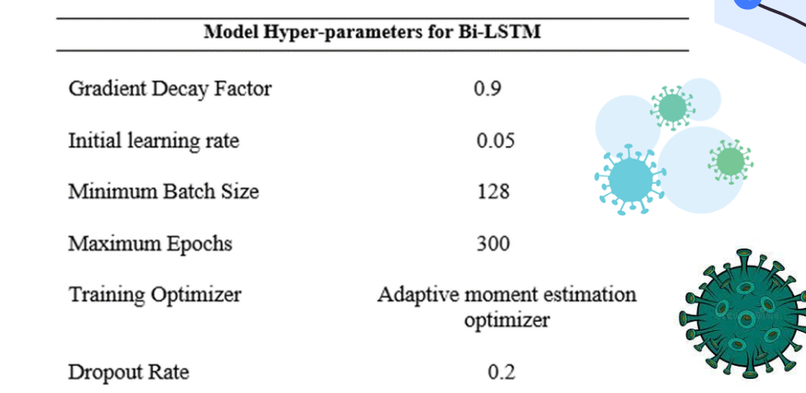
Parameters setup

Slide 10
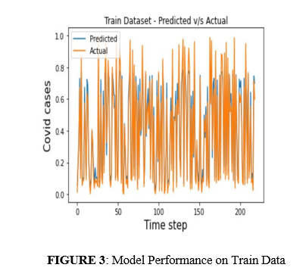
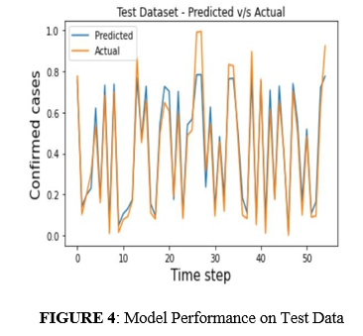
Test/Train

Slide 11
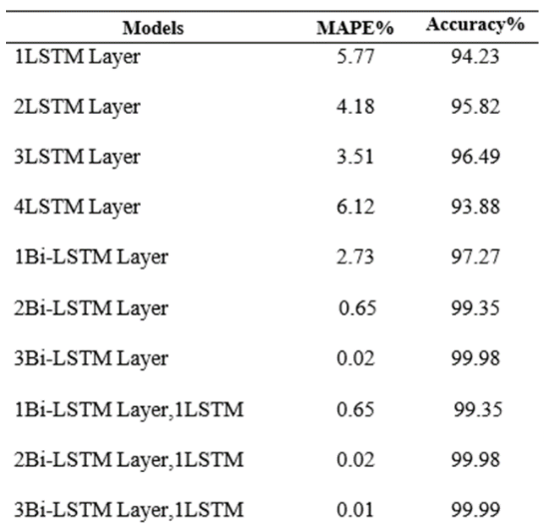
Experimental Results

Slide 12
Result Analysis
Bidirectional and unidirectional LSTM models were built to predict the number of daily confirmed covid cases upto 55 days into the future. The models were evaluated based on the MAPE score obtained during testing.
The results showed a better performance for the bidirectional LSTM model compared to unidirectional LSTM model. The results showed that the four layered BiLSTM model outperformed other models with an accuracy of 99.99%.

Slide 13
While it is acknowledged that more comprehensive testing is required on much larger and cleaner dataset, this contribution demonstrates the potential of BiLSTM and hybrid LSTMs.
Future directions in this research include un-biased collection of more accurate weather data from weather stations. The accuracy of the model can be improved by using more data for training the model and by including new features into the dataset.

Slide 14
References
W. D. B. U. N. N. H. Christophorus Beneditto Aditya Satrioa, "Time series analysis and forecasting of coronavirus disease in Indonesia using ARIMA and PROPHET," 2020.
G. K. P. R. M. S. R. M. Kantha Rao Bhimala, "Prediction of Covid-19 cases using the weather integrated deep learning approach for India," Transboundary and Emerging Diseases, 2021.
M. G. A. H. G. Rohit Salgotra, "Time Series Analysis and Forecast of the COVID-19 Pandemic in India using Genetic Programming," Chaos, Solitons and Fractals, 2020.
D. D. Taib Dbouk, "On respiratory droplets and face masks," Physics of fluids, 32, 2020.
B. p. K. N. A. M. Amitesh Gupta, "Estimating the impact of Daily Weather on the temporal pattern of COVID 19 Outbreak in India," Earth Systems and Environment, 2020.

Slide 15
K., D. N. R. a. C. W. Sasikumar, "Impact of extreme hot climate on COVID-19 outbreak in India," GeoHealth, 2020.
S. Kumar, "Effect of meteorological parameters on spread of COVID-19 in India and air quality during lockdown," Science of the total environment, vol. 745, 2020.
R. R. K. Gaurav Kumar, "A correlation study between meteorological parameters and COVID-19 pandemic in Mumbai, India, Diabetes and Metabolic Syndrome," Clinical Research and Reviews, vol. 14, pp. 1735-1742, 2020.
Allam, M. S., & Sultana, R. (2021). Influences of climatic and non-climatic factors on COVID-19 outbreak: A review of existing literature. Environmental Challenges, 5, 100255.
Ma, Y., Zhao, Y., Liu, J., He, X., Wang, B., Fu, S., ... & Luo, B. (2020). Effects of temperature variation and humidity on the death of COVID-19 in Wuhan, China. Science of the total environment, 724, 138226.

Slide 16
Comunian, S., Dongo, D., Milani, C., & Palestini, P. (2020). Air pollution and COVID-19: the role of particulate matter in the spread and increase of COVID-19’s morbidity and mortality. International journal of environmental research and public health, 17(12), 4487.

Slide 17
Thank You!

