Slide 1













College
Event Management
Prof. - Saurabh Tiwari

Slide 2


Brinda Sorathiya(Group leader)
Viswa Vignan
Barasara Meet
Siddharth Vala
Zeel parmar
Frontend
Brinda Sorathiya
Guna Abhishek
Jain Rushabhkumar
Jethva Manthan
Tatav Shah
Barasara Meet
Siddharth Vala
Bhavya Thakkar
Backend
Guna Abhishek
Jethva Manthan
Tatav shah
Viswa Vignan
Barasara Meet
Siddharth Vala
Zeel Parmar
Brinda Sorathiya
Guna Abhishek
Jain Rushabhkumar
Jethva Manthan
Tatav Shah
Barasara Meet
Siddharth Vala
Bhavya Thakkar
Zeel Parmar
Viswa Vignan
Testing
Documentation

Slide 3
Objective
Engage the student community
Provide a user-friendly interface
Ensure easy availability of content
Enable smooth exchange of ideas and information

Slide 4

Project Planning
Backend Devlopment
Documentation
Feature Integration
  Milestone
UI/UX Design
Testing
Frontend Devlopment
Presentation

Slide 5
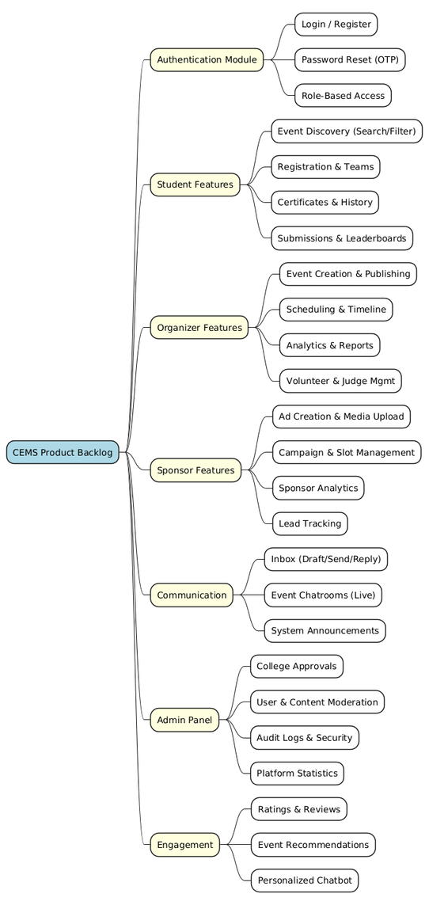
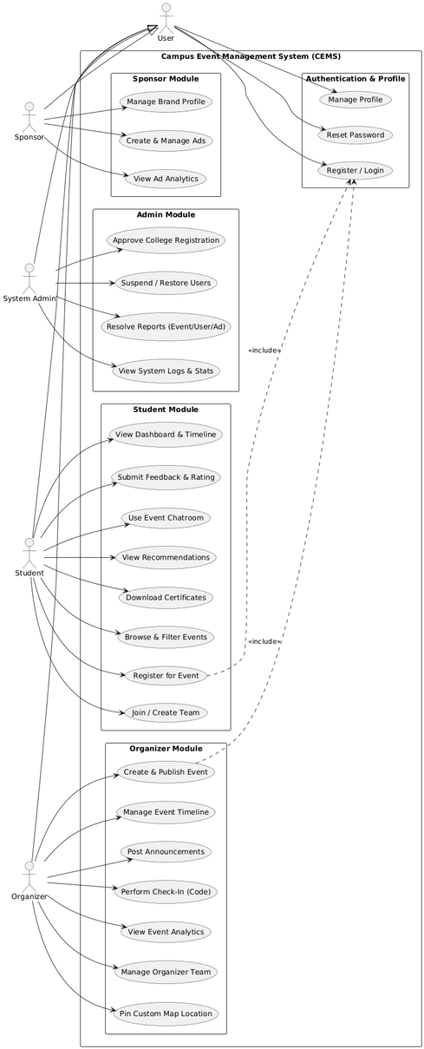
Product backlog/User Stories
Use Case Diagram

Slide 6
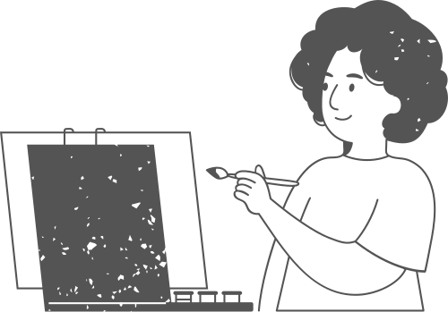
Lesson Learnt
Importance of Clear Requirements
Time Management
Error Handling
Better Error Handling Improves Reliability
Need for Consistent Team Collaboration
Problem Solving

Slide 7


Achivement
  Improved skills in MERN Stack Development
  Successfully Integrated Frontend and Backend Features
  Enhanced Teamwork and Collaboration
  Gained Experience with GitHub & Project Management Tools
  Learned to Plan, Track, and Execute Tasks Efficiently
  Strengthened Problem-Solving Through Real Project Challenges

Slide 8
  Mistake
01
02
03
04
Ineffective time management initially
Deployment challenges due to misconfigured environment variables
Frontend and backend APIs were not aligned initially
Logical bugs in registration workflow

Slide 9
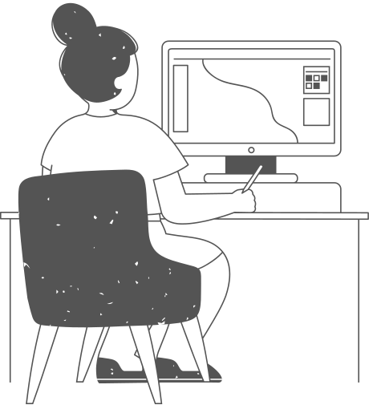
Rating of Your Software Artefacts(0-5)
Design & Documentation
3.5
Coding proficiency
3.25
Project Managment
3.75
Testing and Test Cases
3

Slide 10
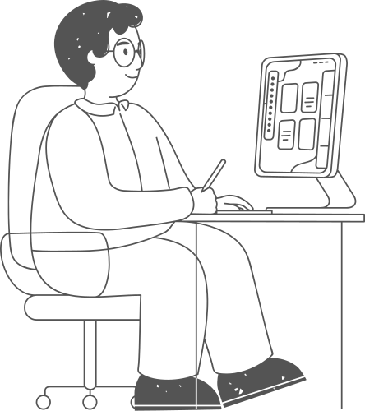
Overall Rating Of Your Project
7 / 10

Slide 11
Thank you very much!

