Slide 1
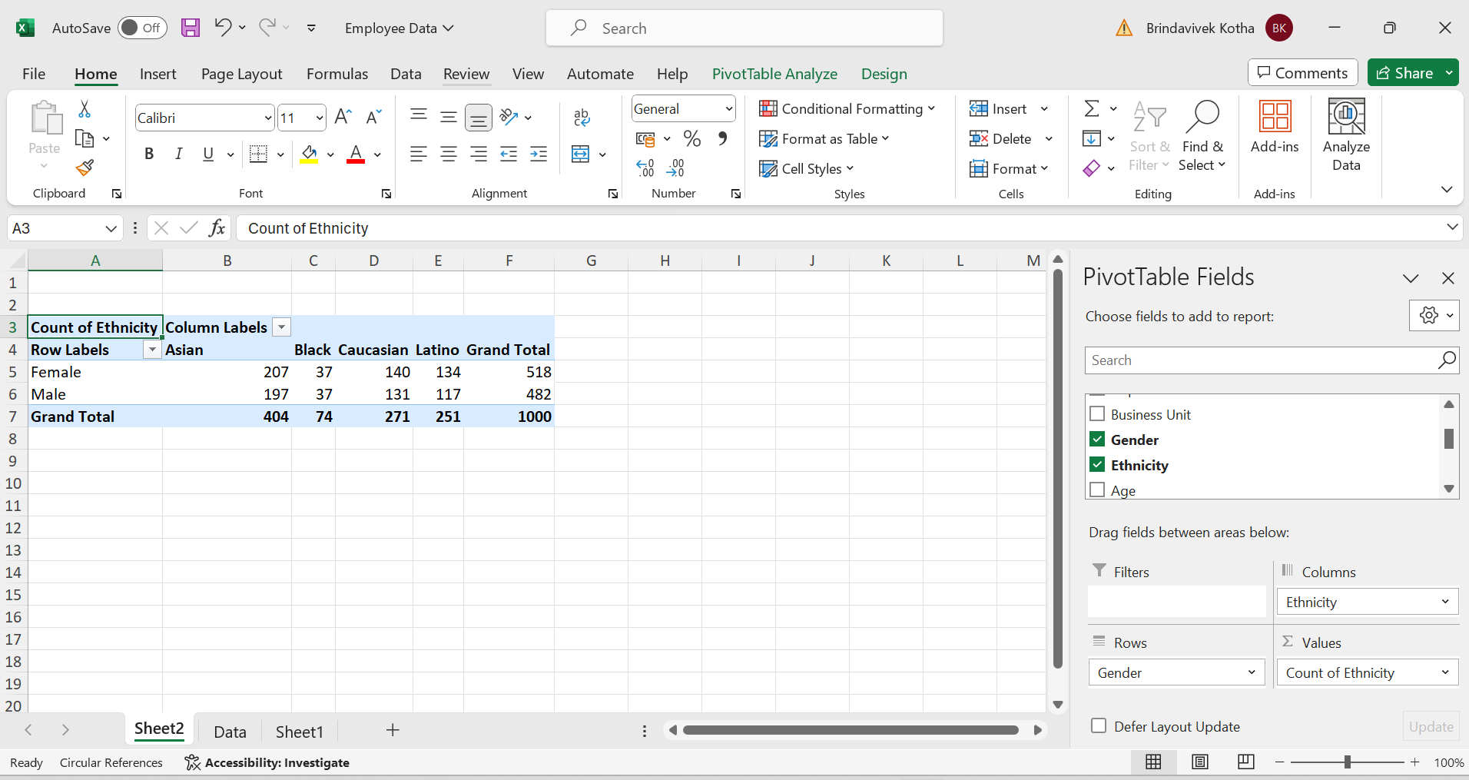
1)Summary of gender ethnicity distribution in company

Slide 2
Gender ethnicity distribution
Count of each ethnic group among genders
Steps:
1)pivot table creation of data
2)rows-gender,cols-ethnicity,values-ethnicity
3)distribution
Insights:
Highesest no.of Asians are working in the company (both male and female)
Least no.of employees belong to black ethnic group

Slide 3
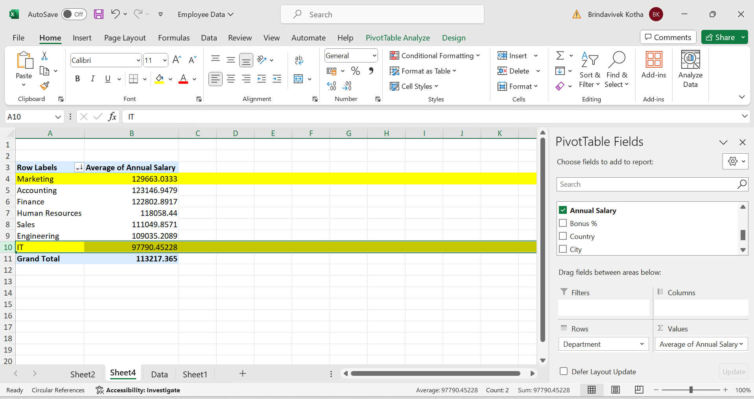
3)Significant decrease in avg salaries of departments

Slide 4
Steps:
1)pivot table,rows-department,col-avg salary
2)change sum salary to avg
Insights:
No significant difference between departments avg salaries.

Slide 5
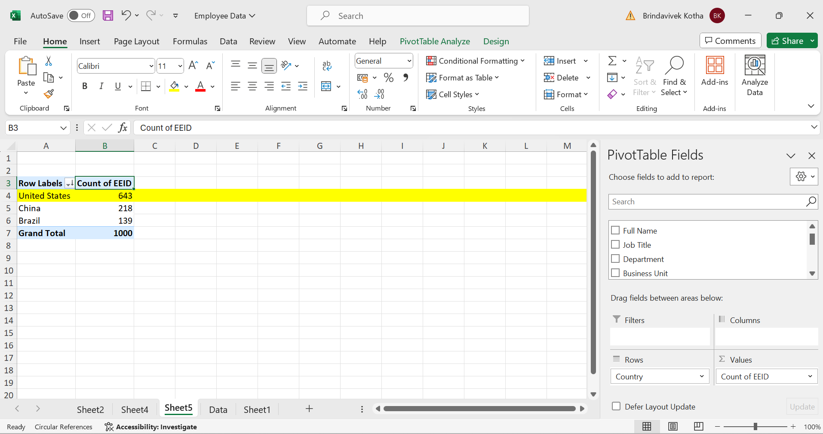
4)Which country has more no.of employees

Slide 6
Steps:
1)pivot table rows-country,value-emp ids
2)sort descending
3)highest country with employees
Insights:
United States country has more no.of emps working in country

Slide 7
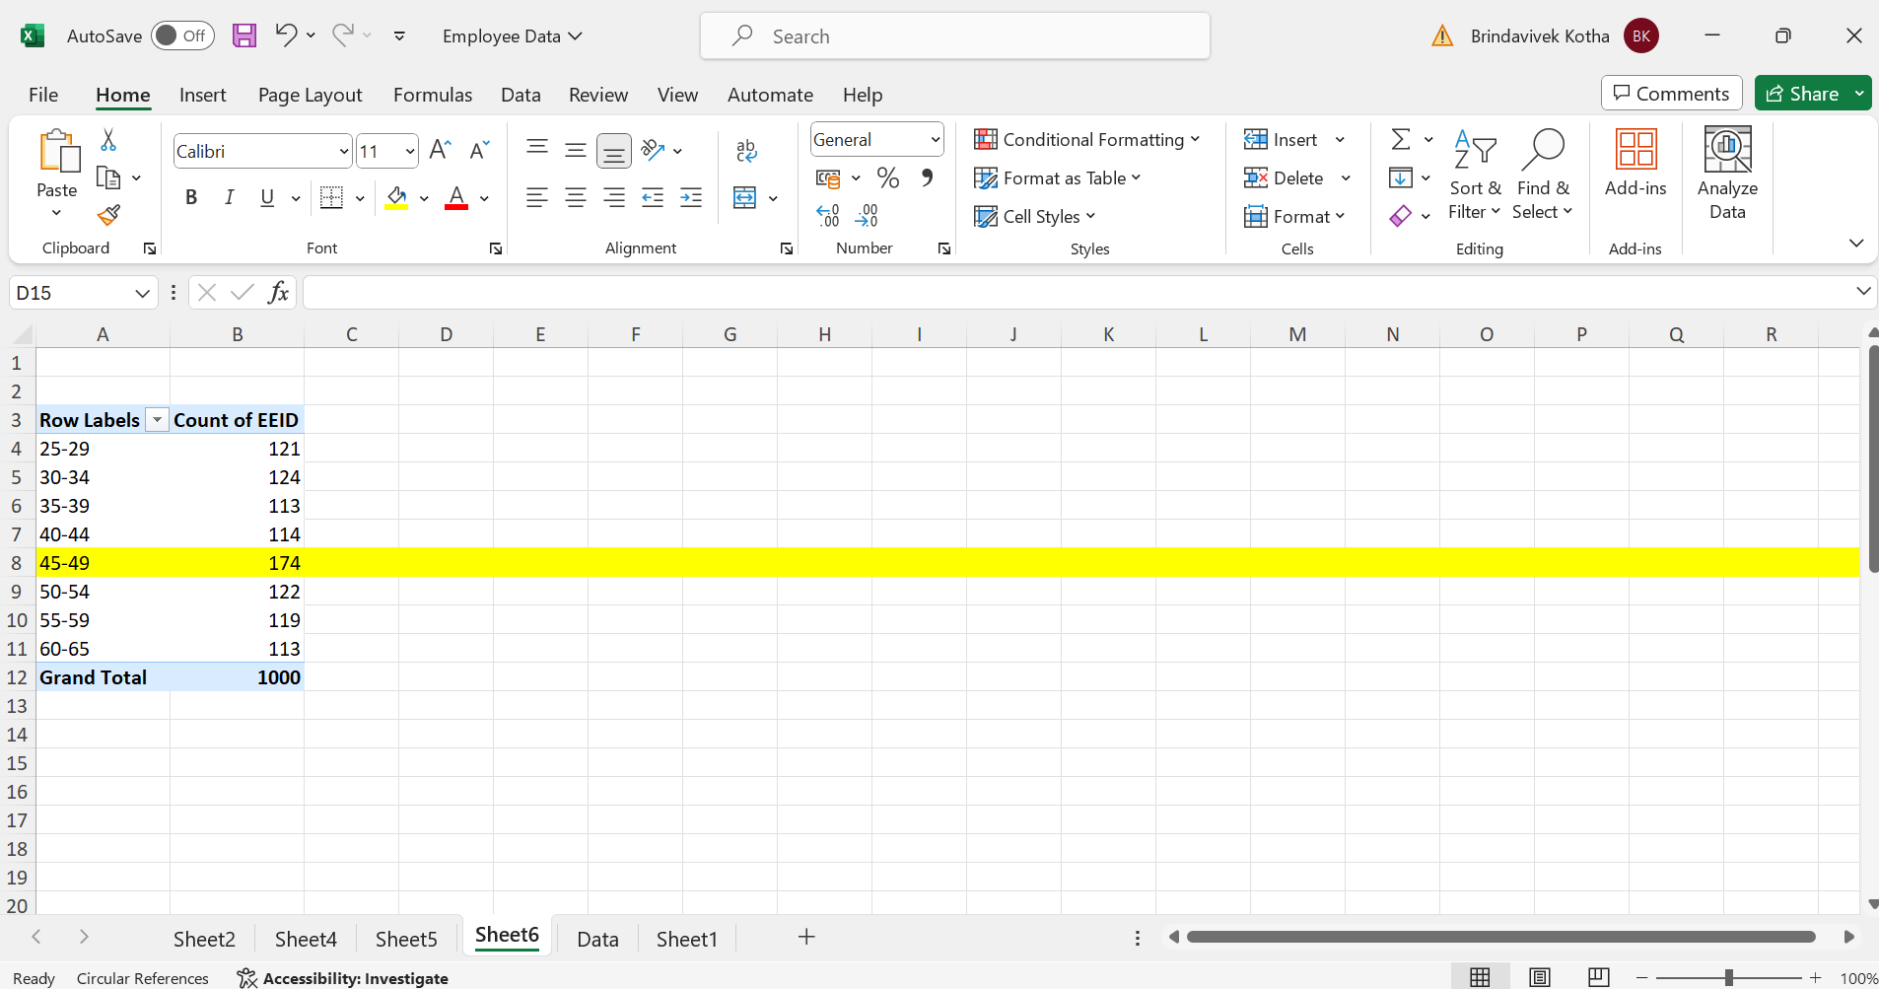
5)Most common age range among emplyees

Slide 8
Steps:
Pivot table,age in rows,emp count in cols
Group emps by group function,giving limits and range
Insights:
Age group between 45-49 has 174 employees more than any other group of ages

Slide 9
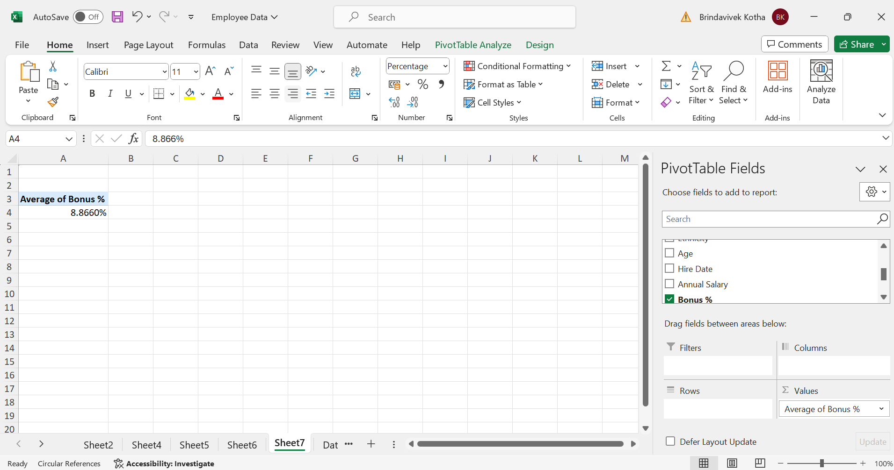
6)Average bonus percentage

Slide 10
Steps:
Pivot table,in values average of bonus%
We will get the value
Insights:
Avg bonus given to employee is approximately 9%

Slide 11
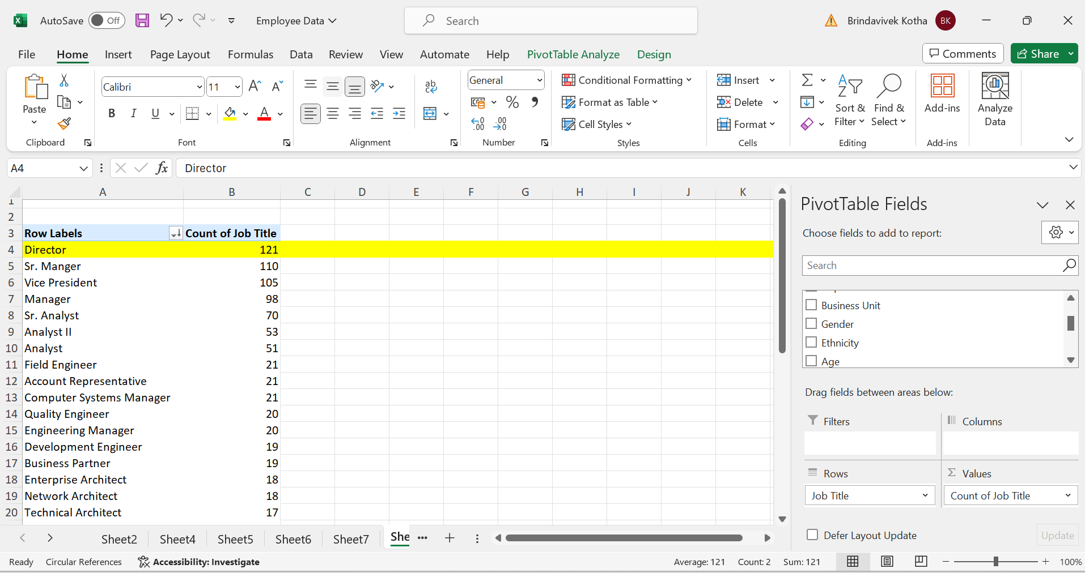
7)Which job title occurs most frequently in the dataset

Slide 12
Steps:
1)pivot table
Row-job title
Col-count of job title to count occurrences of each job title
2)sort in descending order of count
Insights:
1)director job title is the most frequently occurred in this dataset
2)least occurred job title is automation engineer

Slide 13
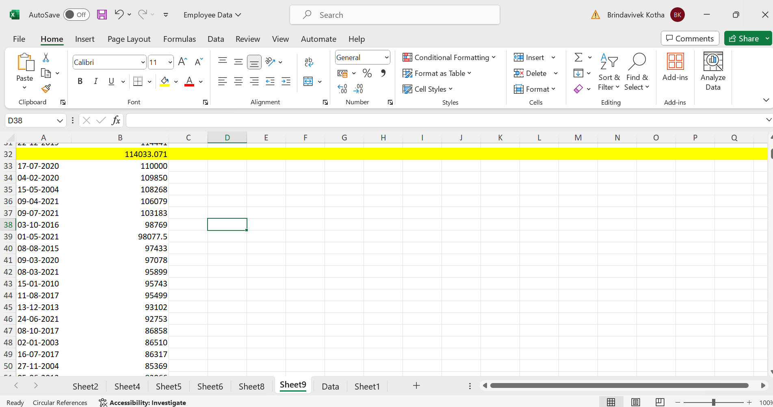
8)Primary reasons for exit 1)no bonuses for most of the employees leaving

Slide 14
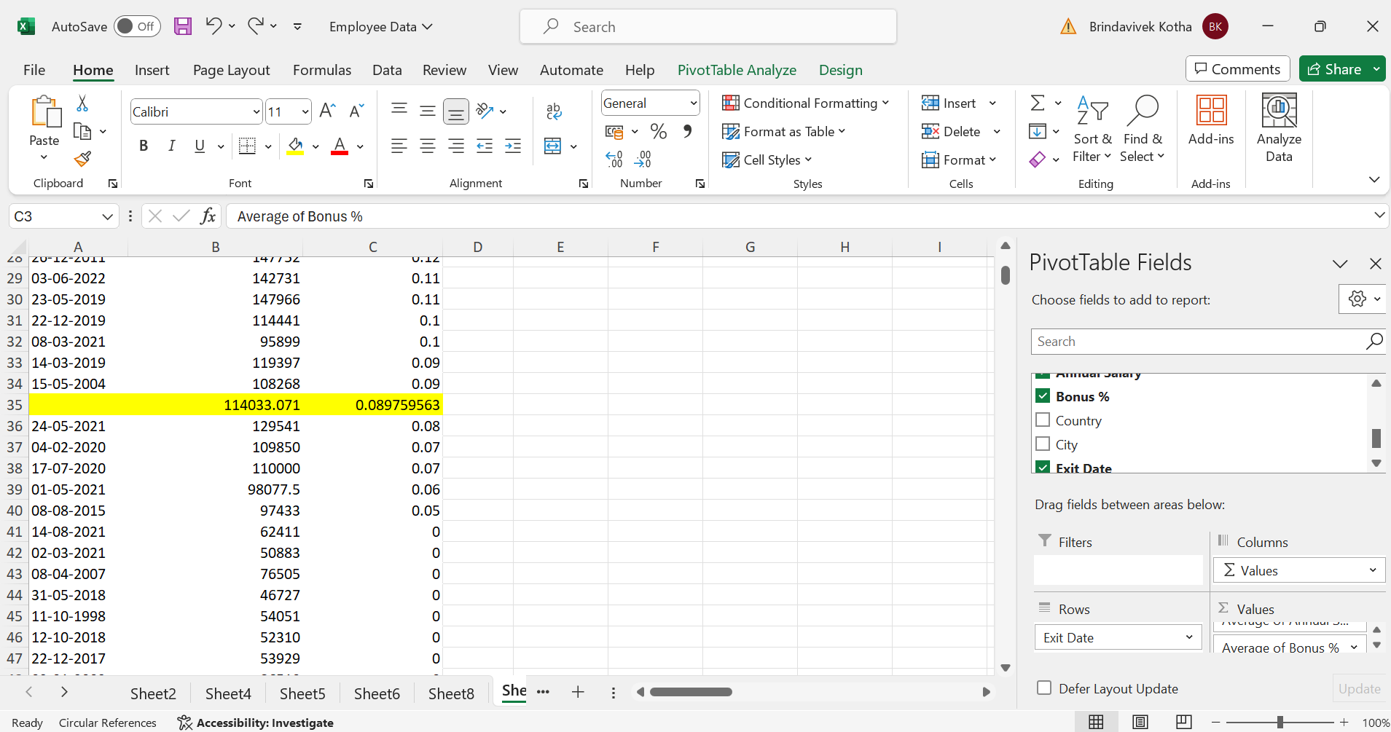
Most of the employees get less bonus or no bonus

Slide 15
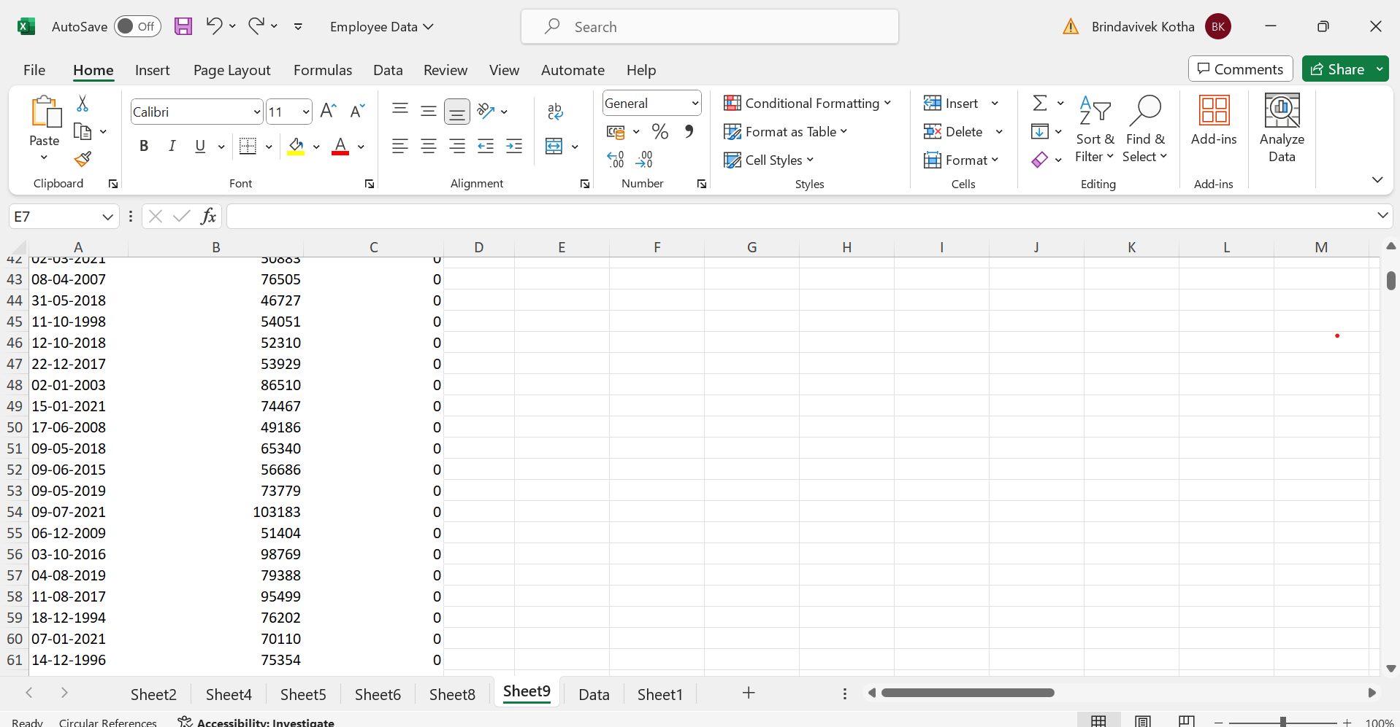

Slide 16
Steps:
1)pivot table,rows-exit dates-avg of annual salary
2)find blank –that is employee avg salary in company
Insights:
No bonus or less bonus.

