Slide 1

Data Quality Framework

Slide 2
Objectives
Showcase how the DQ framework identifies, reports, and tracks data quality issues
Demonstrate end-to-end flow: data → checks → results → insights
Scope Covered
Data source(s): dev_finance.bronze_finance
No. of columns evaluated : 8 different columns for 8 different rules
Environment: Dev
Objective & Scope Covered

Slide 3
1. Completeness
Blank / Null Checks
2. Validity
Length Check
Regex Match
Format Check
Case Standardization
3. Accuracy
Value Threshold
Range Check
4. Uniqueness
Unique Check
Duplicate Check
DQ Dimensions Demonstrated

Slide 4
Demo Flow
Configuration of DQ rules
Execution of DQ job
DQ results at column & row level
Issue summary & metrics
Trend / dashboard view

Slide 5
For any new rule addition, we have two ways
Manually
Through UI
Insert rows in dq_rules and pipeline_metadata tables.
Import the Data quality framework , call the DQ function(run_dq_checks)
Rules added through UI will make an entry in dq_rule_requests
Post approval, the rules will move to dq_rules and pipeline_metadata tables
Import the Data quality framework , call the DQ function(run_dq_checks)

Slide 6
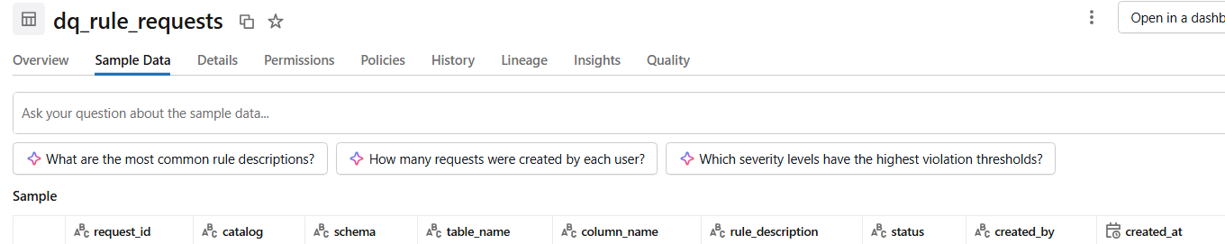
dq_rule_requests

Slide 7
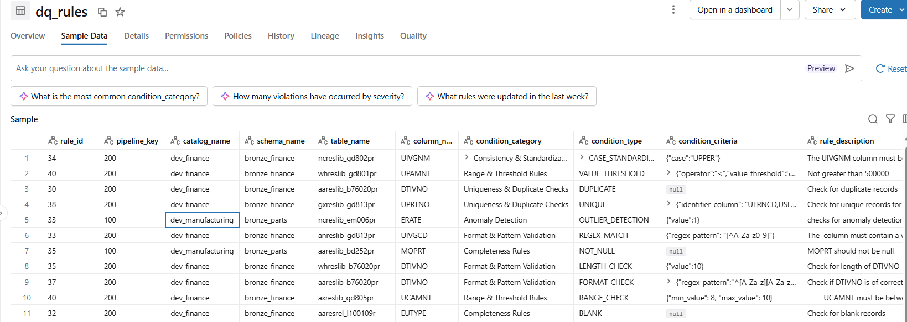
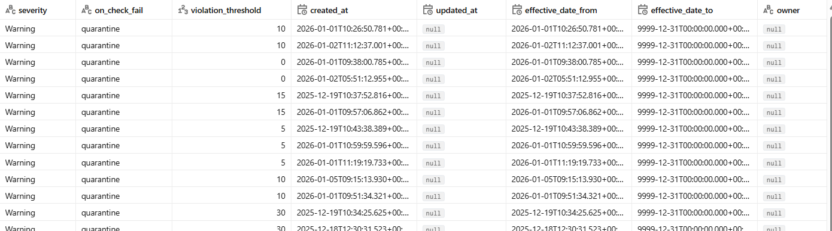
dq_rules table

Slide 8
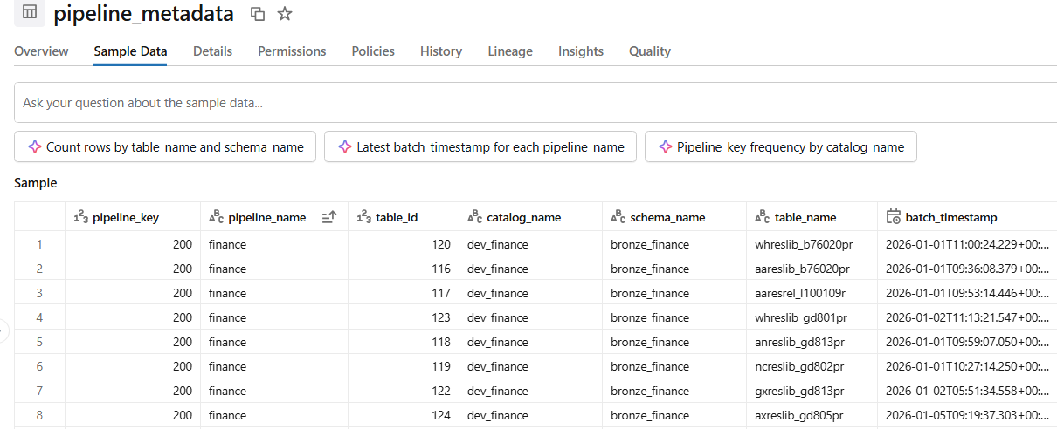
pipeline_metadata

Slide 9
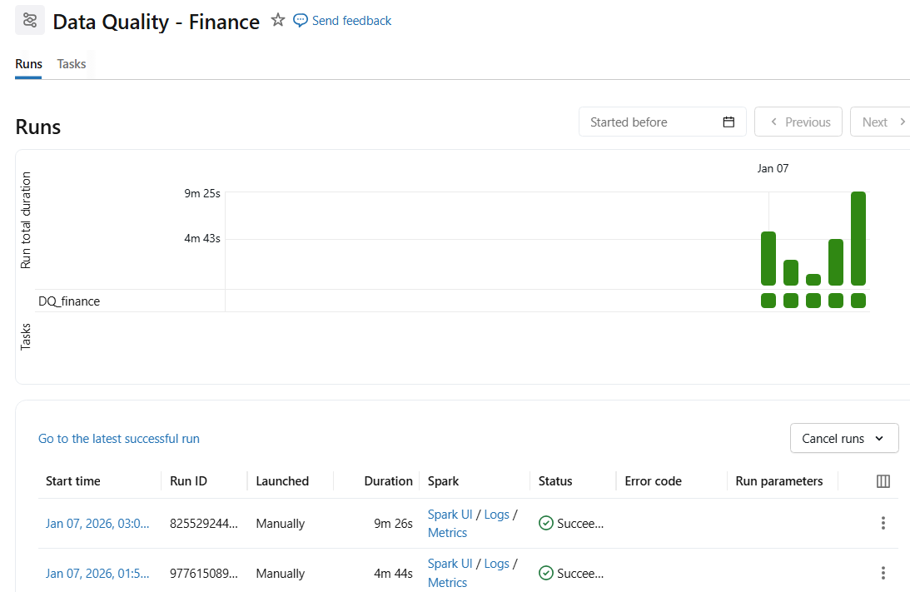
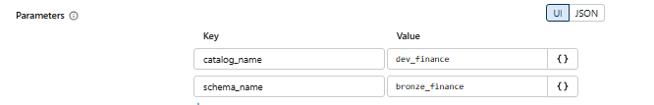
Data Quality Job

Slide 10

Pass / Fail status per rule.
DQ Status Logs: dq_logs table
Bad Records:.dq_bad_records table.
Error Logs: dq_error_logs table
Output Generated

Slide 11
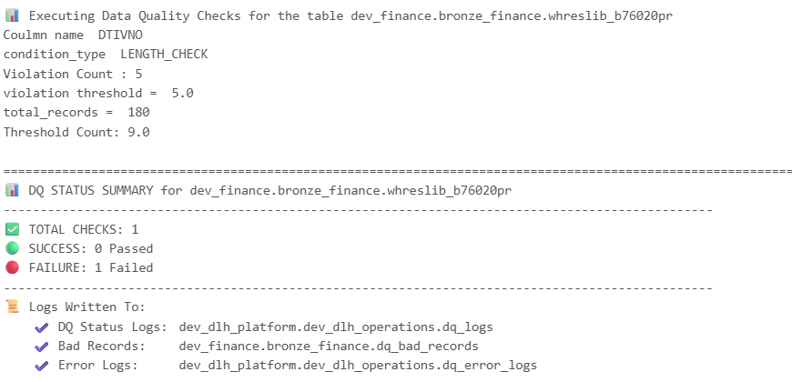
Output

Slide 12
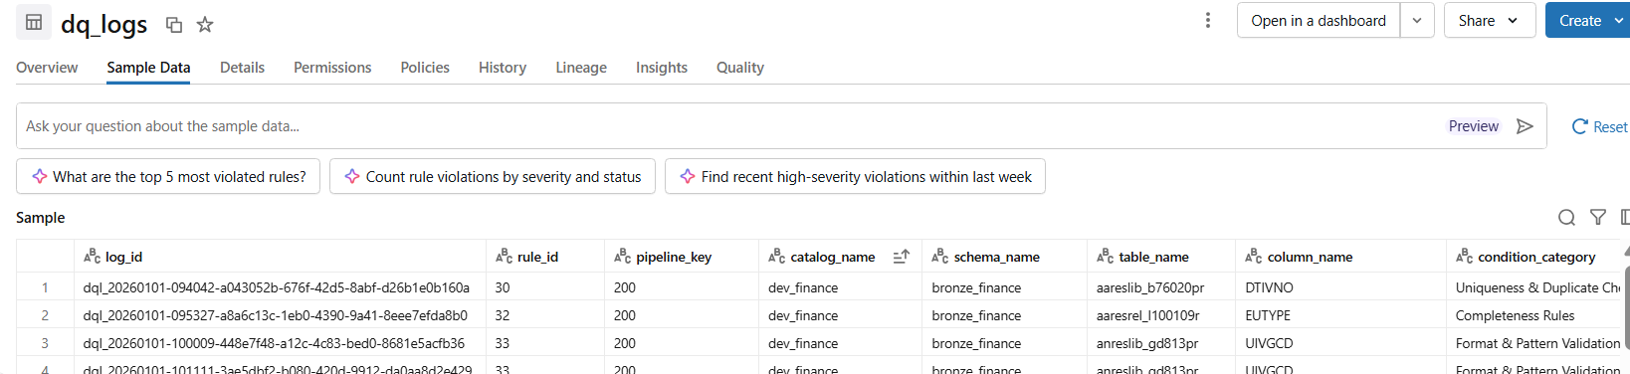
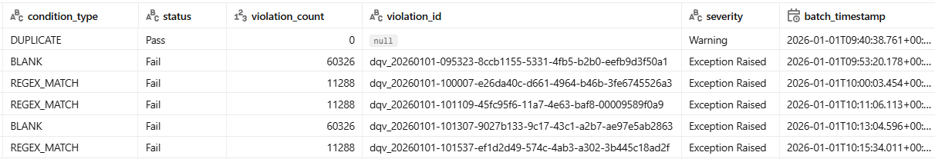

Slide 13
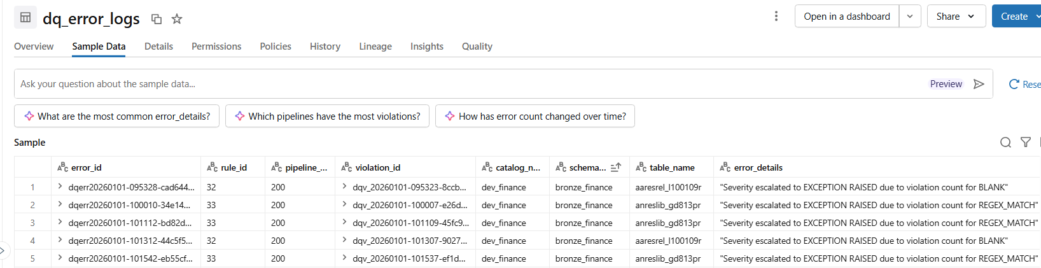
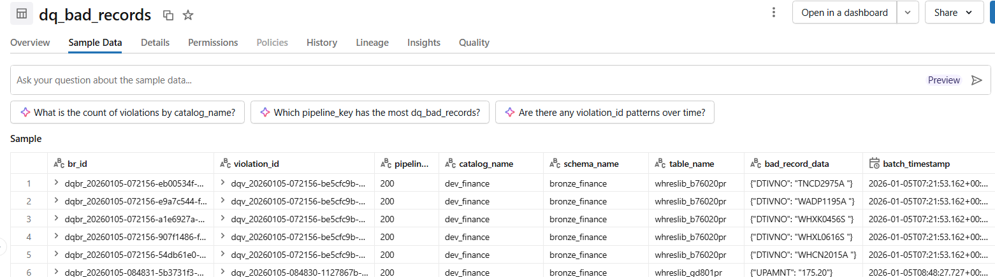

Slide 14
Key Value to Business
Early detection of data issues.
Improved trust in downstream reports.
Standardized & scalable DQ approach.
Audit-ready issue visibility.

Slide 15
Working Session

Slide 16
Let’s Discuss

Slide 17

Thank You

