Slide 1
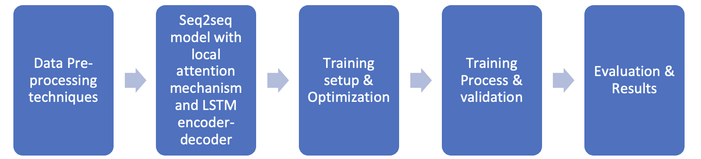
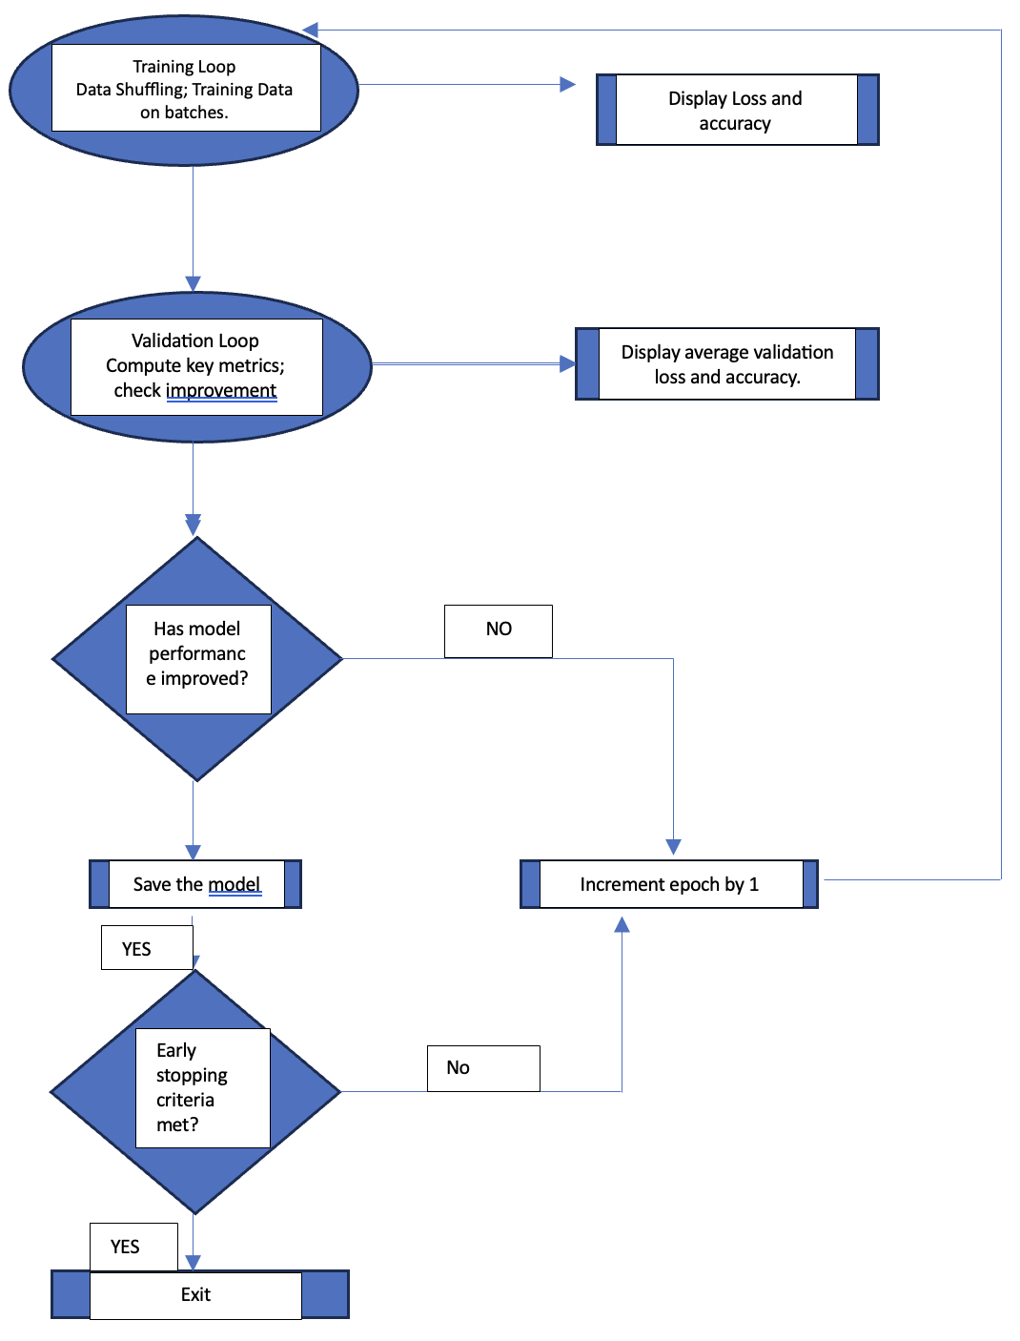
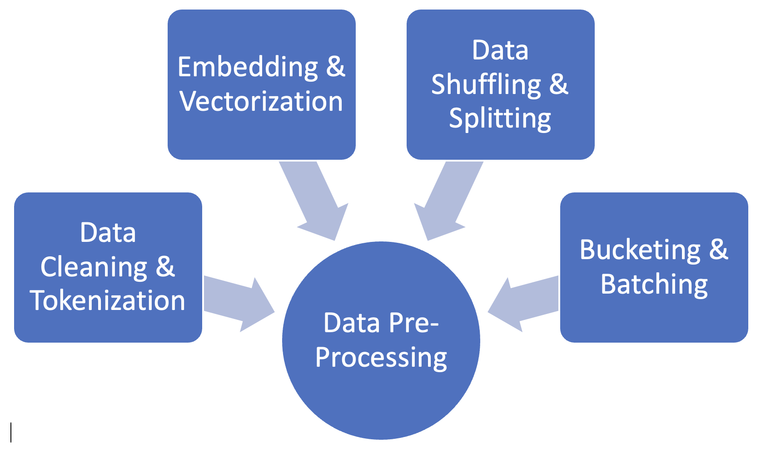

ABSTRACTVERSE
,Brinda Kumar, Kishan Terdal under Prof. Lu Xiao
PROJECT OVERVIEW AND WORKFLOW
TRAINING SET-UP AND OPTIMIZATION
CONCLUSION
This project undertakes the development of an abstractive text summarization model using the Amazon Fine Food Reviews dataset. Key aspects include meticulous data preprocessing, incorporating pre-trained GloVe word embeddings, and employing a sophisticated model architecture with bi-directional LSTM encoders and local attention mechanisms. The training process integrates dropout for regularization, Adam optimizer with gradient clipping, and early stopping to prevent overfitting. The code exemplifies a comprehensive pipeline for creating a robust abstractive summarization model, focusing on data quality, model architecture, and effective training strategies.
.
The training set-up defines essential hyperparameters like hidden size, learning rate, and epochs. It incorporates TensorFlow placeholders for data, implements dropout for regularization, and employs the Adam optimizer with gradient clipping for efficient optimization. Additionally, early stopping with a patience mechanism is integrated to prevent overfitting during training.
Optimization involves using the Adam optimizer with gradient clipping for efficient model training. The cross-entropy cost function with L2 regularization ensures robust performance during the training process.
Abstractive summarization serves as a valuable tool by distilling extensive information into brief, meaningful summaries. Its efficiency aids comprehension and decision-making across various domains. For instance, in information retrieval, it enables a quick grasp of key ideas, saving time and enhancing productivity. Similarly, in journalism, abstractive summarization streamlines content creation by generating concise headlines. Its impact extends to education, where it supports efficient studying by presenting essential concepts succinctly. Overall, abstractive summarization plays a crucial role in simplifying complex content and facilitating effective communication
TRAINING PROCESS AND EVALUATION
REFERENCES
The training process iterates through validation loops, monitoring vital metrics like loss and accuracy. Notably, a saving mechanism retains optimal model snapshots based on improved validation loss, and an early stopping strategy with patience prevents overfitting. This concise approach ensures an effective and adaptive training process for the proposed text summarization model.
Evaluation centers on crucial metrics like loss, accuracy, and validation improvement thereby ensuring the model's effectiveness. The incorporation of early stopping highlights adaptability, guaranteeing reliable abstractive text summarization results.
Rush, A. M. (2015). A Neural Attention Model for Abstractive Sentence Summarization. Proceedings of the 2015 Conference on Empirical Methods in Natural Language Processing (EMNLP).
See, A., Liu, P. J., & Manning, C. D. (2017). Get To The Point: Summarization with Pointer-Generator Networks. Proceedings of the 55th Annual Meeting of the Association for Computational Linguistics (ACL).
https://github.com/keleviss/transformers-nlp-summarization
https://github.com/tensorflow/models/tree/master
Bowman, S. R., Angeli, G., Potts, C., & Manning, C. D. (2015). A large annotated corpus for learning natural language inference. Proceedings of the 2015 Conference on Empirical Methods in Natural Language Processing (EMNLP).
Chopra, S., Auli, M., & Rush, A. M. (2016). Abstractive sentence summarization with attentive recurrent neural networks. Proceedings of the 2016 Conference of the North American Chapter of the Association for Computational Linguistics: Human Language Technologies.
DATA PRE-PROCESSING & MODEL ARCHITECTURE
The project employs rigorous data preprocessing techniques are applied to facilitate text summarization. The Amazon Fine Food Reviews dataset undergoes thorough cleaning, tokenization, and vocabulary creation, accompanied by the integration of pre-trained GloVe word embeddings. The dataset is strategically shuffled, split, and organized into batches based on text length to optimize training efficiency. The resulting processed data, encompassing vocabulary and embeddings, is then saved, ensuring a systematically formatted dataset to train the abstractive summarization model.
Using a Seq2Seq model along with local - attention mechanisms is , architecture incorporates a bi-directional LSTM encoder in order to encode input sequences and an LSTM decoder with local attention for summary generation. The design aims to capture contextual information, ensuring effective abstraction during the training process.
TURNITIN REPORT

