Slide 1





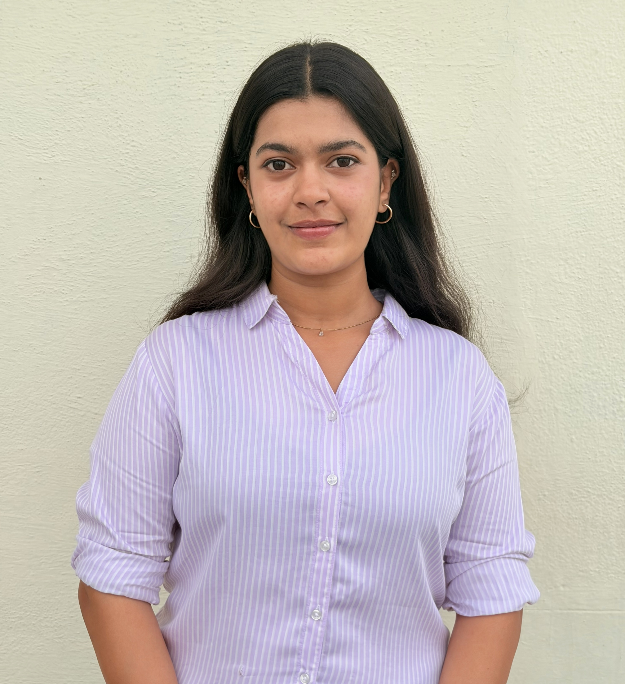


GLOBAL ACADEMY OF TECHNOLOGY
An Autonomous Institute, Approved by AICTE, New Delhi, Affiliated to VTU
Ideal Homes Township, Rajarajeshwari Nagar, Bengaluru – 560 098
Department of Computer Science and Engineering
ANVESHANAM – 2026
A Capstone Project Exhibition
Innovate • Build • Showcase
AI-Powered Cybersecurity System for Real-Time Intrusion Detection
Group No.: G40
ABSTRACT
PHOTO | USN | STUDENT NAME
 | 1GA23CS030 | Brindha Adiga
 | 1GA23CS035 | Deepa MJ
 | 1GA23CS091 | MT Yashas
 | 1GA23CS111 | Nikita Chavan
An adaptive, scalable AI-driven intrusion detection system that classifies network traffic as normal or malicious. Traffic is cleaned, normalized and reduced via ANOVA feature selection, then classified with XGBoost. Trained on CICIDS2017 and cross-tested on CICIDS2018 with chunk-based processing, the model achieved 99.69% accuracy, enabling real-time monitoring and automated threat response.
PROBLEM STATEMENT
Cyber attacks keep growing; signature-based tools miss evolving threats
Manual monitoring is impractical at today's massive data volumes
Need automated systems that learn attack patterns and defend proactively
ROLE | NAME
Project Guide | Prof. Sowmya B K
Project Coordinator | Prof. Vanishree M L
Head of Department | Dr. R Rajkumar Rao
OBJECTIVES
Develop an AI-based model for anomaly and intrusion detection
Analyze malware and phishing patterns using machine learning
Build a scalable framework for real-time cyber threat prediction
Automate threat response and alert generation
Global Academy of Technology | Dept. of CSE | 2026–27

Slide 2
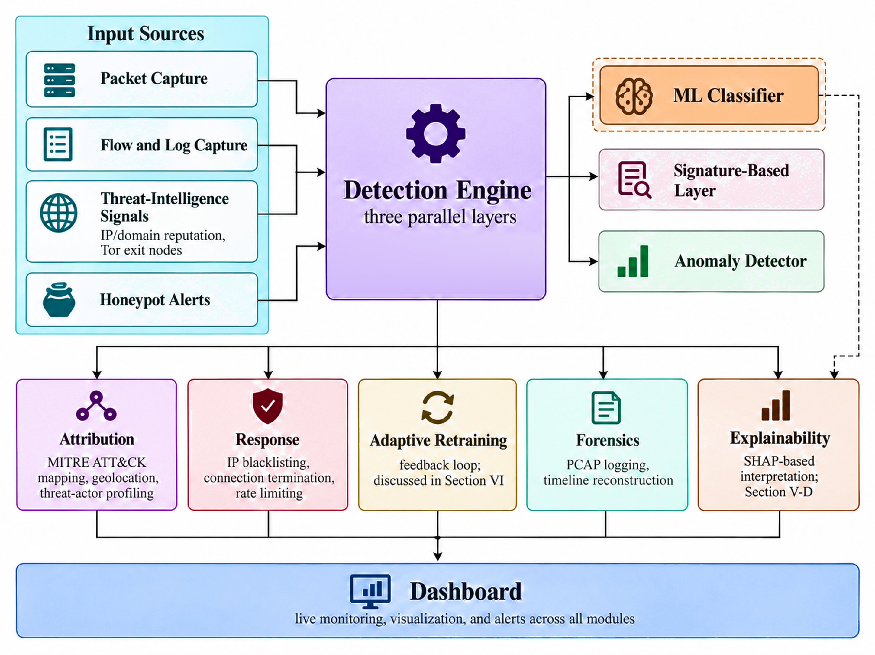
GLOBAL ACADEMY OF TECHNOLOGY
An Autonomous Institute, Approved by AICTE, New Delhi, Affiliated to VTU
Ideal Homes Township, Rajarajeshwari Nagar, Bengaluru – 560 098
Department of Computer Science and Engineering
ANVESHANAM – 2026
A Capstone Project Exhibition
Innovate • Build • Showcase
SYSTEM ARCHITECTURE & MODULES USED
MODULES
1. Data Preprocessing
Cleans, aligns and normalizes traffic flows; chunk-based loading handles large datasets
2. Feature Selection
ANOVA F-test keeps only the most informative traffic features
3. ML Classification
XGBoost labels flows normal or malicious (train CICIDS2017, test CICIDS2018)
4. Detection & Response
Signature, ML & anomaly layers flag threats; auto-blocks, MITRE-maps and alerts live
Hardware specifications
Processor: Intel Core i5 / AMD Ryzen 9
RAM: 8 GB (16 GB recommended)
Storage: 256 GB SSD
Software specifications
OS: Windows / Linux Language: Python 3.14
IDE: VS Code Data: NumPy, Pandas
ML: Scikit-learn, XGBoost, SHAP, Matplotlib, Scapy, Flask
Global Academy of Technology | Dept. of CSE | 2026–27

Slide 3
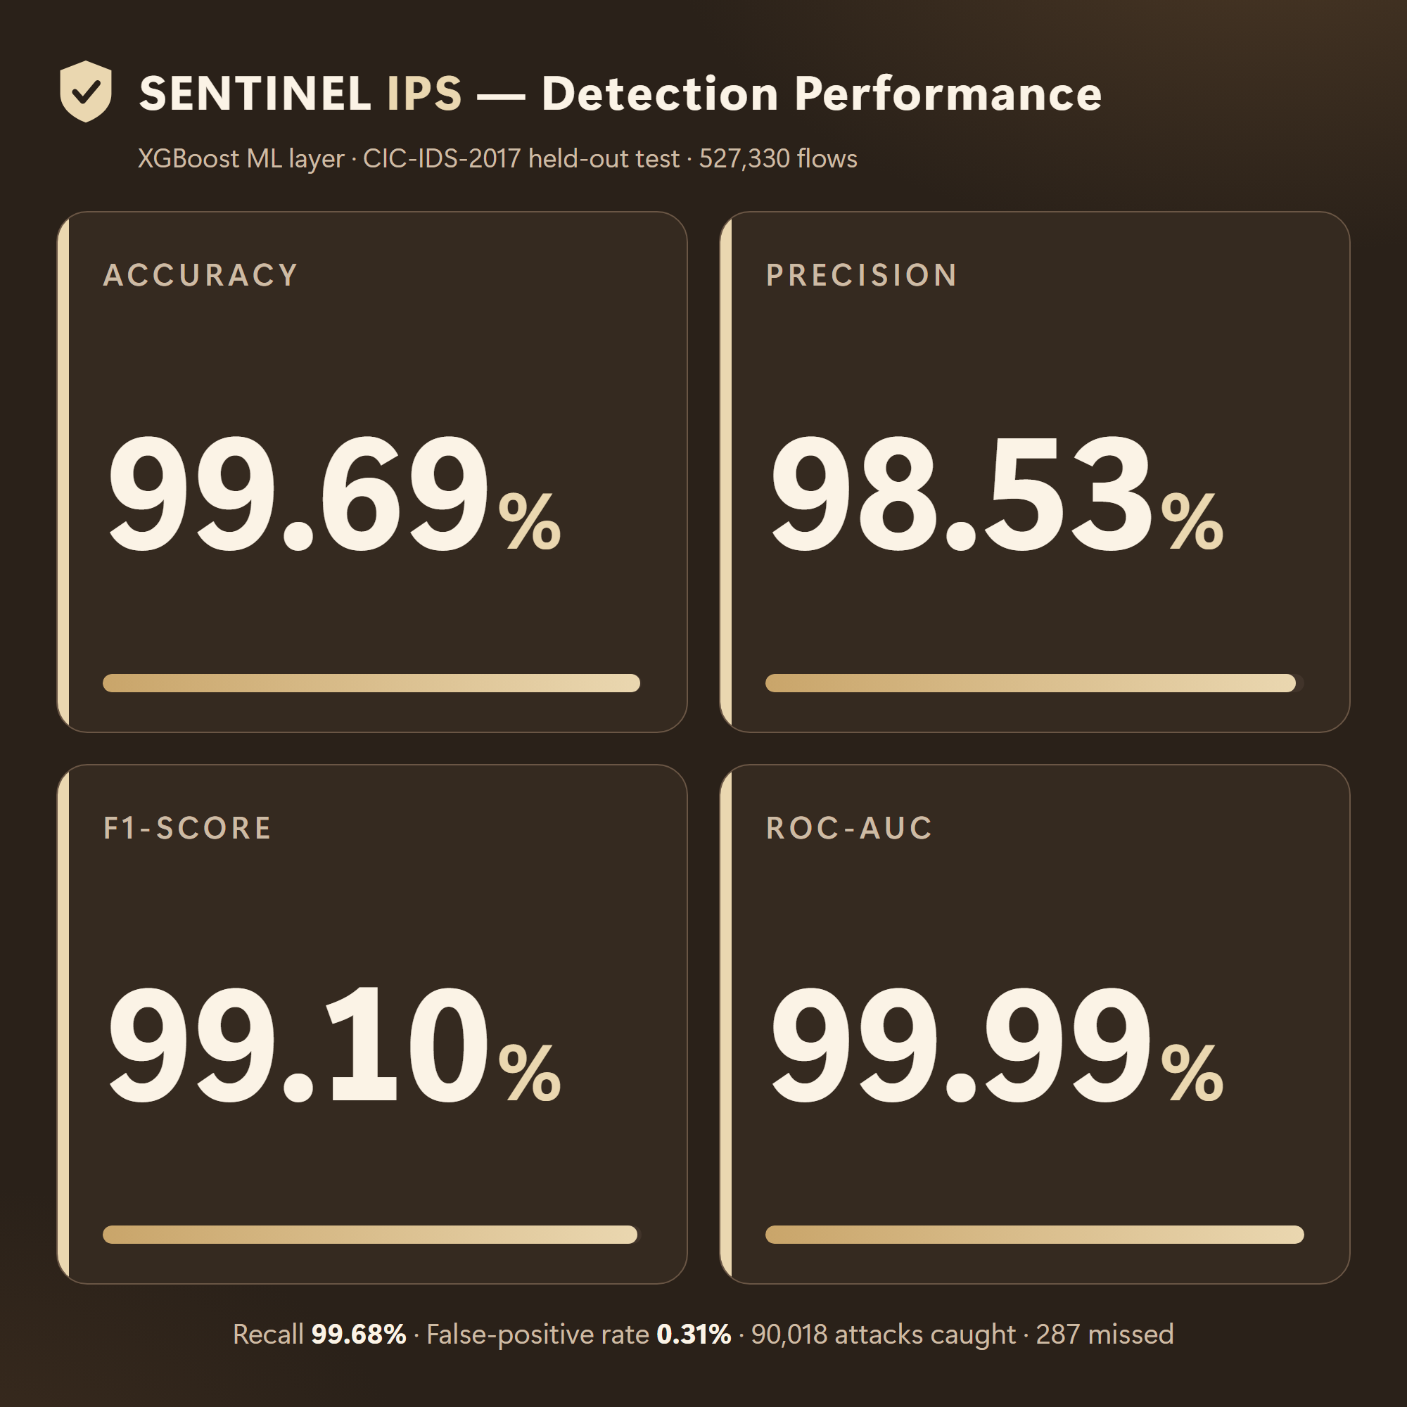
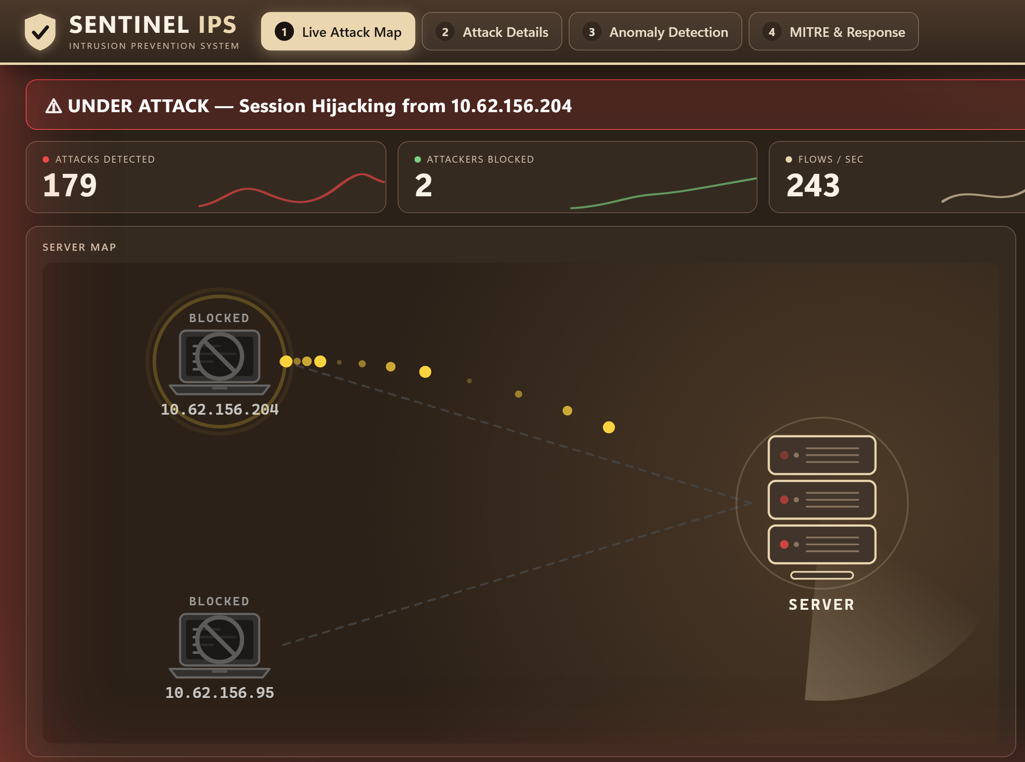
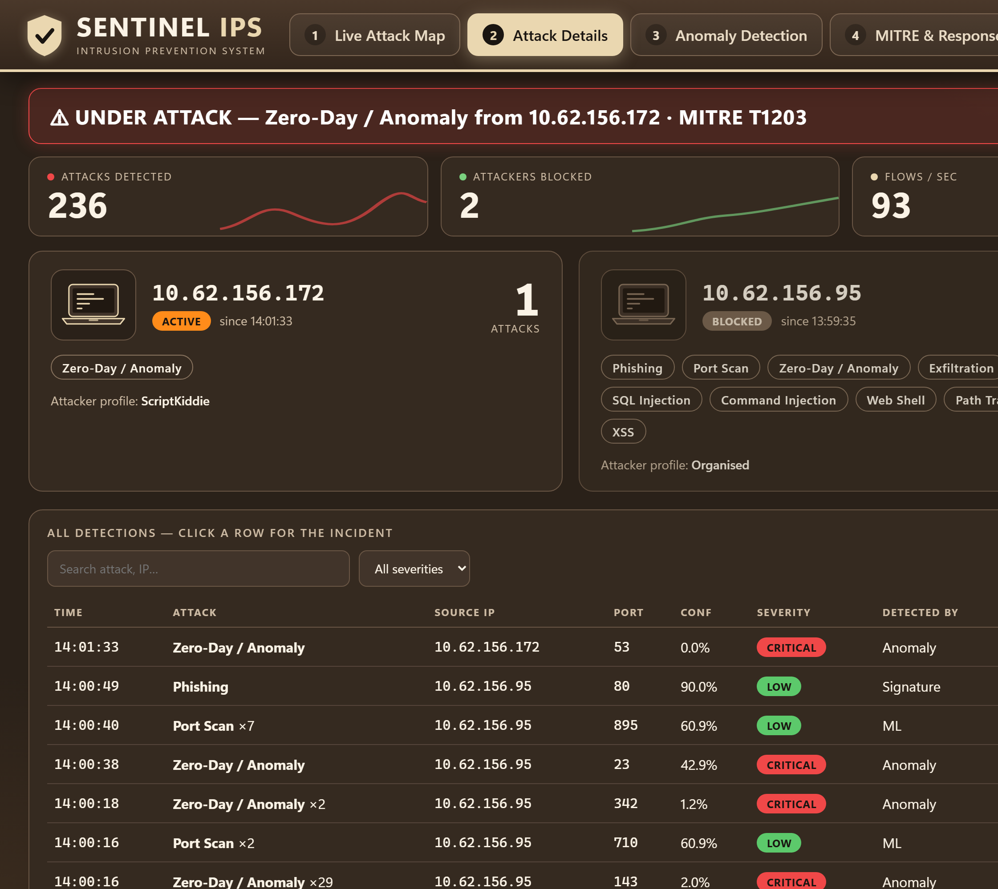
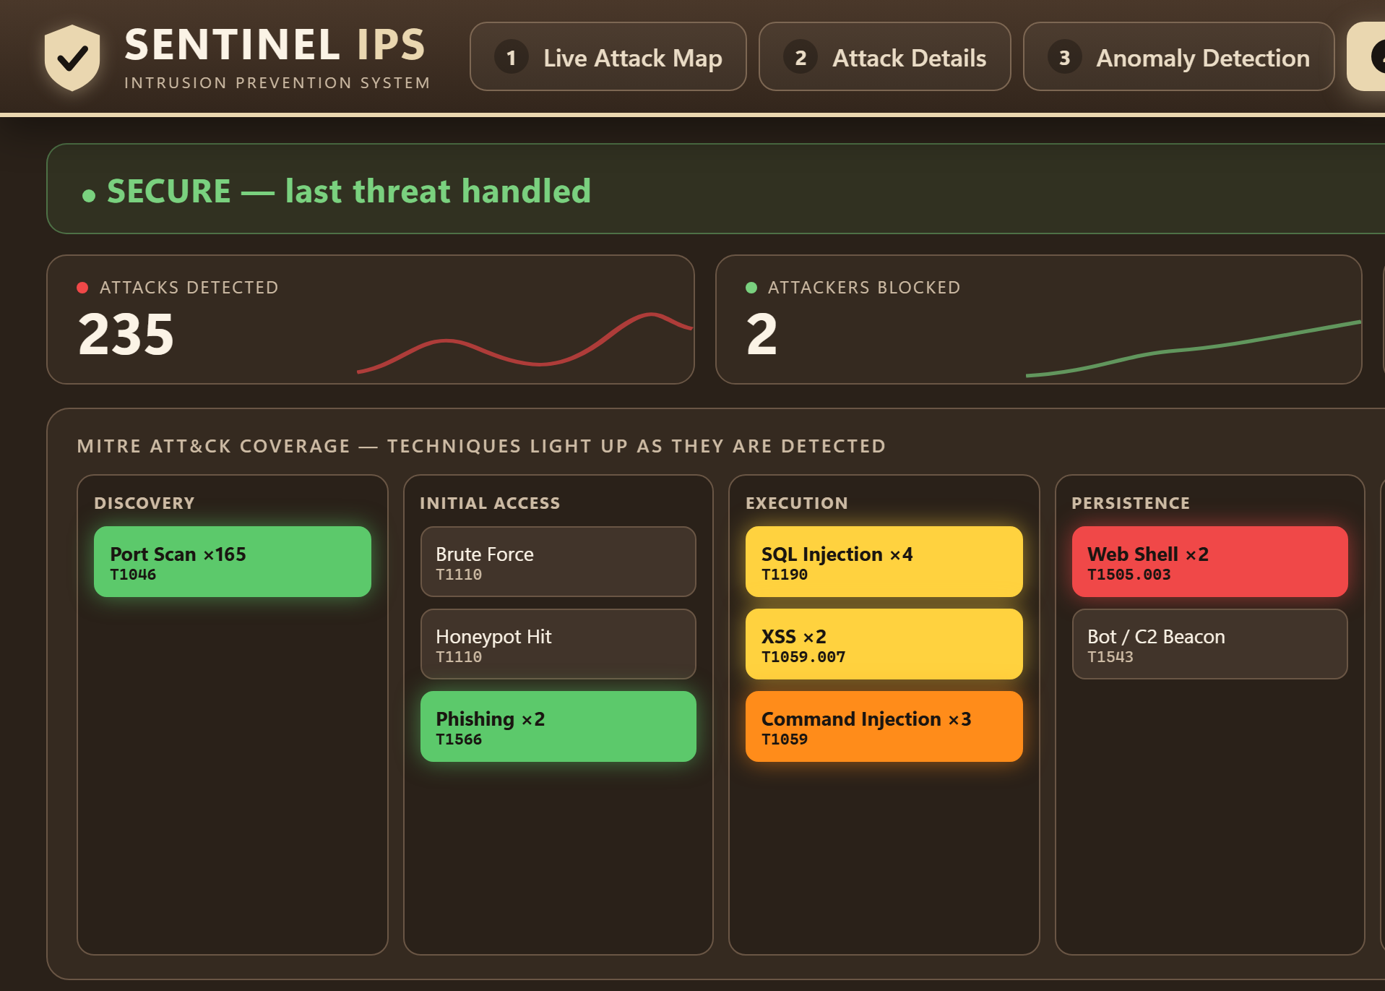
GLOBAL ACADEMY OF TECHNOLOGY
An Autonomous Institute, Approved by AICTE, New Delhi, Affiliated to VTU
Ideal Homes Township, Rajarajeshwari Nagar, Bengaluru – 560 098
Department of Computer Science and Engineering
ANVESHANAM – 2026
A Capstone Project Exhibition
Innovate • Build • Showcase
RESULTS
Fig 1: Detection metrics (99.69% accuracy)
Fig 2: Live attack map & auto-blocking
Fig 3: Attacker profiles & detections
Fig 4: MITRE ATT&CK coverage
CONCLUSION AND FUTURE ENHANCEMENTS
NOVELTY AND REFERENCE
SENTINEL detects intrusions in real time with 99.69% accuracy and a 0.31% false-positive rate, then automatically blocks, attributes and explains each threat.
Future enhancements: JA3-based encrypted-traffic analysis, ransomware/C2 detection (no honest test path in our lab yet), and multi-user cloud-scale deployment.
Novelty: Integration/Hybridization (Signature + ML + Anomaly layers) and Performance Improvement (cross-dataset validated).
Base paper: Cantone, Marrocco & Bria, “Machine Learning in Network Intrusion Detection: A Cross-Dataset Generalization Study,” IEEE Access, vol. 12, 2024.
Global Academy of Technology | Dept. of CSE | 2026–27

