Slide 1

WIPRO NGA Program – C++ LSP Batch
Capstone Project Presentation – 12 August 2024
Project Title Here - Online Voting System Using Client-Server Architecture
Presented by – Brindha Selvaraj
www. rpsconsulting. in

Slide 2

PROJECT OVERVIEW
This project is a concurrent voting system implemented in C++ that utilizes sockets for inter-process communication. The system comprises a voting server, voter clients, and results clients, which work together to facilitate a voting process. The voting server accepts votes from clients, updates election results, and provides them to results clients upon request. The system employs multi-threading and synchronization primitives to ensure thread safety and efficient communication between components.
.

Slide 3
INTRODUCTION
In today's digital age, electronic voting systems have become an essential tool for facilitating democratic processes. This project delves into the development of a concurrent voting system, leveraging C++ and socket programming to create a robust and efficient platform. By designing a voting server, voter clients, and results clients, we explore the intricacies of multi-threading, synchronization, and inter-process communication. This project offers a comprehensive understanding of the technical aspects involved in building a secure and reliable voting system, providing a valuable learning experience for developers and researchers alike.
.

Slide 4
MOTIVATION
The need for a secure and efficient electronic voting system has never been more pressing. Traditional paper-based voting systems are often plagued by issues such as voter fraud, miscounting, and logistical complexities. In contrast, electronic voting systems offer a promising solution, providing a convenient, accurate, and transparent means of casting votes. However, the development of such systems poses significant technical challenges, including ensuring the integrity of votes, managing concurrent access, and maintaining system scalability.

Slide 5
PROJECT SCOPE
To develop a secure and reliable voting system that ensures the integrity of the voting process.
To provide a user-friendly interface for voters to cast their votes electronically.
To ensure the secrecy of the voting process and protect voter privacy.
To provide a convenient and accessible way for voters to participate in elections.

Slide 6
Various Application Tools Used In project
Kernel Development Tools:
GCC(GNU Compiler Collection)
2.System Monitoring Tools:
Netstat
Ss
Lsof
3.Debugging and Testing Tools:
GDB
Valgrind
Shell Scripts

Slide 7
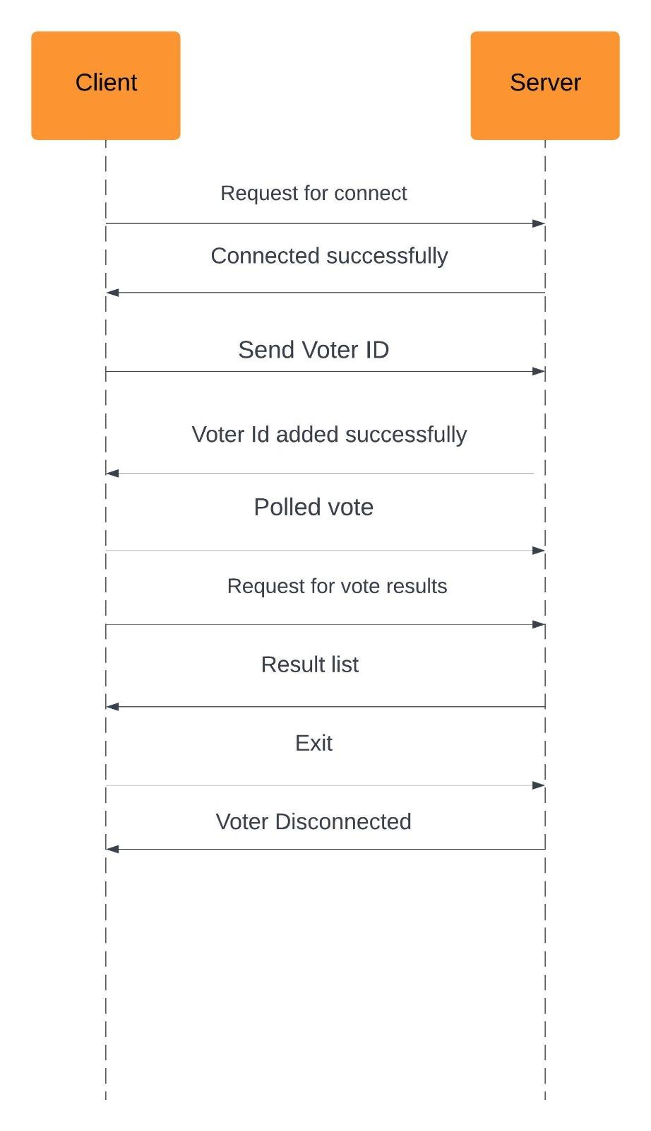
SYSTEM FLOW

Slide 8
Modules
In this project, there are two main modules used:
Server Module
Client Module
Server Components
Socket Programming: The server creates a socket and binds it to a specific address and port. It listens for incoming client connections and accepts them.
Multi-Threading: The server creates a new thread for each incoming client connection. Each thread handles a single client connection and executes the handle_client() function.
Mutexes and Condition Variables: The server uses a mutex (mtx) to protect access to the election results map (election_results). It also uses a condition variable (cv) to notify waiting threads when a new vote is cast.
Election Results Map: The server maintains a map (election_results) to store the election results. The map is updated whenever a new vote is cast.

Slide 9
Client Components
Socket Programming: The client creates a socket and connects to the server's socket. It sends requests to cast votes or retrieve election results.
Vote Casting: The client sends a request to cast a vote for a specific candidate.

Slide 10
The List Of Functions Used
Server Functions:-
handle_client(int client_socket): Handles a client connection, receives data from the client, processes it, and sends a response back to the client.
display_results(): Displays the election results.
main(): The entry point of the server program. It sets up the server, listens for client connections, and spawns threads to handle client requests.
socket(AF_INET, SOCK_STREAM, 0): Creates a socket.
bind(server_socket, (struct sockaddr *)&server_addr, sizeof(server_addr)): Binds the socket to a specific address and port.

Slide 11
listen(server_socket, 3): Listens for incoming client connections.
accept(server_socket, (struct sockaddr *)&client_addr, &client_len): Accepts an incoming client connection.
recv(client_socket, buffer, 1024, 0): Receives data from a client.
send(client_socket, response.c_str(), response.size(), 0): Sends data to a client.
close(client_socket): Closes a client socket.
std::thread t(handle_client, client_socket): Creates a new thread to handle a client request.
threads.push_back(std::move(t)): Adds a thread to a vector of threads.

Slide 12
Client Functions
cast_vote(std::string candidate): Casts a vote for a candidate. It sends a request to the server to cast the vote.
main(): The entry point of the client program. It prompts the user to enter their voter ID and candidate, and then calls the cast_vote function.
socket(AF_INET, SOCK_STREAM, 0): Creates a socket.
connect(client_socket, (struct sockaddr *)&server_addr, sizeof(server_addr)): Connects to a server.
send(client_socket, candidate.c_str(), candidate.size(), 0): Sends a vote to the server.
close(client_socket): Closes a client socket.

Slide 13
Client Functions
cast_vote(std::string candidate): Casts a vote for a candidate. It sends a request to the server to cast the vote.
main(): The entry point of the client program. It prompts the user to enter their voter ID and candidate, and then calls the cast_vote function.
socket(AF_INET, SOCK_STREAM, 0): Creates a socket.
connect(client_socket, (struct sockaddr *)&server_addr, sizeof(server_addr)): Connects to a server.
send(client_socket, candidate.c_str(), candidate.size(), 0): Sends a vote to the server.
close(client_socket): Closes a client socket.

Slide 14
Result Client Functions:-
display_results(): Displays the election results. It sends a request to the server to get the results, receives the results, and prints them to the console.
main(): The entry point of the result program. It calls the display_results function to display the election results.
socket(AF_INET, SOCK_STREAM, 0): Creates a socket.
std::istringstream iss(response): Creates a string stream to parse the response from the server.
iss >> candidate >> votes: Parses the response from the server using a string stream.
std::cout: Prints output to the console.

Slide 15
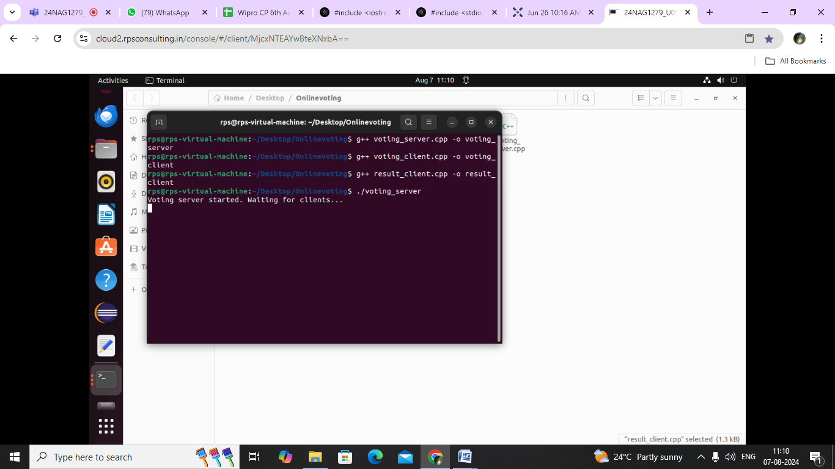
OUTPUT Server side

Slide 16
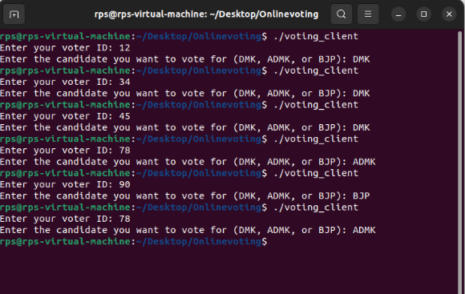
OUTPUT Client side

Slide 17
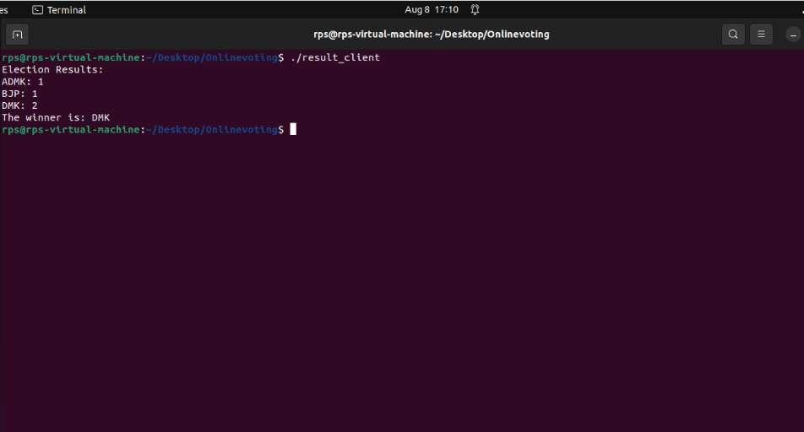
OUTPUT Result side

Slide 18
FUTURE ENHANCEMENTS
The election system can be further enhanced to handle increased load through asynchronous processing and batch data handling, providing extended metrics such as network statistics and application-specific metrics, and customizable metrics for users. Additionally, security enhancements like encryption and access controls can be implemented to ensure data integrity and confidentiality. The system can also be improved with a user-friendly interface, integrating with other systems like voter registration databases, and applying machine learning and predictive analytics to identify trends and patterns, ultimately providing a more comprehensive and efficient election management system.

