Slide 1
Growing City of Melbourne
Business opportunities driven by population growth

Slide 2
Business Problem
Home buyers, investors and entrepreneurs are struggling to pick the right location to buy the first house, invest or start a business, respectively.
Analysing the projected population growth and combining it with information about the development of Melbourne‘s suburbs should give a good indication which suburbs might be favourable.

Slide 3
Data Input
Open source population projections provided by the City of Melbourne
https://data.melbourne.vic.gov.au/resource/vtsx-jhki.csv
Foursquare open location data platform
https://foursquare.com/

Slide 4
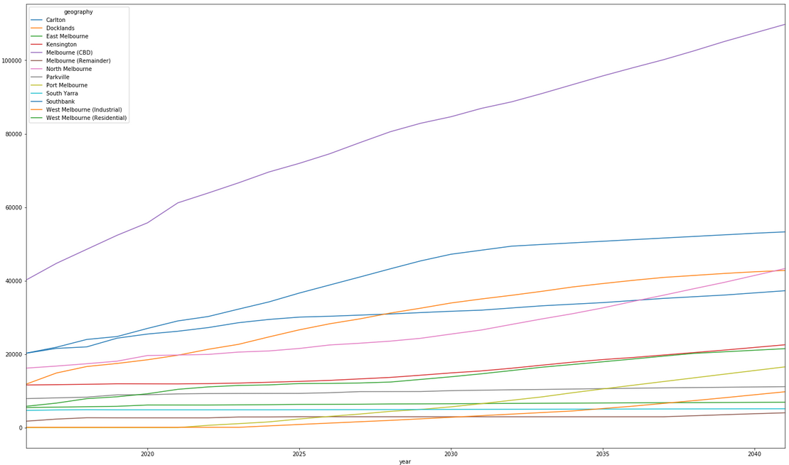
Population Growth

Slide 5
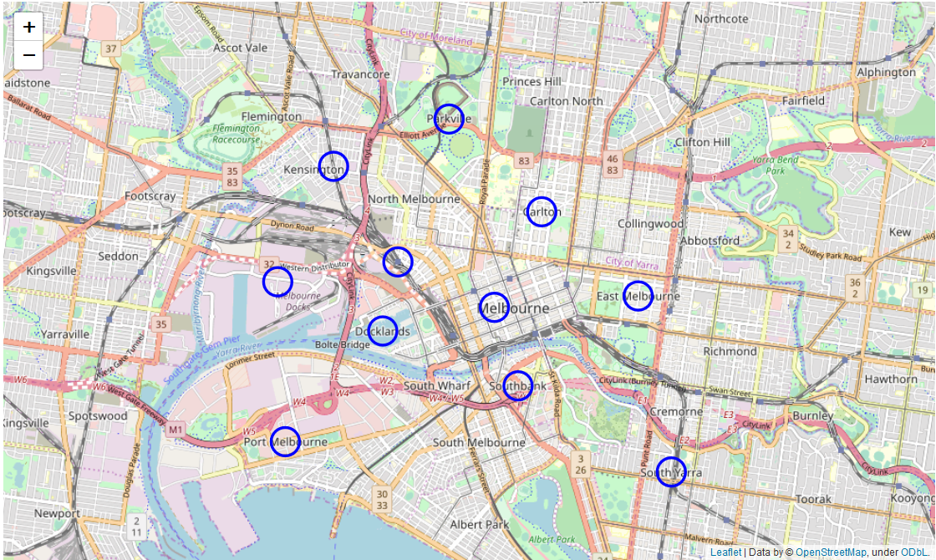
Visualisation of Suburbs

Slide 6
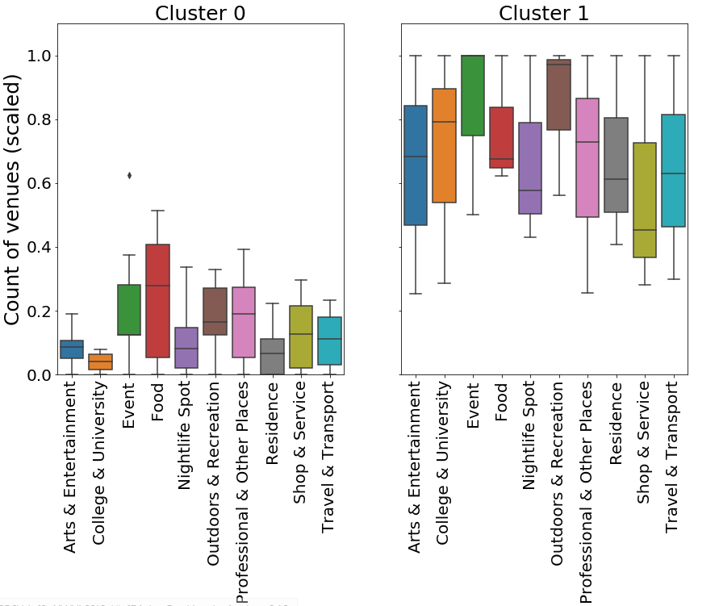
Cluster Analysis

Slide 7
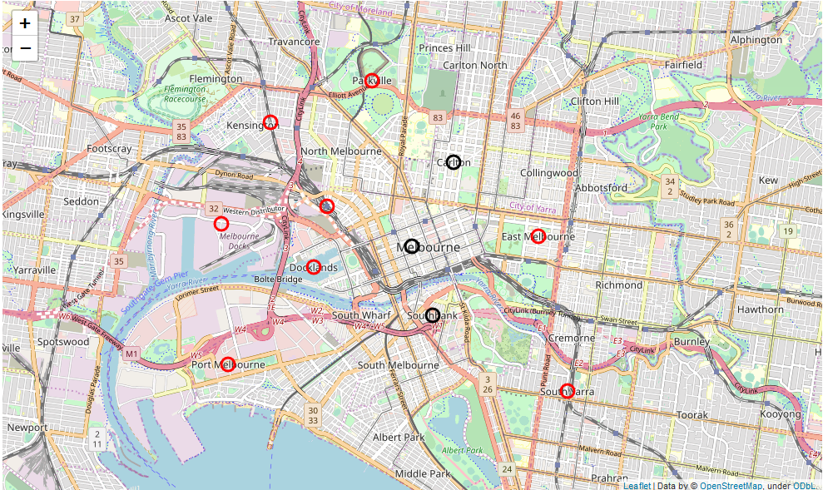
Developed (black) vs. Less Developed (red) Suburbs

Slide 8
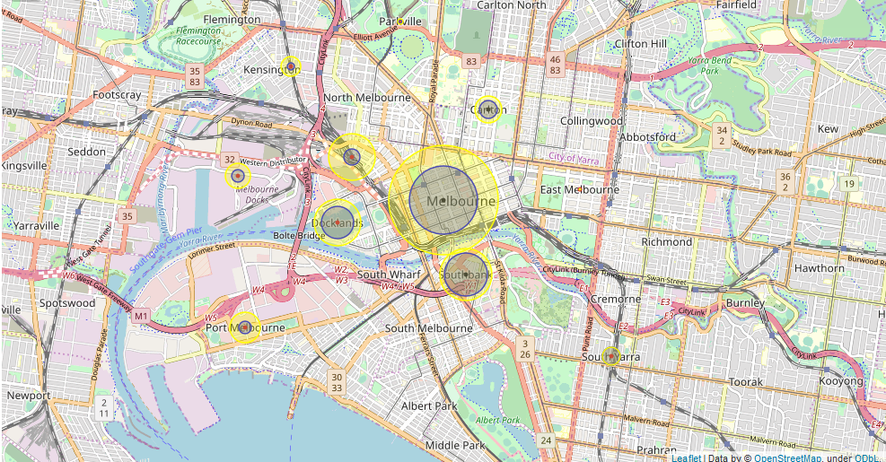
Combined Visualisation
Blue circles indicate population growth by 2031
Yellow circles indicate population growth by 2041

Slide 9
Conclusion
The highest population growth will be seen in Melbourne CBD followed by Southbank, Docklands and North Melbourne.
Docklands and North Melbourne have been evaluated as less developed than the former ones, hence these suburbs seem to have a higher potential for new businesses or real estate investments.
The analysis suggests a similar long-term (2041) growth. However, in the mid-term (2031) Docklands seems to offer more favourable opportunities.

