Slide 1
CNN Architecture
To understand layers: https://youtu.be/qFJeN9V1ZsI?t=1199

Slide 2
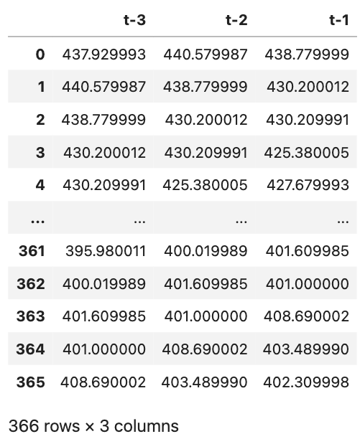
=> 440.579987
440.579987
=> 440.579987
438.779999
=>
=> 440.579987
(3 x 1)
=> 438.779999
Input
Conv1D Kernel (2)
Max Pooling
Flatten

Slide 3
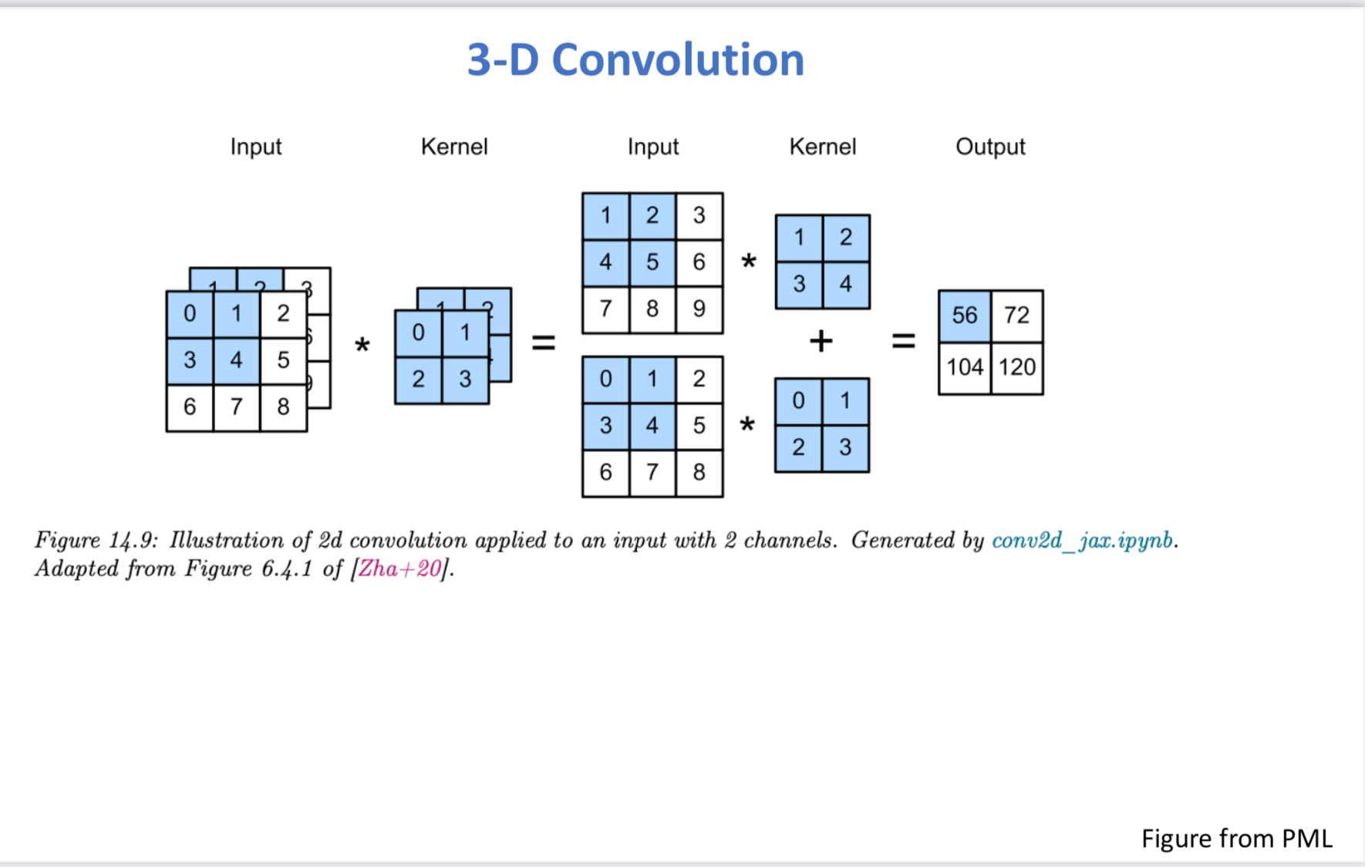
I’m using this to reference the two next slides

Slide 4
*
*
=
+
=
### ###
*
Input
Conv1D Kernel (2)
Input
Max Pooling

Slide 5
*
440...
*
=
+
=
880...
*
440...
Input
Conv1D Kernel (2)
Input
Max Pooling

