Slide 1
6. Intermediate Representation
Prof. O. Nierstrasz
Thanks to Jens Palsberg and Tony Hosking for their kind permission to reuse and adapt the CS132 and CS502 lecture notes.
http://www.cs.ucla.edu/~palsberg/
http://www.cs.purdue.edu/homes/hosking/

Slide 2

Roadmap
Intermediate representations
Example: IR trees for MiniJava
See, Modern compiler implementation in Java (Second edition), chapters 7-8.

Slide 3
Roadmap
Intermediate representations
Example: IR trees for MiniJava

Slide 4
Why use intermediate representations?
Software engineering principle
break compiler into manageable pieces
Simplifies retargeting to new host
isolates back end from front end
Simplifies support for multiple languages
different languages can share IR and back end
Enables machine-independent optimization
general techniques, multiple passes
Notes:
NB: dropped old point 2 “allow a complete pass before code is emitted – lets’ compiler consider more than one option” (too vague)
New point 3 replaces old point 4 “simplifies poly-language/architecture problem” (myth)

Slide 5
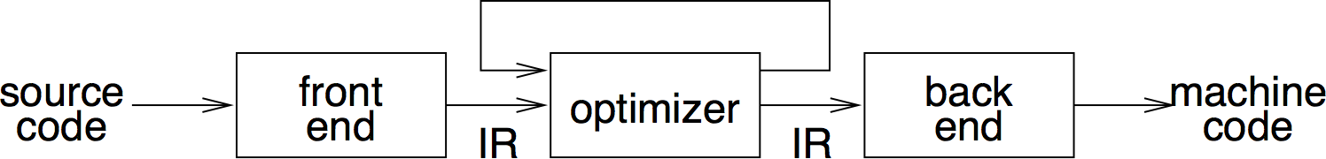
IR scheme
front end produces IR
optimizer transforms IR to more efficient program
back end transform IR to target code

Slide 6
Kinds of IR
Abstract syntax trees (AST)
Linear operator form of tree (e.g., postfix notation)
Directed acyclic graphs (DAG)
Control flow graphs (CFG)
Program dependence graphs (PDG)
Static single assignment form (SSA)
3-address code
Hybrid combinations

Slide 7
Categories of IR
Structural
graphically oriented (trees, DAGs)
nodes and edges tend to be large
heavily used on source-to-source translators
Linear
pseudo-code for abstract machine
large variation in level of abstraction
simple, compact data structures
easier to rearrange
Hybrid
combination of graphs and linear code (e.g. CFGs)
attempt to achieve best of both worlds

Slide 8
Important IR properties
Ease of generation
Ease of manipulation
Cost of manipulation
Level of abstraction
Freedom of expression (!)
Size of typical procedure
Original or derivative
Subtle design decisions in the IR can have far-reaching effects on the speed and effectiveness of the compiler!
➔ Degree of exposed detail can be crucial

Slide 9
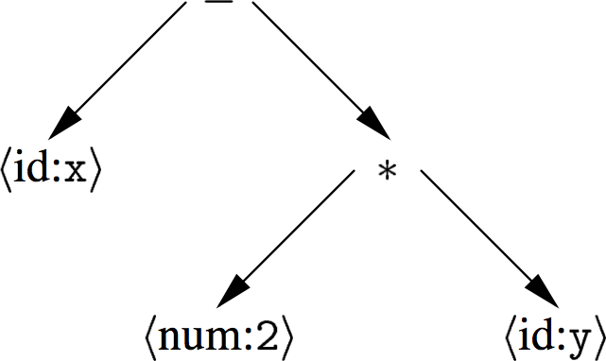
Abstract syntax tree
An AST is a parse tree with nodes for most non-terminals removed.
Since the program is already parsed, non-terminals needed to establish precedence and associativity can be collapsed!
A linear operator form of this tree (postfix) would be:
x 2 y * -

Slide 10
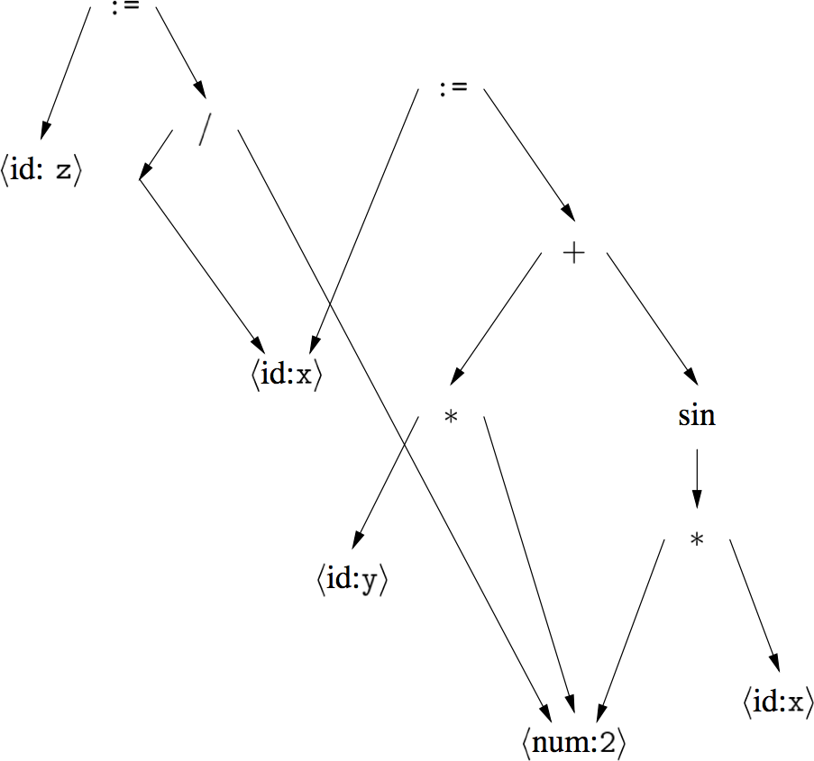
Directed acyclic graph
A DAG is an AST with unique, shared nodes for each value.
x := 2 * y + sin(2*x)
z := x / 2

Slide 11
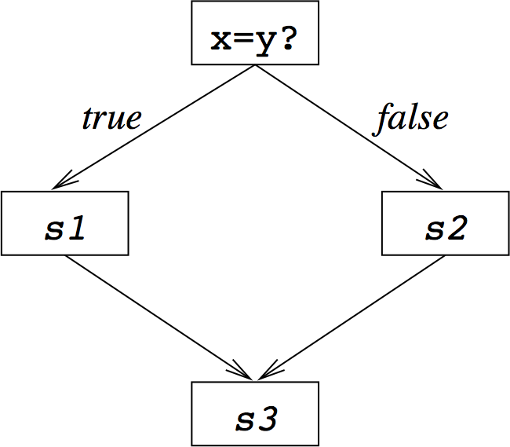
Control flow graph
A CFG models transfer of control in a program
nodes are basic blocks (straight-line blocks of code)
edges represent control flow (loops, if/else, goto …)
if x = y then
S1
else
S2
end
S3

Slide 12
Single static assignment (SSA)
Each assignment to a temporary is given a unique name
All uses reached by that assignment are renamed
Compact representation
Useful for many kinds of compiler optimization …
Ron Cytron, et al., “Efficiently computing static single assignment form and the control dependence graph,” ACM TOPLAS., 1991. doi:10.1145/115372.115320
x := 3;
x := x + 1;
x := 7;
x := x*2;
x₁ := 3;
x₂ := x₁ + 1;
x₃ := 7;
x₄ := x₃*2;
➔
http://en.wikipedia.org/wiki/Static_single_assignment_form

Slide 13
3-address code
Statements take the form: x = y op z
single operator and at most three names
t1 = 2 * y
t2 = x – t1
x – 2 * y
Advantages:
compact form
names for intermediate values

Slide 14
Typical 3-address codes
assignments | x = y op z
 | x = op y
 | x = y[i]
 | x = y
branches | goto L
conditional branches | if x relop y goto L
procedure calls | param x param y call p
address and pointer assignments | x = &y *y = z

Slide 15
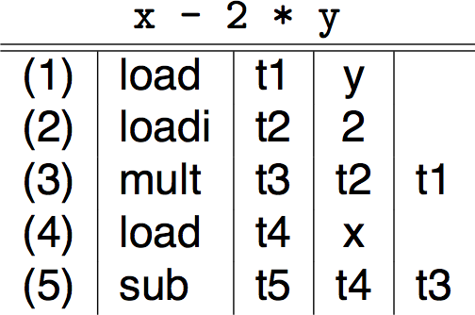
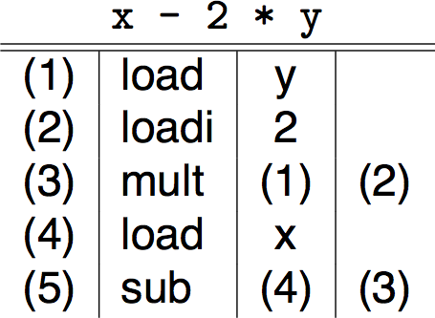
3-address code — two variants
Quadruples
Triples
simple record structure
easy to reorder
explicit names
table index is implicit name
only 3 fields
harder to reorder

Slide 16
IR choices
Other hybrids exist
combinations of graphs and linear codes
CFG with 3-address code for basic blocks
Many variants used in practice
no widespread agreement
compilers may need several different IRs!
Advice:
choose IR with right level of detail
keep manipulation costs in mind

Slide 17
Roadmap
Intermediate representations
Example: IR trees for MiniJava

Slide 18
IR trees — expressions
CONST
MEM
integer constant
contents of
word of memory
i
e
NAME
symbolic constant
CALL
procedure call
n
f
[e1,…,en]
TEMP
register
ESEQ
t
expression
sequence
BINOP
s
e
+, — etc.
e1
e2
NB: evaluation left to right

Slide 19
IR trees — statements
MOVE
EXP
evaluate e
into temp t
evaluate e and discard
TEMP
e
e
t
JUMP
transfer to address e
with value l1 …
e
[l1,…,ln]
MOVE
evaluate e1
to address a;
e2 to word at a
MEM
e2
CJUMP
evaluate and compare
e1 and e2; jump to t or f
e1
e2
t
f
e1
SEQ
LABEL
define name n as current
address (can use
NAME(n) as jump address)
statement
sequence
s1
s2
n
Notes:
CJUMP compares with operators BEQ, BE [signed and unsigned ints] BLT, BGT, BLE or BGE [signed ints]

Slide 20
Converting between kinds of expressions
Kinds of expressions:
Exp(exp) — expressions (compute a value)
Nx(stm) — statements (compute no value)
Cx.op(t,f) — conditionals (jump to true/false destinations)
Conversion operators:
cvtEx — convert to expression
cvtNx — convert to statement
cvtCx(t,f) — convert to conditional

Slide 21
Variables, arrays and fields
Local variables:
t ➔ Ex(TEMP(t))
Array elements:
e[i] ➔ Ex(MEM(+(e.cvtEx(), ×(i.cvtEx(), CONST(w)))))
where w is the target machine’s word size
Object fields:
e.f ➔ Ex(MEM(+(e.cvtEx(), CONST(o))))
where o is the byte offset of field f
Notes:
Examples from MiniJava (Hosking)
Array bounds check: array index I < e.size
Null pointer check: object expression must be non-null

Slide 22
MiniJava: string literals, object creation
String literals:
.word 11
label: .ascii “hello world”
allocate statically
“hello world” ➔ Ex(NAME(label))
Object creation:
allocate object in heap
new T()➔ Ex(CALL(NAME(“new”),
CONST(fields),
NAME(label for T’s vtable)))

Slide 23
Control structures
Basic blocks:
maximal sequence of straight-line code without branches
label starts a new block
Control structure translation:
control flow links up basic blocks
implementation requires bookkeeping
some care needed to produce good code!

Slide 24
while loops
while (c) s ➔ Nx(SEQ(SEQ(c.cvtCx(b,x),
SEQ(LABEL(b), s.cvtNx())),
SEQ(c,cvtCx(b,x),LABEL(x))))
if not (c) jump done
body:
s
if c jump body
done:
for example:

Slide 25
Method calls
eo.m(e1,…,en) ➔ Ex(CALL(MEM(MEM(e0.cvtEx(), -w),
m.index × w),
e1.cvtEx(), …en.cvtEx()))
Notes:
Null pointer check: e0 must be non-null

Slide 26
case statements
case E of V₁ : S₁ … V_{n} : S_{n} end
evaluate E to V
find value V in case list
execute statement for found case
jump to statement after case
Key issue: finding the right case
sequence of conditional jumps (small case set)
⇒ O(# cases)
binary search of ordered jump table (sparse case set)
⇒ O(log₂ # cases)
hash table (dense case set)
⇒ O(1)

Slide 27
case statements — sample translation
t := expr
jump test
L1: code for S1
jump next
L2: code for S2
jump next
…
Ln: code for Sn
jump next
test: if t = V1 jump L1
if t = V2 jump L2
…
if t = Vn jump Ln
code to raise exception
next: …

Slide 28
Simplification
After translation, simplify trees
No SEQ or ESEQ
CALL can only be subtree of EXP() or MOVE(TEMP t, …)
Transformations:
Lift ESEQs up tree until they can become SEQs
turn SEQs into linear list

Slide 29
Linearizing trees
ESEQ(s1, ESEQ(s2, e) | = | ESEQ(SEQ(s1, s2), e)
BINOP(op, ESEQ(s, e1), e2) | = | ESEQ(s, BINOP(op, e1, e2))
MEM(ESEQ(s, e)) | = | ESEQ(s, MEM(e))
JUMP(ESEQ(s,e)) | = | SEQ(s, JUMP(e))
CJUMP(op, ESEQ(s, e1), e2, l1, l2) | = | SEQ(s, CJUMP(op, e1, e2, l1, l2))
BINOP(op, e1, ESEQ(s, e2)) | = | ESEQ(MOVE(TEMP t, e1), ESEQ(s, BINOP(op, TEMP t, e2)))
CJUMP(op, e1, ESEQ(s, e2), l1, l2) | = | SEQ(MOVE(TEMP t, e1), SEQ(s, CJUMP(op, TEMP t, e2, l1, l2)))
MOVE(ESEQ(s, e1), e2) | = | SEQ(s, MOVE(e1, e2))
CALL(f, a) | = | ESEQ(MOVE(TEMP t, CALL(f, a)), TEMP(t))

Slide 30
What you should know!
Why do most compilers need an intermediate representation for programs?
What are the key tradeoffs between structural and linear IRs?
What is a “basic block”?
What are common strategies for representing case statements?

Slide 31
Can you answer these questions?
Why can’t a parser directly produced high quality executable code?
What criteria should drive your choice of an IR?
What kind of IR does JTB generate?

Slide 32

License
http://creativecommons.org/licenses/by-sa/3.0/
Attribution-ShareAlike 3.0 Unported
You are free:
to Share — to copy, distribute and transmit the work
to Remix — to adapt the work
Under the following conditions:
Attribution. You must attribute the work in the manner specified by the author or licensor (but not in any way that suggests that they endorse you or your use of the work).
Share Alike. If you alter, transform, or build upon this work, you may distribute the resulting work only under the same, similar or a compatible license.
For any reuse or distribution, you must make clear to others the license terms of this work. The best way to do this is with a link to this web page.
Any of the above conditions can be waived if you get permission from the copyright holder.
Nothing in this license impairs or restricts the author's moral rights.

