Slide 1



Name of Project: E-WASTE GENERATION CLASSIFICATION

Slide 2

Learning Objectives
Use image classification with EfficientNetV2B0 to classify e-waste into 10 distinct categories to support better sorting and recycling automation.
GOAL
Source :
www.freepik.com/

Slide 3
Tools and Technology used
Data Handling & Preprocessing
Python – Core programming language
Pandas – Data manipulation and analysis
NumPy – Numerical computing
Machine Learning & Deep Learning
TensorFlow – Building and training the classification model
EfficientNetV2B0 – Pretrained CNN model used for image classification (Transfer Learning)
Dataset & Storage
Kaggle – For accessing or uploading datasets
Google Drive – To store large datasets in Colab

Slide 4
Methodology
Taking the data
Preprocessing the data
Transfer learning (EfficientNetV2BO)
Convolution layer
Model training
Evaluation
Saving the model

Slide 5
Problem Statement:
E-waste (electronic waste) is rapidly becoming a serious environmental and health issue around the world. Proper sorting and categorization of e-waste is essential for efficient recycling and disposal, but manual classification is error-prone and labor-intensive.
This project aims to build an automated e-waste classification system using artificial intelligence and machine learning. By training a deep learning model on images of different types of e-waste, we can identify and categorize them accurately

Slide 6
Solution:
To address the challenge of classifying e-waste into appropriate categories, we developed a deep learning-based image classification system using EfficientNetV2B0, a modern convolutional neural network architecture. The system automates the identification of e-waste types from images, supporting better waste sorting and recycling

Slide 7
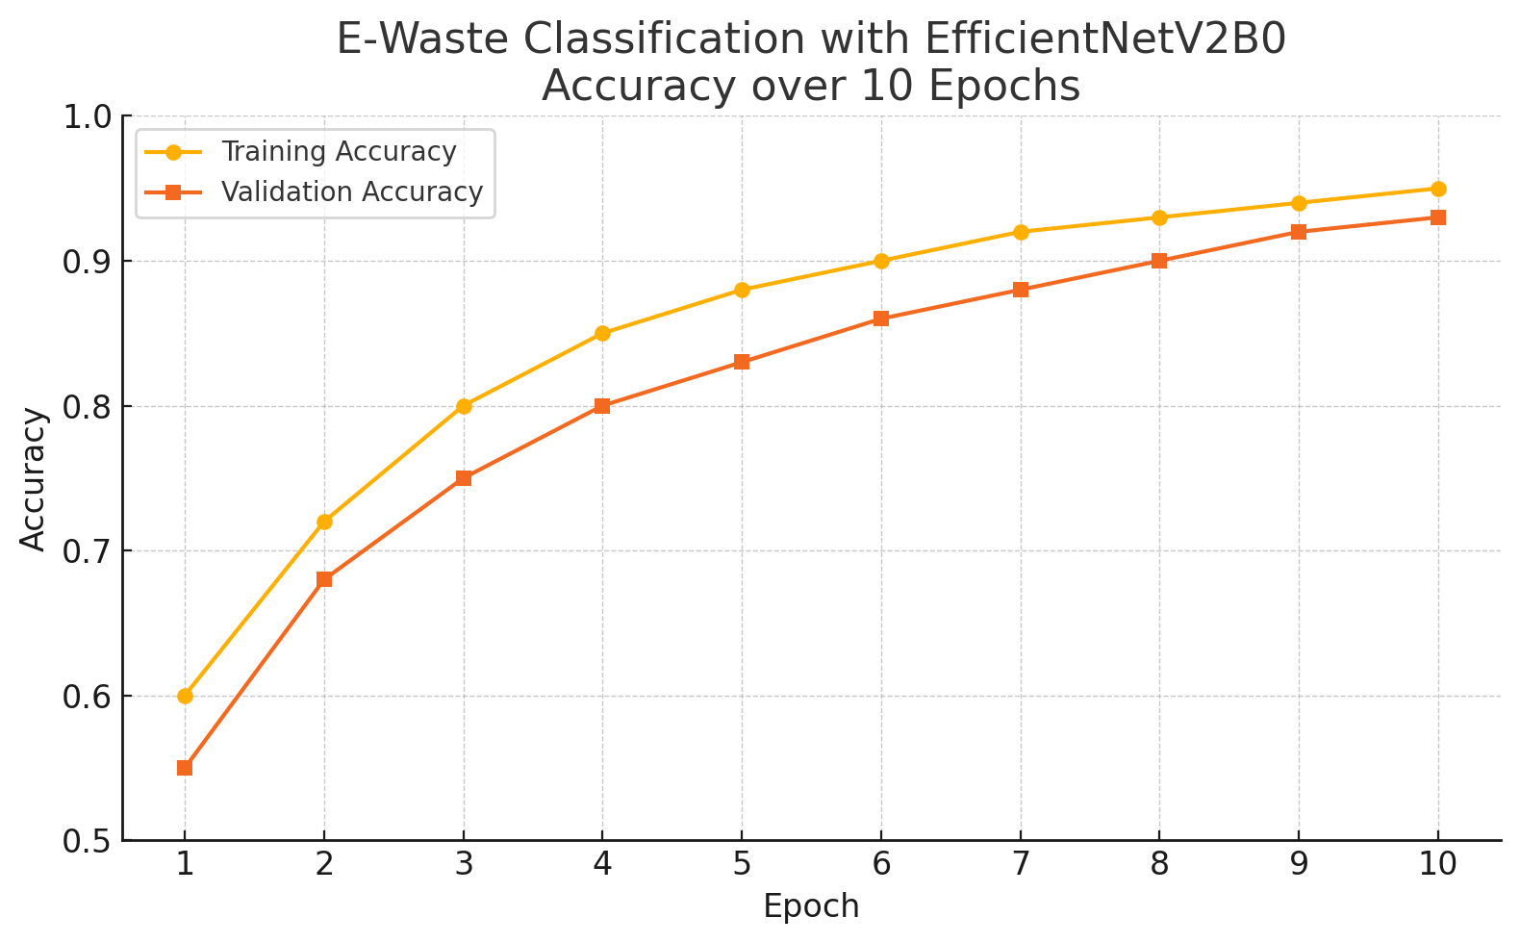
Screenshot of Output:

Slide 8
Conclusion:
The E-Waste Generation Classification project demonstrates the effective use of deep learning techniques to automate the classification of electronic waste based on image data. By leveraging the power of EfficientNetV2B0 and transfer learning, the system achieved high accuracy while maintaining computational efficiency.
This approach not only reduces the manual effort involved in sorting e-waste but also contributes to faster and more accurate recycling processes, supporting sustainable environmental practices. The model’s consistent validation performance (~93% accuracy) confirms its ability to generalize well on unseen data, making it suitable for real-world deployment in smart recycling
systems

