Slide 1


Azure DevOps What’s New
Richard Angus
Dev iQ Pty Ltd
9th May 2019
#BrisAzDevOps #AzureDevOps

Slide 2
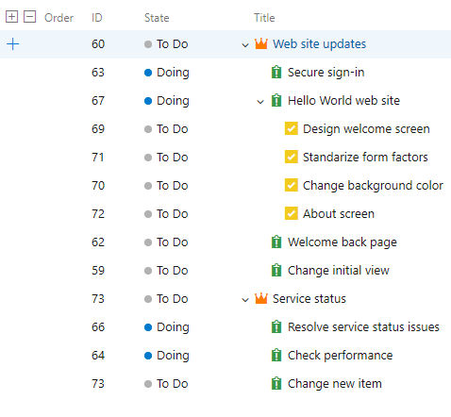
January 14 2019 – Sprint 146
Azure Boards - Simplify the organization of your work using the Basic process
#BrisAzDevOps #AzureDevOps

Slide 3
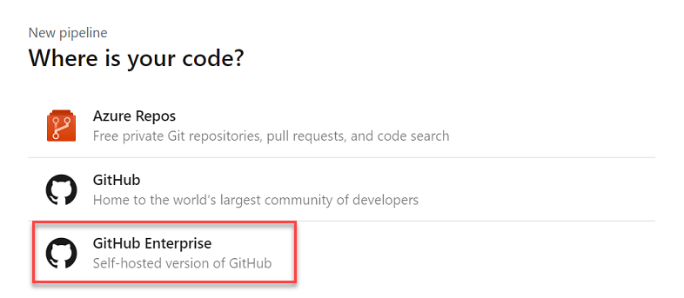
January 14 2019 – Sprint 146
Azure Pipelines - GitHub Enterprise support in the pipeline wizard
Azure Pipelines - Automatic GitHub service connections in pipelines
When using the New build pipeline wizard to create a pipeline for GitHub, the page for choosing or creating a GitHub service connection led to confusion about which connection to select from the list. Now, you don’t need to choose a connection. The wizard automatically creates and re-uses a service connection for the repository you choose
#BrisAzDevOps #AzureDevOps

Slide 4
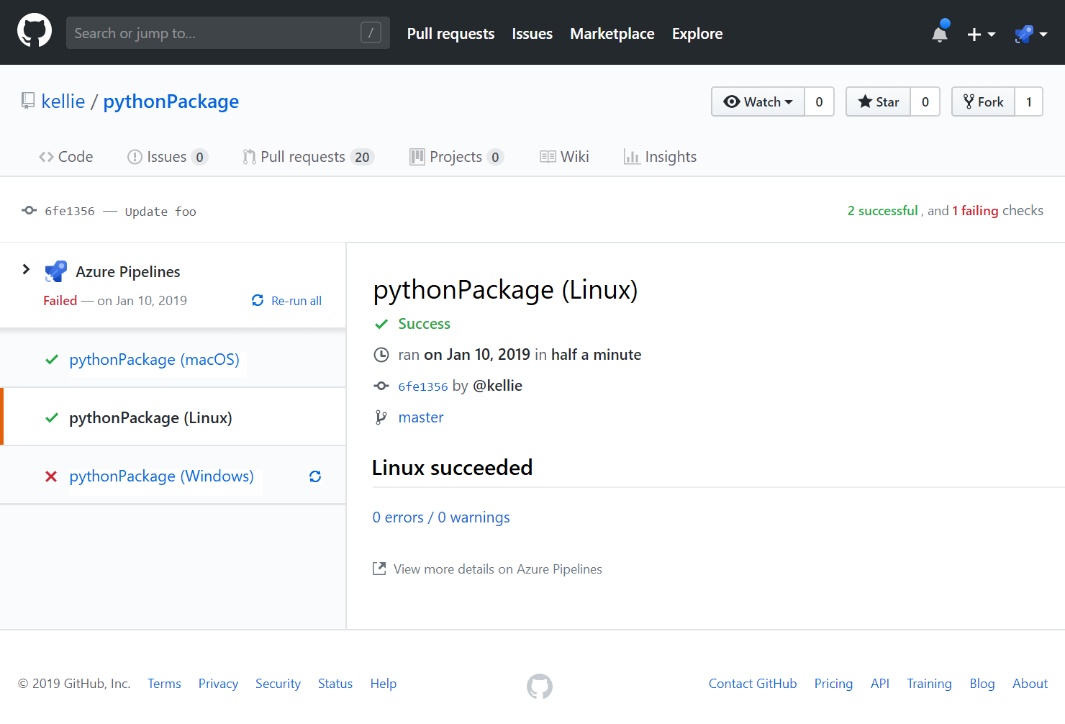
January 14 2019 – Sprint 146
Azure Pipelines - Display status for each pipeline job in GitHub Check
#BrisAzDevOps #AzureDevOps

Slide 5
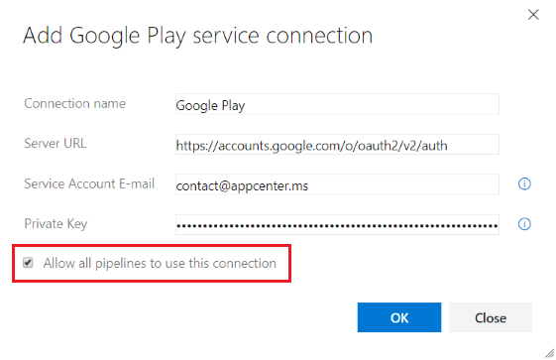
January 14 2019 – Sprint 146
Azure Pipelines - Default authorization for YAML resources in GitHub
#BrisAzDevOps #AzureDevOps
Notes:
If you manage your source code in GitHub and use YAML to define your pipeline, you probably experienced a resource authorization build failure. When you edited your YAML file and added a reference to one of the protected resources (e.g., service connection, agent pool, variable group, or secure file), Azure Pipelines couldn’t validate the identity of the user that made that change and failed the build. To work around this issue, you had to save the build pipeline in the web editor after making a change to the YAML file. Many of the users who hit this issue simply wanted to allow all the pipelines to use the resource.
To avoid the resource authorization build failure, we changed the default behavior of all new service connections, agent pools, and variable groups to be authorized for use in all pipelines. If you want tighter controls on your resources, you can disable the default authorization model (see figure below). When you do so, someone with permissions to use the resource must save the pipeline in the web editor after a resource reference is added to the YAML file.

Slide 6
January 14 2019 – Sprint 146
Azure Pipelines - Service containers for YAML pipelines
Previously, you had to install, start and stop services such as databases or memory caches if your YAML pipeline was using these services. With this update, we added service containers that can handle these tasks. For example, if your pipeline uses a redis cache for integration tests, you can include the redis container image as a service in the pipeline. The agent will automatically fetch the image, start it up and network it so that your pipeline steps can refer to it by the hostname redis. When the pipeline is complete, the agent will spin down the service container cleanly.
Azure Pipelines - Work items linked to GitHub commits in Release Summary
#BrisAzDevOps #AzureDevOps
Notes:
If you manage your source code in GitHub and use YAML to define your pipeline, you probably experienced a resource authorization build failure. When you edited your YAML file and added a reference to one of the protected resources (e.g., service connection, agent pool, variable group, or secure file), Azure Pipelines couldn’t validate the identity of the user that made that change and failed the build. To work around this issue, you had to save the build pipeline in the web editor after making a change to the YAML file. Many of the users who hit this issue simply wanted to allow all the pipelines to use the resource.
To avoid the resource authorization build failure, we changed the default behavior of all new service connections, agent pools, and variable groups to be authorized for use in all pipelines. If you want tighter controls on your resources, you can disable the default authorization model (see figure below). When you do so, someone with permissions to use the resource must save the pipeline in the web editor after a resource reference is added to the YAML file.

Slide 7
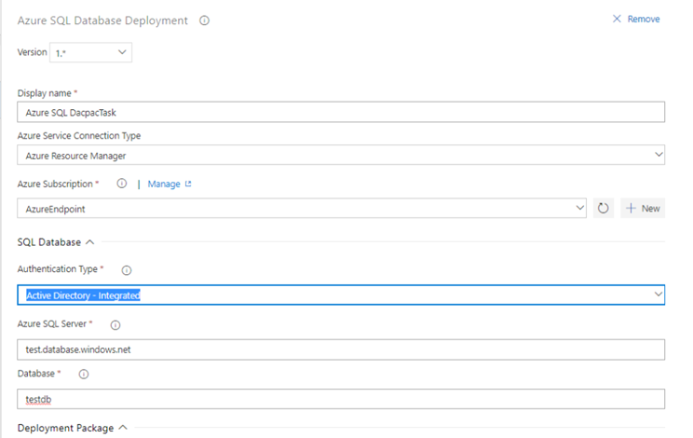
January 14 2019 – Sprint 146
Azure Pipelines - New Azure App Service tasks optimized for YAML
We now support four new tasks which provide an easy yet powerful way to deploy Azure App Services with modern developers in mind. These tasks have an optimized YAML syntax making it simple and intuitive to author deployments to Azure AppServices, including WebApps, FunctionApps, WebApps for Containers and FunctionApp for Containers on both Windows and Linux platforms.
We also support a new utility task for file transformation and variable substitution for XML and JSON formats.
Azure Pipelines - Azure Active Directory (AD) authentication support for Azure SQL task
#BrisAzDevOps #AzureDevOps
Notes:
If you manage your source code in GitHub and use YAML to define your pipeline, you probably experienced a resource authorization build failure. When you edited your YAML file and added a reference to one of the protected resources (e.g., service connection, agent pool, variable group, or secure file), Azure Pipelines couldn’t validate the identity of the user that made that change and failed the build. To work around this issue, you had to save the build pipeline in the web editor after making a change to the YAML file. Many of the users who hit this issue simply wanted to allow all the pipelines to use the resource.
To avoid the resource authorization build failure, we changed the default behavior of all new service connections, agent pools, and variable groups to be authorized for use in all pipelines. If you want tighter controls on your resources, you can disable the default authorization model (see figure below). When you do so, someone with permissions to use the resource must save the pipeline in the web editor after a resource reference is added to the YAML file.

Slide 8
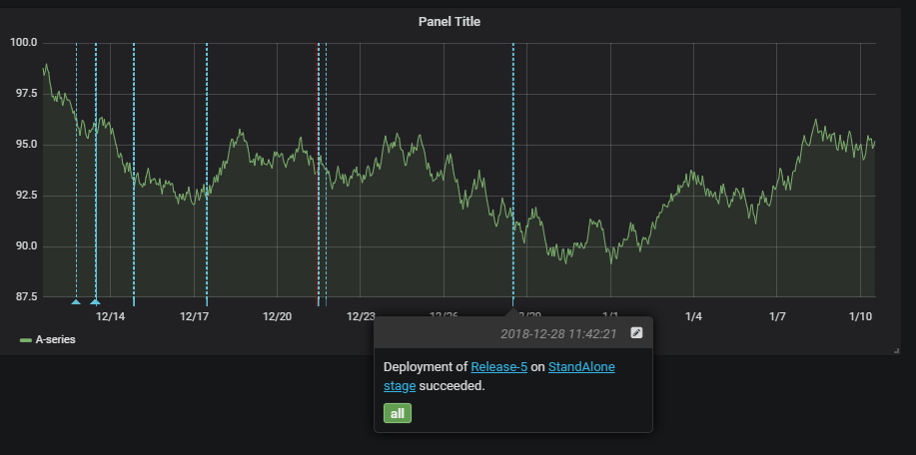
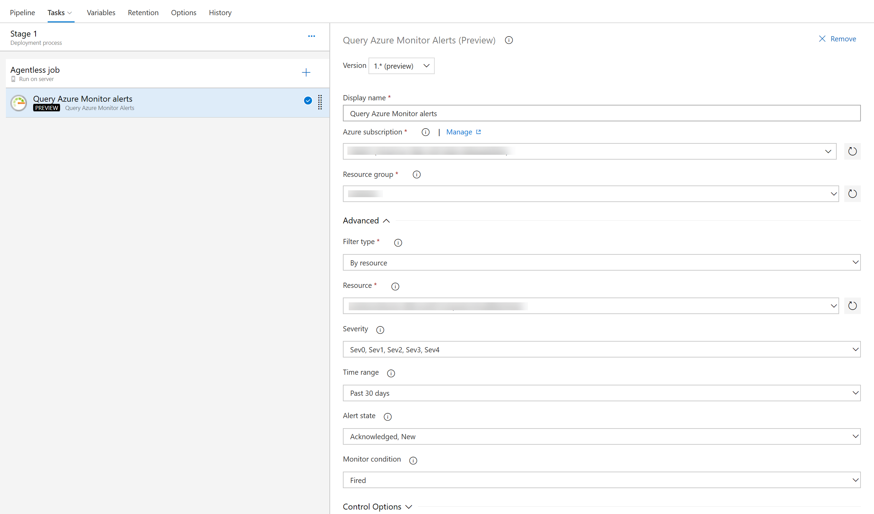
January 14 2019 – Sprint 146
Azure Pipelines - Grafana annotations service hook
Azure Pipelines - Query Azure Monitor alerts tasks
#BrisAzDevOps #AzureDevOps
Notes:
If you manage your source code in GitHub and use YAML to define your pipeline, you probably experienced a resource authorization build failure. When you edited your YAML file and added a reference to one of the protected resources (e.g., service connection, agent pool, variable group, or secure file), Azure Pipelines couldn’t validate the identity of the user that made that change and failed the build. To work around this issue, you had to save the build pipeline in the web editor after making a change to the YAML file. Many of the users who hit this issue simply wanted to allow all the pipelines to use the resource.
To avoid the resource authorization build failure, we changed the default behavior of all new service connections, agent pools, and variable groups to be authorized for use in all pipelines. If you want tighter controls on your resources, you can disable the default authorization model (see figure below). When you do so, someone with permissions to use the resource must save the pipeline in the web editor after a resource reference is added to the YAML file.

Slide 9
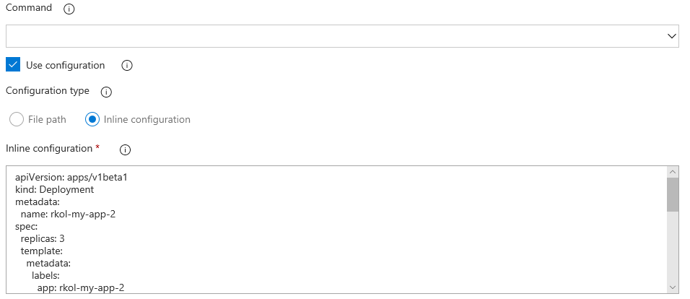
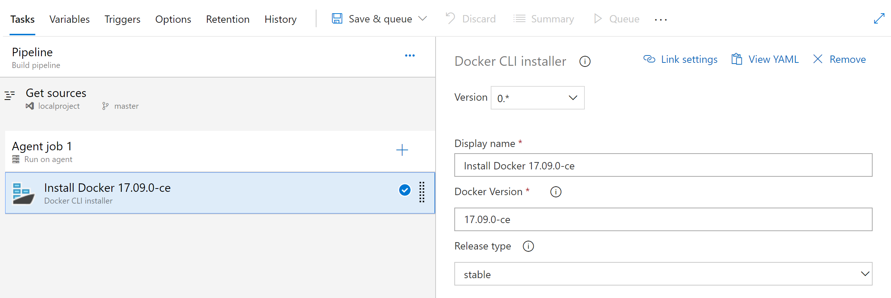
January 14 2019 – Sprint 146
Azure Pipelines - Inline input of spec file in Deploy to Kubernetes task
Azure Pipelines - Docker CLI Installer task
#BrisAzDevOps #AzureDevOps
Notes:
If you manage your source code in GitHub and use YAML to define your pipeline, you probably experienced a resource authorization build failure. When you edited your YAML file and added a reference to one of the protected resources (e.g., service connection, agent pool, variable group, or secure file), Azure Pipelines couldn’t validate the identity of the user that made that change and failed the build. To work around this issue, you had to save the build pipeline in the web editor after making a change to the YAML file. Many of the users who hit this issue simply wanted to allow all the pipelines to use the resource.
To avoid the resource authorization build failure, we changed the default behavior of all new service connections, agent pools, and variable groups to be authorized for use in all pipelines. If you want tighter controls on your resources, you can disable the default authorization model (see figure below). When you do so, someone with permissions to use the resource must save the pipeline in the web editor after a resource reference is added to the YAML file.

Slide 10
January 14 2019 – Sprint 146
Azure Pipelines - Java long-term support (LTS) on Microsoft hosted agents
Azure Pipelines - YAML support for Bitbucket Cloud pipelines
Azure Pipelines - Avoid triggering multiple CI builds for pull requests
Change build numbers, upload and download artifacts in forked repository builds
#BrisAzDevOps #AzureDevOps
Notes:
If you manage your source code in GitHub and use YAML to define your pipeline, you probably experienced a resource authorization build failure. When you edited your YAML file and added a reference to one of the protected resources (e.g., service connection, agent pool, variable group, or secure file), Azure Pipelines couldn’t validate the identity of the user that made that change and failed the build. To work around this issue, you had to save the build pipeline in the web editor after making a change to the YAML file. Many of the users who hit this issue simply wanted to allow all the pipelines to use the resource.
To avoid the resource authorization build failure, we changed the default behavior of all new service connections, agent pools, and variable groups to be authorized for use in all pipelines. If you want tighter controls on your resources, you can disable the default authorization model (see figure below). When you do so, someone with permissions to use the resource must save the pipeline in the web editor after a resource reference is added to the YAML file.

Slide 11
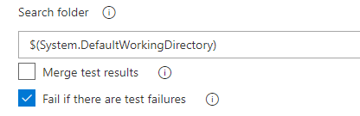
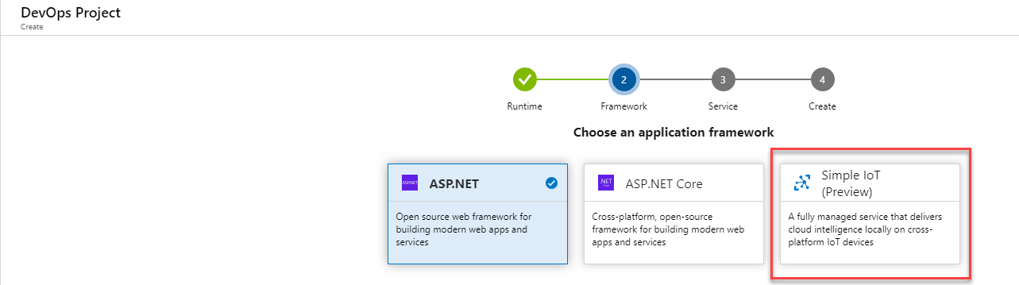
January 14 2019 – Sprint 146
Azure Pipelines - New option in Publish Test Results task to fail build on failed tests
Azure Pipelines - Updates to the Azure Portal for creating an Azure DevOps project
#BrisAzDevOps #AzureDevOps

Slide 12
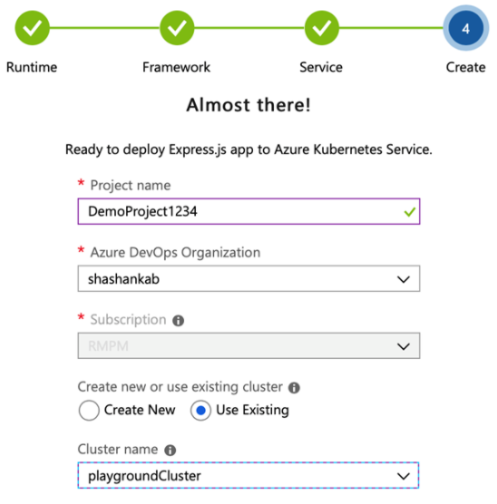
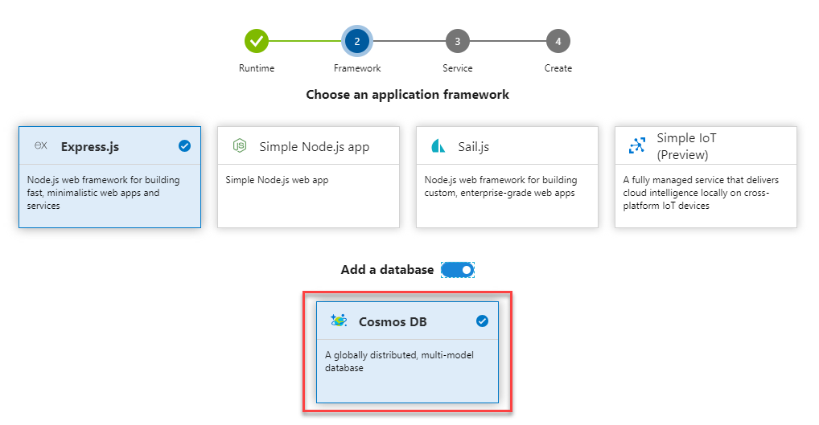
January 14 2019 – Sprint 146
Azure Pipelines - Service
Azure Pipelines - Use the Azure Portal to setup and deploy to a CosmosDB database
#BrisAzDevOps #AzureDevOps

Slide 13
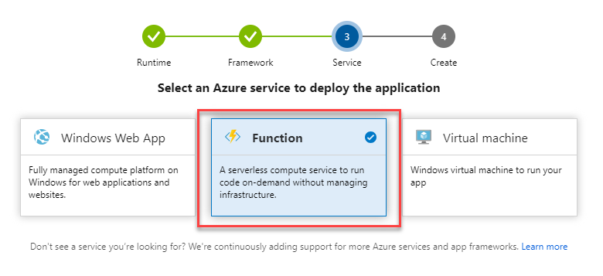
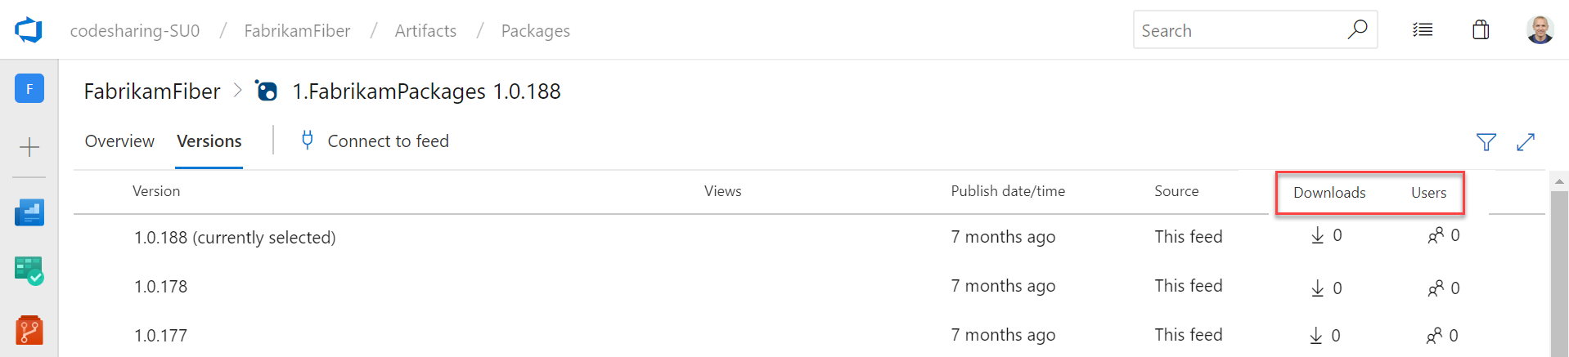
January 14 2019 – Sprint 146
Azure Pipelines - Setup builds and release pipelines for Functions in Azure Portal
Azure Artefacts - Package usage stats
#BrisAzDevOps #AzureDevOps

Slide 14
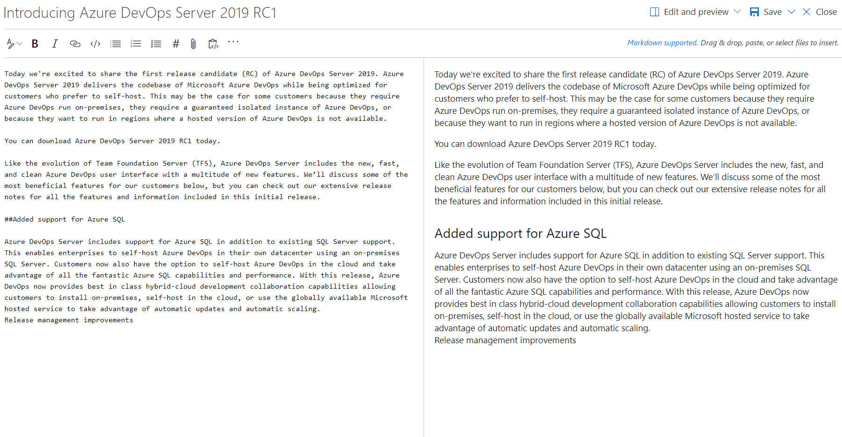
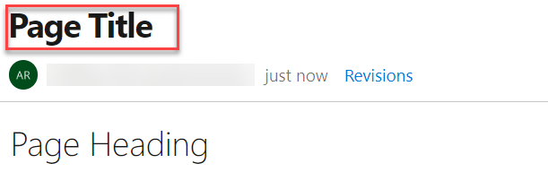
January 14 2019 – Sprint 146
Wiki - Monospaced font for Wiki Markdown editor
Wiki - Bold Wiki page titles
#BrisAzDevOps #AzureDevOps

Slide 15
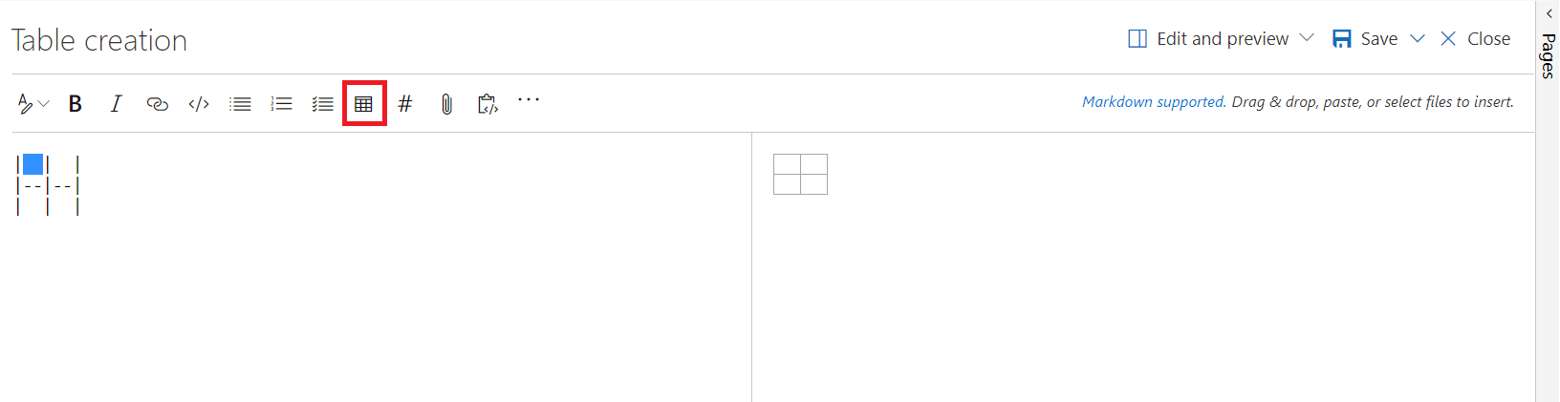
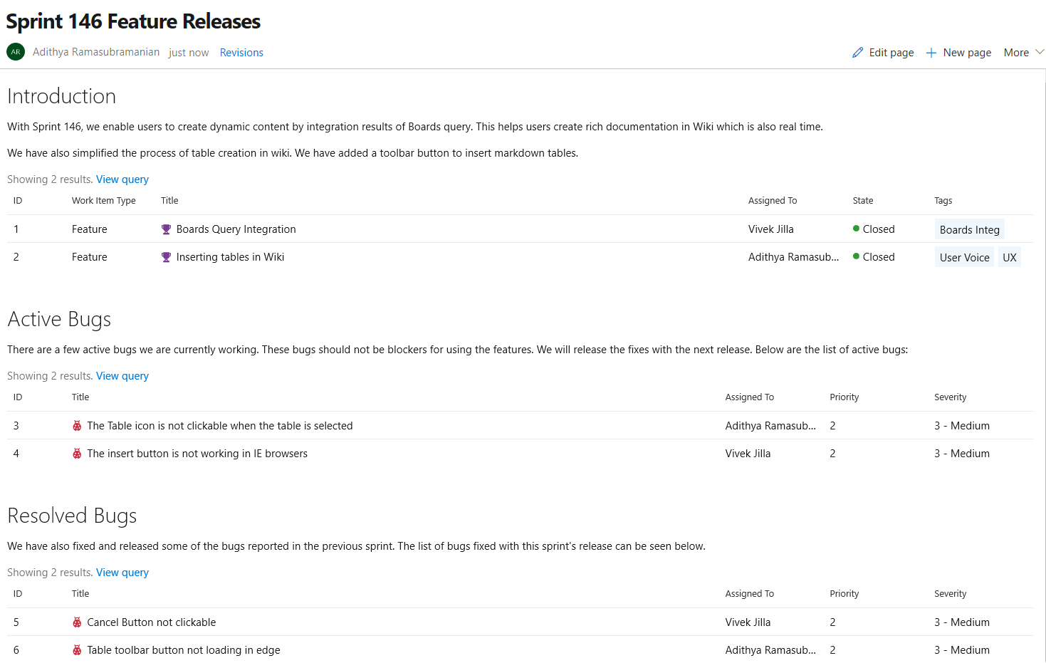
January 14 2019 – Sprint 146
Wiki - Insert Markdown table
Wiki - Embed Azure Boards query results in Wiki
#BrisAzDevOps #AzureDevOps

Slide 16
January 14 2019 – Sprint 146
Administration - Restore deleted projects
#BrisAzDevOps #AzureDevOps

Slide 17
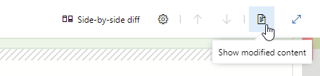
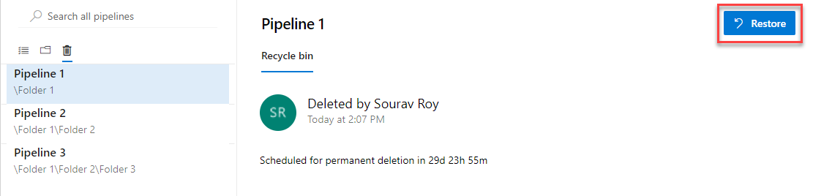
February 4 2019 – Sprint 147
Azure Repos - View just the left or right file in a pull request
Azure Pipelines – Restore deleted release pipelines
#BrisAzDevOps #AzureDevOps

Slide 18
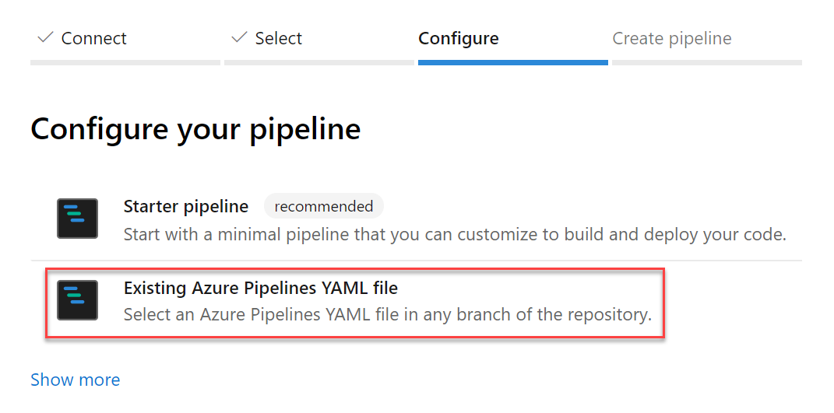
February 4 2019 – Sprint 147
Azure Pipelines - YAML files for a new pipeline are committed by your identity, not our bot
Azure Pipelines - reate pipelines from an existing YAML file in any branch or path
#BrisAzDevOps #AzureDevOps

Slide 19
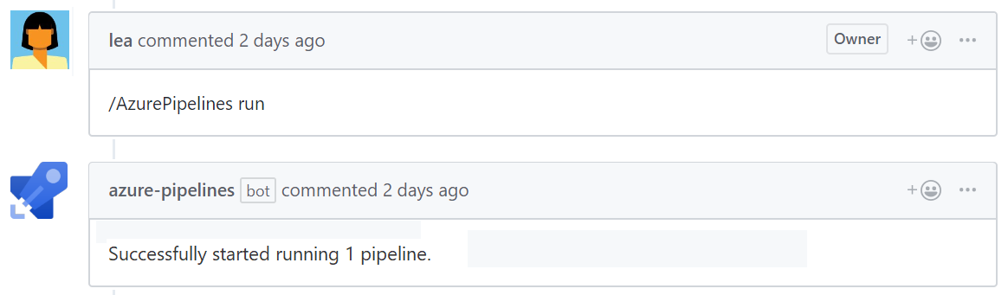
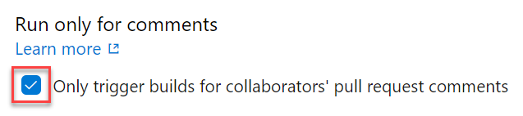
February 4 2019 – Sprint 147
Azure Pipelines - Run pipelines using GitHub pull request comments
Azure Pipelines - Limit pull request validation builds to authorized team members
#BrisAzDevOps #AzureDevOps

Slide 20
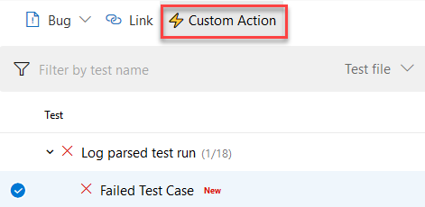
February 4 2019 – Sprint 147
Azure Pipelines - Publish build artifacts with long file paths
Azure Pipelines - New extension contribution points in the Pipelines Test tab
Until now, there was a limitation that prevented uploading build artifacts with paths longer than 233 characters. This could prevent you from uploading code coverage results from Linux and macOS builds with file paths longer than the limit. With this update, we've extended the limit to support long paths.
Custom Action button in the toolbar
Custom Details Tab in the details pane
#BrisAzDevOps #AzureDevOps

Slide 21
February 4 2019 – Sprint 147
Azure Artefacts - Proxy support for Artifacts-related tasks
Azure Artefacts - Delegate who can manage feeds
Added support for proxies to the following tasks:
npm
NuGet - restore and push commands only
.NET Core CLI - restore and NuGet push commands only
Universal Packages
npm Authenticate, Pip Authenticate, Twine Upload Authenticate
.NET Core Tool Installer, NuGet Tool Installer, Node.js Tool Installer
In Azure Artifacts, Project Collection Administrators (PCAs) have always been able to administer all feeds in an Azure DevOps organization. With this update, PCAs can also give this ability to other users and groups, thus delegating the ability to manage any feed.
#BrisAzDevOps #AzureDevOps

Slide 22
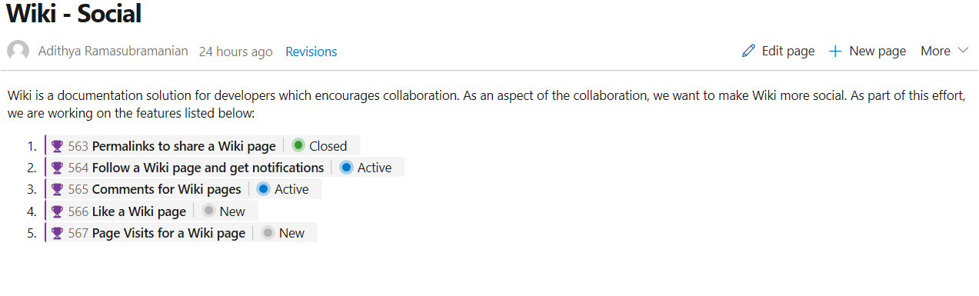
February 4 2019 – Sprint 147
Wiki - Permalinks for Wiki pages
Wiki - Show work item status in Wiki pages
Until now, shared Wiki page links broke if the linked page was renamed or moved. With this update, we've introduced permanent links by adding a page IDs to the URL. This ensures that links you share remain intact as the wiki changes over time.
#BrisAzDevOps #AzureDevOps

Slide 23
February 4 2019 – Sprint 147
Administration - All users now on New Navigation
#BrisAzDevOps #AzureDevOps

Slide 24
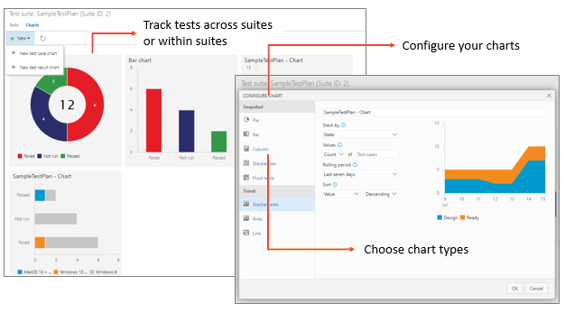
Links
https://docs.microsoft.com/en-us/azure/devops/release-notes/2019/sprint-146-update
https://docs.microsoft.com/en-us/azure/devops/release-notes/2019/sprint-147-update
#BrisAzDevOps #AzureDevOps

