Slide 1


Azure DevOps What’s New
Richard Angus
Dev iQ Pty Ltd
20th June 2019
#BrisAzDevOps #AzureDevOps

Slide 2
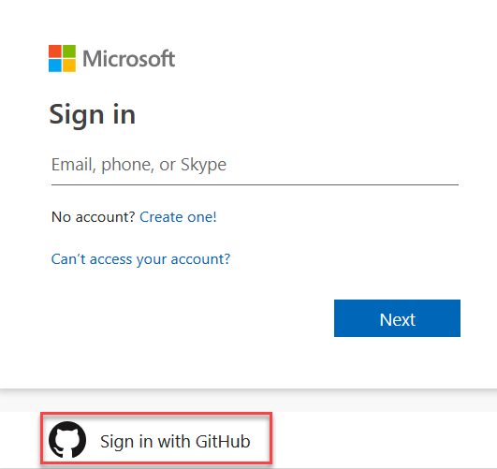
May 13 2019 – Sprint 152
General - Signing into Azure DevOps using your GitHub credentials
#BrisAzDevOps #AzureDevOps
https://www.brisazdevops.org/

Slide 3
May 13 2019 – Sprint 152
General - A simpler way to buy Azure DevOps
Azure Artifacts is switching to a per-GB consumption model
Basic will be $6 flat, with the first 5 users free
On-premises Azure Artifacts now included with Basic license
Introducing Basic + Test Plans license
One license works across multiple organizations
Licenses will be purchased at assignment time
3rd Party Paid Extensions will now be sold directly by 3rd Parties
#BrisAzDevOps #AzureDevOps
https://www.brisazdevops.org/

Slide 4
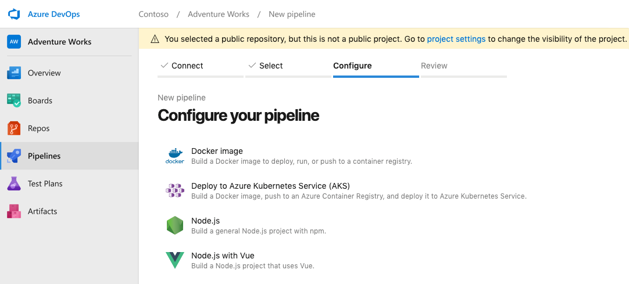
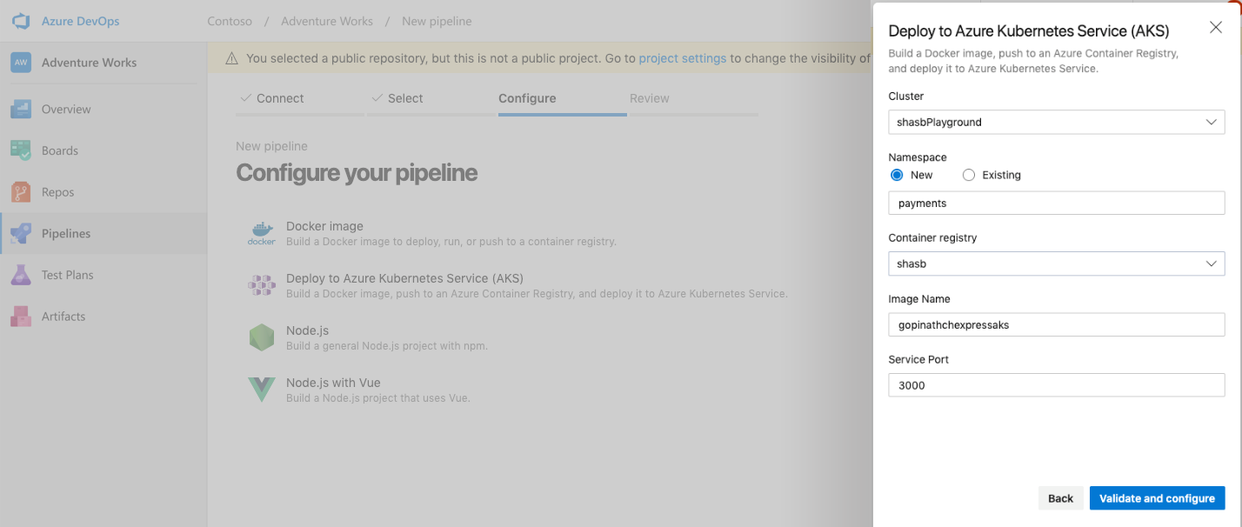
May 13 2019 – Sprint 152
Azure Pipelines - Kubernetes integration for Azure Pipelines
#BrisAzDevOps #AzureDevOps
https://www.brisazdevops.org/

Slide 5
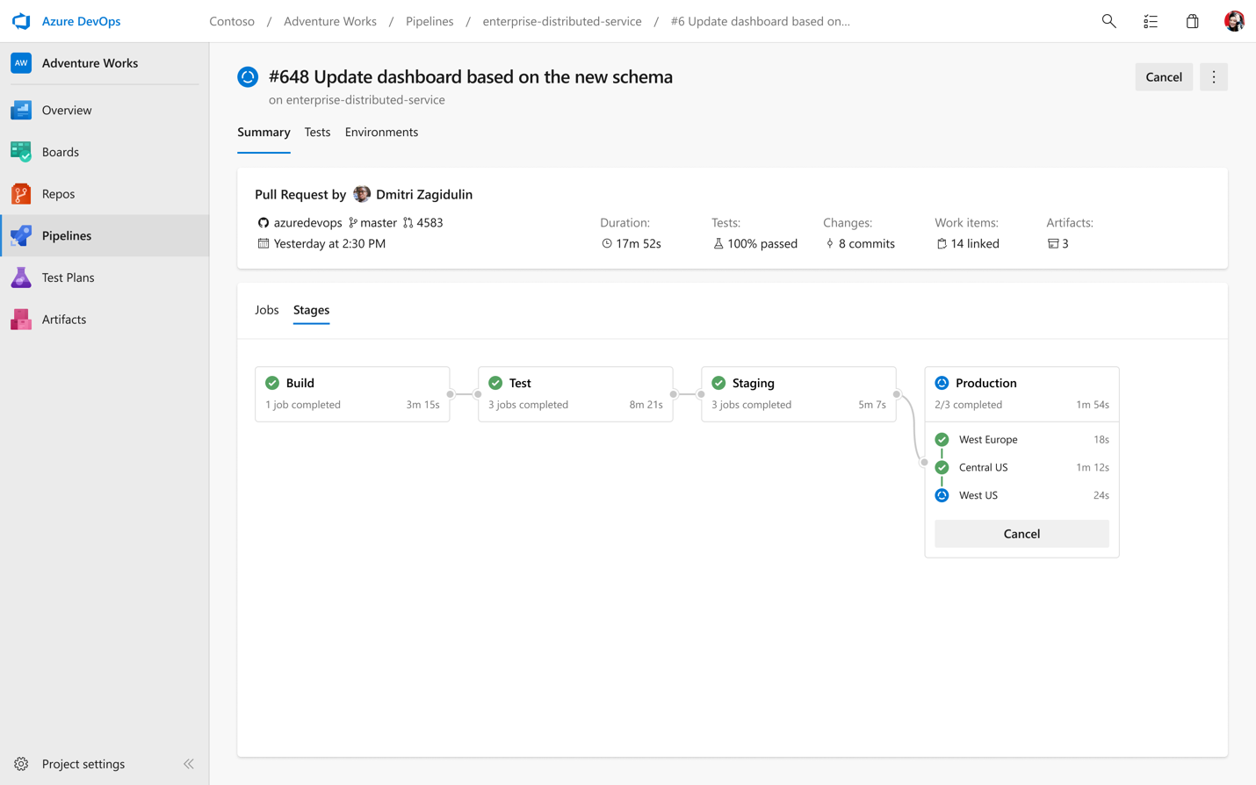
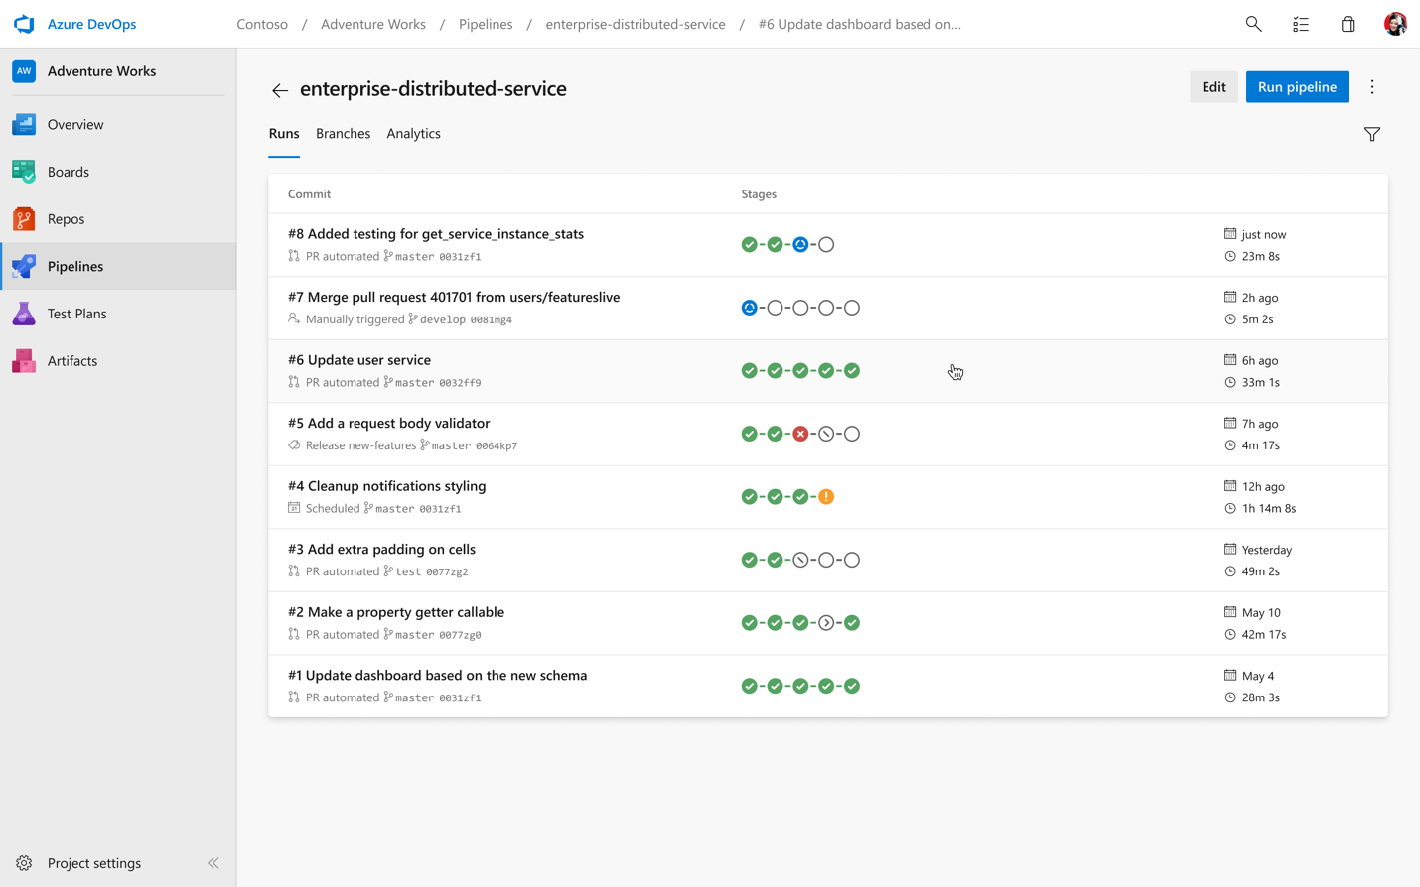
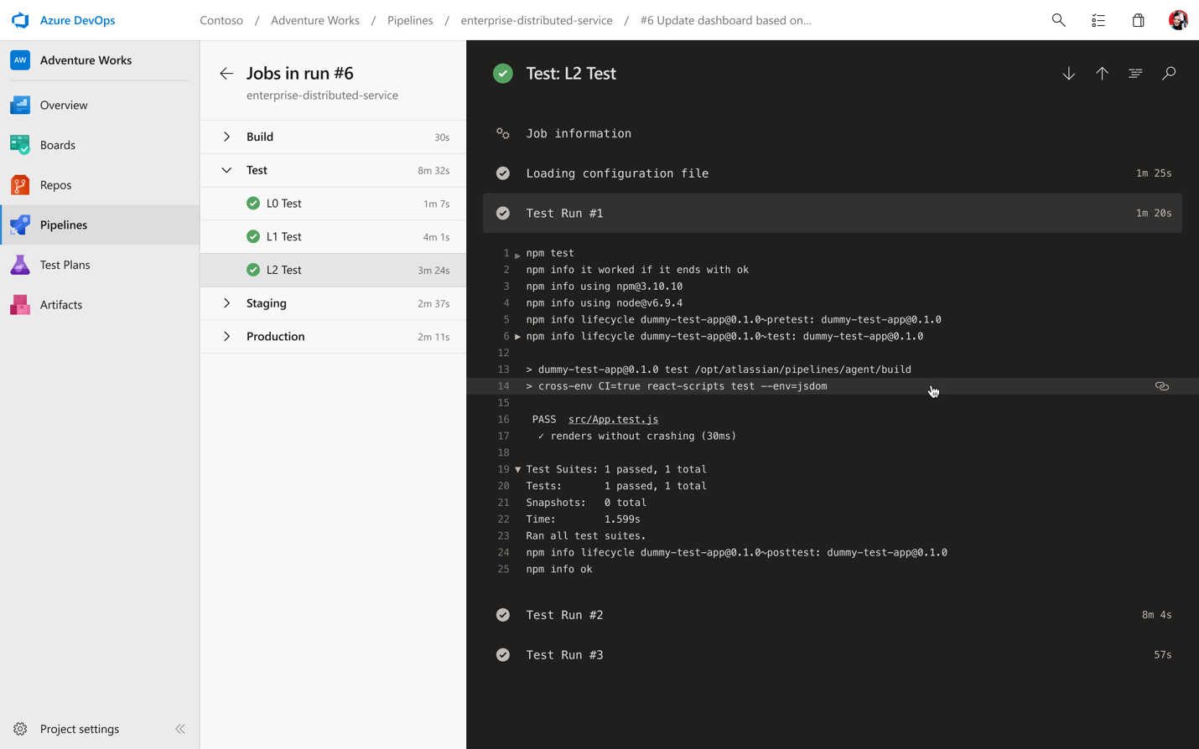
May 13 2019 – Sprint 152
Azure Pipelines - Multi-stage YAML pipelines
#BrisAzDevOps #AzureDevOps
https://www.brisazdevops.org/

Slide 6
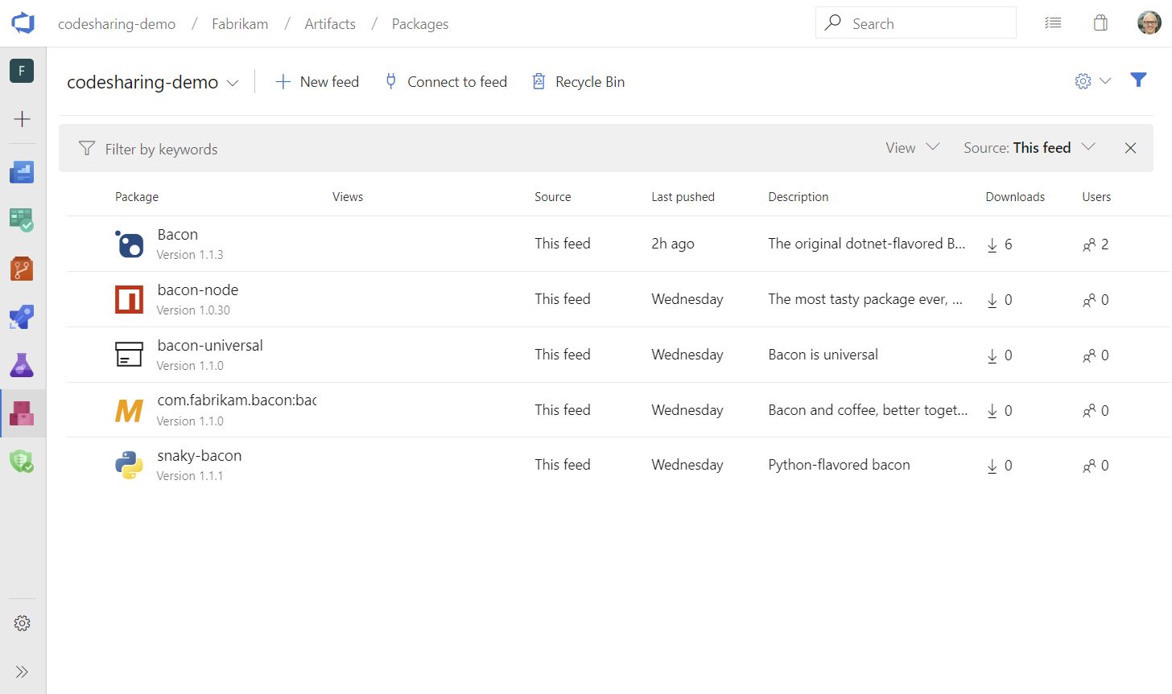
May 13 2019 – Sprint 152
Azure Artifacts- Pay-per-GB
Azure Artifacts - General availability of Python and Universal Packages
#BrisAzDevOps #AzureDevOps
https://www.brisazdevops.org/

Slide 7
May 20 2019 – Sprint 152 Update
General - Manage extensions from the command line (Requires Azure CLI)
You can now manage extensions from the command line using the az devops extension commands. By using the commands, you can create scripts that can be run for all your organizations to ensure the required extensions are available.
General - Invoke REST APIs from the command line
We’ve added the az devops invoke command to let you call any Azure DevOps REST APIs form the command line.
For example, you may have a command line script to handle automation of a particular task, but need to call an additional Azure DevOps REST API call as well. With the invoke command you can call the REST API from the command line and use the authorization available from the CLI to manage authorization and include the REST API as part of your script.
#BrisAzDevOps #AzureDevOps
https://www.brisazdevops.org/

Slide 8
May 20 2019 – Sprint 152 Update
General - Manage users from the command line
As an administrator, you may need to have a standard process to manage users. Currently, you have to repeat the same steps to add a new user and add the user to a license. This process can become tedious and error prone. Now you can use Azure DevOps CLI to create a standard script to enlist, add, and update a user and repeat the steps by just running this script.
Azure Pipelines - Updates to hosted pipelines images
Added Rust 1.34.1 to VS2017, VS2019, and Ubuntu 16.04
Added .NET Framework 4.8 to VS2017 and VS2019
Added Windows SDK 16299 to VS2019
Initialized the Visual Studio experimental instance (VSIX) for VS2017 and VS2019
Updated versions of Go, Maven, Ruby, Python, and DAV Fx
#BrisAzDevOps #AzureDevOps
https://www.brisazdevops.org/

Slide 9
May 20 2019 – Sprint 152 Update
Azure Pipelines - Create and manage pipelines from a command line
YAML-based multi-stage pipelines can now be managed from the command line by using the az pipelines command. For example, you can setup and manage pipelines interactively from the CLI, or automate the entire setup using a script.
Azure Pipelines - Manage build tags from a command line
Managing build tags when you are creating builds from the command line is now easier. With the az pipelines build tag commands, you can now kick off a build and tag the build at the same time. The Azure Pipeline build tag command allows you to add, delete or list build tags.
Azure Pipelines - Share test run results via URL
Added a Copy results URL feature so you can share a single test run results with others in your team.
The sharing levels include:
Run level
Result level
Individual tab selected within test run
Sharing is also compatible with any extension tabs configured
When you share the URL, viewers will see the test run results in the full screen view.
#BrisAzDevOps #AzureDevOps
https://www.brisazdevops.org/

Slide 10
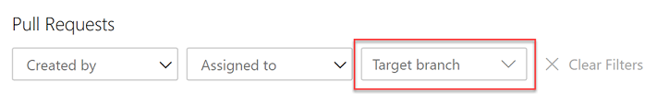
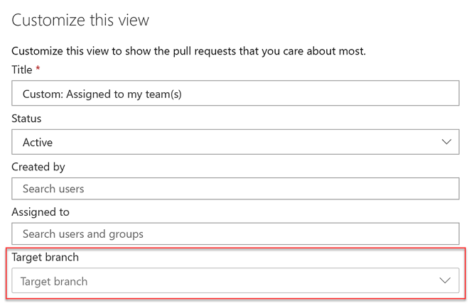
May 20 2019 – Sprint 152 Update
Azure Repos – Filter by target branch in pull requests (PRs)
#BrisAzDevOps #AzureDevOps
https://www.brisazdevops.org/

Slide 11
May 20 2019 – Sprint 152 Update
Azure Repos - Allow extensions to add syntax highlighting and autocomplete
Azure Repos - Manage git references from the command line
With the Azure Repos ref command, you can now create, list, delete references (branch/tag) and also lock or unlock a branch reference. This makes it easier to tag a commit ID without having to checkout the whole repository when working with Azure Repos from the command line.
Azure Artifacts - Manage artifacts in a pipeline run from the command line
If you need to download a set of artifacts generated by a pipeline, you can now download, upload or list the artifacts generated by a particular pipeline run from a command line using the az pipelines runs command.
#BrisAzDevOps #AzureDevOps
https://www.brisazdevops.org/

Slide 12
May 20 2019 – Sprint 152 Update
Wiki - New modern user experience
Wiki - Support for HTML tags
You can now create collapsible sections inside your wiki pages by using the details and summary tags. You can add the open attribute to keep the details expanded by default.
In addition, you can add a caption to your images using the figure and figcaption tags. These tags let you add alternate text for images and create associated image blocks. The figcaption tag can be added above or below the image.
Finally, you can highlight parts of text in your wiki pages by using the mark tag. This lets you highlight important text in your wiki pages to draw readers attention.
#BrisAzDevOps #AzureDevOps
https://www.brisazdevops.org/

Slide 13
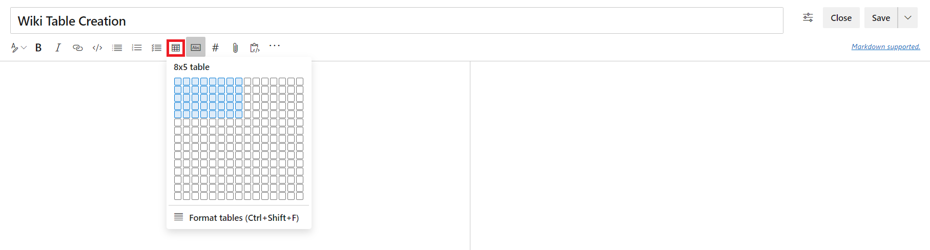
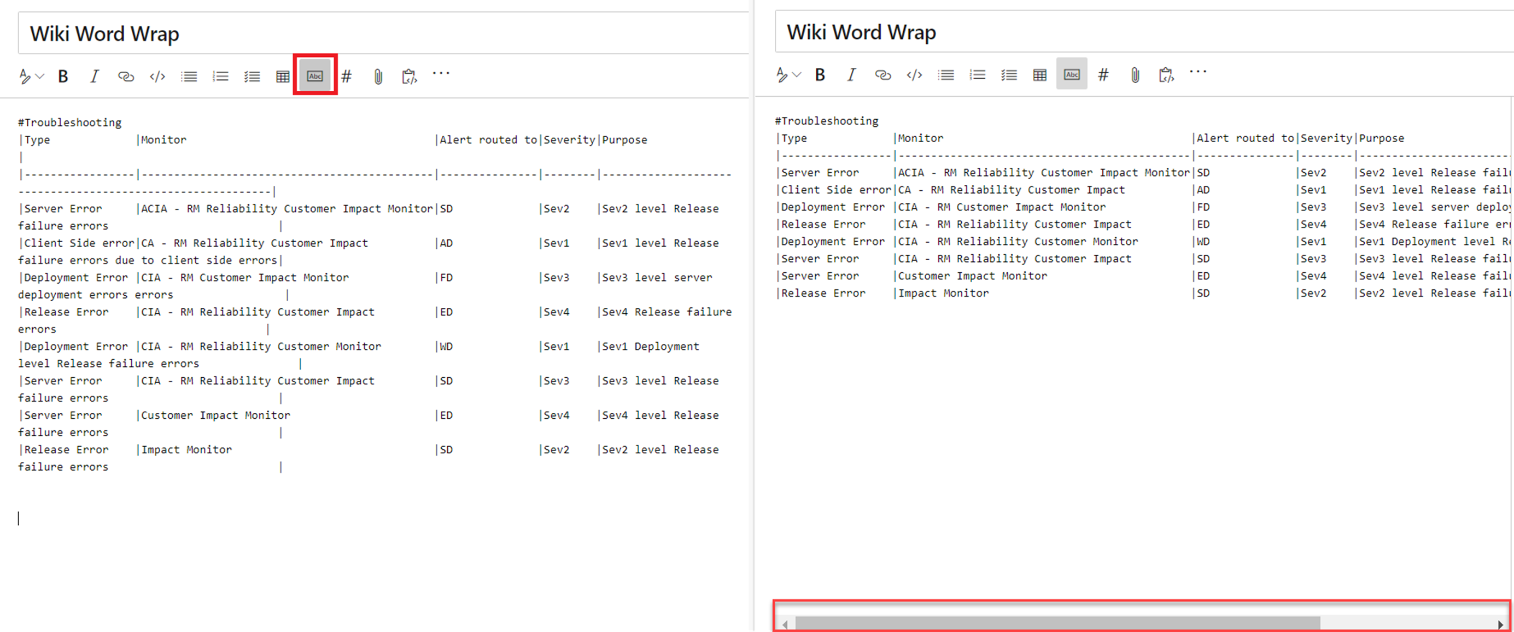
May 20 2019 – Sprint 152 Update
Wiki - Improved table creation and editing
Wiki - Improved table creation and editing
#BrisAzDevOps #AzureDevOps
https://www.brisazdevops.org/

Slide 14
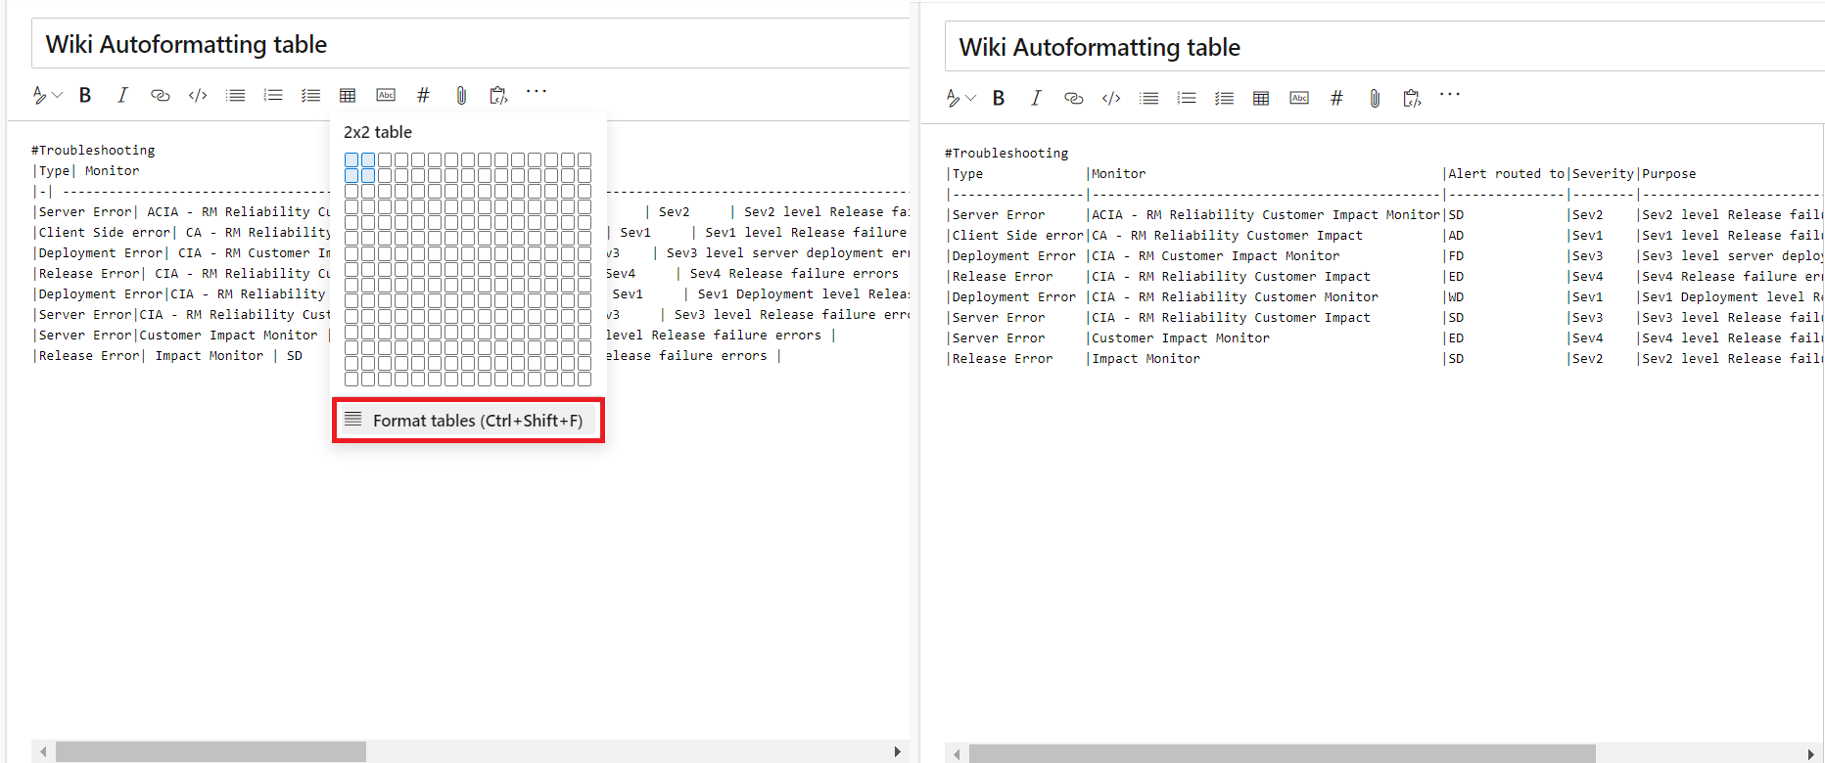
May 20 2019 – Sprint 152 Update
Wiki – Auto-formating markdown tables
#BrisAzDevOps #AzureDevOps
https://www.brisazdevops.org/

Slide 15
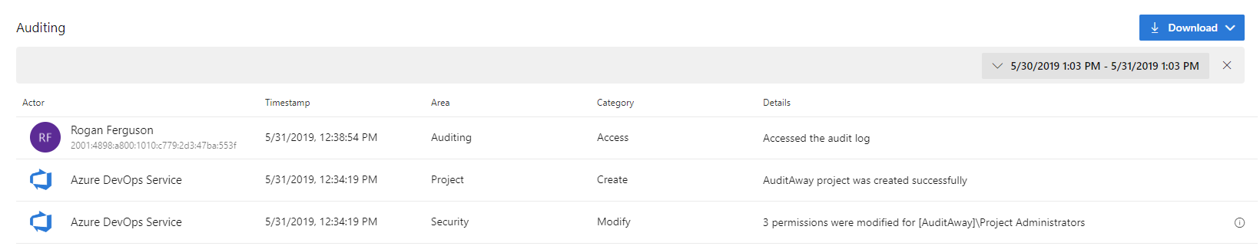
June 10 2019 – Sprint 153 Update
General - Changes to Azure DevOps IP address ranges
IPv4 ranges
13.107.6.0/24
13.107.9.0/24
13.107.42.0/24
13.107.43.0/24
IPv6 ranges
2620:1ec:4::/48
2620:1ec:a92::/48
2620:1ec:21::/48
General - Auditing public preview
#BrisAzDevOps #AzureDevOps
https://www.brisazdevops.org/

Slide 16
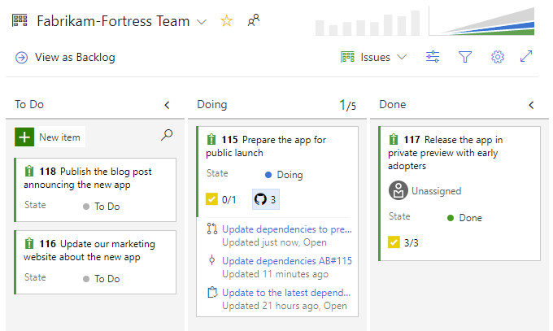
June 10 2019 – Sprint 153 Update
General - Manage security groups and permissions from the command line
Azure Boards - Quickly view linked GitHub activity from the Kanban board
#BrisAzDevOps #AzureDevOps
https://www.brisazdevops.org/

Slide 17
June 10 2019 – Sprint 153 Update
Azure Boards - Copy work items with attachments and links
Azure Boards - Preview text files on work item
Previously, the Azure Artifacts artifact type could only trigger when new package versions were published to the feed. Now, we've also added support for views, so you can trigger releases when packages already in the feed are promoted to a view.
#BrisAzDevOps #AzureDevOps
https://www.brisazdevops.org/

Slide 18
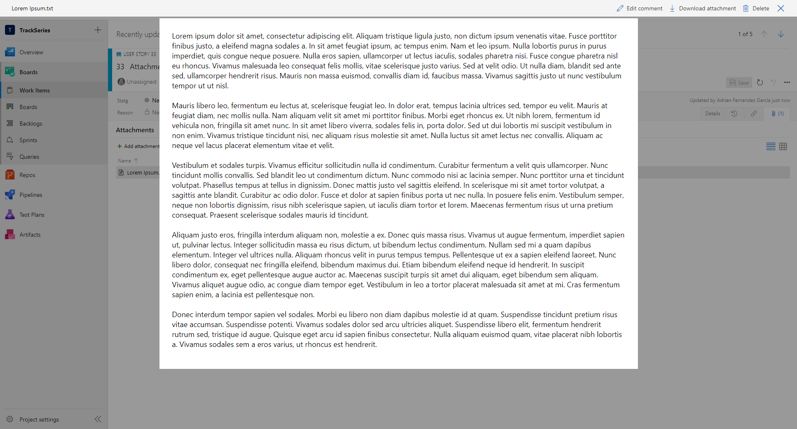
June 10 2019 – Sprint 153 Update
Azure Boards - Preview text files on work item
#BrisAzDevOps #AzureDevOps
https://www.brisazdevops.org/

Slide 19
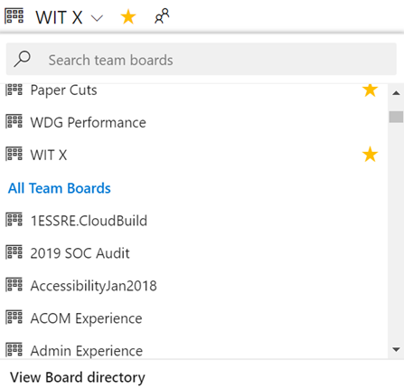
June 10 2019 – Sprint 153 Update
Azure Boards - See all teams in Boards, Backlogs, and Sprints pickers
#BrisAzDevOps #AzureDevOps
https://www.brisazdevops.org/

Slide 20
June 10 2019 – Sprint 153 Update
Azure Pipelines - Updates to hosted pipelines images
Azure Pipelines - A simpler way to work with artifacts
steps:
- publish: bin
artifact: binaries
steps:
- download: current
artifact: binaries
#BrisAzDevOps #AzureDevOps
https://www.brisazdevops.org/

Slide 21
June 10 2019 – Sprint 153 Update
Azure Pipelines - Use cron syntax to specify schedules in a YAML file
schedules:
- cron: "0 0 * * *"
displayName: Daily midnight build
branches:
include:
- master
- releases/*
exclude:
- releases/ancient/*
always: true
Azure Pipelines - Updates to multi-stage pipelines public preview
#BrisAzDevOps #AzureDevOps
https://www.brisazdevops.org/

Slide 22
June 10 2019 – Sprint 153 Update
Azure Repos - Go get command support in Azure Repos
Go is an open source programming language, also referred to as Golang. In Go, you can use the get command to download and install packages and dependencies. With this update, we've added support for go get within an Azure DevOps repository. With go get, you will be able to download packages with their dependencies named by the import paths. You can use the import key word to specify the import path.
Azure Artifacts - Filtered downloads for Universal Packages
Until now, you've always had to download an entire Universal Package, even if you only needed a few files from it. With this update, you can specify a minimatch pattern (using the same syntax as Azure Pipelines) to download a subset of files. For example:
az artifacts universal download --organization "https://dev.azure.com/myorganization/" --feed "myFeed" --name "myPackageName" --version 1.0.0 --path . --file-filter "**/*.exe;**/*.dll"
To use this feature, make sure you've updated to the latest Azure DevOps CLI extension: az extension update -n azure-devops
#BrisAzDevOps #AzureDevOps
https://www.brisazdevops.org/

Slide 23
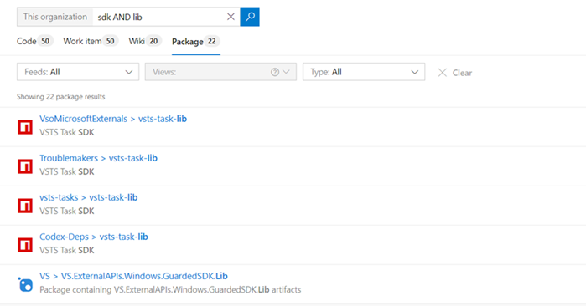
June 10 2019 – Sprint 153 Update
Azure Artifacts - Package Search: Search package by title and description:
#BrisAzDevOps #AzureDevOps
https://www.brisazdevops.org/

Slide 24
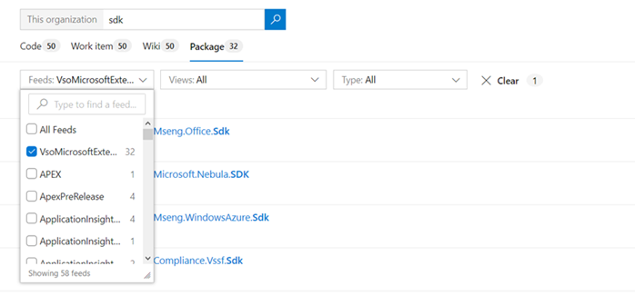
June 10 2019 – Sprint 153 Update
Azure Artifacts - Package Search: Search across all your organization feeds:
#BrisAzDevOps #AzureDevOps
https://www.brisazdevops.org/

Slide 25
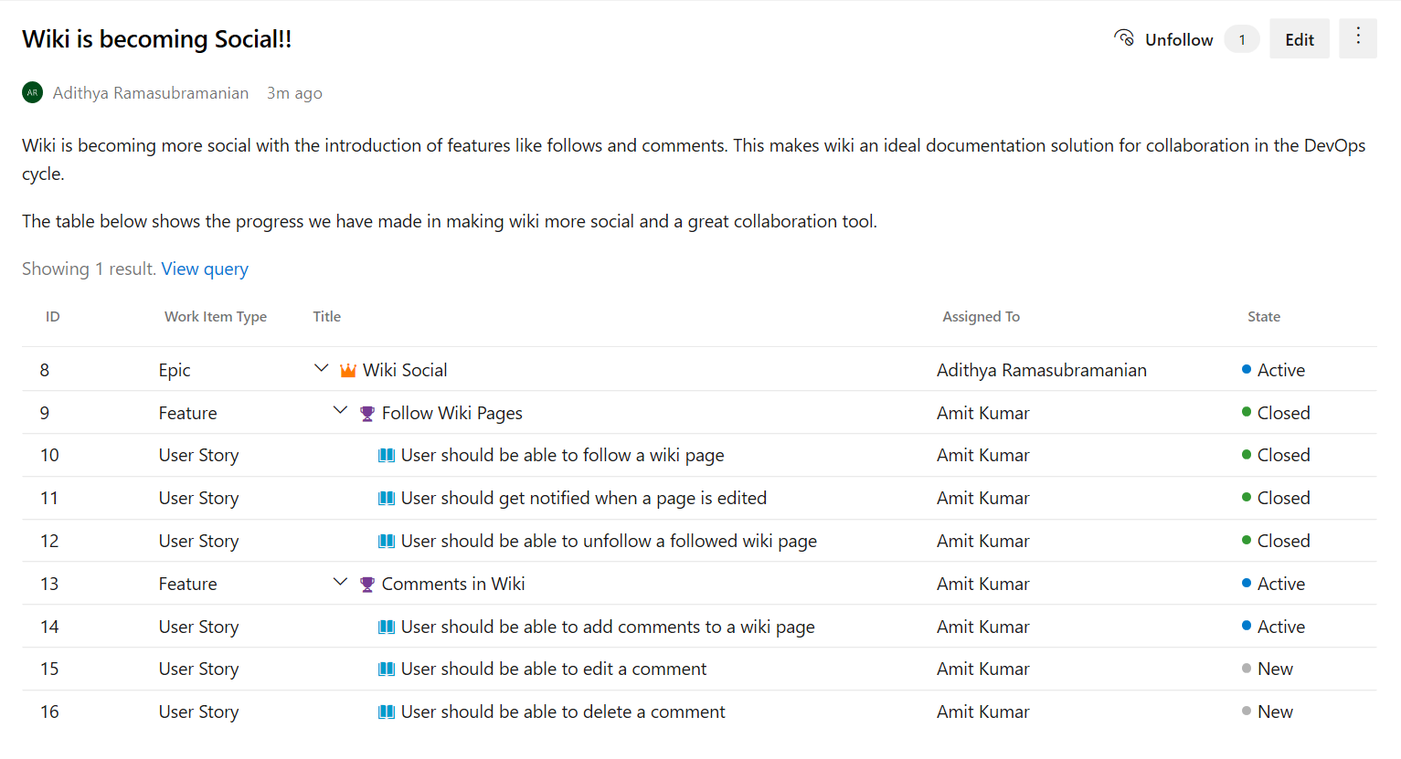
June 10 2019 – Sprint 153 Update
Wiki - Support for queries with tree of work items
#BrisAzDevOps #AzureDevOps
https://www.brisazdevops.org/

Slide 26
June 10 2019 – Sprint 153 Update
Marketplace - Top publisher certification program
We have created a Top Publisher program in the Marketplace to help you evaluate or acquire Azure DevOps extensions/integrations with confidence. The Top Publisher badge implies that the publisher has shown commitment to their customers and the Marketplace through exemplary policies, quality, reliability, and support. Marketplace assigns the badge to a publisher after carefully reviewing the publisher across a variety of parameters. Read about them here and check out the offerings from the Top Publishers.
#BrisAzDevOps #AzureDevOps
https://www.brisazdevops.org/

Slide 27
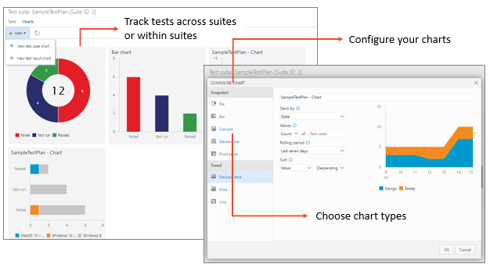
Links
May 13th 2019
May 20th 2019
10th June 2019
#BrisAzDevOps #AzureDevOps
https://www.brisazdevops.org/

