Slide 1

Caching in
by
Joshua Conaghan

Slide 2
Overview
What is caching?
Caching rationale
Distributed versus centralised
Cache scaling
Caching in file system
Database caching
Caching in memory
Additional notes

Slide 3
What is Caching?
A general definition:
“store away in hiding or for future use” - Google^{[1]}
Specific definition:
“Temporarily storing recently used information. The content, which includes HTML pages, images, files and Web objects, is stored on the local hard drive in order to make it faster for the user to access it, which helps improve the efficiency of the computer and its overall performance” - Citrix^{[2]}
Also includes page state in the case of dynamic pages (e.g. SPA)

Slide 4
Caching Rationale - Identifying
How to identify what to cache?
Manual timing logging using microtime
Profiling services such as Blackfire.io^{[6]}
Database query profiling^{[7]}
Automated testing such as Nightwatch^{[8]}

Slide 5
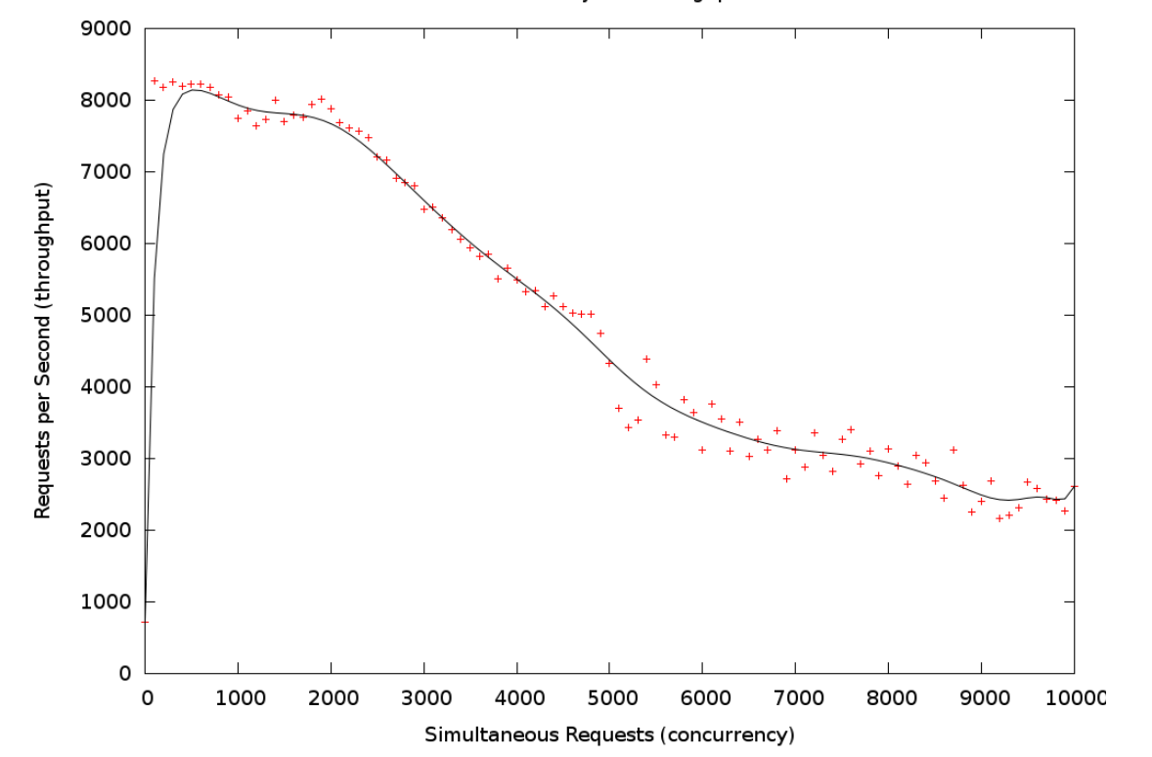
Caching Rationale – PHP Performance
Another critical reason to cache is that PHP performance begins to nose-dive when sufficient concurrency is involved (at least on a single box)^{[9]}

Slide 6
Caching Rationale – Best Practice
“The best cache is the cache that is never served from your server”
HTTP standard has browser directives which allow you greater control of caching behaviour^{[12][13]}
You can tune these via headers from PHP for caching i.e. 'If-Modified-Since' and 'ETag'

Slide 7
Caching Rationale – Cache Invalidation
“There are only two hard things in Computer Science: cache invalidation, naming things, and off-by-one errors”
Fragment caching: Specifically instead of caching an entire HTML document it is split into resources which are cached and invalidated individually (popular in RoR)
Hierarchical caches: Cached data can be stratified into a tree structure with volatile data at the leaf nodes (either not being cached or being invalidated more frequently) and the trunk and branches being cached^{[15]}
Cache Tagging: You can group resources into pools/groups to be cached/invalidated, advantage here is that one resource can be tagged to multiple groups and can be invalidated on more complex logic^{[16]}
Time-to-live (TTL) cache control: You can attach the time to live to each resource based on its known usage or volatility with less updated resources having longer times before being 'refreshed'^{[14]}

Slide 8
Distributed vs. Centralised Cache^{[17]}
Distributed
Has redundancy
Handles more dynamic caching
Network overhead
Data serialisation overhead
Better suited to load-balancing
More expensive in terms of infrastructure
Better for medium to large systems
Better suited to scaling
Centralised
Also known as 'In-Process' cache
Better suited to static caching
Duplicated cache resources (memory overhead)
Does not play nice with load-balancing (a cached resource one one box may not be cached on another box)
Better suited for small systems

Slide 9
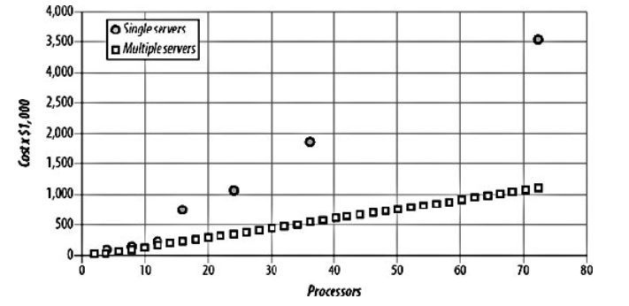
Scaling Cache
Scaling cache relates heavily to if you have chosen a decentralised or an in-process architecture for your caching
Decentralised cache is much better at dealing with horizontal scaling (and scaling in general)
In-process cache requires vertical scaling even if you want to scale horizontally (because chances are if your application has grown the amount that needs to be cached has as well)
^{[18]}

Slide 10
File System Caching – Pros & Cons
Pros:
Frees CPU cycles from DB calls
Good for low memory and/or low CPU VPS with decent storage
Faster than database for very simple fetches
Cons:
HDD overheads
Slower than memory cache (even SSD is not as fast as actual memory)
Is actually how $_SESSION works by default^{[3]}
Messy (permissions issues, security issues, file locks, concurrency)

Slide 11
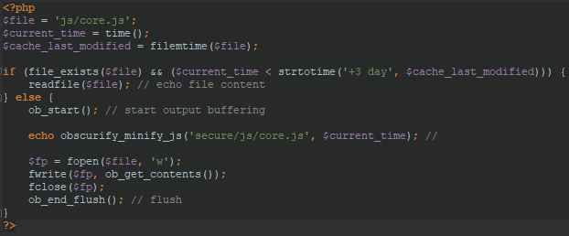
File System Caching – Implementation

Slide 12
File System Caching – Tips and Tricks
If you are already using file system caching a hybrid solution that mimics in-memory caching without changing a single line of code, is to map file system space onto system memory, applications such as tmpfs^{[5]} can be used to do this.

Slide 13
Database Caching – Pros & Cons
Pros:
Speed improvements without code change
Can be use concurrently with other caching (your DB has caching too use it actively)
Best data persistence/fault tolerance
Data mining
Auditing
Cons:
Very CPU intensive
Requires parallelisation for best CPU utilisation
Requires more infrastructure

Slide 14
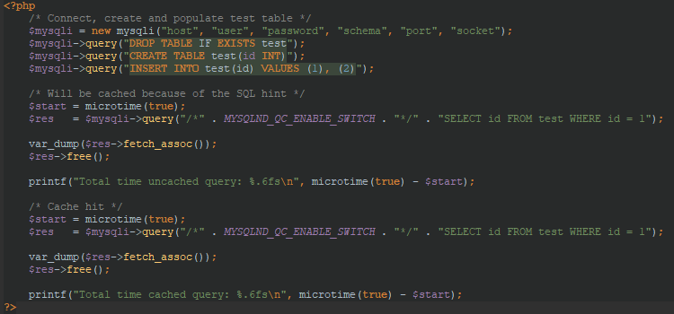
Database Caching – Implementation
Example using database caching^{[4]}

Slide 15
Memory Caching – Pros & Cons
Pros:
Fastest caching method
Basically no side effects
Variety of PHP modules available (Zend, APC, Memcached, etc.)
Cons:
Will increase your PHP process memory usage
Memory is getting expensive
Process crowding
Concurrency overhead

Slide 16
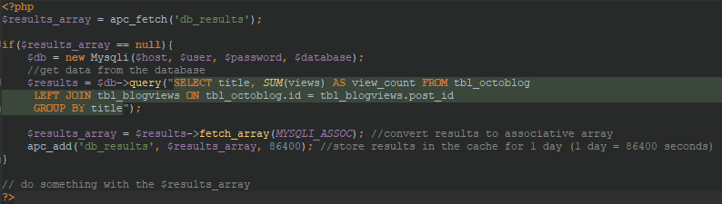
Memory Caching – Implementation
Example using APC^{[3]}
Use APCu for PHP version 5.4+

Slide 17
Memory Caching – Tips and Tricks
Database queries are not the only slow part of your application
Parsing PHP files on every request can be slow, byte-code caching fixes this
PHP OpCache (byte-code cache) is the new hotness
Byte-code cache (OpCache) and data-cache (APCu) are not the same thing^{[10]}

Slide 18

Additional Notes – Micro Cache
Not specifically tied to PHP
It partly solves one very annoying problem for most caching paradigms: dynamic data
Two key differences from other cache^{[11]}:
the period of time the content is cached (very short)
what type of content is cached (event-driven, often mistaken as dynamic)

Slide 19
Additional Notes
Caching can be quite powerful for speeding up PHP process performance for repeated queries, i.e. static data (micro-cache can also alleviate some this for dynamic data as well)
Advantages are usually reduced with high volume of unique queries i.e. if 'fresh data' is always required (again mitigated by micro-cache in some cases)
Selecting a caching method depends on business needs (budget, use cases) and system resources (HDD, memory, CPU)
Question is generally not which 'one' method to use but which combination of methods in conjunction to get the best of all worlds

Slide 20
Sources
Thanks to:
https://www.google.com.au/search?q=define%3A+caching
http://www.citrix.com/glossary/caching.html
http://wern-ancheta.com/blog/2014/01/26/getting-started-with-caching-in-php/
http://php.net/manual/en/mysqlnd-qc.quickstart.caching.php
http://eddmann.com/posts/storing-php-sessions-file-caches-in-memory-using-tmpfs/
https://blackfire.io/
https://docs.microsoft.com/en-us/sql/tools/sql-server-profiler/sql-server-profiler
http://nightwatchjs.org/
https://digitalbazaar.com/2010/myth-busting-php/
https://www.sitepoint.com/understanding-opcache/
https://blog.stackpath.com/glossary/micro-caching/
https://developers.google.com/web/fundamentals/performance/optimizing-content-efficiency/http-caching
https://developer.mozilla.org/en-US/docs/Web/HTTP/Headers/Cache-Control
http://foshttpcache.readthedocs.io/en/latest/invalidation-introduction.html
https://www.php-cache.com/en/latest/hierarchy/
https://www.php-cache.com/en/latest/#tagging
https://dzone.com/articles/process-caching-vs-distributed
https://blog.openshift.com/best-practices-for-horizontal-application-scaling/

