Slide 1

编译原理
陈明帅
m.chen@zju.edu.cn
浙江大学 · 计算机科学与技术学院
Slides partially credited to Zhongxin Liu

Slide 2
Overview
1
Introduction
2
3
4
5
6
Lexical Analysis
Parsing
Abstract Syntax
Semantic Analysis
Activation Records
9
8
7
Instruct. Selection
Blocks & Traces
Interm. Code
10
11
Liveness Analysis
Register Allocation
Fundamentals
13
18
Garbage Collection
Loop Optimizations
Advanced Topics

Slide 3
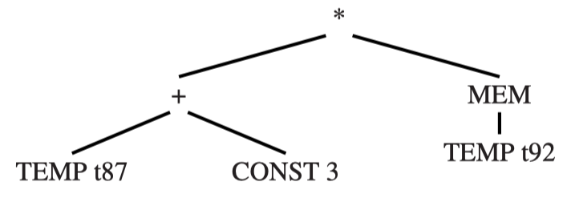
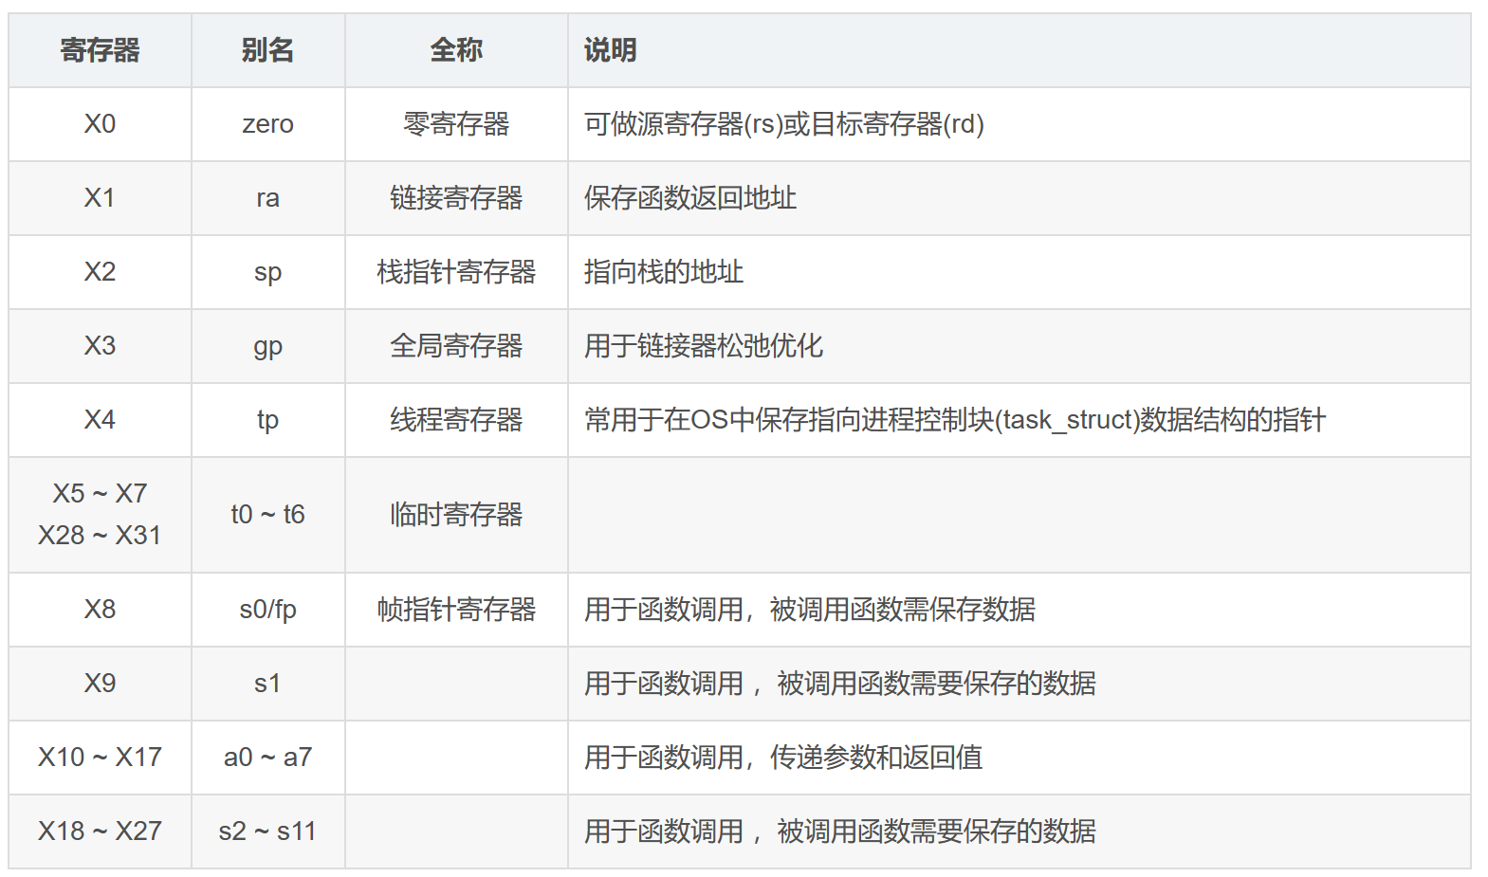
Liveness Analysis - Why
IR
Machine code
t1=x>0
fact=1
t2 = fact * x
fact = t2
…
addi a3,a0,4
addi a4,x0,1
…
addi a2,a3,0
addi a3,a4,0
t910…
t908
t909
Problem:
IR: can use an unbounded number of temporaries.
Real machine: a bounded number of registers.

Slide 4
Liveness Analysis - Why
Two temporaries a and b can fit into the same register, if they are never “in use” at the same time.
a = b + 1;
return a;
When there are too many temporaries to fit in registers, the excess temporaries can be kept in memory.
How to determine whether two variables are never “in use” at the same time?
Liveness Analysis: determine the liveness of each variable and share the register.
A variable is live if it holds a value that may be needed in the future.

Slide 5
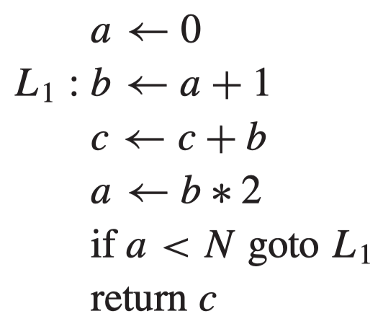
Liveness Analysis - How
How to perform the liveness analysis?
Will variable x be used after statement n?
Which statements may be executed after n?
Make a control flow graph
Will they use x?
Analyze the statements
Backward analysis: from the future to the past

Slide 6
Liveness Analysis - Example
Make a control flow graph:
node: a statement.
edge: control flow. If statement m can be followed by statement n: m -> n
1
a := 0
2
b := a+1
3
c := c+b
4
a := b*2
5
a<N
6
return c

Slide 7
Liveness Analysis - Example
The liveness of variable b
1
a := 0
2
b := a+1
3
c := c+1?
3
c := c+b
3
b := c+1?
4
a := b*2
5
a<N
6
return c

Slide 8
Liveness Analysis - Example
The liveness of variable a
1
a := 0
2
b := a+1
3
c := c+b
4
a := b*2
5
a<N
6
return c

Slide 9
Liveness Analysis - Example
The liveness of variable c
1
a := 0
2
Variable c may be
a function parameter
a local variable (undefined)
b := a+1
3
c := c+b
4
a := b*2
5
a<N
6
return c

Slide 10
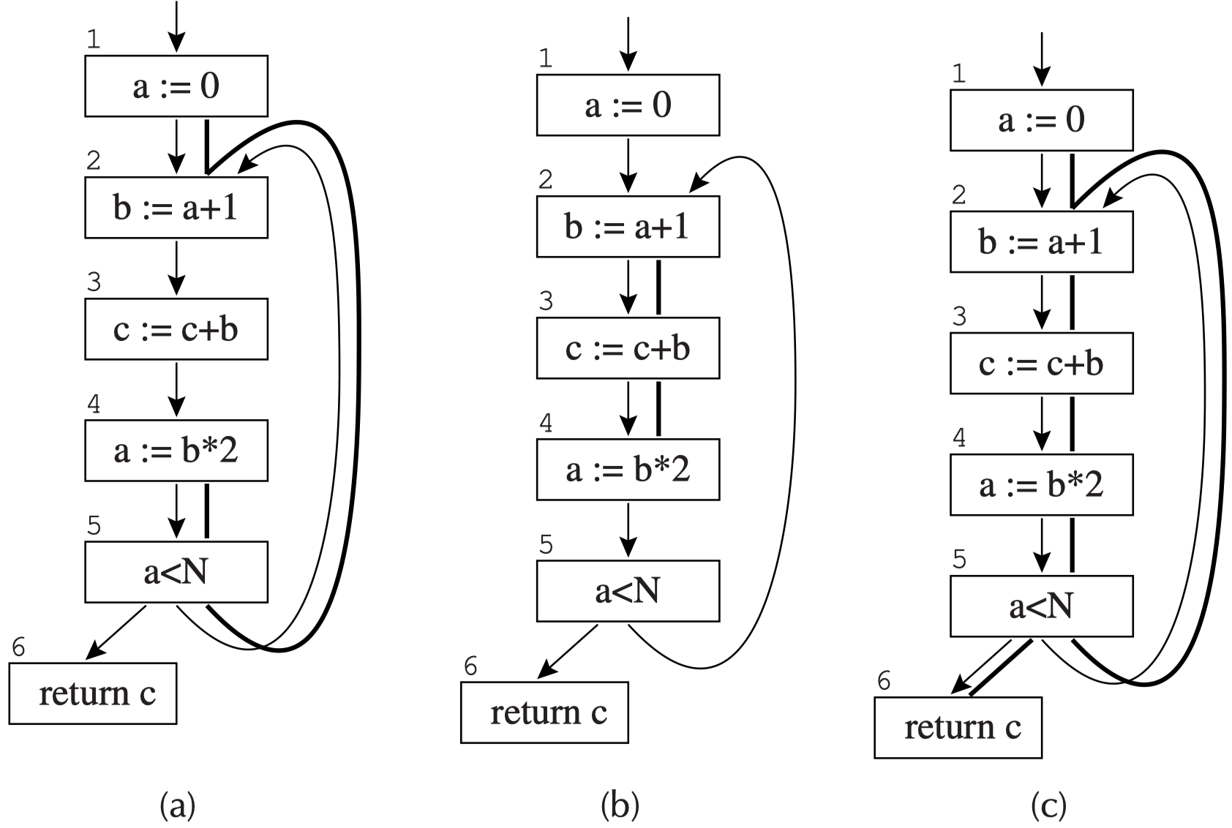
Liveness Analysis - Example
Since a and b are never live at the same time, they can be held in the same register.

Slide 11
Outline
Solution of Dataflow Equations
Liveness in the Tiger Compiler

Slide 12
Outline
Solution of Dataflow Equations
Liveness in the Tiger Compiler

Slide 13
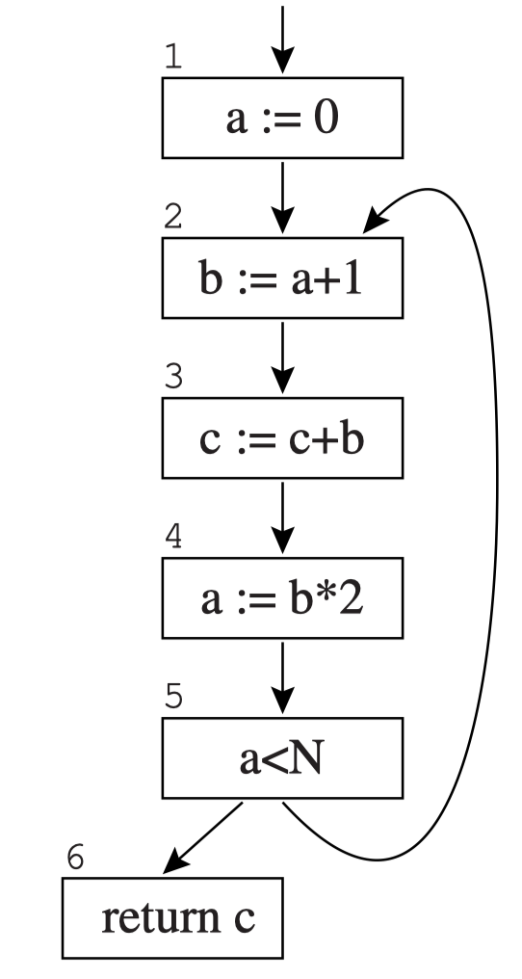
Flow Graph Terminology
Liveness of variables “flows” around the edges of the control-flow graph.
Liveness analysis is an example of dataflow problem (more in Chapter 17).
Flow graph terminology: a flow-graph node n has
out-edges: lead to successor nodes
in-edges: come from predecessor nodes
pred[n]: the set of predecessors
succ[n]: the set of successors
Example
out-edges of node 5: ?
succ[5] = ?
in-edges of 2 are ?
pred[2] = ?

Slide 14
Flow Graph Terminology
Liveness of variables “flows” around the edges of the control-flow graph.
Liveness analysis is an example of dataflow problem (more in Chapter 17).
Flow graph terminology: a flow-graph node n has
out-edges: lead to successor nodes
in-edges: come from predecessor nodes
pred[n]: the set of predecessors
succ[n]: the set of successors
Example
out-edges of node 5: {5->6, 5->2}
succ[5] = {2, 6}
in-edges of 2 are {5->2, 1->2}
pred[2] = {1, 5}

Slide 15
Uses and Defs
An assignment to a variable or temporary defines that variable.
An occurrence of a variable on the right-hand side of an assignment (or in other expressions) uses an variable.
x
:=
y z
*

Slide 16
Uses and Defs
def of a variable: the set of graph nodes that define it
def of a graph node: the set of variables that it defines
use of a variable or graph node is similar.
Example
def(3) = ?
def(a) = ?
use(3) = ?
use(a) = ?

Slide 17
Uses and Defs
def of a variable: the set of graph nodes that define it
def of a graph node: the set of variables that it defines
use of a variable or graph node is similar.
Example
def(3) = {c}
def(a) = {1, 4}
use(3) = {b, c}
use(a) = {2, 5}

Slide 18
Liveness
Liveness: A variable is live on an edge if there is a directed path from that edge to a use of the variable that does not go through any def.
this variable will be used later
this variable will not be re-defined before being used
v
no def(v)
use(v)
Live-in: A variable is live-in at a node if it is live on any of the in-edges of that node;
Live-out: A variable is live-out at a node if it is live on any of the out-edges of the node.
Notions:
in[n]: the live-in set of node n (the variables that are live-in at node n)
out[n]: the live-out set of node n (the variables that are live-out at node n)

Slide 19
Calculation of Liveness
Calculate liveness info. (in[n] and out[n]) via use and def:
If a ∊ in[m] for any m ∊ succ[n], then a ∊ out[n]
If a ∊ use[n], then a ∊ in[n]
i.e., if statement n uses variable a, a is live on entry of n
If a ∊ out[n], then a ∊ in[n] ?
p
b := c+1
in[n] = ?
in[n] = {b, N} ?
n
b < N
out[n] = ?
m1
...
...
m2
m1, m2 and their successors can
use other variables

Slide 20
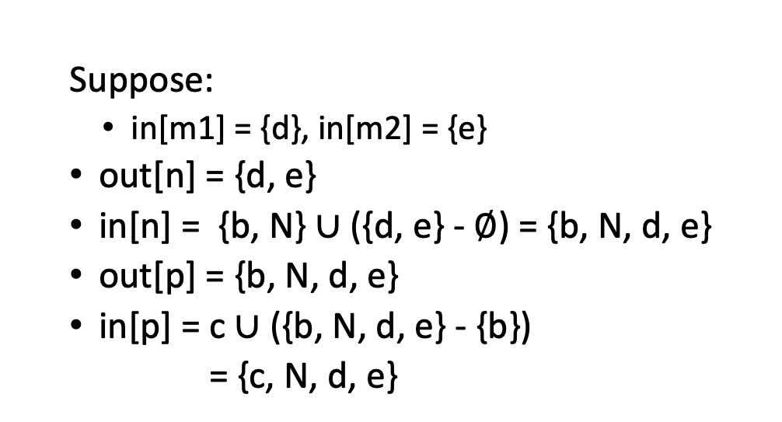
Calculation of Liveness
Calculate liveness info. (in[n] and out[n]) via use and def:
If a ∊ in[m] for any m ∊ succ[n], then a ∊ out[n]
If a ∊ use[n], then a ∊ in[n]
i.e., if statement n uses variable a, a is live on entry of n
If a ∊ out[n] and a ∉ def[n], then a ∊ in[n]
Suppose:
in[m1] = {d}, in[m2] = {e}
out[n] = {d, e}
in[n] = {b, N} ∪ ({d, e} - $∅$) = {b, N, d, e}
out[p] = {b, N, d, e}
in[p] = c ∪ ({b, N, d, e} - {b})
= {c, N, d, e}
{c, N, d, e}
p
b := c+1
{b, N, d, e}
?
{b, N, d, e}
?
n
b < N
{d, e}
?
{d}
{e}
?
m1
...
...
m2

Slide 21
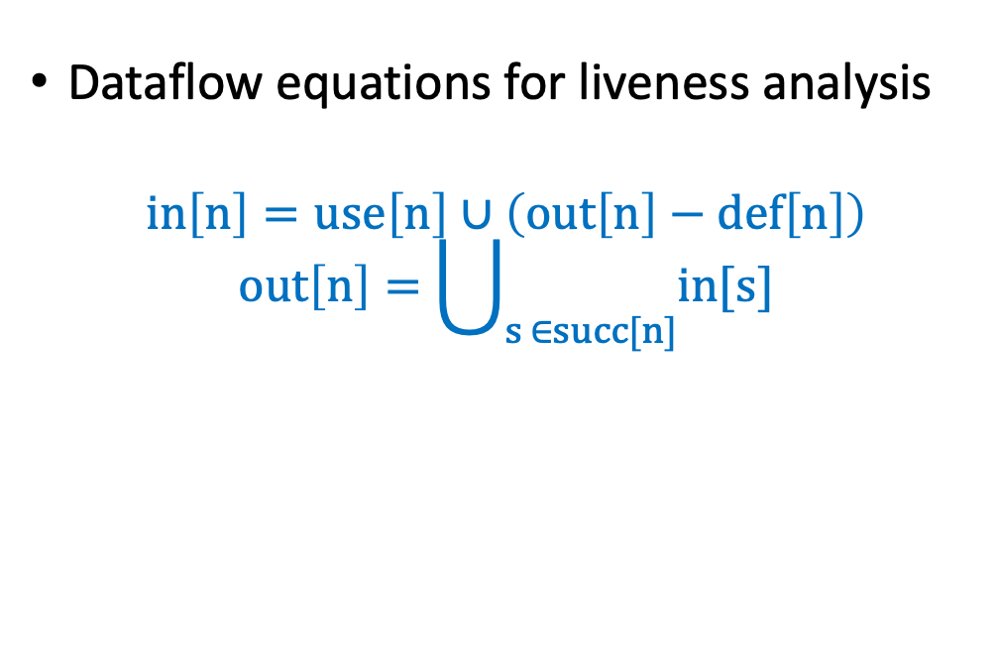
Calculation of Liveness
Calculate liveness info. (in[n] and out[n]) via use and def:
If a ∊ in[m] for any m ∊ succ[n], then a ∊ out[n]
If a ∊ use[n], then a ∊ in[n]
i.e., if statement n uses variable a, a is live on entry of n
If a ∊ out[n] and a ∉ def[n], then a ∊ in[n]
Dataflow equations for liveness analysis
$$in\left[n\right]=use\left[n\right]∪\left(out\left[n\right]−def\left[n\right]\right)$$
$$out\left[n\right]=\bigcup_{s ∈succ[n]}{in[s]}$$
p
b := c+1
n
b < N
m1
...
...
m2

Slide 22

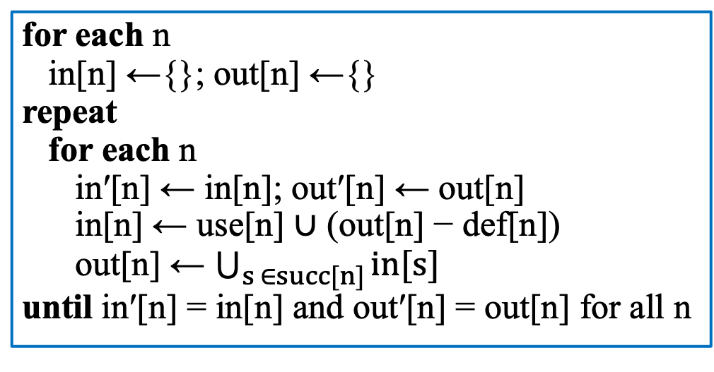
Calculation of Liveness
$$in\left[n\right]=use\left[n\right]∪\left(out\left[n\right]−def\left[n\right]\right)$$
$$out\left[n\right]=\bigcup_{s ∈succ[n]}{in[s]}$$
The algorithm for finding a solution to these equations by iteration:
for each n
in[n] ←{}; out[n] ←{}
repeat
for each n
in′[n] ← in[n]; out′[n] ← out[n]
in[n] ← use[n] ∪ (out[n] − def[n])
out[n] ← $\bigcup_{s ∈succ[n]}{in[s]}$
until in′[n] = in[n] and out′[n] = out[n] for all n

Slide 23
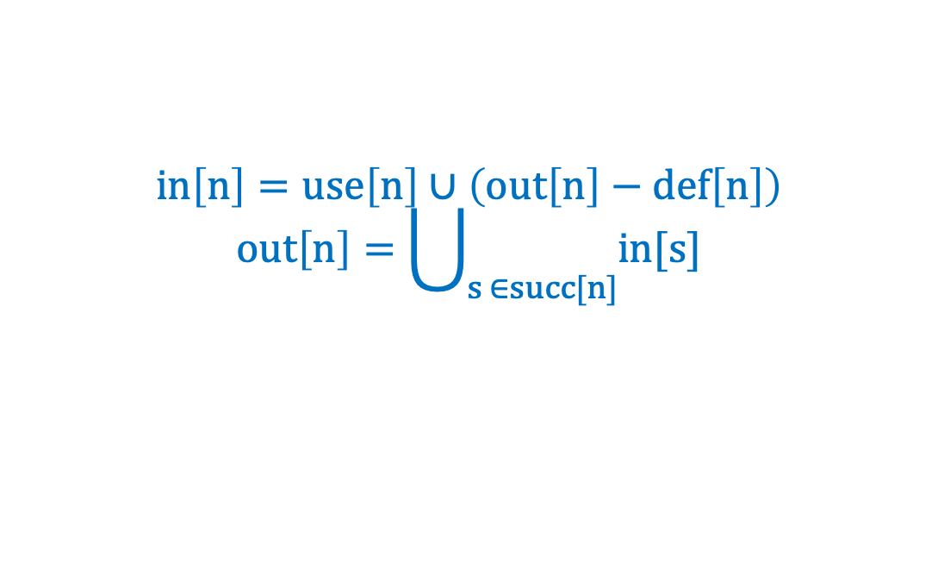
Calculation of Liveness
Example: following forward control-flow edges
 |  |  | 1st |  | 2nd |  | 3rd |  | 4th |  | 5th |  | 6th |  | 7th
 | use | def | in | out | in | out | in | out | in | out | in | out | in | out | in | out
1 |  | a
2 | a | b
3 | bc | c
4 | b | a
5 | a
6 | c
$$in\left[n\right]=use\left[n\right]∪\left(out\left[n\right]−def\left[n\right]\right)$$
$$out\left[n\right]=\bigcup_{s ∈succ[n]}{in[s]}$$

Slide 24
Calculation of Liveness
Example: following forward control-flow edges
 |  |  | 1st |  | 2nd |  | 3rd |  | 4th |  | 5th |  | 6th |  | 7th
 | use | def | in | out | in | out | in | out | in | out | in | out | in | out | in | out
1 |  | a
2 | a | b | a
3 | bc | c
4 | b | a
5 | a
6 | c
$$in\left[n\right]=use\left[n\right]∪\left(out\left[n\right]−def\left[n\right]\right)$$
$$out\left[n\right]=\bigcup_{s ∈succ[n]}{in[s]}$$

Slide 25
Calculation of Liveness
Example: following forward control-flow edges
 |  |  | 1st |  | 2nd |  | 3rd |  | 4th |  | 5th |  | 6th |  | 7th
 | use | def | in | out | in | out | in | out | in | out | in | out | in | out | in | out
1 |  | a
2 | a | b | a
3 | bc | c | bc
4 | b | a
5 | a
6 | c
$$in\left[n\right]=use\left[n\right]∪\left(out\left[n\right]−def\left[n\right]\right)$$
$$out\left[n\right]=\bigcup_{s ∈succ[n]}{in[s]}$$

Slide 26
Calculation of Liveness
Example: following forward control-flow edges
 |  |  | 1st |  | 2nd |  | 3rd |  | 4th |  | 5th |  | 6th |  | 7th
 | use | def | in | out | in | out | in | out | in | out | in | out | in | out | in | out
1 |  | a
2 | a | b | a
3 | bc | c | bc
4 | b | a | b
5 | a
6 | c
$$in\left[n\right]=use\left[n\right]∪\left(out\left[n\right]−def\left[n\right]\right)$$
$$out\left[n\right]=\bigcup_{s ∈succ[n]}{in[s]}$$

Slide 27
Calculation of Liveness
Example: following forward control-flow edges
 |  |  | 1st |  | 2nd |  | 3rd |  | 4th |  | 5th |  | 6th |  | 7th
 | use | def | in | out | in | out | in | out | in | out | in | out | in | out | in | out
1 |  | a
2 | a | b | a
3 | bc | c | bc
4 | b | a | b
5 | a |  | a
6 | c
$$in\left[n\right]=use\left[n\right]∪\left(out\left[n\right]−def\left[n\right]\right)$$
$$out\left[n\right]=\bigcup_{s ∈succ[n]}{in[s]}$$

Slide 28
Calculation of Liveness
Example: following forward control-flow edges
 |  |  | 1st |  | 2nd |  | 3rd |  | 4th |  | 5th |  | 6th |  | 7th
 | use | def | in | out | in | out | in | out | in | out | in | out | in | out | in | out
1 |  | a
2 | a | b | a
3 | bc | c | bc
4 | b | a | b
5 | a |  | a | a
6 | c
$$in\left[n\right]=use\left[n\right]∪\left(out\left[n\right]−def\left[n\right]\right)$$
$$out\left[n\right]=\bigcup_{s ∈succ[n]}{in[s]}$$

Slide 29
Calculation of Liveness
Example: following forward control-flow edges
 |  |  | 1st |  | 2nd |  | 3rd |  | 4th |  | 5th |  | 6th |  | 7th
 | use | def | in | out | in | out | in | out | in | out | in | out | in | out | in | out
1 |  | a
2 | a | b | a
3 | bc | c | bc
4 | b | a | b
5 | a |  | a | a
6 | c |  | c
$$in\left[n\right]=use\left[n\right]∪\left(out\left[n\right]−def\left[n\right]\right)$$
$$out\left[n\right]=\bigcup_{s ∈succ[n]}{in[s]}$$

Slide 30
Calculation of Liveness
Example: following forward control-flow edges
 |  |  | 1st |  | 2nd |  | 3rd |  | 4th |  | 5th |  | 6th |  | 7th
 | use | def | in | out | in | out | in | out | in | out | in | out | in | out | in | out
1 |  | a |  |  |  | a |  | a |  | ac | c | ac | c | ac | c | ac
2 | a | b | a |  | a | bc | ac | bc | ac | bc | ac | bc | ac | bc | ac | bc
3 | bc | c | bc |  | bc | b | bc | b | bc | b | bc | b | bc | bc | bc | bc
4 | b | a | b |  | b | a | b | a | b | ac | bc | ac | bc | ac | bc | ac
5 | a |  | a | a | a | ac | ac | ac | ac | ac | ac | ac | ac | ac | ac | ac
6 | c |  | c |  | c |  | c |  | c |  | c |  | c |  | c
$$in\left[n\right]=use\left[n\right]∪\left(out\left[n\right]−def\left[n\right]\right)$$
$$out\left[n\right]=\bigcup_{s ∈succ[n]}{in[s]}$$

Slide 31
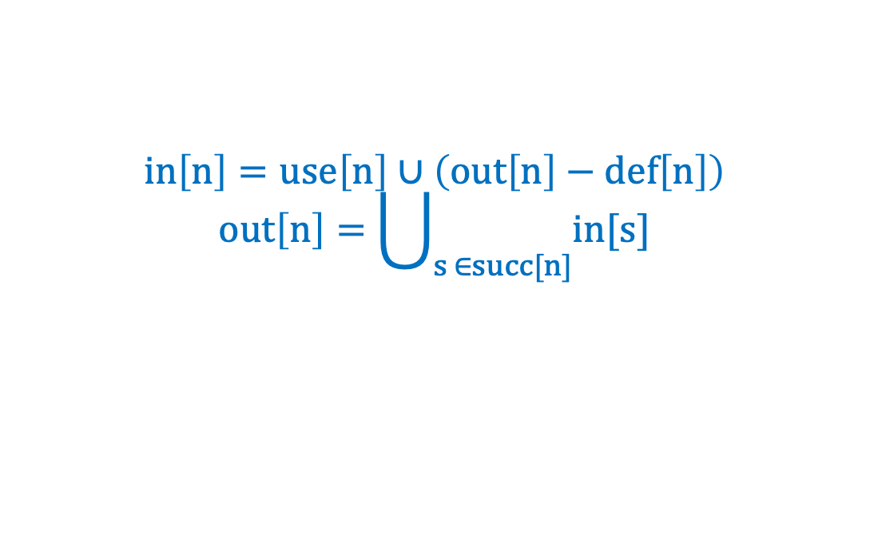
Calculation of Liveness
out[n] is computed from in[s], in[n] is computed from out[n]
We can speed the convergence by computing in the opposite order (from 6 to 1, from out to in)
 |  |  | 1st |  | 2nd |  | 3rd
 | use | def | out | in | out | in | out | in
6 | c
5 | a
4 | b | a
3 | bc | c
2 | a | b
1 |  | a
$$in\left[n\right]=use\left[n\right]∪\left(out\left[n\right]−def\left[n\right]\right)$$
$$out\left[n\right]=\bigcup_{s ∈succ[n]}{in[s]}$$

Slide 32
Calculation of Liveness
out[n] is computed from in[s], in[n] is computed from out[n]
We can speed the convergence by compute in the opposite order (from 6 to 1, from out to in)
 |  |  | 1st |  | 2nd |  | 3rd
 | use | def | out | in | out | in | out | in
6 | c |  |  | c
5 | a
4 | b | a
3 | bc | c
2 | a | b
1 |  | a
$$in\left[n\right]=use\left[n\right]∪\left(out\left[n\right]−def\left[n\right]\right)$$
$$out\left[n\right]=\bigcup_{s ∈succ[n]}{in[s]}$$

Slide 33
Calculation of Liveness
out[n] is computed from in[s], in[n] is computed from out[n]
We can speed the convergence by compute in the opposite order (from 6 to 1, from out to in)
 |  |  | 1st |  | 2nd |  | 3rd
 | use | def | out | in | out | in | out | in
6 | c |  |  | c
5 | a |  | c
4 | b | a
3 | bc | c
2 | a | b
1 |  | a
$$in\left[n\right]=use\left[n\right]∪\left(out\left[n\right]−def\left[n\right]\right)$$
$$out\left[n\right]=\bigcup_{s ∈succ[n]}{in[s]}$$

Slide 34
Calculation of Liveness
out[n] is computed from in[s], in[n] is computed from out[n]
We can speed the convergence by compute in the opposite order (from 6 to 1, from out to in)
 |  |  | 1st |  | 2nd |  | 3rd
 | use | def | out | in | out | in | out | in
6 | c |  |  | c
5 | a |  | c | ac
4 | b | a
3 | bc | c
2 | a | b
1 |  | a
$$in\left[n\right]=use\left[n\right]∪\left(out\left[n\right]−def\left[n\right]\right)$$
$$out\left[n\right]=\bigcup_{s ∈succ[n]}{in[s]}$$

Slide 35
Calculation of Liveness
out[n] is computed from in[s], in[n] is computed from out[n]
We can speed the convergence by compute in the opposite order (from 6 to 1, from out to in)
 |  |  | 1st |  | 2nd |  | 3rd
 | use | def | out | in | out | in | out | in
6 | c |  |  | c
5 | a |  | c | ac
4 | b | a | ac
3 | bc | c
2 | a | b
1 |  | a
$$in\left[n\right]=use\left[n\right]∪\left(out\left[n\right]−def\left[n\right]\right)$$
$$out\left[n\right]=\bigcup_{s ∈succ[n]}{in[s]}$$

Slide 36
Calculation of Liveness
out[n] is computed from in[s], in[n] is computed from out[n]
We can speed the convergence by compute in the opposite order (from 6 to 1, from out to in)
 |  |  | 1st |  | 2nd |  | 3rd
 | use | def | out | in | out | in | out | in
6 | c |  |  | c
5 | a |  | c | ac
4 | b | a | ac | bc
3 | bc | c
2 | a | b
1 |  | a
$$in\left[n\right]=use\left[n\right]∪\left(out\left[n\right]−def\left[n\right]\right)$$
$$out\left[n\right]=\bigcup_{s ∈succ[n]}{in[s]}$$

Slide 37
Calculation of Liveness
out[n] is computed from in[s], in[n] is computed from out[n]
We can speed the convergence by compute in the opposite order (from 6 to 1, from out to in)
 |  |  | 1st |  | 2nd |  | 3rd
 | use | def | out | in | out | in | out | in
6 | c |  |  | c
5 | a |  | c | ac
4 | b | a | ac | bc
3 | bc | c | bc
2 | a | b
1 |  | a
$$in\left[n\right]=use\left[n\right]∪\left(out\left[n\right]−def\left[n\right]\right)$$
$$out\left[n\right]=\bigcup_{s ∈succ[n]}{in[s]}$$

Slide 38
Calculation of Liveness
out[n] is computed from in[s], in[n] is computed from out[n]
We can speed the convergence by compute in the opposite order (from 6 to 1, from out to in)
 |  |  | 1st |  | 2nd |  | 3rd
 | use | def | out | in | out | in | out | in
6 | c |  |  | c
5 | a |  | c | ac
4 | b | a | ac | bc
3 | bc | c | bc | bc
2 | a | b
1 |  | a
$$in\left[n\right]=use\left[n\right]∪\left(out\left[n\right]−def\left[n\right]\right)$$
$$out\left[n\right]=\bigcup_{s ∈succ[n]}{in[s]}$$

Slide 39
Calculation of Liveness
out[n] is computed from in[s], in[n] is computed from out[n]
We can speed the convergence by compute in the opposite order (from 6 to 1, from out to in)
 |  |  | 1st |  | 2nd |  | 3rd
 | use | def | out | in | out | in | out | in
6 | c |  |  | c
5 | a |  | c | ac
4 | b | a | ac | bc
3 | bc | c | bc | bc
2 | a | b | bc
1 |  | a
$$in\left[n\right]=use\left[n\right]∪\left(out\left[n\right]−def\left[n\right]\right)$$
$$out\left[n\right]=\bigcup_{s ∈succ[n]}{in[s]}$$

Slide 40
Calculation of Liveness
out[n] is computed from in[s], in[n] is computed from out[n]
We can speed the convergence by compute in the opposite order (from 6 to 1, from out to in)
 |  |  | 1st |  | 2nd |  | 3rd
 | use | def | out | in | out | in | out | in
6 | c |  |  | c
5 | a |  | c | ac
4 | b | a | ac | bc
3 | bc | c | bc | bc
2 | a | b | bc | ac
1 |  | a
$$in\left[n\right]=use\left[n\right]∪\left(out\left[n\right]−def\left[n\right]\right)$$
$$out\left[n\right]=\bigcup_{s ∈succ[n]}{in[s]}$$

Slide 41
Calculation of Liveness
out[n] is computed from in[s], in[n] is computed from out[n]
We can speed the convergence by compute in the opposite order (from 6 to 1, from out to in)
 |  |  | 1st |  | 2nd |  | 3rd
 | use | def | out | in | out | in | out | in
6 | c |  |  | c
5 | a |  | c | ac
4 | b | a | ac | bc
3 | bc | c | bc | bc
2 | a | b | bc | ac
1 |  | a | ac
$$in\left[n\right]=use\left[n\right]∪\left(out\left[n\right]−def\left[n\right]\right)$$
$$out\left[n\right]=\bigcup_{s ∈succ[n]}{in[s]}$$

Slide 42
Calculation of Liveness
out[n] is computed from in[s], in[n] is computed from out[n]
We can speed the convergence by compute in the opposite order (from 6 to 1, from out to in)
 |  |  | 1st |  | 2nd |  | 3rd
 | use | def | out | in | out | in | out | in
6 | c |  |  | c
5 | a |  | c | ac
4 | b | a | ac | bc
3 | bc | c | bc | bc
2 | a | b | bc | ac
1 |  | a | ac | c
$$in\left[n\right]=use\left[n\right]∪\left(out\left[n\right]−def\left[n\right]\right)$$
$$out\left[n\right]=\bigcup_{s ∈succ[n]}{in[s]}$$

Slide 43
Calculation of Liveness
out[n] is computed from in[s], in[n] is computed from out[n]
We can speed the convergence by compute in the opposite order (from 6 to 1, from out to in)
 |  |  | 1st |  | 2nd |  | 3rd
 | use | def | out | in | out | in | out | in
6 | c |  |  | c |  | c |  | c
5 | a |  | c | ac | ac | ac | ac | ac
4 | b | a | ac | bc | ac | bc | ac | bc
3 | bc | c | bc | bc | bc | bc | bc | bc
2 | a | b | bc | ac | bc | ac | bc | ac
1 |  | a | ac | c | ac | c | ac | c
$$in\left[n\right]=use\left[n\right]∪\left(out\left[n\right]−def\left[n\right]\right)$$
$$out\left[n\right]=\bigcup_{s ∈succ[n]}{in[s]}$$

Slide 44
Calculation of Liveness
When solving dataflow equations by iteration, the order of computation should follow the “flow”.
Liveness flows backward along control-flow arrows, and from “out” to “in”, so should the computation.

Slide 45
Variants of the Calculation
Basic blocks: Flow-graph nodes that have only one predecessor and one successor are not very interesting.
merging them with their predecessors and successors
obtaining a graph with fewer nodes, where each node represents a basic block
One variable at a time: compute dataflow for one variable at a time as information about that variable is needed.
This is also practical, since many temporaries have very short live ranges (and thus searches terminate quickly).

Slide 46
Representations of Sets
How to represent in[n] and out[n] for implementation?
Two methods: as arrays of bits or as sorted lists of variables
Bit Arrays (for dense set)
Suppose: N variables in the program, K bits per word
N bits for each set
The union of two sets: or-ing the corresponding bits at each position.
One set-union operation takes N/K operations.
Sorted Lists (for sparse set)
sorted by any totally ordered key (such as variable name)
The union operation: merging the lists
When the sets are sparse (fewer than N/K elements, on the average), the sorted-list representation is faster.

Slide 47
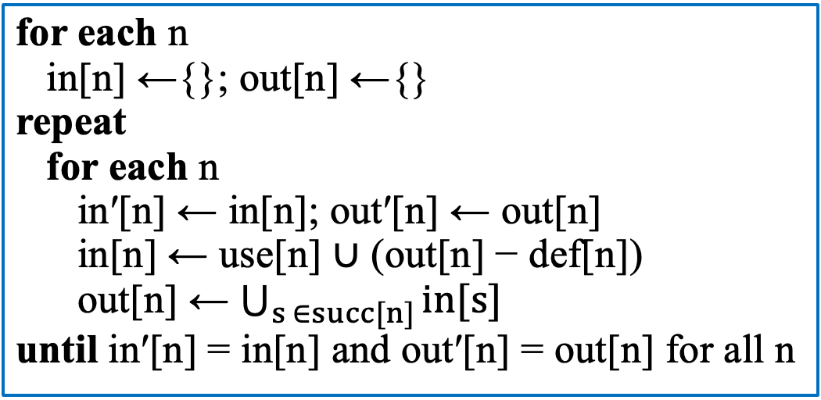
Time Complexity
How fast is iterative dataflow analysis?
A program of size N: at most N nodes and at most N variables.
Each set-union operation takes O(N) time.
For loop: computes a constant number of set operations per node. O(N) nodes => O(N^2) time.
Repeat loop: The sum of the sizes of all in and out sets is 2N^2, which is the most that the repeat loop can iterate.
Why?
The in and out sets are monotonic, and cannot keep growing infinitely.
Worst-case run time:
O(N^4)
In practice (cf. Chapter 17):
Between O(N) and O(N^2)
Proper computation order

Slide 48
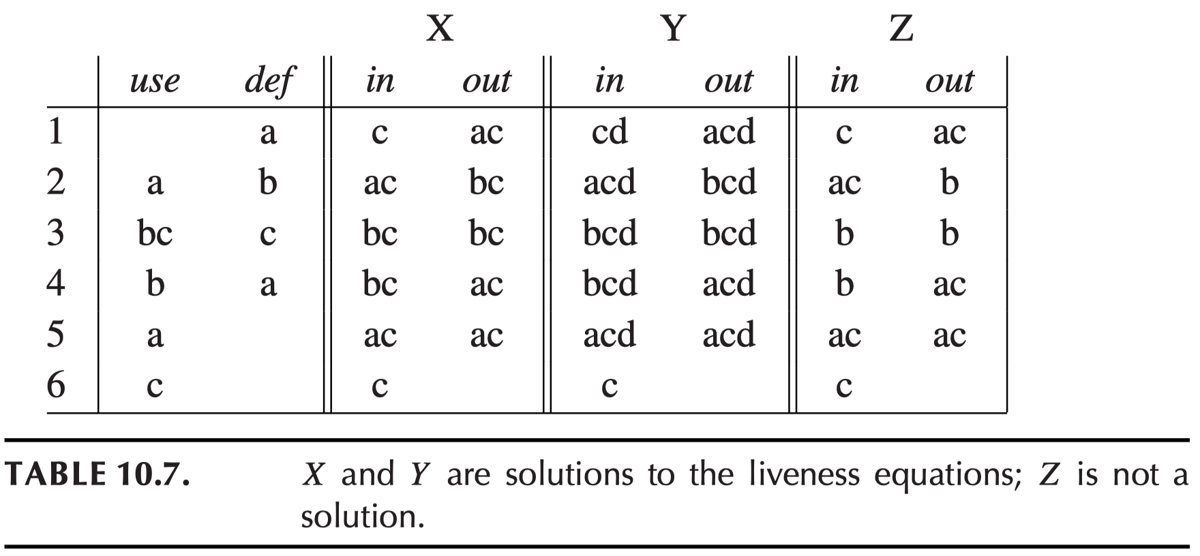
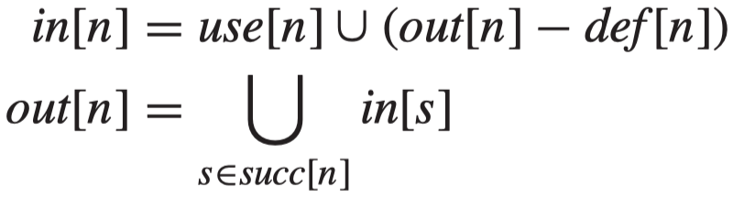
Least Fixed Points
Assume there is another program variable d not used in this fragment.
Any solution to the dataflow equations is a conservation approximation.
If a is needed after node n in some execution, we can be assured that a ∊ out[n] in any solution of the equations.
But the converse is not true. a ∊ out[n] does not mean its value will really be used.
Acceptable?

Slide 49
Least Fixed Points
In the case of liveness analysis, if variables are thought to be live at the same time, then we will make sure to hold their values in different registers.
A conservative approximation of liveness is that one may erroneously believe a variable is live, but will never erroneously believe it is dead.
The consequence of a conservative approximation: the compiled code might use more registers than it really needs; but it will compute the right answer.
Consider the live-in sets Z, which fail to satisfy the dataflow equations.
Based on Z, b and c are never live at the same time
We can assign them to the same register
The resulting program would compute the wrong answer.

Slide 50
Least Fixed Points
A dataflow equation used for compiler optimization should be set up so that any solution to it provides conservative information to the optimizer; imprecise information may lead to suboptimal but never incorrect programs.

Slide 51
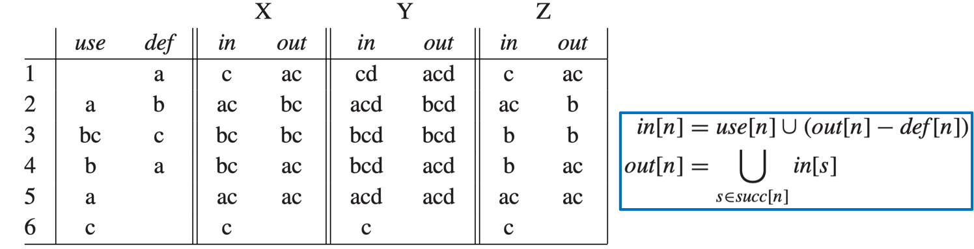
Least Fixed Points
Theorem. Equation 10.3 has more than one solutions
X and Y
If X is the solution of Equation 10.3 and all solutions to Equation 10.3 contains Solution X, we say that X is the least solution (least fixed point) to Equation 10.3.
Equation 10.3 have a least fixed point and the iteration algorithm described above always computes the least fixed point. (Proof. See Exercise 10.2)

Slide 52
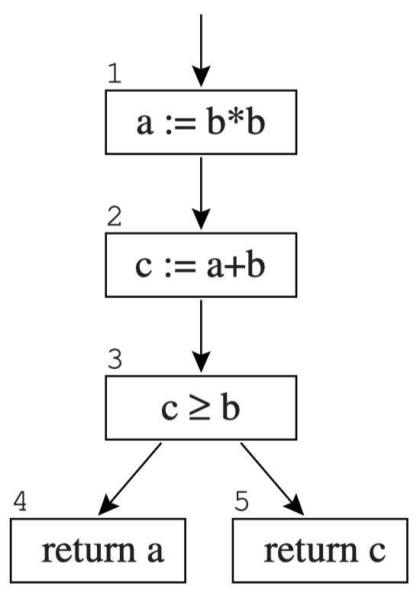
Static and Dynamic Liveness
Node 1: a = b*b >= 0
Node 2: c = a+b >= b
Node 3: always be true
Node 4 will never be reached
The equations are ignorant of which way the conditional branch will go.
“Smarter” equations would permit a and c to be assigned the same register.

Slide 53
Static and Dynamic Liveness
No compiler can ever fully understand how all the control flow in every program will work.
Prove through the halting problem
Theorem. There is no program H that takes as input any program P and input X and returns true if P(X) halts (without infinite-looping) and false otherwise.
Corollary. No program H’(P, L) can tell, for any program P and label L in P, whether the label L is ever reached on an execution of P.
prove by showing that if H’ exists, then H exists.
let L be the end of the program, halt => goto L

Slide 54
Conservative Approximation
This theorem does not mean that we can never tell if a given label is reached or not, just that there is not a general algorithm that can always tell.
We could improve out liveness analysis with some special-case algorithms.
But, no compiler can really tell if a variable’s value is truly needed – whether the variable is truly live.
We have to make do with a conservative approximation.
Assume that any conditional branch goes both ways.

Slide 55
Conservative Approximation
Therefore, we have : dynamic condition
And its static approximation
Dynamic liveness: a variable a is dynamically live at node n if some execution of the program goes from n to a use of a without going through any definition of a.
Static liveness: a variable a is statically live at node n if there is some path of control-flow edges from n to some use of a that does not go though a definition of a.
If a is dynamically live, it is also statically live.

Slide 56
Interference Graphs
One of the most important applications of liveness analysis is for register allocation.
We have a set of temporaries a, b, c, ... and registers r1, ..., rk.
A condition that prevents a and b from being allocated to the same register is called an interference.
Two types of interferences:
overlapping live ranges
when a must be generated by an instruction that cannot address register r1, then a and r1 interfere

Slide 57
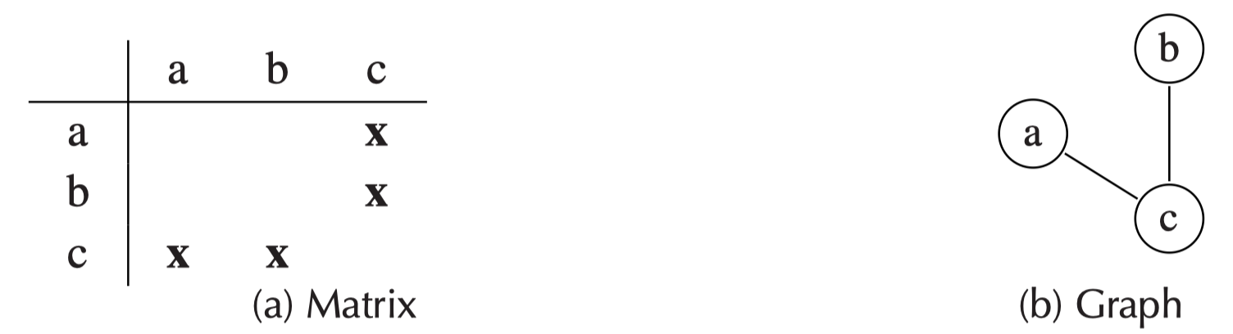
Interference Graphs
The expression of interference:
a matrix
x marking interferences
undirected graph
node: each variable
edge: connecting variables that interfere
b
a
Allocating registers by coloring the inference graph
c

Slide 58
Special Treatment of MOVE instructions
Do not create artificial interferences between the source and destination of a MOVE. Consider:
t := s (copy)
...
x := ... s ... (use of s)
...
y := ... t ... (use of t)
t := s (copy)
t := ...
x := ... s ... (use of s)
...
y := ... t ... (use of t)
Normally, we would make an interference edge (s, t).
But we do not need separate registers for s and t, since they contain the same value.
Solution: not to add an interference edge (s, t) in this case.
If there is a later (non-move) definition of t while s is still live, that will create the inference edge (t, s)

Slide 59
Interference Graphs
Therefore, the way to add interference edges for each new definition is:
At any non-move instruction n that defines a variable a, where out[n] = (b1, ..., bj), add interference edges (a, b1), .., (a, bj).
At a move instruction a := c, where {b1, ..., bj} are the live- out set, add interference edges (a, b1), ..., (a, bj) for any bi that is not the same as c.

Slide 60
Outline
Solution of Dataflow Equations
Liveness in the Tiger Compiler

Slide 61
Liveness in The Tiger Compiler
The flow analysis for the Tiger compiler is done in two stages:
The control flow of the Assem program is analyzed, producing a control-flow graph;
The liveness of variables in the control-flow graph is analyzed, producing an interference graph.
(For detailed implementation, refer to textbook.)

Slide 62
Graphs
When using a graph in an algorithm, we want each node to represent something (e.g., an instruction in a program).
To make node-to-thing mappings, we use a G_table (a Hashtable).
The following idiom associates information x with node n in a mapping mytable.
G_enter(mytable,n,x)
We can also put x directly inside n:
n = G_Node(g, x): creates a new node n with info x
G_nodeInfo(n): retrieves x

Slide 63
Control-Flow Graphs
The FlowGraph package manages control-flow graphs:
node: a instruction (or basic block)
edge(m, n): if instruction m can be followed by instruction n (either by a jump or by falling through)

Slide 64
Control-Flow Graphs
/* ﬂowgraph.h */
Temp_tempList FG_def(G_node n);
Temp_tempList FG_use(G_node n);
bool FG_isMove(G_node n);
G_graph FG_AssemFlowGraph(AS_instrList il);
Each node has the following properties:
FG_def(): what temporaries are defined at this node (destination registers of the instruction).
FG_ use(): what temporaries are used at this node (source registers of the instruction).
FG_isMove(): whether this instruction is a MOVE instruction, one that could be deleted if the def and use were identical.

Slide 65
Information Associated with the Nodes
Information associated with the nodes
A flow graph: associate some use and def information with each node
The liveness-analysis algorithm: remember live-in and live-out information at each node
Other analyses on flow graphs: other kinds of information about each node
We may not want to modify the data structure (which is a widely used interface) for each new analysis.
A graph is a graph, and that a ﬂow graph is a graph along with separately packaged auxiliary information (tables, or functions mapping nodes to whatever).

Slide 66
Liveness Analysis
/* liveness.h */
typedef struct Live_moveList_ *Live_moveList;
struct Live_moveList_ {G_node src, dst; Live_moveList tail;};
Live_moveList Live_MoveList(G_node src, G_node dst, Live_moveList tail);
struct Live_graph { G_graph graph; Live_moveList moves; };
Temp_temp Live_gtemp(G_node n);
struct Live_graph Live_liveness(G_graph flow);
The Liveness module:
input: a flow graph
output: an interference graph + a list of node-pairs (representing MOVE instructions) that should be assigned the same register
Live_gtemp tells what temporary variable is represented by n.

Slide 67
Liveness Analysis
In the implementation of the Liveness module, it is useful to maintain a data structure that remembers what is live at the exit of each flow-graph node:
static void enterLiveMap(G_table t, G_node flowNode, Temp_tempList temps) {
G_enter(t, flowNode, temps);
}
static Temp_tempList lookupLiveMap(G_table t, G_node flownode) {
return (Temp_tempList)G_look(t, flownode);
}
With a complete liveMap, we can construct a interference graph using the way we described just now.

Slide 68
Liveness Analysis
What if a newly defined temporary is not live just after its definition?
A variable is defined but never used.
No need to put it in a register
But if the defining instruction is going to execute (perhaps for some other side effect), then it will write to some register.
That register had better not contain any other live variable.
Thus, zero-length live ranges do interfere with any live ranges that overlap them.

Slide 69
Homework
10.1

