Slide 1

编译原理
陈明帅
m.chen@zju.edu.cn
浙江大学 · 计算机科学与技术学院
Slides partially credited to Zhongxin Liu

Slide 2
Overview
1
Introduction
2
3
4
5
6
Lexical Analysis
Parsing
Abstract Syntax
Semantic Analysis
Activation Records
9
8
7
Instruct. Selection
Blocks & Traces
Interm. Code
10
11
Liveness Analysis
Register Allocation
Fundamentals
13
18
Garbage Collection
Loop Optimizations
Advanced Topics

Slide 3
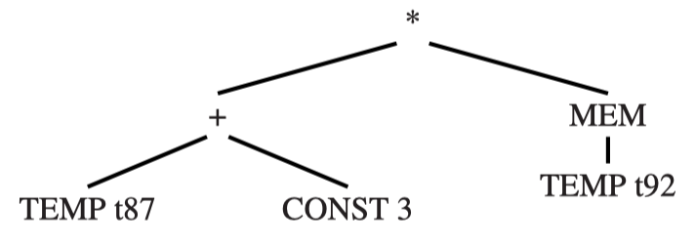
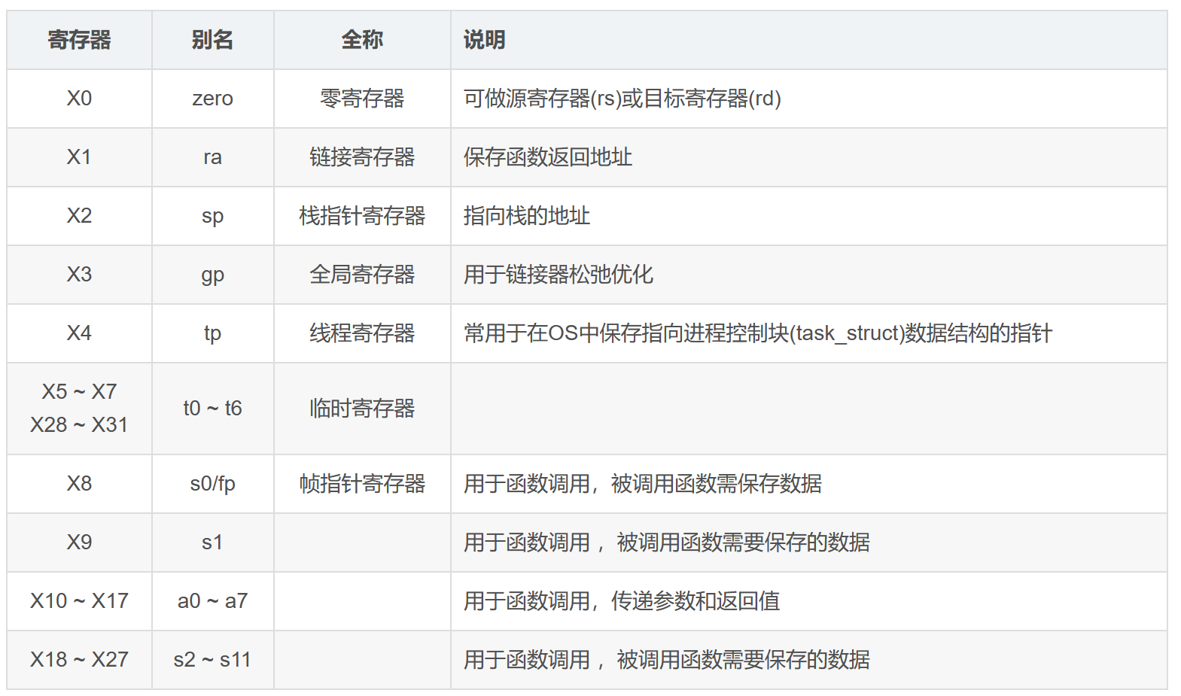
Register Allocation
IR
Machine code
t1=x>0
fact=1
t2 = fact * x
fact = t2
…
addi a3,a0,4
addi a4,x0,1
…
addi a2,a3,0
addi a3,a4,0
t910…
t908
t909
Mapping an unbounded number of IR temporaries to
finitely many machine registers

Slide 4
Register Allocator
What: The job of the register allocator is to assign the many temporaries to a small number of machine registers
Assign the source and destination of a MOVE to the same register so that the MOVE can be deleted.
How:
derive an interference graph (via liveness analysis)
coloring the inference graph
No pair of nodes connected by an inference edge may be assigned the same color.
Colors correspond to registers

Slide 5
Outline
Coloring by Simplification
Coalescing
Precolored Nodes

Slide 6
Outline
Coloring by Simplification
Coalescing
Precolored Nodes

Slide 7
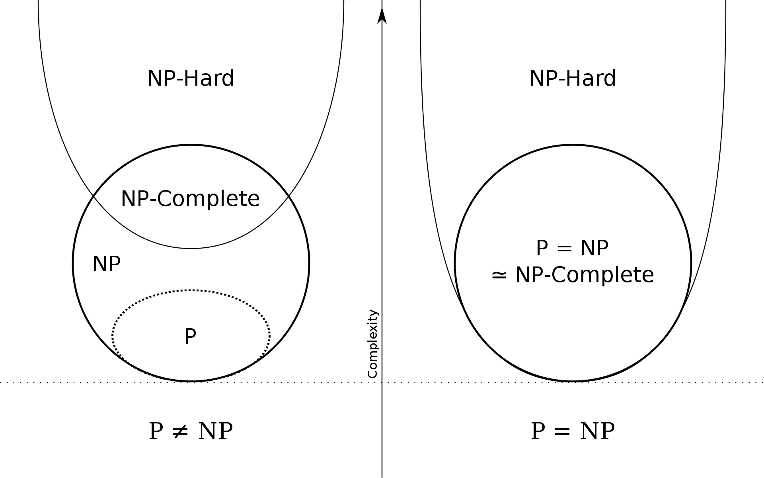
Coloring by Simplification
Register allocation is an NP-complete problem
Graph coloring is also NP-complete
A linear-time approximation algorithm yields good results：
its principal phases: Build, Simplify, Spill, and Select

Slide 8
Build
Construct the interference graphs (via liveness analysis):
Each node represents a temporary value
An edge (t1, t2) indicates a pair of temporaries that cannot be assigned to the same register.
The most common reason for an interference edge is that t1 and t2 are live at the same time.
c
e
a
d
f
b

Slide 9
Simplify
Color the graph using a simple heuristic:
assume K registers available
c
e
c
e
a
d
f
a
d
f
b
b
# Neighbors < K
graph G
graph G’ = G – {b}
if G’ can be colored with K colors, then so can G. why?
This leads naturally to a stack-based (or recursive) algorithm for coloring:
Repeatedly remove (and push on a stack) nodes of degree less than K.
Each such simplification will decrease the degrees of other nodes, leading to more opportunity for simplification
f
c
e
d
a
b

Slide 10
Spill
At some point during simplification, the graph G has nodes only of significant degree (that is, nodes of degree ≥ K).
If K = 3:
c
We choose some node in the graph and decide to represent it in memory, not registers, during program execution.
a
f
d
g
b
e
Do we really have to do that? Not always.
An optimistic approximation to the effect of spilling: the spilled node does not interfere with any of the other nodes remaining in the graph
It can therefore be removed and pushed on the stack, and the simplification continues.
b

Slide 11
Select
Rebuild graph and assign colors to nodes:
When we add a Simplified node to the graph, there must be a color for it.
When potential spill node n that was pushed using the Spill heuristic is popped, there is no guarantee that it will be colorable.
For K = 3:
g
c
f
a
f
e
d
d
g
b
e
c
a
graph G
b
If n’s neighbors have been colored with K different colors
We have an actual spill
We do not assign any color, but continue the Select Phase to identify other actual spill
If n’s neighbors are colored with fewer than K colors, we can color n and n does not become an actual spill.
This technique is known as optimistic coloring

Slide 12
Start Over
If the Select phase can’t find a color for some node(s), then the program must be rewritten to fetch them from memory (LOAD) just before each use, and store them back (STORE) after each def.
Thus, a spilled temporary will turn into several new temporaries with tiny live ranges. These new temporaries may interfere with other temporaries in the graph.
So the algorithm is repeated on this rewritten program. This process iterates until simplify succeeds with no spills.
In practice, one or two iterations almost always suffice.

Slide 13
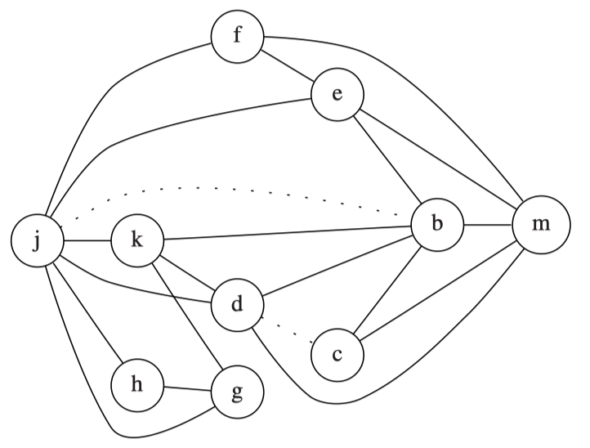
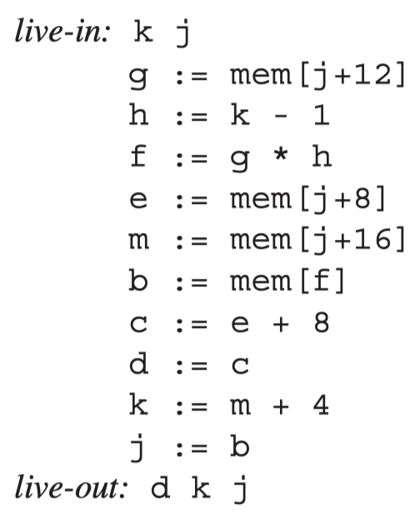
Example
K = 4
The simplify phase can start with the nodes g, h, c, and f in its working set.
Since they have less than 4 neighbors each
Dotted lines indicate move instructions
(not interferences)

Slide 14
Example
Removing h and g and all their edges, then node k becomes a candidate for removal and can be added to the work list
Stack | Assignment
f
e
j
k
b
m
d
c
h
g

Slide 15
Example
Removing h and g and all their edges, then node k becomes a candidate for removal and can be added to the work list
g
Stack | Assignment
f
e
j
k
b
m
d
c
h

Slide 16
Example
Removing h and g and all their edges, then node k becomes a candidate for removal and can be added to the work list
h
g
Stack | Assignment
f
e
j
k
b
m
d
c

Slide 17
Example
Removing h and g and all their edges, then node k becomes a candidate for removal and can be added to the work list
k
h
g
Stack | Assignment
f
e
j
b
m
d
c

Slide 18
Example
Remove d
d
k
h
g
Stack | Assignment
f
e
j
b
m
c

Slide 19
Example
Remove j
j
d
k
h
g
Stack | Assignment
f
e
b
m
c

Slide 20
Example
Removing e
e
j
d
k
h
g
Stack | Assignment
f
b
m
c

Slide 21
Example
Removing f
f
e
j
d
k
h
g
Stack | Assignment
b
m
c

Slide 22
Example
Removing b
b
f
e
j
d
k
h
g
Stack | Assignment
m
c

Slide 23
Example
Removing c
c
b
f
e
j
d
k
h
g
Stack | Assignment
m

Slide 24
Example
Removing m
m
c
b
f
e
j
d
k
h
g
Stack | Assignment

Slide 25
Example
m | 1
c
b
f
e
j
d
k
h
g
Stack | Assignment
m¹

Slide 26
Example
m | 1
c | 3
b
f
e
j
d
k
h
g
Stack | Assignment
m¹
c³

Slide 27
Example
m | 1
c | 3
b | 2
f
e
j
d
k
h
g
Stack | Assignment
b²
m¹
c³

Slide 28
Example
m | 1
c | 3
b | 2
f | 2
e
j
d
k
h
g
Stack | Assignment
f²
b²
m¹
c³

Slide 29
Example
m | 1
c | 3
b | 2
f | 2
e | 4
j
d
k
h
g
Stack | Assignment
f²
e⁴
b²
m¹
c³

Slide 30
Example
m | 1
c | 3
b | 2
f | 2
e | 4
j | 3
d
k
h
g
Stack | Assignment
f²
e⁴
j³
b²
m¹
c³

Slide 31
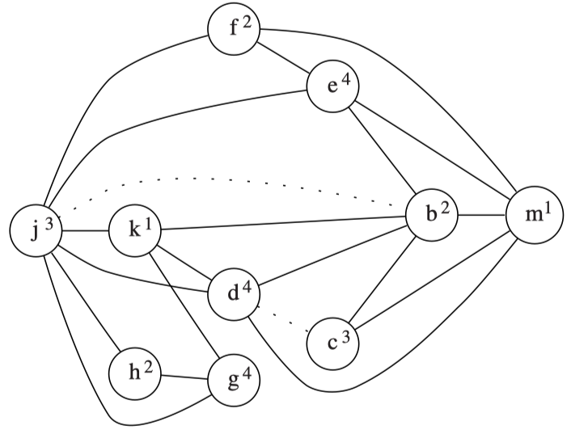
Example
m | 1
c | 3
b | 2
f | 2
e | 4
j | 3
d | 4
k | 1
h | 2
g | 4
Stack | Assignment

Slide 32
Outline
Coloring by Simplification
Coalescing
Precolored Nodes

Slide 33
Coalescing
If there is no edge in the interference graph between the source and destination of a MOVE instruction, then the MOVE can be eliminated.
The source and destination nodes are coalesced into a new node whose edges are the union of those of the nodes being replaced.

Slide 34
Coalescing
The node being introduced is more constrained than those being removed, as it contains a union of edges.
A graph which is colorable with K colors before coalescing may no longer be K-colorable after reckless coalescing.
We wish to coalesce only where it is safe to do so.
safe: the coalescing will not render the graph uncoloarable
How to decide whether the coalescing is safe or not?
Both of the following strategies are safe:
Briggs
George
c
e
Merge a & f
c
e
a
af
f
b
d
b
d

Slide 35
Briggs
Nodes a and b can be coalesced if the resulting node ab will have fewer than K neighbors of significant degree (i.e., having >= K edges).
The coalescing is guaranteed not to turn a K-colorable graph into a non-K-colorable graph.
Why?
The simplify phase will remove all the insignificant-degree nodes from the graph.
The coalesced node will be adjacent only to those neighbors that were of significant degree.
fewer than K neighbors of significant degree => simplify can remove the coalesced node from the graph.

Slide 36
George
Nodes a and b can be coalesced if for every neighbor t of a, either t already interferes with b or t is of insignificant degree.
This coalescing is safe.
Why?
If t already interferes with b, (a, t) and (b, t) will be merged into (ab, t), not leading to the increase of degree.
if t is of insignificant degree, t will be removed by the simplify phase, also not leading to the increase of degree.

Slide 37
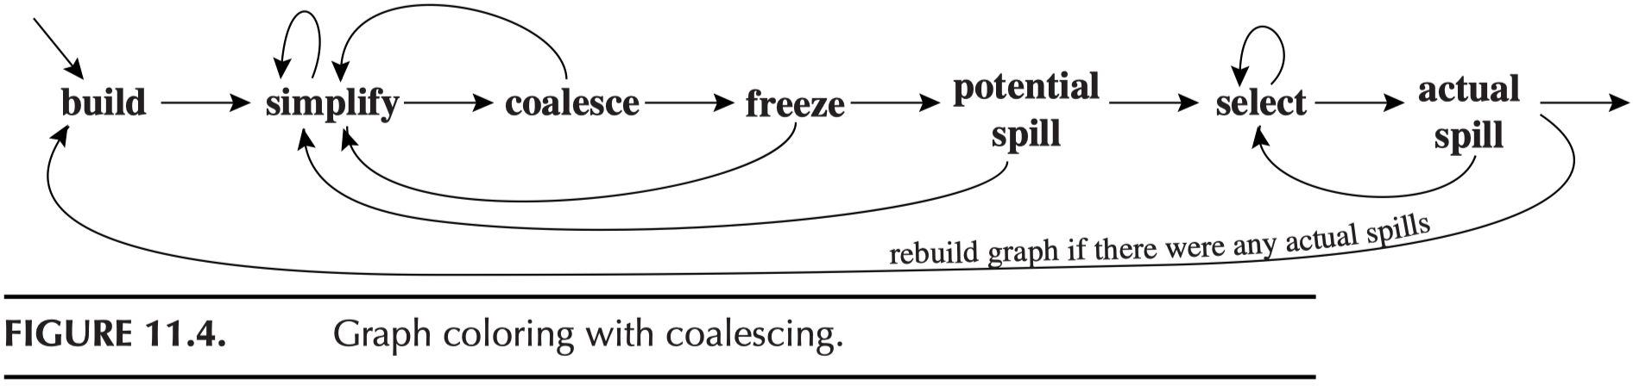
Coloring with Coalescing
How does coloring with coalescing work?
The coalesce, simplify and spill procedures should be alternated until the graph is empty

Slide 38
Coloring with Coalescing
1. Build
Construct the interference graph
Categorize each node as either move-related or non-move-related
A move-related node is one that is either the source or destination of a MOVE instruction

Slide 39
Coloring with Coalescing
2. Simplify
One at a time, remove non-move-related nodes of low (<K) degree from the graph.
3. Coalesce
Perform conservative coalescing on the reduced graph.
The resulting node is no longer move-related, and will be available for the next round of simplification.
Simplify and coalesce are repeated until only signiﬁcant-degree or move-related nodes remain.

Slide 40
Coloring with Coalescing
4. Freeze
If neither simplify nor coalesce applies, we look for a move-related node of low degree. We freeze the moves in which this node is involved.
We give up the hope of coalescing those moves.
Those nodes are considered non-move-related.
Simplify and coalesce are resumed.

Slide 41
Coloring with Coalescing
5. Spill
If there are no low-degree nodes, we select a significant-degree node for potential spilling and push it on the stack.
6. Select
Pop the entire stack, assigning colors.
Rebuild graph if there are any actual spills.

Slide 42
Example
Nodes b, c, d and j are the only move-related nodes.
The initial work-list used in the simplify phase must contain only non-move-related nodes (K=4).
f, g, h
After the removal of g, h, k
f
f
e
e
j
k
b
m
j
b
m
d
d
c
c
h
g

Slide 43
Example
If we invoke a round of coalescing at this point, we discover that c and d are indeed coalesceable (K=4).
Why?
Both Briggs and George
f
f
e
e
j
b
m
j
b
m
d
c&d
c

Slide 44
Example
It is possible to coalesce b and j.
There are no more move-related nodes, and therefore no more coalescing is possible.
f
e
f
e
j
b
m
b&j
m
c&d
c&d

Slide 45
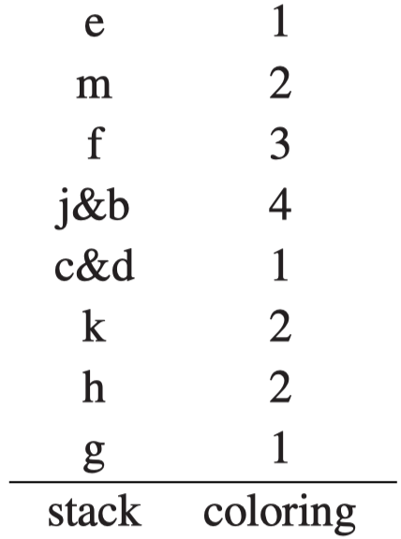

Example
The simplify phase can be invoked one more time to remove all the remaining nodes.
A possible assignment of colors:

Slide 46
Outline
Coloring by Simplification
Coalescing
Precolored Nodes

Slide 47
Precolored Nodes
Some registers are used for special purpose:
argument-registers, frame pointer, return-value-register, ...
For each of such registers, use the particular temporary that is permanently bound to that register (e.g., FP).
Such temporaries are precolored.
only one precolored node of each color
precolored nodes all interfere with each other.
It is common to give an ordinary temporary the same color as a precolored register, as long as they don’t interfere.
a standard calling-convention register can be reused inside a procedure as a temporary variable
We cannot simplify a precoloared node.
We should not spill precolored nodes to memory.
machine registers are by definition registers

Slide 48
Temporary Copies of Machine Registers
The coloring algorithm works by calling simplify, coalesce, and spill until only the precolored nodes remain.
Because precolored nodes do not spill, the front end must be careful to keep their live ranges short:
by generating MOVE instructions to move values to and from precolored nodes.
Suppose r7 is a callee-save register:
Enter: def(r7)
⁞
Exit: use(r7)
Enter: def(r7)
t₂₃₁←r7
⁞
r7 ← t₂₃₁
Exit: use(r7)
If there is register pressure (a high demand for registers) in this function, t231 will spill; otherwise t231 will be coalesced with r7 and the MOVE instructions will be eliminated.

Slide 49
Caller-Save and Callee-Save Registers
foo (){
t = ...
... = ... t ...
s = ...
f()
g()
... = ... s ...
}
A local variable or compiler temporary that is not live across any procedure call should usually be allocated to a caller-save register
Any variable that is live across several procedure calls should be kept in a callee-save-register
If a variable x is live across a procedure call,
then it interferes with all the caller-save (precolored) registers
and it interferes with all the new temporaries created for callee-save registers (e.g., t231)
a spill will occur
Using the common spill-cost heuristic that spills a node with high degree but few uses
But which variable will be spilled first? x or t231?

Slide 50
Example with Precolored Nodes
enter: c←r3
a ← r1
b ← r2
d ← 0
e ← a
loop: d ← d + b
e ← e – 1
if (e > 0) goto loop
r1 ← d
r3 ← c
return (r1, r3 live out)
int f(int a, int b) {
int d = 0;
int e = a;
do { d = d+b;
e = e-1;
} while (e>0);
return d;
}
For a machine with 3 registers:
r1 and r2 are caller-save
r3 is callee-save

Slide 51
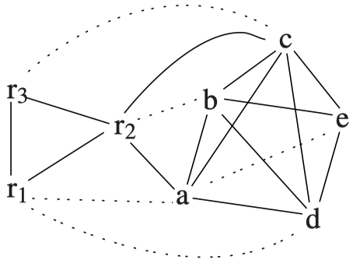
Example with Precolored Nodes (K=3)
enter: c←r3
a ← r1
b ← r2
d ← 0
e ← a
loop: d ← d + b
e ← e – 1
if (e > 0) goto loop
r1 ← d
r3 ← c
return (r1, r3 live out)
Interference Graph
(c – r1 is missing in the textbook)
No opportunity for simplify, coalesce, or freeze.
Simplify: All the non-precolored nodes have degree >= K
Coalesce: would coalesce to a node adjacent to >= K significant-degree nodes
Freeze: a, b, c, d, e are of degree >= K even if considered as non-move-related
We must spill some node.
How to choose the node to spill?
Answer: the node with high degrees but is rarely used.

Slide 52
Example with Precolored Nodes (K=3)
enter: c←r3
a ← r1
b ← r2
d ← 0
e ← a
loop: d ← d + b
e ← e – 1
if (e > 0) goto loop
r1 ← d
r3 ← c
return (r1, r3 live out)
Interference Graph
Node | Uses + Defs outside Loop | Uses + Defs within loop | Degree |  | Spill Priority
a | ( 2 | + 10 x 0 ) | / 4 | = | 0.50
b | ( 1 | + 10 x 1 ) | / 4 | = | 2.75
c | ( 2 | + 10 x 0 ) | / 6 | = | 0.33
d | ( 2 | + 10 x 2 ) | / 4 | = | 5.50
e | ( 1 | + 10 x 3 ) | / 3 | = | 10.33

Slide 53
Example with Precolored Nodes (K=3)
enter: c←r3
a ← r1
b ← r2
d ← 0
e ← a
loop: d ← d + b
e ← e – 1
if (e > 0) goto loop
r1 ← d
r3 ← c
return (r1, r3 live out)
Interference Graph
Node | Uses + Defs outside Loop | Uses + Defs within loop | Degree |  | Spill Priority
a | ( 2 | + 10 x 0 ) | / 4 | = | 0.50
b | ( 1 | + 10 x 1 ) | / 4 | = | 2.75
c | ( 2 | + 10 x 0 ) | / 6 | = | 0.33
d | ( 2 | + 10 x 2 ) | / 4 | = | 5.50
e | ( 1 | + 10 x 3 ) | / 3 | = | 10.33

Slide 54
Example with Precolored Nodes (K=3)
enter: c←r3
a ← r1
b ← r2
d ← 0
e ← a
loop: d ← d + b
e ← e – 1
if (e > 0) goto loop
r1 ← d
r3 ← c
return (r1, r3 live out)
Interference Graph
Node | Uses + Defs outside Loop | Uses + Defs within loop | Degree |  | Spill Priority
a | ( 2 | + 10 x 0 ) | / 4 | = | 0.50
b | ( 1 | + 10 x 1 ) | / 4 | = | 2.75
c | ( 2 | + 10 x 0 ) | / 6 | = | 0.33
d | ( 2 | + 10 x 2 ) | / 4 | = | 5.50
e | ( 1 | + 10 x 3 ) | / 3 | = | 10.33
Spill first

Slide 55
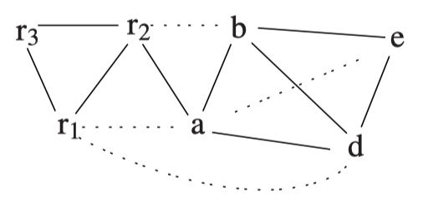
Example with Precolored Nodes (K=3)
1. Spill node c
Interference Graph
c
Spill node c
No simplify is possible
All non-precolored nodes are move-related

Slide 56
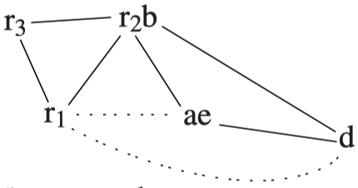
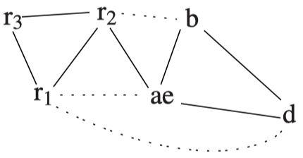
Example with Precolored Nodes (K=3)
1. Spill node c
Interference Graph
2. Coalesce
a & e
3. Coalesce
b & r2
Perform coalescing

Slide 57
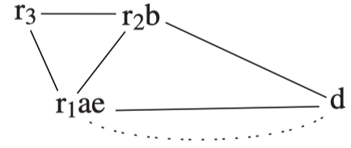
Example with Precolored Nodes (K=3)
4. Coalesce
r1 & ae
Perform coalescing
Now, can we coalesce r1ae and d?
No, r1ae interferes with d
The move between r1ae and d is constrained
We remove it from further considerations
d is no longer treated as move-related (thus can be simplified)

Slide 58
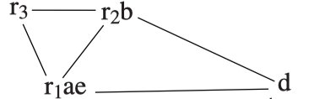
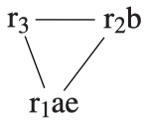
Example with Precolored Nodes (K=3)
5. Simplify d
d
c
We must simplify d.
Now, only precolored nodes.

Slide 59
Example with Precolored Nodes (K=3)
d
c
6. Select
Pop nodes from the stack and assign color to them:
Nodes a, b, e have already been assigned colors by coalescing
Pick d, assign color r3
Pop c: c turns into an actual spill (Why?)

Slide 60
Example with Precolored Nodes (K=3)
7. Rewrite
Rewrite the program to include spill instructions.
Before each use -> fetch
After each def -> store
enter: c₁ ←r3
M[c_{loc}] ← c₁
a ← r1
b ← r2
d ← 0
e ← a
loop: d ← d + b
e ← e – 1
if (e > 0) goto loop
r1 ← d
c₂ ← M[c_{loc}]
r3 ← c₂
return
enter: c←r3
a ← r1
b ← r2
d ← 0
e ← a
loop: d ← d + b
e ← e – 1
if (e > 0) goto loop
r1 ← d
r3 ← c
return
rewrite

Slide 61
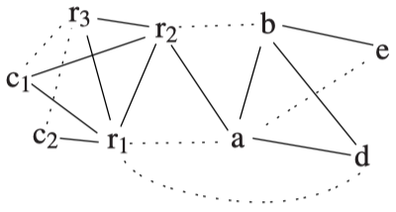
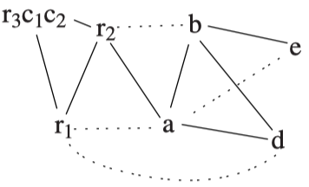
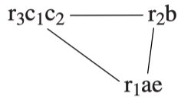
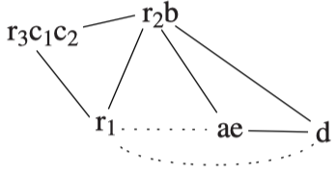
Example with Precolored Nodes (K=3)
9. coalesce c1&r3 and then c2&r3
8. Build a new inference graph
10. coalesce a&e and then b&r2
d
11. coalesce ae&r1 and then simplify d

Slide 62
Example with Precolored Nodes (K=3)
Node | Color
a | r1
b | r2
c1&c2 | r3
d | r3
e | r1
d
12. Select
Poping from the stack and select color r3 for d
all other nodes were coalesced or precolord

Slide 63
Example with Precolored Nodes (K=3)
13. Rewrite the program using the register assignment
enter: c₁ ←r3
M[c_{loc}] ← c₁
a ← r1
b ← r2
d ← 0
e ← a
loop: d ← d + b
e ← e – 1
if (e > 0) goto loop
r1 ← d
c₂ ← M[c_{loc}]
r3 ← c₂
return
Node | Color
a | r1
b | r2
c1&c2 | r3
d | r3
e | r1
enter: r3 ←r3
M[c_{loc}] ← r3
r1 ← r1
r2 ← r2
r3 ← 0
r1 ← r1
loop: r3 ← r3 + r2
r1 ← r1 – 1
if (r1 > 0) goto loop
r1 ← r3
r3 ← M[c_{loc}]
r3 ← r3
return

Slide 64
Example with Precolored Nodes (K=3)
14. delete any move instruction whose source and destination are the same:
enter: r3 ←r3
M[c_{loc}] ← r3
r1 ← r1
r2 ← r2
r3 ← 0
r1 ← r1
loop: r3 ← r3 + r2
r1 ← r1 – 1
if (r1 > 0) goto loop
r1 ← r3
r3 ← M[c_{loc}]
r3 ← r3
return
enter: M[c_{loc}] ← r3
r3 ← 0
loop: r3 ← r3 + r2
r1 ← r1 – 1
if (r1 > 0) goto loop
r1 ← r3
r3 ← M[c_{loc}]
return

Slide 65
Summary
Register allocation by graph coloring
Build
Simplify
Coalesce
Freeze
Spill
Select
Precolored nodes

Slide 66
Homework
11.1, 11.3

