Slide 1

编译原理
陈明帅
m.chen@zju.edu.cn
浙江大学 · 计算机科学与技术学院
Slides partially credited to Zhongxin Liu

Slide 2
Overview
1
Introduction
2
3
4
5
6
Lexical Analysis
Parsing
Abstract Syntax
Semantic Analysis
Activation Records
9
8
7
Instruct. Selection
Blocks & Traces
Interm. Code
10
11
Liveness Analysis
Register Allocation
Fundamentals
13
18
Garbage Collection
Loop Optimizations
Advanced Topics

Slide 3
Manual Memory Management
Manual method
Approach used in C, C++
The use of malloc and free to perform dynamic allocation and de-allocation of pointer
Problems with manual management
Easily lead to problems: memory leaks, double frees,
use-after frees
Type-safe problems
Storage bugs are hard to find
A bug can lead to a visible effect far away in time and program text from the source

Slide 4
Automatic Memory Management
Reclamation of memory is automatic
Garbage: Allocated but no longer used storage
Ideally, we would say that any record that is not dynamically live (will not be used in future computation) is garbage
But it is undecidable whether an object is garbage
Need to rely on a conservative approximation
Heap-allocated records that are not reachable by any chain of pointers from program variables are garbage
not reachable -> garbage
Garbage -> may be reachable

Slide 5
Automatic Memory Management
An object x is reachable if and only if
a register contains a pointer to x, or
another reachable object y contains a pointer to x

Slide 6
Garbage Collection: What
Garbage collection (GC):
The process of reclamation of allocated but no longer used storage without an explicit call to free
Garbage collection is performed not by the compiler but by the runtime system (the support programs linked with the compiled code)
Example:

Slide 7
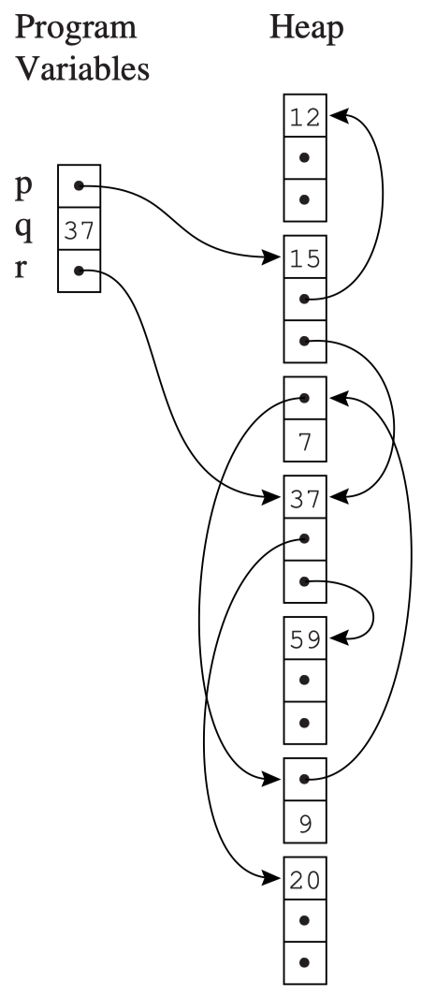
Garbage Collection: Example
let
type list = {link: list, key: int}
type tree = {key: int, left: tree, right: tree}
function maketree() = ···
function showtree(t: tree) = ···
in
let var x := list{link=nil,key=7}
var y := list{link=x,key=9}
in x.link := y
end;
let var p := maketree()
var r := p.right
var q := r.key
in garbage-collect here
showtree(r)
end
end
Reachable
and
Non-reachable nodes?

Slide 8
Outline
Mark-and-Sweep Collection
Reference Counts
Copying Collection
Interface to the Compiler

Slide 9
Outline
Mark-and-Sweep Collection
Reference Counts
Copying Collection
Interface to the Compiler

Slide 10
Mark-and-Sweep Collection
Program variables and heap-allocated records form a directed graph.
The variables are roots of this graph.
A node is reachable if there is a path of directed edges r -> ... -> n
r: some root

Slide 11
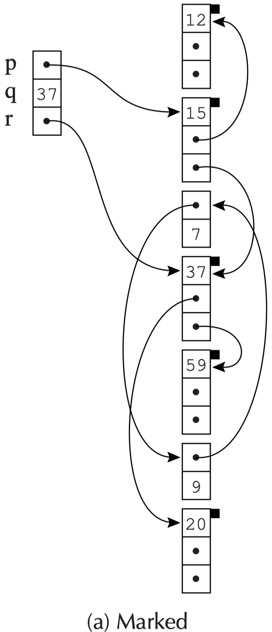
Mark-and-Sweep Collection
A graph-search algorithm such as depth-first search can mark all the reachable nodes.
function DFS(x)
if x is a pointer into the heap
if record x is not marked
mark x
for each ﬁeld fi of record x
DFS(x.fi)

Slide 12
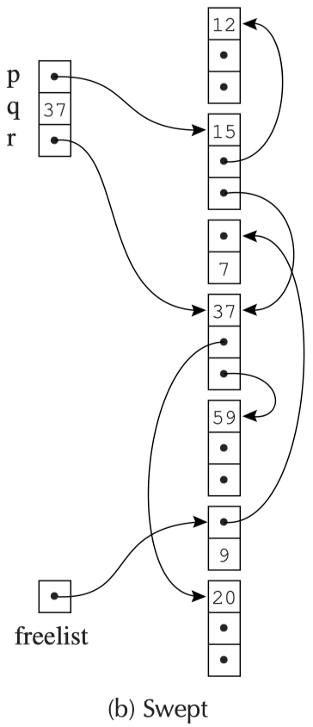
Mark-and-Sweep Collection
Any node not marked must be garbage, and should be reclaimed.
How?
sweep the entire heap, from its first address to its last
look for nodes that are not marked
These garbage can be linked together in a linked list (the freelist).
The sweep phase should also unmark all the marked nodes for the next garbage collection.

Slide 13
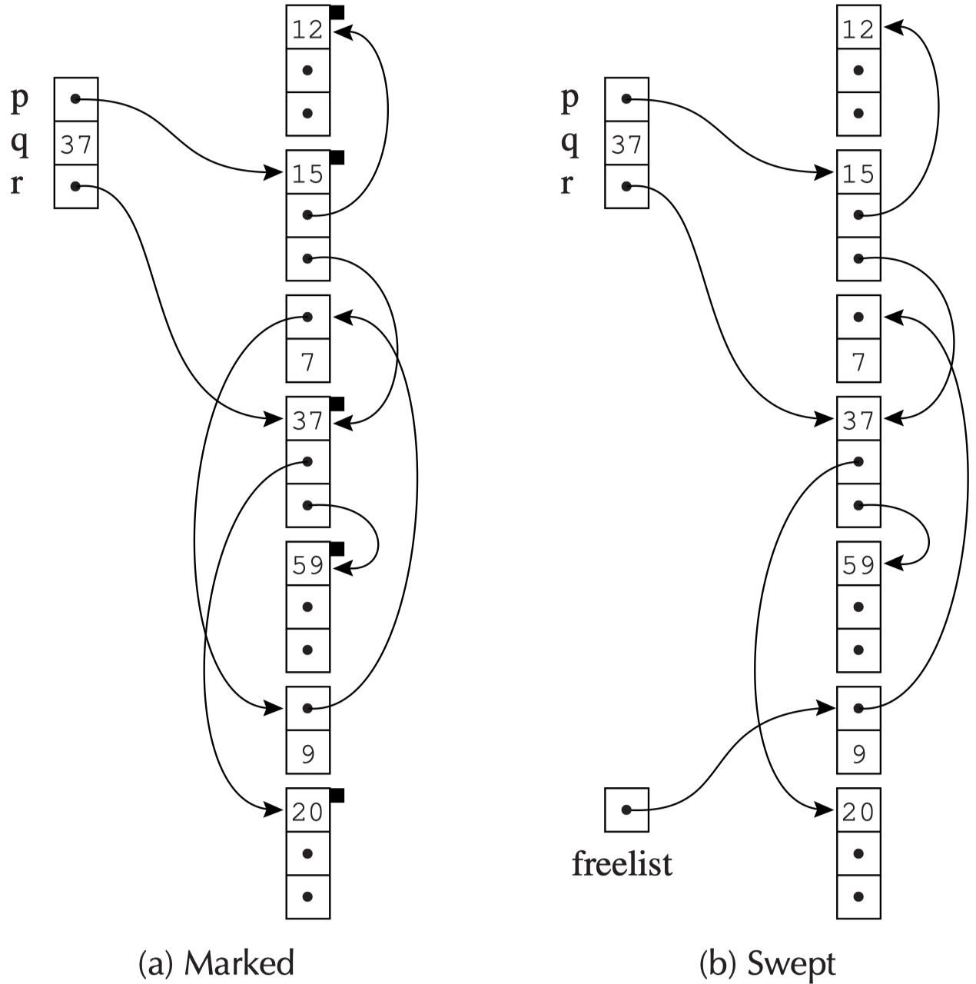
Mark-and-Sweep Collection
Mark
Sweep
freelist
unmark

Slide 14
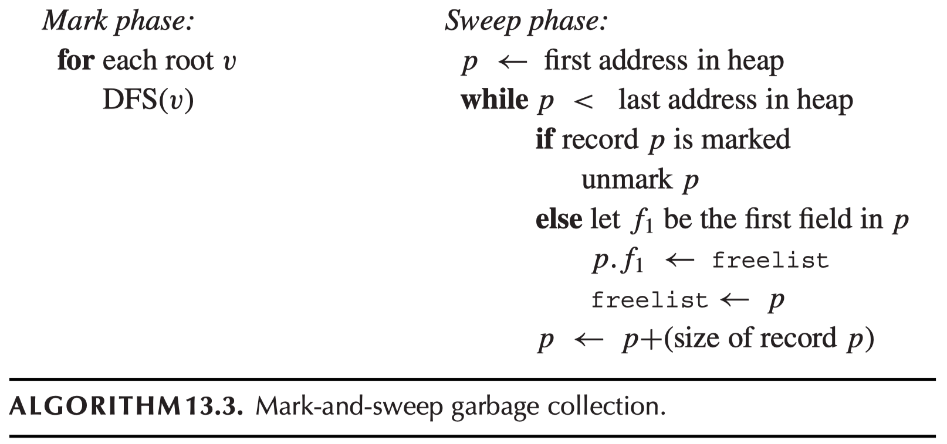
Mark-and-Sweep Collection - Algorithm
After GC, the compiled program resumes execution.
Whenever it needs heap-allocate a new record, it gets a record from the freelist; In case it’s empty, replenish by another GC.

Slide 15
Mark-and-Sweep Collection
Cost of garbage collection:
DFS search : proportional to the number of nodes it marks.
The sweep phase : proportional to the size of the heap (H).
The DFS algorithm is recursive
In the worst case, the length of the stack of activation records would be larger than the entire heap
Solution: Use an explicit stack instead of recursion
H words instead of H activation records

Slide 16
Using an Explicit Stack
function DFS(x)
if x is a pointer and record x is not marked
mark x
t ← 1
stack[t] ← x
while t > 0 // stack is non-empty
x ← stack[t]; t ← t – 1
for each field fi of record x
if x.fi is a pointer and record x.fi is not marked
mark x.fi
t ← t + 1; stack[t] ← x.fi
t: the index of the stack top
stack: a worklist

Slide 17
Pointer Reversal
The following content aims to leave the stack out. Thus, we can save more space in DFS algorithm.
After the contents of field x.fi has been pushed on the stack, the algorithm will never again look the original location x.fi.
We don’t want to waste the space, so x.fi will be made to point back the record from which x was reached. When things about x.fi are done, we can go back and do what’s left for x via x.fi. That’s exactly the meaning of stack.
pointer reversal
As the stack is popped, the ﬁeld x.fi will be restored to its original value.

Slide 18
Pointer Reversal
function DFS(x)
if x is a pointer and record x is not marked
t ← nil
mark x; done[x] ← 0
while true
i ← done[x]
if i < # of fields in record x
y ← x. fi
if y is a pointer and record y is not marked
x. fi ← t; t ← x; x ← y
mark x; done[x] ← 0
else
done[x] ← i + 1
else
y ← x; x ← t
if x = nil then return
i ← done[x]
t ← x. fi; x. fi ← y
done[x] ← i + 1
x1
x0
x2
done: how many fields in each record have been processed
t: the top of the stack
if i = done[x], then x.fi is the “stack link” to the next node
When popping the stack, x.fi is restored to its original value

Slide 19
Pointer Reversal
function DFS(x)
if x is a pointer and record x is not marked
t ← nil
mark x; done[x] ← 0
while true
i ← done[x]
if i < # of fields in record x
y ← x. fi
if y is a pointer and record y is not marked
x. fi ← t; t ← x; x ← y
mark x; done[x] ← 0
else
done[x] ← i + 1
else
y ← x; x ← t
if x = nil then return
i ← done[x]
t ← x. fi; x. fi ← y
done[x] ← i + 1
x1
x1
x0
x0
x2
x2
t = nil
x = x0
mark x0
done[x0] = 0

Slide 20
Pointer Reversal
function DFS(x)
if x is a pointer and record x is not marked
t ← nil
mark x; done[x] ← 0
while true
i ← done[x]
if i < # of fields in record x
y ← x. fi
if y is a pointer and record y is not marked
x. fi ← t; t ← x; x ← y
mark x; done[x] ← 0
else
done[x] ← i + 1
else
y ← x; x ← t
if x = nil then return
i ← done[x]
t ← x. fi; x. fi ← y
done[x] ← i + 1
x1
nil
x1
x0
x0
x2
x2
t = nil
x = x0
i = done[x0] = 0
y = x0.f0 = x1
x0.f0 = t = nil
t = x = x0
x = y = x1
mark x1
done[x1] = 0

Slide 21
Pointer Reversal
function DFS(x)
if x is a pointer and record x is not marked
t ← nil
mark x; done[x] ← 0
while true
i ← done[x]
if i < # of fields in record x
y ← x. fi
if y is a pointer and record y is not marked
x. fi ← t; t ← x; x ← y
mark x; done[x] ← 0
else
done[x] ← i + 1
else
y ← x; x ← t
if x = nil then return
i ← done[x]
t ← x. fi; x. fi ← y
done[x] ← i + 1
nil
x1
x1
x0
x0
x2
x2
t = x0
x = x1
i = done[x1] = 0
y = x1.f0 = not pointer
done[x1] = i+1 = 1
i = done[x1] = 1
y = x1, x = x0 // back to parent
i = done[x0] = 0
t = x0.f0 = nil // update stack top
x0.f0 = x1 // restore
done[x0] = 1

Slide 22
Pointer Reversal
function DFS(x)
if x is a pointer and record x is not marked
t ← nil
mark x; done[x] ← 0
while true
i ← done[x]
if i < # of fields in record x
y ← x. fi
if y is a pointer and record y is not marked
x. fi ← t; t ← x; x ← y
mark x; done[x] ← 0
else
done[x] ← i + 1
else
y ← x; x ← t
if x = nil then return
i ← done[x]
t ← x. fi; x. fi ← y
done[x] ← i + 1
x1
nil
x1
x0
x0
x2
x2
t = nil
x = x0
i = done[x0] = 1
y = x0.f1 = x2
x0.f1 = t = nil
t = x = x0
x = x2
mark x2
done[x2] = 0

Slide 23
Pointer Reversal
function DFS(x)
if x is a pointer and record x is not marked
t ← nil
mark x; done[x] ← 0
while true
i ← done[x]
if i < # of fields in record x
y ← x. fi
if y is a pointer and record y is not marked
x. fi ← t; t ← x; x ← y
mark x; done[x] ← 0
else
done[x] ← i + 1
else
y ← x; x ← t
if x = nil then return
i ← done[x]
t ← x. fi; x. fi ← y
done[x] ← i + 1
nil
x1
x1
x0
x0
x2
x2
t = x0
x = x2
i = done[x2] = 0
y = x2.f0 = not a pointer
done[x2] = 1
i = done[x2] = 1
y = x = x2
x = t = x0
i = done[x0] = 1
t = x0.f1 = nil
x0.f1 = y = x2 // restore
done[x0] = 2

Slide 24
Pointer Reversal
function DFS(x)
if x is a pointer and record x is not marked
t ← nil
mark x; done[x] ← 0
while true
i ← done[x]
if i < # of fields in record x
y ← x. fi
if y is a pointer and record y is not marked
x. fi ← t; t ← x; x ← y
mark x; done[x] ← 0
else
done[x] ← i + 1
else
y ← x; x ← t
if x = nil then return
i ← done[x]
t ← x. fi; x. fi ← y
done[x] ← i + 1
x1
x0
x2
t = nil
x = x0
i = done[x0] = 2
y = x = x0
x = t = nil
return

Slide 25
Fragmentation
External fragmentation:
The program wants to allocate a record of size n, and there are many free records smaller than n but none of the right size
Internal fragmentation:
The program uses a too-large record without splitting it, so that the unused memory is inside the record instead of outside.
·
 |  | · |  | · |  |  | · | ·
·
freelist

