Slide 1

编译原理
陈明帅
m.chen@zju.edu.cn
浙江大学 · 计算机科学与技术学院
Slides partially credited to Zhongxin Liu

Slide 2
Outline
Mark-and-Sweep Collection
Reference Counts
Copying Collection
Interface to the Compiler

Slide 3
Reference Counts
Mark-sweep collection identifies the garbage by first finding out what is reachable.
Instead, it can be done directly by keeping track of how many pointers point to each record.
The reference count of a record: the number of pointers pointing to this record.
Store the reference count with each record

Slide 4
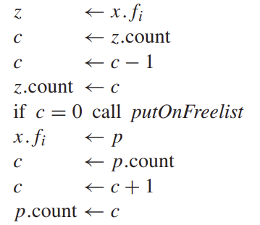
Reference Counts
How to keep track?
The compiler emits extra instructions so that whenever p is stored into x.fi, the reference count of p is incremented, and the reference count of what x.fi previously pointed to is decremented.
If the reference count of some record z reaches zero, then z is put on the freelist, and all the other records that z points to have their reference counts decremented.
x.fi ← p

Slide 5
Reference Counts
Instead of decrementing the counts of r.fi when r is put on the freelist, it is better to do this “recursive” decrementing when r is removed from the freelist, for two reasons:
It breaks up the “recursive decrementing” work into shorter pieces, so that the program can run more smoothly (this is important only for interactive or real-time programs).
e.g., r.fi->p, p.fi->q
The recursive decrementing will be done only in one place, in the allocator

Slide 6
Reference Counts: Problems
Reference counting seems simple and attractive.
But there are two major problems:
Cycles of garbage cannot be claimed
Incrementing the reference counts is very expensive indeed.

Slide 7
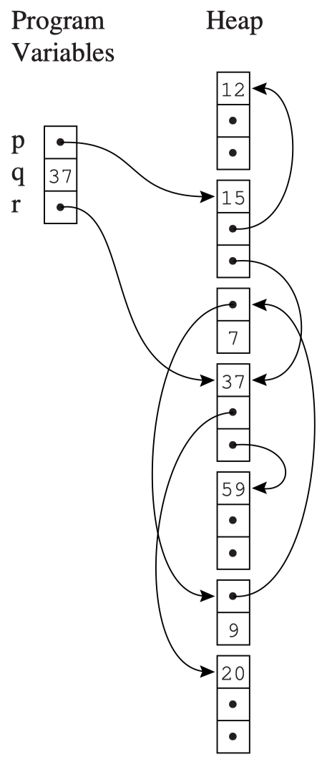
Problem 1: Reference Cycle
A reference cycle is a set of objects that cyclically refer to one another.
e.g., the record storing 7 and the record storing 9
Reference count tracks the number of references, not number of reachable references.
Major problems in languages/systems that use reference counting:
e.g., Perl, Firefox 2.

Slide 8
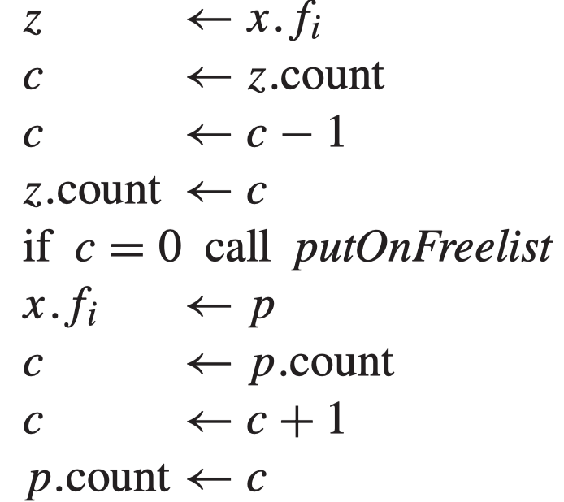
Problem 2
Incrementing the reference counts is very expensive indeed.
In place of the single machine instruction x.fi ← p, the program must execute:
Decrease the reference count of what x.fi previously pointed to
Increase the reference count of p

Slide 9
Analysis of Reference Counts
Advantages:
Simple to implement
Disadvantages:
Fails to reclaim all unreachable objects
Can be slow if a large collection is initiated
Noticeably slows down assignments

Slide 10
Outline
Mark-and-Sweep Collection
Reference Counts
Copying Collection
Interface to the Compiler

Slide 11
Copying Collection
Idea: split the memory into two parts and collect by copying
The reachable part of the heap is a directed graph
nodes: records
edges: pointers
roots: program variables
Copying garbage collection:
traverse this graph (in a part of the heap called from-space)
build an isomorphic copy in a fresh area of the heap (called to-space)
The to-space copy is compact:
occupying contiguous memory without fragmentation.
The roots are made to point at the to-space copy; then the entire from-space is unreachable.

Slide 12
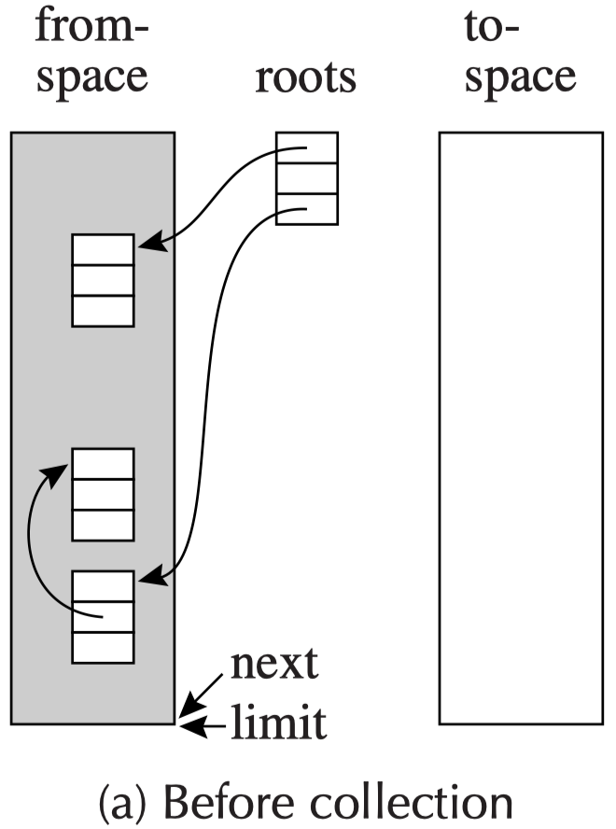
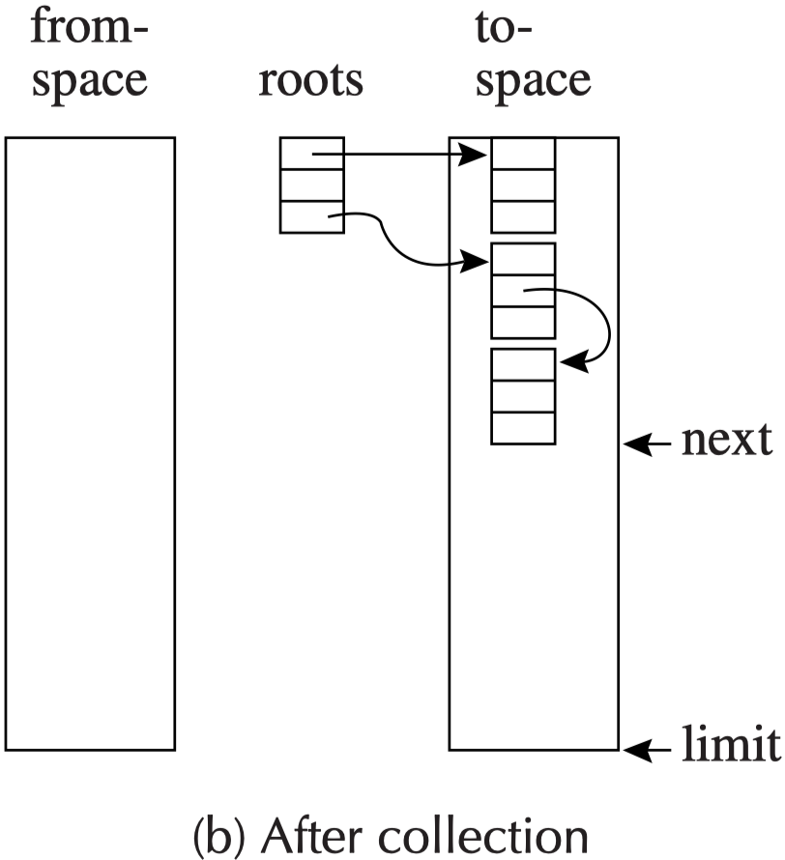
Copying Collection
No space to allocate.
Allocating a new record is easy: p=next, next=next + n.
Does not have a fragmentation problem.
available to allocate

Slide 13
Copying Collection
Initializing a collection
The pointer next is initialized to point at the beginning of to-space
Forwarding
given a pointer p pointing to from-space, make p point to to-space
function Forward(p)
if p points to from-space
then if p. f1 points to to-space
then return p. f1
else for each field fi of p
next. fi ← p. fi
p. f1 ← next
next ← next + size of record p
return p. f1
else return p
1. has already been copied
p.f1: forwarding pointer that indicates where the copy is
2. not yet been copied
3. not a pointer or points outside from-space

Slide 14
Copying Collection – Cheney’s Algorithm
Cheney’s algorithm: a collection algorithm using breadth-first search to traverse the reachable data.
ALGORITHM 13.9: Breadth-first copying garbage collection
scan ← next ← beginning of to-space
for each root r
r ← Forward(r)
while scan < next
for each field fi of record at scan
scan.fi ← Forward(scan.fi)
scan ← scan + size of record at scan
next: for the records which have been copied
scan: for the records whose fields have been copied
The area between scan and next: the queue of the breadth-first search

Slide 15
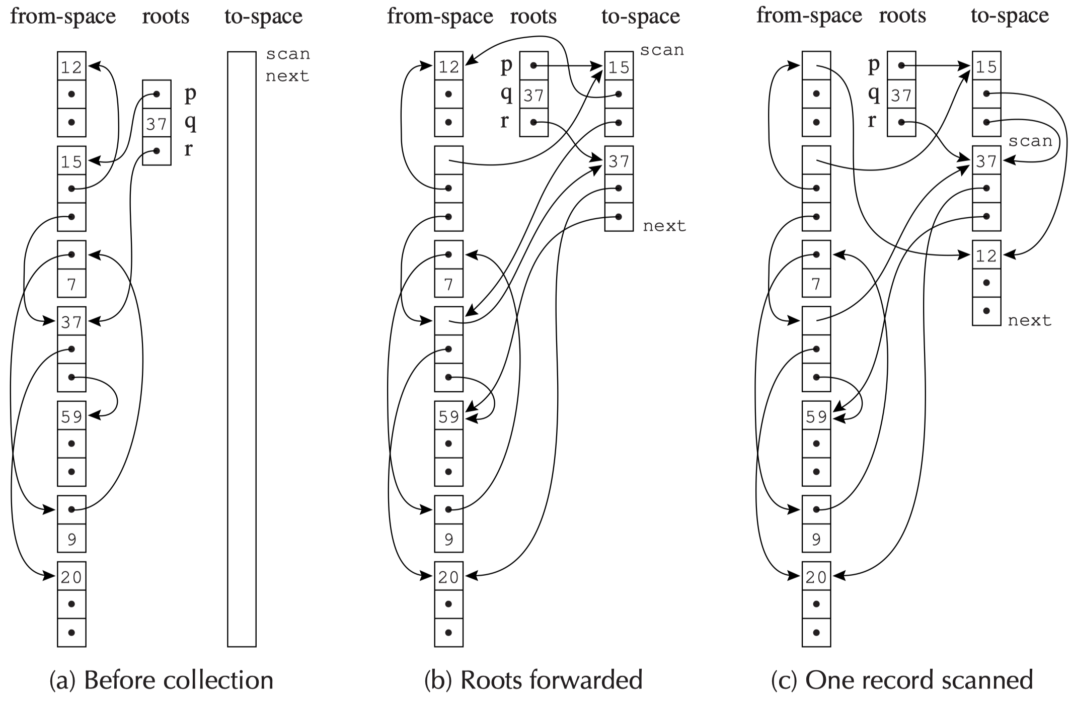
Breadth-First Copying Collection

Slide 16
Locality of Reference
Pointer data structures copied by breadth-first have poor locality of reference.
If a record at address a points to another record at address b, it is likely that a and b will be far apart.
Why?
In a computer system with virtual memory, or with a memory cache, good locality of reference is important:
After the program fetches address a, then the memory subsystem expects addresses near a to be fetched soon.
Depth-first copying gives better locality
But depth-first copy requires pointer-reversal, which is inconvenient and slow.

Slide 17
A Hybrid Algorithm
A hybrid, partly depth-first and partly breadth-first algorithm can provide acceptable locality.
function Forward(p)
if p points to from-space
then if p.f1 points to to-space
then return p.f1
else Chase(p); return p.f1
else return p
function Chase(p)
repeat
q ← next
next ← next+ size of record p
r ← nil
for each ﬁeld fi of record p
q.fi ← p.fi
if q.fi points to from-space and
q.fi.f1 does not point to to-space
then r ← q.fi
p.f1 ← q
p←r
until p = nil
Basic idea: use breadth-first copying, but whenever an object is copied, see if some child can be copied near it.

Slide 18
Outline
Mark-and-Sweep Collection
Reference Counts
Copying Collection
Generational Collection
Incremental Collection
Interface to the Compiler

Slide 19
Interface to the Compiler
The compiler for a garbage-collected language interacts with the garbage collector by:
generating code that allocates records
describing locations of roots for each garbage-collection cycle
describing the layout of data records on the heap
generating instructions to implement a read or write barrier (for some versions of incremental collection)

Slide 20
Fast Allocation
There is a considerable cost to create the heap records.
Copying collection should be used
the next free location is next and the end of the region is limit
the allocation space is contiguous free region

Slide 21
Fast Allocation
The steps to allocate a record of size N:
Call the allocate function
Test next + N < limit ? (If the test fails, call GC)
Move next to result
Clear M[next], M[next+1], ..., M[next + N - 1]
next <- next + N
Return from the allocate function
Move result into some computationally useful place
Store useful values into the record
(Steps A and B are not allocation overhead)

Slide 22
Fast Allocation
Step 1 and 6 should be eliminated by inline expanding the allocate function
The steps to allocate a record of size N:
Call the allocate function
Test next + N < limit ? (If the test fails, call GC)
Move next to result
Clear M[next], M[next+1], ..., M[next + N - 1]
next <- next + N
Return from the allocate function
Move result into some computationally useful place
Store useful values into the record
(Steps A and B are not allocation overhead)

Slide 23
Fast Allocation
Step 3 can often be eliminated by combining it with Step A.
The steps to allocate a record of size N:
Call the allocate function
Test next + N < limit ? (If the test fails, call GC)
A. Move next into some computationally useful place
4. Clear M[next], M[next+1], ..., M[next + N - 1]
5. next <- next + N
6. Return from the allocate function
Move result into some computationally useful place
Store useful values into the record
(Steps A and B are not allocation overhead)

Slide 24
Fast Allocation
Step 4 can be eliminated in favor of Step B.
The steps to allocate a record of size N:
Call the allocate function
Test next + N < limit ? (If the test fails, call GC)
A. Move next into some computationally useful place
4. Clear M[next], M[next+1], ..., M[next + N - 1]
5. next <- next + N
6. Return from the allocate function
Move result into some computationally useful place
Store useful values into the record
(Steps A and B are not allocation overhead)

Slide 25
Fast Allocation
Step 2 and 5 cannot be eliminated. But they can be shared among multiple allocations in a basic block.
The steps to allocate a record of size N:
Call the allocate function
Test next + N < limit ? (If the test fails, call GC)
A. Move next into some computationally useful place
4. Clear M[next], M[next+1], ..., M[next + N - 1]
5. next <- next + N
6. Return from the allocate function
Move result into some computationally useful place
Store useful values into the record
(Steps A and B are not allocation overhead)

Slide 26
Fast Allocation
Step 2: Test next + N < limit ? (If the test fails, call GC)
Step 5: next <- next + N
By keeping next and limit in registers, steps 2 and 5 can be done in a total of three instructions
By this combination of techniques, the cost of allocating a record – and then eventually garbage collecting it - can be brought down to about four instructions

Slide 27
Describing Data Layouts
The collector must be able to operate on records of any types that the program has declared
It must be able to determine the number of fields in each record and whether each field is a pointer
How to know such information? (semantic analysis)
For statically typed language, such as Tiger or Pascal, or for object-oriented languages, such as Java:
have the first word of every object point to a special type- or class-descriptor record.
Type- or class-descriptor
the total size of the object
the location of each pointer field
Type- or class-descriptors are generated by the compiler from the static type information (semantic analysis).

Slide 28
Describing Data Layouts
For statically typed languages: an overhead of one word per record
For object-oriented languages: no additional per-object overhead attributable to garbage collection
They need this descriptor-pointer to implement dynamic method lookup.

Slide 29
Pointer Map
The compiler must identify a pointer map to the collector:
every pointer-containing temporary and local variables
whether it is in a register or in an activation record
The set of live temporaries can change at every instruction.
The pointer map is different at every point in the program:
it is simpler to describe the pointer map only at points where a new garbage collection can begin
Where can a new garbage collection begin?
calls to the alloc function
any function-call
any function-call might be calling a function which
in turn calls alloc

Slide 30
Pointer Map
The pointer map is best keyed by return addresses. Because the return address is what the collector will see in the very next activation record.
To find all the roots, the collector starts at the top of the stack and scans downward
Each return address keys the pointer-map entry that describes the next frame
In each frame, the collector marks (or forwards, if copying collection) from the pointers in that frame
Callee-save registers need special handling
Suppose function f calls g, which calls h.
The pointer map for g must describe which of its callee-save registers contain pointers at the call to h and which are “inherited” from f.

Slide 31
Derived Pointers
Sometimes a compiled program has a pointer that points into the middle of a heap record, or that points before or after the record.
For example:
a[i-2000] can be calculated internally as M[a-2000+i]
If a[i-2000] occurs inside a loop, the compiler might choose to hoist t1 ← a – 2000 outside the loop to avoid recalculating it in each iteration.
if the loop also contains an alloc, and a garbage collection occurs while t1 is live: t1 does not point the the beginning of an object or (worse yet) points to an unrelated object.
t1 ← a-2000
t2 ← t1 + i
t3 ← M[t2]

Slide 32
Derived Pointers
t1 ← a-2000
t2 ← t1 + i
t3 ← M[t2]
We say that t1 is derived from the base pointer a.
The collector will be confused by t1
How to handle this problem?
The pointer map must identify each derived pointer and tell its base pointer.
When the collector relocates a to address a’, it must adjust t1 to point to address t1 + a’ - a
a must remain live as long as t1 is live. For example:

Slide 33
Derived Pointers
r1 ← 100
r2 ← 0
call alloc
a ← r1
t1 ← a – 2000
i ← 1930
L1 : r1 ← M[t1 + i]
call f
L2 : if i ≤ 1990 goto L1
let
var a := int array[100] of 0
in
for i := 1930 to 1990
do f(a[i-2000])
end
The temporary a appears dead after the assignment to t1
But then the pointer map associated with the return address L2 would not be able to “explain” t1 adequately.
Therefore, a derived pointer implicitly keeps its base pointer live.

Slide 34
Summary
Mark-and-Sweep Collection
Reference Counts
Copying Collection
Interface to the Compiler

Slide 35
Homework
13.2

