Slide 1

编译原理
陈明帅
m.chen@zju.edu.cn
浙江大学 · 计算机科学与技术学院
Slides partially credited to Zhongxin Liu

Slide 2
Overview
1
Introduction
2
3
4
5
6
Lexical Analysis
Parsing
Abstract Syntax
Semantic Analysis
Activation Records
9
8
7
Instruct. Selection
Blocks & Traces
Interm. Code
10
11
Liveness Analysis
Register Allocation
Fundamentals
13
18
14
Garbage Collection
Loop Optimizations
Obj.-Ori. Languages
Advanced Topics

Slide 3
Why to Optimize a Loop?
“ Most computer programs spend 80% of the wall time executing only 20% of the code.”
--- Pareto Principle
LOOPS
Loop optimization techniques:
hoisting (code motion)
strength reduction
loop unrolling
…

Slide 4
Loop
Loop (in Webster’s Dictionary): a series of instructions that is repeated util a terminating condition is reached.
A loop in a control-flow graph is a set of nodes S including a header node h with the following properties:
From any node in S there is a path of directed edges leading to h.
There is a path of directed edges from h to any node in S.
There is no edge from any node outside S to any node in S other than h.

Slide 5
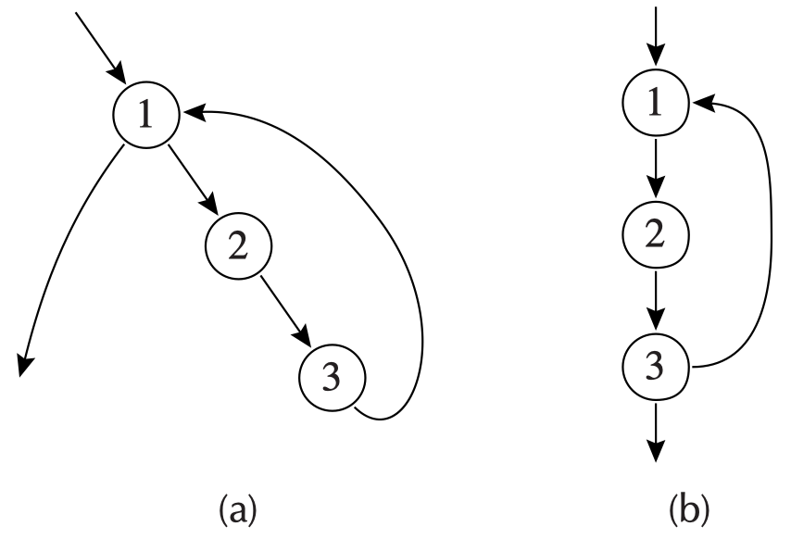
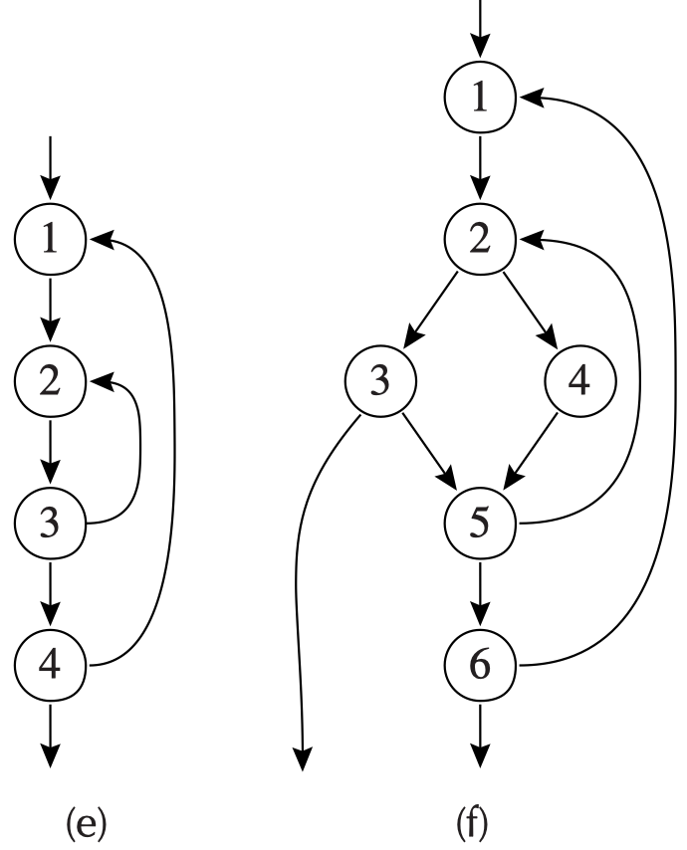
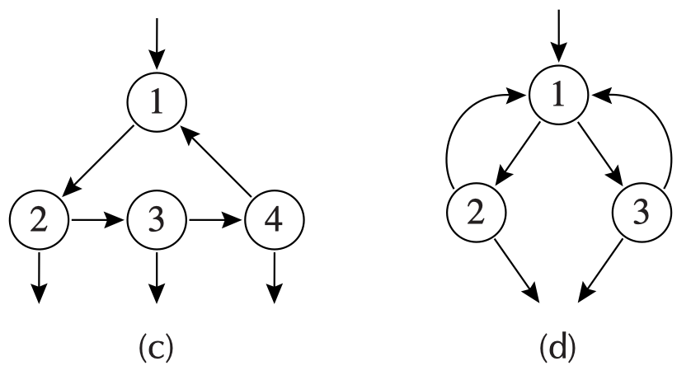
Loop - Example
A loop entry node is one with predecessor outside the loop.
A loop exit node is one with a successor outside the loop.
nested loops
h -> S
S -> h
no other node -> S
only one entry
but may have multiple exits

Slide 6
Outline
Dominators
Loop-Invariant Computations
Induction Variables
Array-Bounds Checks
Loop Unrolling

Slide 7
Outline
Dominators
Loop-Invariant Computations
Induction Variables
Array-Bounds Checks
Loop Unrolling

Slide 8
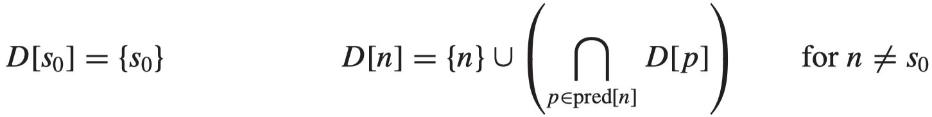
Dominator
To optimize the loops, we must find them in the flow graph. The notion of dominators is useful for this purpose.
Dominator: A node d dominates a node n if every path of directed edges from s₀ to n must go through d.
s₀ is the start node of the control-flow graph.
Every node dominates itself.
n can have more than one dominators.
Algorithm for finding dominators:
let D[n] be the set of nodes that dominate n, Then
Solve this equations by iteration.
Initialize D[n] (for n != s₀) to hold all nodes in the graph.

Slide 9
Immediate Dominators
Theorem: In a connected graph, suppose d dominates n, and e dominates n. Then it must be that either d dominates e or e dominates d.
Every node n (except s₀) has exactly one immediate dominator, idom(n), such that:
idom(n) is not the same node n
idom(n) dominates n, and
idom(n) does not dominate any other dominator of n

Slide 10
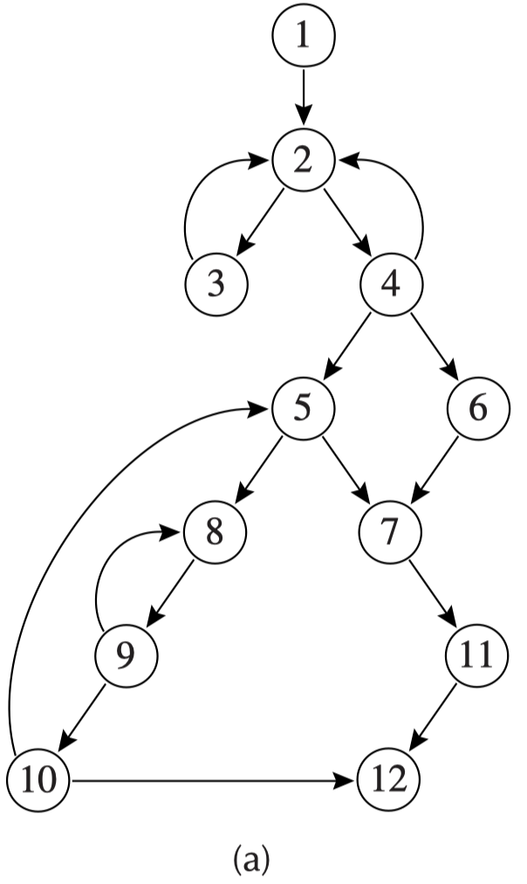
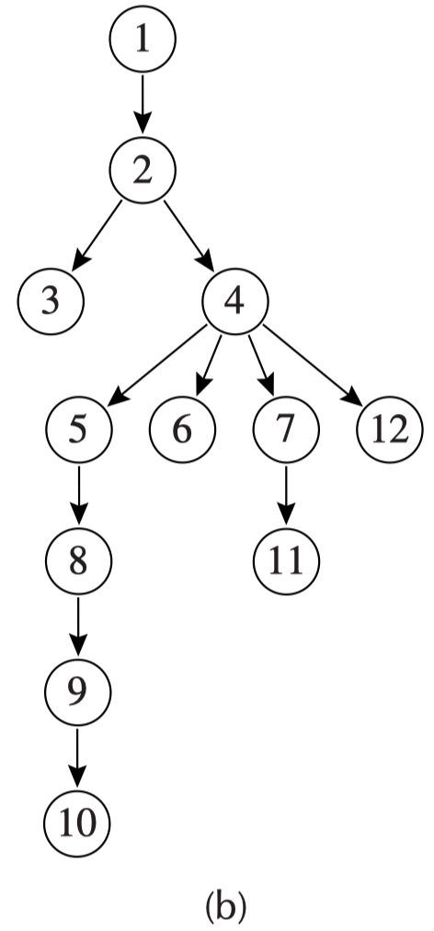
Dominator Tree
Dominator Tree:
Draw a graph containing every node of the flow graph, and for every node n an edge from idom(n) to n.
The resulting graph will be a tree. Why?

Slide 11
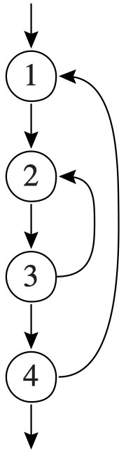
Natural Loops
We care about whether a loop has a single entry node:
Yes => certain initial conditions to hold at the beginning of each iteration through the loop => ease the optimization
This opportunity motivates the need for the definition of a natural loop.
Back edge: a flow-graph edge from a node n to a node h that dominates n is called a back edge.
The natural loop of a back edge n → h is the set of nodes x such that h dominates x and there is a path from x to n not containing h.
The header of this loop will be h

Slide 12
Natural Loops - Example
The natural loop of the back edge 10 -> 5 includes nodes 5, 8, 9, 10, and has the loop 8, 9 nested within it.
A node h can be the header of more than one natural loops
3->2 => {2, 3}
4->2 => {2, 4}

Slide 13
Nested Loop
Nested Loops: If A and B are loops with headers a and b, respectively, such that a ≠ b and b is in A, then the nodes of B are a proper subset of the nodes of A. We say that loop B is nested within A, or that B is the inner loop.

Slide 14
Loop-Nest Tree
We can construct a loop-nest tree of loops in a program:
Compute dominators of the flow graph G.
Construct the dominator tree.
Find all the natural loops, and thus all the loop-header nodes.
For each loop header h, merge all the natural loops of h into a single loop, loop[h].
Construct the tree of loop headers (and implicitly loops), such that h1 is above h2 in the tree if h2 is in loop[h1].

Slide 15
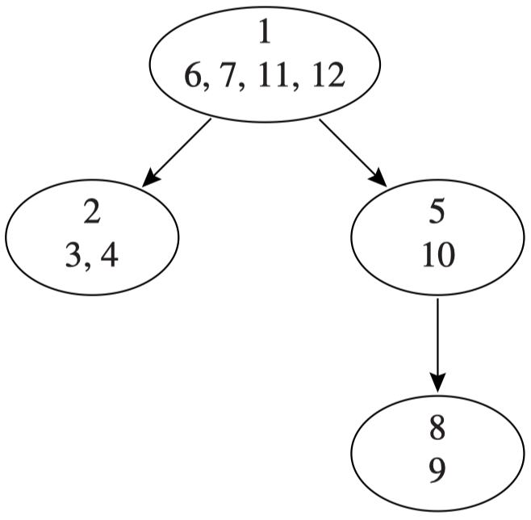
Loop-Nest Tree
we could say that the entire procedure body is a pseudo-loop that sits at the root of the loop-nest tree.

Slide 16
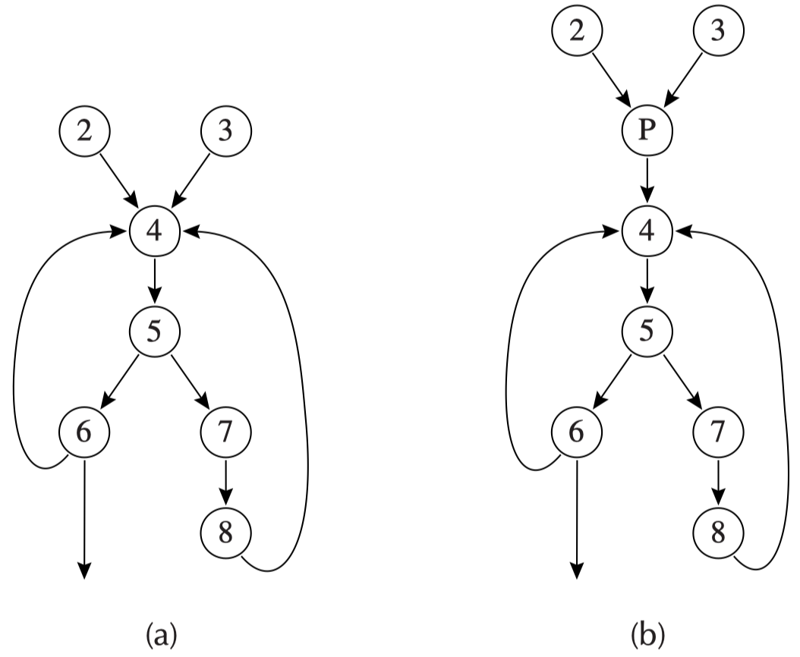
Loop Preheader
Many loop optimizations will insert statements immediately before the loop executes.
loop-invariant hoisting: moves a statement from inside the loop to immediately before the loop
How to insert?
Insert a new, initially empty, preheader node p
all y -> h from nodes y outside the loop are redirected to point to p

Slide 17
Outline
Dominators
Loop-Invariant Computations
Induction Variables
Array-Bounds Checks
Loop Unrolling

Slide 18
Loop-Invariant Computations
If a loop contains a statement t ← a ⊕ b such that a has the same value each time around the loop, and b has the same value each time, then t will also have the same value each time.
We would like to hoist the computation out of the loop.
How to know whether a has the same value every time?

Slide 19
Loop-Invariant Computations
The definition d: t ← a₁ ⊕ a₂ is loop-invariant within loop L if, for each operand a_{i} ,
a_{i} is a constant
or all the definitions of a_{i} that reach d are outside the loop
or only one definition of a_{i} reaches d, and that definition is loop-invariant
Iterative algorithm

Slide 20
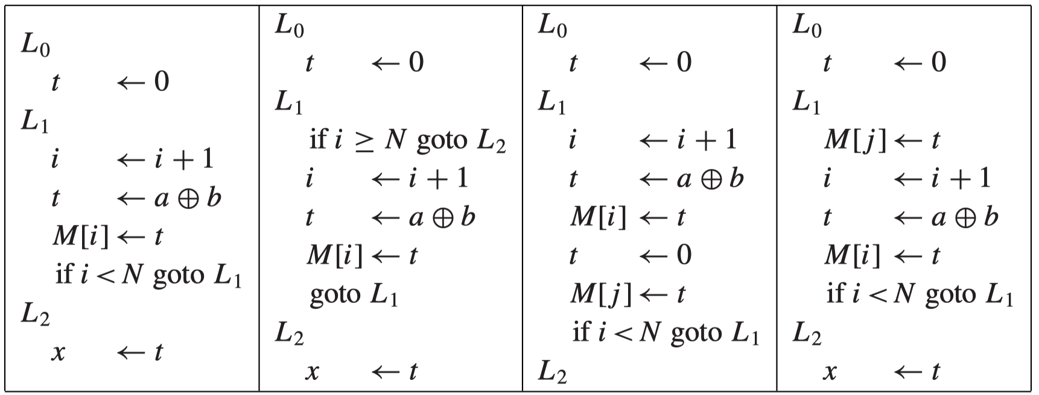
Hoisting
Suppose t ← a ⊕ b is loop-invariant. Can we hoist it out of the loop?
correct
faster
incorrect
not always execute the def
incorrect
more than one def of t
incorrect
a use of t before the def

Slide 21
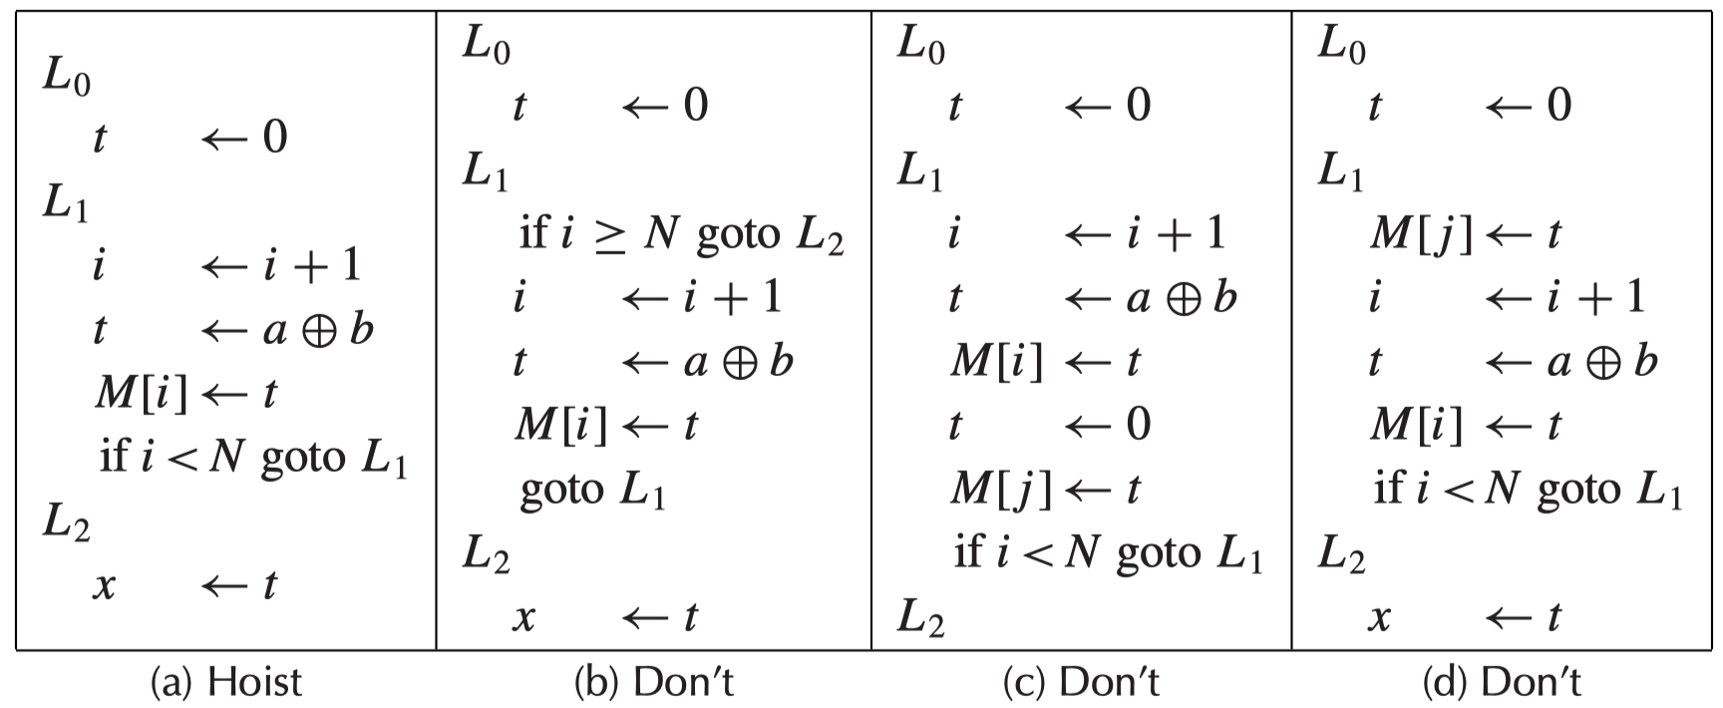



Hoisting
The criteria for hoisting d : t ← a ⊕ b to the end of the loop preheader:
d dominates all loop exits at which t is live-out
and there is only one definition of t in the loop
and t is not live-out of the loop preheader
$$✘$$
=> (b)
$$✘$$
=> (c)
$$✘$$
=> (d)

Slide 22
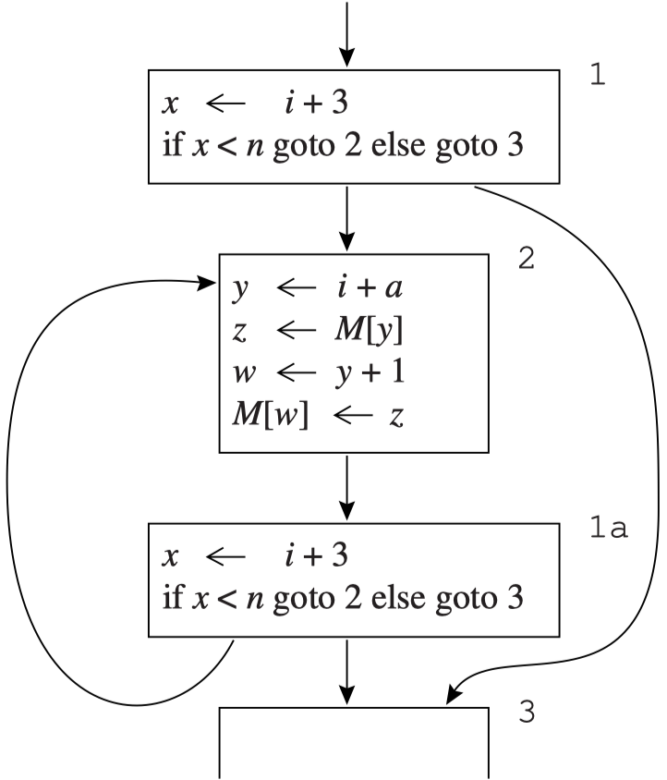
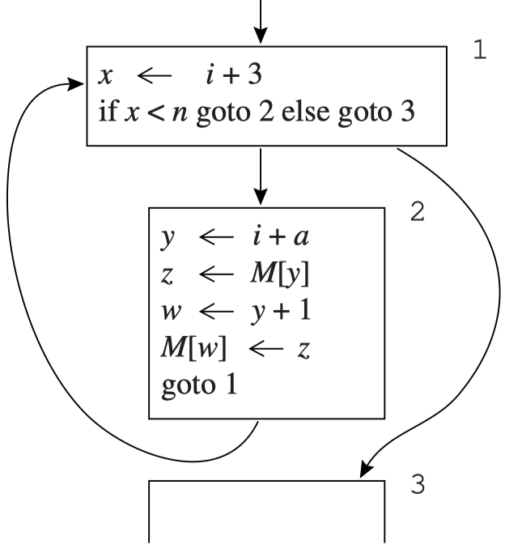
Hoisting
Implicit side effects. These rules need modification if t ← a ⊕ b could raise some sort of arithmetic exception or have other side effects.
Turning while loops into repeat-until loops.
“d dominates all loop exits at which t is live-out”: tends to prevent many computations from being hoisted from while loops.
None of the statements dominates the loop exit node

Slide 23
Outline
Dominators
Loop-Invariant Computations
Induction Variables
Array-Bounds Checks
Loop Unrolling

Slide 24
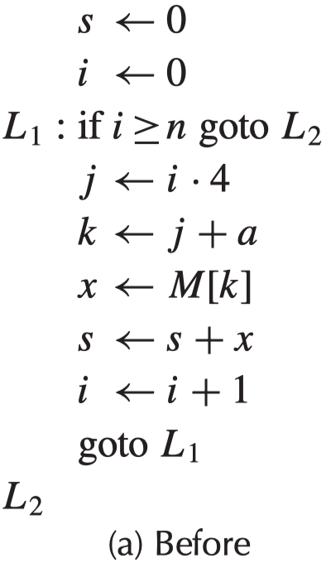
Induction Variables
Some loops have
a variable i that is incremented or decremented
a variable j = i ·c+d where c and d are loop-invariant.
We can calculate j’s value without reference to i
whenever i is incremented by a, j = j + a*c
i is a basic induction variable
j and k are derived induction variable in the family of i
j = a_{j} + i · b_{j} (a_{j}=0, b_{j}=4)
(i, a_{j}, b_{j}) => (i, 0, 4)
k ← j + a (a is loop-invariant)
k = i · 4 + a= a + i · 4
(i, a, 4)

Slide 25
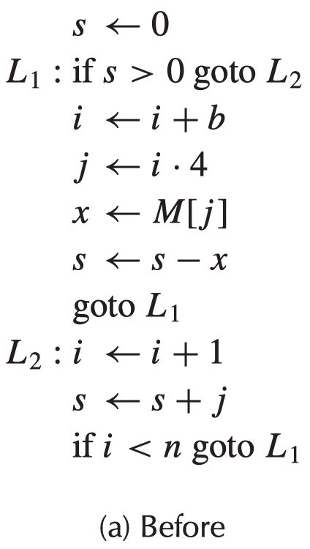
Linear Induction Variable
Linear induction variable: an induction variable changes by the same (constant or loop-invariant) amount in every iteration of the loop
The basic induction variable i is incremented by different amounts in different iterations
not linear
in some iterations j = i · 4 and in other iterations the derived induction variable j gets (temporarily) left behind as i is incremented.

Slide 26
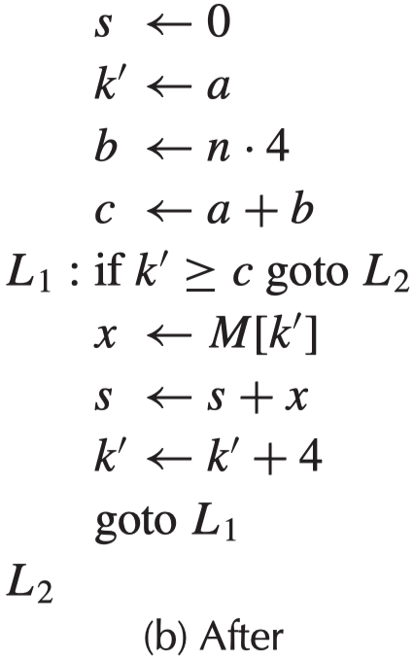
Induction Variables
induction-variable analysis
i & j
strength reduction
replace i*4
induction-variable elimination
i>=n → k >= 4n +a
copy propagation

Slide 27
Detection of Induction Variables
Basic induction variables: The variable i is a basic induction variable in a loop L with header node h if the only definitions of i within L are of the form i ← i + c or i ← i− c, where c is loop-invariant.
Derived induction variables: The variable k is a derived induction variable in loop L, if
There is only one def of k within L, of the form k ← j ·c or k ← j + d, where j is an induction variable and c, d are loop-invariant
and if j is derived induction variable in the family of i, then:
2.1 the only def of j that reaches k is the one in the loop
2.2 and there is no def of i on any path between the def of j and the def of k

Slide 28
Strength Reduction
Multiplication is more expensive than addition.
We would like to replace each derived induction variable whose def is of the form j ← i · c with an addition.
For each derived induction variable j whose triple is (i, a, b), i.e., j ← a + i · b
make a new variable j’
After each assignment i ← i + c, make an assignment j′ ← j′ + c · b, where c · b is a loop-invariant expression that may be computed in the loop preheader.
If c and b are both constant, then the multiplication may be done at compile time.
Replace the (unique) assignment to j with j ← j’
Initialize j′ with j′ ← a + i · b at the end of the loop preheader.
perform dead-code elimination

Slide 29
Strength Reduction - Example
s ← 0
i ← 0
L₁: if i >= n goto L₂
j ← i · 4
k ← j + a
x ← M[k]
s ← s + x
i ← i + 1
goto L₁
L₂:
s ← 0
i ← 0
L₁: if i >= n goto L₂
j ← i · 4
k ← j + a
x ← M[k]
s ← s + x
i ← i + 1
j’ ← j’ + 4
goto L₁
L₂:
make a new variable j’
After each assignment i ← i + c, make an assignment j′ ← j′ + c · b, where c · b is a loop-invariant expression that may be computed in the loop preheader.

Slide 30
Strength Reduction - Example
s ← 0
i ← 0
L₁: if i >= n goto L₂
j ← i · 4
k ← j + a
x ← M[k]
s ← s + x
i ← i + 1
j’ ← j’ + 4
goto L₁
L₂:
s ← 0
i ← 0
j’ ← 0
L₁: if i >= n goto L₂
j ← j’
k ← j + a
x ← M[k]
s ← s + x
i ← i + 1
j’ ← j’ + 4
goto L₁
L₂:
Replace the (unique) assignment to j with j ← j’
Initialize j′ with j′ ← a + i · b at the end of the loop preheader.

Slide 31
Strength Reduction - Example
s ← 0
i ← 0
j’ ← 0
L₁: if i >= n goto L₂
j ← j’
k ← j + a
x ← M[k]
s ← s + x
i ← i + 1
j’ ← j’ + 4
goto L₁
L₂:
s ← 0
i ← 0
j’ ← 0
k’ ← a
L₁: if i >= n goto L₂
j ← j’
k ← k’
x ← M[k]
s ← s + x
i ← i + 1
j’ ← j’ + 4
k’ ← k’ + 4
goto L₁
L₂:
Perform strength reduction on k.

Slide 32
Elimination
After strength reduction
some of the induction variables are not used at all in the loop
and others are used only in comparisons with loop-invariant variables
These induction variables can be deleted.
A variable is useless in a loop L if
it is dead at all exits from L
and its only use is in a definition of itself
All definitions of a useless variable may be deleted.
Can be deleted
s ← 0
i ← 0
j’ ← 0
k’ ← a
L₁: if i >= n goto L₂
j ← j’
k ← k’
x ← M[k]
s ← s + x
i ← i + 1
j’ ← j’ + 4
k’ ← k’ + 4
goto L₁
L₂:

Slide 33
Elimination
After strength reduction
some of the induction variables are not used at all in the loop
and others are used only in comparisons with loop-invariant variables
These induction variables can be deleted.
A variable is useless in a loop L if
it is dead at all exits from L
and its only use is in a definition of itself
All definitions of a useless variable may be deleted.
Can be deleted
s ← 0
i ← 0
j’ ← 0
k’ ← a
L₁: if i >= n goto L₂
j ← j’
k ← k’
x ← M[k]
s ← s + x
i ← i + 1
j’ ← j’ + 4
k’ ← k’ + 4
goto L₁
L₂:

Slide 34
Elimination
After strength reduction
some of the induction variables are not used at all in the loop
and others are used only in comparisons with loop-invariant variables
These induction variables can be deleted.
A variable is useless in a loop L if
it is dead at all exits from L
and its only use is in a definition of itself
All definitions of a useless variable may be deleted.
Can be deleted
s ← 0
i ← 0
j’ ← 0
k’ ← a
L₁: if i >= n goto L₂
j ← j’
k ← k’
x ← M[k]
s ← s + x
i ← i + 1
j’ ← j’ + 4
k’ ← k’ + 4
goto L₁
L₂:

Slide 35
Rewriting Comparisons
A variable k is almost useless
if it is used only in comparisons against loop-invariant values and in deﬁnitions of itself,
and there is some other induction variable c in the same family that is not useless.
An almost-useless variable => a useless variable
by modifying the comparison to use the related induction variable
Example

Slide 36
Rewriting Comparisons - Example
s ← 0
i ← 0
k’ ← a
L₁: if i >= n goto L₂
k ← k’
x ← M[k]
s ← s + x
i ← i + 1
k’ ← k’ + 4
goto L₁
L₂:
s ← 0
i ← 0
k’ ← a
b ← n · 4
c ← a + b
L₁: if k’ >= c goto L₂
k ← k’
x ← M[k]
s ← s + x
k’ ← k’ + 4
goto L₁
L₂:
almost useless variable: i
related induction variable: k’
i >=n → k’ >= a + 4 · n
a + 4 · n is loop-invariant, should be hoisted
delete i

Slide 37
Rewriting Comparisons - Example
s ← 0
i ← 0
k’ ← a
b ← n · 4
c ← a + b
L₁: if k’ > c goto L₂
k ← k’
x ← M[k]
s ← s + x
k’ ← k’ + 4
goto L₁
L₂:
s ← 0
i ← 0
k’ ← a
b ← n · 4
c ← a + b
L₁: if k’ > c goto L₂
x ← M[k’]
s ← s + x
k’ ← k’ + 4
goto L₁
L₂:
copy
propagation

Slide 38
Outline
Dominators
Loop-Invariant Computations
Induction Variables
Array-Bounds Checks
Loop Unrolling

Slide 39
Array-Bounds Checks
Some programming languages automatically insert array-bounds checks on every subscript operation.
We want the compiler to remove any checks that is can prove are redundant.
Removing all the redundant bounds checks is not computable
Many array subscripts are of the form a[i], where i is an induction variable.
The compiler can often understand well enough to optimize.
The bounds for an array are generally of the form 0 ≤ i ∧ i < N.
The criteria for eliminating a bounds check from a loop L are actually quite complicated.
Refer to the textbook.

Slide 40
Outline
Dominators
Loop-Invariant Computations
Induction Variables
Array-Bounds Checks
Loop Unrolling

Slide 41
Loop Unrolling
Some loops have such a small body that most of the time is spent incrementing the loop-counter variable and testing the loop-exit condition.
Unrolling: putting two or more copies of the loop body in a row.
Given a loop L with header node h and back edges s_{i} → h, we can unroll the loop as follows:
Copy the nodes to make a loop L’ with header h’ and back edges s_{i}’ → h’
Change all the back edges in L from s_{i} → h to s_{i} → h’
Change all the back edges in L’ from s_{i}’ → h’ to s_{i}’ → h
h
...
s_{i}
h
...
s_{i}
h’
...
s_{i}’

Slide 42
Loop Unrolling
L₁: x ← M[i]
s ← s + x
i ← i + 4
if i < n goto L₁’ else L₂
L₁’: x ← M[i]
s ← s + x
i ← i + 4
if i < n goto L₁ else L₂
L₂:
L₁: x ← M[i]
s ← s + x
i ← i + 4
if i < n goto L₁ else L₂
L₂:
Nothing useful has been accomplished, each “original” iteration still has an increment and a conditional branch.

Slide 43
Loop Unrolling
We need an induction variable such that every increment i ← i + Δ dominates every back edge of the loop
Agglomerate the increments and loop-exit tests
can only handle even times of iter
L₁: x ← M[i]
s ← s + x
i ← i + 4
if i < n goto L₁’ else L₂
L₁’: x ← M[i]
s ← s + x
i ← i + 4
if i < n goto L₁ else L₂
L₂:
L₁: x ← M[i]
s ← s + x
x ← M[i+4]
s ← s + x
i ← i + 8
if i < n goto L₁ else L₂
L₂:
Fragile

Slide 44
Loop Unrolling
We need an induction variable such that every increment i ← i + Δ dominates every back edge of the loop
Agglomerate the increments and loop-exit tests => Fragile
can only handle even times of iter
Execute “odd” iterations in an epilogue => Robust
if i < n – 8 goto L₁ else L₂
L₁: x ← M[i]
s ← s + x
x ← M[i+4]
s ← s + x
i ← i + 8
if i < n goto L₁ else L₂
L₂: x ← M[i]
s ← s + x
i ← i + 4
if i < n goto L₂ else L₃
L₃
L₁: x ← M[i]
s ← s + x
x ← M[i+4]
s ← s + x
i ← i + 8
if i < n goto L₁ else L₂
L₂:
Fragile
Robust

Slide 45
Summary
Dominators
Loop-Invariant Computations
Induction Variables
Array-Bounds Checks
Loop Unrolling

Slide 46
Final Examination
2023年6月25日，10:30-12:30，玉泉教7-506
以教务系统为准
半开卷（只允许带三张A4纸，打印或手写，可正反面）
考试范围：第1-11、13-14、18章
题型：判断题30道，选择题20道，大题50分
提示：
题量较大，熟练度要高
概念、重要算法一定要弄清楚
作业题要会做

Slide 47
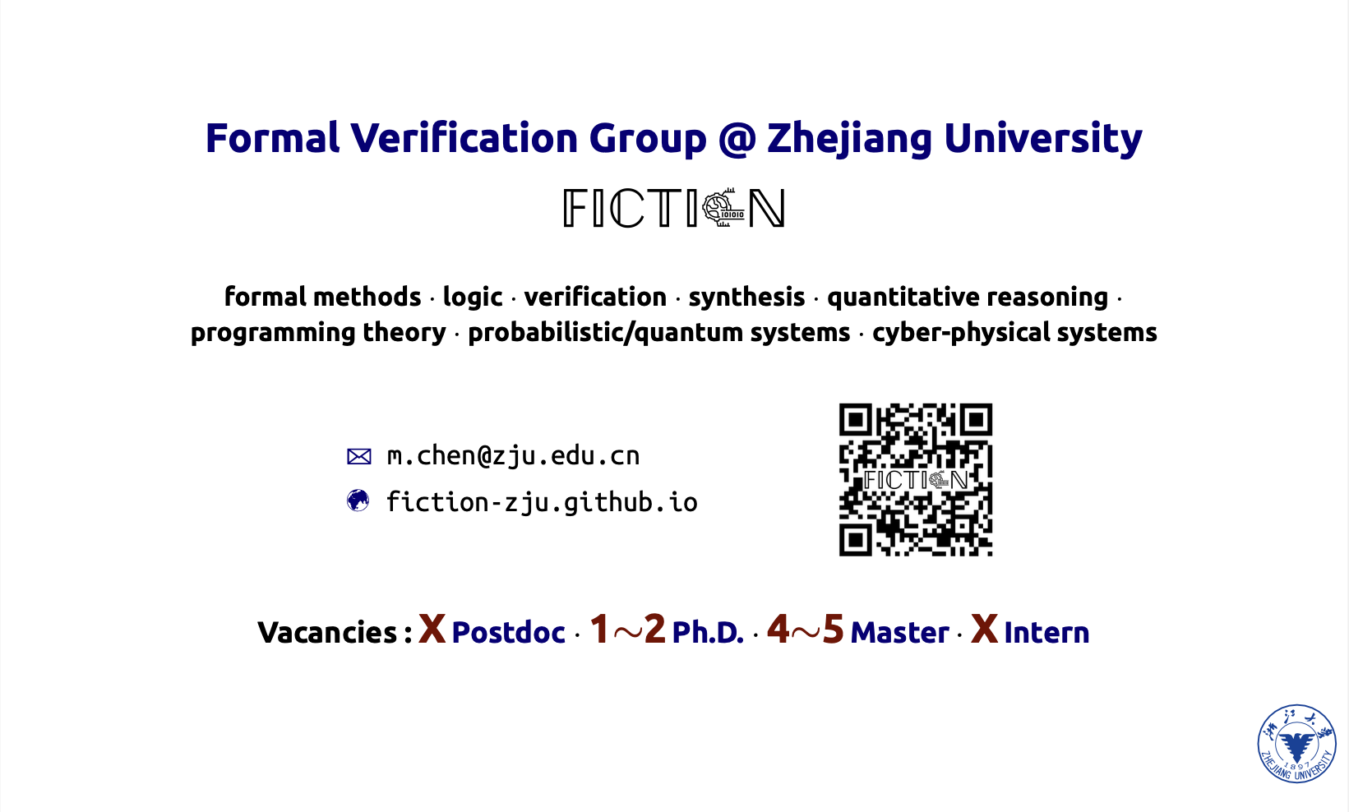
Open Positions

Slide 48
THANKS!

