Slide 1

编译原理
陈明帅
m.chen@zju.edu.cn
浙江大学 · 计算机科学与技术学院

Slide 2
课程内容
1
Introduction
2
3
4
5
6
Lexical Analysis
Parsing
Abstract Syntax
Semantic Analysis
Activation Records
9
8
7
Instruct. Selection
Blocks & Traces
Interm. Code
10
11
Liveness Analysis
Register Allocation
Fundamentals
13
18
Garbage Collection
Loop Optimizations
Advanced Topics

Slide 3






Overview
x := a * 2 + b * (x * 3)
id<x> assign id<a> times int<2> plus id<b> times lparen id<x> times int<3> rparen
词法分析: 将程序字符流分解为记号 (Token) 序列
删除字符串中不必要的部分（如空格）
通常使用正则表达式匹配（DFA 定义）
string
token sequence
词法分析
语法分析
指令选择
寄存器分配
指令调度
语义分析
中间代码生成
机器无关代码优化

Slide 4
Overview
Why separating lexical analysis from parsing ?
Would unduly complicate the parser
How do we discuss lexical analysis?
Attacked with high-powered formalisms and tools
Similar formalisms will be useful in parsing
Similar tools have many applications in areas other than compilation
Stm → id := Exp | (AssignStm) √
Stm → [a-z][a-z0-9]* := Exp | (AssignStm)×

Slide 5
2.1 Lexical Token

Slide 6
Lexical Token
A lexical token: A sequence of characters; A unit in the grammar of a programming language (e.g., terminal symbol)
Classification of lexical tokens: A finite set of token types, e.g.,
Type | Examples
ID | foo n14 last
NUM | 73 0 00 515 082
REAL | 66.1 .5 10. 1e67 5.5e-10
IF | if
COMMA | ,
NOTEQ | !=
LPAREN | (
RPAREN | )
Reserved words, in most languages, not be used as identifiers
such as IF, VOID, RETURN

Slide 7
Lexical Token
Examples of non-tokens:
comment | /* I am a comment */
preprocessor directive | #include<stdio.h>
preprocessor directive | #define NUMS 5, 6
macro | NUMS
blanks, tabs, and new-lines
Some preprocessor processes the source code first:
#include<stdio.h>
#define ZERO 0.
/* find a zero */
float match0(char *s) {
if (!strncmp(s, "0.0", 3))
return ZERO;
}
preprocessor
float match0(char *s) { if (!strncmp(s,"0.0",3)) return 0.;}
to lexical analyzer

Slide 8
Lexical Token
float match0(char *s){ if (!strncmp(s,"0.0",3)) return 0.;}
lexical analyzer
FLOAT | ID(match0) | LPAREN | CHAR | STAR
ID(s) | RPAREN | LBRACE | IF | LPAREN
BANG | ID(strncmp) | LPAREN | ID(s) | COMMA
STRING(0.0) | COMMA | NUM(3) | RPAREN | RPAREN
RETURN | REAL(0.0) | SEMI | RBRACE | EOF
The token-type of each token is reported
Some of the tokens attached semantic values
Such as identifiers and literals, with auxiliary information

Slide 9
Lexical Token
How should the lexical rules of a programming language be described?

Slide 10
Lexical Token
Describing the lexical tokens of a language in English;
An example : identifiers in C or Java
An identifier is a sequence of letters and digits; the first character must be a letter
The underscore _ counts as a letter
Upper- and lowercase letters are different
If the input stream has been parsed into tokens up to a given character, the next token is taken to include the longest string of characters that could possibly constitute a token
Blanks, tabs, newlines, and comments are ignored except as they serve to separate tokens
Some white space is required to separate otherwise adjacent identifiers, keywords, and constants

Slide 11
Lexical Token
In what language should a lexical analyzer be written?
An ad hoc lexer
Any reasonable programming language can be used to implement it
A simple, general purpose, and readable lexical analyzer
(1) Regular expressions: Specify lexical tokens
(easy to understand, but hard to implement)
(2) Deterministic finite automata: Implement lexers
(easy to implement, yet hard to manually construct from specifications)
(3) Mathematics: Connecting the above two

Slide 12
The Workflow
Description of lexical tokens
(in natural language or in mind)
Manually
Regular Expression
?
Deterministic Finite Automata
Table-Driven Implementation
Lexer

Slide 13
The Workflow
Description of lexical tokens
(in natural language or in mind)
Manually
Regular Expression
?
Deterministic Finite Automata
Table-Driven Implementation
Lexer

Slide 14
2.2 Regular Expression

Slide 15
Language
A language is a set of strings (maybe infinite set)
A string is a finite sequence of symbols
A symbol is taken from a finite alphabet
alphabet
strings
language
A,B,C,D,E,F,G...Z
a,b,c,d,e,f,g...z
like, haivabes, QdoW, English...
all strings which are English words
Notes:
Not assign any meaning to the strings;
Only classify each string as in the language or not.

Slide 16
Regular Expression
Regular expressions：
To specify some of these (possibly infinite)
languages with finite descriptions.
(2) Each regular expression stands for a set of strings
A regular expression (RE) is defined inductively:
a ordinary character stands for itself
∊ the empty string
M|N either M or N (alternation), where M, N are RE
M·N N followed by M (concatenation), where M, N are RE
R* concatenation of a RE R zero or more times
(R* = ε|R|RR|RRR|RRRR…)

Slide 17
Regular Expression
Symbol: a
For each symbol a in the alphabet of the language
The regular expression a: denotes the language containing just the string a.
Alternation: A vertical bar |
Given two regular expressions M and N, the alternation operator makes a new regular expression M | N.
A string is in the language of M | N if it is in the language of M or in the language of N.
Example:
The language of a | b contains the two strings a and b

Slide 18
Regular Expression
Concatenation: operator ·
Given two regular expressions M and N, the concatenation makes a new regular expression M · N.
A string is in the language of M · N if it is the concatenation of any two strings α and β such that α is in the language of M and β is in the language of N.
Example:
The regular expression (a | b) · a defines the language containing the two strings aa and ba.

Slide 19
Regular Expression
Epsilon: ∊
The regular expression ∊ represents a language whose only string is the empty string.
Example: (a · b) | ∊ represents the language {"", "ab"}.
Repetition:
Given a regular expression M, its Kleene closure is M*.
A string is in M* if it is the concatenation of zero or more strings, all of which are in M.
Example: ((a | b) · a)* represents the infinite set {"", "aa", "ba", "aaaa", "baaa", "aaba", "baba", "aaaaaa", …}.

Slide 20
Regular Expression
symbols, alternation, concatenation, epsilon, and Kleene closure:
Specify the set of ASCII characters corresponding to the lexical tokens of a programming language
In writing regular expressions, sometimes the concatenation symbol or the epsilon will be omitted
Assuming that
Kleene closure "binds tighter" than concatenation
Concatenation binds tighter than alternation;
so that
ab | c means (a · b) | c, and (a |) means (a | ∊)

Slide 21
Regular Expression
Introducing some more abbreviations:
[abcd] means (a | b | c | d),
[b-g] means [bcdefg],
[b-gM-Qkr] means [bcdefgMNOPQkr],
M? means (M | ∊), and M+ means (M·M*).
These extensions are convenient
But do not bring extra descriptive power
Any set of strings that can be described with these abbreviations could also be described by just the basic set of operators.

Slide 22
Regular Expression
a | An ordinary character stands for itself.
∊ | The empty string. Another way to write the empty string.
M | N | Alternation, choosing from M or N.
M · N | Concatenation, an M followed by an N.
MN | Another way to write concatenation.
M* | Repetition (zero or more times).
M⁺ | Repetition, one or more times.
M? | Optional, zero or one occurrence of M.
[a − zA − Z] | Character set alternation.
. | A period stands for any single character except newline.
"a.+*" | Quotation, a string in quotes stands for itself literally.
Figure 2.1: Regular expression notation.

Slide 23
Regular Expression
if {return IF;}
[a-z][a-z0-9]* {return ID;}
[0-9]+ {return NUM;}
([0-9]+"."[0-9]*)|([0-9]*"."[0-9]+) {return REAL;}
("--"[a-z]*"\n")|(" "|"\n"|"\t")+ {/*do nothing*/}
. {error();}
Figure 2.2: Regular expressions for some tokens
The fifth line of the description recognizes comments or white space but does not report back to the parser.
Instead:
The white space is discarded and the lexer resumed
The comments begin with two dashes, contain only alphabetic characters, and end with new-line
A lexical specification should be complete, in this case error occur when any other situation matches.

Slide 24
Regular Expression
if {return IF;}
[a-z][a-z0-9]* {return ID;}
[0-9]+ {return NUM;}
([0-9]+"."[0-9]*)|([0-9]*"."[0-9]+) {return REAL;}
("--"[a-z]*"\n")|(" "|"\n"|"\t")+ {/*do nothing*/}
. {error();}
These rules are a bit ambiguous.
For example:
ID(if8)
if8
?
IF
NUM(8)
what about if in “if 89” ?

Slide 25
Regular Expression
Two important disambiguation rules used by Lex, JavaCC, SableCC, and other similar lexical-analyzer generators:
Longest match:
The longest initial substring of the input that can match any regular expression is taken as the next token.
Rule priority:
For a particular longest initial substring, the first regular expression that can match determines its token-type.
This means that the order of writing down the regular-expression rules has significance.
Thus,
if8 matches as an identifier by the longest-match rule;
if matches as a reserved word by rule priority.

Slide 26
The Workflow
Description of lexical tokens
(in natural language or in mind)
Manually
Regular Expression
?
Deterministic Finite Automata
Table-Driven Implementation
Lexer

Slide 27
2.3 Finite Automata

Slide 28
Finite Automata
Regular expressions:
Convenient for specifying lexical tokens
Need a formalism:
Implemented as a computer program
Using finite automata (N.B. the singular of automata is automaton)
A finite automaton :
A finite set of states; edges lead from one state to another, and each edge is labeled with a symbol.
One state is the start state, and certain of the states are distinguished as final states.

Slide 29
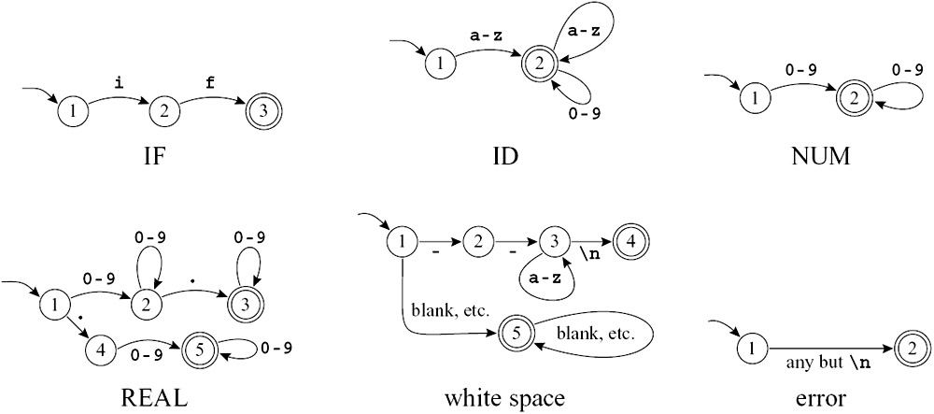
Finite Automata
Figure 2.3: Finite automata for lexical tokens.
The states are indicated by circles;
final states are indicated by double circles.
The start state has an arrow coming in from nowhere.
An edge labeled with several characters is shorthand for many parallel edges.

Slide 30
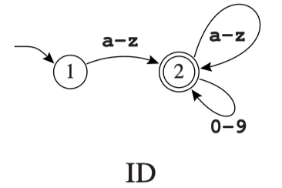
Finite Automata
In a deterministic finite automaton (DFA), no two edges leaving from the same state are labeled with the same symbol.
A DFA accepts or rejects a string as follows.
Starting in the start state, for each character in the input string the automaton follows exactly one edge to get to the next state.
The edge must be labeled with the input character.
After making n transitions for an n-character string, if the automaton is in a final state, then it accepts the string.
If it is not in a final state, or if at some point there was no appropriately labeled edge to follow, it rejects.
The language recognized by an automaton is the set of strings that it accepts.

Slide 31
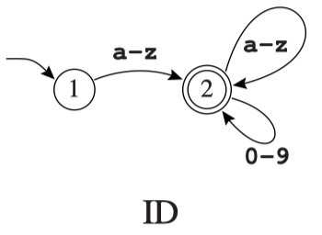
Finite Automata
For example
Any string in the language recognized by automaton ID must begin with a letter.
Any single letter leads to state 2, which is final; so a single-letter string is accepted.
From state 2, any letter or digit leads back to state 2, so a letter followed by any number of letters and digits is also accepted.
In fact, the machines shown in Figure 2.3 accept the same languages as the regular expressions of Figure 2.2

Slide 32
Finite Automata
These are six separate automata; how can they be combined into a single machine that can serve as a lexical analyzer? Try ad hoc method first

Slide 33
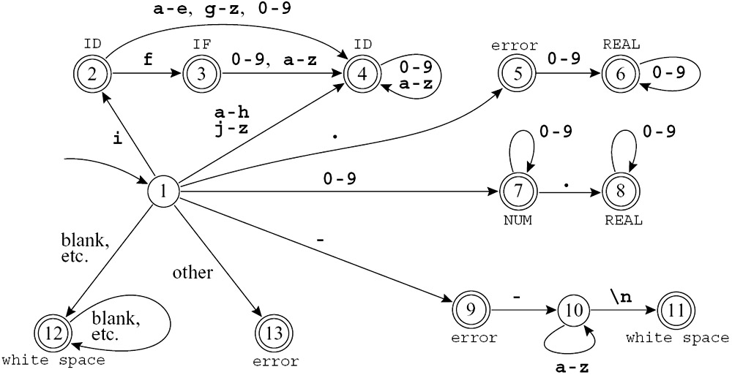
Finite Automata
Figure 2.4: Combined finite automaton
Labeling each final state with the accepted token-type.

Slide 34
Finite Automata
How rule priority is implemented?

Slide 35
Finite Automata
How rule priority is implemented?
State 2 has aspects of state 2 of the IF machine and state 2 of the ID machine; since the latter is final, then the combined state must be final.
State 3 is like state 3 of the IF machine and state 2 of the ID machine;
To disambiguate both final using rule priority to - labeling state 3 with IF because we want this token to be recognized as a reserved word, not an identifier

Slide 36
Finite Automata
We say DFA is easy to implement, but how？
Deterministic Finite Automata
Table-Driven Implementation
Lexer
Hint: A DFA is like a graph; A matrix can be used to describe how states transit

Slide 37
Finite Automata
Encoding this machine as a transition matrix:
a two-dimensional array (a vector of vectors), subscripted by state number and input character.
There will be a "dead" state (state 0) that loops to itself on all characters; we use this to encode the absence of an edge.
int edges[][] = { /* ... 0,1,2... -... e f g,h i, j... */
/* state 0 */ {0,0,...0,0,0...0...0,0,0,0,0,0...},
/* state 1 */ {0,0,...7,7,7...9...4,4,4,4,2,4...},
/* state 2 */ {0,0,...4,4,4...0...4,3,4,4,4,4...},
/* state 3 */ {0,0,...4,4,4...0...4,4,4,4,4,4...},
/* state 4 */ {0,0,...4,4,4...0...4,4,4,4,4,4...},
/* state 5 */ {0,0,...6,6,6...0...0,0,0,0,0,0...},
/* state 6 */ {0,0,...6,6,6...0...0,0,0,0,0,0...},
/* state 7 */ {0,0,...7,7,7...0...0,0,0,0,0,0...},
/* state 8 */ {0,0,...8,8,8...0...0,0,0,0,0,0...},
et cetera
}
A "finality" array, mapping state numbers to actions
- final state 2 maps to action ID, and so on.

Slide 38
Finite Automata
RECOGNIZING THE LONGEST MATCH
How to use this table to recognize whether to accept or reject a string?
The job of a lexical analyzer is to find the longest match, the longest initial substring of the input that is a valid token.
The lexer must keep track of the longest match, say with two variables:
Last-Final (the state number of the most recent final state)
Input-Position-at-Last-Final
Every time a final state is entered, the lexer updates these variables
A dead state (a non-final state with no output transitions) is reached:
the variables tell what token was matched and where it ended.

Slide 39
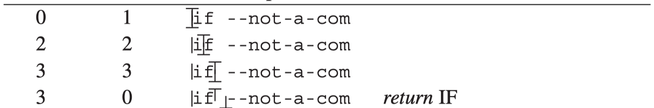
Finite Automata
Figure 2.4
|：input position
⊥: automaton position
T: last final

Slide 40
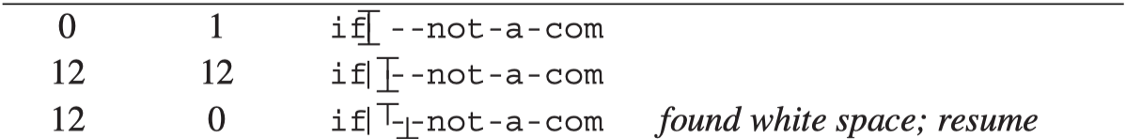
Finite Automata
Figure 2.4
|：input position
⊥: automaton position
T: last final

Slide 41
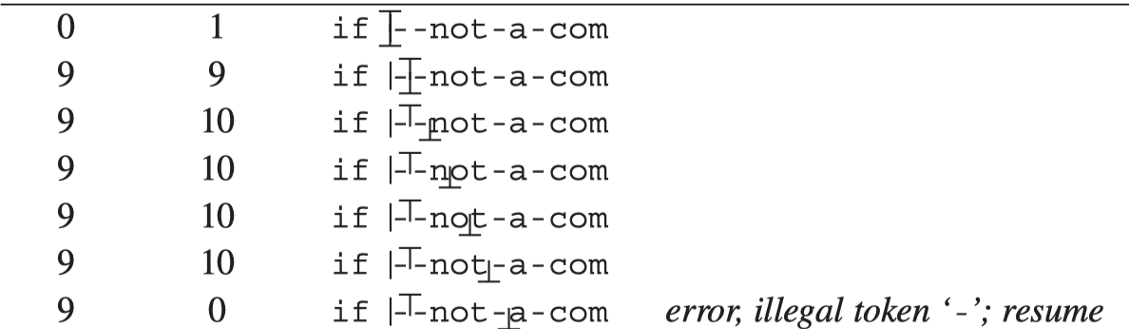
Finite Automata
Figure 2.4
Figure 2.4
|：input position
⊥: automaton position
T: last final

Slide 42
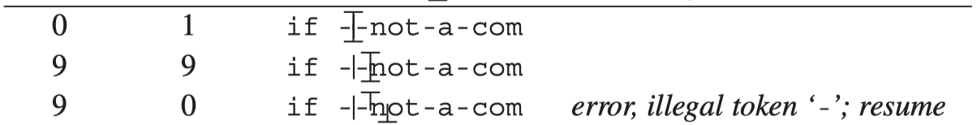
Finite Automata
Figure 2.4
|：input position
⊥: automaton position
T: last final

Slide 43
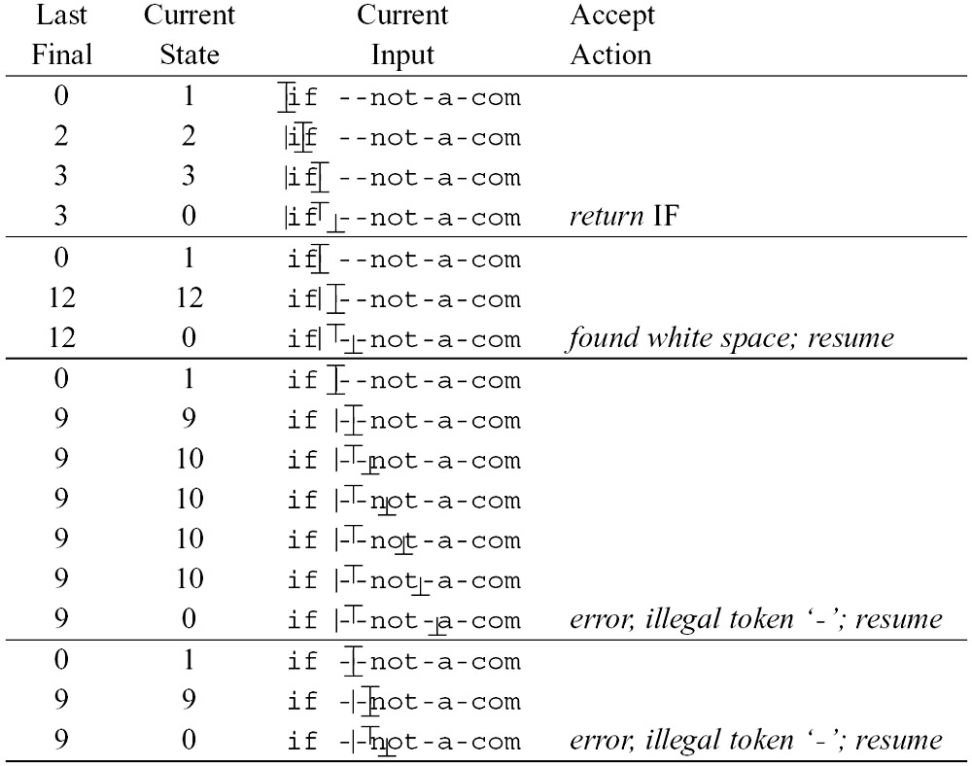
Finite Automata
Figure 2.5: The automaton of Figure 2.4 recognizes several tokens.

Slide 44
The Workflow
Description of lexical tokens
(in natural language or in mind)
Manually
Regular Expression
manually construct DFA from specifications is HARD, so how?
?
Deterministic Finite Automata
Table-Driven Implementation
Lexer

Slide 45
The Workflow
Description of lexical tokens
(in natural language or in mind)
Manually
Regular Expression
Non-Deterministic Finite Automata
Deterministic Finite Automata
Table-Driven Implementation
Lexer

Slide 46
2.4 Nondeterministic Finite Automata

Slide 47
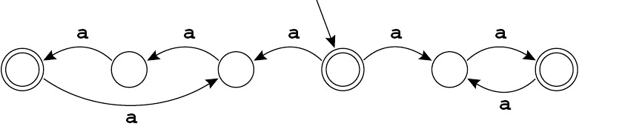
Nondeterministic Finite Automata
A nondeterministic finite automaton (NFA):
Have to choose one from the edges (- labeled with the same symbol -) to follow out of a state
Have special edges labeled with ∊

Slide 48
Nondeterministic Finite Automata
The language recognized by this NFA?
All strings containing a multiple of two or three a's
How the NFA works (in the start state)?
On character a, the automaton can move either left or right
In case of left: string length is a multiple of three
In case of right: string length is even
On the first transition
This machine must choose which way to go?
Must “guess”! And always guess correctly!!

Slide 49
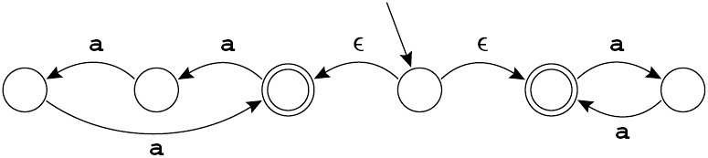
Nondeterministic Finite Automata
Here is another NFA that accepts the same language:
Edges labeled with ∊ may be taken without using up a symbol from the input.
The machine must choose which ∊-edge to take!
A state with some ∊-edges and edges labeled by symbols
Follow the corresponding symbol-labeled edge
Or to follow an ∊-edge instead

Slide 50
Nondeterministic Finite Automata
Description of lexical tokens
(in natural language or in mind)
Manually
Regular Expression (Static, Declarative)
Thompson's Construction
NFA (simulatable, quasi-executable)
Deterministic Finite Automata
Table-Driven Implementation
Lexer

Slide 51

Nondeterministic Finite Automata
HOW TO CONVERT A REGULAR
EXPRESSION TO AN NFA?
The conversion algorithm:
Turning each regular expression into an NFA with a tail (start edge) and a head (ending state).
Similar to regular expressions, the NFA will be primitive or made from smaller NFAs.
In general, any regular expression M
Some NFA with a tail and head:

Slide 52
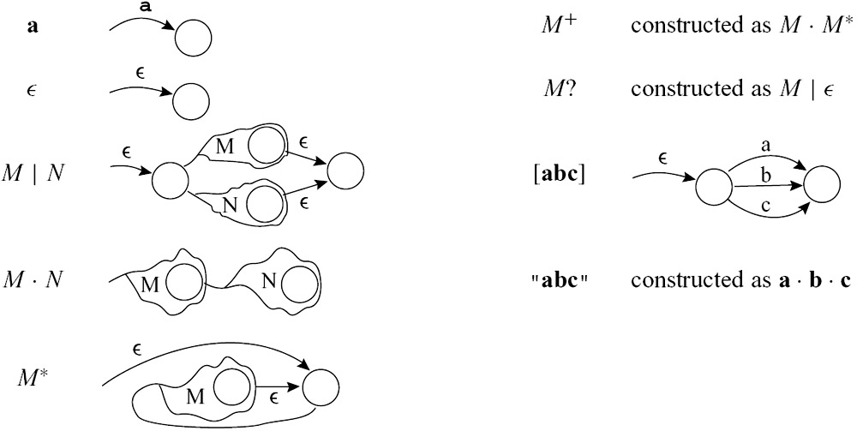
Nondeterministic Finite Automata
The rules for translating regular expressions to nondeterministic automata
Figure 2.6: Translation of regular expressions to NFAs.

Slide 53
Nondeterministic Finite Automata
if {return IF;}
[a-z][a-z0-9]* {return ID;}
[0-9]+ {return NUM;}
. {error();}
Figure 2.2

Slide 54
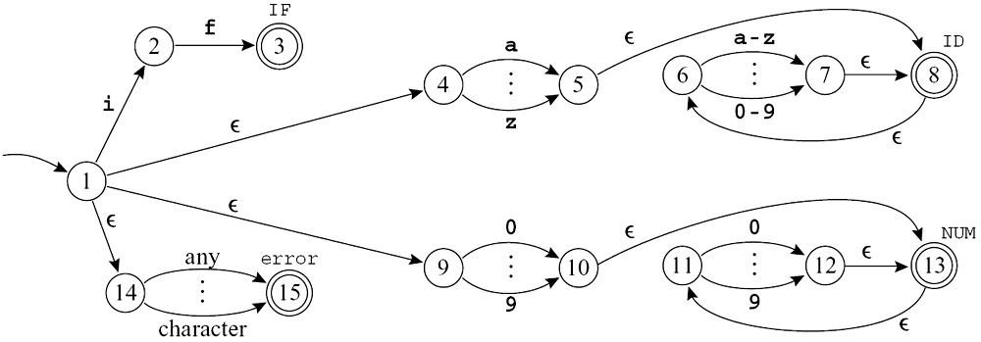
Nondeterministic Finite Automata
The result for the tokens IF, ID, NUM, and error
- after some merging of equivalent NFA states
Figure 2.7: Four regular expressions translated to an NFA
Each expression is translated to an NFA,
The "head" state marked final with a different token type
The tails of all the expressions joined to a new start node

Slide 55
Nondeterministic Finite Automata
THE REASON FOR CONVERTING AN NFA TO A DFA
NFA is cool for regular expressions, and for you, but
not for your computer.
When introducing NFA, we have
This machine must choose which way to go?
Must “guess”! And always guess correctly!!
but it’s hard for a computer to guess right!
computer prefers deterministic programs like DFA

Slide 56
The Workflow
Description of lexical tokens
(in natural language or in mind)
Manually
Regular Expression
Thompson's Construction
Non-Deterministic Finite Automata
Subset Construction, DFA Minimization
Deterministic Finite Automata
Table-Driven Implementation
Lexer

Slide 57
Nondeterministic Finite Automata
Avoid guesses by trying every possibility at once.
For example, simulating the NFA on input string in
accept in
closure({1}) = {1, 4, 9, 14} // ∊-closure of {1}
DFAedge({1, 4, 9, 14}, i) = closure({2, 5, 15}) = {2, 5, 6, 8, 15}
DFAedge({2, 5, 6, 8, 15}, n) = closure({7}) = {6, 7, 8}

Slide 58
Nondeterministic Finite Automata
Starting in state 1
Instead of guessing which ∊-transition to take, the NFA might take any of them
It is in one of the states {1, 4, 9, 14};
That is, we compute the ∊-closure of {1}
No other states reachable without eating the first character

Slide 59
Nondeterministic Finite Automata
Making the transition on the character i
From state 1 to reach 2; from 4 to 5, from 9 to nowhere, and from 14 to 15
So the set {2, 5, 15}.
Again compute the ∊-closure:
From 5 there is an ∊-transition to 8 and From 8 to 6
So the NFA in one of the states {2, 5, 6, 8, 15}.

Slide 60
Nondeterministic Finite Automata
On the character n
Get from state 6 to 7, from 2 to nowhere, from 5 to nowhere, from 8 to nowhere, and from 15 to nowhere.
So the set {7}; its ∊-closure is {6, 7, 8}.

Slide 61
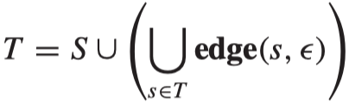
Nondeterministic Finite Automata
Formally define ∊-closure as follows
edge(s, c): the set of all NFA states reachable by following a single edge with label c from state s.
For a set of states S, closure(S) is the set of states that can be reached from a state in S without consuming any of the input, that is, by going only through ∊-edges.
Mathematically, closure(S) is the smallest set T such that

Slide 62
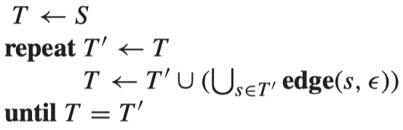
Nondeterministic Finite Automata
Calculating T by iteration
The algorithm must terminate：
(1) T can only grow before termination.
(2) There are only a finite number of distinct states in the NFA. T can be at most the set of all the NFA states.

Slide 63

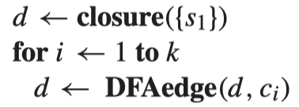
Nondeterministic Finite Automata
Simulating an NFA as described above
Suppose a set d = {s_{i}; s_{k}; s_{l}} of NFA states s_{i} ; s_{k}; s_{l}.
Starting in d and eating the input symbol c
Reaching a new set of NFA states called set DFAedge(d; c)
Writing the NFA simulation algorithm more formally via DFAedge
If the start state of the NFA is s1, the input string is c1,…, ck
The algorithm is
Manipulating sets of states is expensive：
- Costly to do on every character in the source program

Slide 64
Nondeterministic Finite Automata
Do all the sets-of-states calculations in advance.
Making a DFA from the NFA
Each set of NFA states corresponds to one DFA state
The NFA has a finite number n of states
The DFA will have a finite number (at most 2^{n}) of states.
DFA construction with closure and DFAedge algorithms.
The DFA start state d1 is just closure(s1)
There is an edge from di to dj labeled with c if dj = DFAedge(di, c).

Slide 65
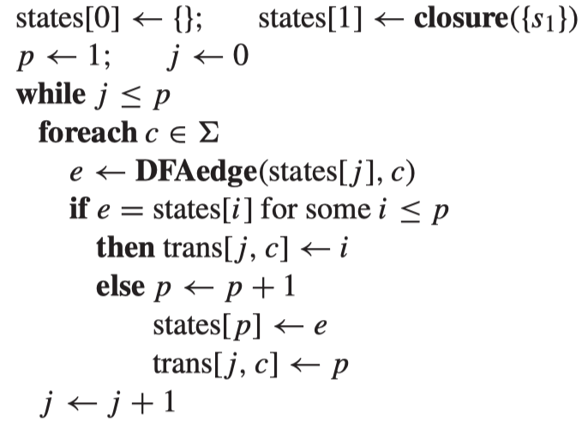
Nondeterministic Finite Automata
2
a
3
ε
4
b
5
 | states
0 | {}
1 | {1,2,6}
2 | {3,4,7,8}
3 | {5,8}
trans | a | b
0 | 0 | 0
1 | 2 | 0
2 | 0 | 3
3 | 0 | 0
ε
ε
1
8
ε
6
7
ε
a
p | j | c | DFAedge(states[j],c)
1 | 0 | a | {}
1 | 0 | b | {}
1 | 1 | a | {3,4,7,8}
2 | 1 | b | {}
2 | 2 | a | {}
2 | 2 | b | {5,8}
3 | 3 | a | {}
3 | 3 | b | {}
3 | 4 | \ | \
{1,2,6}
a
{3,4,7,8}
b
{5,8}

Slide 66
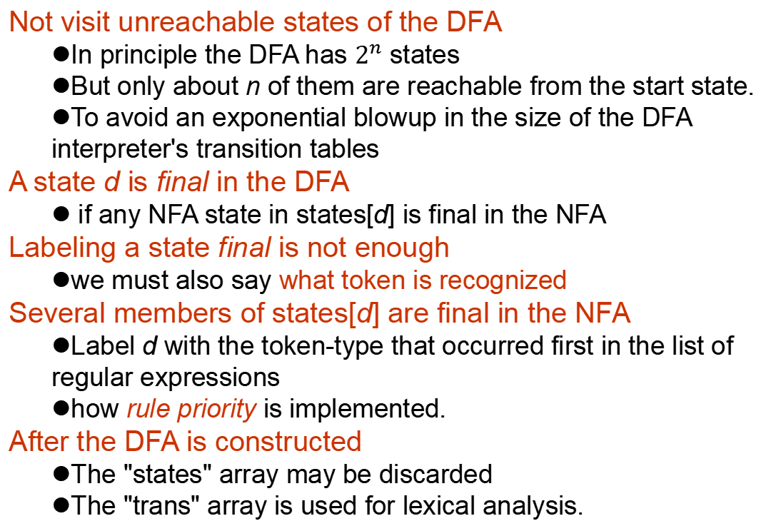
Nondeterministic Finite Automata
Not visit unreachable states of the DFA
In principle the DFA has $2^{n}$ states
But only about n of them are reachable from the start state.
To avoid an exponential blowup in the size of the DFA interpreter's transition tables
A state d is final in the DFA
if any NFA state in states[d] is final in the NFA
Labeling a state final is not enough
we must also say what token is recognized
Several members of states[d] are final in the NFA
Label d with the token-type that occurred first in the list of regular expressions
how rule priority is implemented.
After the DFA is constructed
The "states" array may be discarded
The "trans" array is used for lexical analysis.

Slide 67
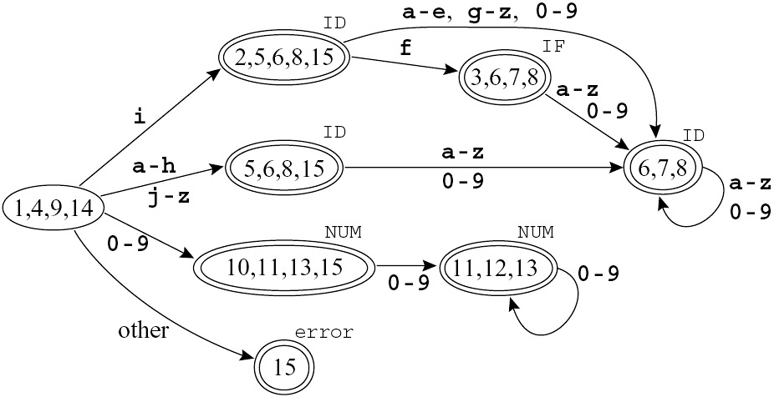
Nondeterministic Finite Automata
Applying the DFA construction algorithm to our NFA:
Rule priority
{3,6,7,8} is marked IF instead of ID
This automaton is suboptimal
not the smallest one recognizing the same language

Slide 68
Nondeterministic Finite Automata
Two states s₁ and s₂ are equivalent
The machine starting in s₁ accepts a string σ if and only if starting in s₂ it accepts σ.
This is certainly true of the states labeled {5,6,8,15} and {6,7,8}, and of the states labeled {10,11,13,15} and {11,12,13}.
In an automaton with two equivalent states s₁ and s₂
Make all of s₂'s incoming edges point to s₁ instead and delete s₂.
E.g., delete {10, 11, 13, 15}

Slide 69
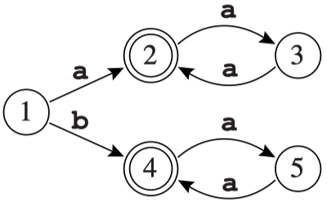
Nondeterministic Finite Automata
How can we find equivalent states?
Certainly, s1 and s2 are equivalent if they are both final or both non-final and, for any symbol c, trans[s1, c] = trans[s2, c];
{10,11,13,15} and {11,12,13} satisfy this criterion.
But this condition is not sufficiently general;
consider the automaton
Here, states 2 and 4 are equivalent, but trans[2, a] ≠ trans[4, a].

Slide 70
Nondeterministic Finite Automata
Finding all equivalent states is hard.
But finding states that are not equivalent is easy!
DFA Minimizing algorithm:
(1) imagine all final states are equivalent, all non-final states are also equivalent. These are two original groups.
(2) Kick out non-equivalent states. ①: Split a group, two state s and t should be in same group if and only if for all input symbol a, trans[s,a]=trans[t,a]. After that we have some new states. Replace original group with new groups. ②: Consider every group for ① .
(3) Keep doing (2) until no group changes.
(4) Now groups are states in minimal DFA.
Start state is the group containing former start state.
Adding edges will be natural, since states in a group goes to the same group via certain input symbol.

Slide 71
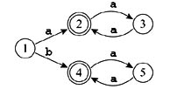
Nondeterministic Finite Automata
 | states
The first process | {1,3,5} , {2,4}
The second process | {1} , {3,5} , {2,4}
a
a
1
2, 4
3, 5
b
a

Slide 72
The Workflow
Description of lexical tokens
(in natural language or in mind)
Manually
Regular Expression
Thompson's Construction
Non-Deterministic Finite Automata
Subset Construction, DFA Minimization
Deterministic Finite Automata
Table-Driven Implementation
Lexer
Now we have the whole work flow!

Slide 73
Quiz One
Construct the NFA for the following regular expression, then convert it to a minimum-state DFA
(ab)*ba(a|b)*

Slide 74
2.5 Lex: A Lexical Analyzer Generator

Slide 75
Lex: A Lexical Analyzer Generator
DFA construction:
A mechanical task easily performed by computer
lexical-analyzer generator :
An automatic generator to translate regular expressions into a DFA
Lex:
A lexical analyzer generator that produces a C program from a lexical specification.

Slide 76
Lex: A Lexical Analyzer Generator
For each token type in the programming language
The specification contains a regular expression and an action.
The action:
Communicates the token type to the next phase of the compiler
The output of Lex is a program in C
– a lexical analyzer that interprets a DFA using the algorithm described in Section 2.3 and executes the action fragments on each match.
The action fragments
just C statements that return token values

Slide 77
Lex: A Lexical Analyzer Generator
Lex is a program:
Input : a text file containing regular expressions, together with the actions to be taken when each expression is matched
Output : Contains C source code defining a procedure yylex that is a table-driven implementation of a DFA corresponding to the regular expressions of the input file, and that operates like a getToken procedure.

Slide 78

Lex: A Lexical Analyzer Generator
The format of a Lex input file (a.l)
{ definitions }
%%
{ rules }
%%
{ auxiliary routines}

Slide 79
Lex: A Lexical Analyzer Generator
1.The first section : definitions
The definition section occurs before the first %%.
1) Any C code that must be inserted external to any function should appear in this section between the delimiters %{ and %}, (Note the order of these characters!)
2) Type names of tokens must be defined in this section.
2. The second section : rules
These consist of a sequence of regular expressions followed by the C code that is to be executed when the corresponding regular expression is matched.
3. The third section: auxiliary routines
Routines are called in the second section and not defined elsewhere.

Slide 80
Lex: A Lexical Analyzer Generator
%{
/* a Lex program that changes all numbers from decimal to hexadecimal notation, printing a summary statistic to stdeer
*/
#include <stdlib.h>
#include <stdio.h>
int count = 0;
%}
digit [0-9]
number {digit}+
%%
{ number } { int n = atoi (yytext);
printf(“%x”, n);
if (n > 9) count ++; }
%%
main( )
{ yylex ( );
fprintf(stdeer, “number of replacements = %d”, count);
return 0;
}

Slide 81
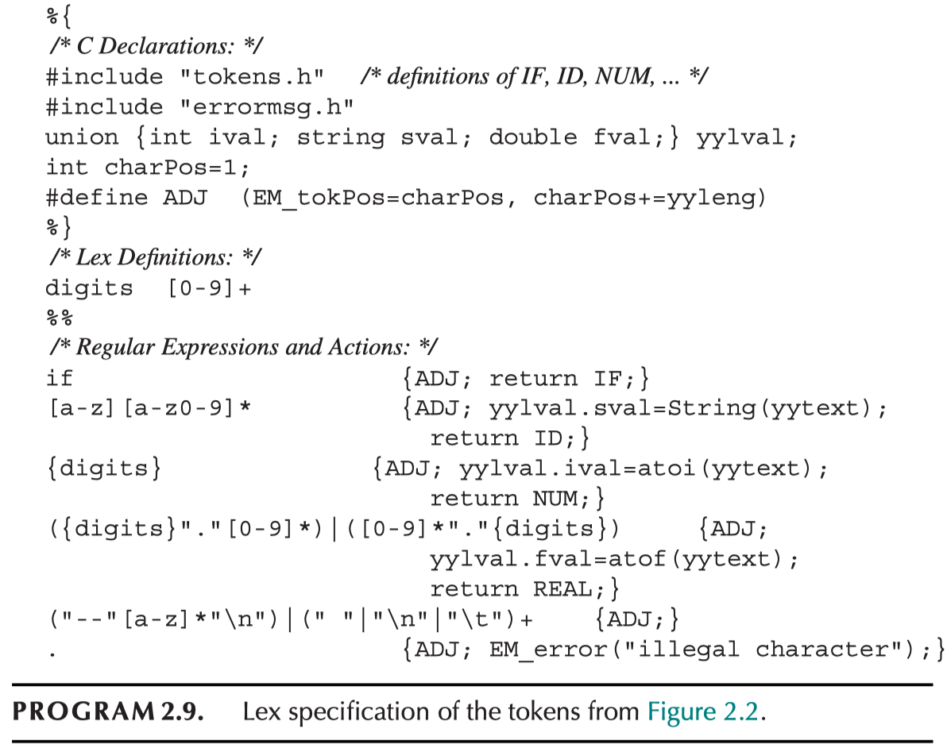

Slide 82
The end of Chapter 2

Slide 83
Exercise
2.1， 2.2， 2.5(a,b) ， 2.6

