Slide 1

编译原理
陈明帅
m.chen@zju.edu.cn
浙江大学 · 计算机科学与技术学院

Slide 2
课程内容
1
Introduction
2
3
4
5
6
Lexical Analysis
Parsing
Abstract Syntax
Semantic Analysis
Activation Records
9
8
7
Instruct. Selection
Blocks & Traces
Interm. Code
10
11
Liveness Analysis
Register Allocation
Fundamentals
13
18
Garbage Collection
Loop Optimizations
Advanced Topics

Slide 3
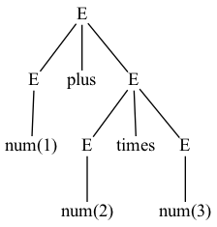
Overview
What is syntax analysis ?
Syn-tax: the way in which words are put together to form phrases, clauses, or sentences.
E := num
| E plus E
| E times E
num(1) plus num(2) times num(3)
token sequence
grammar
1 + 2 * 3
Lexer
Parser
abstract syntax
Syntax analysis: parsing the phrase structure of the program
The parser is constructed based on the grammar, and extracts abstract syntax from a stream of tokens

Slide 4
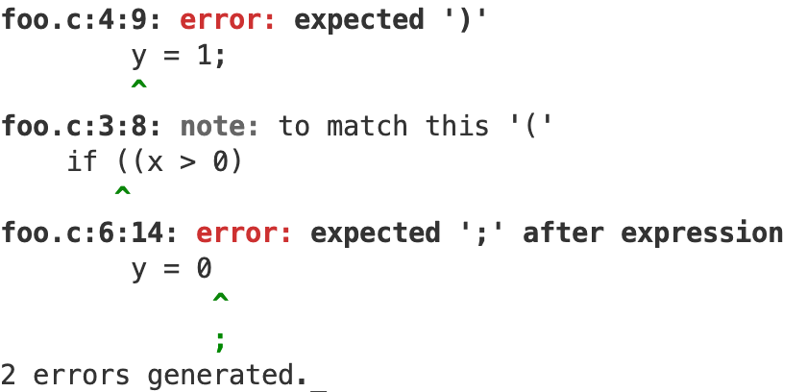
Overview
Why do we need syntax analysis?
int foo(int x){
int y;
if ((x > 0)
y = 1;
else
y = 0
return y;
}
No lexical errors, but multiple syntax errors.
num(1) plus num(2) times num(3)
The expression can be correctly evaluated based on the parse tree rather than token stream.

Slide 5
Outline: How to build a parser?
Specifying the syntax of a programming language with Context-Free Grammars (CFG)
Build the parser based on the CFG:
Top-Down Parsing
Predictive Parsing (LL(k) Parsing)
Bottom-Up Parsing
More about parsing:
Automatic Parser Generation
Error Recovery

Slide 6
Outline: How to build a parser?
Specifying the syntax of a programming language with Context-Free Grammars (CFG)
Build the parser based on the CFG:
Top-Down Parsing
Predictive Parsing (LL(k) Parsing)
Bottom-Up Parsing
More about parsing:
Automatic Parser Generation
Error Recovery

Slide 7
Context-Free Grammars
Not all strings of tokens are programs. A parser must distinguish between valid and invalid strings of tokens.
We need:
A language for describing valid strings of tokens
A method for distinguishing valid from invalid strings of tokens
int main (){
return 0;
}
C tokens
INT ID LP RP LB RET INT SEMI RB
C syntax
language
Lexer
RE
Parser
?
int mian (){
rturn 0;
}
INT LP LP RP LB INT RET SEMI RB ID
method
not C tokens
not C syntax

Slide 8


Context-Free Grammars
Regular languages
The weakest formal languages widely used
Consider the following language:
$$\left\{(^{i})^{i} | i≥0\right\}$$
Recursive Structure
{$ε$, (), (()), ((())), …}
This language is not regular → cannot be recognized by a regular expression (i.e., accepted by a DFA)
Recursive structure is common in programming languages
((1+2) + 3)
We need more powerful formal languages that can handle recursive structure.

Slide 9
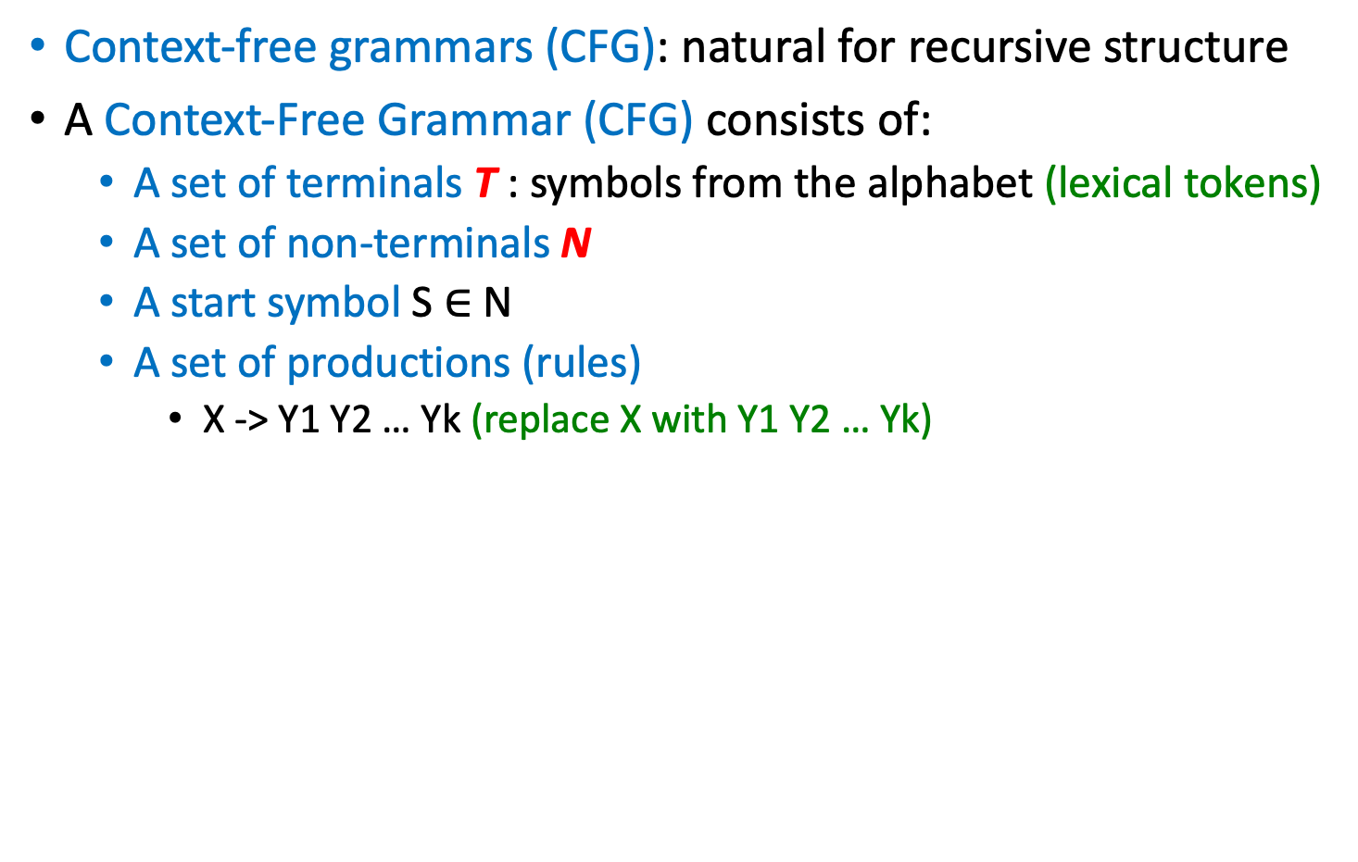




Context-Free Grammars
Context-free grammars (CFG): natural for recursive structure
A Context-Free Grammar (CFG) consists of:
A set of terminals T : symbols from the alphabet (lexical tokens)
A set of non-terminals N
A start symbol S $∈$ N
A set of productions (rules)
X -> Y1 Y2 … Yk (replace X with Y1 Y2 … Yk)
X $∈$ N
Yi $∈$ N $∪$ T $∪$ {$ε$}
T = {(, )}
N = {S}
S
2 productions
S -> (S)
S -> $ε$
$$\left\{(^{i})^{i} \right|i≥0\}$$

Slide 10
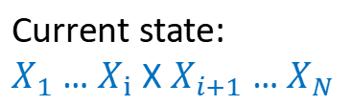
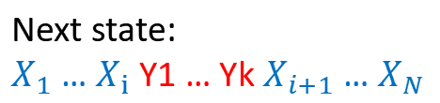
Context-Free Grammars
Derive strings based on a CFG:
Begin with a string with only the start symbol S
Replace any non-terminal X in the string by the right-hand side of some production X -> Y1 … Yk
Repeat (2) until there are only terminals in the string
More formally, at each step:
S -> (S)
(S) -> ((S))
((S)) -> (())
S -> (S)
S -> $ε$
Current state:
$X_{1}$ … $X_{i}$ X $X_{i+1}$ … $X_{N}$
Next state:
$X_{1}$ … $X_{i}$ Y1 … Yk $X_{i+1}$ … $X_{N}$
Some production:
X -> Y1 … Yk

Slide 11


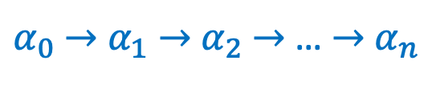
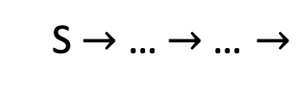
Context-Free Grammars
Let G be a context-free grammar with start symbol S. Then the language L(G) of G is:
* means zero or more steps
Once generated, terminals are permanent
For parsing, terminals are lexical tokens of the language
*
$$\left\{a_{1}…a_{n} \right| ∀_{i}a_{i}∈T ∧ S→a_{1}…a_{n}\}$$
S $→$ … $→$… $→$
$α_{0}$ $→$ $α_{1}$ $→$ $α_{2}$ $→$ … $→$ $α_{n}$
*
$α_{0}$ $→$ $α_{n}$

Slide 12
Context-Free Grammars
1. S → S; S
2. S → id := E
3. S → print ( L )
4. E → id
5. E → num
6. E → E + E
7. E → ( S , E )
8. L → E
9. L → L , E
Grammar 3.1. A syntax for straight-line programs.
Strings in the language of this CFG:
id := num
id := num + num
print ( num )
id := id + (id := num + num, id)
……
T= {id, print, num, +, (, ), }
N = {S, E, L}
Start symbol: S
9 productions
source code can be:
a := 7;
b := c + (d := 5 + 6, d);
print ( a , b )

Slide 13
Context-Free Grammars - Derivations
We need
A language for describing valid strings of tokens
A method for distinguishing valid from invalid strings of tokens -> decide whether a string in is in the language of a CFG
A derivation: start with the start symbol S, then repeatedly replace any non-terminal by one of its right-hand sides
A string is in L(G) iff it is possible to derive that string from the start symbol S.
S -> … -> … -> … -> …
a sequence of productions

Slide 14
Context-Free Grammars - Derivations
Example:
1. E -> E * E
2. E -> E / E
3. E -> E + E
4. E → E - E
5. E → id
6. E → num
7. E -> (E)
Grammar 3.5.
E
E + E
E * E + E
id * E + E
id * id + E
id * id + id
id * id + id
can be derived via
So it is in L(Grammar 3.5.)!

Slide 15
Context-Free Grammars - Derivations
A derivation can be drawn as a tree
Start symbol is the tree’s root
For a production X -> Y1…Yk, add children Y1…Yk to node X
id * id + id
E
E

Slide 16
Context-Free Grammars - Derivations
A derivation can be drawn as a tree
Start symbol is the tree’s root
For a production X -> Y1…Yk, add children Y1…Yk to node X
id * id + id
E
E + E
E
E
+
E

Slide 17
Context-Free Grammars - Derivations
A derivation can be drawn as a tree
Start symbol is the tree’s root
For a production X -> Y1…Yk, add children Y1…Yk to node X
id * id + id
E
E + E
E * E + E
E
E
+
E
E
*
E

Slide 18
Context-Free Grammars - Derivations
A derivation can be drawn as a tree
Start symbol is the tree’s root
For a production X -> Y1…Yk, add children Y1…Yk to node X
id * id + id
E
E + E
E * E + E
id * E + E
E
E
+
E
E
*
E
id

Slide 19
Context-Free Grammars - Derivations
A derivation can be drawn as a tree
Start symbol is the tree’s root
For a production X -> Y1…Yk, add children Y1…Yk to node X
id * id + id
E
E + E
E * E + E
id * E + E
id * id + E
E
E
+
E
E
*
E
id
id

Slide 20
Context-Free Grammars - Derivations
A derivation can be drawn as a tree
Start symbol is the tree’s root
For a production X -> Y1…Yk, add children Y1…Yk to node X
id * id + id
E
E + E
E * E + E
id * E + E
id * id + E
id * id + id
E
E
+
E
E
*
E
id
id
id

Slide 21
Context-Free Grammars - Derivations
A derivation can be drawn as a tree
Start symbol is the tree’s root
For a production X -> Y1…Yk, add children Y1…Yk to node X
id * id + id
E
E + E
E * E + E
id * E + E
id * id + E
id * id + id
E
E
+
E
E
*
E
id
id
id
Parse Tree

Slide 22
Context-Free Grammars - Derivations
The example is a left-most derivation
at each step, replace the left-most non-terminal
There is an equivalent notion of a right-most derivation
E
E + E
E * E + E
id * E + E
id * id + E
id * id + id

Slide 23
Context-Free Grammars - Derivations
id * id + id
E
E + E
E + id
E * E + id
E * id + id
id * id + id
E
E
+
E
E
*
E
id
id
id
Right-Most Derivation
Parse Tree

Slide 24
Context-Free Grammars
id * id + id
E
E + E
E + id
E * E + id
E * id + id
id * id + id
E
E
+
E
E
*
E
id
id
id
Right-Most Derivation
Parse Tree

Slide 25
Context-Free Grammars - Derivations
The left-most and the right-most derivations lead to the same parse tree (in absence of ambiguity).
E
E
E
+
E
E
+
E
Some derivations are neither left-most nor right-most
E
E + E
E * E + E
E * id + E
id * id + E
id * id + id

Slide 26
Context-Free Grammars - Parse Tree
A parse tree has
Terminals at the leaves
Non-terminals at the interior nodes
An in-order traversal of the leaves is the original input
The parse tree shows the association of operations, the input string does not
E
E
+
E
E
*
E
id
id
id

Slide 27
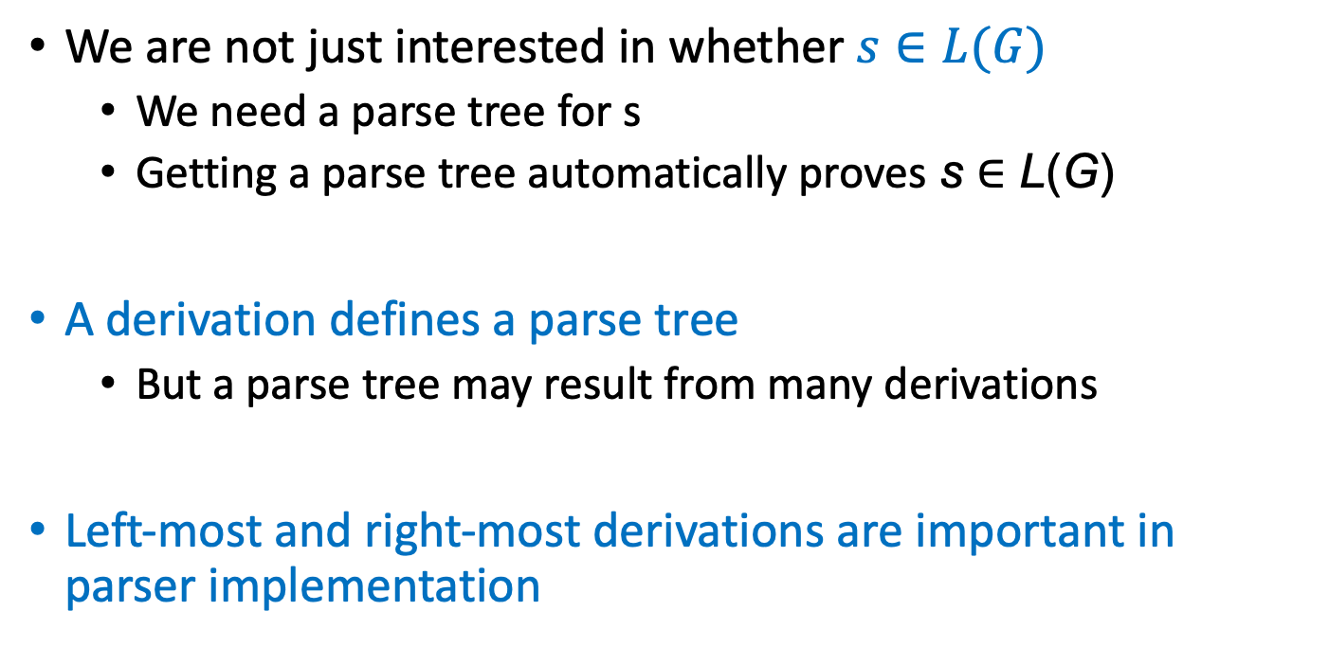
Context-Free Grammars - Parse Tree
We are not just interested in whether $s∈L(G)$
We need a parse tree for s
Getting a parse tree automatically proves s ∈ L(G)
A derivation defines a parse tree
But a parse tree may result from many derivations
Left-most and right-most derivations are important in parser implementation

Slide 28
Context-Free Grammars - Ambiguity
Grammar:
String:
1. E -> E * E
2. E -> E / E
3. E -> E + E
4. E → E - E
5. E → id
6. E → num
7. E -> (E)
Grammar 3.5.
id * id + id
The string has two parse trees:
E
E
E
+
E
E
*
E
E
*
E
id
id
E
+
E
id
id
id
id

Slide 29
Context-Free Grammars - Ambiguity
A grammar is ambiguous if it can derive a string with two different parse trees.
Equivalently, there is more than one right-most or left-most derivation for some string.
Compilers do use parse trees to derive meanings (semantics):
2 * 3 + 4
E
10
E
14
6
E
+
E
4
2
E
*
E
7
E
*
E
4
2
E
+
E
2
3
3
4
Ambiguous grammars are problematic for compiling.
Cause ill-defined meanings of programs

Slide 30
Context-Free Grammars - Ambiguity
We need to handle ambiguity.
Most direct method: transform ambiguous grammars to unambiguous grammars.
We want:
Precedence: * binds tighter than +
Left-association: each operator associates to the left
1 - 2 - 3 should be (1 - 2) - 3 instead of 1 - (2 - 3)
How?
introduce new non-terminals, forcing some productions to be used later than some other productions
1. E -> E * E
2. E -> E / E
3. E -> E + E
4. E → E - E
5. E → id
6. E → num
7. E -> (E)
Grammar 3.5.

Slide 31
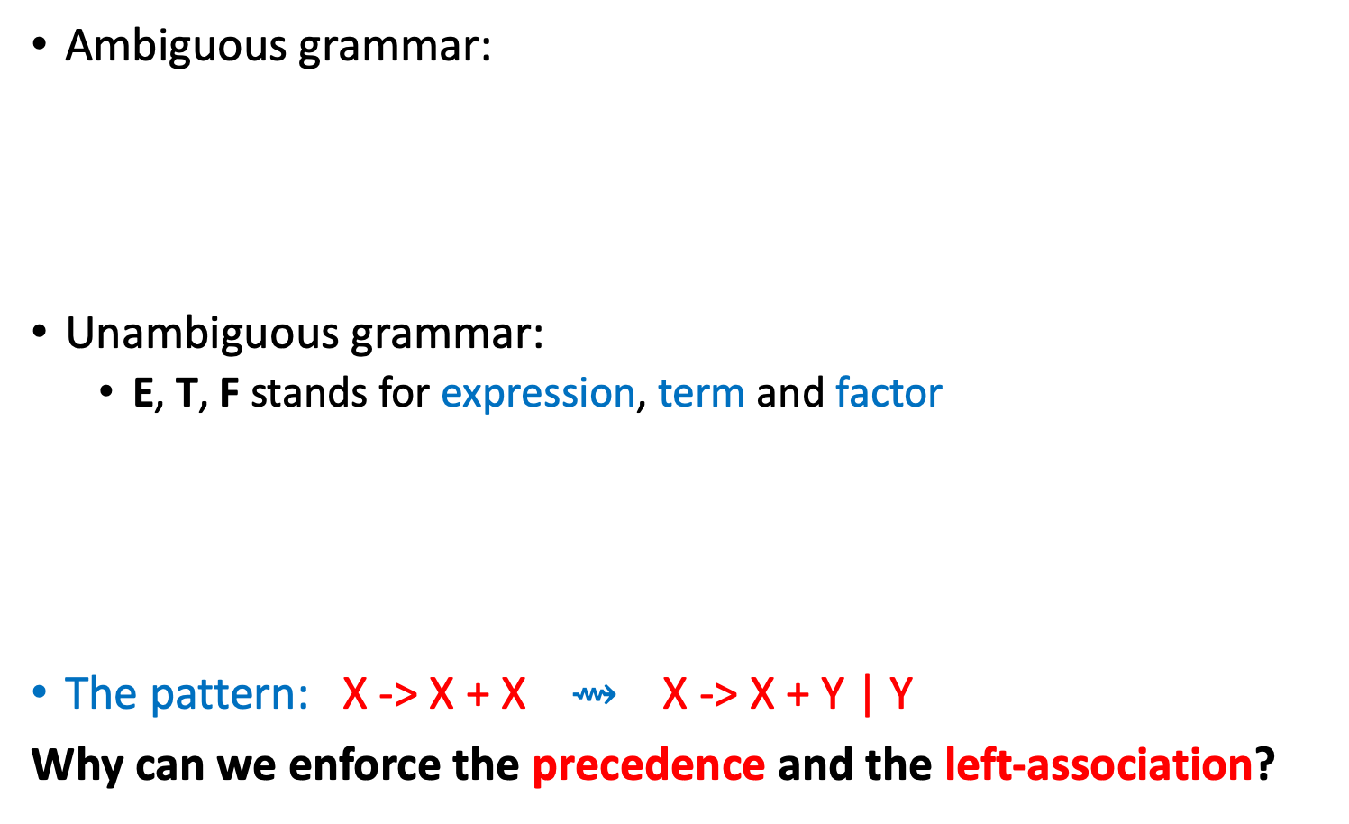
Context-Free Grammars - Ambiguity
Ambiguous grammar:
Unambiguous grammar:
E, T, F stands for expression, term and factor
The pattern: X -> X + X $⇝$ X -> X + Y | Y
Why can we enforce the precedence and the left-association?
1. E -> E * E
2. E -> E / E
3. E -> E + E
4. E → E - E
5. E → id
6. E → num
7. E -> (E)
Grammar 3.5.
E -> E + T
E -> E – T
E -> T
4. T → T * F
5. T → T / F
6. T → F
7. F -> id
8. F -> num
9. F -> (E)
Grammar 3.8.

Slide 32

Context-Free Grammars - Ambiguity
Unambiguous Grammar:
String:
E -> E + T
E -> E – T
E -> T
4. T → T * F
5. T → T / F
6. T → F
7. F -> id
8. F -> num
9. F -> (E)
Grammar 3.8.
id * id + id
Parse Tree:
E
E
Modify
E
+
E
E
*
E
E
*
E
id
id
E
+
E
id
id
id
id

Slide 33
Context-Free Grammars - Ambiguity
Unambiguous Grammar:
String:
E -> E + T
E -> E – T
E -> T
4. T → T * F
5. T → T / F
6. T → F
7. F -> id
8. F -> num
9. F -> (E)
Grammar 3.8.
id * id + id
Why can we enforce the precedence and the left-association?
Precedence: an operator with higher precedence either does not appear or can only be derived later.
Left-association: use left recursion (the first symbol in the right-hand side is the same as the symbol in the left-hand side)
Parse Tree:
E
E
+
T
T
F
T
*
F
id
F
id
id

Slide 34
Context-Free Grammars - Ambiguity
There are some languages that have ambiguous grammars but no unambiguous grammar, such languages may be problematic as programming languages

Slide 35
Context-Free Grammars - EOF Marker
$: end of file (EOF)
To indicate that $ must come after a complete S-phrase
add a new start symbol S’ and a new production S’ -> S$
0. S -> E$
E -> E + T
E -> E – T
E -> T
4. T → T * F
5. T → T / F
6. T → F
7. F -> id
8. F -> num
9. F -> (E)
Grammar 3.10.

Slide 36
Outline: How to build a parser?
Specifying the syntax of a programming language with Context-Free Grammars (CFG)
Build the parser based on the CFG:
Top-Down Parsing
Predictive Parsing (LL(k) Parsing)
Bottom-Up Parsing
More about parsing:
Automatic Parser Generation
Error Recovery

Slide 37
Top-Down Parsing
Parsing all CFGs in one compiler is expensive
algorithms for parsing all CFGs are expensive
sometimes 1/3 of compilation time is spent in parsing
Compiler writers have developed specialized algorithms for parsing the kinds of CFGs that you need to build effective programming languages
Recursive Descent Parsing
top-down parsing, predictive parsing
simple, can be coded by hand
parses many, but not all CFGs
parses LL(1) grammars：Left-to-right parse; Leftmost-derivation; 1 symbol lookahead
Top-down parsing:
the parse tree is constructed from the top to bottom (from left to right)

Slide 38
Top-Down Parsing
Top-Down parsing example
Grammar:
String:
from top to bottom, from left to right:
S -> if E then S else S
S -> begin S L
S -> print E
L -> end
L -> ; S L
E -> num = num
Grammar 3.11.
begin print num = num end
S
S -> begin S L
begin S L -> begin print E L
begin print E L -> begin print num = num L
begin print num = num L -> begin print num = num end
begin
S
L
print
E
end
num = num

Slide 39
Top-Down Parsing
Write a recursive-descent parser for this grammar.
Key ideas:
one recursive function for each non-terminal -> call this function to match this non-terminal
each production becomes one clause in the function
S -> if E then S else S
S -> begin S L
S -> print E
L -> end
L -> ; S L
E -> num = num
Grammar 3.11.
void L(void) {
switch(tok) {
case END: eat(END); break;
case SEMI: eat(SEMI); S(); L(); break;
default: error();
}}

Slide 40
Top-Down Parsing
Write the parser
S -> if E then S else S
S -> begin S L
S -> print E
L -> end
L -> ; S L
E -> num = num
Step 1: Represent the token
enum token {IF, THEN, ELSE, BEGIN, END, PRINT, SEMI, NUM, EQ};

Slide 41
Top-Down Parsing
Write the parser
S -> if E then S else S
S -> begin S L
S -> print E
L -> end
L -> ; S L
E -> num = num
Step 2: build infrastructure for reading tokens from lexer
// call lexer
extern enum token getToken(void);
// store the next token
enum token tok;
void advance() {tok=getToken();}
// consume the next token and get the new one
void eat(enum token t) {if (tok==t) advance(); else error();}

Slide 42
Top-Down Parsing
Write the parser
S -> if E then S else S
S -> begin S L
S -> print E
L -> end
L -> ; S L
E -> num = num
Step 3: build a function for each non-terminal
void S(void) {
switch(tok) {
case IF: eat(IF); E(); eat(THEN); S(); eat(ELSE); S(); break;
case BEGIN: eat(BEGIN); S(); L(); break;
case PRINT: eat(PRINT); E(); break;
default: error(); }
}
void L(void) {
switch(tok) {
case END: eat(END); break;
case SEMI: eat(SEMI); S(); L(); break;
default: error(); }
} void E(void) { eat(NUM); eat(EQ); eat(NUM); }

Slide 43
Top-Down Parsing
enum token {IF, THEN, ELSE, BEGIN, END, PRINT, SEMI, NUM, EQ};
extern enum token getToken(void);
enum token tok;
void advance() {tok=getToken();}
void eat(enum token t) {if (tok==t) advance(); else error();}
void S(void) {
switch(tok) {
case IF: eat(IF); E(); eat(THEN); S(); eat(ELSE); S(); break;
case BEGIN: eat(BEGIN); S(); L(); break;
case PRINT: eat(PRINT); E(); break;
default: error(); }}
void L(void) {
switch(tok) {
case END: eat(END); break;
case SEMI: eat(SEMI); S(); L(); break;
default: error(); }} void E(void) { eat(NUM); eat(EQ); eat(NUM); }

Slide 44
Top-Down Parsing
This grammar is very special
For each non-terminal, the first symbols Y1 in the right-hand sides of its productions are different terminals
S -> if E then S else S
S -> begin S L
S -> print E
L -> end
L -> ; S L
E -> num = num

Slide 45
Top-Down Parsing
How to write the parser for the following language?
S -> E$
E -> E + T
E -> E – T
E -> T
T → T * F
T → T / F
T → F
F -> id
F -> num
F -> (E)
Step 3: build a function for each non-terminal
void S(void) { E(); eat(EOF); }
void E(void) {
switch (tok) {
case ?: E(); eat(PLUS); T(); break;
case ?: E(); eat(MINUS); T(); break;
case ?: T(); break;
default: error();
}
}
If tok == num, which production to choose?

Slide 46
Predictive Parsing
Predictive parsing works only for grammars where the first terminal symbol of each subexpression provides enough information to choose which production to use.
Q: if tok == num, which production to choose?
First, we need to know the possible first terminal symbols when we choose each of the three productions
Second, if the possible first terminal symbols of multiple productions can be num, we need to rewrite the grammar so that only one production can be used.
E -> E + T
E -> E – T
E -> T
tok is a terminal symbol

Slide 47
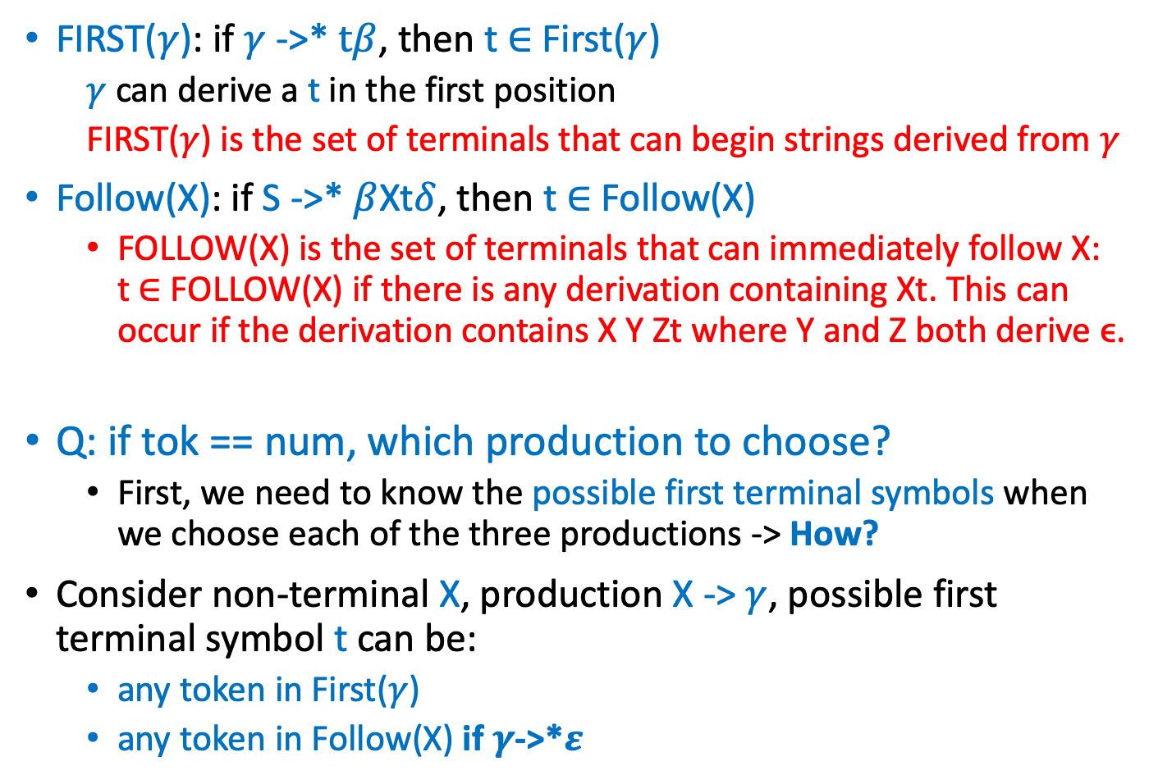
Predictive Parsing - First and Follow Sets
FIRST($γ$): if $γ$ ->* $tβ$, then t $∈$ First($γ$)
$γ$ can derive a t in the first position
FIRST($γ$) is the set of terminals that can begin strings derived from $γ$
Follow(X): if S ->* $β$Xt$δ$, then t $∈$ Follow(X)
FOLLOW(X) is the set of terminals that can immediately follow X: t ∈ FOLLOW(X) if there is any derivation containing Xt. This can occur if the derivation contains X Y Zt where Y and Z both derive ϵ.
Q: if tok == num, which production to choose?
First, we need to know the possible first terminal symbols when we choose each of the three productions -> How?
Consider non-terminal X, production X -> $γ$, possible first terminal symbol t can be:
any token in First($γ$)
any token in Follow(X) if $γ$->*$ε$

Slide 48
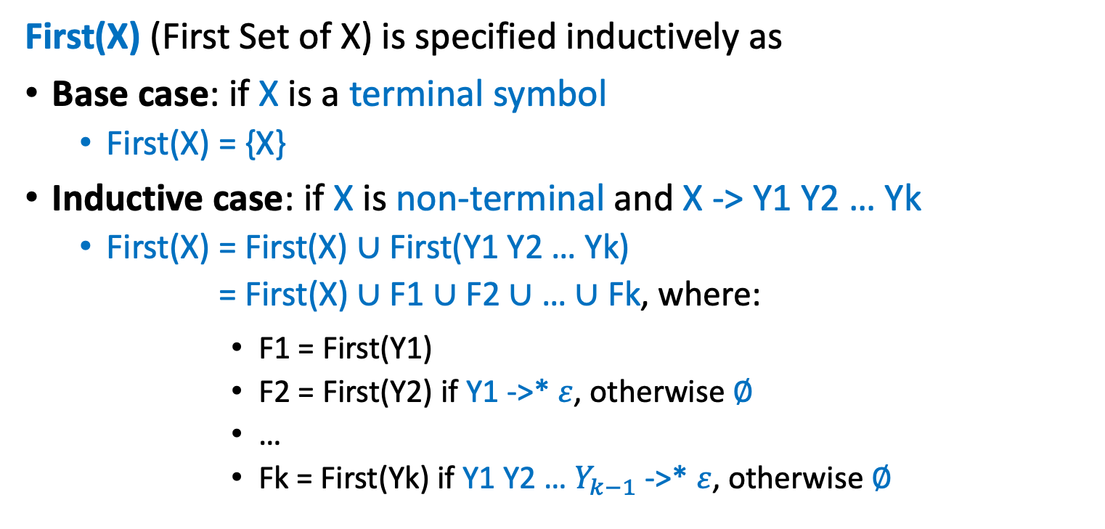
Predictive Parsing - First and Follow Sets
First(X) (First Set of X) is specified inductively as
Base case: if X is a terminal symbol
First(X) = {X}
Inductive case: if X is non-terminal and X -> Y1 Y2 … Yk
First(X) = First(X) $∪$First(Y1 Y2 … Yk)
= First(X) $∪$F1 $∪$ F2 $∪$ … $∪$ Fk, where:
F1 = First(Y1)
F2 = First(Y2) if Y1 ->* $ε$, otherwise $∅$
…
Fk = First(Yk) if Y1 Y2 … $Y_{k−1}$ ->* $ε$, otherwise $∅$

Slide 49
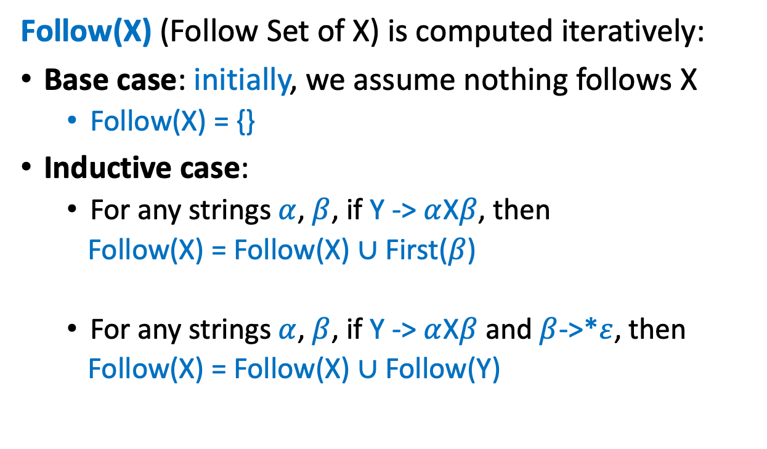
Predictive Parsing - First and Follow Sets
Follow(X) (Follow Set of X) is computed iteratively:
Base case: initially, we assume nothing follows X
Follow(X) = {}
Inductive case:
For any strings $α$, $β$, if Y -> $α$X$β$, then
Follow(X) = Follow(X) $∪$ First($β$)
For any strings $α$, $β$, if Y -> $α$X$β$ and $β$->*$ε$, then
Follow(X) = Follow(X) $∪$ Follow(Y)

Slide 50
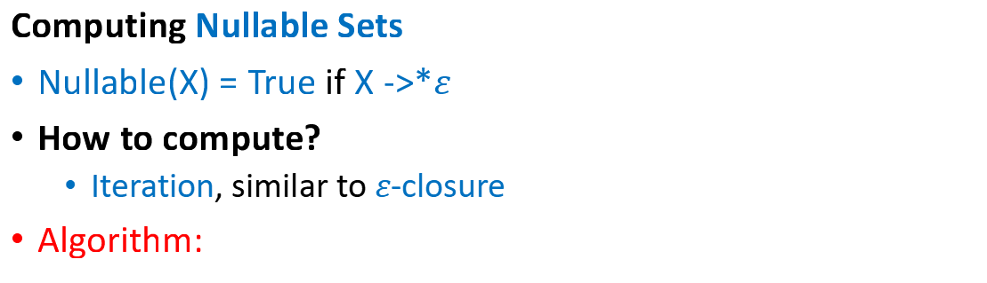
Predictive Parsing - First and Follow Sets
Computing Nullable Sets
Nullable(X) = True if X ->*$ε$
How to compute?
Iteration, similar to $ε$-closure
Algorithm:
for each symbol X:
Nullable(X) = False
repeat
for each production X -> Y1 Y2 … Yk:
if Nullable(Yi) = True for all 1 <= i <= k:
Nullable(X) = True
until Nullable did not change in this iteration

Slide 51
Predictive Parsing - First and Follow Sets
To know possible first terminal symbols of each production, we need to calculate the Nullable, First and Follow sets
Z → X Y Z
Z → d
Y → c
Y →
X → a
X → Y
 | nullable | first | follow
Z
Y
X

Slide 52
Predictive Parsing - First and Follow Sets
To know possible first terminal symbols of each production, we need to calculate the Nullable, First and Follow sets
Z → X Y Z
Z → d
Y → c
Y →
X → a
X → Y
 | nullable | first | follow
Z | False
Y | False
X | False
Initialize nullable

Slide 53
Predictive Parsing - First and Follow Sets
To know possible first terminal symbols of each production, we need to calculate the Nullable, First and Follow sets
Z → X Y Z
Z → d
Y → c
Y →
X → a
X → Y
 | nullable | first | follow
Z | False
Y | False
X | False

Slide 54
Predictive Parsing - First and Follow Sets
To know possible first terminal symbols of each production, we need to calculate the Nullable, First and Follow sets
Z → X Y Z
Z → d
Y → c
Y →
X → a
X → Y
 | nullable | first | follow
Z | False
Y | False
X | False

Slide 55
Predictive Parsing - First and Follow Sets
To know possible first terminal symbols of each production, we need to calculate the Nullable, First and Follow sets
Z → X Y Z
Z → d
Y → c
Y →
X → a
X → Y
 | nullable | first | follow
Z | False
Y | True
X | False

Slide 56
Predictive Parsing - First and Follow Sets
To know possible first terminal symbols of each production, we need to calculate the Nullable, First and Follow sets
Z → X Y Z
Z → d
Y → c
Y →
X → a
X → Y
 | nullable | first | follow
Z | False
Y | True
X | True

Slide 57
Predictive Parsing - First and Follow Sets
To know possible first terminal symbols of each production, we need to calculate the Nullable, First and Follow sets
Z → X Y Z
Z → d
Y → c
Y →
X → a
X → Y
 | nullable | first | follow
Z | False
Y | True
X | True

Slide 58
Predictive Parsing - First and Follow Sets
To know possible first terminal symbols of each production, we need to calculate the Nullable, First and Follow sets
Z → X Y Z
Z → d
Y → c
Y →
X → a
X → Y
 | nullable | first | follow
Z | False
Y | True
X | True

Slide 59
Predictive Parsing - First and Follow Sets
To know possible first terminal symbols of each production, we need to calculate the Nullable, First and Follow sets
Z → X Y Z
Z → d
Y → c
Y →
X → a
X → Y
 | nullable | first | follow
Z | False
Y | True
X | True

Slide 60
Predictive Parsing - First and Follow Sets
To know possible first terminal symbols of each production, we need to calculate the Nullable, First and Follow sets
Z → X Y Z
Z → d
Y → c
Y →
X → a
X → Y
 | nullable | first | follow
Z | False
Y | True
X | True
Stop iteration

Slide 61
Predictive Parsing - First and Follow Sets
To know possible first terminal symbols of each production, we need to calculate the Nullable, First and Follow sets
Z → X Y Z
Z → d
Y → c
Y →
X → a
X → Y
 | nullable | first | follow
Z | False | {}
Y | True | {}
X | True | {}
Initialize first sets

Slide 62
Predictive Parsing - First and Follow Sets
To know possible first terminal symbols of each production, we need to calculate the Nullable, First and Follow sets
Z → X Y Z
Z → d
Y → c
Y →
X → a
X → Y
 | nullable | first | follow
Z | False | {}
Y | True | {}
X | True | {}

Slide 63
Predictive Parsing - First and Follow Sets
To know possible first terminal symbols of each production, we need to calculate the Nullable, First and Follow sets
Z → X Y Z
Z → d
Y → c
Y →
X → a
X → Y
 | nullable | first | follow
Z | False | {d}
Y | True | {c}
X | True | {a}

Slide 64
Predictive Parsing - First and Follow Sets
To know possible first terminal symbols of each production, we need to calculate the Nullable, First and Follow sets
Z → X Y Z
Z → d
Y → c
Y →
X → a
X → Y
 | nullable | first | follow
Z | False | {d}
Y | True | {c}
X | True | {a}

Slide 65
Predictive Parsing - First and Follow Sets
To know possible first terminal symbols of each production, we need to calculate the Nullable, First and Follow sets
Z → X Y Z
Z → d
Y → c
Y →
X → a
X → Y
 | nullable | first | follow
Z | False | {d}
Y | True | {c}
X | True | {a, c}

Slide 66
Predictive Parsing - First and Follow Sets
To know possible first terminal symbols of each production, we need to calculate the Nullable, First and Follow sets
Z → X Y Z
Z → d
Y → c
Y →
X → a
X → Y
 | nullable | first | follow
Z | False | {d, a, c}
Y | True | {c}
X | True | {a, c}

Slide 67
Predictive Parsing - First and Follow Sets
To know possible first terminal symbols of each production, we need to calculate the Nullable, First and Follow sets
Z → X Y Z
Z → d
Y → c
Y →
X → a
X → Y
 | nullable | first | follow
Z | False | {d, a, c}
Y | True | {c}
X | True | {a, c}

Slide 68
Predictive Parsing - First and Follow Sets
To know possible first terminal symbols of each production, we need to calculate the Nullable, First and Follow sets
Z → X Y Z
Z → d
Y → c
Y →
X → a
X → Y
 | nullable | first | follow
Z | False | {d, a, c}
Y | True | {c}
X | True | {a, c}

Slide 69
Predictive Parsing - First and Follow Sets
To know possible first terminal symbols of each production, we need to calculate the Nullable, First and Follow sets
Z → X Y Z
Z → d
Y → c
Y →
X → a
X → Y
 | nullable | first | follow
Z | False | {d, a, c}
Y | True | {c}
X | True | {a, c}
Iterate again.
No change.
Stop iteration.

Slide 70
Predictive Parsing - First and Follow Sets
To know possible first terminal symbols of each production, we need to calculate the Nullable, First and Follow sets
Z → X Y Z
Z → d
Y → c
Y →
X → a
X → Y
 | nullable | first | follow
Z | False | {d, a, c} | {}
Y | True | {c} | {}
X | True | {a, c} | {}
Initialize follow sets

Slide 71
Predictive Parsing - First and Follow Sets
To know possible first terminal symbols of each production, we need to calculate the Nullable, First and Follow sets
Z → X Y Z
Z → d
Y → c
Y →
X → a
X → Y
 | nullable | first | follow
Z | False | {d, a, c} | {}
Y | True | {c} | {d, a, c}
X | True | {a, c} | {c, d, a}
First(Z) = ?
First(YZ) = ?

Slide 72
Predictive Parsing - First and Follow Sets
To know possible first terminal symbols of each production, we need to calculate the Nullable, First and Follow sets
Z → X Y Z
Z → d
Y → c
Y →
X → a
X → Y
 | nullable | first | follow
Z | False | {d, a, c} | {}
Y | True | {c} | {d, a, c}
X | True | {a, c} | {c, d, a}

Slide 73

Predictive Parsing - First and Follow Sets
To know possible first terminal symbols of each production, we need to calculate the Nullable, First and Follow sets
Z → X Y Z
Z → d
Y → c
Y →
X → a
X → Y
 | nullable | first | follow
Z | False | {d, a, c} | {}
Y | True | {c} | {d, a, c}
X | True | {a, c} | {c, d, a}
Follow(Y) = Follow(X) $∪$ Follow(Y)

Slide 74
Predictive Parsing - First and Follow Sets
To know possible first terminal symbols of each production, we need to calculate the Nullable, First and Follow sets
Z → X Y Z
Z → d
Y → c
Y →
X → a
X → Y
 | nullable | first | follow
Z | False | {d, a, c} | {}
Y | True | {c} | {d, a, c}
X | True | {a, c} | {c, d, a}
Iterate again.
No change.
Stop iteration.

Slide 75
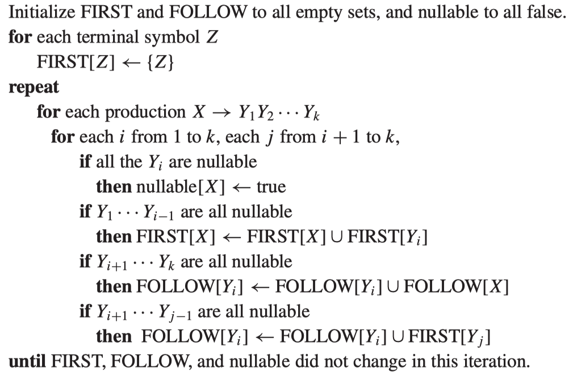
Predictive Parsing - First and Follow Sets
The algorithm to calculate First, Follow and Nullable Sets
for each production

Slide 76
Predictive Parsing - First and Follow Sets
The algorithm to calculate First, Follow and Nullable Sets
compute nullable iteratively

Slide 77
Predictive Parsing - First and Follow Sets
The algorithm to calculate First, Follow and Nullable Sets
Analyze each prefix Y1…Yi-1

Slide 78
Predictive Parsing - First and Follow Sets
The algorithm to calculate First, Follow and Nullable Sets
Analyze each suffix Yi+1…Yk

Slide 79
Predictive Parsing - First and Follow Sets
The algorithm to calculate First, Follow and Nullable Sets
X -> Y1 Y2 ... Yi …… Yj … Yk
this substring
Analyze each substring,
Yi+1…Yj-1 can be empty

Slide 80
Predictive Parsing - First and Follow Sets
The algorithm to calculate First, Follow and Nullable Sets
Iteration

Slide 81
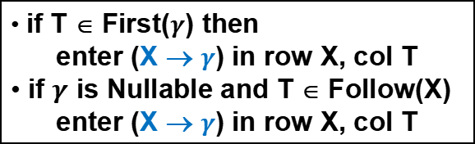
Predictive Parsing - Predictive Parsing Tables
Grammar:
 | nullable | first | follow
Z | no | d,a,c
Y | yes | c | a,c,d
X | yes | a,c | a,c,d
Z → X Y Z
Z → d
Y → c
Y →
X → a
X → Y
Build parsing table where row X, col T tells parser which clause to execute in function X with next-token T:
if T ∈ First($γ$) then
enter (X → $γ$) in row X, col T
if $γ$ is Nullable and T ∈ Follow(X)
enter (X → $γ$) in row X, col T
 | a | c | d
Z
Y
X

Slide 82
Predictive Parsing - Predictive Parsing Tables
Grammar:
 | nullable | first | follow
Z | no | d,a,c
Y | yes | c | a,c,d
X | yes | a,c | a,c,d
Z → X Y Z
Z → d
Y → c
Y →
X → a
X → Y
Build parsing table where row X, col T tells parser which clause to execute in function X with next-token T:
if T ∈ First($γ$) then
enter (X → $γ$) in row X, col T
if $γ$ is Nullable and T ∈ Follow(X)
enter (X → $γ$) in row X, col T
 | a | c | d
Z | Z->XYZ | Z->XYZ | Z->XYZ
Y
X
First(XYZ)

Slide 83
Predictive Parsing - Predictive Parsing Tables
Grammar:
 | nullable | first | follow
Z | no | d,a,c
Y | yes | c | a,c,d
X | yes | a,c | a,c,d
Z → X Y Z
Z → d
Y → c
Y →
X → a
X → Y
Build parsing table where row X, col T tells parser which clause to execute in function X with next-token T:
if T ∈ First($γ$) then
enter (X → $γ$) in row X, col T
if $γ$ is Nullable and T ∈ Follow(X)
enter (X → $γ$) in row X, col T
 | a | c | d
Z | Z->XYZ | Z->XYZ | Z->XYZ Z->d
Y |  | Y->c
X | X->a

Slide 84
Predictive Parsing - Predictive Parsing Tables
Grammar:
 | nullable | first | follow
Z | no | d,a,c
Y | yes | c | a,c,d
X | yes | a,c | a,c,d
Z → X Y Z
Z → d
Y → c
Y →
X → a
X → Y
Build parsing table where row X, col T tells parser which clause to execute in function X with next-token T:
if T ∈ First($γ$) then
enter (X → $γ$) in row X, col T
if $γ$ is Nullable and T ∈ Follow(X)
enter (X → $γ$) in row X, col T
 | a | c | d
Z | Z->XYZ | Z->XYZ | Z->XYZ Z->d
Y | Y-> | Y->c Y-> | Y->
X | X->a
Follow(Y)

Slide 85

Predictive Parsing - Predictive Parsing Tables
Grammar:
 | nullable | first | follow
Z | no | d,a,c
Y | yes | c | a,c,d
X | yes | a,c | a,c,d
Z → X Y Z
Z → d
Y → c
Y →
X → a
X → Y
Build parsing table where row X, col T tells parser which clause to execute in function X with next-token T:
if T ∈ First($γ$) then
enter (X → $γ$) in row X, col T
if $γ$ is Nullable and T ∈ Follow(X)
enter (X → $γ$) in row X, col T
 | a | c | d
Z | Z->XYZ | Z->XYZ | Z->XYZ Z->d
Y | Y-> | Y->c Y-> | Y->
X | X->a X->Y | X->Y | X->Y
Follow(X) $∪$ First(Y)

Slide 86
Predictive Parsing - Predictive Parsing Tables
Grammar:
 | nullable | first | follow
Z | no | d,a,c
Y | yes | c | a,c,d
X | yes | a,c | a,c,d
Z → X Y Z
Z → d
Y → c
Y →
X → a
X → Y
What if there are blanks?
--> syntax errors
 | a | c | d
Z | Z->XYZ | Z->XYZ | Z->XYZ Z->d
Y | Y-> | Y->c Y-> | Y->
X | X->a X->Y | X->Y | X->Y

Slide 87
Predictive Parsing - Predictive Parsing Tables
Grammar:
 | nullable | first | follow
Z | no | d,a,c
Y | yes | c | a,c,d
X | yes | a,c | a,c,d
Z → X Y Z
Z → d
Y → c
Y →
X → a
X → Y
Is it possible to put 2 grammar rules in the same box?
 | a | c | d
Z | Z->XYZ | Z->XYZ | Z->XYZ Z->d
Y | Y-> | Y->c Y-> | Y->
X | X->a X->Y | X->Y | X->Y

Slide 88
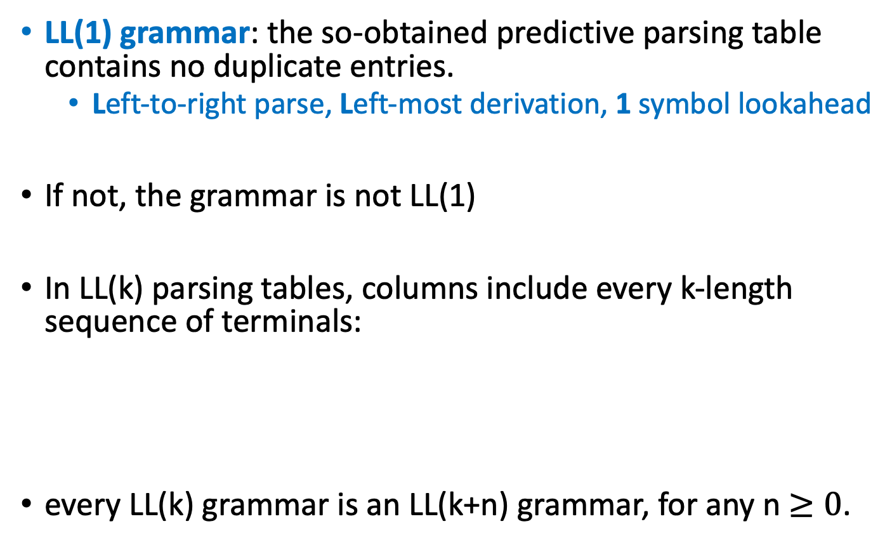
Predictive Parsing - Predictive Parsing Tables
LL(1) grammar: the so-obtained predictive parsing table contains no duplicate entries.
Left-to-right parse, Left-most derivation, 1 symbol lookahead
If not, the grammar is not LL(1)
In LL(k) parsing tables, columns include every k-length sequence of terminals:
every LL(k) grammar is an LL(k+n) grammar, for any n $≥0$.
aa | ab | ba | bb | ac | ca | ...

Slide 89
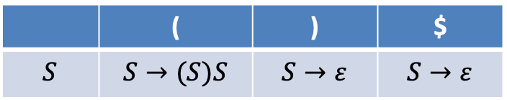
Predictive Parsing - Predictive Parsing Tables
Tokens to parse: Lparen Rparen $ (write as “( ) $” below)
Grammar: S→(S) S∣ε
 | ( | ) | $
$$S$$ | $$S→(S)S$$ | $$S→ε$$ | $$S→ε$$
( ) $
parsing table
Stack top:
Input symbol:
action:
S
(
S
S
$
)
input
input
input
$
(
)
(
S
)
S
$
accept!
derive
match
derive
derive
match
Terminal: Match
Non-terminal: derive
The Basic
Method
parsing stack

Slide 90

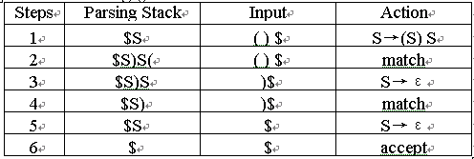
Predictive Parsing - Predictive Parsing Tables
S→(S) S∣ε
Terminal: Match
Non-terminal: derive
The Basic
Method

Slide 91
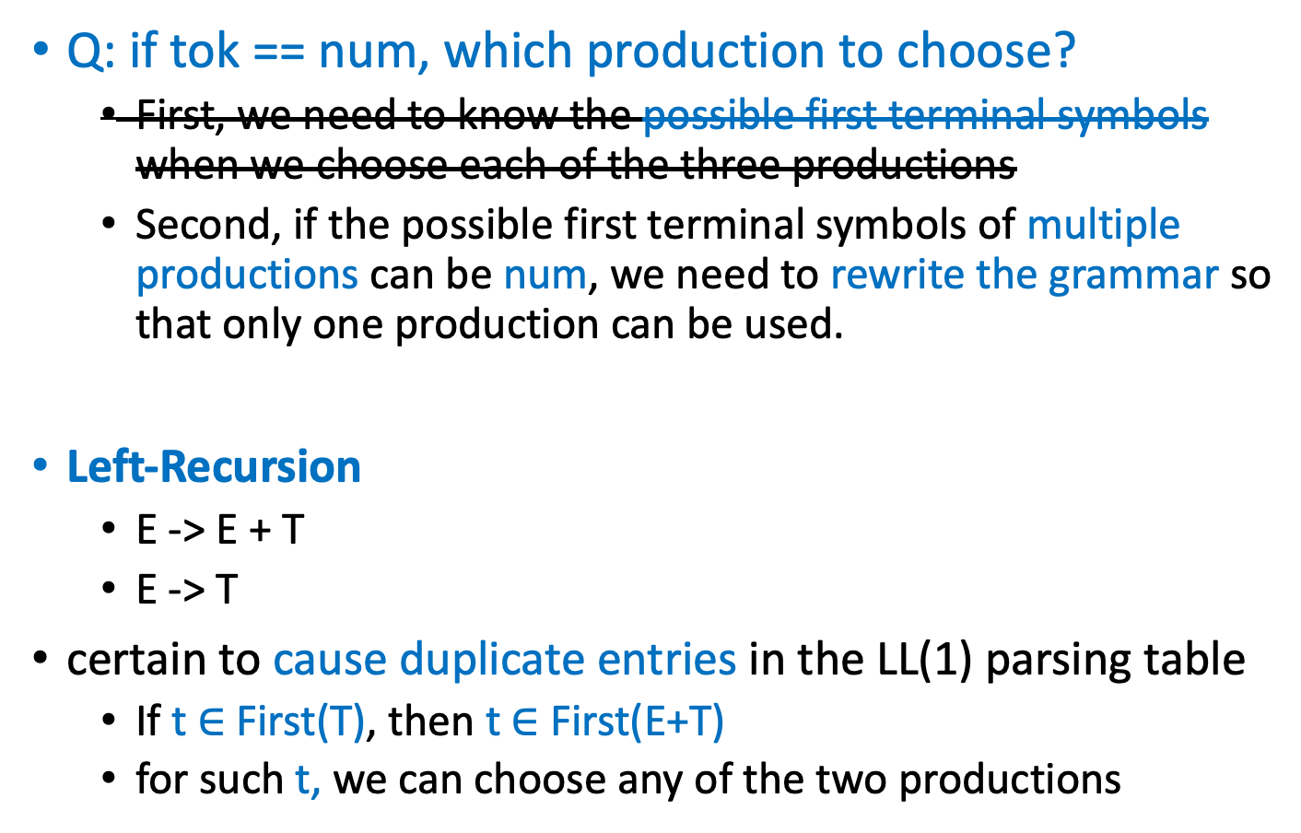
Predictive Parsing - Eliminate Left-Recursion
Q: if tok == num, which production to choose?
First, we need to know the possible first terminal symbols when we choose each of the three productions
Second, if the possible first terminal symbols of multiple productions can be num, we need to rewrite the grammar so that only one production can be used.
Left-Recursion
E -> E + T
E -> T
certain to cause duplicate entries in the LL(1) parsing table
If t $∈$ First(T), then t $∈$ First(E+T)
for such t, we can choose any of the two productions
{T, T + T, T + T + T, T + T + T + T, …}

Slide 92



Predictive Parsing - Eliminate Left-Recursion
How to eliminate left-recursion?
Rewrite the grammar so it parses the same language but with different productions
In general
E -> E + T
E -> T
E -> T E’
E’ -> + T E’
E’ ->
A -> A$a$
A -> $β$
A ->$β$A’
A’ -> $a$A’
A’ ->
{$β$,$βa$,$βaa$, …}
Use right recursion to generate the repetitions

Slide 93
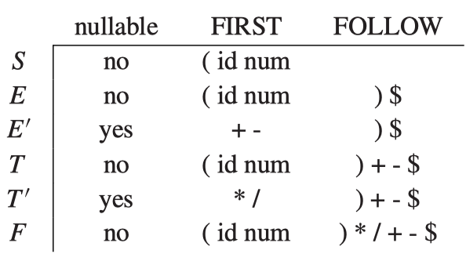
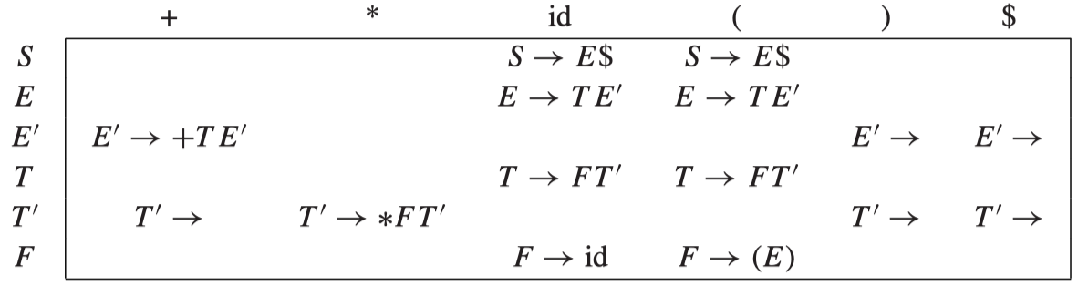
Predictive Parsing - Eliminate Left-Recursion
S → E $
E → T E’
E’ → + T E’
E’ → − T E’
E’ → ε
T → F T’
T’ → * F T’
T’ → / F T’
T’ →ε
F → id
F → num
F →(E)
- is similar to +, / is similar to *, num is similar to id

Slide 94
Predictive Parsing - Left Factoring
If two productions of the same non-terminal start with the same symbols, LL(1) parsing table will contain duplicate entries.
S -> if E then S X
X ->
X -> else S
S -> if E then S else S
S -> if E then S

Slide 95
Predictive Parsing - Error Recovery
A blank entry indicates a syntax error
How should errors be handled?
Raise an exception and quit parsing
print an error message and recover from the error
Raise an exception and quit:
void T( ) {
switch (tok) {
case ID:
case NUM:
case LPAREN: F(); Tprime(); break;
default: error!
}
}

Slide 96
Predictive Parsing - Error Recovery
print an error message and recover from the error
Errors can be recovered by deleting, replacing, or inserting tokens.
Through inserting: pretend we have the token and return normally
Deleting tokens is safer, because the loop must eventually terminate when EOF is reached
void T( ) {
switch (tok) {
case ID:
case NUM:
case LPAREN: F( ); Tprime( ); break;
default: print("expected id, num, or left-paren");
}
}
may not terminate

Slide 97
Predictive Parsing - Error Recovery
Simple recover by deletion works by skipping tokens util a token in the FOLLOW set is reached.
int Tprime_follow [ ] = {PLUS, RPAREN, EOF};
void Tprime( ) {
switch (tok) {
case PLUS: break;
case TIMES: eat(TIMES); F(); Tprime(); break;
case RPAREN: break;
case EOF: break;
default: print("expected +, *, right-paren, or end-of-file");
skipto(Tprime_follow);
}
}

Slide 98
Summary
CFGs are good at specifying programming language structure (in contrast to regular expressions)
We define parsers from simple classes of CFGs
LL(k), LR(k)
We can build a predictive parser for LL(k) grammars by
computing Nullable, First and Follow sets
constructing a parsing table from these sets
checking for duplicate entries, which indicate failures
creating a C program from the parsing table
If parser construction fails, we can
rewrite the grammar (left factoring, eliminating left recursion) and try again
try to build a parser using some other methods

