Slide 1

编译原理
陈明帅
m.chen@zju.edu.cn
浙江大学 · 计算机科学与技术学院

Slide 2
课程内容
1
Introduction
2
3
4
5
6
Lexical Analysis
Parsing
Abstract Syntax
Semantic Analysis
Activation Records
9
8
7
Instruct. Selection
Blocks & Traces
Interm. Code
10
11
Liveness Analysis
Register Allocation
Fundamentals
13
18
Garbage Collection
Loop Optimizations
Advanced Topics

Slide 3
Outline: How to Build a Parser
Specifying the syntax of a programming language with Context-Free Grammars (CFG)
Build the parser based on the CFG:
Top-Down Parsing
Predictive Parsing (LL(k) Parsing)
Bottom-Up Parsing
LR Parsing
More about parsing:
Automatic parser generation
Error Recovery

Slide 4
Review
Specifying the syntax of a programming language with Context-Free Grammars (CFG)
terminals, non-terminals, start symbol, productions (rules)
derivations & parse trees
ambiguous grammars
Build the parser based on the CFG:
Top-Down Parsing
Predictive Parsing (LL(k) Parsing)
easy to write as C programs
algorithms for automatic construction from a CFG
error recovery

Slide 5
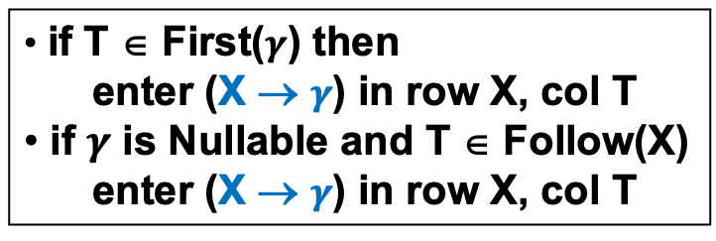
Predictive Parsing – Nullable, First, Follow Sets
Z → X Y Z
Z → d
Y → c
Y →
X → a
X → Y
 | nullable | first | follow
Z
Y
X
 | a | c | d
Z
Y
X
if T ∈ First($γ$) then
enter (X → $γ$) in row X, col T
if $γ$ is Nullable and T ∈ Follow(X)
enter (X → $γ$) in row X, col T

Slide 6
Quiz Two
Consider the following grammar:
S → A S → B A → e A → f
B → (C) C → SD D → AD D → ε
Calculate the Nullable, FIRST, and FOLLOW sets for nonterminals in the grammar;
Construct the LL(1) parsing table for the grammar;
Explain whether the grammar is LL(1) or not.

Slide 7
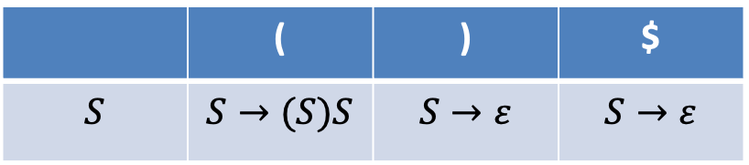
Review: Drawbacks of LL(k)
LL(k) parsing is efficient and easy to write by hand
The weakness of LL(k) parsing is that they must predict which production to use, having seen only the first k tokens of the right-hand side.
 | ( | ) | $
$$S$$ | $$S→(S)S$$ | $$S→ε$$ | $$S→ε$$
E -> T + E
E -> T
T -> int * T
T -> int
Grammars like:
Stack top: T
Next token: int
Cannot be handled by LL(1) parsing

Slide 8
Bottom-Up Parsing
LR(k) parsing: The most prevalent type
Shift-Reduce Parsing
More powerful than LL(k) parsing: able to postpone the decision until it has seen input tokens corresponding to the entire right-hand side of the production in question.
LR(k): Left-to-right parse
Rightmost derivation
k-token lookahead
Variant: LALR (Look-Ahead LR) parsing:
basis for parsers of most modern programming languages
implemented in tools such as Yacc

Slide 9
Bottom-Up Parsing
grammar
int * int + int
int * T + int
T + int
T + T
T + E
E
productions
E
E -> T + E
E -> T
T -> int * T
T -> int
T -> int
T -> int * T
T -> int
E -> T
E -> T+E
T
E
T
T
int
*
int
+
int
Idea: reduce the string to the start symbol
Reduce: replace the RHS of a production with its LHS
Read the input from left to right (LR(k))
Reduce the string to the start symbol by inverting the right-most derivation (LR(k))
Bottom-up parsing: from the bottom of the parse tree to the root.
if we can reduce to the start symbol, then we successfully parse the string.

Slide 10
LR Parsing
$α$ . β: left substring has terminals and non-terminals, right substring contains only terminals.
. int * int + int $
int * T . + int $
T . + int $
T + T . $
T + E . $
E . $
S -> E $
E -> T + E
E -> T
T -> int * T
T -> int

Slide 11
LR Parsing
$α$ . β: left substring has terminals and non-terminals, right substring contains only terminals.
Input
. int * int + int $
int * T . + int $
T . + int $
T + T . $
T + E . $
E . $
. int * int + int $
int
. * int + int $
int *
. int + int $
S -> E $
E -> T + E
E -> T
T -> int * T
T -> int
int * int
. + int $
int * T
. + int $
T
. + int $
T +
. int $
T + int
. $
T + T
. $
T + E
. $
E
. $

Slide 12
LR Parsing
$α$ . β: left substring has terminals and non-terminals, right substring contains only terminals.
Stack
“parse state”
Input
. int * int + int $
int * T . + int $
T . + int $
T + T . $
T + E . $
E . $
. int * int + int $
int
. * int + int $
int *
. int + int $
S -> E $
E -> T + E
E -> T
T -> int * T
T -> int
int * int
. + int $
int * T
. + int $
T
. + int $
T +
. int $
T + int
. $
T + T
. $
T + E
. $
E
. $

Slide 13
LR Parsing
Parser keeps track of
position in current input (what input to read next)
a stack of terminal & non-terminal symbols representing the “parse so far”
The parser performs several actions:
shift: push next input onto top of stack
reduce R:
top of stack should match RHS of rule R (e.g., X -> A B C)
pop the RHS from the top of stack (e.g., pop C B A)
push the LHS onto the stack (e.g., push X)
error
accept: shift $ and can reduce what remains on stack
How does parser know when to shift and when to reduce?

Slide 14
LR(0) Parsing
Start from the simplest LR parsing, i.e., LR(0) Parsing
LR(0) grammars are those can be parsed looking only at the stack, making shift/reduce decisions without any lookahead.
How to make such decisions?
Use DFA! (summarize the “parsing state” and enumerate all valid parsing states and the transitions between them based on the grammar).

Slide 15
LR(0) Parsing
. : the current position of the parser
start with S’ -> . S $: stack should be empty and the input is expected to be a complete S-sentence followed by $
A -> 𝛼 . β: LR(0) item
means the parser has processed 𝛼 and expects to see β next.
We obtain an NFA
We can convert it into a DFA through subset construction
S’ -> . S $
S
S’ -> S . $
ε
S’ -> S $
S -> ( S )
S -> a
ε
S -> . ( S )
(
S -> ( . S )
S
S -> ( S . )
)
S -> ( S ) .
ε
ε
a
S -> . a
S -> a .

Slide 16
LR(0) Parsing
The state of the DFA is a set of items
We can also directly construct this DFA based on a procedure named Closure.
)
S’ -> . S $
S -> . ( S )
S -> . a
(
S -> ( . S )
S -> . ( S )
S -> . a
S
S -> ( S . )
S -> ( S ) .
(
S
a
a
S’ -> S . $
S -> a .
S’ -> S $
S -> ( S )
S -> a
NFA

Slide 17
LR(0) Parsing
I: a set of items
X: a symbol ( terminal or non-terminal)
T: the set of states
E: the set of (shift or goto) edges
Closure(I) =
repeat
for any item A → α.Xβ in I
for any production X → γ
I ← I ∪ {X → .γ}
until I does not change
return I
Initialize T to {Closure({S ′ → .S$})}
Initialize E to empty.
repeat
for each state I in T
for each item A → α.Xβ in I
let J be Goto(I, X)
T ← T ∪ {J}
E ← E ∪ {I → J}
until E and T do not change
Goto(I, X) =
set J to the empty set
for any item A → α.Xβ in I
add A → αX.β to J
return Closure(J)
X
calculate the new state
store the state
store the edge

Slide 18
LR(0) Parsing
0 S’ -> S $
1 S -> ( L )
2 S -> x
3 L -> S
4 L -> L , S
S -> x .
2
x
x
L -> L , . S
S -> . ( L )
S -> . x
S’ -> . S $
S -> . ( L )
S -> . x
8
1
x
L -> L , S .
S -> ( . L )
L -> . S
L -> . L , S
S -> . ( L )
S -> . x
9
3
(
S
(
,
S
L
S -> ( L . )
L -> L . , S
5
S’ -> S . $
4
(
S
)
L -> S .
S -> ( L ) .
7
6

Slide 19
LR(0) Parsing
0 S’ -> S $
1 S -> ( L )
2 S -> x
3 L -> S
4 L -> L , S
action:
input:
6
reduce 1
accept!
reduce 3
shift 2
shift 3
reduce 2
goto 5
goto 7
shift 6
2
)
goto 4
7
5
(
x
)
$
4
x
3
S
L
L -> S
S -> x
S -> (L)
S
1
(
state
symbol

Slide 20
0 S’ -> S $
1 S -> ( L )
2 S -> x
3 L -> S
4 L -> L , S
Stack (states) | Stack (symbols) | Input | Action
1 |  | ( x ) $ | shift 3
1, 3 | ( | x ) $ | shift 2
1, 3, 2 | ( x | ) $ | reduce 2 S -> x
1, 3 | ( S | ) $ | goto 7
1, 3, 7 | ( S | ) $ | reduce 3 L -> S
1, 3 | ( L | ) $ | goto 5
1, 3, 5 | ( L | ) $ | shift 6
1, 3, 5, 6 | ( L ) | $ | reduce 1 S -> ( L )
1 | S | $ | goto 4
1, 4 | S | $ | accept

Slide 21
LR(0) Parsing
Actions:
Shift: For edge labeled with terminal t and from state i to state n:
T[i, t] = sn (shift n)
Goto: For edge labeled with non-terminal X and from state i to state n:
T[i, X] = gn (goto n)
Reduce: For item in a state i with dot at the end (e.g., X -> A … C .):
T[i, each terminal] = rk (reduce k)
k is the index of this production
Accept: For each state i containing
S’ -> S . $:
T[i, $] = accept
 | ( | ) | x | , | $ | S | L
1 | s3 |  | s2 |  |  | g4
2 | r2 | r2 | r2 | r2 | r2
3 | s3 |  | s2 |  |  | g7 | g5
4 |  |  |  |  | a
5 |  | s6 |  | s8
6 | r1 | r1 | r1 | r1 | r1
7 | r3 | r3 | r3 | r3 | r3
8 | s3 |  | s2 |  |  | g9
9 | r4 | r4 | r4 | r4 | r4

Slide 22
LR(k) Parsing – Parsing Algorithm
Look up top stack state, and input symbol, get action; If action is:
Shift(n): | Advance input one token; push n on stack.
Reduce(r): | Pop stack as many times as the number of symbols on the RHS of rule r; Let X be the LHS symbol of rule r; In the state now on top of stack, look up X to get “goto n”; Push n on top of stack.
Accept: | Stop parsing, report success.
Error: | Stop parsing, report failure.
Only the state stack is used
This is a general algorithm and can be used by other LR parsing
For LR(0), we do not need to look up input symbol to know whether we should shift or reduce.

Slide 23
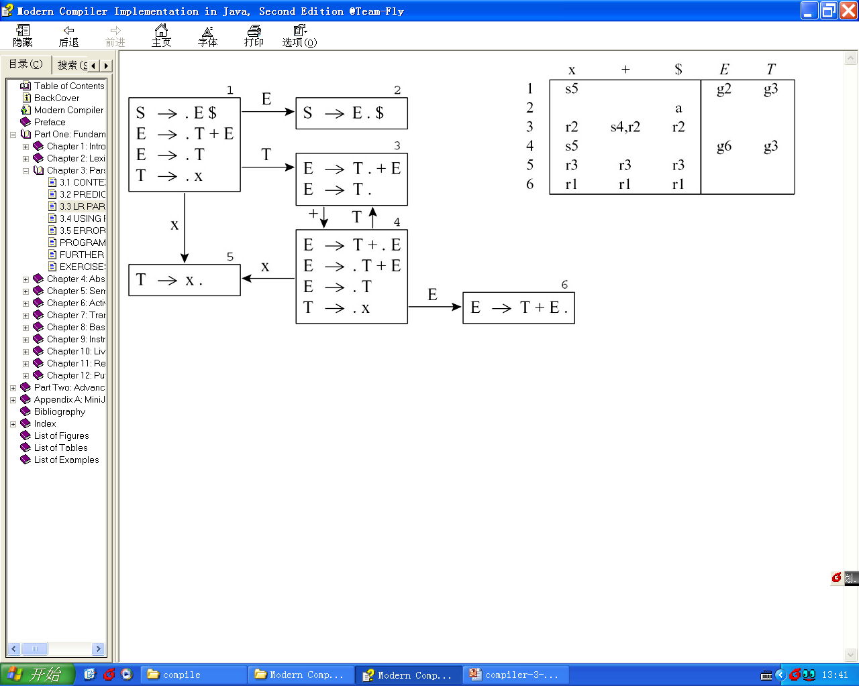
Shift-Reduce Conflicts
0 S → E $
1 E → T + E
2 E → T
3 T → x
Shift-reduce conflict indicates that the grammar is not LR(0) - it cannot be parsed by an LR(0) parser.

Slide 24


Shift-Reduce Conflicts
0 S → E $
1 E → T + E
2 E → T
3 T → x
$$✘$$
$$✘$$
What are the valid next tokens for r2?
Idea: we can choose the reduce action only if the next input token
t ∈ Follow(E)
Follow(E) = {$}
only T[3, $] can be r2!

Slide 25
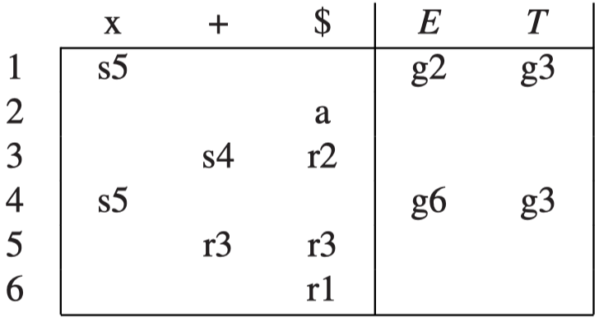
SLR (Simple LR) Parsing
SLR Parsing: Simple LR Parsing
Put reduce actions into the table only where indicated by the FOLLOW set.
R ← {}
for each state I in T
for each item A → α. in I
for each token X in FOLLOW(A)
R ← R ∪ {(I, X, A → α)}
I: the row
X: the column
A → α: the production

Slide 26
LR(1) Parsing
There can still be conflicts in SLR parsing tables
S’ -> . S $
S -> . V = E
S -> . E
V -> . x
V -> . * E
E -> . V
V -> * . E
E -> . V
V -> . x
V -> . * E
V -> * E .
0 S’ -> S $
1 S -> V = E
2 S -> E
3 E -> V
4 V -> x
5 V -> * E
E
*
V
x
x
V -> x .
E -> V .
V
S
E
x
S’ -> S . $
V
S -> V = . E
E -> . V
V -> . x
V -> . * E
Follow(E) = {$, =}
S -> V . = E
E -> V .
=
E
conflict!
S -> E .
S -> V = E .

Slide 27
LR(1) Parsing
LR(1) parsing is more powerful than SLR parsing.
Idea: add more information into the state of DFA so that we can resolve the conflicts!
An LR(1) item consists of a production, a right-hand-side position (represented by the dot), and a lookahead symbol.
(A → α.β, x)
We record the token after the whole RHS of this production
An item (A → α.β, x) indicates that the sequence α is on top of the (symbol) stack, and at the head of the input is a string derivable from βx.
For item (A → α.β, x), the next input token should be in First(βx) (β can be empty)

Slide 28
LR(1) Parsing
Closure(I) =
repeat
for any item (A → α.Xβ, z) in I
for any production X → γ
for any w ∈ FIRST(βz)
I ← I ∪ {(X → .γ, w)}
until I does not change
return I
Closure(I) =
repeat
for any item A → α.Xβ in I
for any production X → γ
I ← I ∪ {X → .γ}
until I does not change.
return I
LR(0) Closure
LR(1) Closure
1. Change the notion of item
2. When performing ε-transitions, record the context on the right (i.e., w)
The start state is the closure of the item (S′ → .S $, ?)

Slide 29
LR(1) Parsing
Goto(I, X) =
J ← {}
for any item (A → α.Xβ, z) in I
add (A → αX. β, z) to J
return Closure(J).
Goto(I, X) =
set J to the empty set
for any item A → α.Xβ in
add A → αX.β to J
return Closure(J)
LR(1) Goto
LR(0) Goto
Only change the notion of item

Slide 30
LR(1) Parsing
R ← {}
for each state I in T
for each item A → α. in I
for each token X in FOLLOW(A)
R ← R ∪ {(I, X, A → α)}
R ← { }
for each state I in T
for each item (A → α., z) in I
R ← R ∪{(I, z, A → α)}
LR(1) Reduce Actions
Add z in items and reduce actions
SLR Reduce Actions
The action (I, z, A → α) indicates that in state I, on lookahead symbol z, the parser will reduce by rule A → α.
Some tokens in Follow(A) may not always be valid in the states with A → α.
The lookahead token of LR(1) is more accurate than that of SLR.

Slide 31
LR(1) Parsing
R ← {}
for each state I in T
for each item A → α. in I
for each token X in FOLLOW(A)
R ← R ∪ {(I, X, A → α)}
R ← { }
for each state I in T
for each item (A → α., z) in I
R ← R ∪{(I, z, A → α)}
LR(1) Reduce Actions
Add z in items and reduce actions
SLR Reduce Actions
The action (I, z, A → α) indicates that in state I, on lookahead symbol z, the parser will reduce by rule A → α.
Some tokens in Follow(A) may not always be valid in the states with A → α.
The lookahead token of LR(1) is more accurate than that of SLR.

Slide 32
LR(1) Parsing
0 S’ -> S $
1 S -> V = E
2 S -> E
3 E -> V
4 V -> x
5 V -> * E
S’ -> . S $ ?
S -> . V = E $
S -> . E $
V -> . x =
V -> . * E =
E -> . V $
V -> . x $
V -> . * E $
S’ -> . S $ ?
S -> . V = E $
S -> . E $
V -> . x $, =
V -> . * E $, =
E -> . V $
This grammar is not an SLR grammar, but an LR(1) grammar

Slide 33
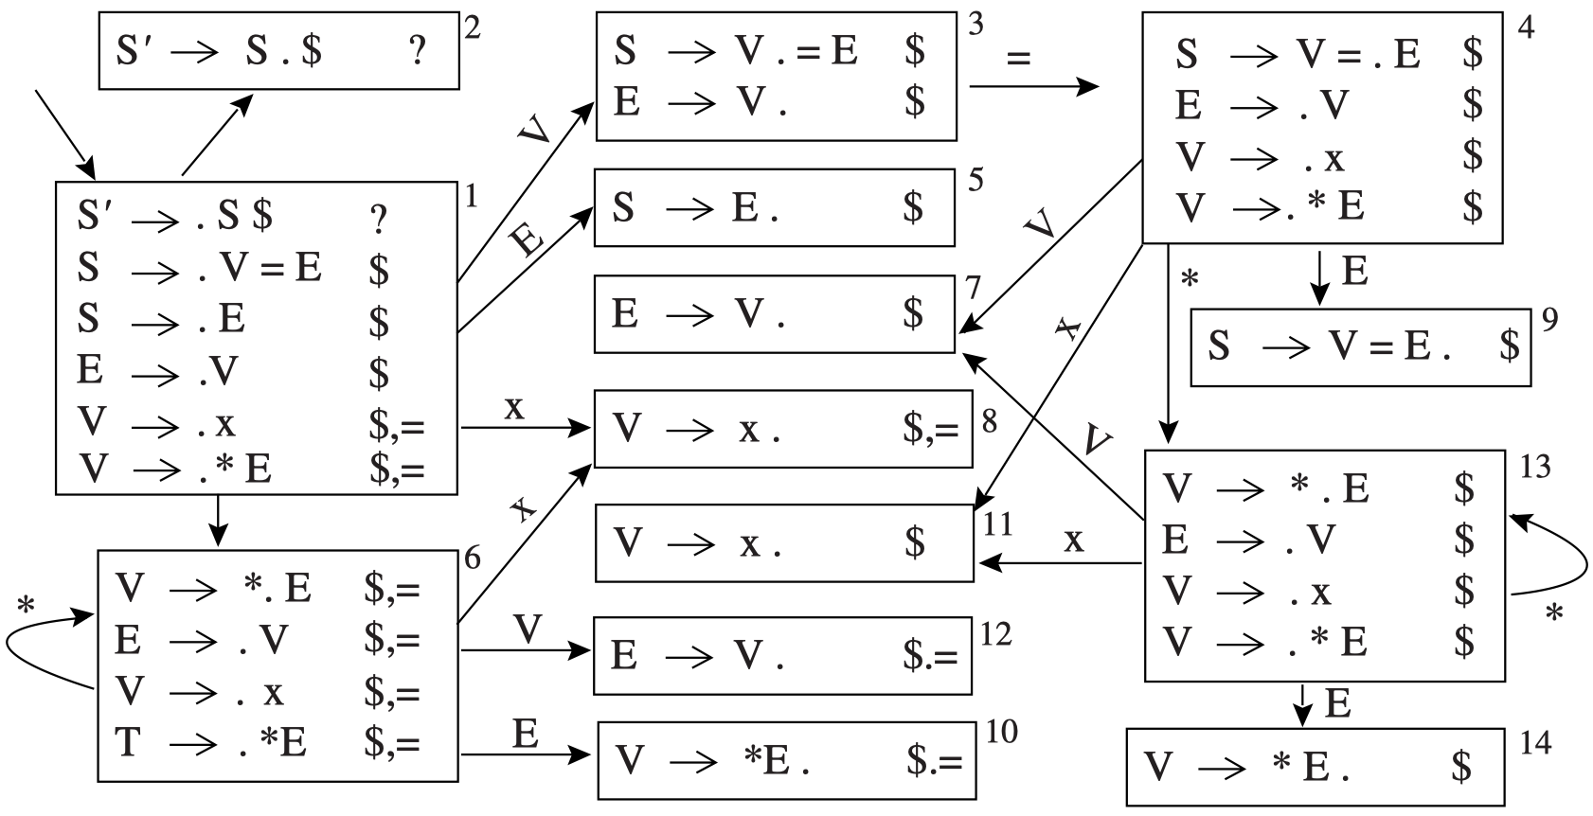
LR(1) Parsing
Some states are only different on the lookahead symbols
0 S’ -> S $
1 S -> V = E
2 S -> E
3 E -> V
4 V -> x
5 V -> * E

Slide 34
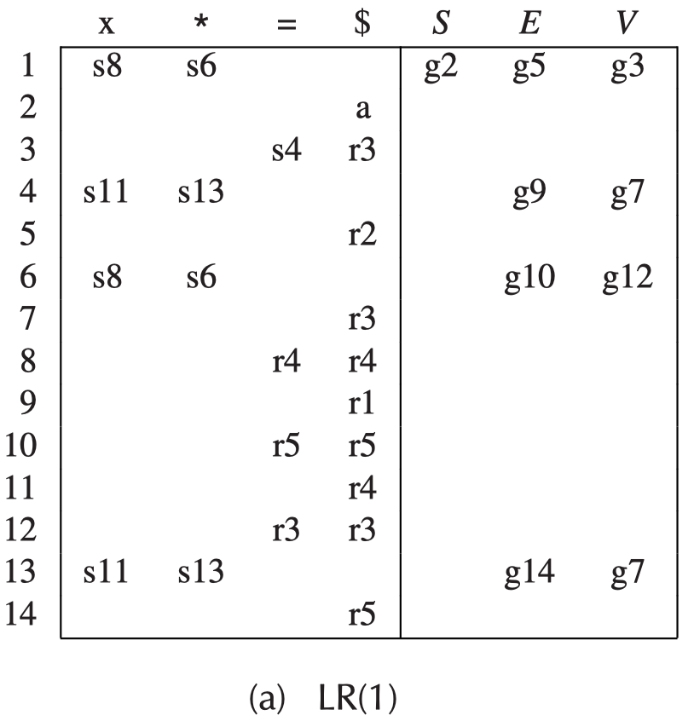
LR(1) Parsing
0 S’ -> S $
1 S -> V = E
2 S -> E
3 E -> V
4 V -> x
5 V -> * E

Slide 35
LR(1) Parsing
LR(1) parsing tables can be very large, with many states.
LALR(1) parsing: the parsing table is made by merging any two states whose items are identical except for lookahead sets in the LR(1) parsing table.
Look-Ahead LR(1)

Slide 36
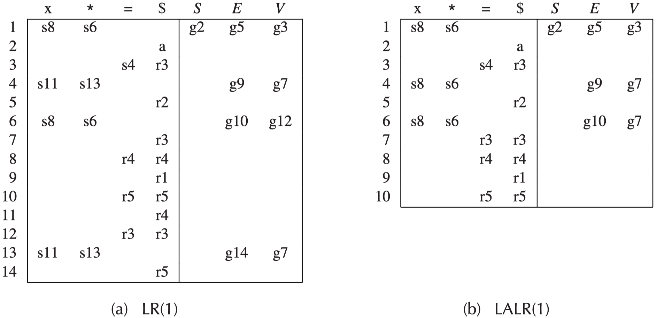
LR(1) Parsing
For some grammars, the LALR(1) table contains reduce-reduce conﬂicts where the LR(1) table has none, but in practice the difference matters little.
LALR(1) parsing table requires less memory to represent than the LR(1) table.

Slide 37
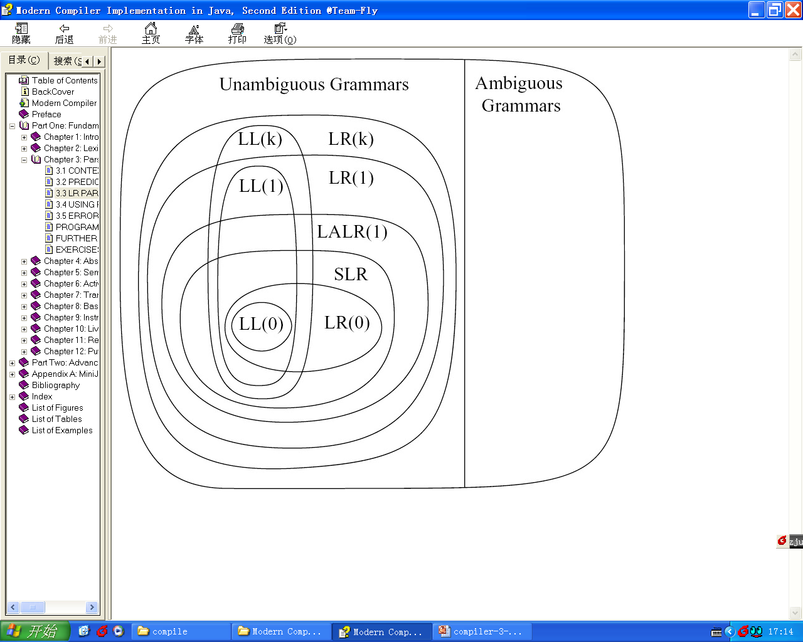
Hierarchy of Grammar Classes
The relationship between several classes of grammars:
All SLR grammars are LALR(1)
but not vice versa

Slide 38
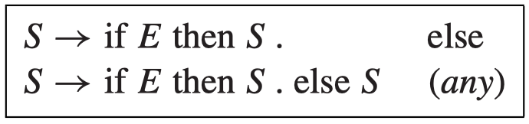
LR Parsing of Ambiguous Grammars
Most programming languages have grammar rules such as
if a then if b then s1 else s2
In most programming languages, an else must match the most recent possible then, so interpretation (1) is correct.
S → if E then S else S
S → if E then S
S → other
if a then { if b then s1 else s2 }
(2) if a then { if b then s1 } else s2
(2)
(1)
Shift-Reduce Conflict

Slide 39
LR Parsing of Ambiguous Grammars
The ambiguity can be eliminated by introducing auxiliary non-terminals M (for matched if) and U (for unmatched if).
Or leave the grammar unchanged. When constructing the parsing table, this conflict should be resolved by shifting (prefer interpretation (1)).
Caution: Most shift-reduce conﬂicts, and probably all reduce-reduce conﬂicts, are symptoms of an ill-speciﬁed grammar, and they should be resolved by eliminating ambiguities.
S → M
S → U
M → if E then M else M
M → other
U → if E then S
U → if E then M else U
M : all then are matched
U : some then is unmatched
This then is unmatched
This then is matched

Slide 40
Exercises
3.6, 3.9, 3.13, 3.14

