Slide 1

编译原理
陈明帅
m.chen@zju.edu.cn
浙江大学 · 计算机科学与技术学院
Slides partially credited to Zhongxin Liu

Slide 2
课程内容
1
Introduction
2
3
4
5
6
Lexical Analysis
Parsing
Abstract Syntax
Semantic Analysis
Activation Records
9
8
7
Instruct. Selection
Blocks & Traces
Interm. Code
10
11
Liveness Analysis
Register Allocation
Fundamentals
13
18
Garbage Collection
Loop Optimizations
Advanced Topics

Slide 3
Outline: How to Build a Parser?
Specifying the syntax of a programming language with Context-Free Grammars (CFG)
Build the parser based on the CFG:
Top-Down Parsing
Predictive Parsing (LL(k) Parsing)
Bottom-Up Parsing
LR Parsing
More about parsing:
Automatic parser generation
Error Recovery

Slide 4
Parser Implementation
Write a parser from scratch
Can we automatically generate parsers?
LL(k) and LR(k) both have general table-driven parsing algorithms.
Different grammars lead to different parsing tables.
We have learned how to automatically construct parsing tables.
Use a Parser Generator
general and robust
sometimes not quite as efficient as hand-written parsers
Nevertheless, good for lazy compiler writers.
stream of
tokens
Parser
Specification
Parser
parser
generator
abstract syntax

Slide 5
Yacc
Yacc: Yet another compiler-compler
Input: a specification file (usually with a suffix .y)
Output: an output file consisting of C source code for the parser (usually with a suffix tab.c)
A Yacc specification file has the basic format
{definitions}
%%
{rules}
%%
{auxiliary routines}

Slide 6
Yacc: An Example
exp → exp addop term | term
addop → + | -
term → term mulop factor | factor
mulop → *
factor → ( exp ) | number

Slide 7
Yacc: An Example
%{
#include <stdio.h>
#include <ctype.h>
int yylex(void);
int yyerror (char * s);
%}
%token NUMBER
%%
command: exp {printf("%d\n", $1);};
exp: exp '+' term {$$ = $1 + $3;}
| exp '-' term {$$ = $1 - $3;}
| term {$$ = $1}
;
term: term '*' factor {$$ = $1 * $3;}
| factor {$$ = $1;}
;
factor: NUMBER {$$ = $1;}
| ‘(’ exp ‘)' {$$ = $2;}
;
%%
int main() {
return yyparse();
}
int yylex(void){
int c;
// eliminate blanks
while ( (c=getchar()) == ' ');
if (isdigit(c)) {
ungetc(c, stdin);
scanf("%d", &yylval);
return (NUMBER);
}
if (c == '\n‘)
return 0; // stop the parse
return c;
}
int yyerror (char * s){
fprintf (stderr, "%s\n",s ) ;
return 0;
}

Slide 8
Yacc: Auxiliary Routines
yyparse is declared to return an integer value, which is 0 if the parse succeeds, and 1 if it does not.
The yyparse procedure calls a lexer procedure (yylex)
Yacc expects the end of input to be signaled by a return of the null value 0 by yylex.
yylex returns a token type or 0 and yylval stores the semantic value.
yyerror prints an error message when an error is encountered during the parse.
%%
int main() {
return yyparse();
}
int yylex(void){
int c;
// eliminate blanks
while ( (c=getchar()) == ' ');
if (isdigit(c)) {
ungetc(c, stdin);
scanf("%d", &yylval);
return (NUMBER);
}
if (c == '\n‘)
return 0; // stop the parse
return c;
}
int yyerror (char * s){
fprintf (stderr, "%s\n",s ) ;
return 0;
}

Slide 9
Yacc: Definitions
%{
#include <stdio.h>
#include <ctype.h>
int yylex(void);
int yyerror (char * s);
%}
%token NUMBER
%%
command: exp {printf("%d\n", $1);};
exp: exp '+' term {$$ = $1 + $3;}
| exp '-' term {$$ = $1 - $3;}
| term {$$ = $1}
;
term: term '*' factor {$$ = $1 * $3;}
| factor {$$ = $1;}
;
factor: NUMBER {$$ = $1;}
| ‘(’ exp ‘)' {$$ = $2;}
;
Two ways of recognizing tokens:
Any character inside single quotes in a grammar rule will be recognized as itself. e.g., ‘+’
Symbolic tokens may be declared in a YACC %token declaration .
%token NUMBER
%start symbol (define the start symbol .)

Slide 10
Yacc: Rules
%{
#include <stdio.h>
#include <ctype.h>
int yylex(void);
int yyerror (char * s);
%}
%token NUMBER
%%
command: exp {printf("%d\n", $1);};
exp: exp '+' term {$$ = $1 + $3;}
| exp '-' term {$$ = $1 - $3;}
| term {$$ = $1}
;
term: term '*' factor {$$ = $1 * $3;}
| factor {$$ = $1;}
;
factor: NUMBER {$$ = $1;}
| ‘(’ exp ‘)' {$$ = $2;}
;
Rules:
Rule {Action Code}
Action code will be executed after the parse performs a reduce action using the rule.
Action code is placed at the end of each grammar rule choice, although. It is also possible to write embedded actions within a choice.

Slide 11
Yacc: Rules
%{
#include <stdio.h>
#include <ctype.h>
int yylex(void);
int yyerror (char * s);
%}
%token NUMBER
%%
command: exp {printf("%d\n", $1);};
exp: exp '+' term {$$ = $1 + $3;}
| exp '-' term {$$ = $1 - $3;}
| term {$$ = $1}
;
term: term '*' factor {$$ = $1 * $3;}
| factor {$$ = $1;}
;
factor: NUMBER {$$ = $1;}
| ‘(’ exp ‘)' {$$ = $2;}
;
Pseudo variables: $$, $1, $3
yylex may store the semantic value of a token in yylval (global)
by default, yylval = 0
When a grammar rule is recognized, each symbol in the rule possesses a semantic value.
$$: the value of the LHS of the rule
$i: the i_th symbol in the RHS of the rule
These values are kept on the top of a value stack by Yacc.

Slide 12
Yacc: Rules
%{
#include <stdio.h>
#include <ctype.h>
int yylex(void);
int yyerror (char * s);
%}
%token NUMBER
%%
command: exp {printf("%d\n", $1);};
exp: exp '+' term {$$ = $1 + $3;}
| exp '-' term {$$ = $1 - $3;}
| term {$$ = $1}
;
term: term '*' factor {$$ = $1 * $3;}
| factor {$$ = $1;}
;
factor: NUMBER {$$ = $1;}
| ‘(’ exp ‘)' {$$ = $2;}
;
Example: 3 * 4
Action | Symbol Stack | Value Stack
Shift | Num | 3 (from yylval)
reduce | factor | 3
reduce | term | 3
shift | term, ‘*’ | 3, 0 (default)
shift | term, ‘*’, Num | 3, 0, 4
reduce | term, ‘*’, factor | 3, 0, 4
reduce | term | 12
reduce | exp | 12
reduce | command

Slide 13
Yacc: Rules
%{
#include <stdio.h>
#include <ctype.h>
int yylex(void);
int yyerror (char * s);
%}
%token NUMBER
%%
command: exp {printf("%d\n", $1);};
exp: exp '+' term {$$ = $1 + $3;}
| exp '-' term {$$ = $1 - $3;}
| term {$$ = $1}
;
term: term '*' factor {$$ = $1 * $3;}
| factor {$$ = $1;}
;
factor: NUMBER {$$ = $1;}
| ‘(’ exp ‘)' {$$ = $2;}
;
Pseudo variables: $$, $1, $3
yylex may store the semantic value of a token in yylval (global)
by default, yylval = 0
YYSTYPE yylval;
This data type is always defined in Yacc by the C preprocessor symbol YYSTYPE.
By default:
#define YYSTYPE int

Slide 14
Yacc: YYSTYPE
For the values of exp and op, what are their types?
Different values for different grammar rules / symbols
How to handle this?
Declare the union directly in the Yacc specification using the %union Yacc declaration:
%union { double val;
char op;}
Define a new data type in the definitions or in a separate include file, and define YYSTYPE to this type
The appropriate values must be constructed by hand in the associated action code.
#define YYSTYPE ASTNode
exp→ exp op term | term
op→ ‘+’ | ‘-’

Slide 15
Yacc: %union & %type
%token NUMBER
%union { double val;
char op;}
%type <val> exp term NUMBER
%type <op> op
%%
command : exp { printf("%f\n",$1);}
;
exp : exp op term {
switch ($2){
case '+' : $$=$1+$3; break;
case '-' : $$=$1-$3; break;
}
}
| term {$$ = $1;}
;
op : '+' {$$ = $1;}
| '-' {$$ = $1;}
;
All non-terminals obtain their values by such user supplied actions
Tokens may also be assigned values, this is done in the Lexer using yylval.
Use %union to define value types
Use %type to specify the value type of each symbol
necessary
$$ = $1 + $3
(yyval.val)=(yyvsp[1-3].val) + (yyvsp[3-3].val)

Slide 16
Yacc: Embedded Actions
It is necessary to execute some code prior to the complete recognition of a grammar rule choice during parsing.
How can we record the “type” of each “id”?
decl→ type var-list
type→ int | float
var-list→ var-list, id | id

Slide 17
Yacc: Embedded Actions
decl: type {current_type=$1} var-list
;
type: INT {$$=INT_TYPE;}
| FLOAT {$$=FLOAT_TYPE;}
;
var_list: var_list ',' ID {setType(tokenString, current_type);}
| ID {setType(tokenString, current_type);}
;
list: item1 { do_item1($1); } item2 { do_item2($3); } item3
list: item1 _rule01 item2 _rule02 item3
_rule01: { do_item1($0); }
_rule02: { do_item2($0); }

Slide 18
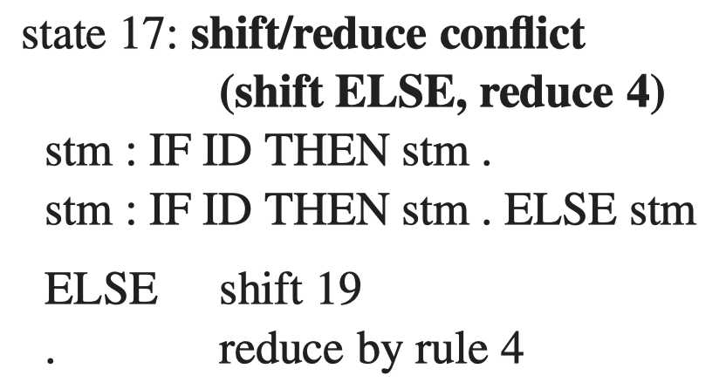
Yacc: Conflicts
Yacc reports shift-reduce and reduce-reduce conﬂicts
By default, Yacc resolves:
shift-reduce conﬂicts by shifting
reduce-reduce conﬂicts by using the rule that appears earlier in the grammar
Most shift-reduce conﬂicts, and all reduce-reduce conﬂicts, are serious problems and should be eliminated by rewriting the grammar.

Slide 19
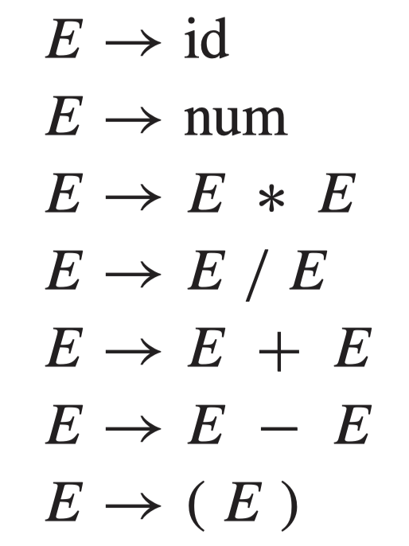
Yacc: Precedence Directives
exp → exp addop term | term
addop → + | -
term → term mulop factor | factor
mulop → *
factor → ( exp ) | number
disambiguating
The left grammar is natural but ambiguous (no precedence nor left-association).
The right grammar is Unambiguous yet hard to understand.
Is there a way to write natural grammar while enforcing operator precedence and associativity?
Yacc provides built-in precedence directives (disambiguating rules.

Slide 20
Yacc: Precedence Directives
The grammar in the left is natural but highly ambiguous. There are many shift-reduce conflicts in its LR(1) parsing table.
Resolve ambiguity based on operator precedence and associativity.
Choose shift (operator precedence)
Choose reduce (left associativity)
If a != b != c is not allowed, then != is non-associative
E -> E + E . *
E -> E . * E (any)
E -> E + E . +
E -> E . + E (any)

Slide 21
Yacc: Precedence Directives
How to specify such disambiguating rules in Yacc?
Operators PLUS and MINUS have the same precedence and are left associative
Operators TIMES and DIV have higher precedence than PLUS and MINUS and are also left associative
Operator EXP is right associative
Operators EQ and NEQ have the lowest precedence and are noassicative
%nonassoc EQ NEQ
%left PLUS MINUS
%left TIMES DIV
%right EXP

Slide 22
Yacc: Precedence Directives
How Yacc resolve conflicts using these precedence directives?
The precedence declarations (%left, etc.) give priorities to the tokens.
The priority of shifting a token is given by this token.
The priority of a rule is given by the last token occurring on the right-hand side of that rule.
If the rule has higher priority, choose reducing
If the token and the rule have equal priority, then:
%left favors reducing
%right favors shifting
%nonassoc yields an error action

Slide 23
Yacc: Precedence Directives
Reduce: *
Shift: +
* > +
=> reduce
E -> E * E . +
E -> E . + E (any)
%nonassoc EQ NEQ
%left PLUS MINUS
%left TIMES DIV
%right EXP
Reduce: +
Shift: +
+ = +
% left => reduce
E -> E + E . +
E -> E . + E (any)

Slide 24
Yacc: Precedence Directives
How to parse -6 * 8?
should be (-6) * 8, not – (6 * 8)
How to specify this rule?
Assign a specific precedence to a rule using the %prec directive
%{ // declarations of yylex and yyerror
%}
%token INT PLUS MINUS TIMES UMINUS
%start exp
%left PLUS MINUS
%left TIMES
%left UMINUS
%%
exp : INT
| exp PLUS exp
| exp MINUS exp
| exp TIMES exp
| MINUS exp %prec UMINUS
The token UMINUS is never returned by the Lexer. It is just a placeholder.
The directive %prec UMINUS gives the rule exp : MINUS exp the highest precedence

Slide 25
Yacc: Syntax v.s. Semantics
Consider a programming language with arithmetic expressions such as x + y and Boolean expressions such as a&(b = c)
%{ //declarations of yylex and yyerror
%}
%token ID ASSIGN PLUS MINUS AND EQUAL
%start stm
%left OR
%left AND
%left PLUS
%% stm : ID ASSIGN ae
| ID ASSIGN be
be : be OR be
| be AND be
| ae EQUAL ae
| ID
ae : ae PLUS ae
| ID
Arithmetic operators bind tighter than the Boolean operators
A Boolean expression cannot be added to an arithmetic expression
There are arithmetic variables and Boolean variables

Slide 26
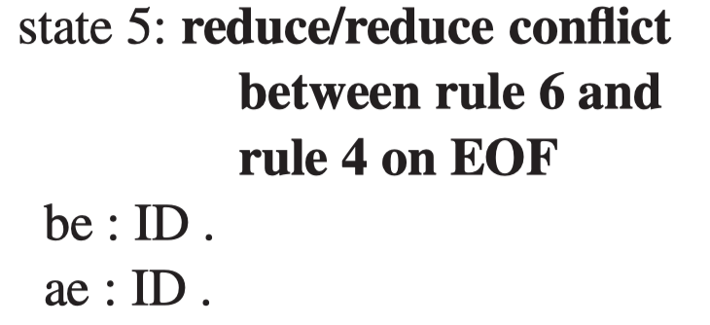
Yacc: Syntax v.s. Semantics
%{ //declarations of yylex and yyerror
%}
%token ID ASSIGN PLUS MINUS AND EQUAL
%start stm
%left OR
%left AND
%left PLUS
%% stm : ID ASSIGN ae
| ID ASSIGN be
be : be OR be
| be AND be
| ae EQUAL ae
| ID
ae : ae PLUS ae
| ID
reduce-reduce
conflict
Defer this analysis until the “semantic phase” of the compiler.
e.g., a + 5&b => syntactically correct
S → id := E
E → id
E → E & E
E → E = E
E → E + E

Slide 27
Error Recovery
Motivation: developers would like to have all the errors in the program reported, not just the ﬁrst error.
Error recovery techniques:
Local error recovery
Global error repair

Slide 28
Error Recovery: Local Error Recovery
Local error recovery mechanisms work by adjusting the parse stack and the input at the point where the error was detected in a way that will allow parsing to resume.
One local recovery mechanism used by Yacc:
uses a special error symbol to control the recovery process
We can specify that if a syntax error is encountered in the middle of an expression, the parser should skip to the next semicolon or right parenthesis and resume parsing.
exp → ID
exp → exp + exp
exp → ( exps )
exps → exp
exps → exps ; exp
exp → ( error )
exps → error ; exp
synchronizing tokens

Slide 29
Error Recovery: Local Error Recovery
What does the parser-generator do with the error symbol?
error is considered a terminal symbol, and shift actions are entered in the parsing table for it as if it were an ordinary token.
How does the parser-generator perform error recovery?
exp → ( error )
exps → error ; exp

Slide 30
Error Recovery: Local Error Recovery
Stack (symbol) | Input | Action
 | (ID++)$ | shift
( | ID++)$ | shift
(ID | ++)$ | reduce
(exp | ++)$ | shift
exp → ID
exp → exp + exp
exp → ( exps )
exps → exp
exps → exps ; exp
exp → ( error )
exps → error ; exp
input tokens: (ID++)$

Slide 31
Error Recovery: Local Error Recovery
Stack (symbol) | Input | Action
 | (ID++)$ | shift
( | ID++)$ | shift
(ID | ++)$ | reduce
(exp | ++)$ | shift
(exp+ | +)$ | error
exp → ID
exp → exp + exp
exp → ( exps )
exps → exp
exps → exps ; exp
exp → ( error )
exps → error ; exp
input tokens: (ID++)$

Slide 32
Error Recovery: Local Error Recovery
Stack (symbol) | Input | Action
 | (ID++)$ | shift
( | ID++)$ | shift
(ID | ++)$ | reduce
(exp | ++)$ | shift
(exp+ | +)$ | error
(exp | error+)$ | pop
exp → ID
exp → exp + exp
exp → ( exps )
exps → exp
exps → exps ; exp
exp → ( error )
exps → error ; exp
input tokens: (ID++)$

Slide 33
Error Recovery: Local Error Recovery
Stack (symbol) | Input | Action
 | (ID++)$ | shift
( | ID++)$ | shift
(ID | ++)$ | reduce
(exp | ++)$ | shift
(exp+ | +)$ | error
(exp | error+)$ | pop
( | error+)$ | pop
exp → ID
exp → exp + exp
exp → ( exps )
exps → exp
exps → exps ; exp
exp → ( error )
exps → error ; exp
input tokens: (ID++)$

Slide 34
Error Recovery: Local Error Recovery
Stack (symbol) | Input | Action
 | (ID++)$ | shift
( | ID++)$ | shift
(ID | ++)$ | reduce
(exp | ++)$ | shift
(exp+ | +)$ | error
(exp | error+)$ | pop
( | error+)$ | pop
(error | +)$ | shift
exp → ID
exp → exp + exp
exp → ( exps )
exps → exp
exps → exps ; exp
exp → ( error )
exps → error ; exp
input tokens: (ID++)$

Slide 35
Error Recovery: Local Error Recovery
Stack (symbol) | Input | Action
 | (ID++)$ | shift
( | ID++)$ | shift
(ID | ++)$ | reduce
(exp | ++)$ | shift
(exp+ | +)$ | error
(exp | error+)$ | pop
( | error+)$ | pop
(error | +)$ | shift
(error | )$ | discard input
exp → ID
exp → exp + exp
exp → ( exps )
exps → exp
exps → exps ; exp
exp → ( error )
exps → error ; exp
input tokens: (ID++)$

Slide 36
Error Recovery: Local Error Recovery
Stack (symbol) | Input | Action
 | (ID++)$ | shift
( | ID++)$ | shift
(ID | ++)$ | reduce
(exp | ++)$ | shift
(exp+ | +)$ | error
(exp | error+)$ | pop
( | error+)$ | pop
(error | +)$ | shift
(error | )$ | discard input
(error) | $ | shift
exp | $ | reduce
exp → ID
exp → exp + exp
exp → ( exps )
exps → exp
exps → exps ; exp
exp → ( error )
exps → error ; exp
input tokens: (ID++)$

Slide 37
Error Recovery: Local Error Recovery
When the LR parser reaches an error state, it takes the following actions:
Pop the stack (if necessary) until a state is reached in which the action for the error token is shift.
Shift the error token
Discard input symbols (if necessary) until a state is reached that has a non-error action on the current lookahead token.
Resume normal parsing

Slide 38
Error Recovery: Local Error Recovery
Caution
During local error recovery, popping states from the stack can lead to seemingly “impossible” semantic actions, especially if the actions contain side effects.
What if a syntax error is found after some left parentheses have been parsed?
Solution: have side-effect-free semantic actions (Chap 4.)
statements: statements exp SEMICOLON
| statements error SEMICOLON
| /* empty */
exp : increment exp decrement
| ID
increment: LPAREN {nest=nest+1;}
decrement: RPAREN {nest=nest-1;}
Pop the stack until we reach the last SEMICOLON or the beginning of the input
Shift error
Discard input tokens until we see SEMICOLON
nest – 1 never be executed
nest > 0 after error recovery!

Slide 39
Error Recovery: Global Error Repair
tydec → type type-id = ty
vardec → var id := exp
→ var id : type-id := exp
ty → type-id
→ { tyfields }
→ array of type-id
let type a := intArray [ 10 ] of 0 in . . .
How does local error recovery techniques recover this error?
A local technique will discover a syntax error with := as lookahead symbol:
delete the phrase from type to 0 (let error in)
or, replace the := by =, and will encounter another syntax error at the ‘[’ token
Global error repair finds the smallest set of insertions and deletions that would turn the source string into a syntactically correct string, even if the insertions and deletions are not at a point where an LL or LR parser would first report an error.

Slide 40
Error Recovery: Burke-Fisher Error Repair
Burke-Fisher error repair: tries every possible single-token insertion, deletion, or replacement at every point that occurs no earlier than K tokens before the point where the parser reported the error:
limited but useful
How to choose the best error repair?
The correction that allows the parser to parse furthest past the original reported error.
Generally, if a repair carries the parser R = 4 tokens beyond where it originally got stuck, this is “good enough.”
The parsing engine must be able to back up K tokens and reparse.
How to implement this technique?

Slide 41
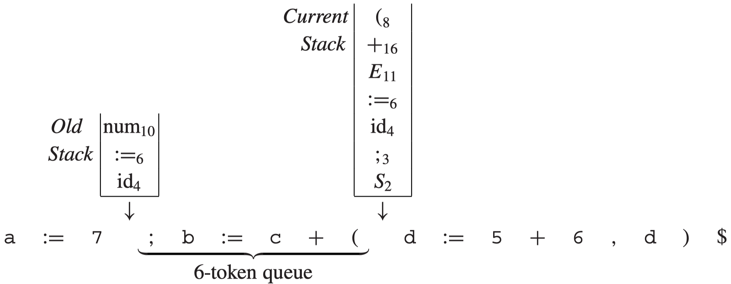
Error Recovery: Burke-Fisher Error Repair
id₄
(₈
+₁₆
E₁₁
:=₆
id₄
;₃
S₂
E₁₁
:=₆
id₄
;₃
S₂
S₂
Maintain two parse stacks: the current stack and the old stack.
Keep a queue of K tokens.
As each new token is shifted:
It is pushed on the current stack and put onto the tail of the queue
The head of the queue is removed and shifted onto the old stack
With each shift onto the old or current stack, the appropriate reduce actions are also performed.

Slide 42
Error Recovery: Burke-Fisher Error Repair
Suppose a syntax error is detected at the current token:
For each possible insertion, deletion, or substitution of a token at any position of the queue, the Burke-Fisher error repairer makes that change to within (a copy of) the queue, then attempts to reparse from the old stack.
Generally, if three or four tokens past the current token can be parsed, this is considered a completely successful repair.

Slide 43
Error Recovery: Global Error Repair
The advantage of Burke-Fisher Error Repair
The grammar is not modified at all (no error productions). Only the parsing engine, which interprets the parsing tables, is modiﬁed.
Semantic Actions
Shift and reduce actions are tried repeatedly and discarded.
What if the programmer-speciﬁed semantic actions associated with reduce actions have side effects?
e.g., nest + 1 and nest -1
Solution: does not execute any of the semantic actions as reductions are performed on the current stack, but waits until the same reductions are performed (permanently) on the old stack.

Slide 44
Error Recovery: Global Error Repair
Semantic values for insertions
When tokens such as numbers or identiﬁers must be inserted, where can their semantic values come from?
ML-Yacc parser generator has a %value directive
%value ID ("bogus")
%value INT (1)
%value STRING ("")

Slide 45
Error Recovery: Global Error Error
Programmer-specified substitutions
Sometimes a particular single-token insertion or substitution is very commonly required and should be tried ﬁrst. (Provide hints for parser)
ML-Yacc parser generator has a %change directive
IN INT END -> a scope closer
let …. in …. end: the nesting structure in Tiger
the scope closer automatically closes the scope of let
%change EQ -> ASSIGN
| ASSIGN -> EQ
| SEMICOLON ELSE -> ELSE
| -> IN INT END

Slide 46
Stack | Input | action
1 | (a++;b)$ | s4
14, ( | a++;b)$ | s5
145, (a | ++;b)$ | r
146, (e | ++;b)$ | s3
1463, (e+ | +;b)$ | error
14, ( | +;b)$ | s12
1412, (error | ;b)$ | s10
141210, (error; | b)$ | s5
1412105, (error; b | )$ | r
14121013, (error; e | )$ | r
148, (exps | )$ | s9
1489, (exps) | $ | r
12,e | $ | r
S → exp
exp → ID
exp → exp + exp
exp → ( exps )
exps → exp
exps → exps ; exp
exp → ( error )
exps → error ; exp
input tokens: (a++;b)$

Slide 47
1
3
S → .exp
exp → .ID
exp →. exp + exp
exp →. ( exps )
exp → .( error )
2
exp
+
exp →exp +. exp
exp → .ID
exp →. exp + exp
exp →. ( exps )
exp → .( error )
S → exp.
exp →exp .+ exp
ID
(
(
5
ID
ID
4
(
exp → ( .exps )
exp → (. error )
exps → .exp
exps → .exps ; exp
exps → .error ; exp
exp → .ID
exp →. exp + exp
exp →. ( exps )
exp → .( error )
exp → ID.
7
exp
+
+
ID
6
exp →exp + exp.
exp →exp .+ exp
exp
exps → exp.
exp →exp. + exp
9
exps
)
exp → ( exps ).
+
8
exp → ( exps. )
exps → exps. ; exp
11
;
exps → exps ; .exp
exp → .ID
exp →. exp + exp
exp →. ( exps )
exp → .( error )
(
12
error
10
exp → (error. )
exps → error .; exp
exps → error ; .exp
exp → .ID
exp →. exp + exp
exp →. ( exps )
exp → .( error )
)
exp
13
14
;
exp → (error ) .
exps → error ; exp.
exp →exp .+ exp

Slide 48
Summary: How to Build a Parser?
Specifying the syntax of a programming language with Context-Free Grammars (CFG)
Build the parser based on the CFG:
Top-Down Parsing
Predictive Parsing (LL(k) Parsing)
Bottom-Up Parsing
LR Parsing
More about parsing:
Automatic parser generation
Error Recovery

