Slide 1

编译原理
陈明帅
m.chen@zju.edu.cn
浙江大学 · 计算机科学与技术学院
Slides partially credited to Zhongxin Liu

Slide 2
课程内容
1
Introduction
2
3
4
5
6
Lexical Analysis
Parsing
Abstract Syntax
Semantic Analysis
Activation Records
9
8
7
Instruct. Selection
Blocks & Traces
Interm. Code
10
11
Liveness Analysis
Register Allocation
Fundamentals
13
18
Garbage Collection
Loop Optimizations
Advanced Topics

Slide 3
4.1 Semantic Actions
grammar
A parser recognizes whether a sentence belongs to the language of a grammar.
stream of
tokens
abstract
syntax
Syntax
Analysis
Parser
A compiler must do more useful things with that sentence:
constructing abstract syntax tree
performing semantic analysis
generating Intermediate Representation (IR)
The semantic actions of a parser can do useful things with the phrases that are parsed.
Semantic actions in:
(1) Recursive Descent (2) Yacc-Generated Parsers

Slide 4
Recursive Descent
enum token {EOF, ID, NUM, PLUS, MINUS, ...};
int F_follow[] = { PLUS, TIMES, RPAREN, EOF, -1 };
void F(void) {switch (tok) {
case ID: { advance(); break; }
case NUM: { advance(); break; }
case LPAREN: { eat(LPAREN); E();
eatOrSkipTo(RPAREN, F_follow);
break; }
case EOF:
default: printf(“expected ID, NUM, or left-paren”);
skipto(F_follow);
}}
S → E $
E → T E′
E′ → + T E′
E′ →− T E′
E′ →
T → F T′
T′ →* F T′
T′ → / F T′
T′ →
F → id
F → num
F → (E)
What if we want to evaluate the input string with parsing?

Slide 5
Semantic Actions in Recursive Descent
enum token {EOF, ID, NUM, PLUS, MINUS, ...};
union tokenval {string id; int num; ...};
enum token tok;
union tokenval tokval;
//assume a lookup table mapping identifiers to integers
int lookup(string id) { ... }
int F_follow[] = { PLUS, TIMES, RPAREN, EOF, -1 };
int F(void) {switch (tok) {
case ID: { int i=lookup(tokval.id); advance();
return i;}
case NUM: { int i=tokval.num; advance(); return i; }
case LPAREN: { eat(LPAREN); int i = E();
eatOrSkipTo(RPAREN, F_follow); return i;}
case EOF:
default: printf("expected ID, NUM, or left-paren");
skipto(F_follow); return 0;
}}
S → E $
E → T E′
E′ → + T E′
E′ →− T E′
E′ →
T → F T′
T′ →* F T′
T′ → / F T′
T′ →
F → id
F → num
F → (E)

Slide 6
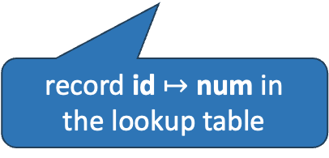
Semantic Actions in Recursive Descent
In a recursive-descent parser, the semantic actions are the values returned by parsing functions, or the side effects of those functions, or both.
Examples of side effects:
S -> id := num S -> print (id)
record id $↦$ num in
the lookup table
print the value of id
For each terminal and nonterminal symbol, we associate a type of semantic values representing phrases derived from that symbol.
The type is from the implementation language of the compiler
Notes:
此处更改了example

Slide 7
Semantic Actions in Recursive Descent
enum token {EOF, ID, NUM, PLUS, MINUS, ...};
union tokenval {string id; int num; ...};
enum token tok;
union tokenval tokval;
//assume a lookup table mapping identifiers to integers
int lookup(string id) { ... }
int F_follow[] = { PLUS, TIMES, RPAREN, EOF, -1 };
int F(void) {switch (tok) {
case ID: { int i=lookup(tokval.id); advance();
return i;}
case NUM: { int i=tokval.num; advance(); return i; }
case LPAREN: { eat(LPAREN); int i = E();
eatOrSkipTo(RPAREN, F_follow); return i;}
case EOF:
default: printf("expected ID, NUM, or left-paren");
skipto(F_follow);return 0;
}}
S → E $
E → T E′
E′ → + T E′
E′ →− T E′
E′ →
T → F T′
T′ →* F T′
T′ → / F T′
T′ →
F → id
F → num
F → (E)

Slide 8
Semantic Actions in Recursive Descent
T -> T * F
The semantic action:
int a = T(); eat(TIMES); int b=F(); return a*b;
T → F T′
T′ →* F T′
T′ → / F T′
T′ →
The semantic action: ?

Slide 9
Semantic Actions in Recursive Descent
int T( void) {switch (tok) {
case ID:
case NUM:
case LPAREN: return Tprime(F());
default: print("expected ID, NUM, or left-paren");
skipto(T_follow);
return 0;
}}
int Tprime(int a) {switch (tok) {
case TIMES: eat(TIMES); return Tprime(a*F());
case PLUS:
case RPAREN:
case EOF: return a;
default: ...
}}
S → E $
E → T E′
E′ → + T E′
E′ →− T E′
E′ →
T → F T′
T′ →* F T′
T′ → / F T′
T′ →
F → id
F → num
F → (E)
Notes:
这里我认为复杂语法带来的主要区别是，由于Tprime不知道前一个乘数无法计算semantic value，因此这里引入了一个参数a，故这里标记了int a这块

Slide 10
Semantic Actions in Yacc-Generated Parsers
%{ … %}
%union {int num; string id;}
%token <num> INT
%token <id> ID
%type <num> exp
...
%left UMINUS
%%
exp: INT {$$ = $1;}
| exp PLUS exp {$$ = $1 + $3;}
| exp MINUS exp {$$ = $1 - $3;}
| exp TIMES exp {$$ = $1 * $3;}
| MINUS exp %prec UMINUS {$$ = -$2;}
{ … }: semantic actions
$i: the semantic values of the i_th RHS symbol
$$: the semantic value of the LHS nonterminal symbol
%union: difference possible types for semantic values to carry
<variant>: declares the type of each terminal or nonterminal

Slide 11
Semantic Actions in Yacc-Generated Parsers
How to implement semantic values?
A Yacc-generated parser keeps a stack of semantics values parallel to the state stack.
When the parser performs a reduction, it must execute the corresponding C-language semantic action.
How to know $i for a rule A -> Y1 … Yk?
from the top k elements of the stack
When the parser pops Yk … Y1 from the symbol stack and pushes A, it also pops k values from the semantic value stack and pushes the value obtained by executing the C semantic action code.

Slide 12
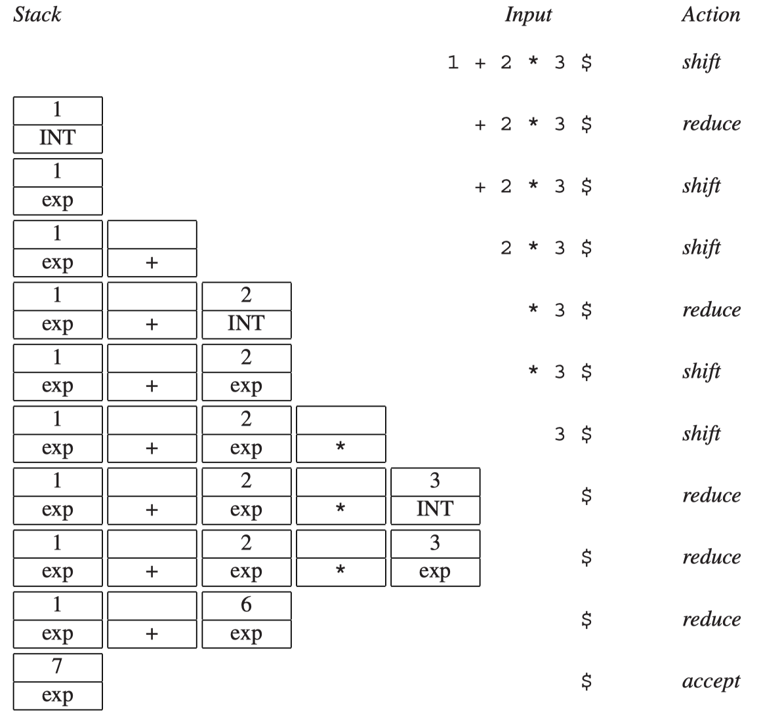
Semantic Actions in Yacc-Generated Parsers
$$ = $1 + $3
val = 1 + 6
pop
<exp2, 6>
<+, NULL>
<exp1, 1>
push
<exp, val>

Slide 13
Semantic Actions
Each terminal and nonterminal may be associated with its own type of semantic value.
A -> B C D
The semantic action must return a value whose type is the one associated with the nonterminal A.
It can build this value from the values associated with the matched terminals and nonterminals B, C, D.
An LR parser does perform reductions, and associated semantic actions, in a deterministic and predictable order: a bottom-up, left-to-right traversal of the parse tree.
the (virtual) parse tree is traversed in postorder
E
T
E
T
T
int
*
int
+
int

Slide 14
4.2 Abstract Parse Trees
It is possible to write an entire compiler that ﬁts within the semantic action phrases of a Yacc parser.
difficult to read and maintain
must analyze the program in exactly the order it is parsed
void foo() { bar(); }
void bar() { ... }
Idea: separate issues of syntax (parsing) from issues of semantics (type-checking and translation to machine code).
One solution: the parser produces a parse tree that later phases can traverse.
Yacc error: unknown function bar()

Slide 15
Parse Tree
Technically, a parse tree has exactly one leaf for each token of the input and one internal node for each grammar rule reduced during the parsing procedure.
Such a parse is called a concrete parse tree, representing the concrete syntax of the source language.
E -> E + T
| T
T -> T * F
| F
F -> n | ( E )
E
E
+
T
A concrete parse tree is inconvenient to use directly:
redundant and useless tokens for later phases
e.g., (, )
memory usage depends too much on the grammar
The grammar changes -> parse tree changes
F
T
F
(
E
)
2
E
+
E
T
T
F
F
3
4

Slide 16
Abstract Syntax Tree
An abstract syntax makes a clean interface between the parser and the later phases of a compiler.
The abstract syntax is not meant for parsing.
The parser uses the concrete syntax to build a parse tree for the abstract syntax —— abstract syntax tree
E -> E + T
| T
T -> T * F
| F
F -> n | ( E )
+
E -> n
| E + E
| E * E
2
*
3
4
Concrete Syntax
Abstract Syntax
Abstract Syntax Tree
The abstract syntax tree conveys the phrase structure of the source program, with all parsing issues resolved but without any semantic interpretation.

Slide 17
Abstract Syntax Tree
To use abstract syntax tree in later phases, the compiler will need to represent and manipulate abstract syntax trees as data structures. How?
A typedef for each nonterminal, a union-variant for each production.
typedef struct A_exp_ *A_exp;
struct A_exp_ {
enum {A_numExp, A_plusExp, A_timesExp} kind;
union {
int num;
struct {A_exp left; A_exp right;} plus;
struct {A_exp left; A_exp right;} times;
} u;
};
A_exp A_NumExp(int num);
A_exp A_PlusExp(A_exp left, A_exp right);
A_exp A_TimesExp(A_exp left, A_exp right);
E -> n
| E + E
| E * E

Slide 18
Abstract Syntax Tree
To use abstract syntax tree in later phases, the compiler will need to represent and manipulate abstract syntax trees as data structures. How?
A typedef for each nonterminal, a union-variant for each production.
A_exp A_PlusExp(A_exp left, A_exp right) {
A_exp e = checked_malloc(sizeof(*e));
e->kind = A_plusExp;
e->u.plus.left = left;
e->u.plus.right = right;
return e;
}

Slide 19
Abstract Syntax Tree
Construct the abstract syntax tree of 2 + 3 * 4 using these data structures and the concrete syntax:
PlusExp
left
right
e1 = A_NumExp(2);
e2 = A_NumExp(3);
e3 = A_NumExp(4);
e4 = A_TimesExp(e2,e3);
e5 = A_PlusExp(e1,e4);
NumExp
num = 2
TimeExp
left
right
NumExp
3
NumExp
4

Slide 20
Abstract Syntax Tree
Can we construct abstract syntax trees automatically?
The Yacc (or recursive-descent) parser, parsing the concrete syntax, constructs the abstract syntax tree.
How?
%left PLUS
%left TIMES
%%
exp : NUM {$$=A_NumExp($1);}
| exp PLUS exp {$$=A_PlusExp($1,$3);}
| exp TIMES exp {$$=A_TimesExp($1,$3);}

Slide 21
Positions
In a one-pass compiler, lexical analysis, parsing, and semantic analysis are all done simultaneously.
If there is a type error that must be reported to the user, the current position of the lexical analyzer is a reasonable approximation of the source position of the error.
In a one-pass compiler, the lexical analyzer keeps a “current position” global variable.
For a compiler that uses abstract-syntax-tree data structures:
It need not do all the parsing and semantic analysis in one pass
The lexer reaches the end of ﬁle before semantic analysis even begins.
How can we know the error position if there is a type error?

Slide 22
Positions
The source-ﬁle position of each node of the abstract syntax tree must be remembered.
How?
The abstract-syntax data structures must be sprinkled with pos ﬁelds, which indicate the position, within the original source ﬁle, of the characters from which these abstract syntax structures were derived.
2 + 3 * 4
e1 = A_NumExp(2, pos);
e2 = A_NumExp(3, pos);
e3 = A_NumExp(4, pos);
e4 = A_TimesExp(e2, e3, pos);
e5 = A_PlusExp(e1, e4, pos);
NumExp
3
(line 1, pos 3)
Notes:
这几页文字太多了，加了一个前文的例子

Slide 23
Positions
How to set the pos fields?
First, the lexer must pass the positions of the beginning and end of each token to the parser
Then, for parsers:
Ideally, the parser should maintain a position stack along with the semantic value stack, making the position of each symbol available for the semantic actions to use.
Bison can do this, Yacc does not

Slide 24
Positions
Yacc: one solution is to deﬁne a nonterminal symbol pos whose semantic value is a source location (line number, or line number and position within line).
e.g., access the position of the PLUS
%{ extern A_OpExp (A_exp,A_binop,A_exp,position); %}
%union { int num; string id; position pos;….};
%type <pos> pos
exp: exp PLUS pos exp {$$= A_OpExp($1, A_plus, $4, $3); }
pos: { $$ = EM_tokpos; }
global variable in lexer

Slide 25
Homework
4.2

