Slide 1

编译原理
陈明帅
m.chen@zju.edu.cn
浙江大学 · 计算机科学与技术学院
Slides partially credited to Zhongxin Liu

Slide 2
Mid-Term Exam
期中考试安排（总成绩占比15%）：
时间：90分钟（4月29日6-8节）
地点：曹光彪大楼西楼-202
题型：判断题 + 选择题 + 简答题
形式：
半开卷（可携带一张带有notes等内容的A4纸）
自备稿纸，携带学生证
范围：
第1-5章（第1-3章为重点内容）
代码实现及Tiger语言细节不在此次考试范围内）

Slide 3
Activation Records
1
Introduction
2
3
4
5
6
Lexical Analysis
Parsing
Abstract Syntax
Semantic Analysis
Activation Records
9
8
7
Instruct. Selection
Blocks & Traces
Interm. Code
10
11
Liveness Analysis
Register Allocation
Fundamentals
13
18
Garbage Collection
Loop Optimizations
Advanced Topics

Slide 4
Storage Organization
From the perspective of the compiler writer, the executing target program runs in its own logical address space in which each program value has a location.
The run time representation of an object program consists of data and program areas.
A typical way of subdividing memory is:
Code: the executable target code
Static: the data objects of which the size can be known at compile time, e.g.,
global constants
data generated by compiler (for, e.g., GC)
Stack: data structures called activation records that get generated during procedure calls
Heap: data that is allocated and deallocated under program control
for C: malloc, free
Code
Low
Static
Heap
Free Memory
Stack
High

Slide 5
Activation Records
function f(x:int): int =
let var y :== x+x
in if y<10
then f(y)
else return y-1
end
There are recursive calls, many of these x’s exist simultaneously.
A new instantiation of x is created (and initialized by f’s caller) each time that f is called.
In many languages (including C, Pascal, Java, and Tiger), local variables are destroyed when a function returns.
How to hold local variables?
Function calls behave in last-in-first-out (LIFO) fashion
use a LIFO data structure – a stack

Slide 6
Activation Records
Procedure (i.e., function) calls and returns are usually managed by a run-time stack called control stack.
Each time a procedure is called, space for its local variables is pushed onto the stack.
When the procedure terminates, that space is popped off the stack.
Procedure calls are also called activations of procedures.
Each live activation has an activation record (sometimes called a frame) on the control stack.

Slide 7


Higher-Order Functions
Using stack: we assume local variables will not be used after f returns
In languages supporting both nested functions and function-valued variables, it may be necessary to keep local variables after a function has returned.
fun f(x) =
let fun g(y) = x+y
in g
end
val h = f(3)
val j = f(4)
val z = h(5)
val w = j(7)
A function: $σ ↦ 3 + σ$
A function: $σ ↦ 4 + σ$
Written in ML
The combination of nested functions and functions returned as results.
Local variables need lifetime longer than their enclosing function invocations.

Slide 8
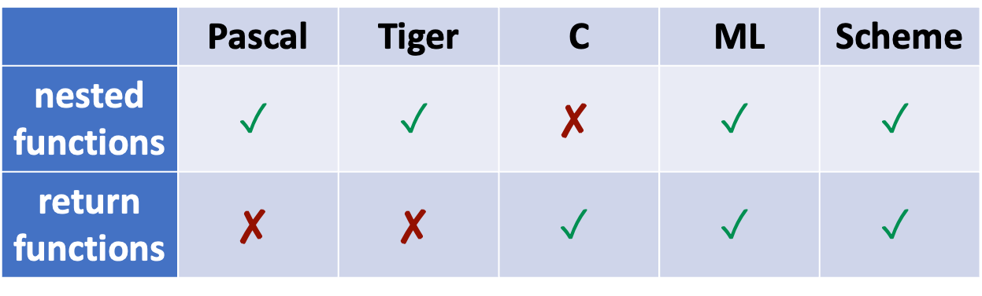
Higher-Order Functions
 | Pascal | Tiger | C | ML | Scheme
nested functions | $$✓$$ | $$✓$$ | $$✘$$ | $$✓$$ | $$✓$$
return functions | $$✘$$ | $$✘$$ | $$✓$$ | $$✓$$ | $$✓$$
can use stacks to hold
local variables
higher-order functions: cannot use stacks to hold all local variables
(cf. Chapter 15)

Slide 9
6.1 Stack Frame
Stack: push and pop, normally only stack top is accessible
However,
Local variables are pushed/popped in large batches
Local variables are not always initialized right after their creation
We want to continue accessing variables deep within the stack
So we treat the stack as a big array
Stack Pointer – a special register that points at some location
garbage (empty) | allocated
Low address
Stack Pointer
High address

Slide 10
6.1 Stack Frame
The stack usually grows only at the entry to a function, by an increment large enough to hold all the local variables for that function, and, just before the exit from the function, shrinks by the same amount.
A function’s activation record or stack frame: The area on the stack devoted to the local variables, parameters, return address, and other temporaries for this function.
Run-time stacks usually start at a high memory address and grow toward lower addresses.

Slide 11
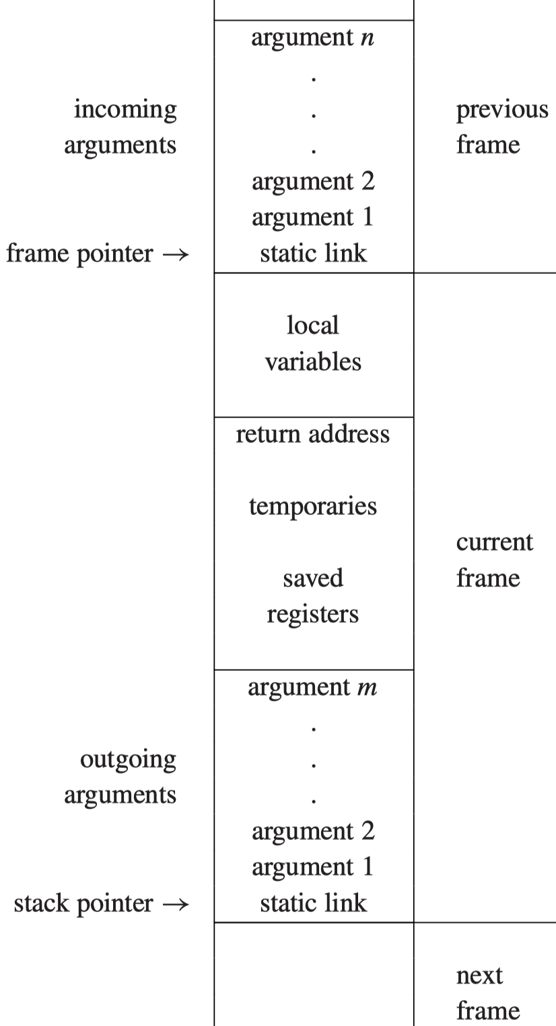
High
A Typical Stack Frame Layout
incoming arguments: passed by the caller
some local variables are in this frame, other local variables are kept in machine registers
the return address: where (within the calling function) control should return:
created by the CALL instruction
saved registers: make room for other uses of the registers
outgoing argument: pass parameters to other functions
static link
caller
callee
Low

Slide 12
High
Code
Low
Static
Heap
Free Memory
Stack
High
Low
Notes:
加了一个结构图，不然这个栈帧不知道在什么地方

Slide 13
Frame Pointer (FP)
Suppose function g(…) calls function f(a1,…, an)
g: caller
f: callee
When g calls f:
The stack pointer points to the first argument that g passes to f
f allocates a frame by simply subtracting the frame size from the stack pointer SP
FP
frame of g
SP
a2
a1
frame of f

Slide 14
Frame Pointer
When enter f:
save the old frame pointer FP in memory in the frame
FP = SP
SP = SP - # framesize
When f exists:
SP = FP
fetch back the saved old FP
FP
frame of g
FP
SP
a2
a1
frame of f
FP
SP
This arrangement is useful if f ’s frame size can vary, or if frames are not always contiguous on the stack.
If the frame size is fixed: FP = SP + #framesize
FP is a “fictional” register

Slide 16
Registers
Accessing registers is faster than accessing memory.
A modern machine has a large set of registers (typically 32). But many different procedures and functions need to use registers, there will be conflicts.
Suppose:
f is using register r to hold a local variable and calls procedure g.
g also uses r for its own calculations.
r must be saved (stored into a stack frame) before g uses it. and restored (fetched back from the frame) after g is finished using it.
r is a caller-save register if the caller (in this case, f) must save and restore it.
r is a callee-save register if it is the responsibility of the callee (in this case, g)
register allocator
(cf. Chapter 11)

Slide 18
Parameter Passing
It causes needless memory traffic and consumes more time if arguments are all passed only on the stack.
Parameter-passing conventions for modern machines specify:
the ﬁrst k arguments (for k = 4 or k = 6, typically) of a function are passed in registers r_{p}, …, r_{p+ k−1}, and the rest of the arguments are passed in memory (stack).
E.g., f(a₁, …, a_{n}) received parameters in r₁, …, r_{n} and calls h(z)
f must pass z in r_{1.}
f saves the old contents of r₁ in its stack frame before calling h
Such memory traffic was supposedly avoided by passing arguments in register.

Slide 19
Parameter Passing
How has the use of registers saved any time?
Leaf procedures need not write their incoming arguments to memory.
leaf procedures: the procedures that don’t call other procedures
Some optimizing compilers use interprocedural register allocation, analyzing all the functions in an entire program at once.
They assign different procedures different registers to receive parameters and hold local variables
Parameter x is a dead variable at the point where h(z) is called. Then f(x) can overwrite r₁ without saving it.
Some architectures have register windows, so that each function invocation can allocate a fresh set of registers without memory traffic.

Slide 21
Return Address
Suppose function g calls function f. When f returns, where to go back to?
If the call instruction within g is at address a, then (usually) the right place to return to is a + 1, the next instruction in g.
This is called the return address.
On modern machines, the call instruction merely puts the return address in a designated register.
For MIPS, this register is $ra
A non-leaf procedure will have to write it to the stack
unless interprocedural register allocation is used
A leaf procedure will not.

Slide 23
Frame-Resident Variables
Modern procedure-call convention will:
pass function parameters in registers
pass the return address in a register
return the function result in a register
Many of local variables and intermediate results will be allocated to registers
When to write values to memory (in the stack frame)?

Slide 24
Frame-Resident Variables
Values are written to memory (in the stack frame) only when necessary for one of these reasons:
the variable will be passed by reference, so it must have a memory address (e.g., & in the C language);
the variable is accessed by a procedure nested inside the current one;
the value is too big to ﬁt into a single register;
the variable is an array, for which address arithmetic is necessary to extract components;
the register holding the variable is needed for a speciﬁc purpose, such as parameter passing (as described above);
or there are so many local variables and temporary values that they won’t all ﬁt in registers, in which case some of them are “spilled” into the frame.

Slide 25
Frame-Resident Variables
A variable escapes if :
it is passed by reference,
its address is taken (using C’s & operator),
or it is accessed from a nested function
Escaping variables must be written to memory.

Slide 27
Static Links
Block Structure: In languages allowing nested function declarations (such as Pascal, ML, and Tiger), the inner functions may use variables declared in outer functions.

Slide 28
Static Links
type tree = {key: string, left: tree, right: tree}
function prettyprint(tree: tree) : string =
let
var output := “”
function write(s: string) =
output := concat(output,s)
function show(n:int, t: tree) =
let function indent(s: string) =
(for i := 1 to n
do write(“ ”));
output := concat(output, s);
write("\n"))
in if t=nil
then indent(".")
else (indent(t.key));
show(n+1, t.left);
show(n+1, t.right))
end
in show(0, tree); output
end
How to make this work?
write must have access to the frame of prettyprint;
indent must have access to the frames of show and prettyprint

Slide 29
Implementing Block Structures
How to implement block structures?
Whenever a function f is called, it can be passed a pointer to the frame of the function statically enclosing f ; this pointer is the static link.
A global array can be maintained, containing – in position i – a pointer to the frame of the most recently entered procedure whose static nesting depth is i. This array is called a display.
When g calls f, each variable of g that is actually accessed by f (or by any function nested inside f) is passed to f as an extra argument. This is called lambda lifting.

Slide 30
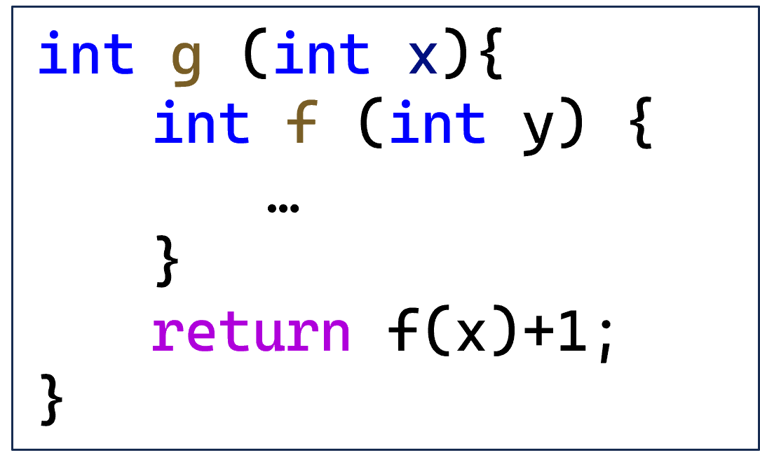
Static Links
Whenever a function f is called, it is passed a pointer to the stack frame of the “current” (most recently entered) activation of the function g that immediately encloses f in the text of the program.

Slide 31
Static Links
type tree = {key: string, left: tree, right: tree}
function prettyprint(tree: tree) : string =
let
var output := “”
function write(s: string) =
output := concat(output,s)
function show(n:int, t: tree) =
let function indent(s: string) =
(for i := 1 to n
do write(“ ”));
output := concat(output, s);
write("\n"))
in if t=nil
then indent(".")
else (indent(t.key));
show(n+1, t.left);
show(n+1, t.right))
end
in show(0, tree); output
end
passing pretryprint’s own frame pointer (FP) as show’s static link:
prettyprint is the immediate enclosing function of show
show’s static link = prettyprint’s FP

Slide 32
Static Links
type tree = {key: string, left: tree, right: tree}
function prettyprint(tree: tree) : string =
let
var output := “”
function write(s: string) =
output := concat(output,s)
function show(n:int, t: tree) =
let function indent(s: string) =
(for i := 1 to n
do write(“ ”));
output := concat(output, s);
write("\n"))
in if t=nil
then indent(".")
else (indent(t.key));
show(n+1, t.left);
show(n+1, t.right))
end
in show(0, tree); output
end
show stores its static link (the address of prettyprint’s FP)

Slide 33
Static Links
type tree = {key: string, left: tree, right: tree}
function prettyprint(tree: tree) : string =
let
var output := “”
function write(s: string) =
output := concat(output,s)
function show(n:int, t: tree) =
let function indent(s: string) =
(for i := 1 to n
do write(“ ”));
output := concat(output, s);
write("\n"))
in if t=nil
then indent(".")
else (indent(t.key));
show(n+1, t.left);
show(n+1, t.right))
end
in show(0, tree); output
end
show calls indent, passing its own FP as indent’s static link

Slide 34
Static Links
type tree = {key: string, left: tree, right: tree}
function prettyprint(tree: tree) : string =
let
var output := “”
function write(s: string) =
output := concat(output,s)
function show(n:int, t: tree) =
let function indent(s: string) =
(for i := 1 to n
do write(“ ”));
output := concat(output, s);
write("\n"))
in if t=nil
then indent(".")
else (indent(t.key));
show(n+1, t.left);
show(n+1, t.right))
end
in show(0, tree); output
end
show calls show, passing its own static link (not its own FP) as the static link

Slide 35
Static Links
type tree = {key: string, left: tree, right: tree}
function prettyprint(tree: tree) : string =
let
var output := “”
function write(s: string) =
output := concat(output,s)
function show(n:int, t: tree) =
let function indent(s: string) =
(for i := 1 to n
do write(“ ”));
output := concat(output, s);
write("\n"))
in if t=nil
then indent(".")
else (indent(t.key));
show(n+1, t.left);
show(n+1, t.right))
end
in show(0, tree); output
end
fetch n at an appropriate offset from indent’s static link (which points at the frame of show)

Slide 36
Static Links
type tree = {key: string, left: tree, right: tree}
function prettyprint(tree: tree) : string =
let
var output := “”
function write(s: string) =
output := concat(output,s)
function show(n:int, t: tree) =
let function indent(s: string) =
(for i := 1 to n
do write(“ ”));
output := concat(output, s);
write("\n"))
in if t=nil
then indent(".")
else (indent(t.key));
show(n+1, t.left);
show(n+1, t.right))
end
in show(0, tree); output
end
indent calls write. It must pass the FP of prettyprint as the static link. How?
indent’s static link (show’s FP) + offset = show’s static link = prettyprint’s FP

Slide 37
Static Links
type tree = {key: string, left: tree, right: tree}
function prettyprint(tree: tree) : string =
let
var output := “”
function write(s: string) =
output := concat(output,s)
function show(n:int, t: tree) =
let function indent(s: string) =
(for i := 1 to n
do write(“ ”));
output := concat(output, s);
write("\n"))
in if t=nil
then indent(".")
else (indent(t.key));
show(n+1, t.left);
show(n+1, t.right))
end
in show(0, tree); output
end
…
static link
…
…
static link
…
…
static link
…
pp’s
frame
show’s
frame
indent’s frame
How can indent use output from prettyprint’s frame?
It starts with its own static link, then fetches show’s, then fetches output.

Slide 38
Static Links
Nesting structure:
High
def pp: ##depth 0
…
def write: ##depth 1
def show: ##depth 1
…
def indent: ##depth 2
pp frame
pp calls show, need FP of pp, fetch chain length 0
show frame
show calls show in pp, need FP of pp, fetch chain length 1
show frame
indent frame
indent calls write in pp, need FP of pp, fetch chain length 2
On each procedure call or variable access, a chain of zero or more fetches is required;
The length of the chain is just the difference in static nesting depth between the two functions involved.
write frame
…
Write uses output in pp, fetch chain length 1
Low

Slide 39
6.2 Frames in The Tiger Compiler
The frame interface will look something like this:
/* frame.h */
typedef struct F_frame_ *F_frame;
typedef struct F_access_ *F_access;
typedef struct F_accessList_ *F_accessList;
struct F_accessList_ {F_access head; F_accessList tail;};
F_frame F_newFrame(Temp_label name, U_boolList formals);
Temp_label F_name(F_frame f);
F_accessList F_formals(F_frame f);
F_access F_allocLocal(F_frame f, bool escape);
The abstract interface frame.h is implemented by a module specific to the target machine. E.g., mipsframe.c
/* mipsframe.c */
#include "frame.h"
...

Slide 40
Frames in The Tiger Compiler
/* frame.h */
typedef struct F_frame_ *F_frame;
F_frame F_newFrame(Temp_label name, U_boolList formals);
Temp_label F_name(F_frame f);
The type F_frame holds information about formal parameters and local variables allocated in this frame.
U_boolList formals: which parameters escape
F_newFrame(g, U_BoolList(TRUE,
U_BoolList(FALSE,
U_BoolList(FALSE, NULL))))

Slide 41
Frames in The Tiger Compiler
/* frame.h */
typedef struct F_access_ *F_access;
The F_access type describes formals and locals that may be in the frame or in registers.
An abstract data type. The contents of struct F_access_ are visible only inside the Frame module:
e.g., InFrame(X), InReg(t₈₄)
/* mipsframe.c */
#include "frame.h"
struct F_access_ {
enum {inFrame, inReg} kind;
union {
int offset; /* InFrame */
Temp_temp reg; /* InReg */
} u;
};
static F_access InFrame(int offset);
static F_access InReg(Temp_temp reg);

Slide 42
Frames in The Tiger Compiler
/* frame.h */
F_accessList F_formals(F_frame f);
The F_formals interface function extracts a list of k “accesses” denoting the locations where the formal parameters will be kept at run time, as seen from inside the callee.
Parameters may be seen differently by the caller and the callee.
parameters are passed on the stack
caller: offset from the stack pointer
callee: offset from the frame pointer
parameters are passes through registers, e.g.,
caller: register 6
callee: register 13
“Shift of View”

Slide 43
Frames in The Tiger Compiler
This “shift of view” depends on the calling conventions of the target machine.
it must be handled by the Frame module, starting with newFrame.
For each formal parameter, newFrame must calculate two things:
How the parameter will be seen from inside the function (in a register, or in a frame location);
What instructions must be produced to implement the “view shift.”

Slide 44
Representation of Frame Descriptions
The implementation module Frame is supposed to keep the representation of the F_frame type secret from any clients of the Frame module.
F_frame is a data structure holding:
The locations of all the formals,
Instructions required to implement the “view shift,”
The number of locals allocated so far,
The label at which the function’s machine code is to begin

Slide 45
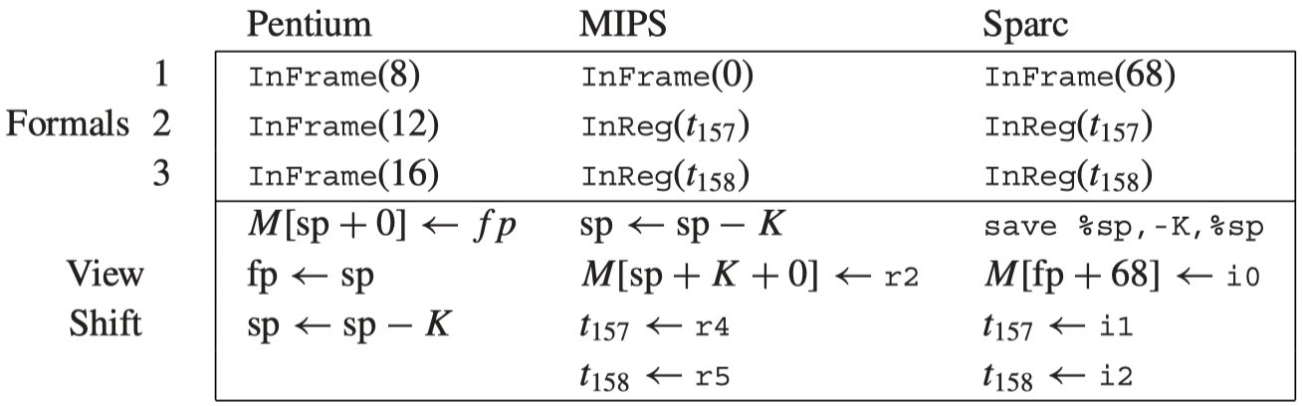
Representation of Frame Descriptions
Suppose function g has three parameters where the first parameter escapes
Why move r4 and r5 to t₁₅₇ and t₁₅₈?
function m(x:int, y:int) = (h(y,y); h(x,x))

Slide 46
Local Variables
Some local variables are kept in the frame; others are kept in registers.
To allocate a new local variable, the semantic analysis phase calls
If escape = True, F_allocLocal returns an InFrame access
If escape = False, F_allocLocal can return an InReg access
When to call F_allocLocal?
F_access F_allocLocal(F_frame f, bool escape);

Slide 47
Local Variables
function f() =
let var v := 6
in (print(v);
let var v := 7
in print(v)
end;
print(v);
let var v := 8
in print(v)
end;
print(v))
end
void f() {
int v = 6;
print(v);
{int v = 7;
print(v);}
print(v);
{int v = 8;
print(v);}
print(v);
}
Three different variables
Variable-declaration blocks nested inside the body of a function.
What is the result?
As each variable declaration is encountered during processing, allocLocal will be called to allocate a temporary or new space in the frame, associated with the name v.
As each end (or closing brace) is encountered, the association with v will be forgotten–but the space is still reserved in the frame.
A distinct temporary or frame slot for every variable declared within the entire function

Slide 48
Local Variables
function f() =
let var v := 6
in (print(v);
let var v := 7
in print(v)
end;
print(v);
let var v := 8
in print(v)
end;
print(v))
end
void f() {
int v = 6;
print(v);
{int v = 7;
print(v);}
print(v);
{int v = 8;
print(v);}
print(v);
}
Three different variables
Variable-declaration blocks nested inside the body of a function.
print 6 7 6 8 6
The register allocator will use as few registers as possible to represent the temporaries.
The second and third v variables could be held in the same temporary
A clever compiler might also notice two frame-resident variables could be allocated to the same slot.

Slide 49
Calculating Escapes
When calling allocLocal, it is important to know whether the variable escapes or not.
A findEscape function can look for escaping variables and record this information in the escape ﬁelds of the abstract syntax. (Remember what is escape variable?)
How to implement findEscape?
Traverse the entire abstract syntax tree, looking for escaping uses of every variable.
Use environments to record whether the particular variable escapes.
/* escape.h */
void Esc_findEscape(A_exp exp); /* escape.c */
static void traverseExp(S_table env, int depth, A_exp e);
static void traverseDec(S_table env, int depth, A_dec d);
static void traverseVar(S_table env, int depth, A_var v);

Slide 50
Calculating Escapes
For example
Whenever a variable or formal-parameter declaration x is found at static function-nesting depth d, e.g.,:
enter <a, EscapeEntry(d, &(x->u.var.escape))> into the environment
whenever a is used at depth > d, set x->u.var.escape = True
Other situations (variable addresses are taken explicitly or there are call-by-reference parameters) are similar.
x = A_VarDec(pos, symbol(“a”), typ, init, escape)

Slide 51
Temporaries and Labels
The compiler’s semantic analysis phase will want to choose registers for parameters and local variables, and choose machine-code addresses for procedure bodies.
But it is too early to determine them exactly.
Temporary: a value that is temporarily held in a register
Label: some machine-language location whose exact address is yet to be determined

Slide 52
Temporaries and Labels
Temps: abstract names for local variables
Labels: abstract names for static memory addresses
/* temp.h */
typedef struct Temp_temp_ *Temp_temp;
Temp_temp Temp_newtemp(void);
typedef S_symbol Temp_label;
Temp_label Temp_newlabel(void);
Temp_label Temp_namedlabel(string name);
string Temp_labelstring(Temp_label s);
typedef struct Temp_tempList_ *Temp_tempList;
struct Temp_tempList_ {Temp_temp head; Temp_tempList tail;}
Temp_tempList Temp_TempList(Temp_temp head, Temp_tempList tail);
typedef struct Temp_labelList_ *Temp_labelList;
struct Temp_labelList_{Temp_label head; Temp_labelList tail;}
Temp_labelList Temp_LabelList(Temp_label head, Temp_labelList tail);

Slide 53
Temporaries and Labels
Temps: abstract names for local variables
Labels: abstract names for static memory addresses
/* temp.h */
typedef struct Temp_temp_ *Temp_temp;
Temp_temp Temp_newtemp(void);
typedef S_symbol Temp_label;
Temp_label Temp_newlabel(void);
Temp_label Temp_namedlabel(string name);
string Temp_labelstring(Temp_label s);
typedef struct Temp_tempList_ *Temp_tempList;
struct Temp_tempList_ {Temp_temp head; Temp_tempList tail;}
Temp_tempList Temp_TempList(Temp_temp head, Temp_tempList tail);
typedef struct Temp_labelList_ *Temp_labelList;
struct Temp_labelList_{Temp_label head; Temp_labelList tail;}
Temp_labelList Temp_LabelList(Temp_label head, Temp_labelList tail);

Slide 54
Temporaries and Labels
Temps: abstract names for local variables
Labels: abstract names for static memory addresses
/* temp.h */
typedef struct Temp_temp_ *Temp_temp;
Temp_temp Temp_newtemp(void);
typedef S_symbol Temp_label;
Temp_label Temp_newlabel(void);
Temp_label Temp_namedlabel(string name);
string Temp_labelstring(Temp_label s);
typedef struct Temp_tempList_ *Temp_tempList;
struct Temp_tempList_ {Temp_temp head; Temp_tempList tail;}
Temp_tempList Temp_TempList(Temp_temp head, Temp_tempList tail);
typedef struct Temp_labelList_ *Temp_labelList;
struct Temp_labelList_{Temp_label head; Temp_labelList tail;}
Temp_labelList Temp_LabelList(Temp_label head, Temp_labelList tail);
There could be different functions with the same name in different scopes

Slide 55
Temporaries and Labels
Temps: abstract names for local variables
Labels: abstract names for static memory addresses
/* temp.h */
typedef struct Temp_temp_ *Temp_temp;
Temp_temp Temp_newtemp(void);
typedef S_symbol Temp_label;
Temp_label Temp_newlabel(void);
Temp_label Temp_namedlabel(string name);
string Temp_labelstring(Temp_label s);
typedef struct Temp_tempList_ *Temp_tempList;
struct Temp_tempList_ {Temp_temp head; Temp_tempList tail;}
Temp_tempList Temp_TempList(Temp_temp head, Temp_tempList tail);
typedef struct Temp_labelList_ *Temp_labelList;
struct Temp_labelList_{Temp_label head; Temp_labelList tail;}
Temp_labelList Temp_LabelList(Temp_label head, Temp_labelList tail);

Slide 56
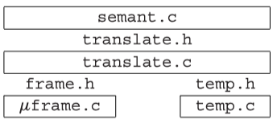
Two Layers of Abstraction
The frame.h and temp.h interfaces provide machine-independent views of memory-resident and register-resident variables.
We need not care where variables are exactly stored.
The Translate module augments this by handling the notion of nested scopes (via static links), providing the interface translate.h to the Semant module.

Slide 57
Two Layers of Abstraction
/* translate.h */
typedef struct Tr_access_ *Tr_access;
typedef ... Tr_accessList ...
Tr_accessList Tr_AccessList(Tr_access head, Tr_accessList tail);
Tr_level Tr_outermost(void);
Tr_level Tr_newLevel(Tr_level parent, Temp_label name,
U_boolList formals);
Tr_accessList Tr_formals(Tr_level level);
Tr_access Tr_allocLocal(Tr_level level, bool escape);
The goal: handling nesting scopes
Why do we need to handle nesting scopes?

Slide 58
Two Layers of Abstraction
type tree = {key: string, left: tree, right: tree}
function prettyprint(tree: tree) : string =
let
var output := “”
function write(s: string) =
output := concat(output,s)
function show(n:int, t: tree) =
let function indent(s: string) =
(for i := 1 to n
do write(“ ”));
output := concat(output, s);
write("\n"))
in if t=nil
then indent(".")
else (indent(t.key));
show(n+1, t.left);
show(n+1, t.right))
end
in show(0, tree); output
end
frame of f1
frame of f2
frame of f3
frame of indent

Slide 59
Two Layers of Abstraction
/* translate.h */
typedef struct Tr_access_ *Tr_access;
typedef ... Tr_accessList ...
Tr_accessList Tr_AccessList(Tr_access head, Tr_accessList tail);
Tr_level Tr_outermost(void);
Tr_level Tr_newLevel(Tr_level parent, Temp_label name,
U_boolList formals);
Tr_accessList Tr_formals(Tr_level level);
Tr_access Tr_allocLocal(Tr_level level, bool escape);
The goal: handling nesting scopes
Why do we need to handle nesting scopes?
for implementing block structure
for calculating escaping variables
How to achieve this goal?
create nesting levels
associate a nesting level to each function and each variable

Slide 60
Two Layers of Abstraction
/* translate.h */
...
Tr_level Tr_newLevel(Tr_level parent, Temp_label name, U_boolList formals);
...
Tr_access Tr_allocLocal(Tr_level level, bool escape);
When and how to create nesting levels?
transDec creates a new “nesting level” for each function by calling Tr_newLevel
How to associate a nesting level to each function?
keep the nesting level of each function in its FunEntry (stored in the environment)
How to associate a nesting level to each variable?
When Semant processes a local variable declaration at level lev, it calls Tr_allocLocal(lev,esc) to create the variable in this level
Semant records Tr_access in each VarEntry in the value env

Slide 61
Two Layers of Abstraction
/* new versions of VarEntry and FunEntry */
struct E_enventry_ {
enum {E_varEntry, E_funEntry} kind;
union {
struct {Tr_access access; Ty_ty ty;} var;
struct {Tr_level level; Temp_label label;
Ty_tyList formals; Ty_ty result;} fun;
} u;
};
E_enventry E_VarEntry(Tr_access access, Ty_ty ty);
E_enventry E_FunEntry(Tr_level level, Temp_label label,
Ty_tyList formals, Ty_ty result);
/* inside translate.c */
struct Tr_access_ {Tr_level level; F_access access;};

Slide 62
Managing Static Links
We use the Translate module to manage static links.
Why not use the Frame module to manage them?
Frame should be independent of the specific source language being compiled
Many source languages do not have nested function declarations.
Translate knows that each frame contains a static link. The static link is passed to a function in a register and stored into the frame.
just like a parameter
We will treat the static link as a parameter (as much as possible)

Slide 63
Managing Static Links
/* translate.h */
typedef struct Tr_access_ *Tr_access;
typedef ... Tr_accessList ...
Tr_accessList Tr_AccessList(Tr_access head, Tr_accessList tail);
...
Tr_accessList Tr_formals(Tr_level level);
...
When Semant calls Tr_formals(level), it will get the access values of the original parameters.

Slide 64
Keeping Track of Levels
/* translate.h */
typedef struct Tr_access_ *Tr_access;
typedef ... Tr_accessList ...
Tr_accessList Tr_AccessList(Tr_access head, Tr_accessList tail);
Tr_level Tr_outermost(void);
Tr_level Tr_newLevel(Tr_level parent, Temp_label name,
U_boolList formals);
Tr_accessList Tr_formals(Tr_level level);
Tr_access Tr_allocLocal(Tr_level level, bool escape);
Tr_outermost: returns the outermost level
The level within which the Tiger main program is nested
All “library” functions are declared at this outermost level, which does not contain a frame or formal parameter list.

Slide 65
Homework
6.3, 6.7(a,b)

