Slide 1

编译原理
陈明帅
m.chen@zju.edu.cn
浙江大学 · 计算机科学与技术学院

Slide 2
Overview
1
Introduction
2
3
4
5
6
Lexical Analysis
Parsing
Abstract Syntax
Semantic Analysis
Activation Records
9
8
7
Instruct. Selection
Blocks & Traces
Interm. Code
10
11
Liveness Analysis
Register Allocation
Fundamentals
13
18
Garbage Collection
Loop Optimizations
Advanced Topics

Slide 3








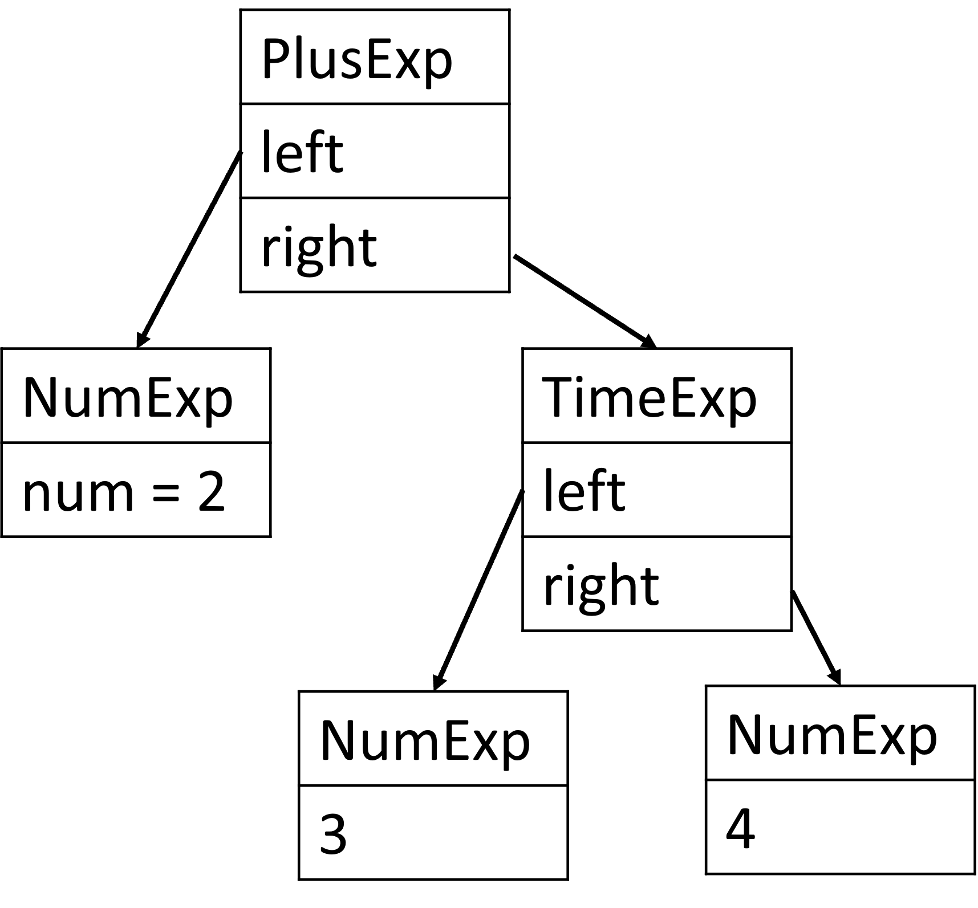
Overview
前端
后端
词法分析
语 语
法 义
分 分
析 析
前端
指令选择
寄存器分配
指令调度
中间代码生成
机器无关代码优化
程序员编写的源程序
机器硬件上运行的目标代码
中端
后端
read x
t1=x>0
if_false t1 goto L1
fact=1
…
abstract syntax
IR generator
IR code

Slide 4
What is Intermediate Representation?
An intermediate representation (IR) is a kind of abstract machine language:
It expresses the target-machine operations without committing to too much machine-specific details
It is independent of the details of the source language
Many different kinds of IR are used in compilers:
Three-Address Code (TAC)
Static Single-Assignment (SSA)
Control Flow Graph (CFG)
Abstract Syntax Tree (AST)
Expression Trees (IR Tree, used by Tiger Compiler)

Slide 5
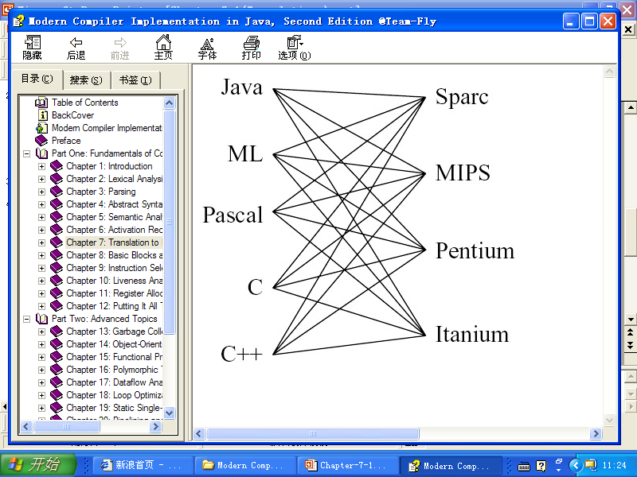
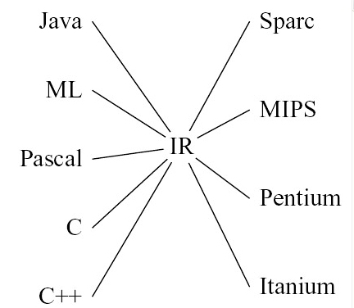
Motivation
Why do we need an IR?
Translating directly to real machine code?
hinders modularity
hinders portability
N * M
N + M

Slide 6
Outline
Three-Address Code
Intermediate Representation Tree
Translation into IR Trees
Expressions
Simple Variables
Array Variables
Structured L-Values
Subscripting and Field Selection
Arithmetic
Conditionals
While Loops
For Loops
Function Call
Translation of Declarations
Variable Definition
Function Definition

Slide 7
Outline
Three-Address Code
Intermediate Representation Tree
Translation into IR Trees
Expressions
Simple Variables
Array Variables
Structured L-Values
Subscripting and Field Selection
Arithmetic
Conditionals
While Loops
For Loops
Function Call
Translation of Declarations
Variable Definition
Function Definition

Slide 8
Three-Address Code
What is three-address code (TAC)?
TAC refers to the encoding method that only uses a maximum of 3 operand addresses in each instruction

Slide 9
Three-Address Code
The most basic instruction of three address code:
x = y op z
t1 = 2 * a
2*a + (b-3) t2 = b - 3
t3 = t1 + t2
It is necessary to vary the form of three-address code for different constructs in a programming language, e.g.,
t2 = - t1
No standard form for three-address code exists:
One of the reasons: new forms need to be invented to express unusual features in a language
temporary operands

Slide 10
Three Address Code - Example
High-level language
Three-address code
read x
if 0 < x then
fact:=1;
repeat
fact:=fact*x;
x:=x-1
until x=0;
write fact
end
read x
t1=x>0
if_false t1 goto L1
fact=1
label L2
t2 = fact * x
fact = t2
t3 = x - 1
x = t3
t4= x == 0
if_false t4 goto L2
write fact
label L1
halt

Slide 11
Three Address Code - Example
High-level language
Three-address code
read x
if 0 < x then
fact:=1;
repeat
fact:=fact*x;
x:=x-1
until x=0;
write fact
end
read x
t1=x>0
if_false t1 goto L1
fact=1
label L2
t2 = fact * x
fact = t2
t3 = x - 1
x = t3
t4= x == 0
if_false t4 goto L2
write fact
label L1
halt

Slide 12
Three Address Code - Example
High-level language
Three-address code
read x
if 0 < x then
fact:=1;
repeat
fact:=fact*x;
x:=x-1
until x=0;
write fact
end
read x
t1=x>0
if_false t1 goto L1
fact=1
label L2
t2 = fact * x
fact = t2
t3 = x - 1
x = t3
t4= x == 0
if_false t4 goto L2
write fact
label L1
halt

Slide 13
Three Address Code - Example
High-level language
Three-address code
read x
if 0 < x then
fact:=1;
repeat
fact:=fact*x;
x:=x-1
until x=0;
write fact
end
read x
t1=x>0
if_false t1 goto L1
fact=1
label L2
t2 = fact * x
fact = t2
t3 = x - 1
x = t3
t4= x == 0
if_false t4 goto L2
write fact
label L1
halt

Slide 14
Three Address Code - Example
High-level language
Three-address code
read x
if 0 < x then
fact:=1;
repeat
fact:=fact*x;
x:=x-1
until x=0;
write fact
end
read x
t1=x>0
if_false t1 goto L1
fact=1
label L2
t2 = fact * x
fact = t2
t3 = x - 1
x = t3
t4= x == 0
if_false t4 goto L2
write fact
label L1
halt
Easier to construct from AST (need no context);
Can be optimized later

Slide 15
Three-Address Code - Implementation
The entire sequence of three-address instructions is implemented as an array or linked list
The most common implementation is to implement three-address code as quadruples:
one field for the operation
three fields for the addresses
For those instructions that need fewer than three addresses, some of the address fields is given a null or “empty” value.
Other implementation: triples, indirect triples.
t1=x>0
if_false t1 goto L1
fact=1
label L2
(gt, x, 0, t1)
(if_f, t1, L1, _)
(asn, 1, fact, _)
(lab, L2, _, _)

Slide 16
Outline
Three-Address Code
Intermediate Representation Tree
Translation into IR Trees
Expressions
Simple Variables
Array Variables
Structured L-Values
Subscripting and Field Selection
Arithmetic
Conditionals
While Loops
For Loops
Function Call
Translation of Declarations
Variable Definition
Function Definition

Slide 17
Intermediate Representation Trees
A good IR has several qualities:
Convenient for the semantic analysis phase to produce
Convenient to translate into all targeted machine language
Each construct must have a clear and simple meaning
So that IR optimizing transformations can easily be specified and implemented
AST
IR
Assem (x86)

Slide 18


Intermediate Representation Trees
Abstract syntax may have instructions with complex effects (CE), the same is true for machine language
But their effects are not well corresponded
CE
procedure
calls
tensor
inst.
CE
array
subscripts
vector
operation
AST
IR
Assem

Slide 19

Intermediate Representation Trees
Abstract syntax may have instructions with complex effects (CE), the same is true for machine language
But their effects are not well corresponded
IR should be simple enough to split up complex instructions of an abstract syntax and then be combined up to form true machine instructions
CE
procedure
calls
tensor
inst.
CE
add
array
subscripts
vector
operation
fetch
move
store
jump
AST
IR
Assem

Slide 20
Intermediate Representation Trees
The expressions (T_exp):
CONST(i) | The integer constant i.
NAME(n) | The symbolic constant n (assembly language label).
TEMP(t) | Temporary t (similar to a register in a real machine).
BINOP(o, e1, e2) | The application of binary operator o to operands e1, e2. The integer arithmetic operators: PLUS, MINUS, MUL, DIV; the integer bitwise logical operators: AND, OR, XOR; the integer logical shift operators: LSHIFT, RSHIFT; the integer arithmetic right-shift: ARSHIFT.
MEM(e) | The contents of wordSize bytes of memory starting at address e. When MEM is used as the left child of a MOVE, it means "store", but anywhere else it means "fetch".
CALL(f, l) | A procedure call: the application of function f to argument list l. Evaluate from left to right.
ESEQ(s, e) | The statement s is evaluated for side effects, then e is evaluated for a result.

Slide 21
Intermediate Representation Trees
The expressions (T_exp):
independent of Tiger, or any other source languages
CONST(i) | The integer constant i.
NAME(n) | The symbolic constant n (assembly language label).
TEMP(t) | Temporary t (similar to a register in a real machine).
BINOP(o, e1, e2) | The application of binary operator o to operands e1, e2. The integer arithmetic operators: PLUS, MINUS, MUL, DIV; the integer bitwise logical operators: AND, OR, XOR; the integer logical shift operators: LSHIFT, RSHIFT; the integer arithmetic right-shift: ARSHIFT.
MEM(e) | The contents of wordSize bytes of memory starting at address e. When MEM is used as the left child of a MOVE, it means "store", but anywhere else it means "fetch".
CALL(f, l) | A procedure call: the application of function f to argument list l. Evaluate from left to right.
ESEQ(s, e) | The statement s is evaluated for side effects, then e is evaluated for a result.

Slide 22
Intermediate Representation Trees
The expressions (T_exp):
every expression has a return value; may induce side effects
CONST(i) | The integer constant i.
NAME(n) | The symbolic constant n (assembly language label).
TEMP(t) | Temporary t (similar to a register in a real machine).
BINOP(o, e1, e2) | The application of binary operator o to operands e1, e2. The integer arithmetic operators: PLUS, MINUS, MUL, DIV; the integer bitwise logical operators: AND, OR, XOR; the integer logical shift operators: LSHIFT, RSHIFT; the integer arithmetic right-shift: ARSHIFT.
MEM(e) | The contents of wordSize bytes of memory starting at address e. When MEM is used as the left child of a MOVE, it means "store", but anywhere else it means "fetch".
CALL(f, l) | A procedure call: the application of function f to argument list l. Evaluate from left to right.
ESEQ(s, e) | The statement s is evaluated for side effects, then e is evaluated for a result.

Slide 23
Intermediate Representation Trees
perform side effects and control flow; no return value
The statements (T_stm):
MOVE(TEMP t, e) | Evaluate e and move it into temporary t.
MOVE(MEM(e₁), e₂) | Evaluate e₁, yielding address a. Then evaluate e₂, and store the result into wordSize bytes of memory starting at a.
EXP(e) | Evaluate e and discard the result (perform side effects only).
JUMP(e, labs) | Transfer control (jump) to address e; The destination e may be a literal label, as in NAME(lab), or an address returned by any other kind of expression. labs specifies all possible locations that e can evaluate to (for dataflow analysis).
CJUMP(o, e₁, e₂, t, f) | Evaluate e₁, e₂ in that order, yielding values a, b. Then compare a, b using the relational operator o. If the result is true, jump to t; otherwise jump to f.
SEQ(s₁, s₂) | The statement s₁ followed by s₂.
LABEL(n) | Define the constant value of name n to be the current machine code address.

Slide 24
Outline
Three-Address Code
Intermediate Representation Tree
Translation into IR Trees
Expressions
Simple Variables
Array Variables
Structured L-Values
Subscripting and Field Selection
Arithmetic
Conditionals
While Loops
For Loops
Function Call
Translation of Declarations
Variable Definition
Function Definition

Slide 25
Translation into Trees
Abstract Syntax Expression
Intermediate Trees

Slide 26
Outline
Three-Address Code
Intermediate Representation Tree
Translation into IR Trees
Expressions
Simple Variables
Array Variables
Structured L-Values
Subscripting and Field Selection
Arithmetic
Conditionals
While Loops
For Loops
Function Call
Translation of Declarations
Variable Definition
Function Definition

Slide 27
Kinds of Expressions
What should the representation of an AST expression A_exp be in the language?
Expressions with return values:
Ex (suitable for T_exp instructions)
Expressions that return no value (such as some procedure calls, or while expressions)
Nx (suitable for T_stm instructions)
Expressions with Boolean values, such as a > b
a conditional jump (Cx)
a combination of T_stm inst. and a pair of destinations
represented by labels ()
Tr_Cx (patchList trues, patchList falses, T_stm stm);

Slide 28
Kinds of Expressions
CJUMP(>, a, b, ?, z)
LABEL (z)
CJUMP(<, c, d, ?, ?)
a>b | c<d
SEQ
CJUMP
SEQ
GT
a
b
NULL_{t}
z
LABEL
CJUMP
z
LT
c
d
NULL_{t}
NULL_{f}

Slide 29
Kinds of Expressions
We won’t know the true-destination and false-destination until much later.
We make a list of places which are now filled in with NULL and need to be filled in with t when t is known, and another list of all the places that need to be filled in with f:
trues: {0,3} -> {1,1,3}
falses: {1,1,4}
SEQ
0
1
patch lists
CJUMP
SEQ
3
1
GT
a
b
NULL_{t}
z
LABEL
CJUMP
3
4
z
LT
c
d
NULL_{t}
NULL_{f}

Slide 30
Kinds of Expressions
Sometimes we need to convert an expression of one kind to an equivalent expression of another kind.
Tiger statement: flag := (a>b | c<d)
requires the conversion of a Cx into an Ex
There are special methods to implement interconversions:
e.g., toEx(Cx) is implemented to convert Cx to Ex
For different kinds of output expressions, we use different conversion functions.
flag := (a>b | c<d)
e = Cx(trues, falses, stm)
MOVE (TEMP(flag), toEx(e))

Slide 31
Kinds of Expressions
How is toEx(Cx) implemented?
Use a temporary register:
if Cx
return 1
else
return 0
MOVE(TEMP r, 1)
Cx
LABEL(f)
MOVE(TEMP r, 0)
LABEL(t)
TEMP(r)

Slide 32
Kinds of Expressions
MOVE(TEMP r, 1)
CJUMP(GT, a, b, t, z)
LABEL(z)
CJUMP(LT, c, d, t, f)
LABEL(f)
MOVE(TEMP r, 0)
LABEL(t)
TEMP(r)
MOVE(TEMP r, 1)
e
LABEL(f)
MOVE(TEMP r, 0)
LABEL(t)
TEMP(r)
e = (a > b) | (c < d)

Slide 33
Outline
Three-Address Code
Intermediate Representation Tree
Translation into IR Trees
Expressions
Simple Variables
Array Variables
Structured L-Values
Subscripting and Field Selection
Arithmetic
Conditionals
While Loops
For Loops
Function Call
Translation of Declarations
Variable Definition
Function Definition

Slide 34
Simple Variables
How to translate a simple variable v declared in the current procedure’s stack frame:
k is the offset of v within the frame
TEMP fp: the frame-pointer register
For the Tiger compiler, all variables are the same size (integer/pointer) — the natural word size of the machine
MEM
BINOP
PLUS
TEMP fp
CONST k
MEM(BINOP(PLUS, TEMP fp, CONST k))

Slide 35
Simple Variables
To translate v, we need the frame pointer and the word size
Machine-dependent definitions
We add a frame-pointer register FP and a constant whose value is the machine’s natural word size into the Frame module.
/* frame.h */
......
Temp_temp F_FP(void);
extern const int F_wordSize;
T_exp F_Exp(F_access acc, T_exp framePtr);
An access a is InFrame(k): F_Exp(a, T_Temp(F_FP()) returns
An access a is InReg(t₈₃₂) simply returns
TEMP t₈₃₂
MEM(BINOP(PLUS,TEMP FP,CONST(k)))

Slide 36
Simple Variables
We will abbreviate BINOP(PLUS, e1, e2) as + (e1, e2)
MEM
MEM
BINOP
+
PLUS
TEMP fp
CONST k
TEMP fp
CONST k
MEM(BINOP(PLUS, TEMP fp, CONST k))
MEM(+(TEMP fp, CONST k))

Slide 37
Outline
Three-Address Code
Intermediate Representation Tree
Translation into IR Trees
Expressions
Simple Variables
Array Variables
Structured L-Values
Subscripting and Field Selection
Arithmetic
Conditionals
While Loops
For Loops
Function Call
Translation of Declarations
Variable Definition
Function Definition

Slide 38
Array Variables
Different programming languages treat array-valued variables differently.
In Pascal: An array variable stands for the contents of the array
The following snippet copies the contents (all 12 integers) of array a into array b
In C: arrays are like “pointer constants”
var a,b : array[1..12] of integer;
begin
b:=a
end.
{ int a[12], b[12];
b=a;
}
{ int a[12], *b;
b=a;
}
Illegal
legal
b points to the beginning of the array a

Slide 39
Array Variables
In Tiger (as in Java and ML), array variables behave as pointers
has no named array constants as in C
new array values are created (and initialized) by the construct
t_{a}[n] of i
t_{a} is the name of an array type
n is the number of elements
i is the initial value of each element
a
let
type intArray = array of int
var a := intArray[5] of 0
var b := intArray[5] of 7
in b := a
end
0 | 0 | 0 | 0 | 0
b
7 | 7 | 7 | 7 | 7

Slide 40
Array Variables
Tiger record values are also pointers.
Record assignment, like array assignment, is pointer assignment and does not copy all the ﬁelds.
In contrast to struct assignment in C, which copies all the fields of a struct.

Slide 41
Outline
Three-Address Code
Intermediate Representation Tree
Translation into IR Trees
Expressions
Simple Variables
Array Variables
Structured L-Values
Subscripting and Field Selection
Arithmetic
Conditionals
While Loops
For Loops
Function Call
Translation of Declarations
Variable Definition
Function Definition

Slide 42
L-Values
L-value: the result of an expression that can occur on the left of an assignment statement.
x, p.y, or a[i+2]
denotes a location that can be assigned to
can occur on the right of an assignment statement
R-value: the result of an expression that can only appear on the right of an assignment.
a + 3 or f(x)
does not denote an assignable location

Slide 43
Structured L-Values
An integer or pointer value is a “scalar”: it has only one component (thus requiring 1 word size space)
In Tiger:
All the variables and L-values are scalar
An array or record variable is really a pointer (a kind of scalar)
In C or Pascal, there are structured L-values – structs in C, arrays and records in Pascal – that are not scalar
To translate structured L-values to IR tree, update T_Mem:
T_exp T_Mem(T_exp, int size);
MEM(+(TEMP fp,CONST k_{n}), S)
S indicates the size of the object to be fetched or stored

Slide 44
Outline
Three-Address Code
Intermediate Representation Tree
Translation into IR Trees
Expressions
Simple Variables
Array Variables
Structured L-Values
Subscripting and Field Selection
Arithmetic
Conditionals
While Loops
For Loops
Function Call
Translation of Declarations
Variable Definition
Function Definition

Slide 45
Subscripting and Field Selection
To compute the address of a[i]:
(i − l) × s + a
l: the lower bound of the index range
s: the size (in bytes) of each array element
a: the base address of the array elements
If a is global, with a compile-time constant address, the subtraction a – l x s can be done at compile time.
Similarly, to calculate the address of the field f of a record a
= i x s – l x s + a
offset(f) + a

Slide 46
Subscripting and Field Selection
An array variable a is an L-value, so is an array subscript expression a[i].
To obtain the address of a[i], we need to do arithmetic on the address of a, e.g., (i − l) × s + a.
In a Pascal compiler,
If we translate the L-value a into something like the left IR tree, we can not do arithmetic on the address of a.
Therefore, we should translate the L-value a into the Tree expression representing its address, just like the right IR tree.
content of a is not an address in Pascal
MEM
the address of a is the base address
+
+
TEMP fp
CONST k
TEMP fp
CONST k

Slide 47
Subscripting and Field Selection
In a Pascal compiler, what could happen to this L-value a?
A particular element might be subscripted, yielding a (smaller) L-value, e.g., a[i]. A “+” node would add (i − l) × s to a.
The L-value (representing the entire array) might be used in a context where an R-value is required, e.g., b = a. Then the L-value is coerced into an R-value by applying the MEM operator to it.

Slide 48
Subscripting and Field Selection
In the Tiger language, all record and array values are really pointers to record and array structures.
The “base address” of the array is really the content of a pointer variable, so MEM is required.
IR tree of a[i] is
MEM
+
BINOP
MEM(e) represents a
W is the word size
MEM
MUL
i
CONST
e
W
MEM(+(MEM(e),BINOP(MUL, i, CONST W)))

Slide 49
Subscripting and Field Selection
Technically, an L-value should be represented as an address (without the top MEM node)
Converting an L-value to an R-value: fetching from that address
Assigning to an L-value: storing to that address
Recap: In the Tree IR, MEM means both store (when used as the left child of a MOVE) and fetch (when used elsewhere)

Slide 50
Outline
Three-Address Code
Intermediate Representation Tree
Translation into IR Trees
Expressions
Simple Variables
Array Variables
Structured L-Values
Subscripting and Field Selection
Arithmetic
Conditionals
While Loops
For Loops
Function Call
Translation of Declarations
Variable Definition
Function Definition

Slide 51
Arithmetic
Each integer arithmetic operator corresponds to a Tree operator
The Tree language has no unary arithmetic operators
Unary negation of integers: implemented as subtraction from zero; -n => 0 - n
Unary complement: implemented as XOR with all ones
Unary floating-point negation cannot be implemented as subtraction from zero.
Many floating-point representations allow a negative zero
The negation of negative zero is positive zero, and vice versa
The Tree language does not support unary negation very well

Slide 52
Outline
Three-Address Code
Intermediate Representation Tree
Translation into IR Trees
Expressions
Simple Variables
Array Variables
Structured L-Values
Subscripting and Field Selection
Arithmetic
Conditionals
While Loops
For Loops
Function Call
Translation of Declarations
Variable Definition
Function Definition

Slide 53
Conditionals
The result of a comparison operator will be a Cx expression
a statement (T_stm) s that will jump to any true-destination and false-destination
The whole point of the Cx representation is that conditional expressions can be combined easily with operators & and |
e.g., a > b | c < d
Therefore, an expression such as x < 5 will be translated as a Cx with:
stm = CJUMP (LT, x, CONST(5), NULL_{t}, NULL_{f})
trues = {t}
falses = {f}
x < 5 & y > 6 ?

Slide 54
Conditionals
How to handle if-expression?
if e₁ then e₂ else e₃
The most straightforward thing:
e1 : Cx expression;
e2 and e3 : Ex expressions
apply toCx to e1
apply toEx to e2 and e3
make two labels t and f for the conditional
allocate a temporary r
after label t, move e2 to r
after label f, move e3 to r
both branches finish by jumping to a newly created “join” label, then return r
toCx(e1)
LABEL t
r = toEx(e2)
JUMP join
LABEL f
r = toEx(e3)
JUMP join
…
LABEL join
TEMP r
…
pseudo-
code
Correct but not very efficient

Slide 55
Conditionals
If e2 and e3 are both “statements” (expressions that return no value), toEx will work, but it might be better to recognize this case specially.
If e2 or e3 is a Cx expression, toEx will yield a horrible tangle of jumps and labels.
Example: if x < 5 then a > b else 0
The naive way (treat as Ex):
CJUMP(<,x,5,t,f)
LABEL t
r = toEx(e2)
JUMP join
LABEL f
MOV(TEMP r, 0)
JUMP join
LABEL join
RET r
CJUMP(<,x,5,t,f)
LABEL t
MOVE(TEMP r, 1)
CJUMP(>,a,b,t1,f1)
LABEL(f1)
MOVE(TEMP r, 0)
LABEL(t1)
JUMP join
LABEL f
MOV(TEMP r, 0)
JUMP join
LABEL join
RET r
SEQ(S1(t, f), SEQ(LABEL t, SEQ(MOV(), SEQ(S2(t1,f1), SEQ(LABEL f1, SEQ(MOV(), SEQ(LABEL t1, SEQ(JUMP join, SEQ(……)))))))))
IR

Slide 56
Conditionals
If we recognize this case specially?
x < 5 translates into Cx(s1)
a > b will be translated as Cx(s2)
Similar to
if x < 5 & a > b then 1 else 0
SEQ
SEQ
CJUMP
LT
x
CONST
z
f
LABEL
CJUMP
z
GT
a
b
t
f
5
SEQ(S1(z,f), SEQ(LABEL Z, S2(t,f)))

Slide 57
Outline
Three-Address Code
Intermediate Representation Tree
Translation into IR Trees
Expressions
Simple Variables
Array Variables
Structured L-Values
Subscripting and Field Selection
Arithmetic
Conditionals
While Loops
For Loops
Function Call
Translation of Declarations
Variable Definition
Function Definition

Slide 58
While Loops
The general layout of a while loop is:
test:
if not(condition) goto done
body
goto test
done:
If a break statement occurs within the body (and not nested within any interior while statements), the translation is simply a JUMP to done
How to know the done label (in case of nested loops)?
Translation of break statements needs to have a new formal parameter break which is set to the done label of the nearest enclosing loop

Slide 59
Outline
Three-Address Code
Intermediate Representation Tree
Translation into IR Trees
Expressions
Simple Variables
Array Variables
Structured L-Values
Subscripting and Field Selection
Arithmetic
Conditionals
While Loops
For Loops
Function Call
Translation of Declarations
Variable Definition
Function Definition

Slide 60
For Loops
A straightforward approach to translate for statements
rewrite the abstract syntax into the abstract syntax of the let/while expression shown.
for i := lo to hi
do body
let var i := lo
var limit := hi
in while i <= limit
do (body; i := i+1)
end
if lo > hi goto done
i := lo
limit := hi
test:
body
if i >= limit goto done
i := i+1
goto test
done:
Problem:
when limit=maxint, i+1 will overflow
How to solve this problem?

Slide 61
Outline
Three-Address Code
Intermediate Representation Tree
Translation into IR Trees
Expressions
Simple Variables
Array Variables
Structured L-Values
Subscripting and Field Selection
Arithmetic
Conditionals
While Loops
For Loops
Function Call
Translation of Declarations
Variable Definition
Function Definition

Slide 62
Function Call
Translating a function call f(a₁,…,a_{n}) is simple, except that the static link must be added as an implicit* extra argument:
l_{f}: the label of f
sl: the static link
CALL(NAME l_{f}, [sl, e₁, e₂, …, e_{n}])
*implicit means normally we do not write it out as part of IR instructions

Slide 63
Outline
Three-Address Code
Intermediate Representation Tree
Translation into IR Trees
Expressions
Simple Variables
Array Variables
Structured L-Values
Subscripting and Field Selection
Arithmetic
Conditionals
While Loops
For Loops
Function Call
Translation of Declarations
Variable Definition
Function Definition

Slide 64
Declarations
For each variable declaration within a function body
additional space will be reserved in the frame
For each function declaration
a new “fragment” of Tree code will be kept for the function’s body

Slide 65
Variable Declarations
The transDec function updates the value environment and type environment for the body of a let expression.
The initialization of a variable translates into a Tree expression that must be put just before the body of the let.
transDec: translates initializations to assignment expressions.
If transDec is applied to function and type declarations, the result will be a “no-op” expression, such as Ex(CONST(0)).

Slide 66
Function Declarations
A function is translated into:
a prologue (入口处理代码), a body and an epilogue (出口处理代码)
A prologue contains:
pseudo-instructions to mark the beginning of a function (needed in the particular assembly language)
a label definition of the function name
an instruction to adjust the stack pointer (to allocate a new frame)
instructions to save “escaping” arguments (including the static link) into the frame, and to move non-escaping arguments into fresh temporary registers;
store instructions to save any callee-save registers (including the return address register) used within the function

Slide 67
Function Declarations
The body of a Tiger function is an expression
The translated expression
An epilogue contains:
an instruction to move the return value (result of the function) to the register
load instructions to restore the callee-save registers
an instruction to reset the stack pointer (to deallocate the frame)
a return instruction (JUMP to the return address)
pseudo-instructions, as needed, to announce the end of a function

Slide 68
Fragment
The Translate phase should produce a fragment for each function, which contains:
frame: The frame descriptor containing machine-specific information about local variables and parameters
body: The result returned from procEntryExit1

Slide 69
Fragment
/* frame.h */
...
typedef struct F_frag_ * F_frag;
struct F_frag_ {
enum {F_stringFrag, F_procFrag} kind;
union {
struct {Temp_label label; string str;} stringg;
struct {T_stm body; F_frame frame;} proc;
} u;
};
F_frag F_StringFrag(Temp_label label, string str);
F_frag F_ProcFrag(T_stm body, F_frame frame);
typedef struct F_fragList_ *F_fragList;
struct F_fragList_ {F_frag head; F_fragList tail;};
F_fragList F_FragList(F_frag head, F_fragList tail);
/* translate.h */
...
void Tr_procEntryExit(Tr_level level, Tr_exp body, Tr_accessList formals);
F_fragList Tr_getResult(void);
The frag datatype

Slide 70
Fragment
/* frame.h */
...
typedef struct F_frag_ * F_frag;
struct F_frag_ {
enum {F_stringFrag, F_procFrag} kind;
union {
struct {Temp_label label; string str;} stringg;
struct {T_stm body; F_frame frame;} proc;
} u;
};
F_frag F_StringFrag(Temp_label label, string str);
F_frag F_ProcFrag(T_stm body, F_frame frame);
typedef struct F_fragList_ *F_fragList;
struct F_fragList_ {F_frag head; F_fragList tail;};
F_fragList F_FragList(F_frag head, F_fragList tail);
/* translate.h */
...
void Tr_procEntryExit(Tr_level level, Tr_exp body, Tr_accessList formals);
F_fragList Tr_getResult(void);
The frag datatype

Slide 71
Fragment
/* frame.h */
...
typedef struct F_frag_ * F_frag;
struct F_frag_ {
enum {F_stringFrag, F_procFrag} kind;
union {
struct {Temp_label label; string str;} stringg;
struct {T_stm body; F_frame frame;} proc;
} u;
};
F_frag F_StringFrag(Temp_label label, string str);
F_frag F_ProcFrag(T_stm body, F_frame frame);
typedef struct F_fragList_ *F_fragList;
struct F_fragList_ {F_frag head; F_fragList tail;};
F_fragList F_FragList(F_frag head, F_fragList tail);
/* translate.h */
...
void Tr_procEntryExit(Tr_level level, Tr_exp body, Tr_accessList formals);
F_fragList Tr_getResult(void);
The frag datatype

Slide 72
Outline
Three-Address Code
Intermediate Representation Tree
Translation into IR Trees
Expressions
Simple Variables
Array Variables
Structured L-Values
Subscripting and Field Selection
Arithmetic
Conditionals
While Loops
For Loops
Function Call
Translation of Declarations
Variable Definition
Function Definition

Slide 73
Homework
7.2

