Slide 1

编译原理
陈明帅
m.chen@zju.edu.cn
浙江大学 · 计算机科学与技术学院

Slide 2
Overview
1
Introduction
2
3
4
5
6
Lexical Analysis
Parsing
Abstract Syntax
Semantic Analysis
Activation Records
9
8
7
Instruct. Selection
Blocks & Traces
Interm. Code
10
11
Liveness Analysis
Register Allocation
Fundamentals
13
18
Garbage Collection
Loop Optimizations
Advanced Topics

Slide 3








Overview
词法分析
语 语
法 义
分 分
析 析
前端
指令选择
寄存器分配
指令调度
中间代码生成
中间代码优化
程序员编写的源程序
机器硬件上运行的目标代码
中端
后端
if-then-else
<
>
0
x
5
a
b

Slide 4
Motivation
The IR trees generated by semantic analysis phase must be translated into assembly or machine language.
The operators of the Tree language (IR) are chosen carefully to match the capabilities of most machines.
However,
Some aspects of the Tree language do not correspond exactly with machine languages
Some aspects of the Tree language interfere with compile-time optimization analyses.

Slide 5
Motivation
Some of the mismatches between Trees and machine-language programs:
The CJUMP instruction can jump to either of two labels.
Real machines' conditional jump instructions fall through to the next instruction if the condition is false.
ESEQ nodes within expressions are inconvenient.
Different orders of evaluating subtrees yield different results.
But it is useful to be able to evaluate the subexpressions of an expression in any order.
CALL nodes within expressions cause the same problem.
CALL nodes within the argument-expressions of other CALL nodes will cause problems when trying to put arguments into a ﬁxed set of formal-parameter registers.
e.g., CALL(f, [e1, CALL(g, [e2, …])])

Slide 6
Solution
How to eliminate these mismatches?
We transform the tree in three stages:
SEQ
MOVE
SEQ
TEMP r
1
CJUMP
SEQ
>
a
b
t1
f1
LABEL
SEQ
f1
MOVE
SEQ
1. A tree is rewritten into a list of canonical trees without SEQ or ESEQ nodes
TEMP r
0
LABEL
JUMP
t1
join

Slide 7
Solution
How to eliminate these mismatches?
We transform the tree in three stages:
MOVE
B1
TEMP r
1
CJUMP
B2
>
a
b
t1
f1
LABEL
f1
MOVE
2. This list is grouped into a set of basic blocks, which contain no internal jumps or labels.
B3
TEMP r
0
LABEL
JUMP
t1
join

Slide 8
Solution
How to eliminate these mismatches?
We transform the tree in three stages:
B1
Trace 1
MOVE
TEMP r
1
CJUMP
B2
>
a
b
t1
f1
LABEL
Trace 2
f1
MOVE
3. The basic blocks are ordered into a set of traces in which every CJUMP is immediately followed by its false label.
B3
TEMP r
0
LABEL
JUMP
t1
join

Slide 9
Outline
Canonical Trees
Taming Conditional Branches
Basic Blocks
Traces

Slide 10
Canonical Trees
Stage one: A tree is rewritten into a list of canonical trees
Canonical Trees are defined as having these properties:
No SEQ or ESEQ
The parent of each CALL is either EXP(…) or MOVE(TEMP t, …)
Property 1:
Each canonical tree only contains one statement node, i.e., the root node. Other nodes are all expression nodes.
Property 1 and property 2:
The parent of a CALL node must be the root node of a canonical tree and must be EXP(..) or MOVE(TEMP t, ..).
There can only be one CALL node in a canonical tree, because EXP(…) and MOVE(TEMP t, ...) can only contains one CALL.

Slide 11
Canonical Trees
To perform stage-one transformation, we need to
eliminate ESEQs
move CALLs to top level
eliminate SEQs

Slide 12
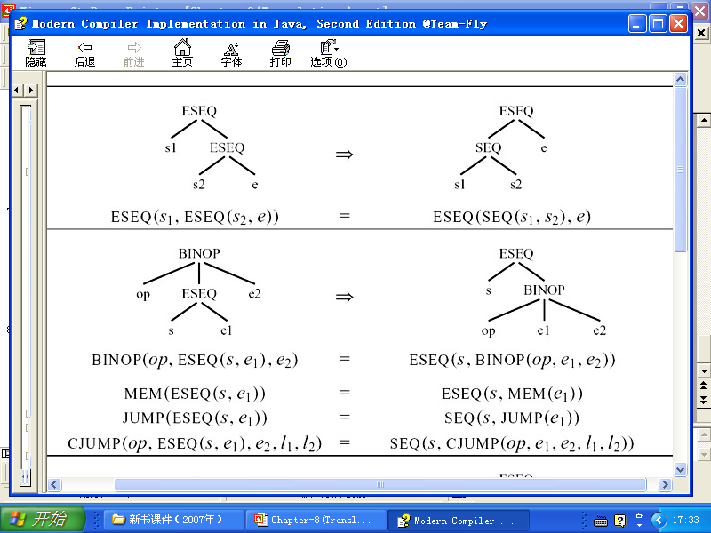
Transformations on ESEQ
How can the ESEQ nodes be eliminated?
ESEQ(s, e): The statement s is evaluated for side effects, then e is evaluated for a result.
Idea: Lift ESEQ higher and higher in the tree, until its parent is a statement node, and thus it can become a SEQ node.

Slide 13

Transformations on ESEQ
Given ESEQ(s, e):
extract s
rewrite its parent via ESEQ or SEQ with s

Slide 14
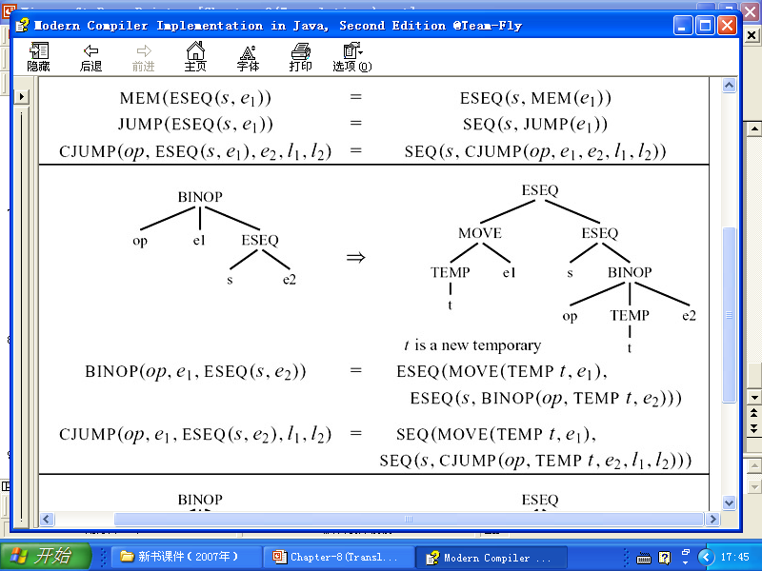
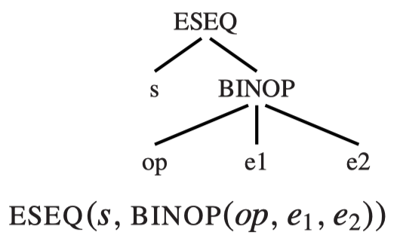
Transformations on ESEQ
?
Suppose:
s = MOVE(MEM(x), y); e1 =MEM(x)
To preserve the order of evaluation, we must pull e1 out of the BINOP with s
How?

Slide 15
Transformations on ESEQ

Slide 16
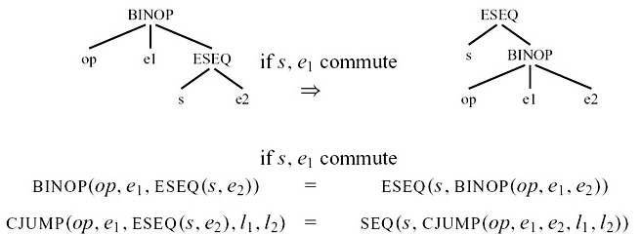
Transformations on ESEQ
s, e1 commute: If the temporaries and memory locations assigned by s are not referenced by e1 (and s and e1 don’t both perform external I/O)

Slide 17
Transformations on ESEQ
Whether a statement s commutes with an expression e?
We cannot always know this at compile time, e.g.,
s = MOVE(MEM(x), y); e = MEM(z)
Whether x == z?
We conservatively approximate whether statements commute
commute(s, e) = True if s and e deﬁnitely commute
commute(s, e) = False otherwise
This commute function estimates (very naively) whether a statement commutes with an expression:
A constant (CONST(i), NAME(n)) commutes with any statement
An empty statement (e.g., EXP(CONST(i))) commutes with any expression
Anything else is assumed not to commute

Slide 18
General Rewriting Rules
The transformation for removing ESEQ(s, e):
extract s
rewrite its parent via ESEQ (if its parent is an expression) or SEQ (if its parent is a statement)
For each kind of Tree statement or expression, similar rules can be made to pull ESEQs out of the statement or expression.
Given a Tiger program (which is a T_stm), we can recursively perform this transformation to lift all ESEQs higher and higher in the tree, until they can become SEQ nodes.
How to rewrite each kind of statement or expression?

Slide 19
General Rewriting Rules
In general, for each kind of Tree statement or expression, we can identify its subexpressions.
e.g., [e1, e2, ESEQ(s, e3)]
Rewrite: Extracts the “statement” in its subexpressions and update the subexpressions of the statement or expression.
s commutes with e1, e2
[e1, e2, ESEQ(s, e3)]
(s; [e1, e2, e3])
s does not commute with e2
(SEQ(MOVE(t1, e1), SEQ(MOVE(t2, e2), s)); [TEMP(t1), TEMP(t2), e3])
s commutes with e2, yet not with e1
(SEQ(MOVE(t1, e1), s); [TEMP(t1), e2, e3])

Slide 20
General Rewriting Rules
The rewriting algorithm:
Step 1: Make a “subexpression-extraction” method for each kind of Tree statement or expression
extract the “statement” in the subexpressions and convert each subexpression into its ESEQ-clean version.
Step 2: Make a “subexpression-insertion” method:
Build a new version of the expression or statement with the ESEQ-clean version of each subexpression.

Slide 21
Example
Deal with CJUMP(<, CONST 343, MEM(ESEQ(sx, TEMP a), t, f)
CONST(343)
=> s1 = EXP(CONST(0)), e1’ = CONST(343)
MEM(ESEQ(sx, TEMP a))
recursively lift ESEQ: ESEQ(sx, MEM(TEMP a))
=> s2 = sx, e2’ = MEM(TEMP a)
update the subexpressions:
left -> e1’ = CONST(343)
right -> e2’ = MEM(TEMP a)
extract the statement and return:
SEQ(s1,s2) = SEQ(EXP(CONST(0)), sx)
remove empty statement => sx
do not need add MOVE since commute(s2, e1’) = True
return SEQ(sx, CJUMP(<, CONST 343, MEM(TEMP a), t, f))

Slide 22
Canonical Trees
To perform stage-one transformation, we need to:
eliminate ESEQs
move CALLs to top level
eliminate SEQs

Slide 23
Move CALLs to Top Level
The Tree language permits CALL nodes to be used as subexpressions
However, each function returns its result in the same dedicated return-value register TEMP(RV)
BINOP(PLUS, CALL(...), CALL(...))
The second call will overwrite the RV register before the PLUS can be execute
How to solve this problem?

Slide 24
Move CALLS to Top Level
Idea: assign each return value immediately into a fresh temporary register:
CALL(fun, args) ->
ESEQ(MOVE(TEMP t, CALL(fun, args)), TEMP t)

Slide 25
Canonical Trees
To perform stage-one transformation, we need to:
eliminate ESEQs
move CALLs to top level
eliminate SEQs

Slide 26
A Linear List of Statements
Once an entire function body s0 is processed with do_stm, the result is a tree s0′ where all the SEQ nodes are near the top
SEQ(SEQ(SEQ(..., sx), sy), sz)
The linearize function repeatedly applies the rule:
SEQ(SEQ(a, b), c) = SEQ(a, seq(b, c))
s0’ is linearized into a statement of the form:
SEQ(s₁, SEQ(s₂, ..., SEQ(s_{n-1},s_{n})...))
provides no structuring information
We can just consider this to be a simple list of statements:
s₁, s₂, ..., s_{n-1}, s_{n}
None of the s_{i} contain SEQ or ESEQ nodes

