Slide 1

编译原理
陈明帅
m.chen@zju.edu.cn
浙江大学 · 计算机科学与技术学院

Slide 2
Solution
How to eliminate these mismatches?
We transform the tree in three stages:
SEQ
MOVE
SEQ
TEMP r
1
CJUMP
SEQ
>
a
b
t1
f1
LABEL
SEQ
f1
MOVE
SEQ
1. A tree is rewritten into a list of canonical trees without SEQ or ESEQ nodes
TEMP r
0
LABEL
JUMP
t1
join

Slide 3
Solution
How to eliminate these mismatches?
We transform the tree in three stages:
MOVE
B1
TEMP r
1
CJUMP
B2
>
a
b
t1
f1
LABEL
f1
MOVE
2. This list is grouped into a set of basic blocks, which contain no internal jumps or labels.
B3
TEMP r
0
LABEL
JUMP
t1
join

Slide 4
Outline
Canonical Trees (SEQ, ESEQ, CALL)
Taming Conditional Branches (CJUMP)
Basic Blocks
Traces

Slide 5
Basic Blocks
In determining where the jumps go in a program, we are analyzing the program’s control flow.
Control flow is the sequencing of instructions in a program
ignoring the data values in registers and memory
ignoring the arithmetic calculations
In analyzing the control ﬂow of a program, any non-jump instruction has an entirely uninteresting behavior.
Lump together any sequence of non-branch instructions into a basic block and analyze the control flow between basic blocks

Slide 6
Basic Blocks
A basic block is a sequence of statements that is always entered at the beginning and exited at the end, that is:
The first statement is a LABEL
The last statement is a JUMP or CJUMP
There are no other LABELs, JUMPs, or CJUMPs
B3
LABEL
JUMP
t1
join

Slide 7
Basic Blocks
The algorithm for dividing a long sequence of statements into basic blocks is as follows:
Scanning the sequence from beginning to end;
Whenever a LABEL is found, a new block is started (the the previous block is ended);
Whenever a JUMP or CJUMP is found, a block is ended (and the next block is started).
If this leaves any block not ending with a JUMP or CJUMP, then a JUMP to the next block’s label is appended to the block.
If any block has been left without a LABEL at the beginning, a new LABEL is invented and stuck here.

Slide 8
Basic Blocks
…
xxx
LABEL x
…
…
xxx
…
JUMP x
xxx
…
…
JUMP x
LABEL x
…
xxx
…
If xxx not JUMP/CJUMP
If xxx not LABEL
…
xxx
JUMP x
…
JUMP x
LABEL a
xxx
…
LABEL x
…
Why do we need to explicitly add JUMPs/LABELs?

Slide 9
Basic Blocks - Example for TAC
(1) x := input
(2) y := x - 1
(3) z := x * y
(4) if z < x goto (7)
(5) p := x / y
(6) q := p + y
(7) a := q
(8) b := x + a
(9) c := a - b
(10) if p == q goto (12)
(11) goto (3)
(12) return
Algorithm:
Scanning the sequence from beginning to end
Whenever a LABEL is found, a new block is started (the the previous block is ended)
start from (3), (7), (12)
Whenever a JUMP or CJUMP is found, a block is ended (and the next block is started)
end at (4), (10), (11)
and start from (5), (11), (12)
Add LABELs and JUMPs
ignored for TAC
should be done for Tree language

Slide 10
Solution
How to eliminate these mismatches?
We transform the tree in three stages:
MOVE
B1
TEMP r
1
CJUMP
B2
>
a
b
t1
f1
LABEL
f1
MOVE
2. This list is grouped into a set of basic blocks, which contain no internal jumps or labels.
B3
TEMP r
0
LABEL
JUMP
t1
join

Slide 11
Solution
How to eliminate these mismatches?
We transform the tree in three stages:
B1
Trace 1
MOVE
TEMP r
1
CJUMP
B2
>
a
b
t1
f1
LABEL
Trace 2
f1
MOVE
3. The basic blocks are ordered into a set of traces in which every CJUMP is immediately followed by its false label.
B3
TEMP r
0
LABEL
JUMP
t1
join

Slide 12
Outline
Canonical Trees
Taming Conditional Branches
Basic Blocks
Traces

Slide 13
Traces
The basic blocks can be arranged in any order, and the result of executing the program will be the same.
Based on this, we can choose an ordering of the blocks satisfying the condition that each CJUMP is followed by its false label.
We can also arrange that many of the unconditional JUMPs are immediately followed by their target label.
This will allow the deletion of these jumps, which will make the compiled program run a bit faster.
CJUMP(op, a, b, lt, lf)
LABEL(lf)
...
JUMP(NAME next)
LABEL(next)

Slide 14
Traces
A trace is a sequence of statements that could be consecutively executed during the execution of the program and can include conditional branches.
A program can have many different, overlapping traces.
For our purposes in arranging CJUMPs and false-labels, we want to make a set of traces that exactly covers the program:
Each block must be in exactly one trace
We would like to have as few traces as possible in our covering set.
To minimize the number of JUMPs from one trace to another

Slide 15
Traces
How to find a covering set of traces?
The idea is to start with some block - the beginning of a trace - and follow a possible execution path - the rest of the trace.
Suppose block b1 ends with a JUMP to b4, and b4 has a JUMP to b6. Then we can make the trace b1, b4, b6.
Suppose b6 ends with a conditional jump CJUMP(cond, b7, b3). We append b3 to our trace and continue with the rest of the trace after b3. The block b7 will be in some other trace.
ensure CJUMP(cond, lt, lf) is immediately followed by LABEL(lf)
b1
b4
b6
LABEL(b1)
...
JUMP(NAME b4)
LABEL(b4)
...
JUMP(NAME b6)
LABEL(b6)
...
b6
b3
b7
LABEL(b6)
...
CJUMP(cond, b7, b3)
LABEL(b3)
...
LABEL(b7)
...

Slide 16
Traces
How to find a covering set of traces?
The idea is to start with some block - the beginning of a trace - and follow a possible execution path - the rest of the trace.
trace 1
trace 1
trace 1
trace 1
b1
b4
trace 2
CJUMP is immediately followed by its false label
t
b6
b7
f
b3

Slide 17
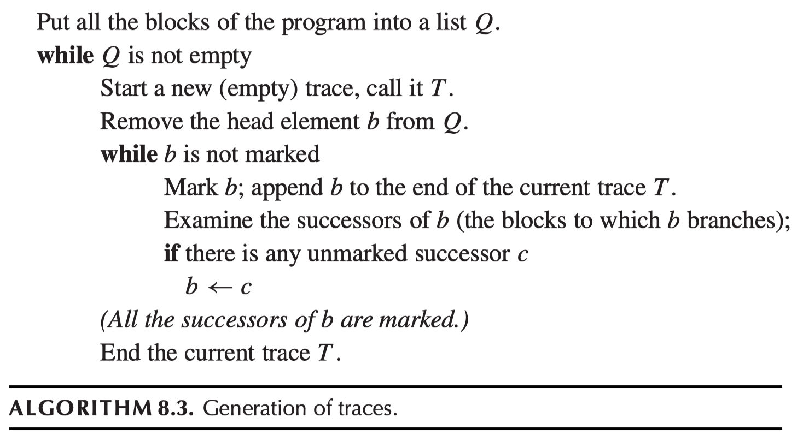
Traces
depth-first search over the control-flow graph

Slide 18
Traces
Algorithm 8.3 (make a set of traces that covers the program and each block is in one trace):
It starts with some block and follows a chain of jumps,
marking each block and appending it to the current trace.
Eventually it comes to a block whose successors are all marked,
so it ends the trace and picks an unmarked block to start the next trace.

Slide 19
Finishing Up
Flatten the ordered list of traces back into one long list of statements, then perform some minor adjustments:
Any CJUMP immediately followed by its false label we let alone (there will be many of these).
For any CJUMP followed by its true label, we switch the true and false labels and negate the condition.
For any CJUMP(cond, a, b, lt, lf) followed by neither label, we invent a new false label lf′ and rewrite the single CJUMP statement as three statements, just to achieve the condition that the CJUMP is followed by its false label:
CJUMP(cond, a, b, lt, lf′)
LABEL lf′
JUMP(NAME lf )

Slide 20
Optimal Traces
Any frequently executed sequence of instructions (such as the body of a loop) should occupy its own trace.
This helps to minimize the number of unconditional jumps.
This helps with other kinds of optimizations.
register allocation
instruction scheduling
…

Slide 21
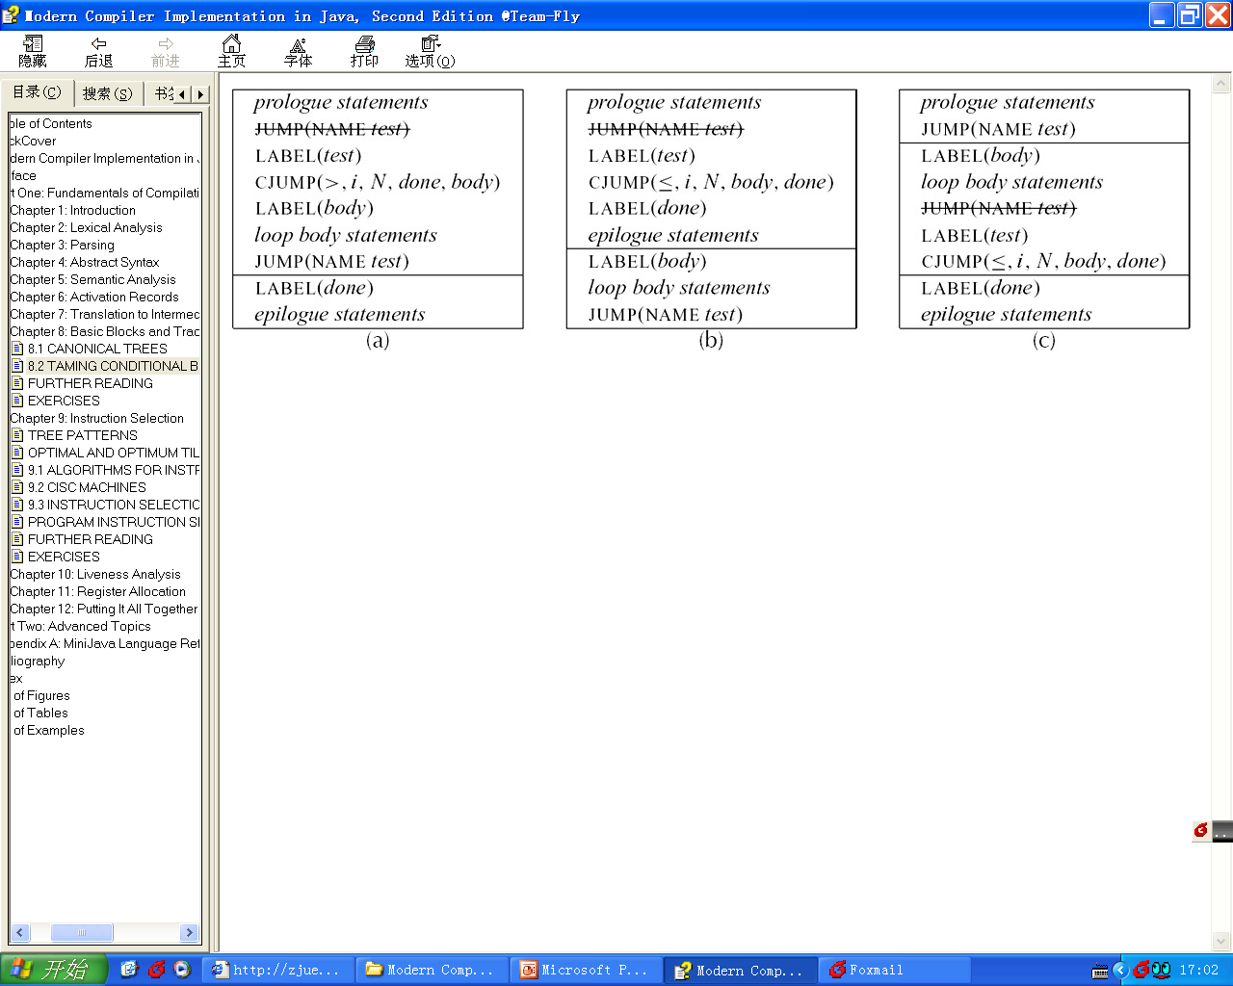
Optimal Traces
Which is better?

Slide 22
Summary
Eliminating mismatches related to ESEQ and CALL
Canonical Trees (SEQ, ESEQ, CALL)
Taming Conditional Branches (CJUMP)
Basic Blocks
Traces

Slide 23
Homework
8.2, 8.6, 8.7

