Slide 1
Chapter 5 Induction and Recursion
5.1 Mathematical Induction
5.2 Strong Induction and Well-Ordering
5.3 Recursive Definitions and Structural Induction
5.4 Recursive Algorithms

Slide 2
5.1 Mathematical Induction
1. Introduction
Mathematical induction is used to prove propositions of the form ∀nP(n), where the domain of discourse is the set of positive integers.
In this section we will discuss:
How can mathematical induction be used?
Why is mathematical induction valid?

Slide 3
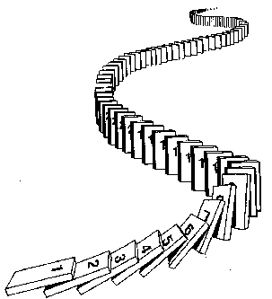
5.1 Mathematical Induction
Prove ∀ n P(n) by mathematical induction:
Basis step： Establish P(1)
Inductive step： Prove that P(k) → P(k+1) for k≥ 1
Conclusion: ∀ n P(n) , where the domain
is the set of positive integers

Slide 4
5.1 Mathematical Induction
2. Mathematical Induction
The (first) principle of Mathematical Induction
(P(1) ∧∀ k(P(k) → P(k+1))) →∀ n P(n)
The principle has the following form.
        P(1)
        ∀ k P(k)→ P(k +1)
        ∴∀nP(n)

Slide 5
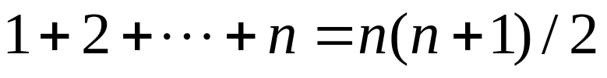
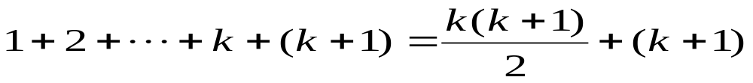
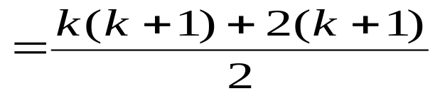
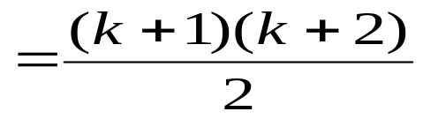
5.1 Mathematical Induction
〖Example 1〗 , where n is a positive integer
Proof:
Let P(n):
Basis step: P(1) is true because 1=1(1+1)/2
Inductive step: Assume P(k) holds for an arbitrary positive
Integer k. That is,
then
Therefore ∀ k P(k) → P(k+1) is true
By mathematical induction, ∀ n P(n) is true for all positive integer n

Slide 6
5.1 Mathematical Induction
〖Example 2〗Use mathematical induction to prove that
n < 2^{n} for all positive integers n.
Proof:
Let P(n): n < 2^{n}.
Basis step: P(1) is true because 1 < 2¹ = 2.
Inductive step: Assume P(k) holds for an arbitrary positive
  Integer k, i.e., k < 2^{k}.
  Since by the inductive hypothesis, k < 2^{k}, it follows that:
  k + 1 < 2^{k} + 1 ≤ 2^{k} + 2^{k} = 2 ∙ 2^{k} = 2^{k+1}
Therefore ∀ k P(k) → P(k+1) is true
By mathematical induction, n < 2^{n} holds for all positive integers n.

Slide 7



〖Example 3〗Tiling Checkerboards. Show that every 2^{n} ×2^{n} checkerboard with one square removed can be tiled using right triominoes.
A right triomino is an L-shaped tile which covers three squares at a time.
Proof:
Let P(n) be the proposition that every 2^{n} ×2^{n} checkerboard with one
square removed can be tiled using right triominoes. Use mathematical
induction to prove that P(n) is true for all positive integers n.
BASIS STEP: P(1) is true, because each of the four 2 ×2
checkerboards with one square removed can be tiled using one
right triomino.
  INDUCTIVE STEP: Assume that P(k) is true for every 2^{k} ×2^{k}
  checkerboard, for some positive integer k.

Slide 8
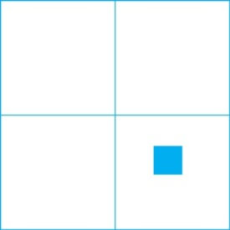

Proof:
Consider a 2^{k+1} ×2^{k+1} checkerboard with one square removed.
Split this checkerboard into four checkerboards of size 2^{k} ×2^{k},
by dividing it in half in both directions.
Remove a square from one of the four 2^{k} ×2^{k} checkerboards.
By the inductive hypothesis, this board can be tiled. Also by the
inductive hypothesis, the other three boards can be tiled with
the square from the corner of the center of the original board removed.
We can then cover the three adjacent squares with a triomino.
Hence, the entire 2^{k+1} ×2^{k+1} checkerboard with one square
removed can be tiled using right triominoes.
.

Slide 9
5.1 Mathematical Induction
The validity of mathematical induction follows from the well-ordering property for the set of positive integers.
A set S is well ordered if every nonempty subset of S has a least element.
For example,
N is well ordered
Z is not well ordered under the ≤ relation (Z has no smallest element).
(0, 1) is not well ordered since (0,1) does not have a least element.

Slide 10
5.1 Mathematical Induction
The well-ordering property
Every nonempty set of nonnegative integers has a
least element.

Slide 11
5.1 Mathematical Induction
P(1)
∀ k(P(k)→ P(k+1))
Why mathematical induction is valid?
∀nP(n)
Proof:
Assume that there is at least one positive integer for which P(n) is false.
S: the set of positive integer for which P(n) is false.
Then S is nonempty.
By the well-ordering property, S has a least element, which will be denoted by m.
Then m≠1, m-1 is a positive integer. m-1 is not in S. So P(m -1) is true.
Since the implication P(m-1)→ P(m ) is also true, P(m) must be true.
By contradiction, ∀nP(n)

Slide 12
5.1 Mathematical Induction
More general form
∀n ≥ b (P(n))
The procedure :
Basis step: Establish P(b)
Inductive step: Prove that P(k) → P(k+1) for k≥ b
Conclusion: The basis step and the inductive step
together imply ∀n ≥ b (P(n)) .

Slide 13
5.1 Mathematical Induction
〖Example 4〗Prove that if a set S has |S| = n, then |P(S)| = 2^{n}
Proof:
Let P(n): If |S| = n, then |P(S)| = 2^{n}
Basis step: P(0) is true because
S=ø, P(S) = {ø} and |P(S)| = 1 = 2⁰
Inductive step: Assume P(k): If |S| = k, then |P(S)| = 2^{k}
Prove that if |T| = k+1, then |P(T)| = 2^{k+1}
T= S U {a} for some S ⊂ T with |S| = k, and a ∈ T.
P(T) = {X | a ∈ X∧X-{a}⊆S } U {X | X ⊆S }
Equivalently, P(T) = {X | a ∈ X∧X-{a}⊆S } U P(S)
|P(T)| = |P(S)| + |P(S)| = 2 |P(S)| =2⋅2^{k} = 2^{k+1}
By mathematical induction, ∀ n P(n) is true for all nonnegative integers n

Slide 14
Homework (Due on March 30)
Ver. 8 & Ver. 7
Sec. 5.1 46， 47， 48

